Slide 1

MODIS Aerosol C6 Improvements
MET 611 – Satellite Data Applications
Jennifer D. S. Griswold

Slide 2
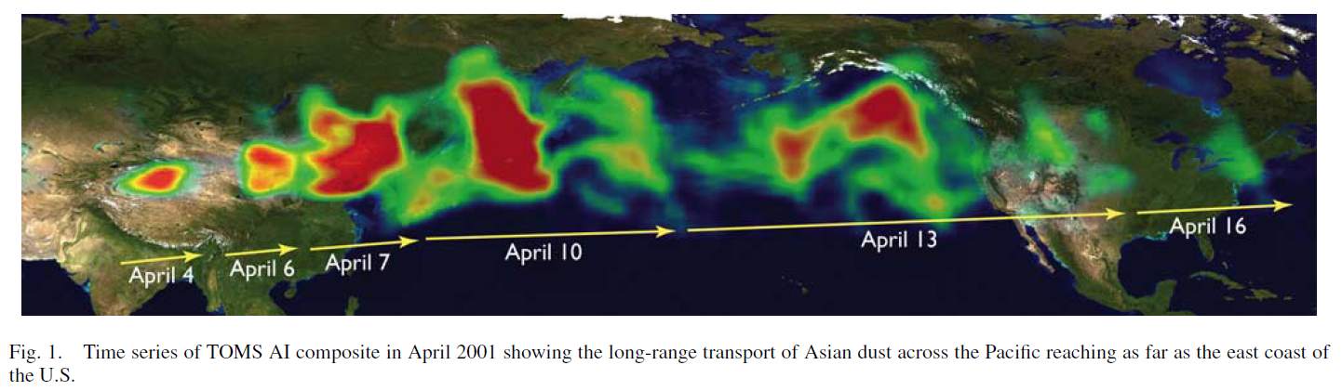
Aerosols can travel a long way
Mineral dust from Taklimakan desert transported to North America
  Hsu et al., IEEE TGARS (2006)
  Renewed attention in Yu et al., Science/Atmos. Res., (2012)
We also see Asian pollution transported to North America, Saharan dust transported to the Amazon and Europe, African smoke transported to South America, Asian dust to Europe, high-latitude smoke circling the world in both hemispheres, etc...

Slide 3
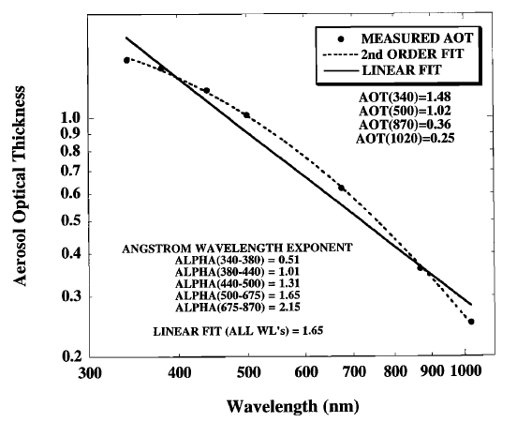
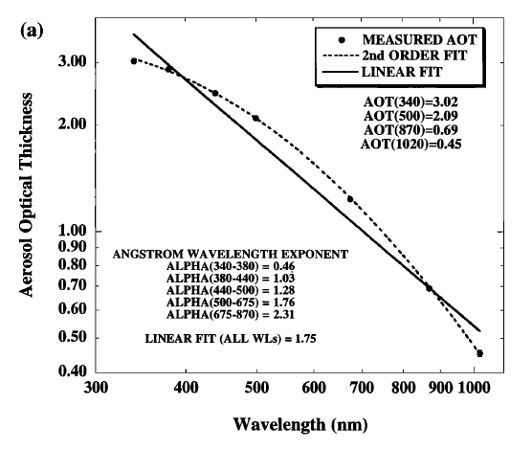
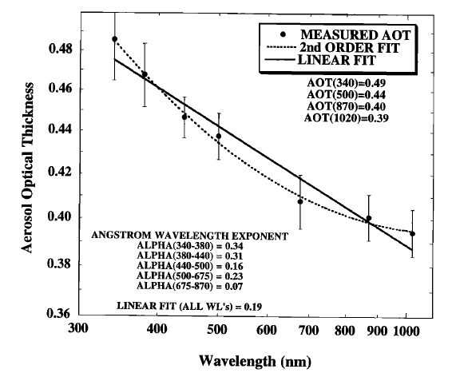
Aerosols and properties of interest: AE
Urban aerosols
(NASA GSFC, USA)
Smoke aerosols
(Bolivia)
Mineral dust aerosols
(Dalanzadgad, Mongolia)
From Eck et al., JGR, 1999
Ångström exponent (AE, α): spectral dependence of AOD
  Values < 1 suggest optical dominance of coarse particles (e.g. dust)
  Values > 1 suggest optical dominance of fine particles (e.g. smoke)
  Depends on wavelength range used to calculate it

Slide 4
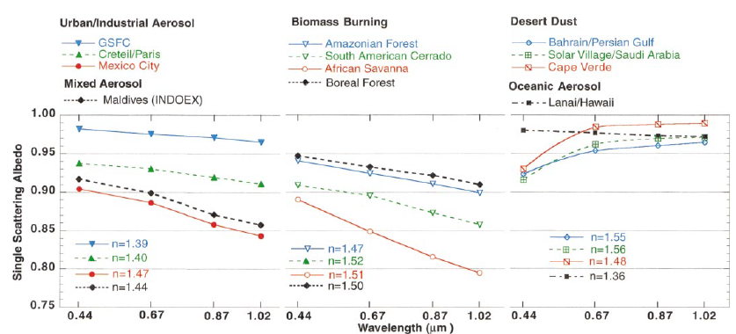
Aerosols and properties of interest: SSA
From Dubovik et al., JAS, 2002
Single Scattering Albedo (SSA) : measure of light absorption by aerosols
  SSA = 0: Pure absorbing aerosols (never encountered)
  SSA = 1: Pure scattering aerosols
  Typical range ~0.8 (some industrial/smoke) - 0.99 (‘clean’ continental, marine aerosols)
  Also has wavelength dependence

Slide 5
Aerosol algorithm REVIEW
The aerosol remote sensing retrieval algorithm has multiple phases:
Organizing Level 1B radiance data into 10 km boxes for each 5 minute granule.
Removing distortion (gas absorption, angular effects) from the satellite signal
Deciding whether over “land” or “ocean”
Separating signal (aerosol) from noise (clouds, surface inhomogeneities, instrument issues, etc), includes “cloud masking”
Correctly interpreting the signal to AOD and aerosol size. “the retrieval”
Assigning quality assurance, reporting retrieved, derived, and diagnostic products. “the post-process”

Slide 6
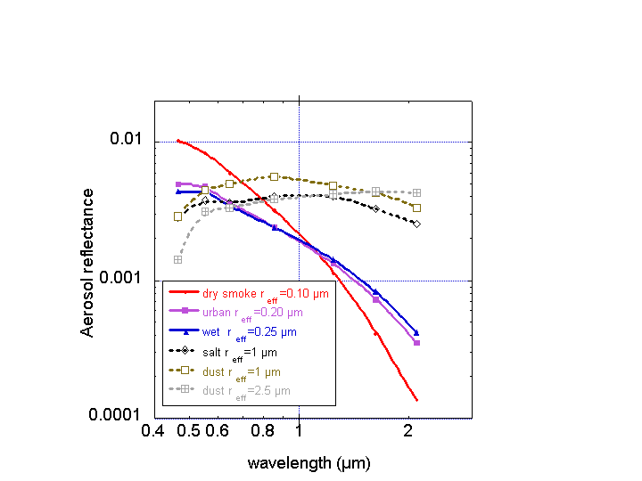
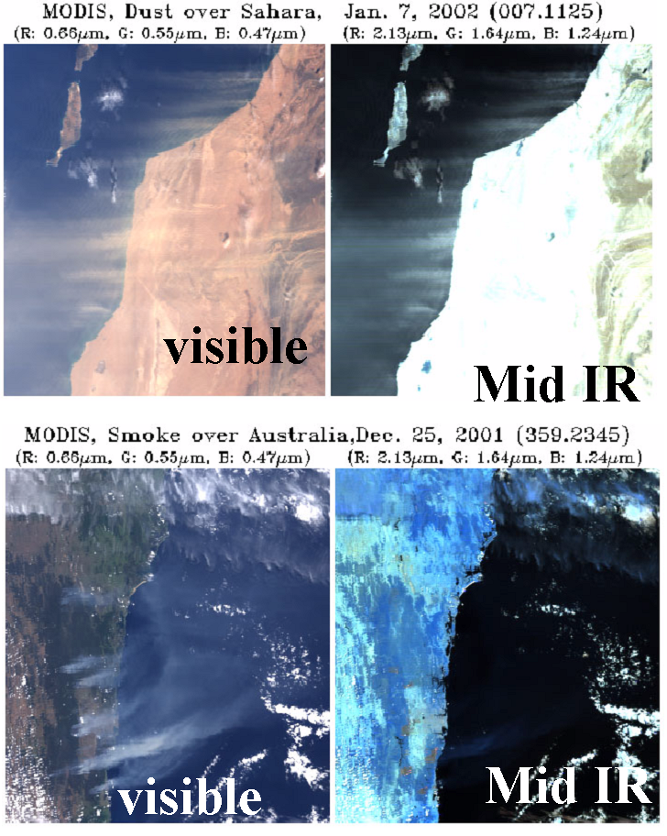
AOD is “spectrally” (wavelength) dependent
(which is primarily dependent on aerosol size)
Coarse
(Dust/Sea salt)
Dust
Fine
(combustion)
Smoke
0.47
0.55
0.86
0.65
1.24
1.63
2.11
“Big” particles (e.g. Dust) reflect in IR “Small” particles (smoke/pollution) do not.
MODIS “Channels”
Used for DT aerosol
Y. Kaufman, D. Tanré

Slide 7
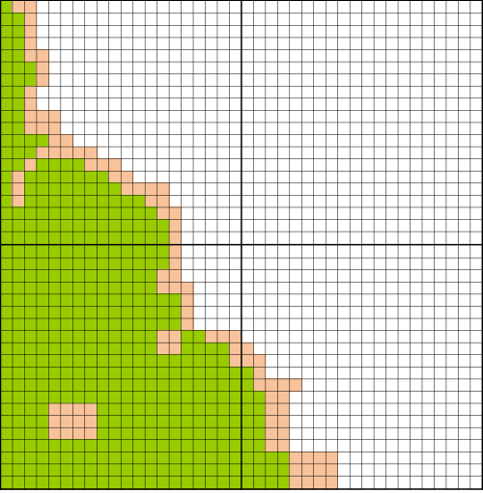
Some Basics About the Grid Boxes
Uses calibrated L1B reflectance data at primarily 500 m resolution.
Splits up the granule into 20x20 boxes (~10 km at nadir).
Corrects for “gas absorption” in each pixel (H₂O, O₃, CO₂).
Decides whether pixel is “land” or “ocean”
  If “all” pixels are ocean (white) then try Ocean retrieval algorithm
  If “any” pixels are land (green), then try Land (must be at least 24)
  Coastal or ambiguous (peach) pixels are Neither.
<--10 km (20 pixels-)--- >
<--10 km (20 pixels-)--- >
L
O
<--10 km (20 pixels-)--- >
L
N
<--10 km (20 pixels-)--- >
Notes:
This is an illustration of a few 10 km boxes created from the larger granule. White is ocean, Green is land, and pale color is “other” (includes coastal, ephemeris or shallow water, etc).

Slide 8
Cloud Masking
There are many “tests” for clouds in the MODIS scene.
Spatial Variability Tests (clouds appear bumpy)
Visible channel brightness (clouds appear bright)
Visible channel gradients (aerosols appear “colored”)
Cirrus Cloud Removal (high clouds obscure water vapor)
IR tests: (clouds are colder than the surface)

Slide 9
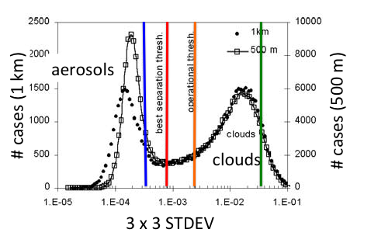
MODIS “aerosol” cloud mask
X
Calculate the standard
deviation of the observed
reflectance in every 3 x 3
set of pixels (at 500 m or 1 km).
If the STDEV > threshold THEN the center pixel is cloudy
aerosols tend to be homogeneous and clouds are fractal
For C6: Slight changes for thresholds and formulas
Martins et al., (2002)
Notes:
This is the main difference between the “aerosol” cloud mask and the standard MxD35 cloud mask. We rely heavily on spatial variability to screen out clouds.

Slide 10
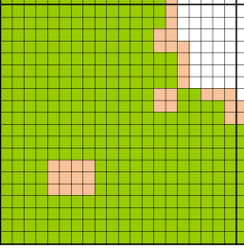
Land Retrieval: Review
Know that at least some % of 20x20 (500 m) pixels are “land”
Cloud masking (pixel de-selection) is performed
More pixel de-selection (inland water, surface heterogenitity, snow, ice, etc)
→ We have N* “clear” pixels
Sort N* pixels in ascending order in terms of reflectance magnitude, remove 20% darkest and 50% brightest (residual cloud contamination including shadows, biasing towards “dark” targets)
→ We have N “clear” pixels
Calculate average reflectance of N pixels in five channels
  (0.47, 0.65, 0.86, 1.24, 2.11 μm)

Slide 11
Ocean Retrieval: Review
Know that 100% of 20x20 (500 m) pixels are “ocean”
Cloud masking (pixel de-selection) is performed
More pixel de-selection (underwater sediments, glint, etc)
→ We have N* “clear” pixels (not marked with “X”)
Sort N* pixels in ascending order in terms of reflectance magnitude, remove 25% darkest and 25% brightest (residual cloud contamination including shadows)
→ We have N “clear” pixels (not “X” or “Y”)
Calculate average reflectance of N pixels in six channels
  (0.55, 0.65, 0.86, 1.24, 1.63, 2.11 μm)
 |  |  |  |  |  | X
 | X | X | X | X | X |  |  |  |  |  |  |  |  | Y | Y | Y | Y
 | X | X | X | X | X |  |  |  |  |  |  |  |  | Y | Y | Y | Y
 |  | X | X | X | X | X |  |  |  |  |  |  |  | Y | Y | Y | Y |  | X
 |  |  |  |  |  |  |  |  |  |  |  |  |  |  |  |  |  |  | X
 |  |  |  |  |  | Y | Y | Y | Y |  |  |  | X |  |  |  |  |  | X
 |  |  |  |  |  | Y | Y | Y | Y
 |  |  |  | X | X
 |  |  |  | X | X
X |  |  |  | X | X | X |  |  |  |  |  |  |  |  |  | X
X |  |  |  | X | X | X |  |  |  |  |  |  | X | X | X | X | X
X |  |  | X | X | X |  |  |  |  |  |  |  | X | X | X | X | X
X |  |  |  | X | X |  |  |  |  |  |  |  | X | X | X | X | X
 |  |  |  | X | X | X |  |  |  |  |  |  |  | X | X |  | X | X
 |  | Y | Y | Y | Y | Y
 |  | Y | Y | Y | Y | Y |  |  |  |  |  |  | Y | Y | Y
 |  |  |  |  |  |  |  |  |  |  |  |  | Y | Y | Y

Slide 12
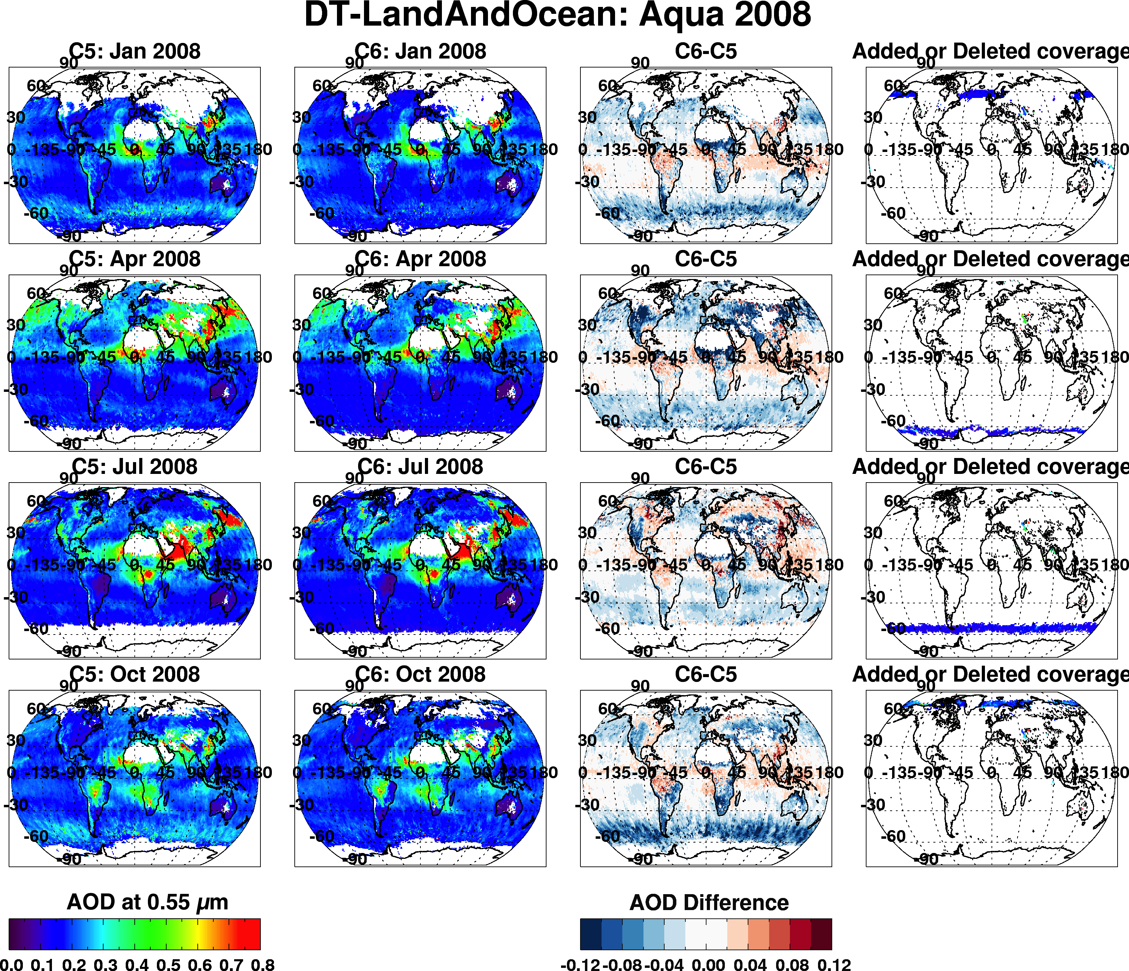
Overall changes (C6 vs C5): Aqua, 2008
Jan
Apr
Jul
Oct
0.0 0.8
-0.1 0.0 0.1

Slide 13
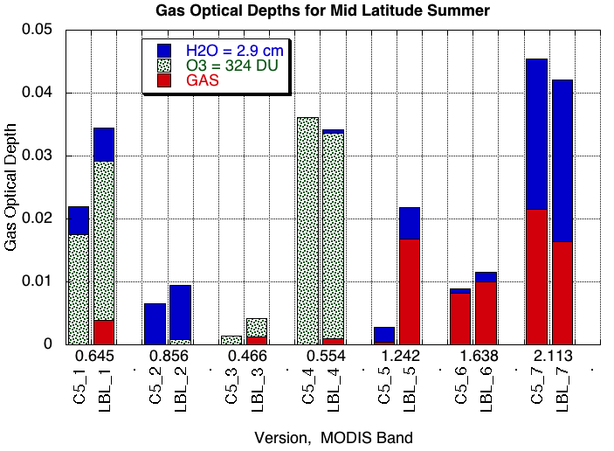
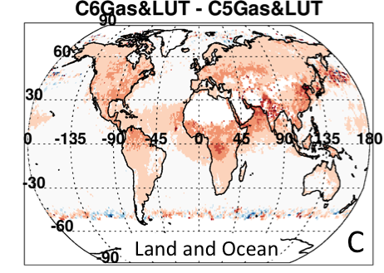

Correction for gas absorption and Rayleigh optical depth
In atmospheric “windows”, there is still absorption from: water vapor, ozone, CO₂ & other gases.
Absorption of these gases varies by wavelength! And can be up to optical depths of 0.05!
Must account for this accurately!
For C6:
Uses modern Radiative Transfer code to account for gas absorption
Recalculates center wavelengths and Rayleigh optical depths
Upshot: global AOD increased by 0.02

Slide 14
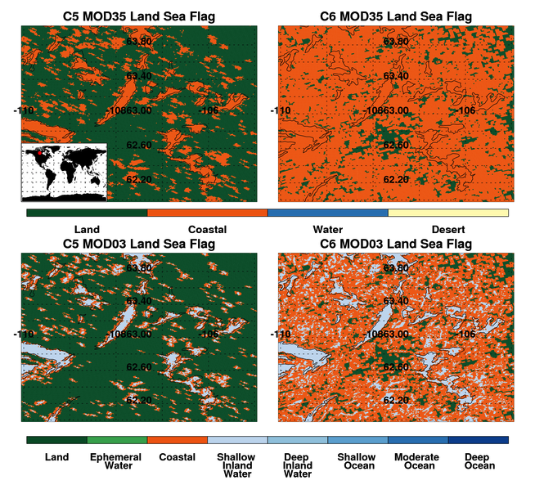
Land/Sea Flag Land or Ocean?
If ALL pixels in the 10 x 10 kilometer box are ocean the Ocean Algorithm is used.
If ANY land pixels are observed in the 10 Km box the Land Algorithm is used.
The MOD35 cloud mask product is used to determine if each pixel is land or ocean. However this MOD35 is based on MOD03, which is further based on a global land/sea mask.
Essentially, the land/sea mask was changed!
Upshot: no “global” change, but big local
changes. Also new retrievals over inland
water bodies.

Slide 15
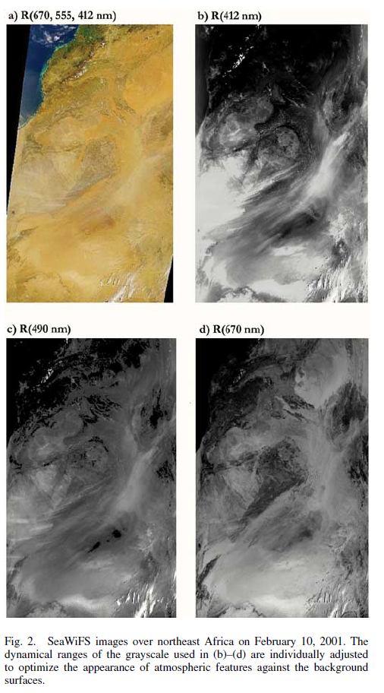
Deep Blue: Review
Often, darker surface and stronger aerosol signal in the violet/blue (~400-490 nm) than at longer wavelengths
  Prescribe surface reflectance
  Retrieve AOD independently at several wavelengths
Advantages:
  Avoids regional artifacts arising from e.g. global prescription of surface reflectance ratios
  Avoids requirement for auxiliary data (so can run in near real-time)
  Can be applied to many sensors
Disadvantages:
  Drastic departures from expected surface cover type can lead to localized artefacts
  Can’t directly calculate aerosol effective radius, volume etc
Figure from Hsu et al., IEEE TGARS (2004)

Slide 16
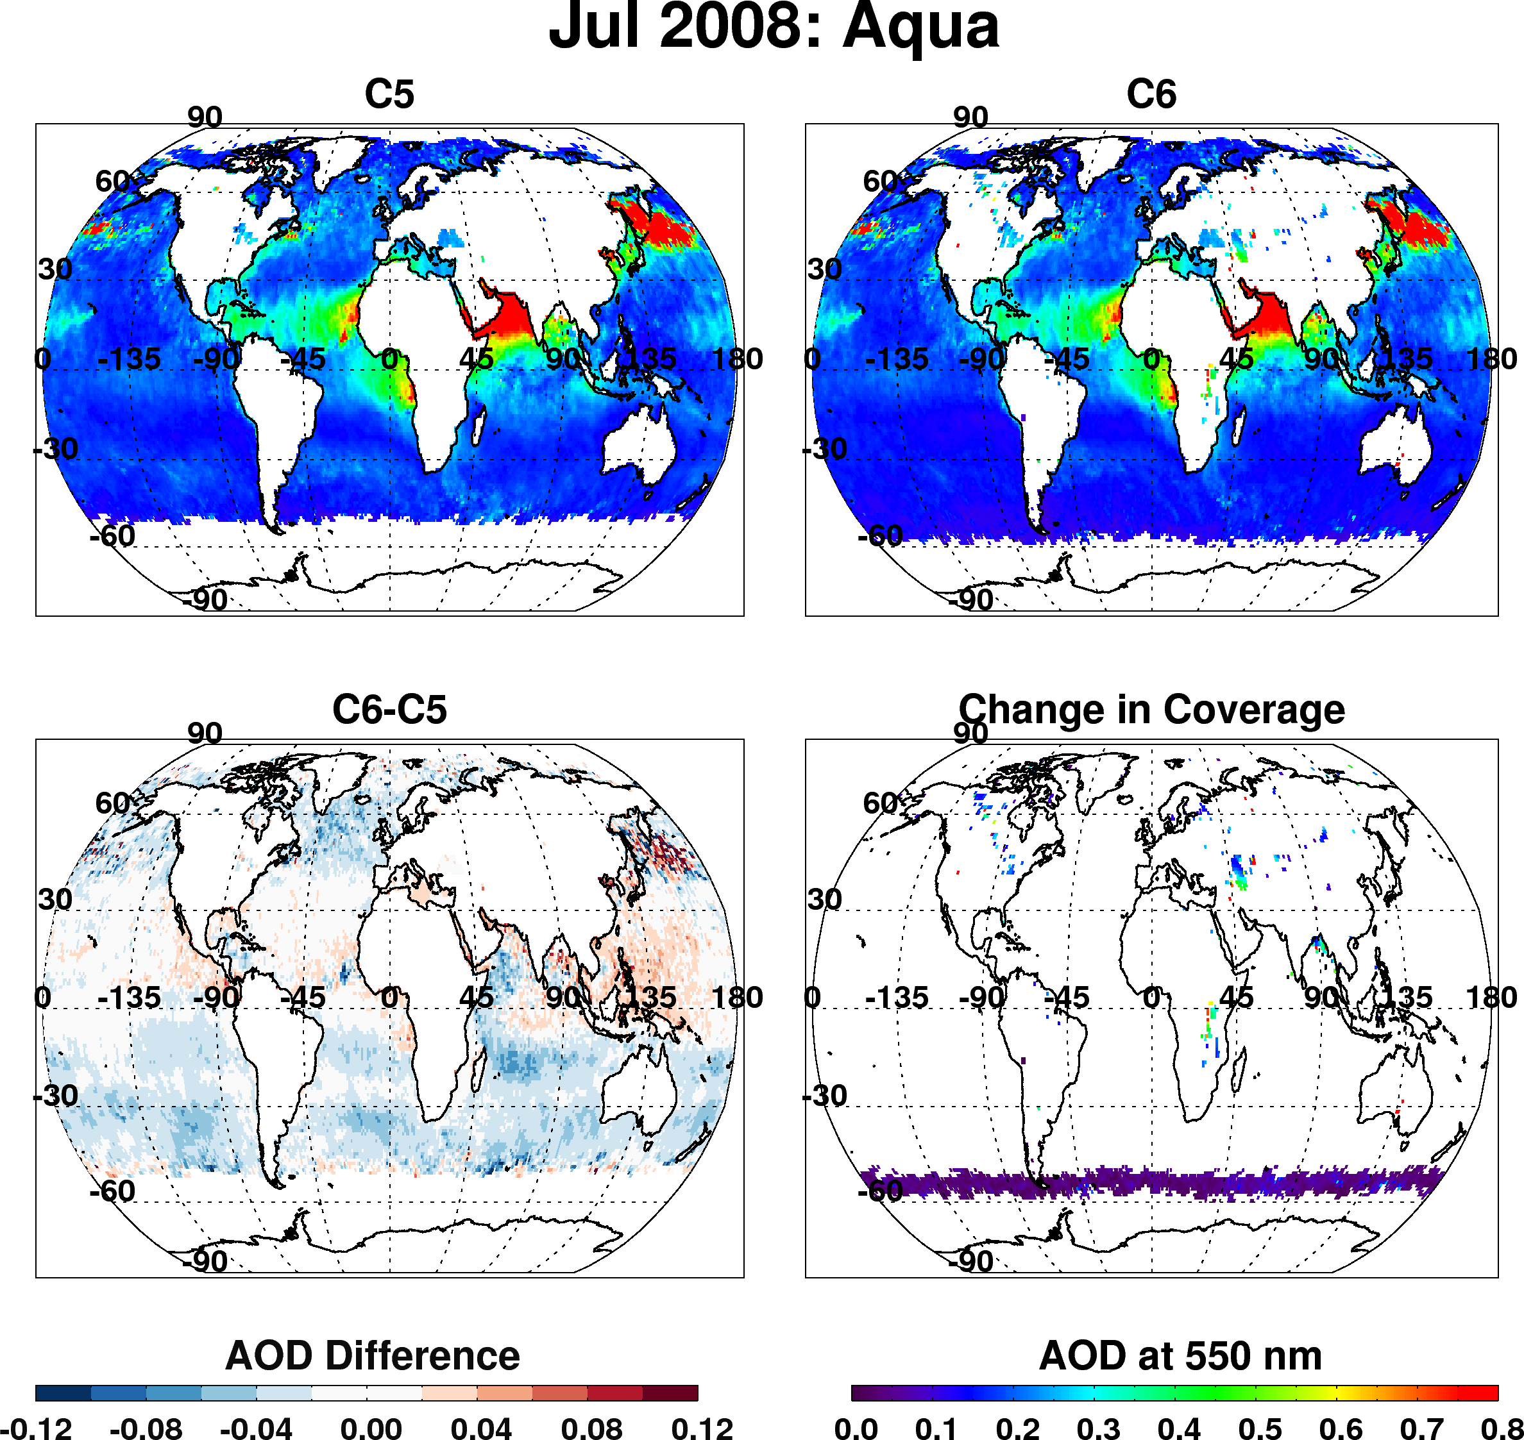
Dark target over ocean - overall changes to products (Aqua, Jul 2008)
Overall decrease of AOD in mid-latitudes
Strong decrease in “roaring 40s” (even stronger in other months)
Overall increase in tropics
“New” coverage over inland lakes
Increase in coverage toward poles

Slide 17
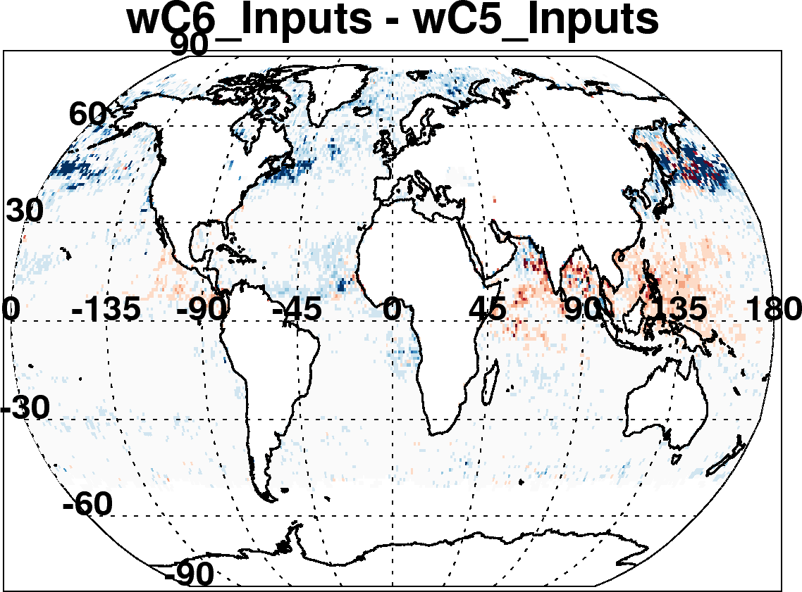
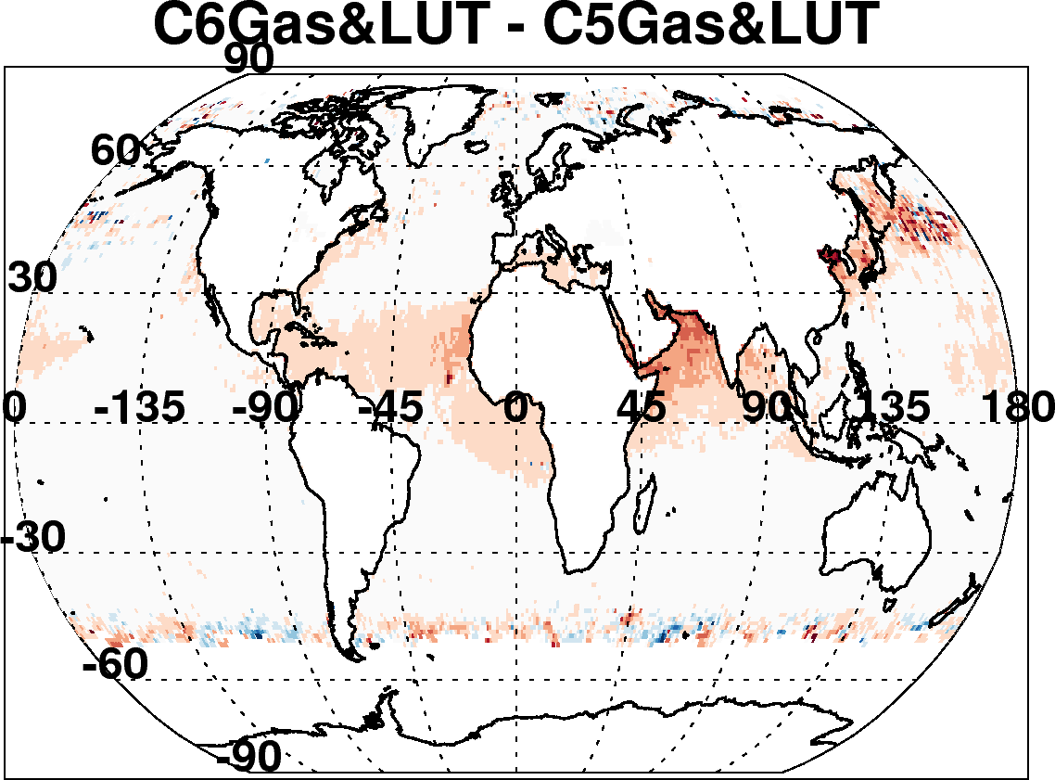
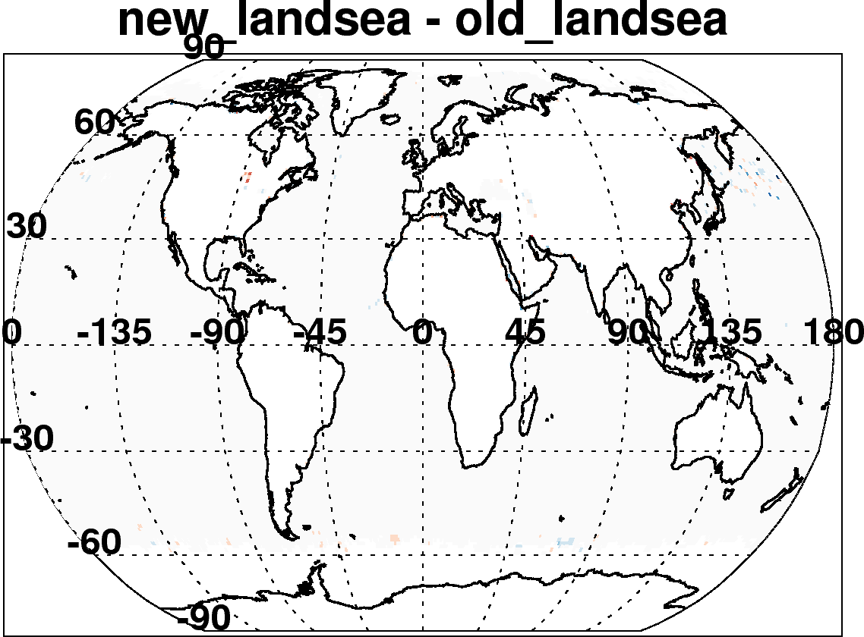
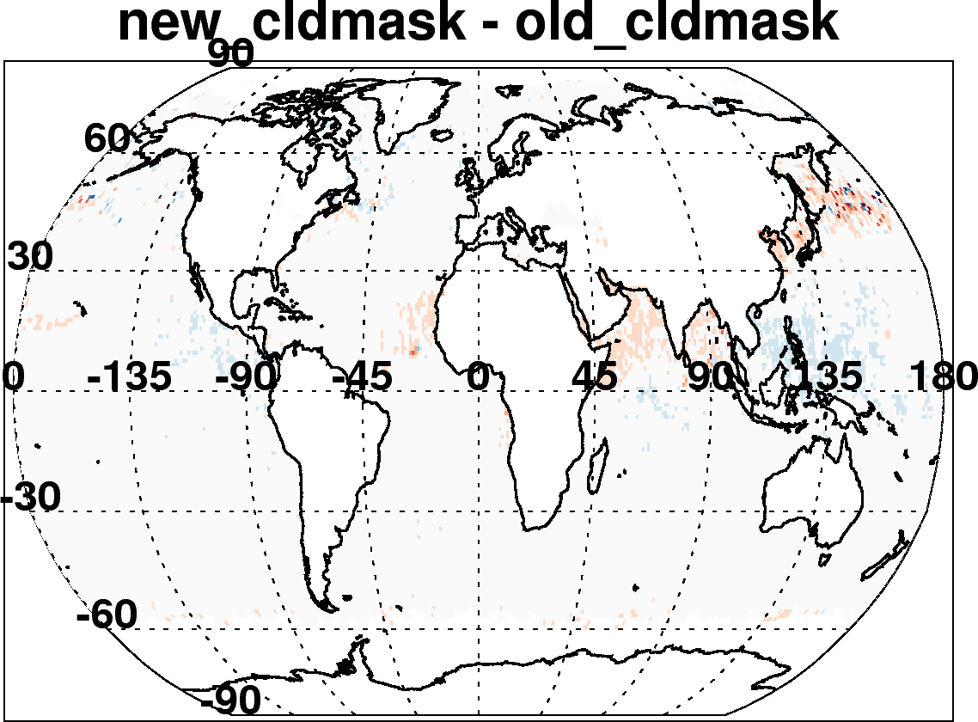
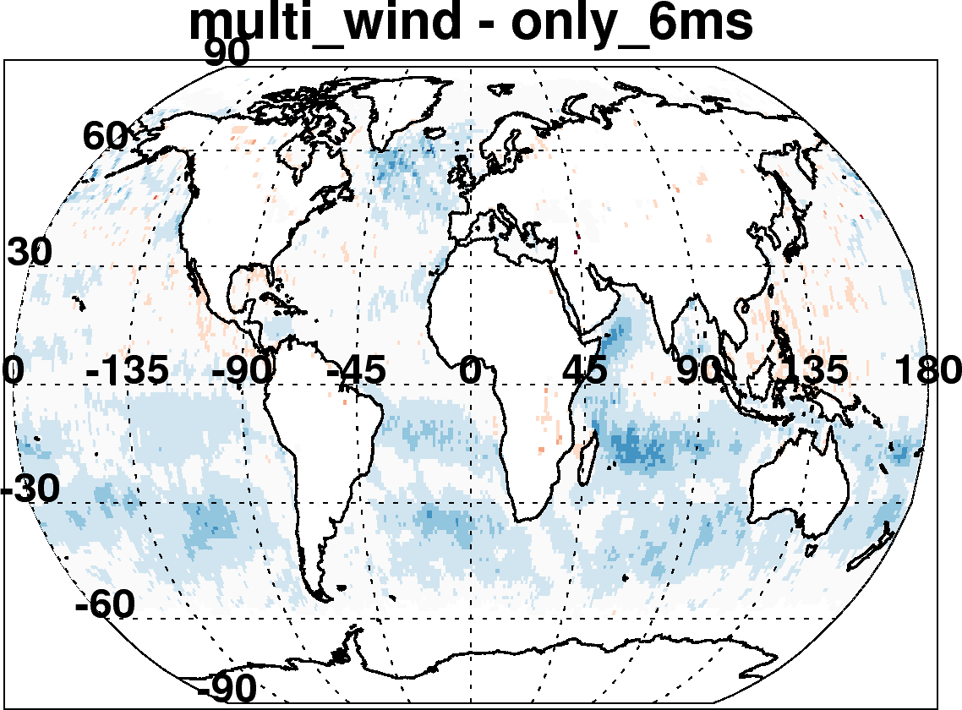

C6-C5 ocean: Due to many incremental changes (Aqua, July 2008)
New reflectance, geo-location inputs, Wisconsin cloud mask
Updated radiative transfer
Re-define land and sea
Account for wind speed impact on surface
Improved cloud mask
Also changed “Quality Assurance” Filtering
Changed aerosol definitions of land and sea

Slide 18
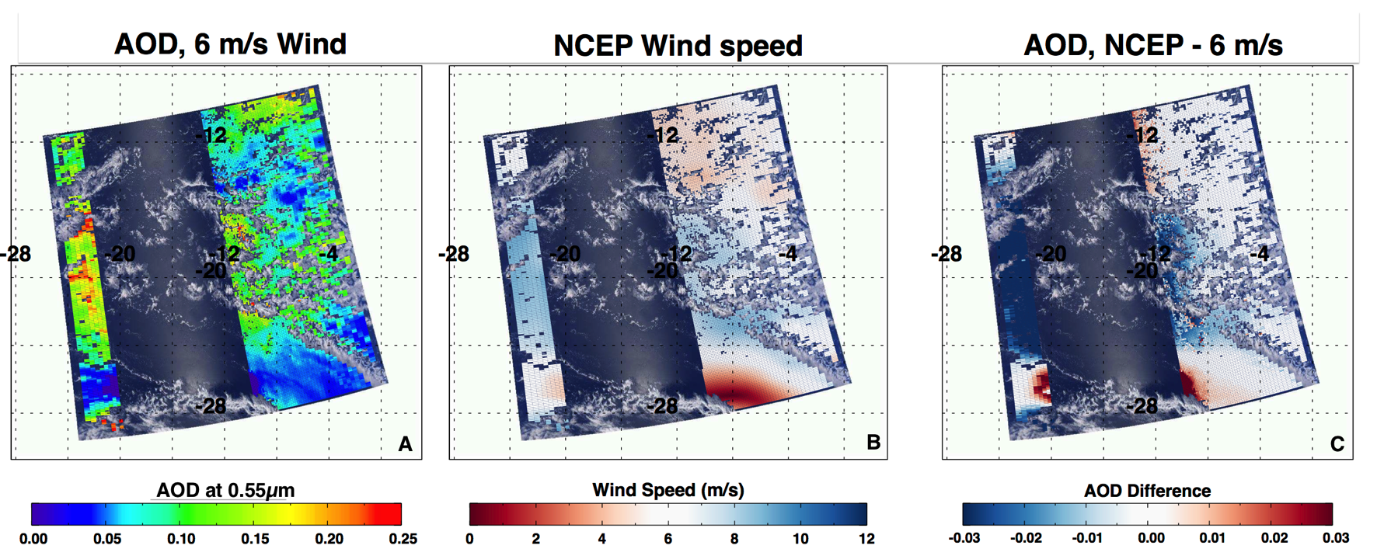
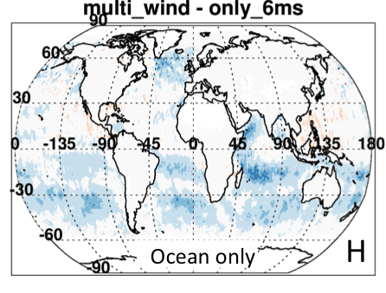
Over ocean: Wind speed dependence
Upshot: reduced AOD by 0.01 over all ocean
Especially important in Southern Hemisphere

Slide 19
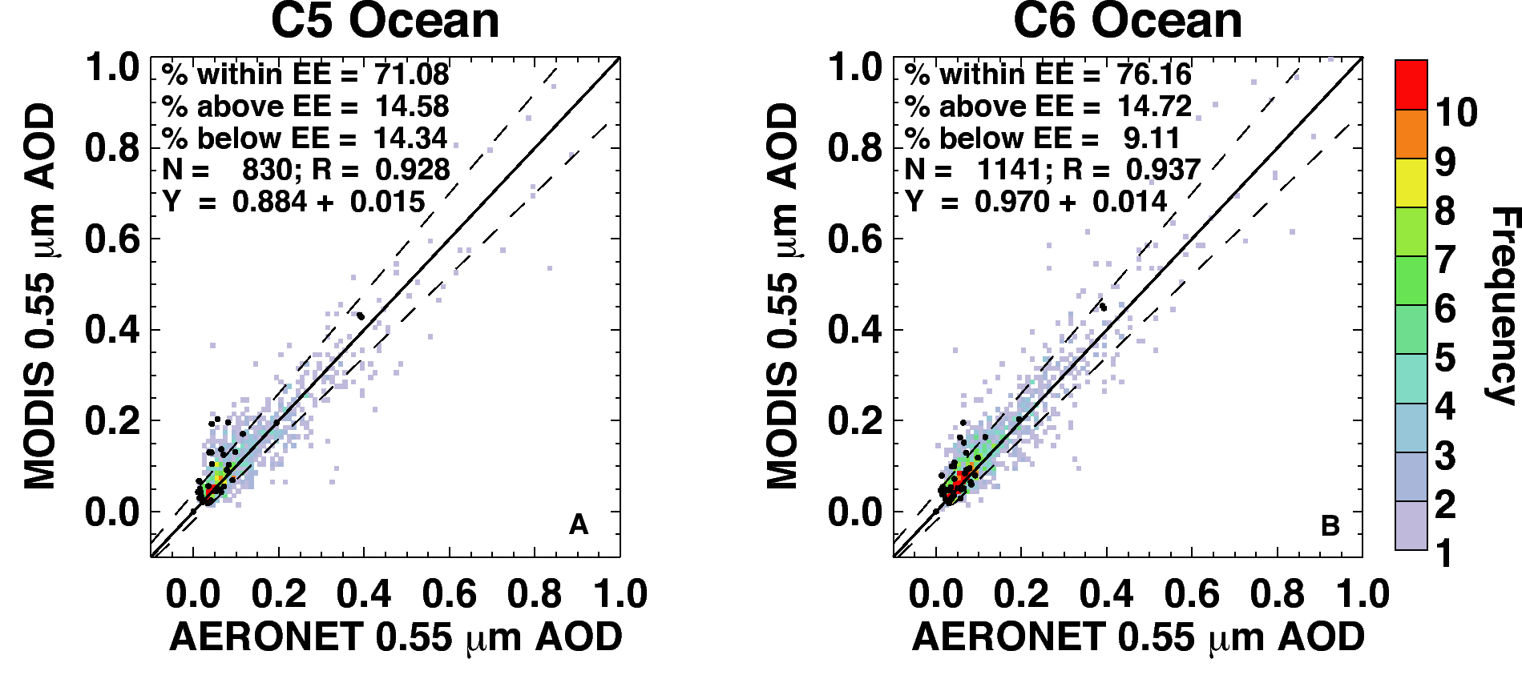
Comparison with AERONET and MAN
Aqua for 8 months (Jan + July, 2003, 2008 and 2010; Apr + Oct 2008).
Overall, not much change over ocean (slope, intercept, correlation)
But 30% more valid points to compare with (1141 versus 830).
AERONET are gray and colored, MAN are black dots

Slide 20
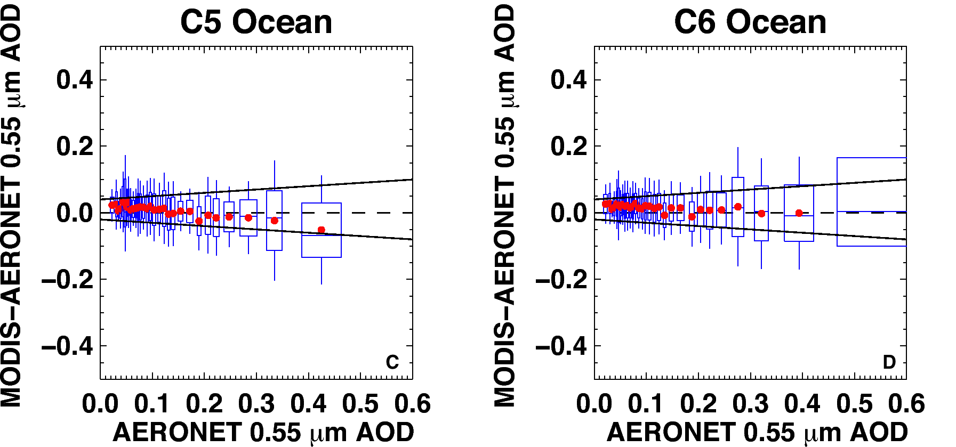
Better way to see MODIS improvement
MODIS error (MODIS–AERONET) versus AERONET; zero “error” is dashed line
Boxes represent middle 67% of each dataset, whiskers are middle 95% of MODIS-AERONET
Solid lines are “expected error” (EE) envelope; note asymmetry (new definition for C6).
Note that in C6, that the MODIS error is within EE for nearly all bins of AOD
C5 EE = ±(0.03 + 5%). C6 EE = (-0.02 – 10%), (+0.04 + 10%) )
Less overall “bias” in C6.
Validation available for all years of Aqua data

Slide 21
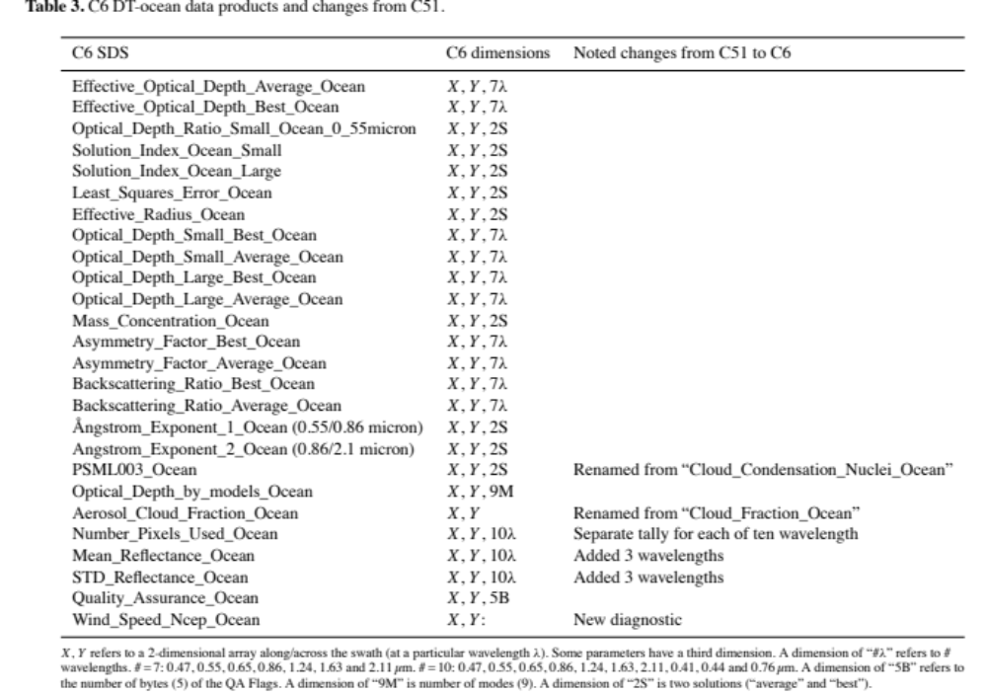
SDSs over ocean
Notes:
You can’t read this, but here are SDSs over ocean within the MxD04_L2 file, pulled out from the AMT paper. Most SDSs are same from C5, but there are some that are renamed (e.g. PSML003_Ocean”, and others that have revised dimensions.

Slide 22
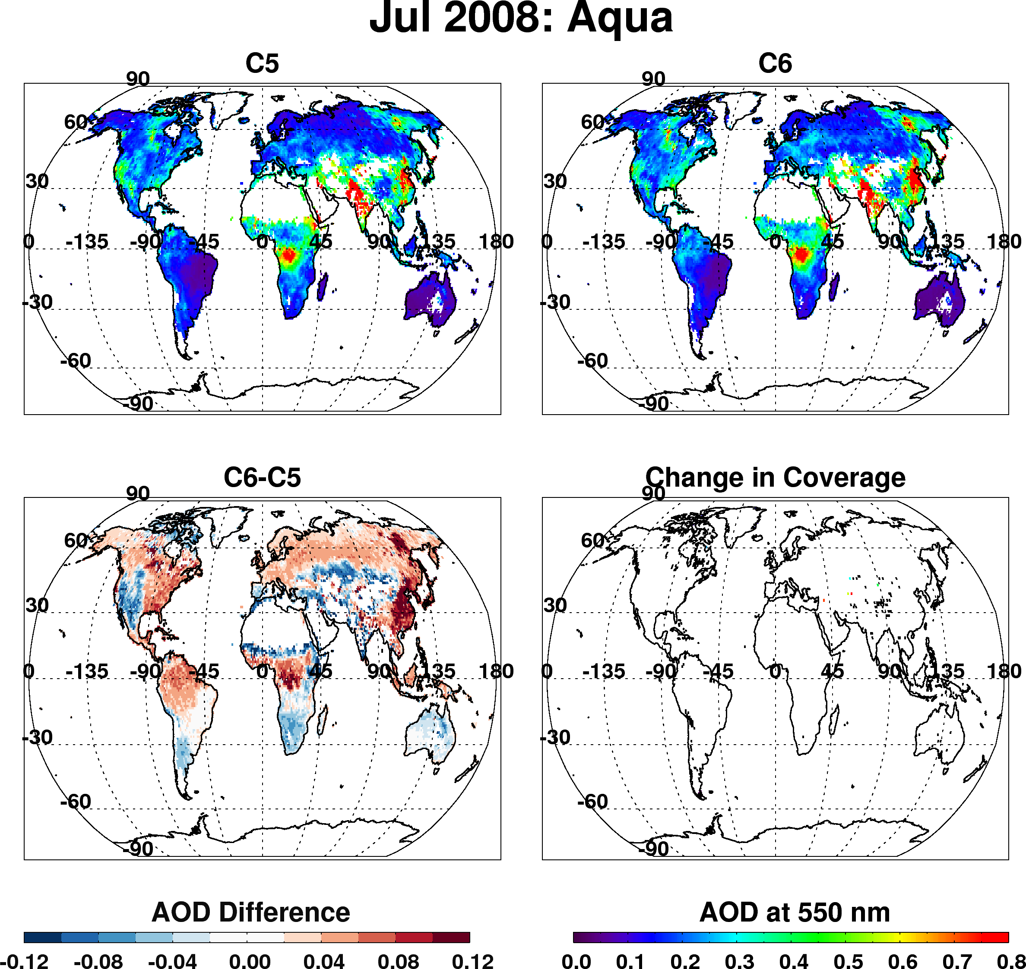
Dark target over land - overall changes to products (Aqua, Jul 2008)
Overall decrease of AOD in semi-arid
Overall increase over vegetation
Strong increase over Eastern Asia
Slight change in coverage here and there

Slide 23
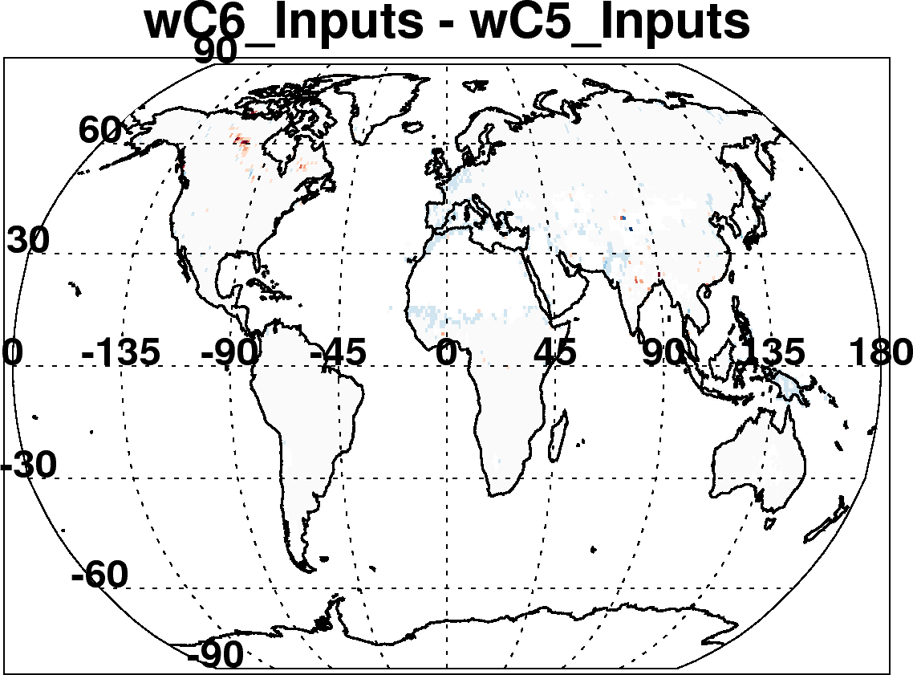
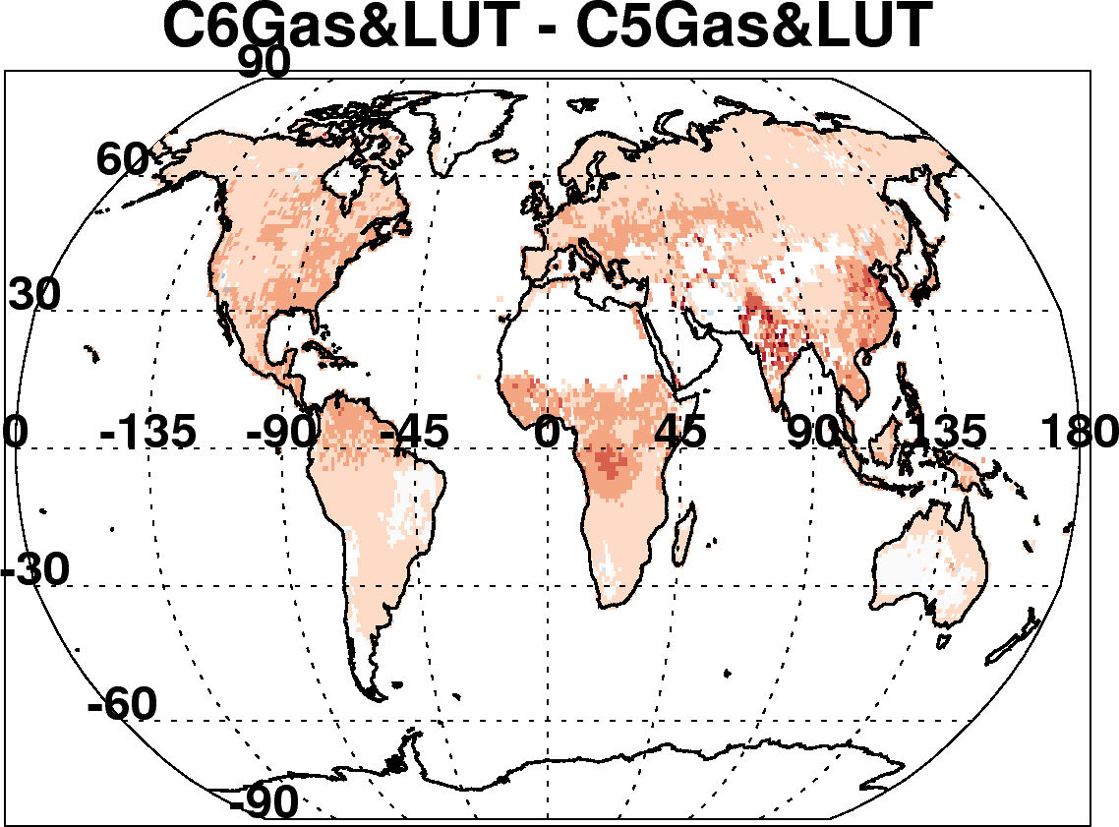
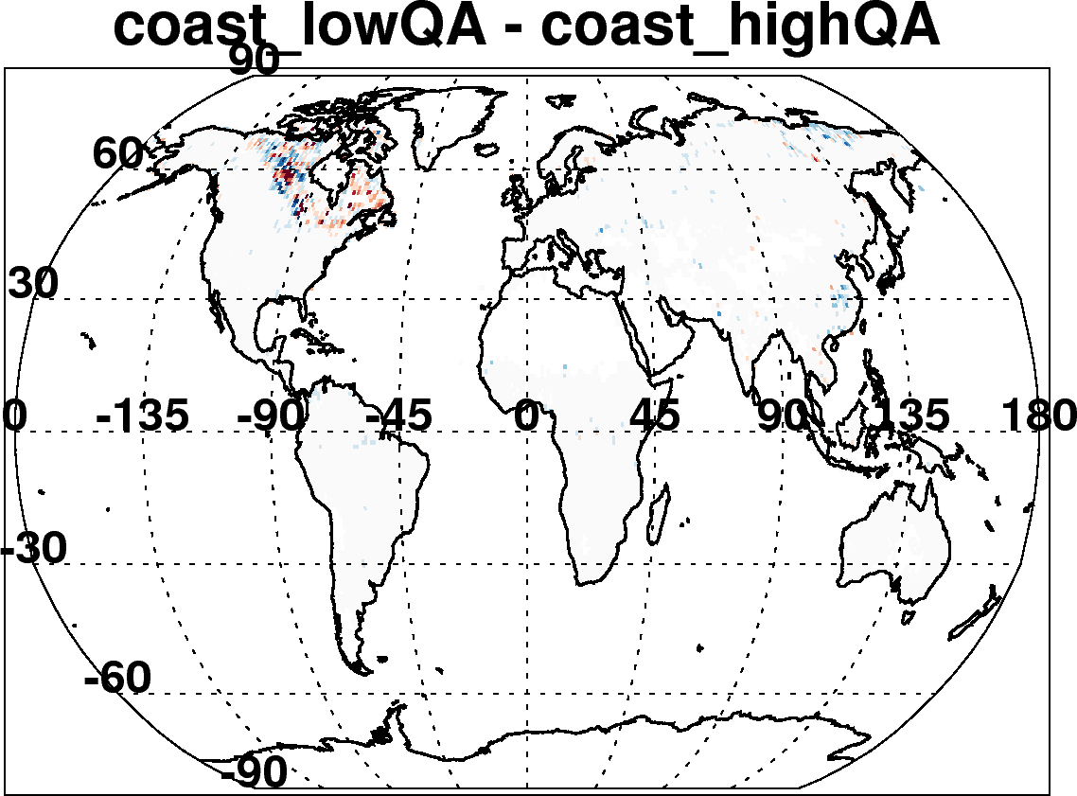
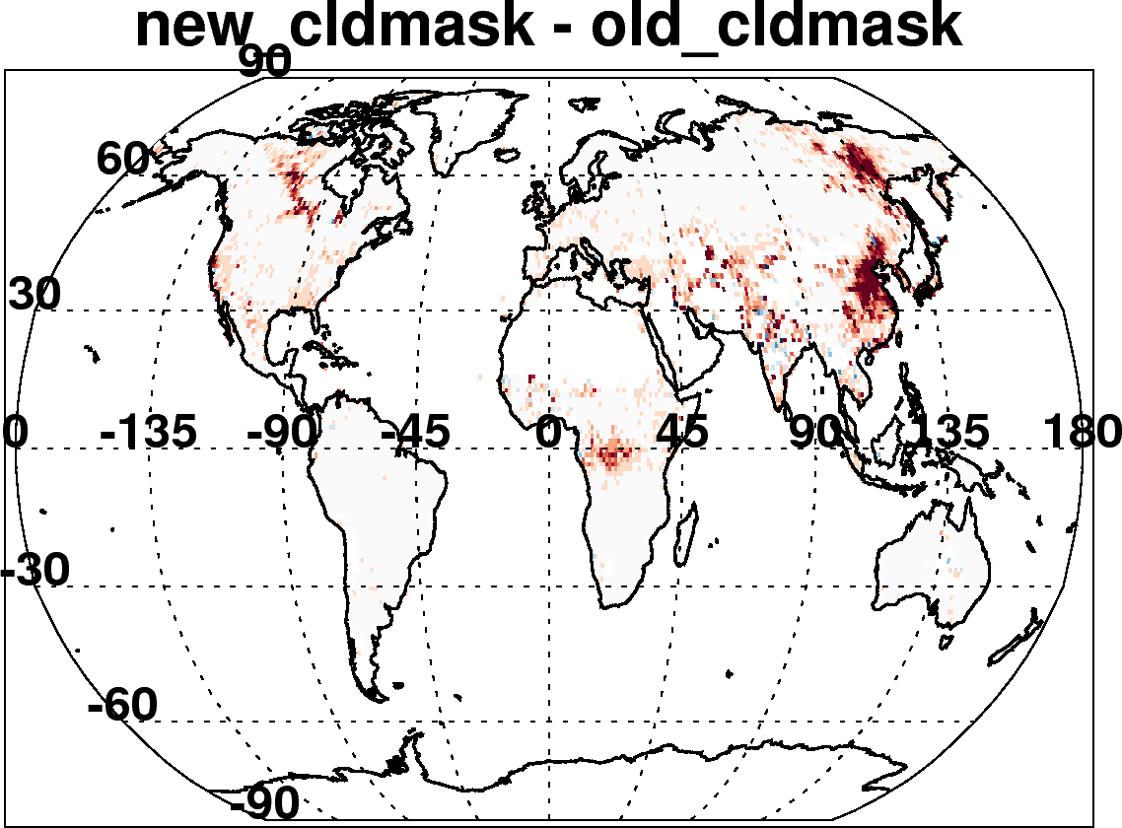
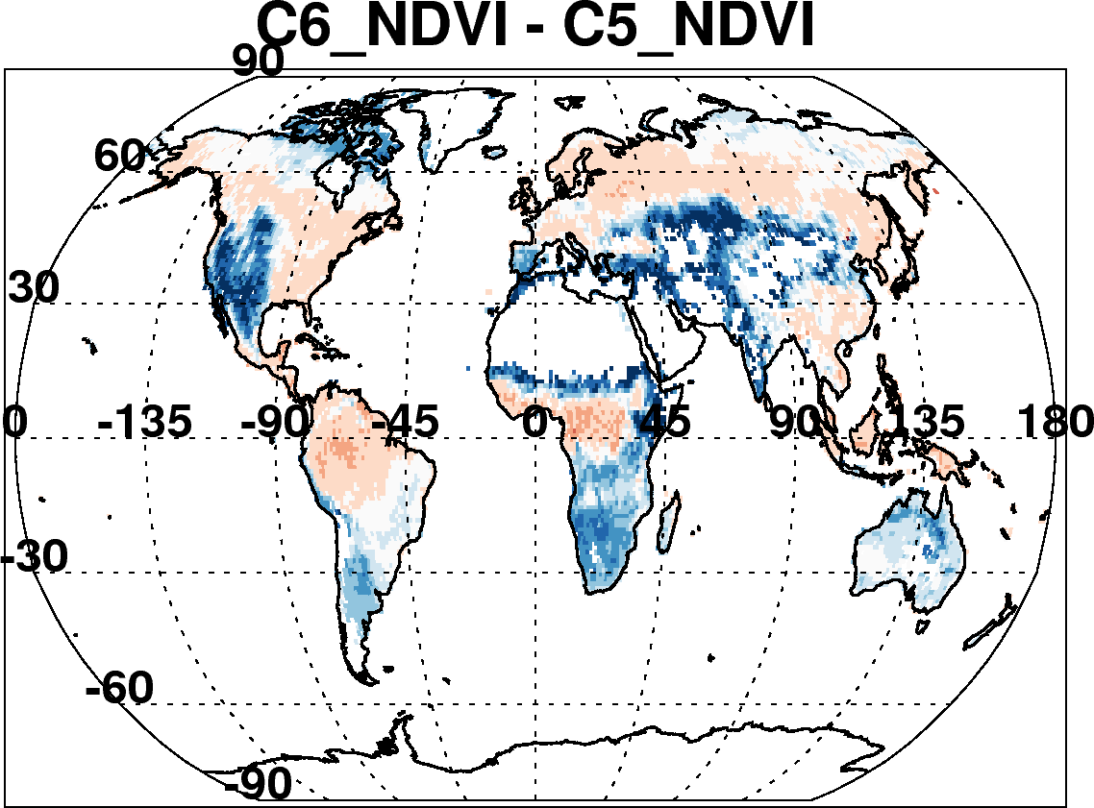
C6-C5 land: Due to many incremental changes
(Aqua, July 2008)
New reflectance and geo-location inputs
Updated radiative transfer
Re-define land and sea
Improved cloud mask to detect smoke
Fixed surface reflectance dependence on TOA NDVI
Also changed “Quality Assurance” Filtering
Changed aerosol definitions of land and sea
This was a major bug!

Slide 24
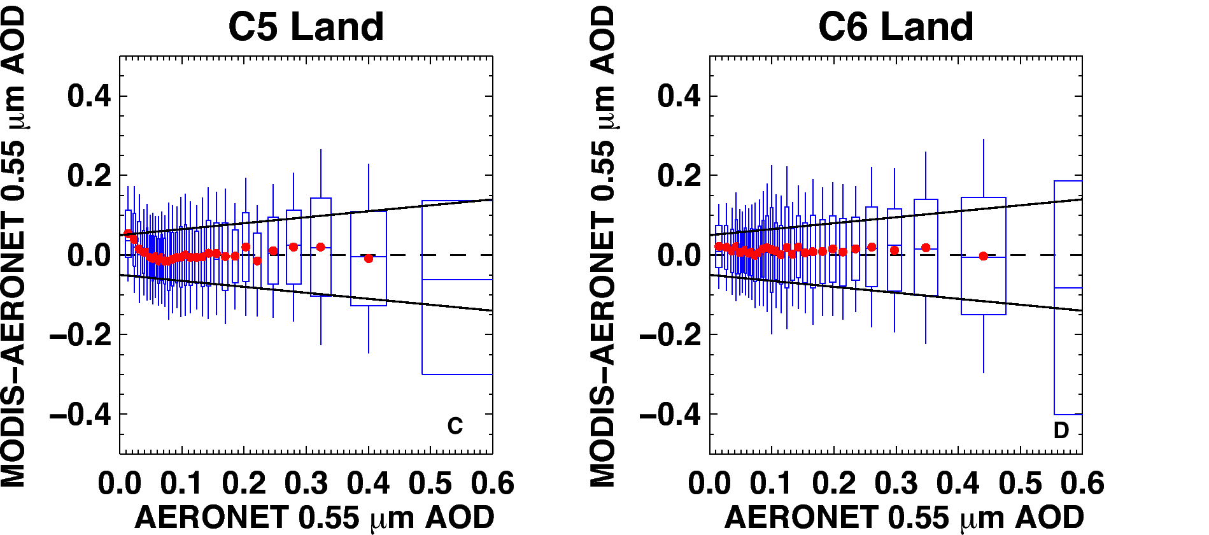
Preliminary comparison with AERONET
(8 months of Aqua data)
MODIS error (MODIS–AERONET) versus AERONET; zero “error” is dashed line
Boxes are middle 67% of dataset, whiskers are middle 95% of MODIS-AERONET
Solid lines are “expected error” (EE) envelope; no asymmetry
C6 MODIS error is within EE for nearly all bins of AOD (even at low values)
C5 EE = ±(0.05 + 15%)). Keep definition for C6.
Note, there are 10+ years of validation now with Aqua

Slide 25
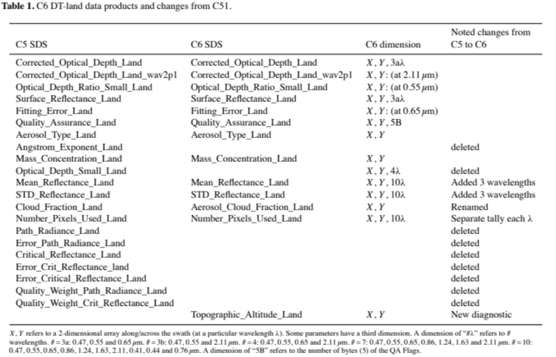
SDSs over land
Notes:
You can’t read this, but here are SDSs over land within the MxD04_L2 file, pulled out from the AMT paper. Most SDSs are same from C5, but there are some that are renamed (e.g. “Aerosol_Cloud_Fraction”, and others that have revised dimensions. A few are deleted (eg. The Angstron exponent and optical depth small land) because there is no quantitative value to them. The Path radiance and critical reflectance products were also deleted due to no known users.

Slide 26
SDSs combined land/ocean
“joint” SDSs that take the best of both land and ocean. There are two versions:
  Image_Optical_Depth_Land_And_Ocean: populated for all pixels in which either land or ocean made a retrieval.
    This is intended for imagery with fewer holes
  Optical_Depth_Land_And_Ocean: populated for pixels that meet Quality Assurance criteria
    This is intended for more scientific integrity
    For land: QA = 3 (only)
    For ocean: QA ≥ 1 ( =1, 2 or 3).
  Land_Sea_Flag: This new SDS integer describes whether retrieval over land or ocean (or neither).
  Land_Ocean_Quality_Flag: This new SDS integer repeats the QA for land and ocean, but in an integer form (no decoding bits and bytes).
Notes:
These are described in the AMT paper

Slide 27
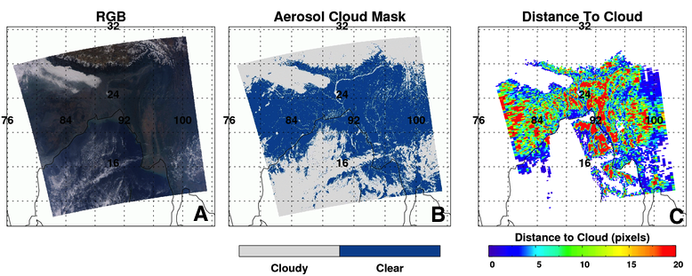
What else for C6 Level 2?
Diagnostic SDSs (wind speed, topographic elevation, etc)
“Cloud mask”, “distance to nearest cloud” (these are at native 500 m resolution).
Changes to SDS names

Slide 28
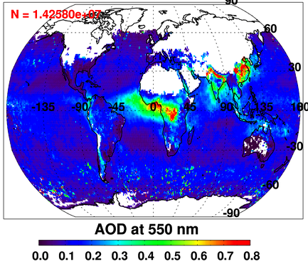
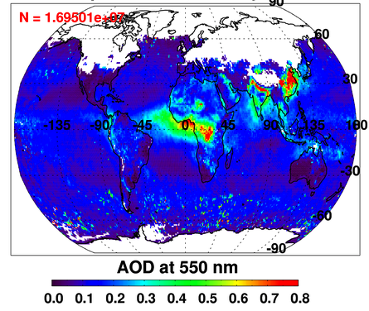
Deep Blue/Dark Target Merge:
Dark Target AOD
DeepDark AOD
Merging deep blue & dark target produces best global coverage
Deep blue is land-only; need dark target for oceans
Deep blue introduces coverage over Australian outback, Sahara desert
  and Arabian peninsula
Still no coverage over snow (see: most of Northern Hemisphere).

Slide 29
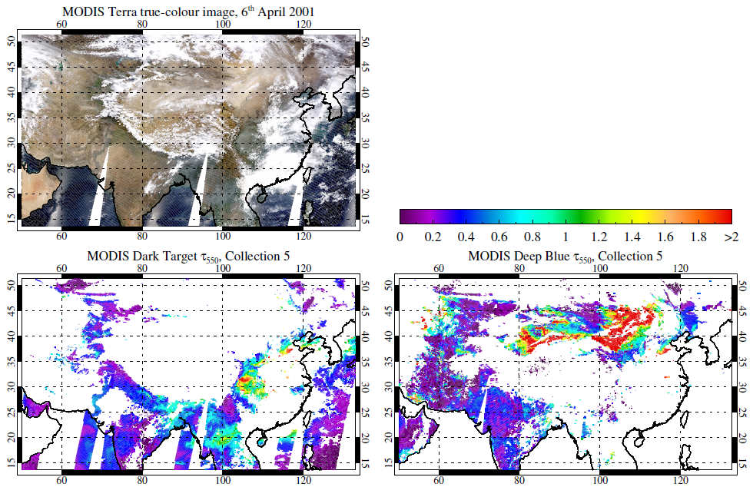
Deep Blue: original motivation
‘Dark Target’ AOD algorithm does not retrieve over bright surfaces
  Violates algorithmic assumptions
These are important aerosol sources, especially mineral dust
Deep Blue filled in some gaps
  (Now, it does more than that)

Slide 30
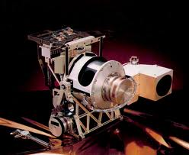
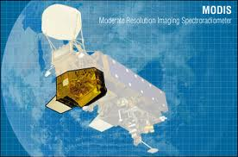
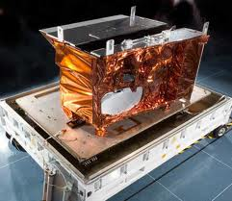
Sensors Deep Blue has been applied to
 |  | 1997 |  |  |  |  |  | 2000 |  |  |  | 2002 |  |  |  |  |  |  |  |  |  |  |  |  |  |  |  | 2010 |  | 2011 |  | Present |  |  | ?
SeaWiFS
MODIS
(Terra)
MODIS
(Aqua)
VIIRS
(Suomi-NPP)
Images courtesy of SeaWiFS/MODIS projects and Raytheon

Slide 31
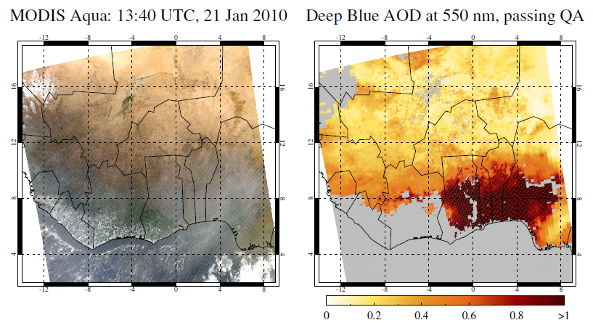
Example Level 2 data
Science Data Set (SDS) names relevant for most users:
  Deep_Blue_Aerosol_Optical_Depth_550_Land_Best_Estimate
    This has our quality filters applied, i.e. any retrieval not set to the fill value (-9.999) should be usable
    For the bulk of applications, quality assurance (QA) filters should be used
  Latitude
  Longitude
Example granule shown here: MYD021KM.A2010021.1340.006.2012064111514.hdf

Slide 32
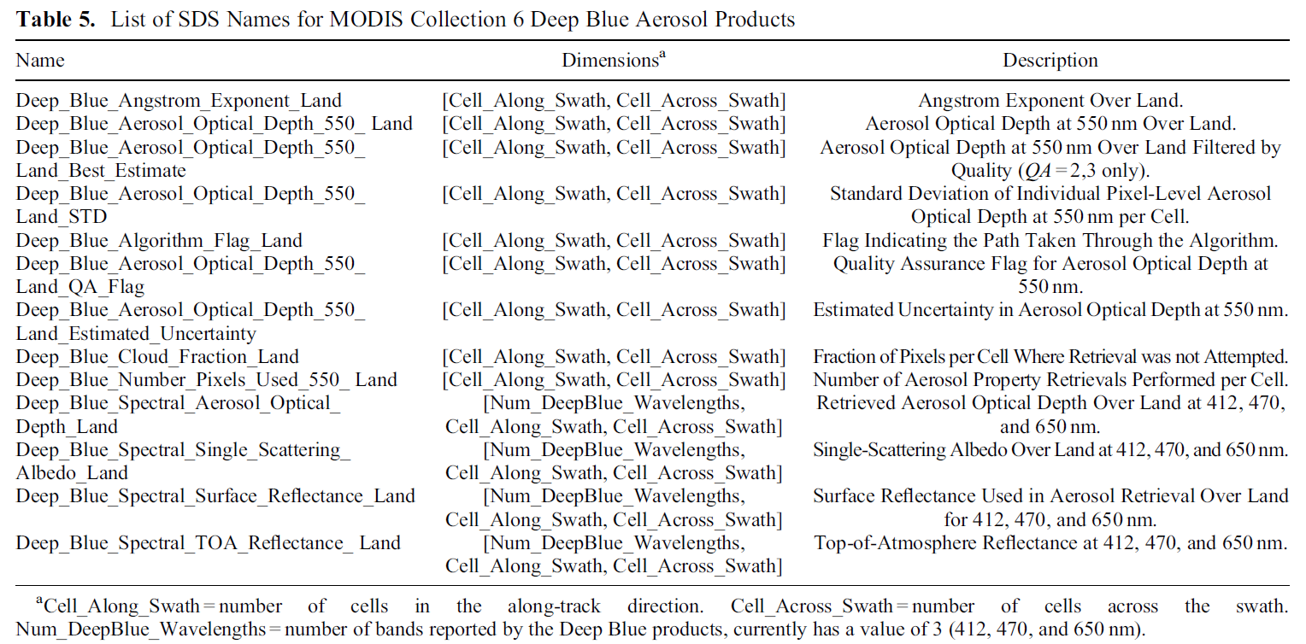
Example Level 2 data
AE (useful in high AOD)
Algorithm flag (indicates surface reflectance method)
QA flag (required if not using prefiltered SDS)
AOD uncertainty estimate
(new for C6!)
Table from Hsu et al., JGR (2013)
Other stuff included in files but not listed above:
  Diagnostic information (e.g. geometry, land/sea mask)
  Dark Target and ocean aerosol data
  Deep Blue/Dark Target ‘merged’ SDS

Slide 33
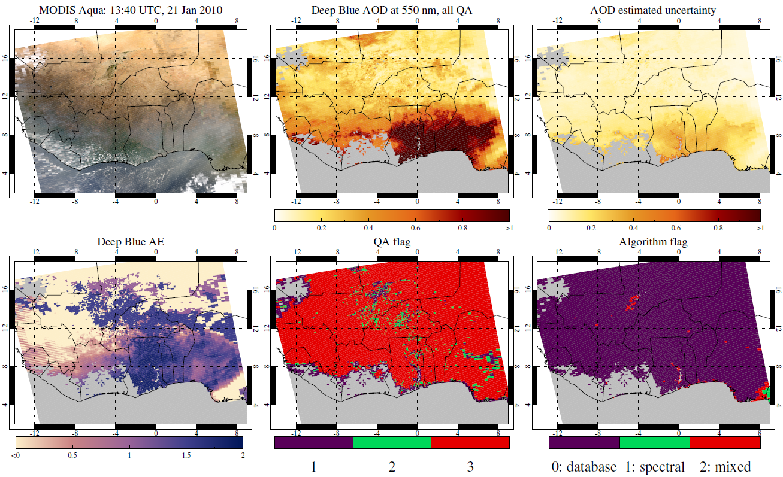
Example Level 2 data

Slide 34
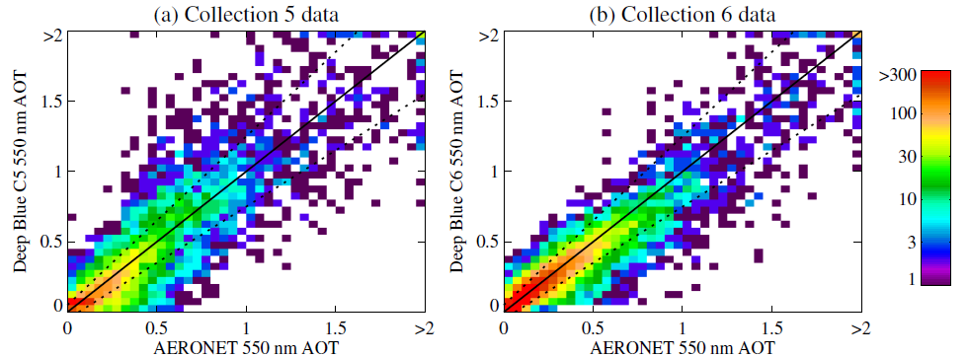
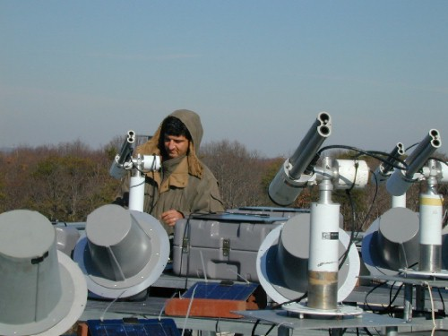
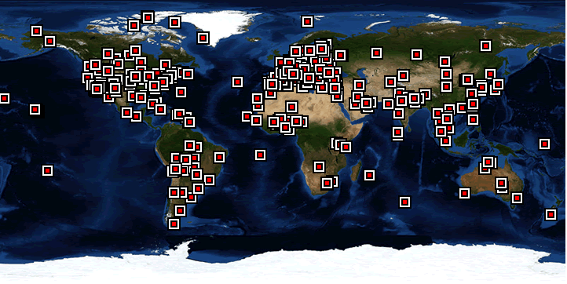
e-Deep Blue: main developments in C6
  Described by Hsu et al., JGR (2013); Sayer et al., JGR (2013)
  Enhanced Deep Blue (e-Deep Blue)
  Summary: more retrievals, better retrievals
Refinements to e-Deep Blue in MODIS Collection 6:
Extended coverage to vegetated surfaces, as well as bright land
Improved surface reflectance models
Improved aerosol optical models
Improved cloud screening
Simplified quality assurance (QA) flag reading
Radiometric calibration improvements
Images from NASA AERONET page, http://aeronet.gsfc.nasa.gov/

Slide 35
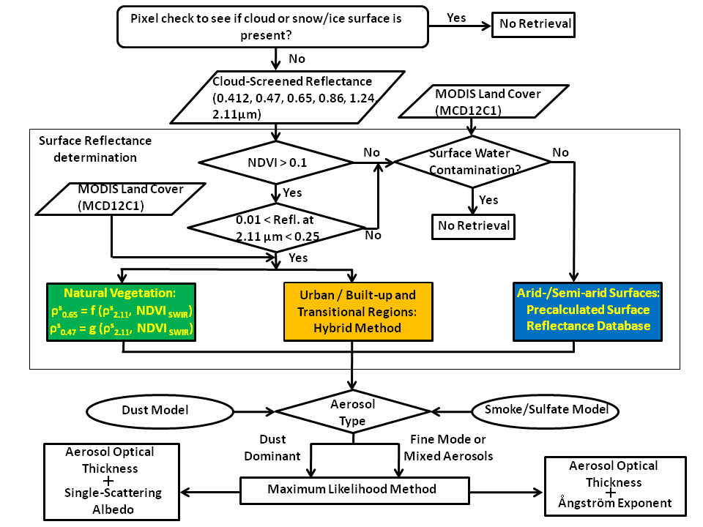
e-Deep Blue: C6 flow chart
  Described by Hsu et al., JGR (2013)

Slide 36
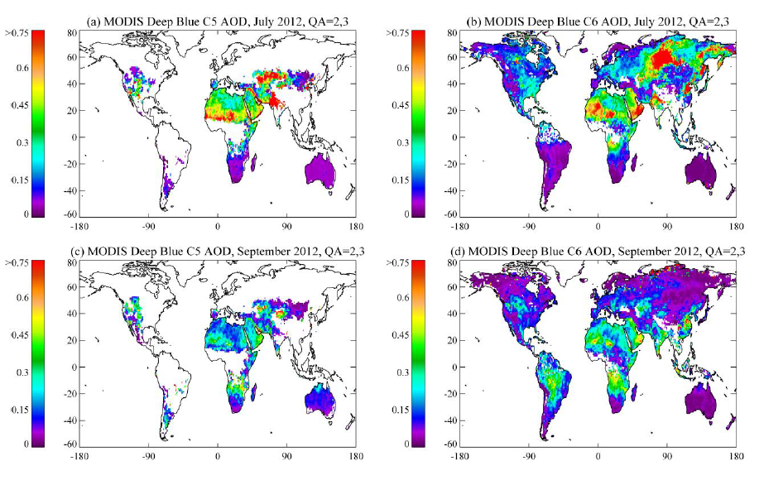
MODIS C6: extended spatial coverage

Slide 37
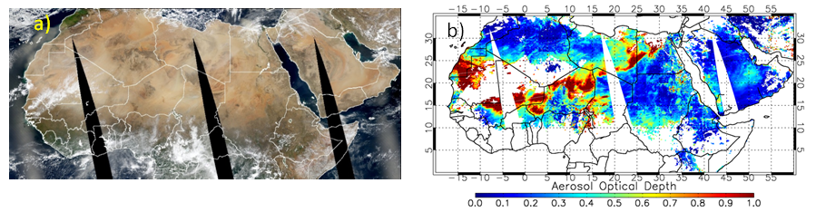

MODIS C6: improved cloud screening
MODIS RGB image over northern Africa on March 7, 2006
MODIS C5 Deep Blue AOD
TOA Reflectance at 1.38 μm
Precipitable water vapor, cm
BTD,
11-12 μm, K
Brightness temperature at 11 μm, K
MODIS C6 Deep Blue AOD
Traditional cirrus detection techniques can fail over moisture-deprived regions

Slide 38
Summary
e-Deep Blue provides aerosol data at ~10 km spatial resolution over vegetated, urban, and arid land surfaces, in near real time, suitable for quantitative use in scientific applications
  Primary data product AOD at 550 nm
  Ångström exponent, SSA useful in some situations
  Collection 6 has more and better retrievals than Collection 5
Links:
MODIS Atmospheres website: modis-atmos.gsfc.nasa.gov
NASA LAADS (data distribution) website: ladsweb.nascom.nasa.gov
MODIS Collection 6 on the NASA LAADS ftp server: ladsweb.nascom.nasa.gov/allData/6/<product name>
Key references:
Hsu, N. C., S. C. Tsay, M. D. King, and J. R. Herman (2004), Aerosol properties over bright-reflecting source regions, IEEE Trans. Geosci. Remote Sens., 42, 557–569
Hsu, N. C., S. C. Tsay, M. D. King, and J. R. Herman (2006), Deep blue retrievals of Asian aerosol properties during ACE-Asia, IEEE Trans. Geosci. Remote Sens., 44, 3180–3195
Hsu, N. C., M.-J. Jeong, C. Bettenhausen, A. M. Sayer, R. Hansell, C. S. Seftor, J. Huang, and S.-C. Tsay (2013), Enhanced Deep Blue aerosol retrieval algorithm: The second generation, J. Geophys. Res. Atmos., 118, 9296–9315, doi:10.1002/jgrd.50712
Sayer, A. M., N. C. Hsu, C. Bettenhausen, and M.-J. Jeong (2013), Validation and uncertainty estimates for MODIS Collection 6 “Deep Blue” aerosol data, J. Geophys. Res. Atmos., 118, 7864–7872, doi:10.1002/jgrd.50600

Slide 39


Changes to Level 3 (MxD08_M3)
C5
C6
C6-C5
In C5, averaging daily data did not look like monthly data (left, from Giovanni web application)
C5 monthly was “pixel weighted”. A day with 100 retrieved pixels was worth 10 times more than one with 10. It was clear-sky biased.
C6 monthly is “equal day” weighted. If at least five pixels in a day, than that day counts.
→ Increases monthly mean AOD over land, and ocean. Less clear sky biased?
C5

Slide 40


Trends in Collection 5
Over land, Terra decreases (-0.04/decade), Aqua constant
Terra / Aqua divergence is the same everywhere on the globe!
In NH, observations are 1.5 hours apart, while SH are 4.5 hours
So, probably not due to diurnal cycle of aerosol

Slide 41




Impact to “observed” reflectance
“Global” Aqua changes in visible bands by -0.001 or less
“Global” Terra changes in visible bands by +0.002 or more
Overall Aqua changes are relatively stable, but Terra’s changes vary over time.
reflectance
Difference reflectance

Slide 42

Impact of New Terra calibration
Big changes to blue and red bands
Biggest impacts over land
  Global increase by 0.02 (for this particular month). 10% of global mean!
Smaller impacts over ocean
  Global increase by 0.004 (for this particular month)

Slide 43


Impact of new calibration on trend of Terra-Aqua AOD
8 months processed with same dark-target aerosol algorithms
Terra now more “in sync” with Aqua time series
New calibration → Terra/Aqua divergence removed for C6!
(Terra-Aqua) offset remains 0.02 (land) and 0.015 (ocean)

Slide 44
Continuing MODIS Calibration Challenges
VIS/NIR response vs. scan angle (RVS)
  Band (detector) and mirror side dependent
Large solar diffuser (SD) degradation at short wavelengths (esp. Terra)
  Impact on radiometric uncertainty estimates
  SWIR SD degradation not tracked by SDSM
Polarization sensitivity changes found in Terra MODIS
  Band (detector), RVS, and mirror side dependent
  No noticeable change seen in Aqua to date
Aging instruments
  Undesirable features, unpredictable changes
Which is why Terra has taken longer to reprocess. Get it right!

