Slide 1

CALIOP Aerosol
MET 611 – Satellite Data Applications
Jennifer D. S. Griswold

Slide 2
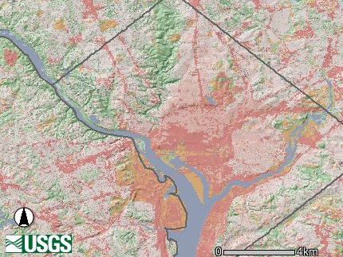
“A-Train” Nadir Footprints
6x7 km POLDER
Cloud
1. 4 km Cloudsat
0.09 km CALIPSO
13.5 km AIRS IR; AMSU & HSB μ wave
OCO
1x1.5 km
0.5 km MODIS Band 3-7
5.3 x 8.5 km TES
Washington DC
USGS Map

Slide 3
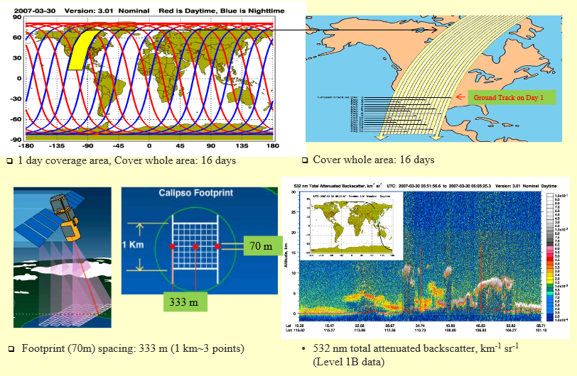
CALIPSO Spatial and Temporal Coverage

Slide 4
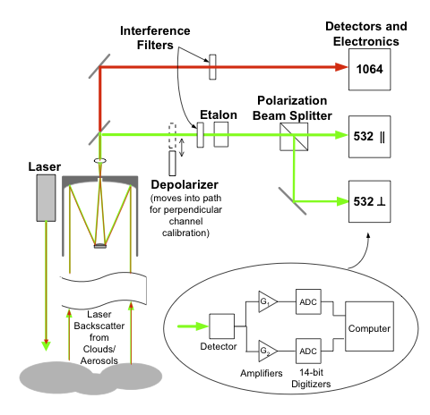
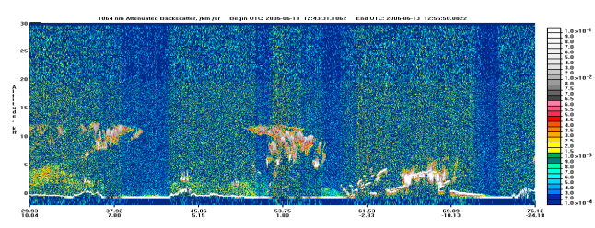
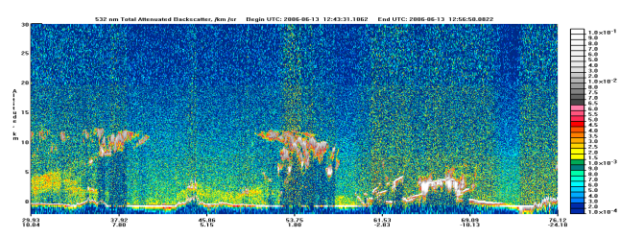
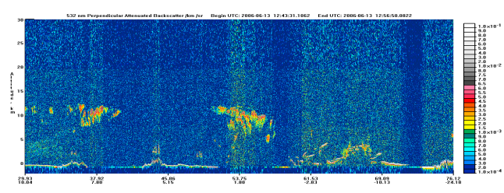
How does CALIOP work?
1064,Total
Total = || + ⊥
532,Total
532,⊥
3
4
1
LIDAR signal
Attenuated backscatter coefficient
Atmospheric two-way transmittance
= signal attenuation (cloud, aerosol, molecule, gas)
2
scattering layer
Total backscatter coefficient (cloud, aerosol, molecule)

Slide 5

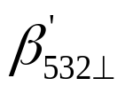

Lidar Signal Interpretation
 |  |  | Particle Type
Enhanced Signal | Enhanced Signal | Same intensity as 532 | Non-Spherical Coarse
Enhanced Signal | Enhanced Signal | Lower intensity than 532 | Non-Spherical Fine
Enhanced Signal | Non Enhanced Signal | Same intensity as 532 | Spherical Coarse
Enhanced Signal | Non Enhanced Signal | Lower intensity than 532 | Spherical Fine
Total attenuated backscatter 532 nm
Total attenuated backscatter 1064 nm
A
B

Slide 6
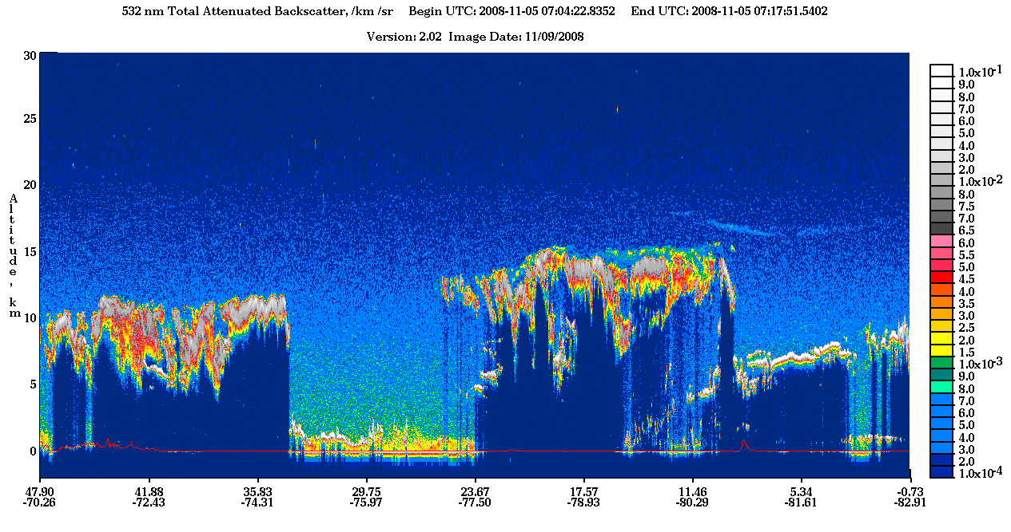
CALIPSO
“Curtain”
Notes:
Backscattering can occur in quite different physical situations, where the incoming waves or particles are deflected from their original direction by different mechanisms:
Diffuse reflection from large particles and Mie scattering, causing alpenglow and gegenschein, and showing up in weather radar;
inelastic collisions between electromagnetic waves and the transmitting medium (Brillouin scattering and Raman scattering), importa

Slide 7
CALIPSO products
Version 3.3 Product | Primary Parameter | Resolution due to averaging
 |  | Horizontal | Vertical (<8km)
Level 1 Measured | Total_Attenuated_Backscatter_532 Perpendicular_Attenuated_Backscatter_532 Total_Attenuated_Backscatter_1064 | 1/3km | 30m
Level 2 LAYER Retrieved | Cloud Layer_Top/ Base_Altitude | 1/3, 1, 5km | 30m
 | Aerosol Layer_Top/ Base_Altitude | 5km | 30m
Level 2 PROFILE Retrieved | Cloud and Aerosol Total_Backscatter_Coefficient_532 Extinction_Coefficient_532 | 5km | 60m
Level 2 Vertical Feature Mask Retrieved | Feature_Classification_Flags | 5km | 30m

Slide 8
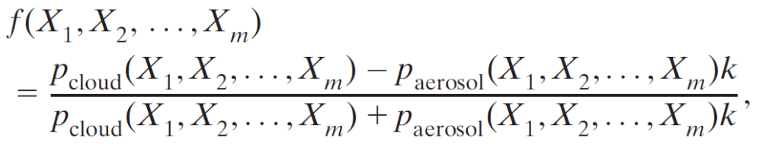
Cloud Aerosol Discrimination
The discrimination between clouds and aerosols is performed mainly based on the differences in their optical and physical properties. The algorithm is driven by the confidence function
where p_{cloud} and p_{aerosol} are the multidimensional PDFs, respectively, for clouds and aerosols, as a function of attributes X1, X2, . . . , Xm.
k is a scaling factor that is related to the ratio of the numbers of aerosol layers and cloud layers and is determined based on the measurement.
  It may vary depending on locations, altitudes, and seasons.

Slide 9
Cloud Aerosol Discrimination (CAD)
Attributes X1, X2, . . . , Xm can be
  lidar observables:
    backscatter intensity
    wavelength dependency
    depolarization ratio
    layer heights
  or ancillary parameters
    temperature
    pressure
    location
    season
The function f is a normalized differential probability. Its value ranges from -1 to 1.
  Within the CALIOP level 2 layer products, a percentile (integer) value of f ranging from -100 to 100 is reported as the ‘‘CAD score’’ characterizing each feature.

Slide 10
Feature Identification
The identification of a feature as either cloud or aerosol is performed based on the sign of the CAD score.
  If f(X1, X2, . . . , Xm) > 0
    then the probability that [X1, X2, . . . , Xm] represents a cloud is larger than the probability that [X1, X2, . . . , Xm] represents an aerosol, and the feature is therefore classified as a cloud.
  Otherwise, if f(X1, X2, . . . , Xm) < 0
    the cloud probability is smaller than the aerosol probability, and so the feature is classified as an aerosol.
  When f(X1, X2, . . . , Xm) = 0
    the probability that the feature represented by [X1, X2, . . . , Xm] is a cloud is equal to its probability of being an aerosol, and thus the classification is indeterminate.

Slide 11
Feature Identification
In regions where |f| = 1 (or |CAD| = 100), the classification can be made unambiguously.
The absolute value of the CAD score provides a confidence level for the classification:
  the larger the magnitude of the CAD score, the higher the confidence that the classification is correct.
Theoretically, an absolute value of 100 therefore indicates complete confidence.
Absolute values less than 100, corresponding to regions where the cloud and aerosol PDFs overlap, indicate some ambiguity in the classification.
  In this case, a definitive classification cannot be made
  although they can provide a ‘‘best guess’’ classification, this guess could be wrong.

Slide 12
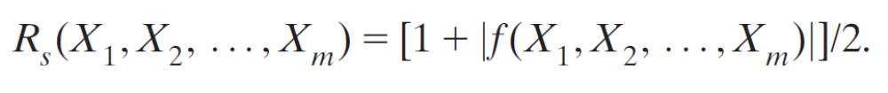
Success Rate of Classification
  Theoretically, a success rate R_{s} (or a failure rate R_{f}), defined as the ratio of correctly classified events to the total number of events (R_{f} = 1 - R_{s}), is related to f by (Liuet al. 2005)
The performance of the classification is limited essentially by the degree of the overlap in the cloud and aerosol PDFs
  the smaller the overlap region, the more complete the separation between the cloud and aerosol distributions, and the better the classification performance.

Slide 13
Reducing PDF Overlaps
To reduce the overlap, PDFs with a larger number of attribute dimensions are desired
  separation between the cloud and aerosol clusters is more complete in a higher-dimensional space (Liu et al.2004).
In principle, as many of the available observables as possible should be used to achieve the best performance.
The addition of an attribute dimension may not improve the classification significantly if the attribute to be added is not totally independent from the other attributes used.
  Some practical issues such as computing time and the latency of any ancillary data should also be considered when selecting attribute dimensions for operational classification.

Slide 14
Selecting Attributes – Cloud and Aerosol Discrimination
A very strong preference should be given to the intrinsic properties of features:
  physical and optical characteristics of the feature that depend solely on the layer composition and are independent of particle concentration.
In many cases estimates of the intrinsic properties of a feature can only be obtained after computing (and subsequently correcting for) the extinction profile within the feature.
  The dilemma:
    deriving the extinction solution requires an estimate of the feature lidar ratio, this estimate in turn is derived from an assessment of layer type.
    Because the CAD is the first step of the scene classification analysis that is performed before the extinction coefficient is retrieved by HERA, some intrinsic attributes (e.g., the particulate backscatter color ratio) are not available for use and, thus, are replaced by the corresponding extrinsic feature properties (e.g., the attenuated backscatter color ratio).

Slide 15
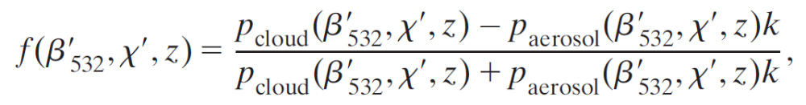
Development PDFs
The core part of the cloud and aerosol classification is based on multidimensional PDFs of clouds and aerosols.
Attributes of:
  layer-averaged attenuated backscatter (β’)
  attenuated total backscatter color ratio (χ’)
  and mid-layer heights (z)
  have been selected in the prelaunch version (version 1) that was used in the first lidar data release (Liu et al. 2004) and in version 2 of the CAD algorithm.
The f function can then be rewritten as

Slide 16
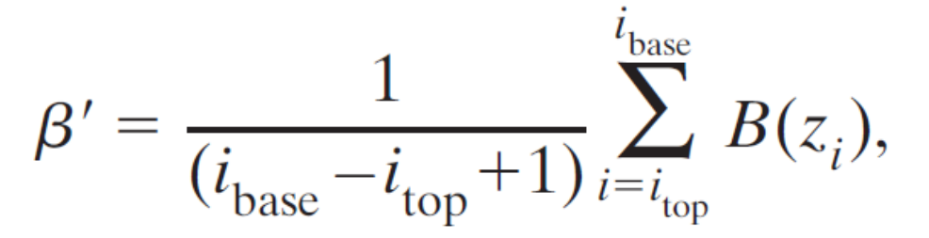
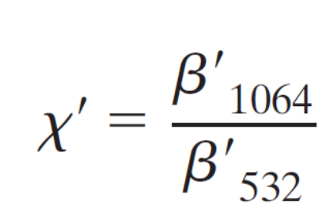
Development PDFs
Where:
and B is the attenuated backscatter coefficient at range z_{i} with additional corrections for the effects of molecular and ozone attenuations applied.

Slide 17
Development PDFs
PDFs are implemented as a 100 x 100 x 20 three-dimensional array.
The attenuated backscatter dimension of the PDFs is logarithmic
  100 elements starting at ln(β’) = -12 with an increment of 0.14.
The attenuated total backscatter color ratio dimension also has 100 elements
  starting at χ’ = 0 with increments of 0.02
The mid-layer altitude dimension is binned for every 1 km from 0 to 20 km (20 elements).

Slide 18
Expert Classification
The cloud and aerosol PDF database has been updated based on expert manual classification of all layers detected during one full day of data acquired by CALIOP on 12 August 2006.
In contrast to the automated production CAD processing that performs feature classifications in isolation, based on the properties of single vertical layer, this expert reclassification identifies features by:
  simultaneous inspection of two-dimensional vertical–horizontal images of several different lidar measurements:
    attenuated backscatter,
    attenuated backscatter color ratio,
    and volume depolarization ratio

Slide 19
Expert Classification
In addition to χ’, β’, and mid-layer altitude, this expert reclassification also makes use of additional information:
  layer structures
  textures
  connections with the surrounding layers
  geographic locations in the assessment of feature types.
Due to the large amount of data that must be examined (e.g., ~0.3 million 5-km layers for the selected day), manual classification of layer types can be very time consuming.
For this reason, a computer tool has been developed to facilitate this kind of image-based manual identification of features by immediately and interactively providing the quantitative, measured data associated with each layer.
Despite this computerized assistance and the application of spatial coherence tests, there remain some cases that cannot be identified with high confidence.

Slide 20
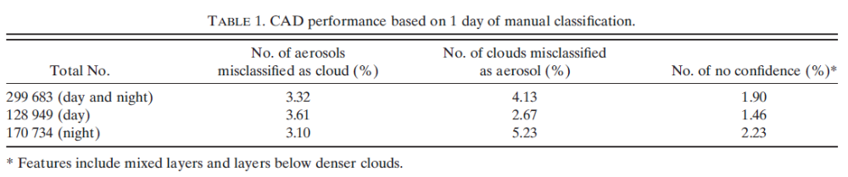
CAD “bad” Performance
These cases include:
  layers at edges of clouds
  mixed layers of cloud and aerosol
  and layers below dense clouds whose optical properties are not correctly measured due to the detection issues such as the detector transient response, multiple scattering, etc.
These layers, labeled as “no confidence” in the manual classification, account for ~2% of the selected day’s manually classified data.

Slide 21
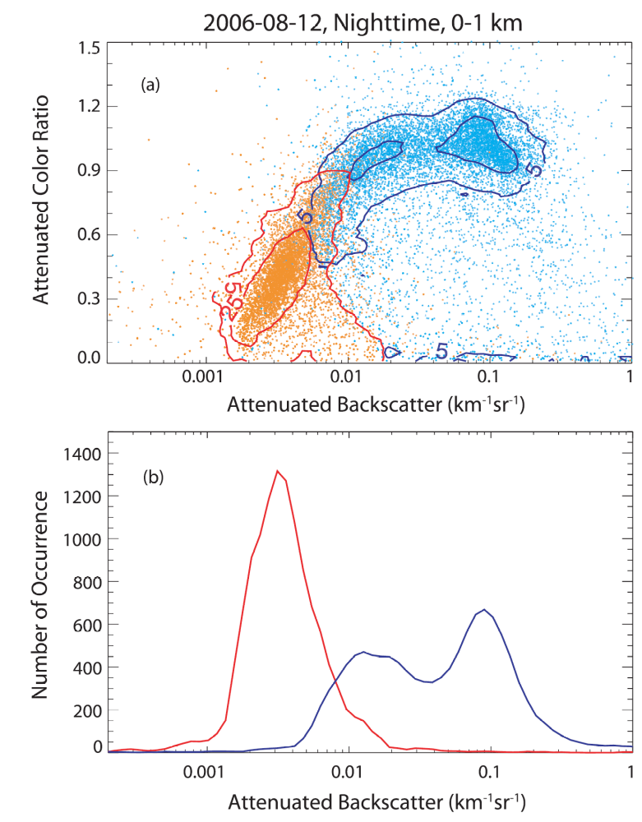
Example
Figure 1 (Liu et al 2009) presents (a) a combination scatterplot–contour plot in the backscatter–color ratio space and (b) the occurrence distribution as a function of attenuated backscatter of clouds (blue) and aerosols (red) within the 0–1-km altitude range measured by CALIOP on 12 August 2006.
As seen in Fig. 1, aerosols generally have smaller backscatter intensities and attenuated backscatter color ratios when compared with clouds, and the two classes are largely separated in the backscatter–color ratio space

Slide 22
Flowchart of the version 2 CAD algorithm
The version 2 CAD algorithm improves upon version 1 by using additional tests to ensure the correct classification of several well-defined special cases.

Slide 23
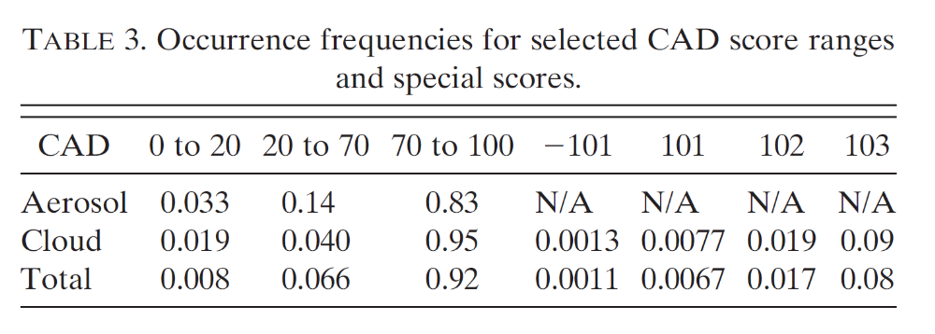
CAD Special
Scores
In addition to the standard CAD scores, which range between -100 and 100, special CAD scores are also reported in the CALIOP cloud-layer products
  -101
  101
  102
  103
These special scores distinguish features/artifacts identified by other tests as described in Fig. 2.
Figure 5 presents an example of (a) the occurrence distribution and (b) the cumulative occurrence frequency of the CAD score derived from one month (July 2006) of the CALIOP 5-km-layer products data (version 2.01).
FIG. 5. (a) Number of occurrences and (b) cumulative occurrence frequency of the CAD score derived from one month (July2006) of the CALIOP layer products data (version 2.01).

Slide 24
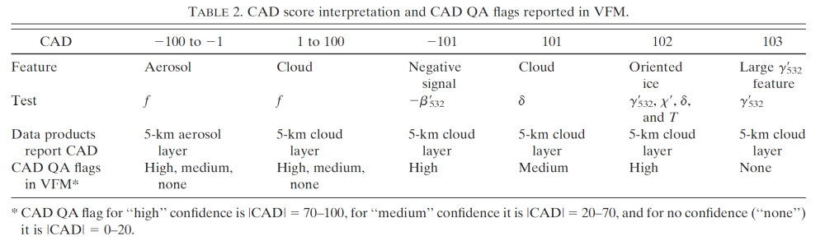
CAD Special Score Meanings
The special CAD score of -101 indicates features that have a negative mean attenuated backscatter.
  These features should not occur based on the algorithm design. However, they occurred in the current layer products due to some unknown programming reasons.
  The fraction of these features is very low, ~0.1% of the total tropospheric features, including clouds and aerosols for the one month of data shown in Fig. 5, and they should be eliminated in future data releases.
  Layers flagged -101 should never be used.

Slide 25
CAD Special Score Meanings
The rest of the special scores (101, 102, and 103) correspond mostly to genuine atmospheric features.
  special score of 101 is assigned to the features that are classified as cloud by the depolarization ratio test (the d switch in Fig. 2).
    About 0.7% of the total features have CAD scores of 101, and these mostly occur at high latitudes.
  special score of 102 is assigned to those features that are highly likely to contain large fractions of oriented ice crystals.
    These features account for ~0.2% of the total features.
  special score of 103 may be a mixture of oriented ice crystals with other types of cloud particles, or a feature whose optical properties are artificial due to improper data processing, or may not be an atmospheric feature.
    Therefore, caution should be taken in the interpretation and use of this class of features

Slide 26
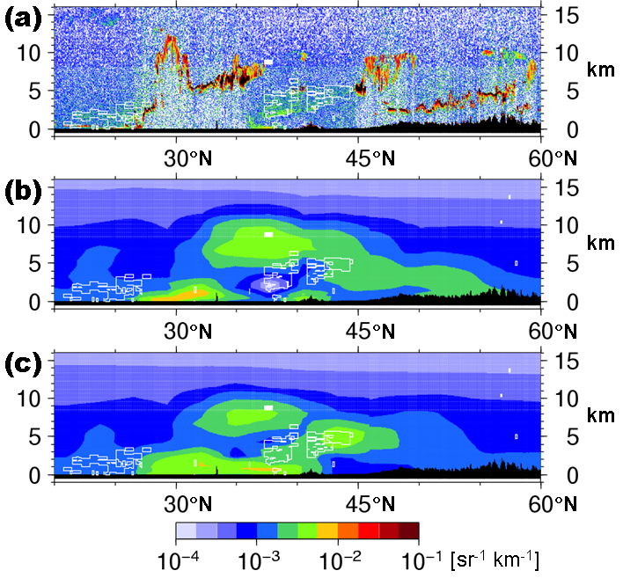
CALIOP Data Screening by CAD Score
CALIOP Level 1B attenuated backscattering coefficients at 532nm;
before data assimilation in model;
after data assimilation in model.
after data assimilation in model.
White squares are areas where the Cloud-Aerosol-Discrimination scores are less than -33.

Slide 27
Algorithm Conventions
Conventions used in the version 2 CAD algorithm are provided in the following:
  Only two classes of tropospheric features are defined in the CAD algorithm: ‘‘cloud’’ and ‘‘aerosol.’’
    The aerosol class is defined as all airborne particles, excluding activated water droplets and frozen ice crystals.
    This class includes all commonly defined aerosol types (maritime, continental, dust, and smoke).
    The cloud class is defined as an air mass containing any activated water droplets and/or ice crystals.
    All normally defined clouds (high-, middle-. and low-cloud families) are included in the cloud class.

Slide 28
Algorithm Conventions
Conventions used in the version 2 CAD algorithm are provided in the following:
  Based on the definition above, a mixed layer of cloud and aerosol that is erroneously identified as a single layer by the CALIOP feature finder is classified as a cloud.
  Fogs, in either liquid form or frozen form, are included in the cloud class.
  Diamond dust also belongs to the cloud class because it consists mostly of falling ice crystals.
  Hazes belong to the aerosol class, whereas mists are classified as clouds.

Slide 29
Example Cloud-Aerosol Discrimination
Example of the cloud and aerosol discrimination measured by CALIOP on 27 Jun 2007 from a nighttime orbit across central and southern Europe and North Africa.
  (top) Attenuated backscatter at 532 nm, along with the orbit track (pink line)
  (middle) volume depolarization ratio
  (bottom) the corresponding classification results.
Feature types in the bottom panel:
  0 = invalid (|CAD| , 20 or CAD 5 103);
  1 = clear air
  2 = cloud
  3 = aerosol
  4 = stratospheric feature
  5 = surface
  6 = subsurface
  7 =no signal (total attenuated).

Slide 30
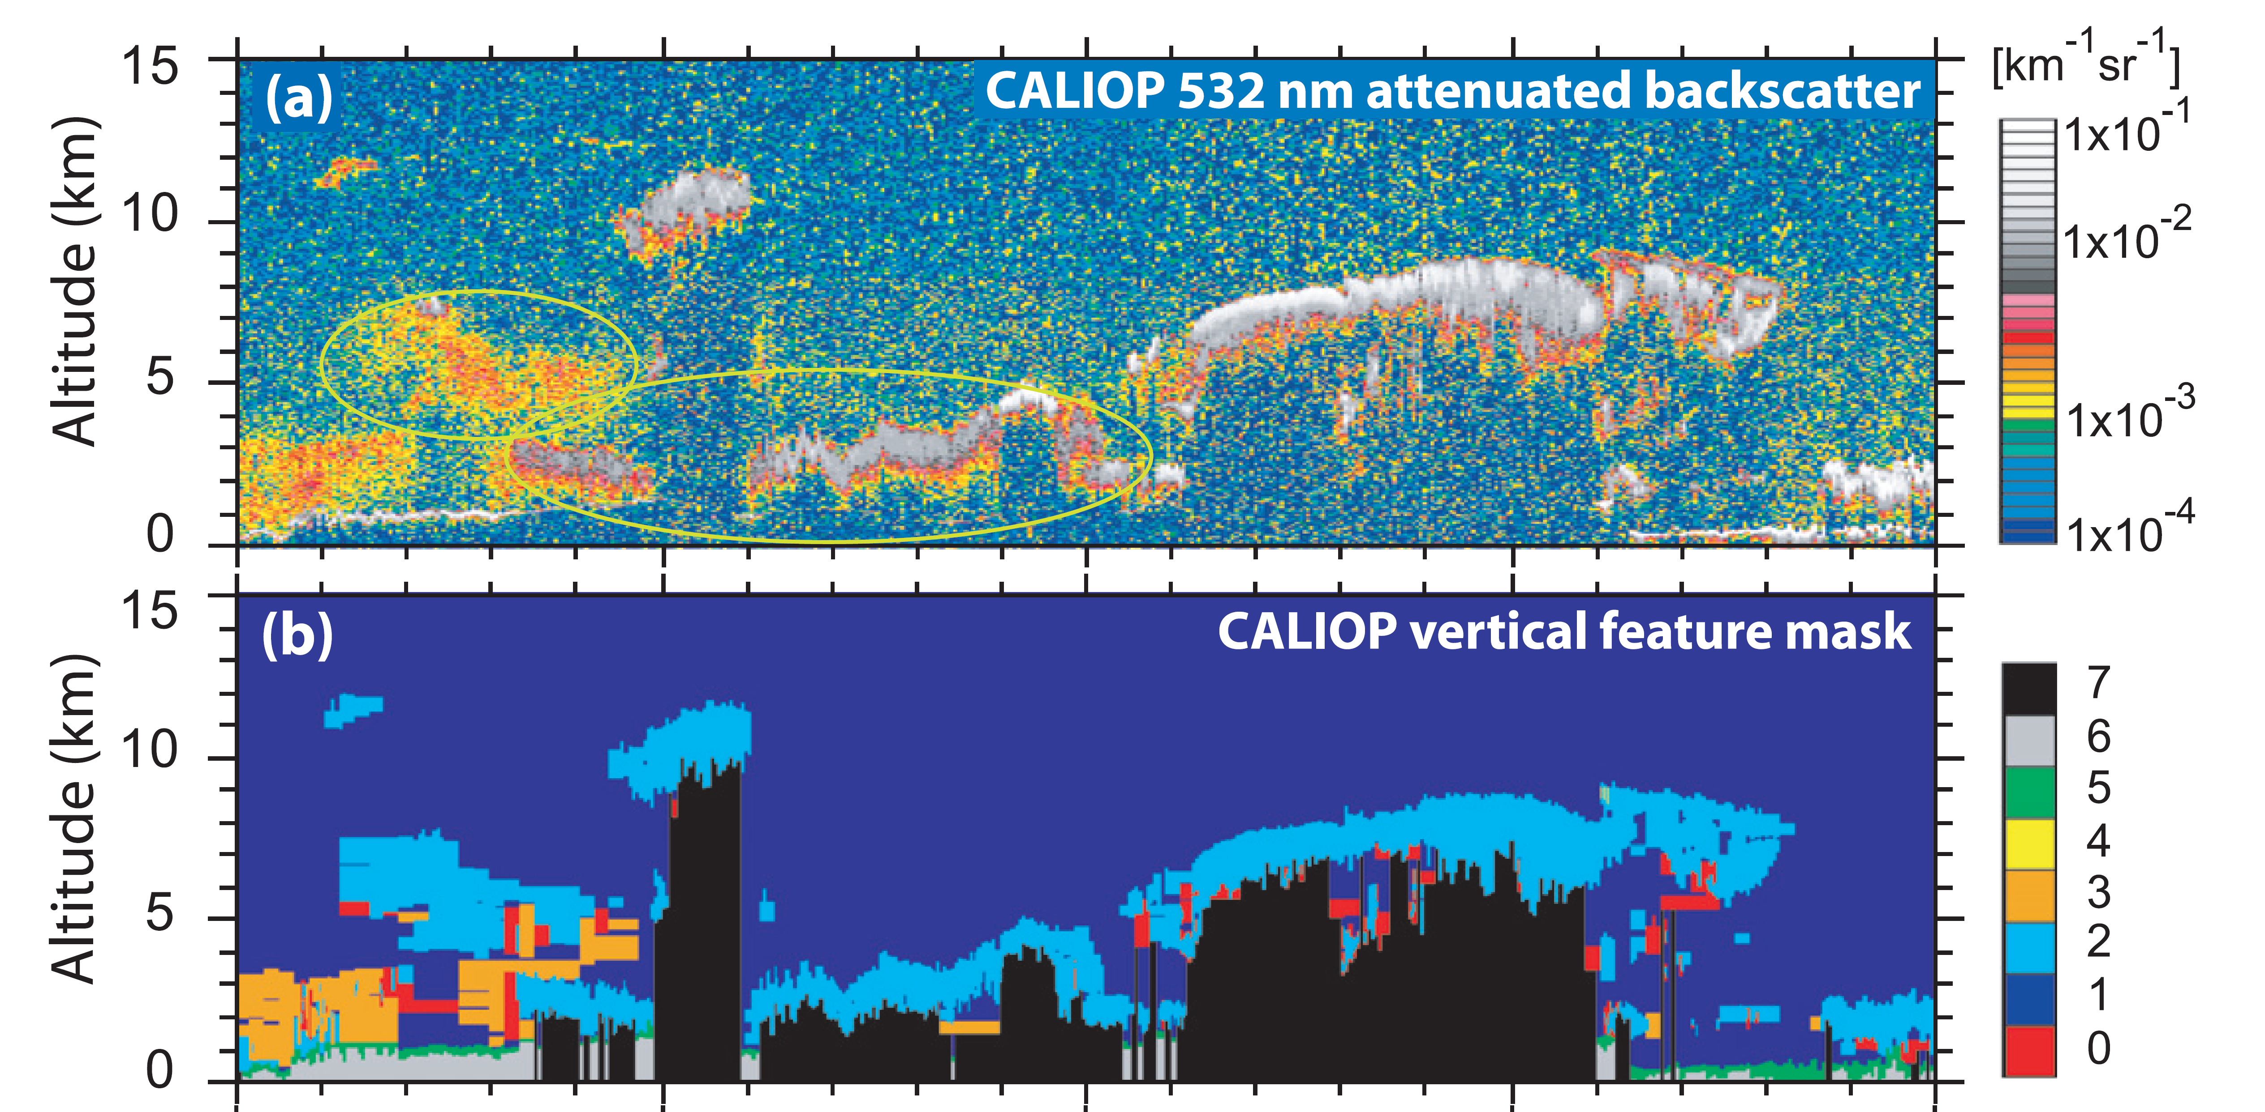
Example Mis-classification
Example of misclassification of a dust storm generated in the Gobi Desert observed on 30 Mar 2007:
  (a) CALIOP 532-nm attenuated backscatter
  (b) VFM (same color bar as in Fig. 5)
  The circled features in (a) are dust layers that have been misclassified. Note that there are small-scale clouds on the top of each circled scene (7–8 km around 37.18 and 4–5 km near 448).

Slide 31
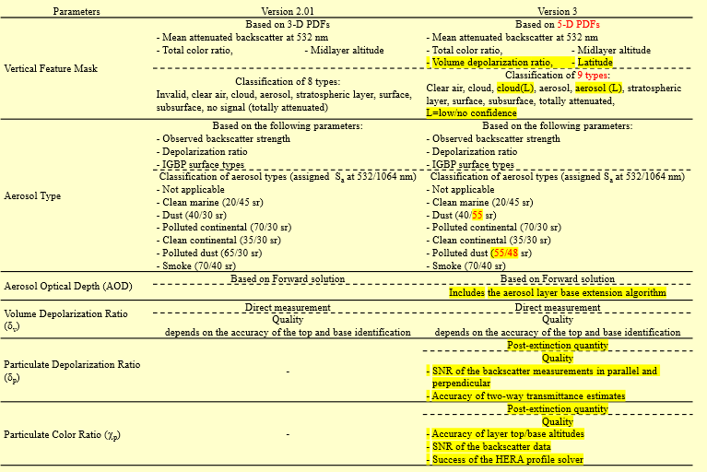
Comparison of V 2.01 and V3

Slide 32
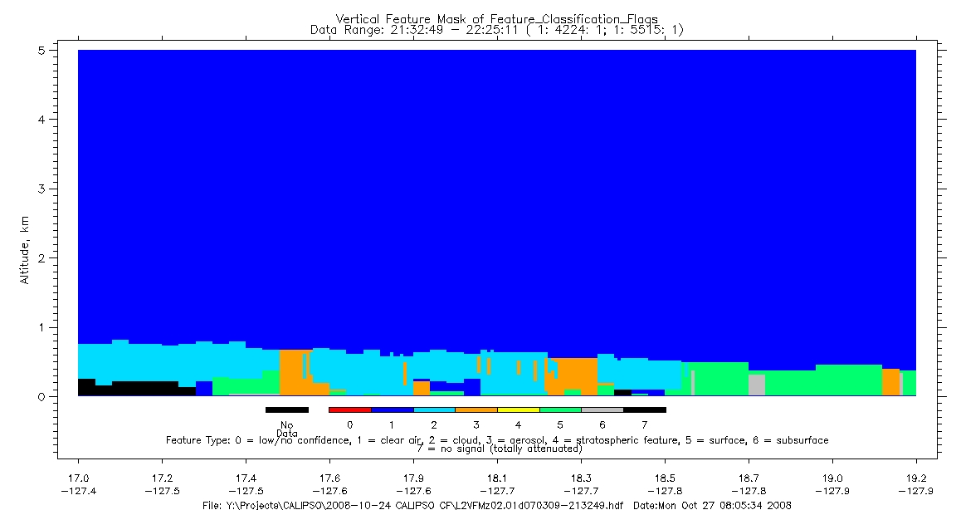
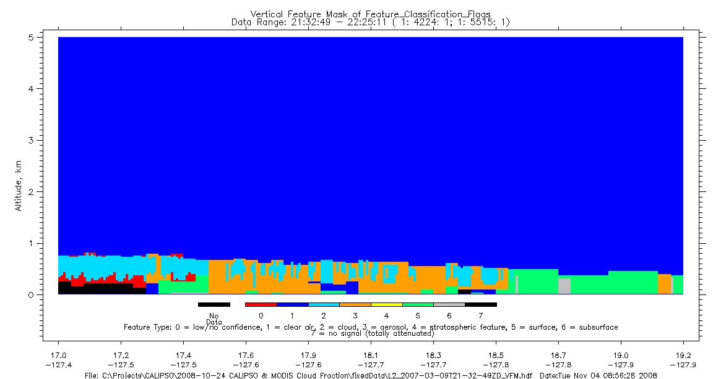
Differences Between V2.01 and V3
V2.01
cloud
aerosol
V3 (correct)
Brian.J.Getzewich@nasa.gov
32

Slide 33
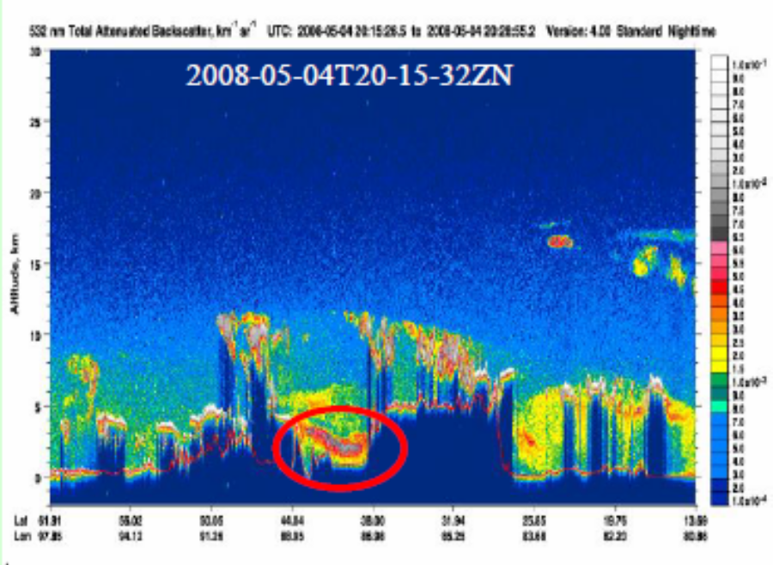
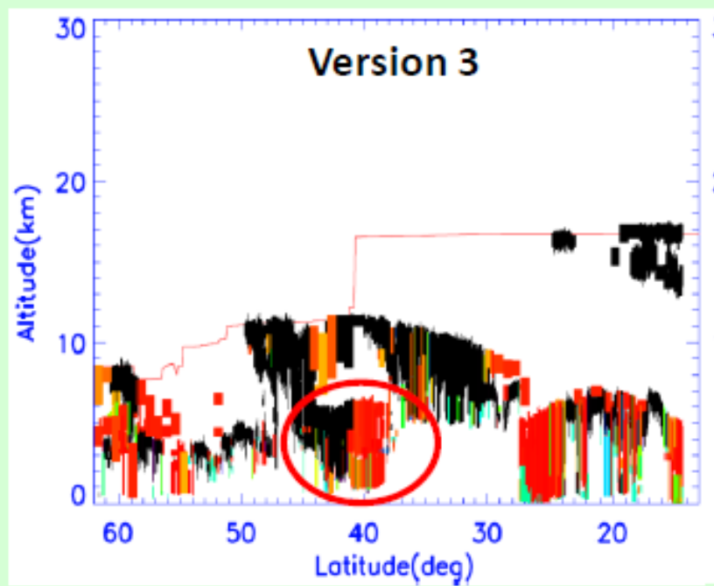
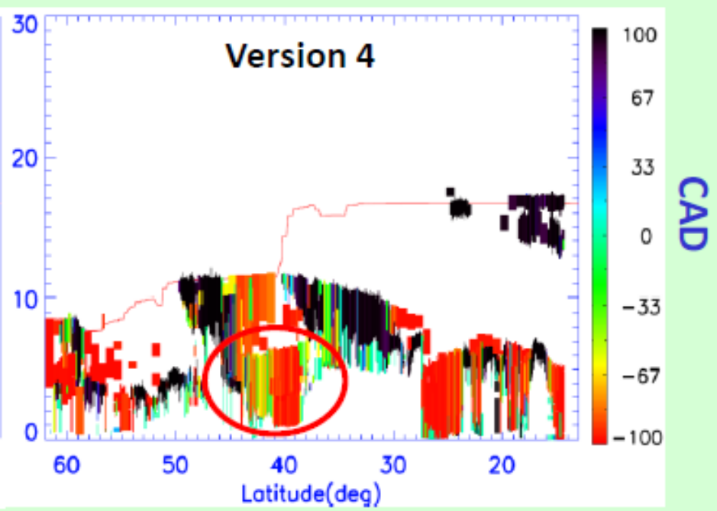
Troposphere Differences V3 and V4
Improved classification of thick dust layers as aerosols over Taklamakan desert— misclassification of these as clouds were reported in earlier versions (Chen et al., 2010, Jin et al., 2014).
http://stm.dpc.cira.colostate.edu/sites/default/files/2016_posters/17-Kar-SCMeeting_poster_CAD_final.pdf

Slide 34
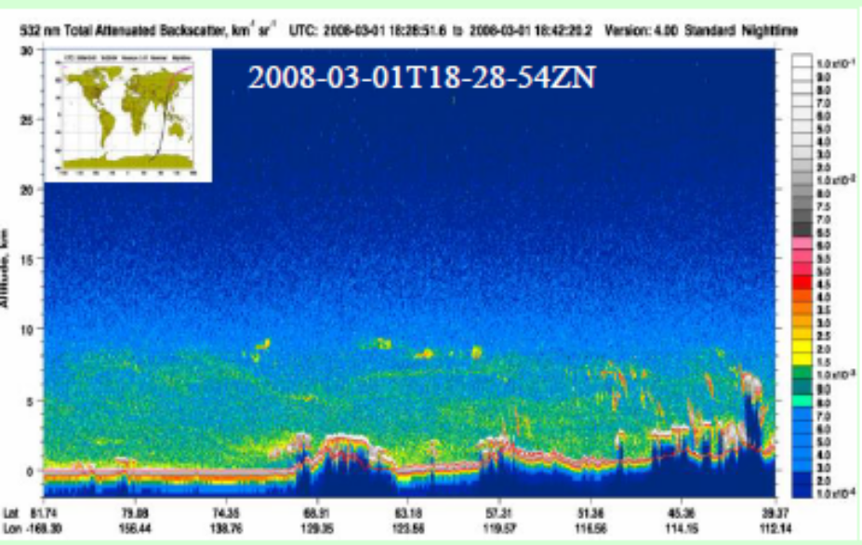
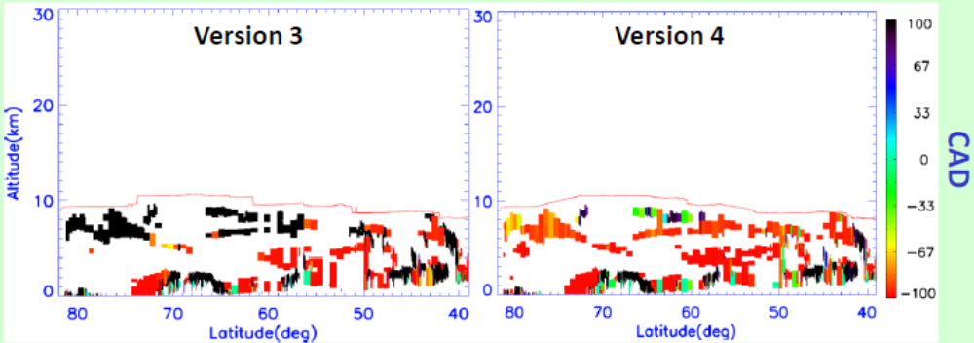
Troposphere Differences V3 and V4
Significant improvement in classifying Asian dust and polluted dust layers transported to the Arctic in Spring (clouds in V3). Misclassification reported earlier (Di Pierro et al. 2011) have been mostly resolved.
http://stm.dpc.cira.colostate.edu/sites/default/files/2016_posters/17-Kar-SCMeeting_poster_CAD_final.pdf

Slide 35
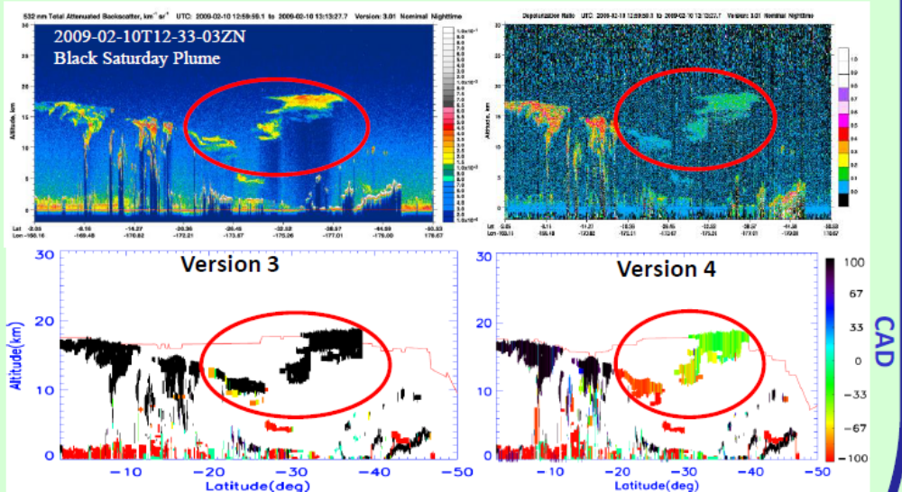
Troposphere Differences V3 and V4
Correct classification of high altitude smoke layers as aerosols in V4 rather than clouds in V3. Lower CAD scores for the plume between 30oS-40oS are likely due to the high backscatter and depolarization ratios.
http://stm.dpc.cira.colostate.edu/sites/default/files/2016_posters/17-Kar-SCMeeting_poster_CAD_final.pdf

Slide 36
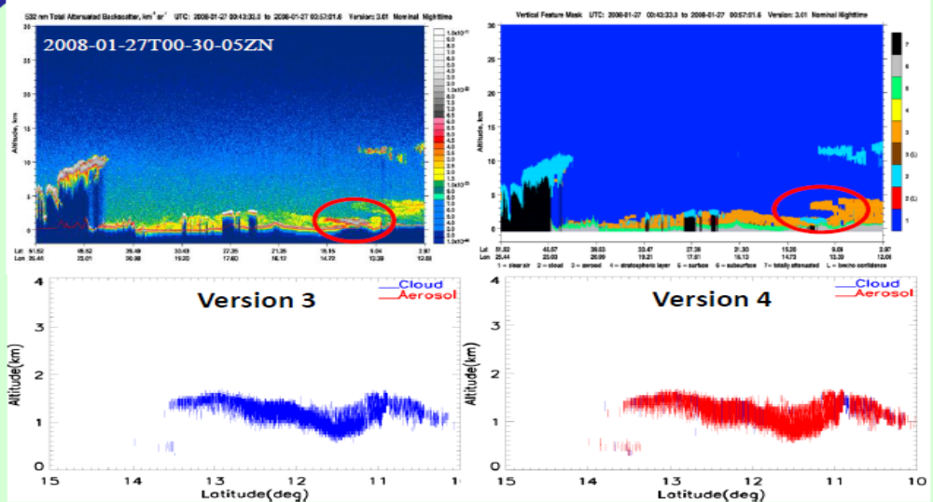
Troposphere Differences V3 and V4
Thick single shot layers (333m)often embedded within extended dust or smoke layers classified as clouds in V3 (by default) are now classified as aerosols.
http://stm.dpc.cira.colostate.edu/sites/default/files/2016_posters/17-Kar-SCMeeting_poster_CAD_final.pdf

Slide 37
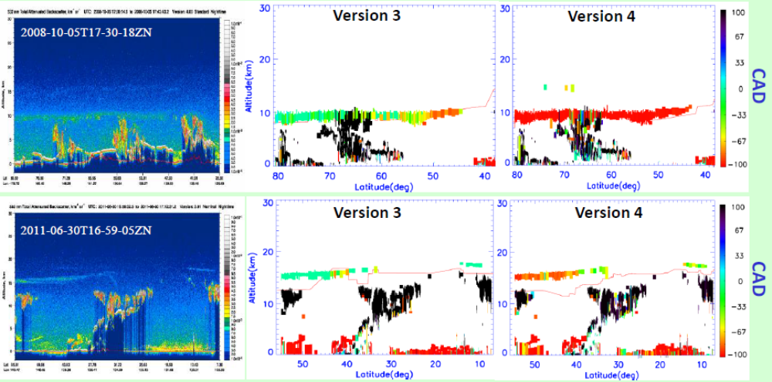
Stratosphere Differences V3 and V4
Volcanic layers (“stratospheric features” in V3) are classified as aerosols in V4 CAD. (Top—Kasatochi; Bottom—Nabro)
http://stm.dpc.cira.colostate.edu/sites/default/files/2016_posters/17-Kar-SCMeeting_poster_CAD_final.pdf

Slide 38
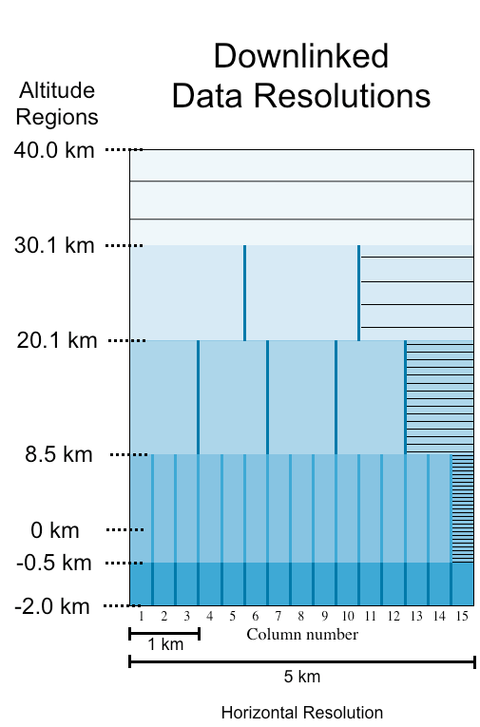
Vertical and Horizontal Resolution
Schematic of 15 consecutive full-resolution lidar profiles (i.e., a 5-km horizontal distance), annotated to illustrate how CALIOP's on-board averaging scheme varies vertically and horizontally as a function of altitude.
The five different averaging regimes are shown using five different shades of blue.

Slide 39
Vertical and Horizontal Resolution
The vertical lines within each blue band delineate the individual profiles created by horizontally averaging the full resolution data.
  For example, between 8.5-km and 20.1-km the data is averaged horizontally to a nominal spatial resolution of 1-km; i.e., the data from 3 full resolution (333 m) profiles are averaged to create each 1 km averaged profile segment.
  Similarly, between 20.1 km and 30.1 km, 5 full resolution (333 m) profiles are averaged to create 3 profiles that each spans a nominal horizontal extent of 5/3 km.
Processing in the vertical is done in a similar fashion, as indicated by the thin horizontal black lines shown in the profile on the far right within each altitude regime.

Slide 40
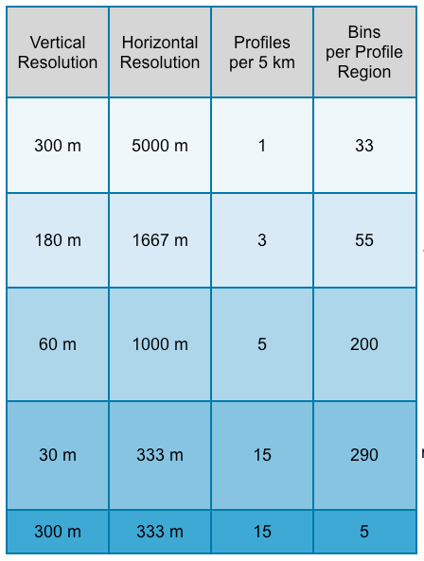
Vertical and Horizontal Resolution
The table in the middle gives the numerical values of the horizontal and vertical averaging for all the altitude regions.
The highest resolution data available is in the region between -0.5 and 8.5 km which is provided at 333 m horizontally and 30 m in the vertical.

Slide 41
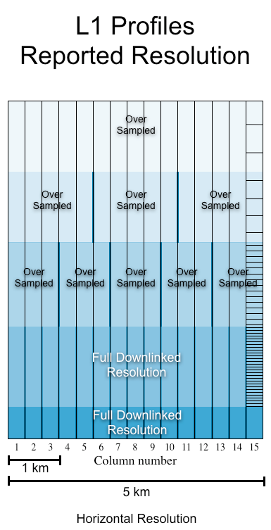
Vertical and Horizontal Resolution
During level 1 processing the data is regridded to a uniform horizontal grid of 333 m (see the right hand image above
However, the vertical (i.e. altitude) resolution remains identical to that of the downlinked data.
  Even though the level 1B profile data is reported at a uniform horizontal resolution of 333 m, in regions above 8.5 km it is over sampled.
  For example, to create 15 "pseudo single shot" profiles in the altitude region between 8.5 km to 20.1 km, the downlinked 1 km profiles in this region are replicated and grafted onto the top of three consecutive full resolution (single shot) profiles.

Slide 42
Vertical and Horizontal Resolution
The preceding commentary refers specifically to the 532 nm parallel and perpendicular channels only.
The 1064 nm channel is recorded at a vertical resolution of 60 m in the range be -0.5 and 8.2 km, also no 1064 nm data is available above 20.1 km.
Nominal vertical resolution of 15 m (10 MHz sampling rate)
  at a laser pulse repetition rate of 20.16 Hz
  Horizontal profile spacing of ~333 m (when accounting the satellites orbital velocity)
  Within the lower atmosphere the footprint of each profile is ~90 m in diameter.

Slide 43
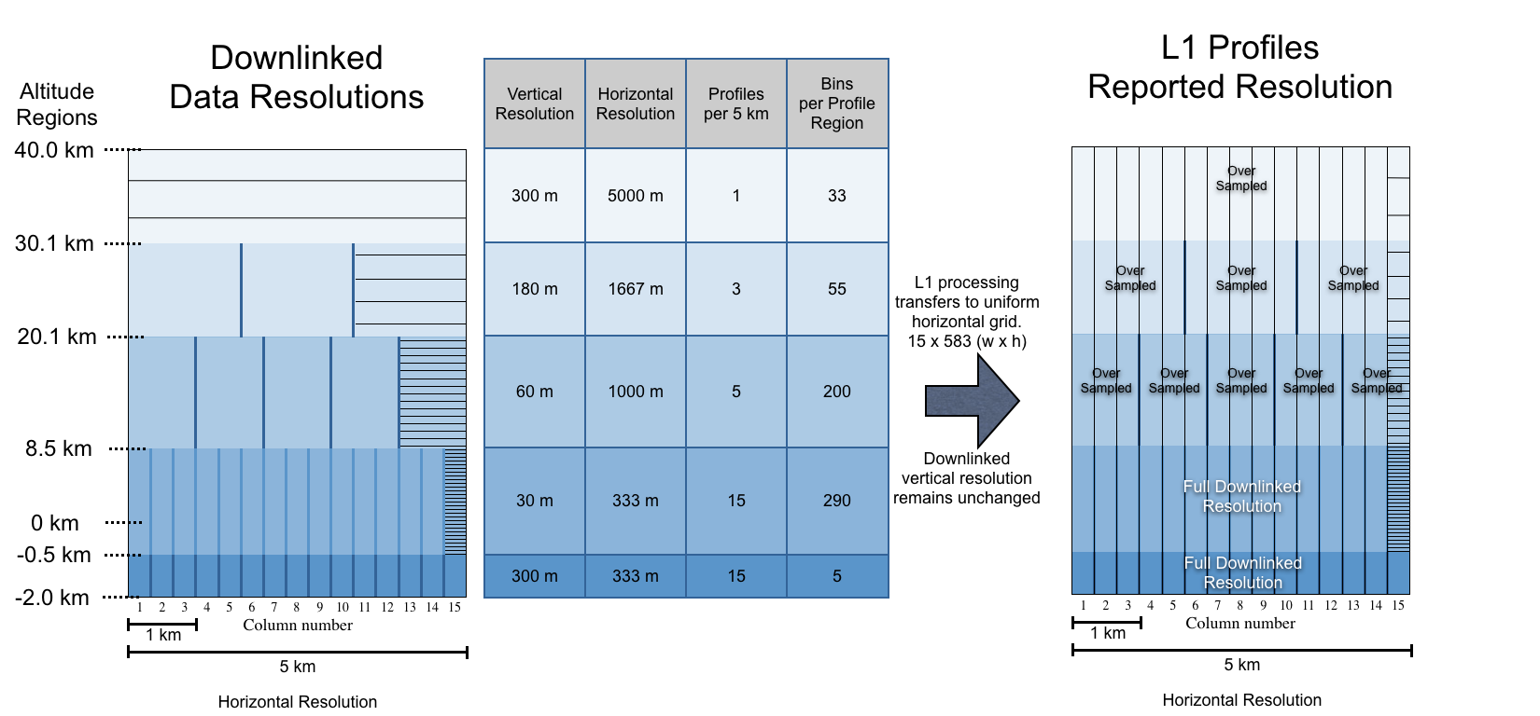
Summary Vertical and Horizontal Resolution
The on-board averaging scheme provides the highest resolution in the lower troposphere where the spatial variability of clouds and aerosols is the greatest and coarser resolutions higher in the atmosphere. The degree of averaging varies with altitude, as detailed in the figure below.

Slide 44
Multi-Gridded Averaging Scheme
The peak backscatter intensities of the features measured by space-borne lidar range over several orders of magnitude.
Strongly scattering features such as stratus and fair weather cumulus are easily detected using a single laser pulse.
For more tenuous features - e.g., thin cirrus clouds - the average of several laser pulses may be required to obtain the signal-to-noise ratio necessary to differentiate feature boundaries from the ambient scattering environment.
The unambiguous detection of the very weakest features - faint aerosol layers and sub-visible cirrus - may require averaging over a substantial number of pulses.

Slide 45
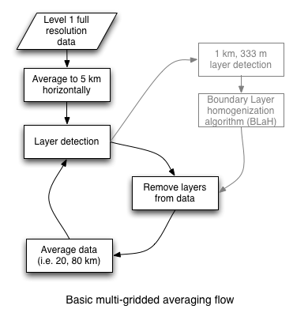
Multi-Gridded Averaging Scheme
To identify all of the features within a given scene at the maximum possible spatial resolution we employ a Selective Iterated Boundary Location (SIBYL) scheme.
The SIBYL algorithm makes multiple passes through a specified scene, constructing profiles of attenuated scattering ratios at a series of increasingly coarse spatial resolutions, nominally at 5, 20 and 80 km.
Immediately after construction, each profile is scanned for the presence of clouds, aerosol layers, and/or surface returns using a profile scanner, (the 'Layer detection' box at right).

Slide 46
Multi-Gridded Averaging Scheme
The backscatter data from those regions identified as containing a feature are removed from subsequent processing.
As a consequence, features found at high spatial resolutions (i.e., with less averaging) will not be included in the profiles of attenuated scattering ratios scanned at coarser resolutions (i.e., more averaging).
This encompasses the 'Remove layers...' and 'Average data to 20 or 80 km' boxes.

Slide 47
Multi-Gridded Averaging Scheme
Note that the layer detection at 1 km and 333 m horizontal resolution are only performed for those regions where 5 km layers were detected.
The boundary layer homogenization algorithm (BLaH) will not be further discussed. Users are encouraged to read section 4 (section 4.4 is about BLaH) in the feature detection ATBD.

Slide 48
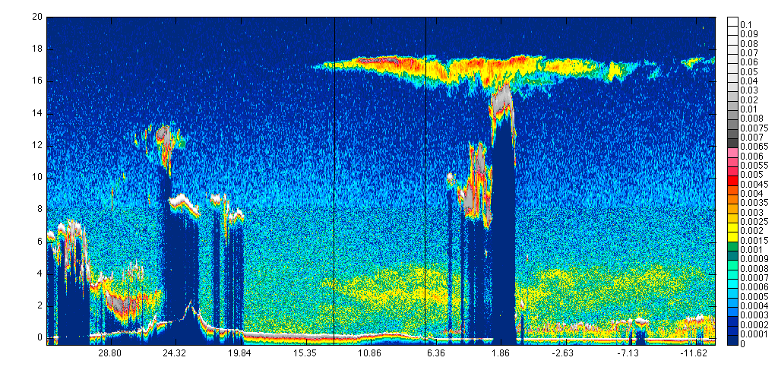
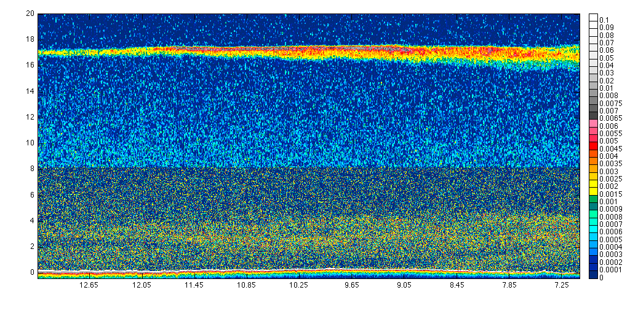
Example
Browse image of the total 532 nm attenuated backscatter signal (the sum of the 532 nm parallel and perpendicular return signals).
Zoomed in version of above image from the area between the black lines.
There is a transparent cirrus cloud located at ~17 km and an aerosol layer (most likely dust) located from the surface or in some places ~ 1km up to an altitude of 4 km.
The surface return is seen as the white/red/yellow band near 0 km.
The horizontal line at 8 km is from the changing noise characteristics in the data due to the change in horizontal and vertical averaging of the data.
Data is plotted a 333 m horizontal resolution.
~333m

Slide 49
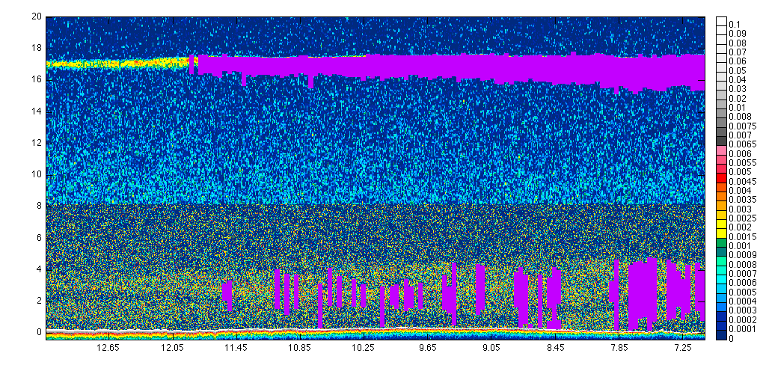
Example
~333m
BELOW: vertical and horizontal locations of all features that were detected at the 5 km horizontal resolution.
Only the data in the regions as identified by the magenta color are used to compute the layer optical properties as would be found in the 5 km layer products.
The layer data in those regions will then be zeroed-out before the 5 km is averaged to 20 km.
5 km & ~333m

Slide 50
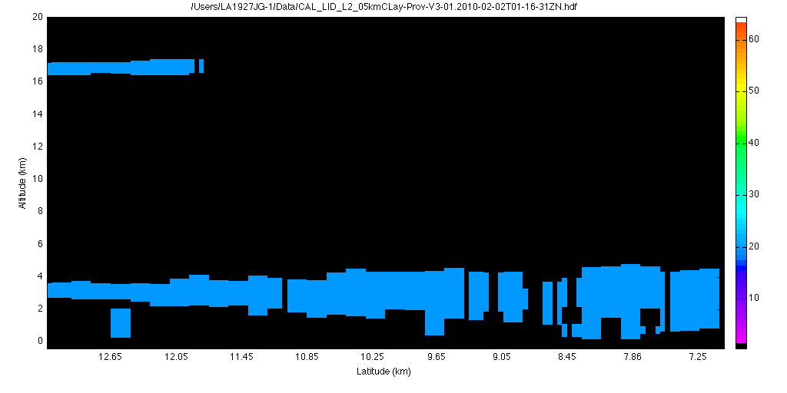
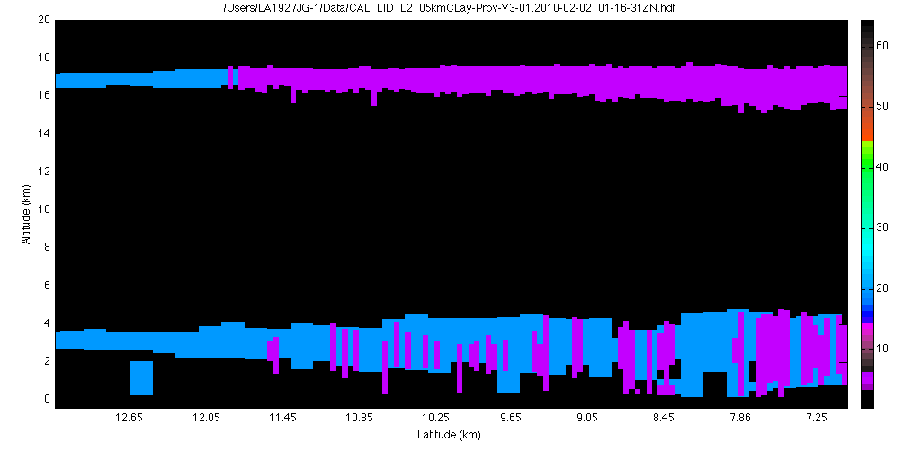
Example
20 km
After the removal of features that were detected at the 5 km resolution, a search is made for features at the 20 km resolution.
The image at right shows features that are found at the 20 km resolution in blue.
The image (below-right) shows both the 5 km features and the 20 km features.
Only the data in the regions shown in blue are used to calculate the layer optical properties for those same regions.
The regions in magenta are not included in the averages for the features detected on the 20 km resolution. Layer optical properties are repeated (i.e. reported in the data products) for each 5 km column in which they appear.
5 km & 20 km

Slide 51
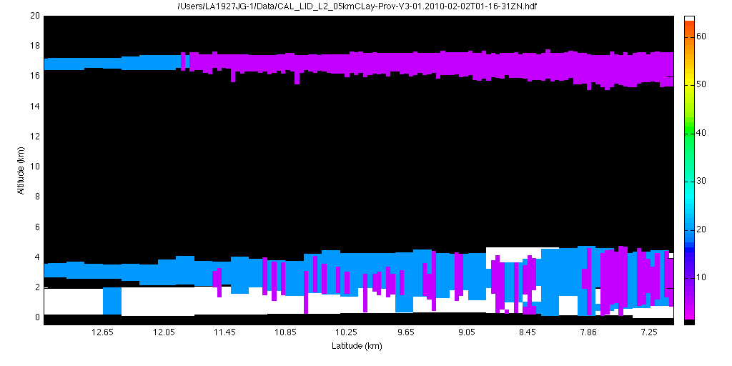
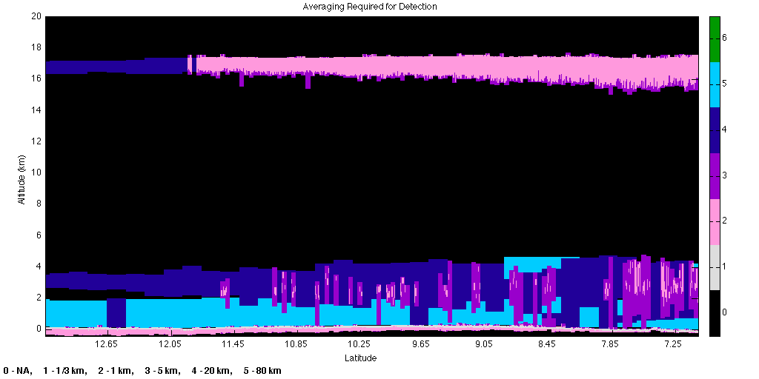
Example
5, 20, & 80 km
Final composite 'feature mask' image showing 5, 20 and 80 km horizontal resolutions.
Below: Another version of the 'feature mask' showing the same horizontal resolution as above-right but including the 1 km and 333 m layer extents.
The 1 km and 333 m profile data are only scanned for layers in regions where a 5 km layer was found, therefore 1 km layers will only be found in regions where a 5 km layers were found and subsequently 333 m are only found where 1 km layers were found.

Slide 52
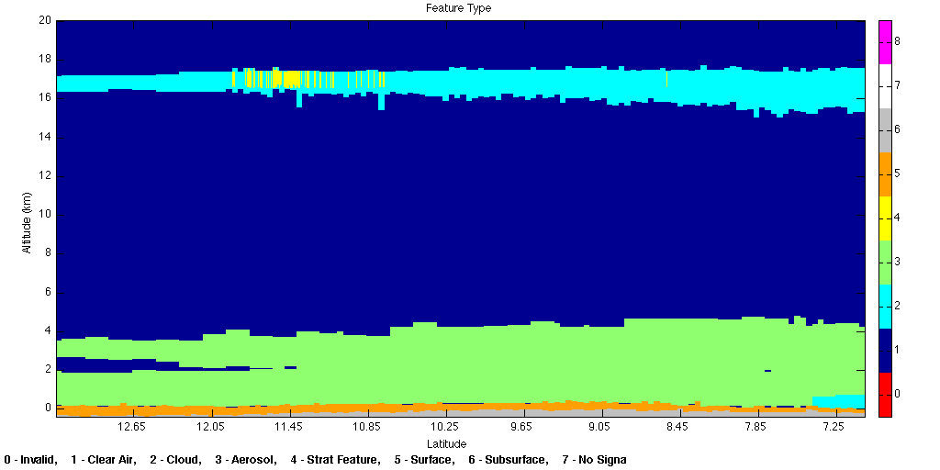
Example
This 'vertical feature mask' image shows the vertical locations of all layers detected by the level 2 processing code, colors represent the type of layer as determined by the scene classification algorithm.
Cloud layers are identified by the cyan color
Aerosols by green
Dark blue is 'clear air' where no layers were detected, etc.
Original ~333m

