Slide 1

TOMS and OMI Aerosol
MET 611 – Satellite Data Applications
Jennifer D. S. Griswold

Slide 2
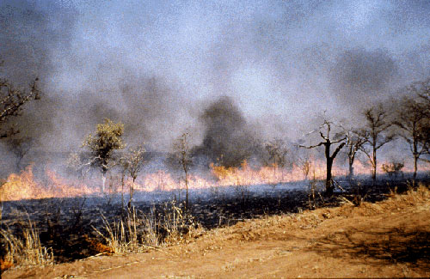
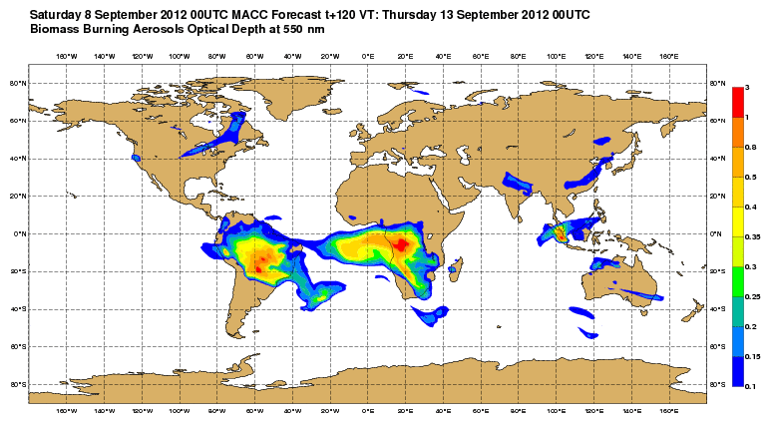
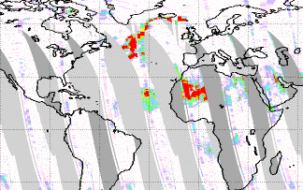
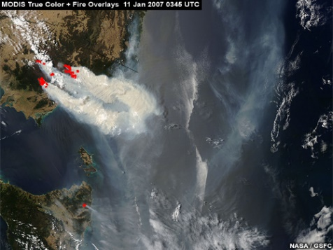
Introduction to TOMS and OMI
Smoke from biomass burning, and dust particles from desert storms are among the main atmospheric constituents that affect the air quality and the Earth’s climate system.
Monitoring of these atmospheric constituents is only possible through satellite measurements because ground based measurements are very limited in space and time and these constituents get transported over long distance from their source region.
For more than two decades, Total Ozone Mapping Spectrometer (TOMS) instruments (McPeters et al, 1996) have been providing useful global data on the long range transport of smoke and dust plumes.
TOMS measures back scattered radiances in the near UltraViolet (UV) region of the spectrum and from these measurements, the TOMS ozone retrieval algorithm computes an absorbing Aerosol Index (AI), which is a qualitative measure of the presence of UV absorbing aerosols such as mineral dust and smoke.

Slide 3
Introduction to TOMS and OMI
At the present time, the long-term data record of the aerosol information from the TOMS instrument is continued by the Ozone Monitoring Instrument (OMI) flown on the EOS Aura spacecraft (launched July 2004).
The key objectives (Levelt et al., 2000) of the OMI measurements (Ahmad et al., 2003) include:
  monitoring of aerosols and smokes from biomass burning
  SO2 from volcanic eruptions
  key tropospheric pollutants
  surface UV radiation
In general, threats to human health.
Because of better measurement accuracy and better spatial resolution (13x24 km) OMI provides better estimates of atmospheric pollutants and their transport through the Earth’s atmosphere than TOMS.
https://disc.gsfc.nasa.gov/datasets?page=1&keywords=TOMS
https://disc.gsfc.nasa.gov/datasets?page=1&keywords=OMI

Slide 4
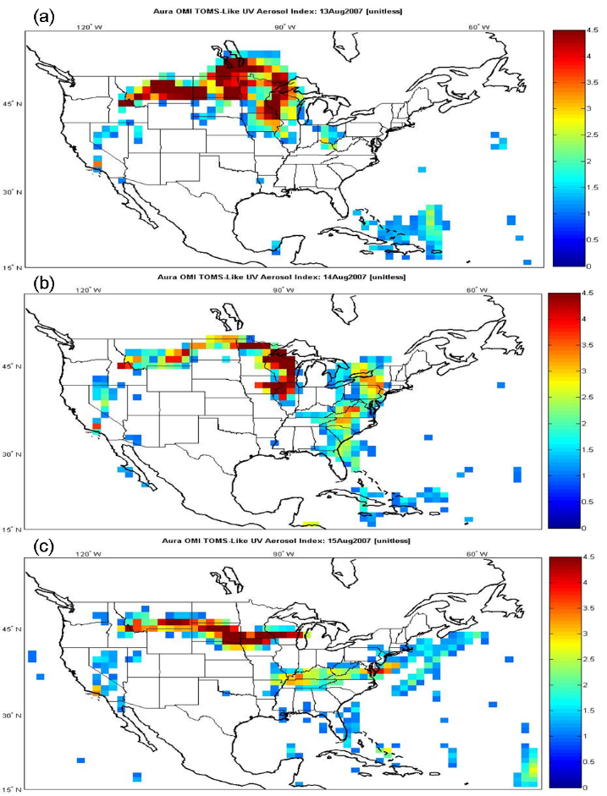
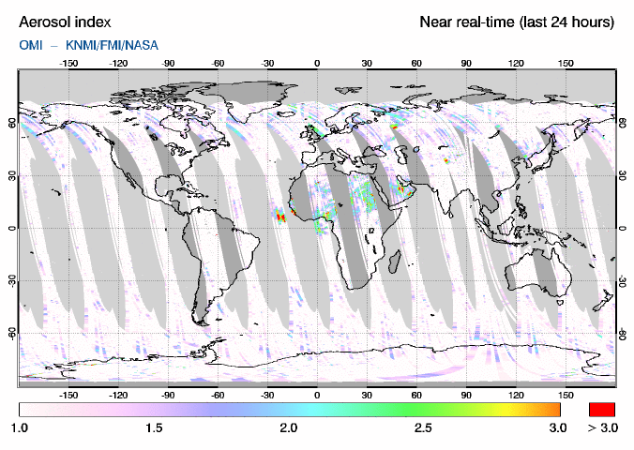
Aerosol Index
In spite of the fact that the Aerosol Index is a qualitative indicator of the presence of the absorbing aerosols, many scientists have used it in variety of applications with the encouraging results.
For example, AI has been used in identifying the sources of air pollution over the globe, understanding the transport of air pollution across the oceans and continents, air quality forecast models, and radiation energy balance, and climate forcing studies.
We’ll use data from three satellites and two instrument types in this course:
  NIMBUS 7 - TOMS
  Earth Probe -TOMS
  Aura - OMI

Slide 5
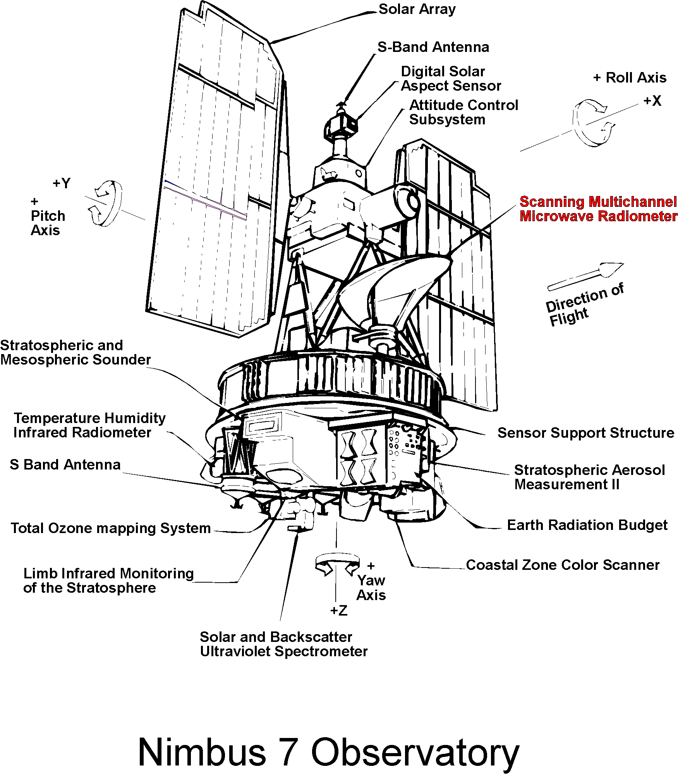
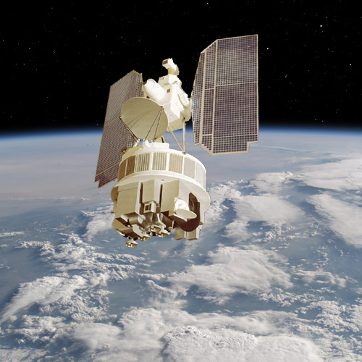
Nimbus 7
Earth-oriented platform for the testing of advanced systems for sensing and collecting data in the pollution, oceanographic and meteorological disciplines (Launched 1978).
The polar-orbiting spacecraft consisted of three major structures:
  a hollow torus-shaped sensor mount
  solar paddles
  a control housing unit that was connected to the sensor mount by a tripod truss structure.
The spacecraft spin axis was pointed at the earth. An advanced attitude-control system permitted the spacecraft's orientation to be controlled to within plus or minus 1 deg in all three axes (pitch, roll, and yaw).
Eight experiments were selected:
  (1) limb infrared monitoring of the stratosphere (LIMS)
  (2) stratospheric and mesopheric sounder (SAMS)
  (3) coastal-zone color scanner (CZCS)
  (4) stratospheric aerosol measurement II (SAM II)
  (5) earth radiation budget (ERB)
  (6) scanning multichannel microwave radiometer (SMMR)
  (7) solar backscatter UV and total ozone mapping spectrometer (SBUV/TOMS)
  (8) temperature-humidity infrared radiometer (THIR).

Slide 6
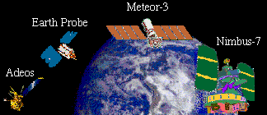
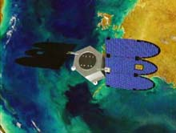
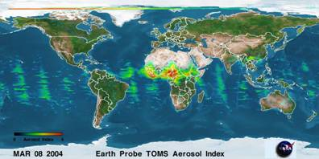
Earth Probe
The Total Ozone Mapping Spectrometer, launched in July 1996 onboard an Earth Probe Satellite (TOMS/EP)
Continued NASA's long-term daily mapping of the global distribution of the Earth's atmospheric ozone and absorbing aerosol.
EP/TOMS made 35 measurements every 8 seconds, each covering 30 to 125 miles (50 to 200 kilometers) wide on the ground, strung along a line perpendicular to the motion of the satellite.
Almost 200,000 daily measurements cover every single spot on the Earth except areas near one of the poles, where the Sun remains close to or below the horizon during the entire 24-hour period.
AEROSOL INDEX - The data are an aerosol index formed directly from the measured radiances in two TOMS channels. Positive values generally represent absorbing aerosols (dust and smoke) while negative values represent nonabsorbing aerosols. The identification is not perfect because of geophysical reasons (e.g., aerosol too low to the ground).

Slide 7
N7 and EP TOMS Summary
TOMS provides measurements of ozone, tropospheric aerosols, volcanic SO₂, ultraviolet irradiance, erythemal UV exposure, and effective reflectivity from the Earth's surface and clouds.
Four TOMS instruments have been successfully flown in orbit – aboard the:
  Nimbus-7 (Nov. 1978 - May 1993) → Aerosol Index available
  Meteor-3 (Aug. 1991 - Dec. 1994)
  Earth Probe (July 1996 – December 2006) → Aerosol Index available
  ADEOS (Sep. 1996 - June 1997)
Version 8 TOMS data products are available from the Goddard Earth Sciences Distributed Information and Services Center (GES DISC).
  Level 3 gridded data (1.0° x 1.25°)
  Level 2 instrument resolution data (between 50x50 km and 26x26 km pixel at nadir).
  At this time, the data are from the Nimbus-7 and Earth Probe TOMS instruments.
WARNING: EP TOMS started experiencing calibration problems a few years after launch.
  Data beginning in year 2000, the calibration had been stabilized relative to NOAA-16 SBUV/2 in the equatorial zone.
  Because of this error, data since 2002 had been recommended NOT be used for trend analysis.
The principle investigator for TOMS is Dr. Richard McPeters (Richard.D.McPeters@nasa.gov). For more information about TOMS, please see the official TOMS web site (http://ozoneaq.gsfc.nasa.gov).

Slide 8
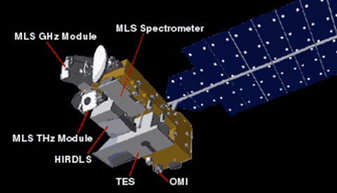
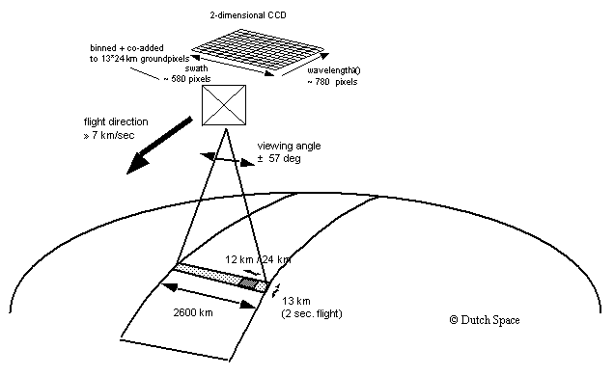
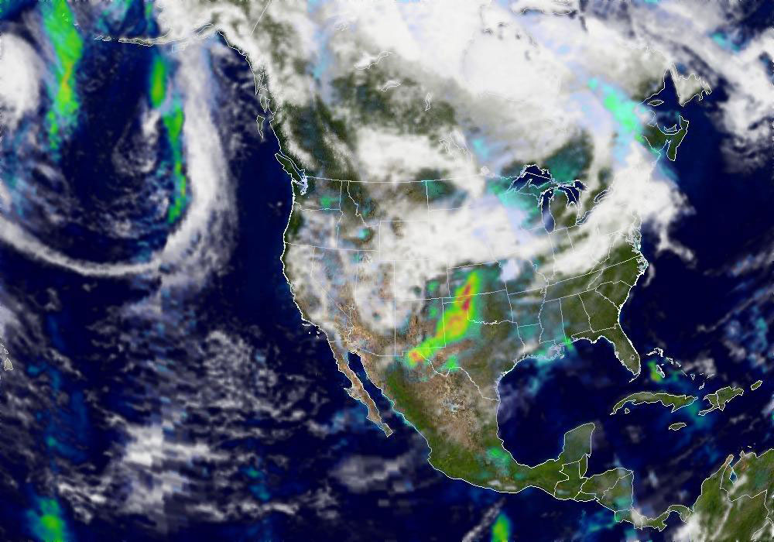
OMI
Launched in 2004 on Aura - hyperspectral imaging in a push-broom mode to observe solar backscatter radiation in the visible and ultraviolet.
The Earth will be viewed in 740 wavelength bands along the satellite track with a swath large enough to provide global coverage in 14 orbits (1 day).
The nominal 13 x 24 km spatial resolution can be zoomed to 13 x 13 km for detecting and tracking urban-scale pollution sources.
Distinguish between aerosol types, such as smoke, dust, and sulfates.
Measure cloud pressure and coverage, which provide data to derive tropospheric ozone.
It is a wide-field-imaging spectrometer with a 114° across-track viewing angle range that provides a 2600 km wide swath, enabling measurements with a daily global coverage

Slide 9
Aura OMI
double channel spectrograph covering 270 - 510 nm at 0.7 nm resolution
measures column O₃, NO₂, BrO, OClO, CH₂O, SO₂, aerosol indices
data products:
  atmospheric column of above gases
  trop NO₂
  trop O₃
  aerosol data

Slide 10
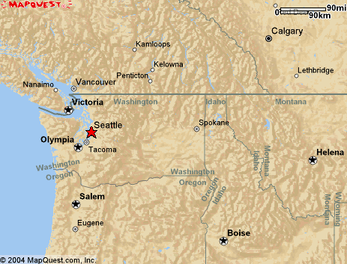
GOME
Sciamachy
OMI
1
TOMS
single pixel size for four satellite instruments

Slide 11
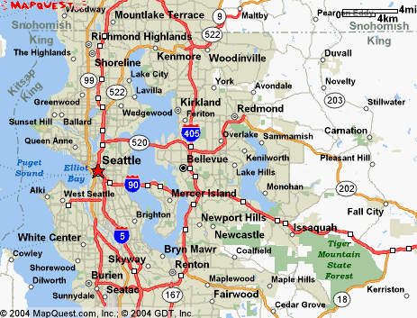
OMI single pixel
OMI pixel 12 km x 13 km superposed onto the Seattle airshed (zoom mode)

Slide 12
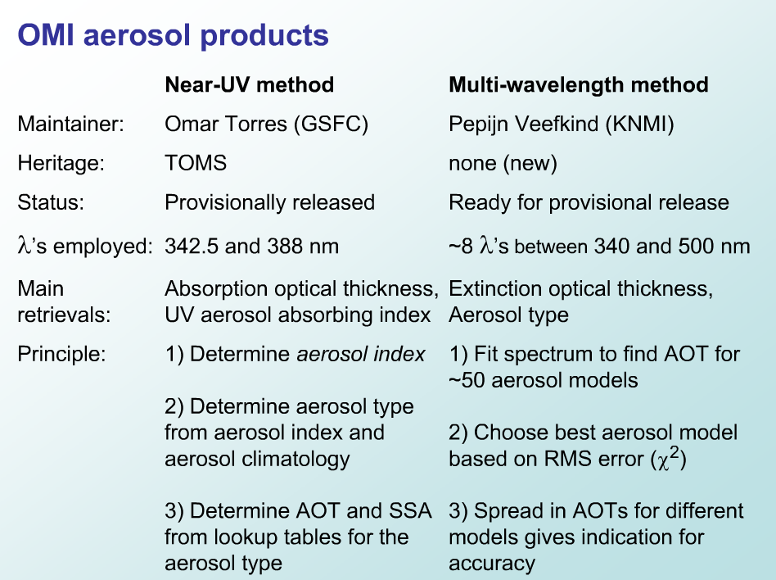

Slide 13
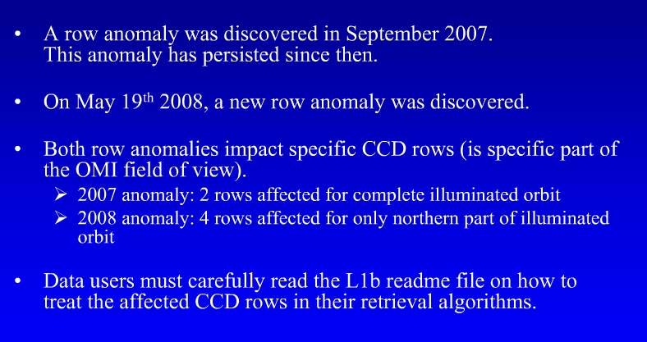
OMI Row Anomaly - 2007

Slide 14
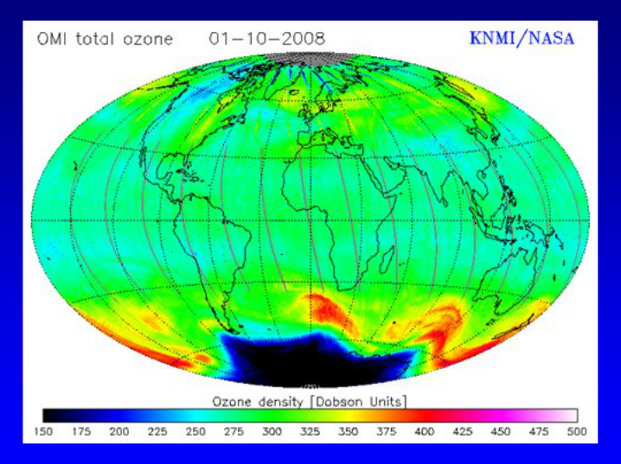
Row Anomaly Impact on L2

Slide 15
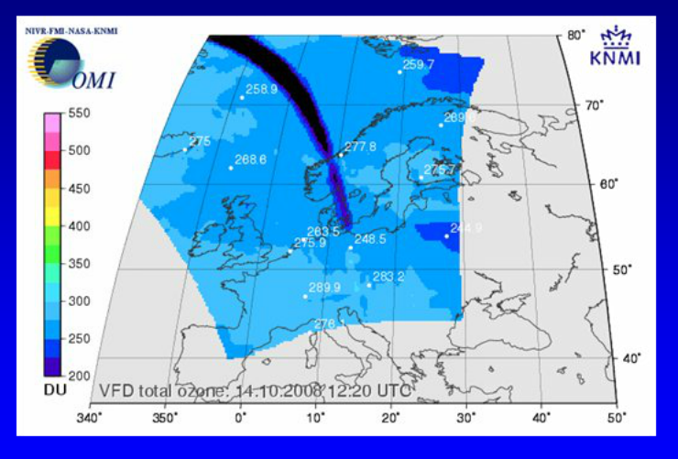
Row Anomaly Impact on L2

Slide 16
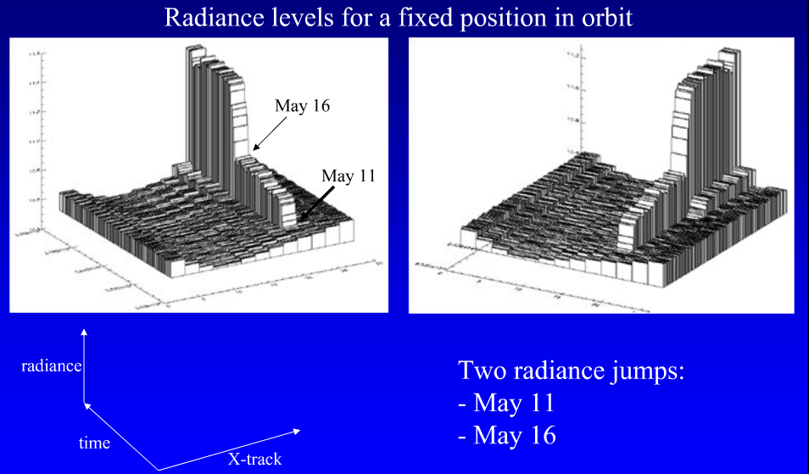
Row Anomaly: When did it start?

Slide 17
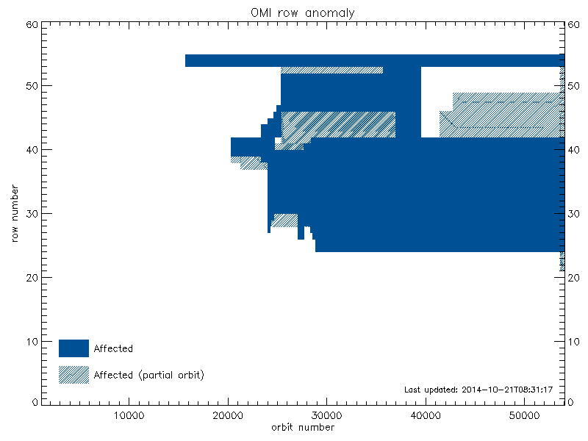
Row Anomaly up to 2014

Slide 18
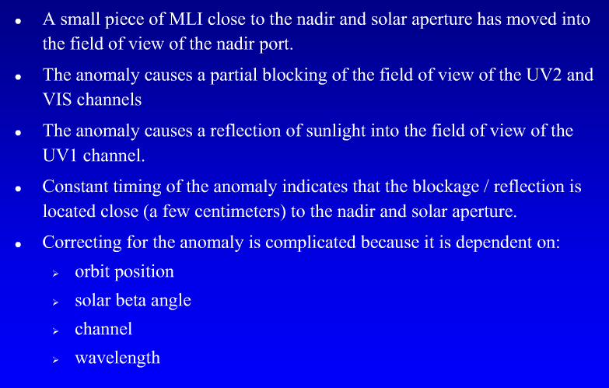
OMI Row Anomaly - Summary

Slide 19
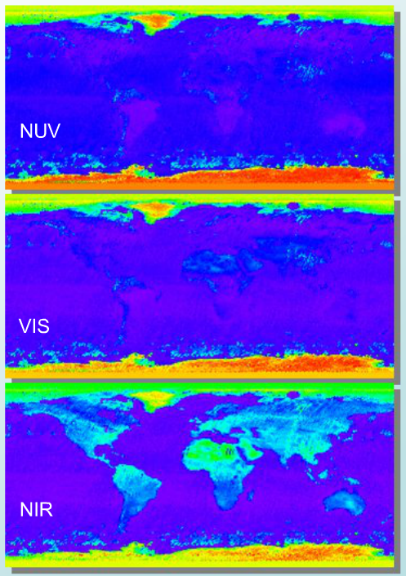
Advantages of Near UV
Aerosol types can be distinguished from surface spectral absorption characteristics
Low surface albedo over land.

Slide 20
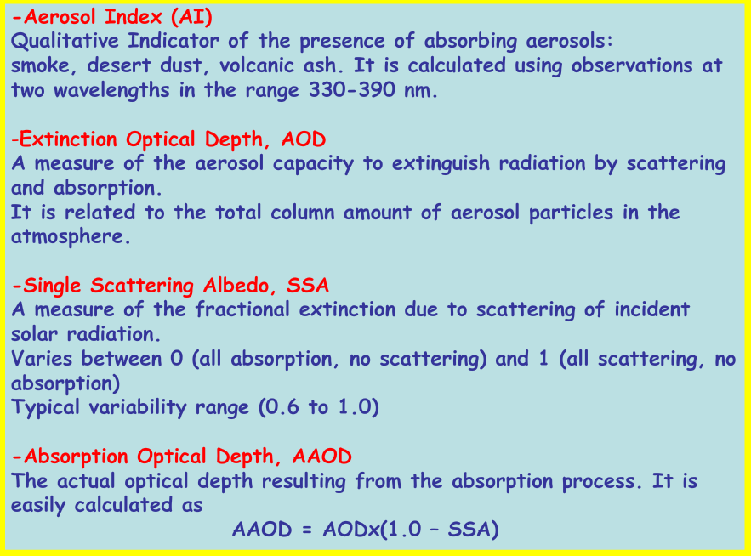
OMI near UV Products 388 nm

Slide 21
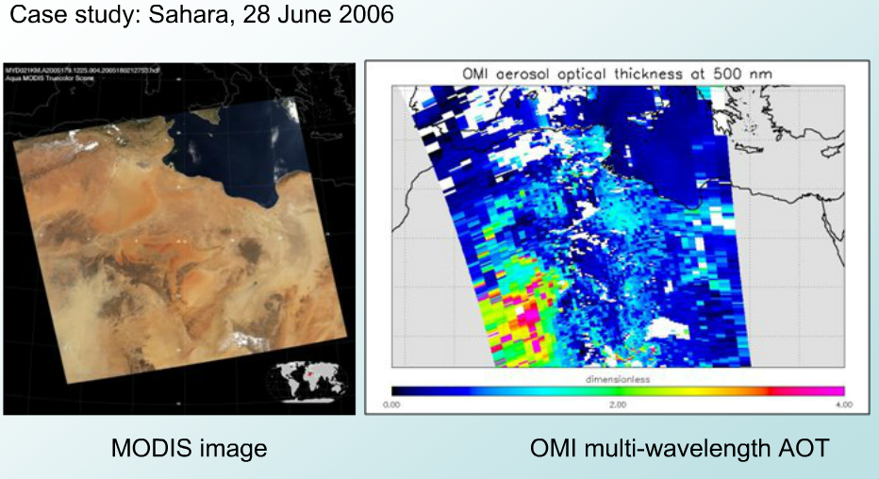
Multi-Wavelength Aerosol Product Example

Slide 22
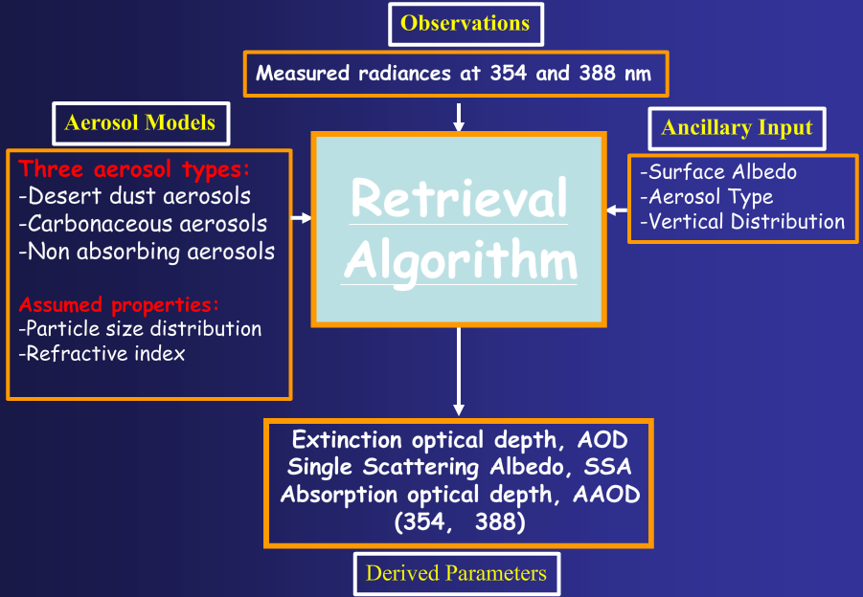
Inversion Proceedure
Measured radiances at 331 and 360
(331 and 360)

Slide 23
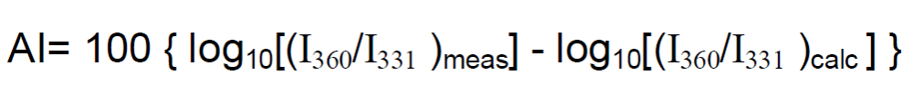
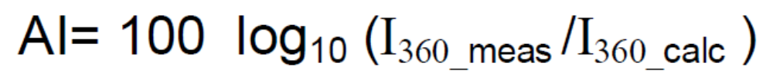
Absorbing Aerosol Index
The absorbing aerosol index (AI) from the difference between the measured (includes aerosols effects) spectral contrast of the 360 and 331 nm wavelength radiances and the contrast calculated from the radiative transfer theory for a pure molecular (Rayleigh particles) atmosphere.
In the current version 8 Nimbus 7 TOMS (1979-1993) and Earth Probe TOMS (1996-2006) and version 2 Aura OMI (2004-present) algorithms, it is mathematically defined as:
Since I_{360 calc} calculation uses reflectivity derived from the 331 nm measurements, the Aerosol Index definition essentially simplifies to:

Slide 24
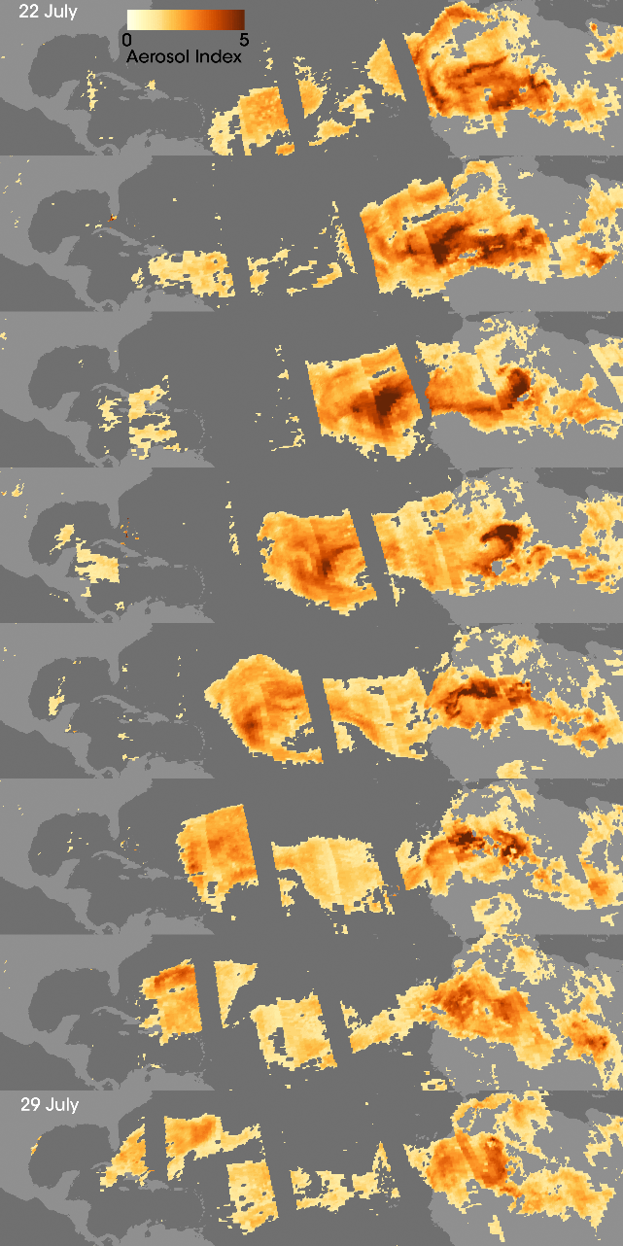
Aerosol Index
The Aerosol Index detects dust, smoke and volcanic ash over all terrestrial surfaces including deserts and snow-ice covered surfaces. These aerosol types are also detected intermingled with clouds and above cloud decks.
The AI can differentiate very well between absorbing and non absorbing aerosols, because it provides a measure of absorption of UV radiation by smoke and desert dust.

Slide 25
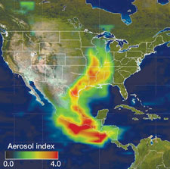
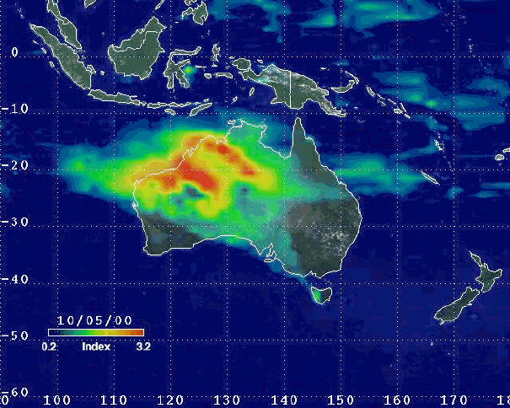
Properties of AI
AI positive values are associated with UV-absorbing aerosols, mainly mineral dust, smoke and volcanic aerosols.
However, negative values are associated with non-absorbing aerosols (for example, sulfate and sea salt particles) from both natural and anthropogenic sources (Torres et al, 1998) with sizes less than 0.2 microns. In practice, it is difficult to separate aerosol effects from other non-aerosol effects that also produce negative AI values

Slide 26
Properties of AI
Near zero values indicate cloud presence. In interpreting the results care has to be taken that some surface effects, such as sea-glint and ocean color, can also enhance the AI.
Magnitude of positive AI depends mainly on aerosol absorption optical depth and height of aerosol layer and also depends on aerosol microphysical properties.

Slide 27
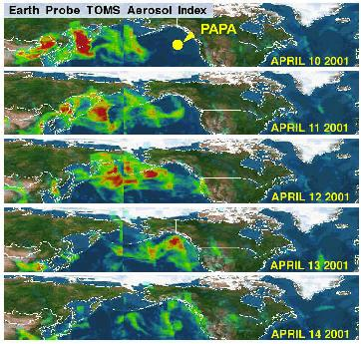
Properties of Aerosol Index
Detects absorbing aerosols over all surface types: ocean, vegetated surfaces, deserts, snow/ice, etc.
Detects absorbing aerosols under partial cloudiness conditions and above clouds
Aerosol Index is insensitive to carbonaceous aerosols (smoke) below ~2 km
Large sensitivity to low altitude desert aerosols (~ 0.5 km)
Aerosol Index signal meaningful for values larger than 0.5
Direct conversion of AI to any physically meaningful parameter is not possible because of multiple dependencies (AOD, SSA, height, etc).

Slide 28
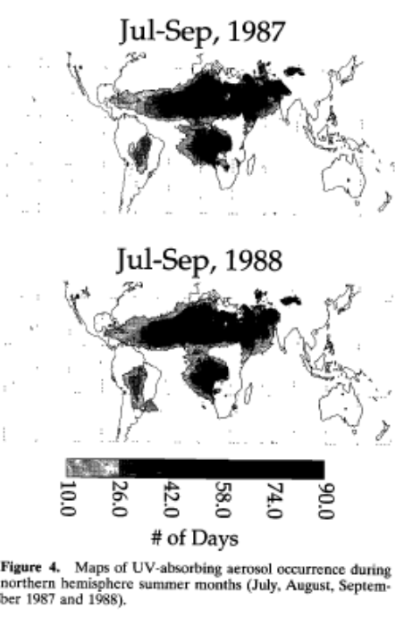
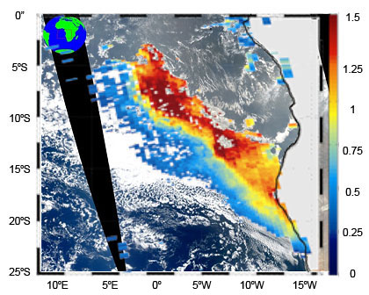
Applications
The Aerosol Index, though initially computed for the correction of aerosol induced errors in the retrieval of total ozone (Torres and Bhartia, 1999), has been extensively used in a variety of other applications.
In particular, NASA and other scientists have used AI in:
  Mapping and analyzing the global distribution of UV-absorbing aerosols (Herman et al., 1997)
  studying the aerosol properties (Torres et al.,1998, 2001)
  estimating UV reduction at the earth's surface (Herman et al. 1999; Krotkov et al. 1998 )
  estimating the radiative forcing effects of mineral aerosols and the smoke layer above the cloud deck, in conjunction with Earth Radiation Budget Experiment (ERBE) data (Hsu et al. 2000).

Slide 29
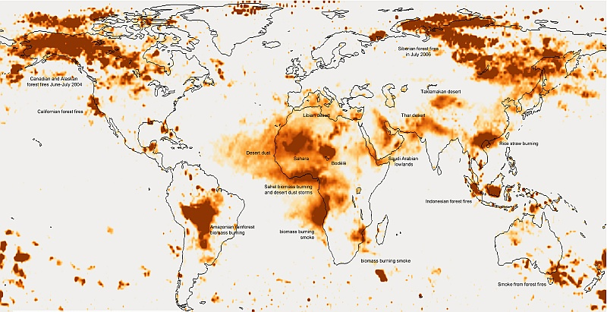
Applications – Soil Dust Sources
studying the inter-annual variability of soil dust aerosols in conjunction with Advanced Very High Resolution Radiometer (AVHRR) data (Cakmur et al. 2001)
environmental characterization of soil dust sources (Prospero et al. 2002)

Slide 30
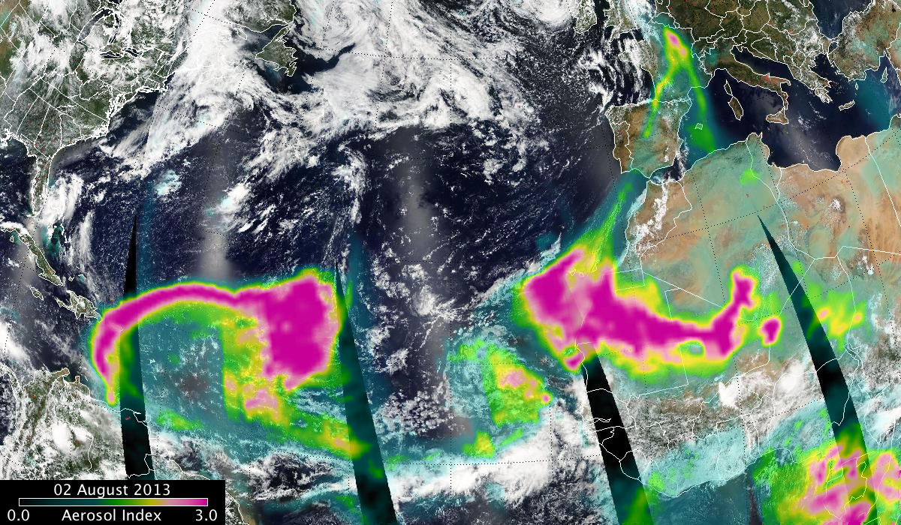
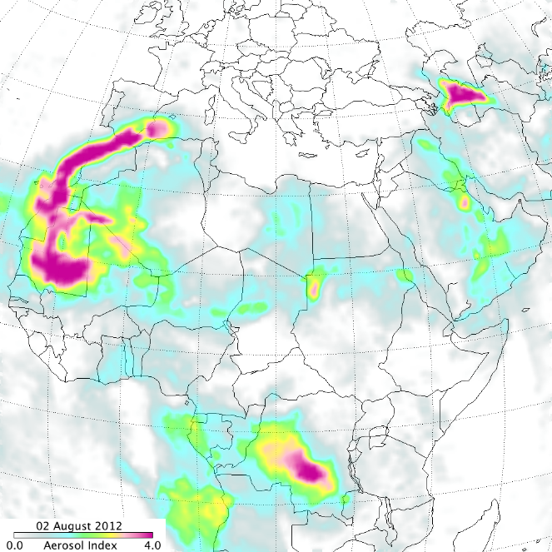
Applications – Dust Impacts
monitoring of health hazard microorganisms transported by African dust across the Atlantic Ocean) and identifying microbes and pollutants in the African soil dust(Prospero, 2004)
monitoring of the ecosystems, for example the decline of coral reefs caused by the dust from Saharan desert dumping into the North Atlantic Ocean(Shinn, et al.,2000)

Slide 31
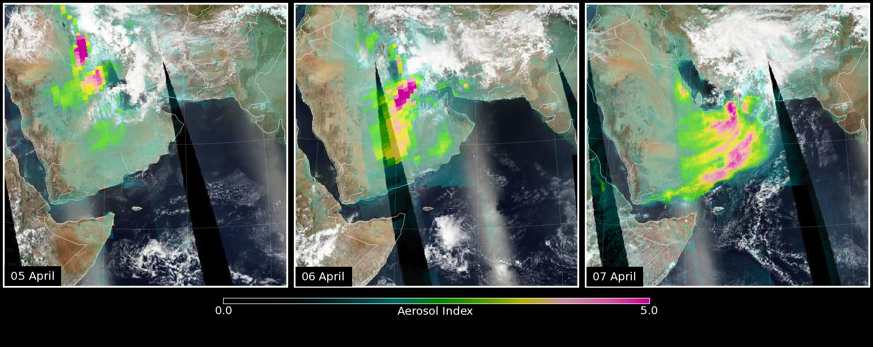
Applications - DUST
identifying the dust aerosol induced biases in retrieved sea surface temperature and devising a correction based on the relationship between errors in AVHRR-derived SST and the TOMS AI.(Diaz et al. 2001)
initializing forecasting model of dust aerosol (Alpert et al., 2002)
developing a global dust source function for aerosol transport model (Ginoux et al., 2001), and validating dust distribution at the regional and global scale.

Slide 32
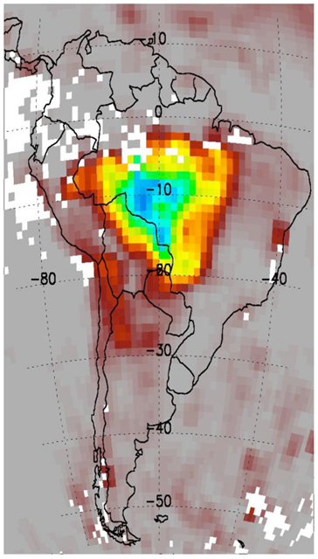
Applications – Biomass Burning Smoke
monitoring of transport of biomass burning emissions deeply injected into the lower stratosphere, followed by the phenomenon of pyrocumulonimbus events (Fromm et al, 2005).
Although the AI is a very useful qualitative indicator of aerosol presence, an actual inversion procedure is needed to interpret the measured radiance departures from a Rayleigh atmosphere model, in terms of traditional aerosol parameters such as optical depth, τ, and single scattering albedo, ω0 (Torres et al. 1998 ).

Slide 33
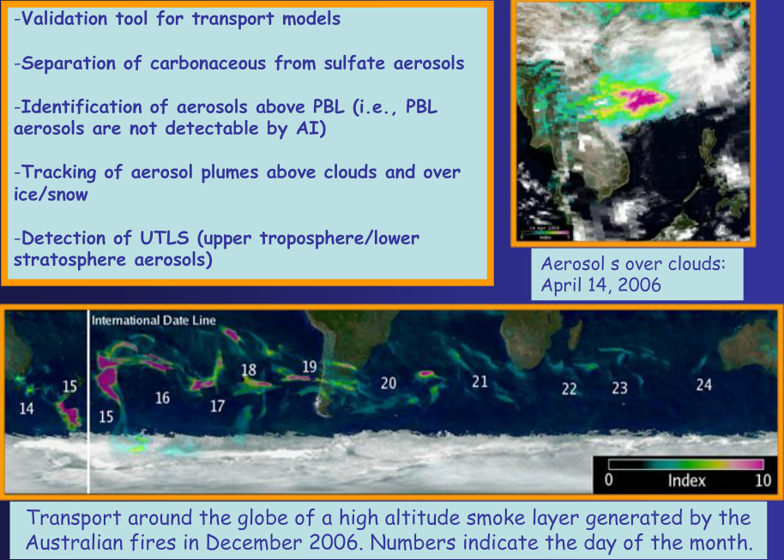
Applications

Slide 34
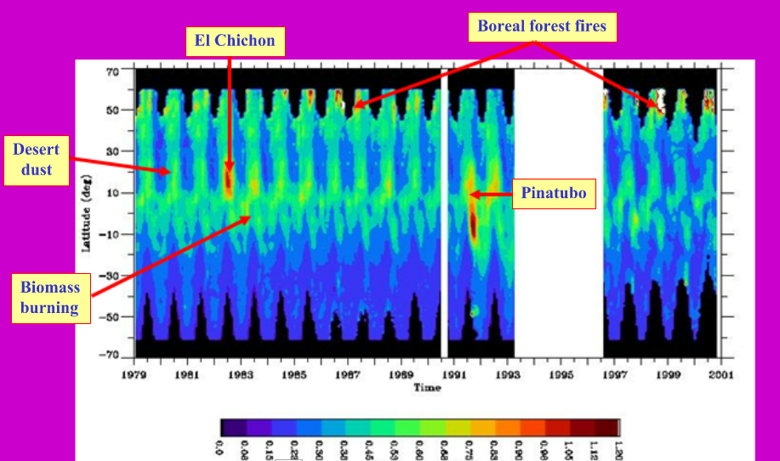
Long Term History

Slide 35
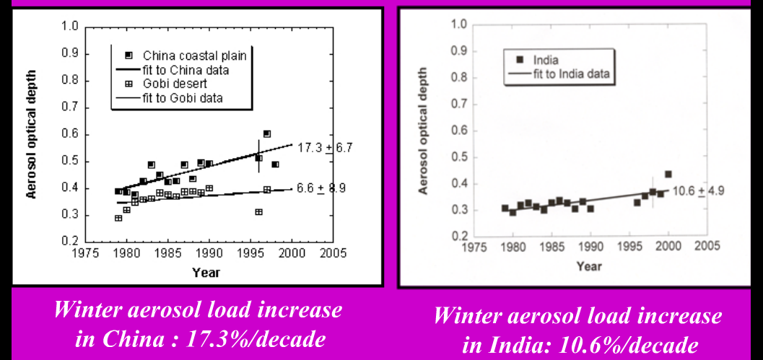
Trends in Aerosol Optical Depth from TOMS

Slide 36
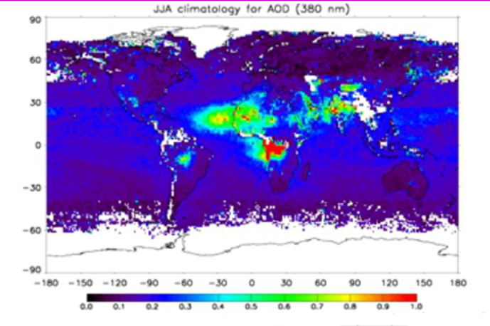
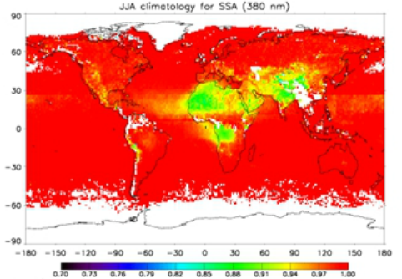
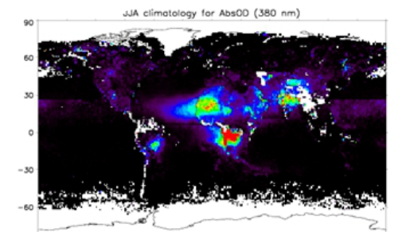
EP-TOMS Climatology (1996-2001)
AOD
SSA
Absorption AOD –
Vertical column integral of spectral aerosol absorption coefficient: AAOD = exp(-K. Δz) where K is the absorption coefficient [km⁻¹] and Δz the vertical path [km]

Slide 37
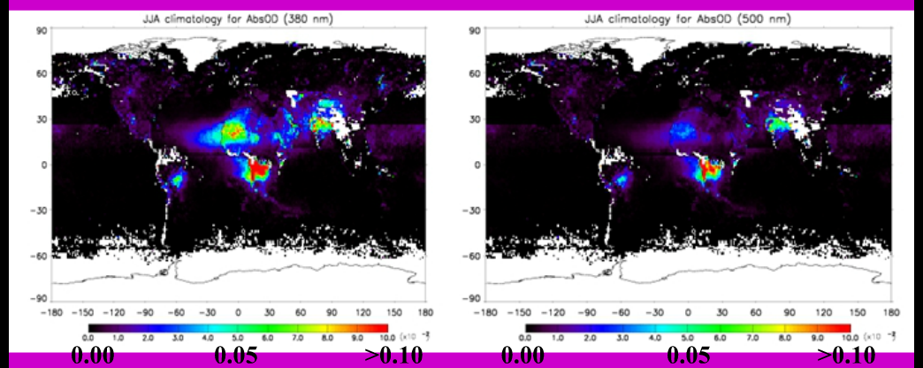
Seasonal Climatology at 380 nm and 500 nm

Slide 38
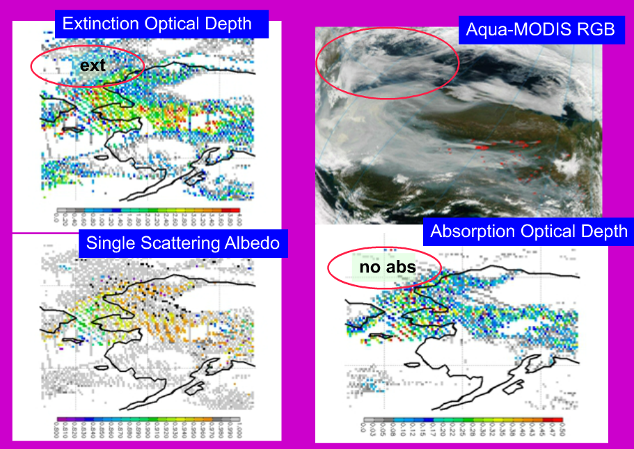
Example OMI Results - SMOKE

Slide 39
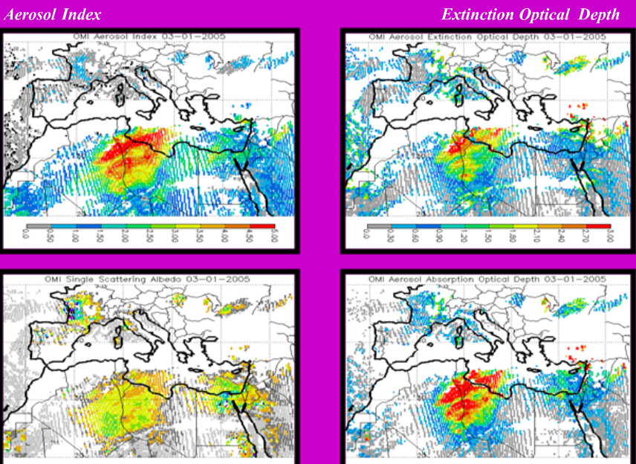
Dust Over Mediterranean

Slide 40
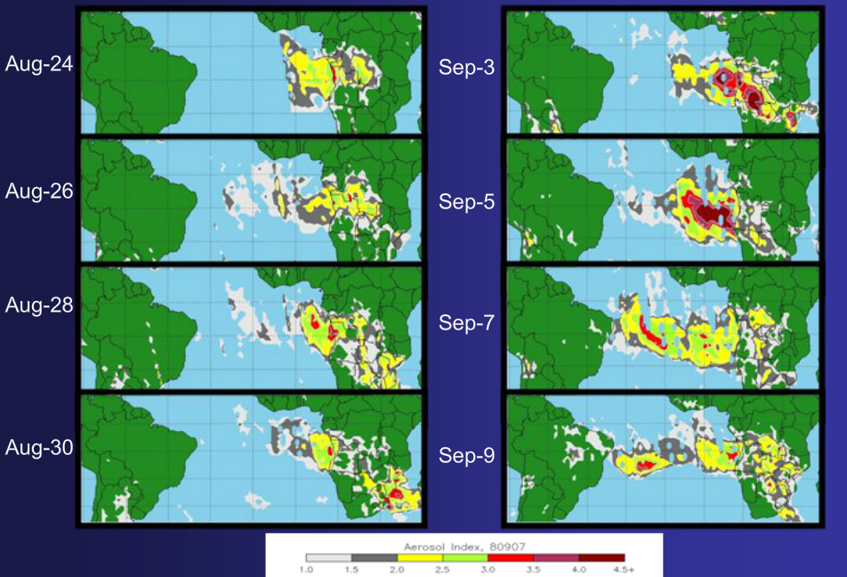
A case study: 2008 Trans-Atlantic aerosol transport in the SH.

Slide 41


Slide 42

Near-UV Validation with TOMS
82% of points are within expected accuracy limits (0.1 or 30%)
63% within +/- 0.03
87% within +/- 0.05
(Torres et al. 2005)
Performance for OMI similar or better

Slide 43

Potential A-Train Comparisons
Other instruments on the A-Train that observe aerosols:
  on EOS-Aqua: MODIS and AIRS
  on PARASOL: POLDER
  on CALIPSO: CALIOP

Slide 44





Comparison with MODIS

Slide 45
Summary
TOMS and OMI Satellite measurements in the near UV produce valuable global information on aerosol absorption over the oceans and the continents.
A global data set on Aerosol Absorption Optical Depth has been produced from TOMS observations.
The long term TOMS record revels the existence of trends in aerosol optical depth in Chin and India.
OMI observations of aerosol absorption will extend the TOMS long-term record on aerosol absorption.

