Slide 1

Aerosol Type from CALIOP
MET 611 – Satellite Data Applications
Jennifer D. S. Griswold

Slide 2
Aerosol Type
Are more broadly characterized as anthropogenic (urban/industrial pollution and biomass burning) and natural (desert dust, sea salt, biogenic, and volcanic) aerosols
Original purpose was to estimate the lidar ratio used in the extinction retrieval
  But, it turned out aerosol type was interesting in its own right
Each aerosol “type” is assumed to be a mixture of species
  eg: “polluted con0nental” = sulfate + nitrate + BC + dust
Typing is performed before the extinction retrieval
  Therefore, must be based on Level 1 profile data
  In the future, we may retrieve for each type and select the best solution

Slide 3
Aerosol Properties from Space
One of the challenges of satellite-based passive remote sensing of aerosol properties is the separation of the path radiance from the top-of-atmosphere (TOA) radiance.
  The path radiance is due to atmospheric reflection, whereas TOA radiance includes reflection by the surface.
For aerosol retrieval from passive instruments, once the path radiance is isolated, some methods use simulations of the top-of-atmosphere radiation to relate satellite-based observations to aerosol properties by using theoretical models.
  These models are usually based on measurements or established climatologies (e.g., d’Almeida et al. 1991; WCRP 1986).
  In most cases these algorithms make assumptions with significant contributions to TOA radiation including
    vertical distribution of aerosols
    surface reflectance

Slide 4
CALIPSO/CALIOP Aerosol
CALIPSO (Winker et al. 2009, 2007) is an active sensor that makes range-resolved measurements of atmospheric constituents
  it does not require the assumptions about vertical distribution and surface reflectance that are fundamental to most passive measurements.
To determine aerosol type, these algorithms use:
  the integrated attenuated backscatter measurements
  the volume depolarization ratio measurements
  surface type
  layer altitude
The algorithms do make a fundamental assumption for the extinction retrieval of most aerosol layers (discussed later).

Slide 5
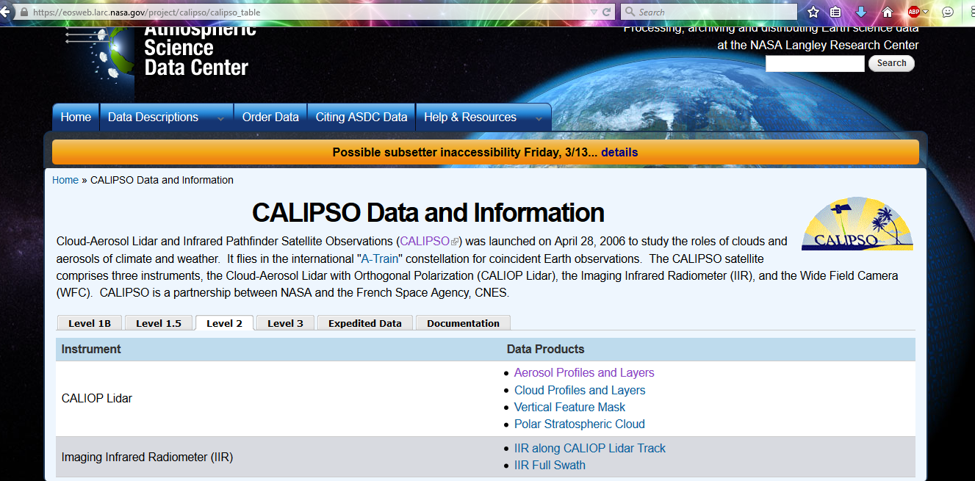
CALIPSO/CALIOP Aerosol
The aerosol subtyping products generated by the algorithms are available to the public at the Langley Atmospheric Sciences Data Center (ASDC) as part of the level 2 suite of products.
https://eosweb.larc.nasa.gov/project/calipso/calipso_table

Slide 6
Extinction-to-Backscatter (lidar) ratio
Although backscatter lidar measurements such as CALIPSO are free from surface effects, they do suffer from a need to assume an aerosol extinction-to-backscatter ratio Sa (also referred to as the aerosol–lidar ratio) to enable, in most cases, the calculation of extinction from lidar backscatter signals.
Determining aerosol type is complex, we need aerosol models:
  to determine the aerosol type
  choose the appropriate aerosol model for the type,
  determine the appropriate Sa.
  The choice of Sa (the aerosol subtype product) is useful for developing global distributions of aerosol types for science studies, such as source attribution of aerosol forcing and pollution episodes.

Slide 7
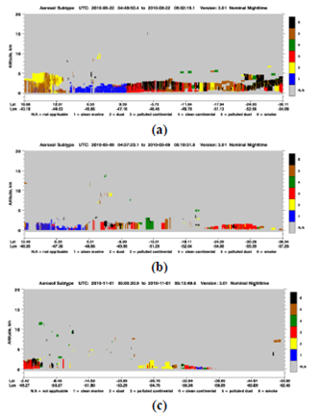
Performance of Subtyping
To determine performance of aerosol subtyping and Sa selection, qualitative measures are used, such as:
  the distributions of optical depths
  expected aerosol types both geographically and seasonally
  convergence of the extinction calculation when model Sa values are used

Slide 8
CALIPSO Aerosol Models
The CALIPSO aerosol models are based on the cluster analysis of multiyear (1993–2002) AERONET data
  determine characteristic aerosol types grouped using nearly instantaneously observed physical and optical properties (see Omar et al. 2005).
The cluster analysis identified six aerosol types representative of the aerosol mixtures most frequently observed at the AERONET sites.

Slide 9
CALIPSO Aerosol Models
The CALIPSO models use some of the information derived from AERONET cluster analysis to determine Sa values.
The typing and lidar ratio selection algorithm uses the lidar observables and surface-type information to aid in selecting values of Sa.
  The goal is to constrain the uncertainty in Sa to no more than 30%.
  The observed range of variability of Sa is between 10 and 110 sr (Anderson et al. 2000)
  The modeled range is between 15 and 80 sr (Ackermann 1998).
  Allowing for an uncertainty of 30%, our selected range of Sa values for this algorithm spans a range of 14–90 sr.

Slide 10
CALIPSO Aerosol Models
For each aerosol model obtained from the cluster analysis of AERONET measurements, a lidar ratio was calculated and compared with field measurements of Sa for that aerosol type.
  These measurements, primarily at 532 nm, come from a variety of techniques including:
    180° nephelometer (Anderson et al. 2000)
    Raman lidar (Ackermann 1998),
    slant path techniques
    and transmittance methods (Young 1995)
  The AERONET derived model parameters were adjusted, when necessary, to bring the derived lidar ratio into better agreement with the measurements.

Slide 11
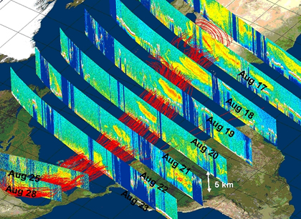
CALIPSO Aerosol Models
Of the six AERONET clusters, three are adopted as CALIPSO aerosol models:
  biomass burning
  polluted continental
  polluted dust (dust + smoke)
Two models were built either directly from measurements of size distributions and complex refractive indices or by adjusting model parameters to general observed Sa values.
  marine
  background/clean continental
The dust model is based on the work of Kalashnikova and Sokolik (2002).

Slide 12
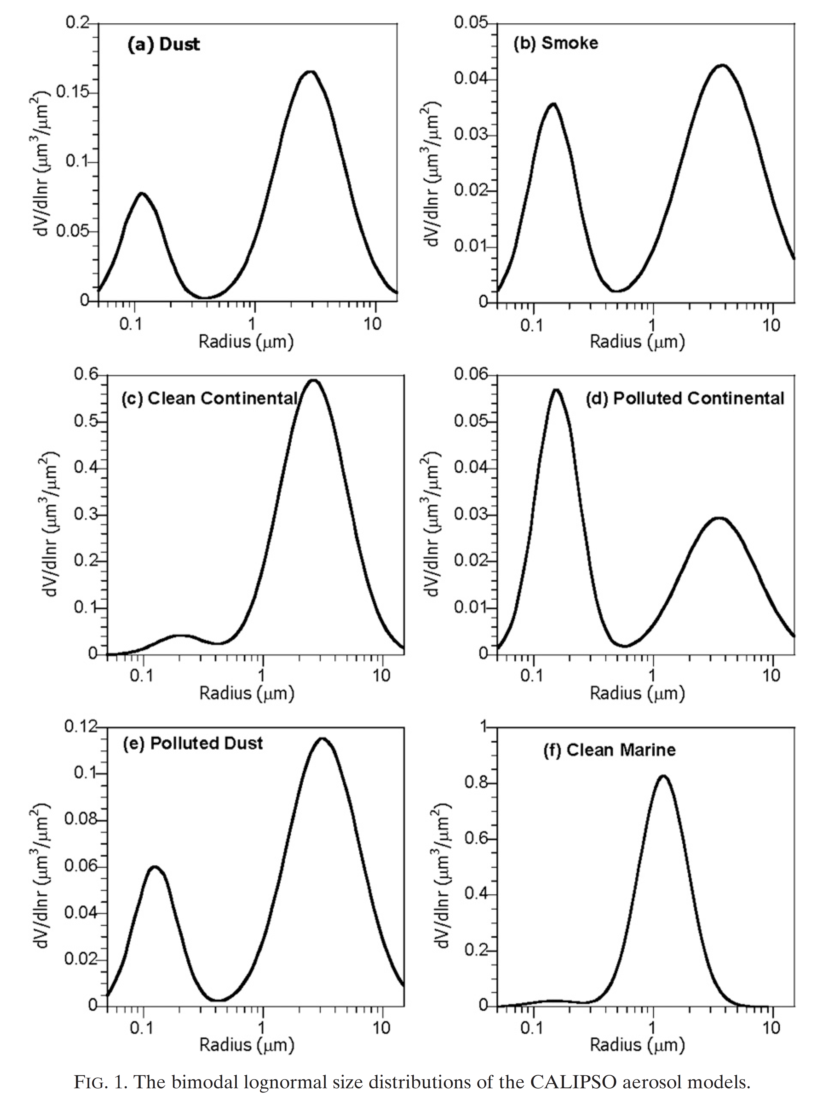
CALIPSO Aerosol Models
Omar et al 2001
The size distributions based on volume are shown in Fig. 1
There are Dust, Smoke, Clean Continental, Polluted Continental, Polluted Dust and Clean Marine.

Slide 13
CALIPSO Aerosol Model
Omar et al 2001
The table shows the microphysical and derived properties associated with each of the six CALIPSO aerosol models.

Slide 14
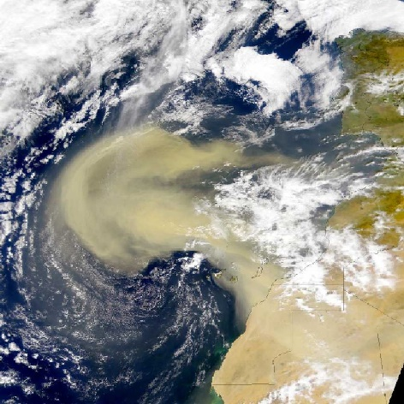
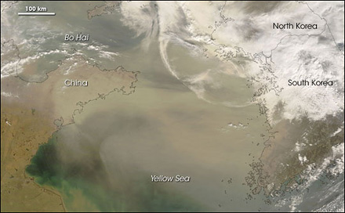
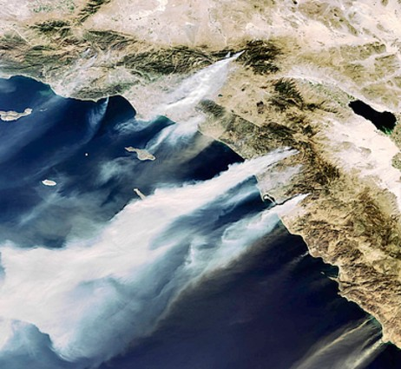
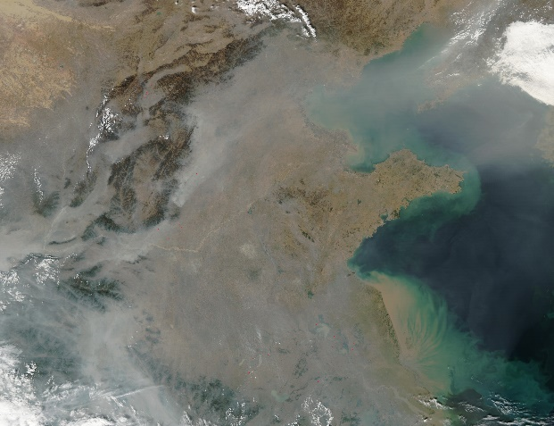
CALIOP Aerosol Type
Type | Criteria
Dust | High depolarization
Polluted Dust | Medium depolarization, assume dust is mixed with smoke
Smoke | Higher altitude, Low depolarization
Clean Continental | Overland, Low backscatter
Polluted Continental | Higher backscatter, low depolarization, near surface
Marine | Over ocean, in marine boundary layer

Slide 15
CALIPSO Aerosol Type Models
DUST
  The CALIPSO dust model is based on theoretical particle scattering calculations by using the discrete dipole approximation (DDA) technique, with inputs of realistic compositions and irregular shapes (Kalashnikova and Sokolik 2002).
  The CALIPSO model Sa values for Dust are:
    40 sr at 532 nm
    55 sr at 1064 nm
POLLUTED CONTINENTAL
  The CALIPSO model for polluted continental is based on the AERONET data.
  The CALIPSO model Sa values for Polluted Continental are:
    70 sr at 532 nm
    30 sr at 1064 nm

Slide 16
CALIPSO Aerosol Type Models
POLLUTED DUST
  This aerosol model is designed to account for episodes of dust mixed with biomass burning smoke (e.g. regions close to strong sources of both [West Africa and Asia]).
    Also, dust mixed with urban pollution (e.g. Asia and Europe).
    A mixture of the AERONET desert dust (coarse mode) and biomass burning (fine mode) clusters.
  The CALIPSO model Sa values for Dust are:
    65 sr at 532 nm
    30 sr at 1064 nm
SMOKE (Biomass Burning)
  The biomass burning cluster of AERONET measurements is used to model the CALIPSO smoke aerosol.
  The CALIPSO model Sa values for Smoke are:
    70 sr at 532 nm
    40 sr at 1064 nm

Slide 17
CALIPSO Aerosol Type Models
CLEAN CONTINENTAL
  This aerosol is also referred to as clean background.
  The AERONET records of the background cluster from Omar et al. (2005) have low mean optical depths (<0.05 at 673 nm). The CALIPSO background aerosol model was derived by fitting size distributions and refractive indices to measurements of Sa of long-range continental transport (Anderson et al. 2000).
  The CALIPSO model Sa values for Clean Continental are:
    35 sr at 532 nm
    30 sr at 1064 nm
CLEAN MARINE
  Derived from the parameters measured during the Shoreline Environmental Aerosol Study (SEAS) experiment (Masonis et al. 2003).
  The CALIPSO model Sa values for Clean Marine are:
    20 sr at 532 nm
    45 sr at 1064 nm

Slide 18
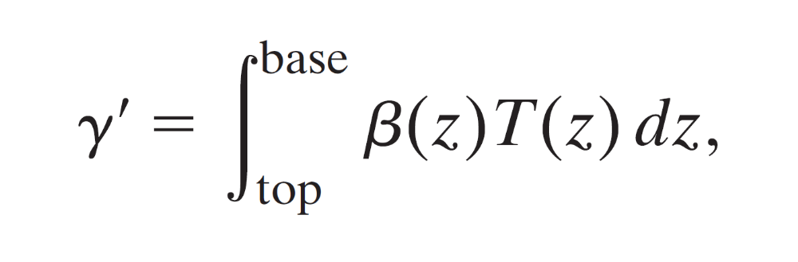
Algorithm Design
The goal of the aerosol typing algorithm is to identify the aerosol type closely enough to estimate the appropriate value of Sa to within 30% of the true value.
These values are then passed on for use in the extinction retrieval algorithm (Young and Vaughan 2009).
The selection scheme uses the observed backscatter strength, that is, the integrated attenuated backscatter at 532 nm (γ’), defined as:

Slide 19
Algorithm Design
The integrated attenuated backscatter at 532 nm (γ’), defined as:
β = the total (molecular m + particulate p backscatter)
T = the atmospheric transmittance due to both molecules and particles.

Slide 20
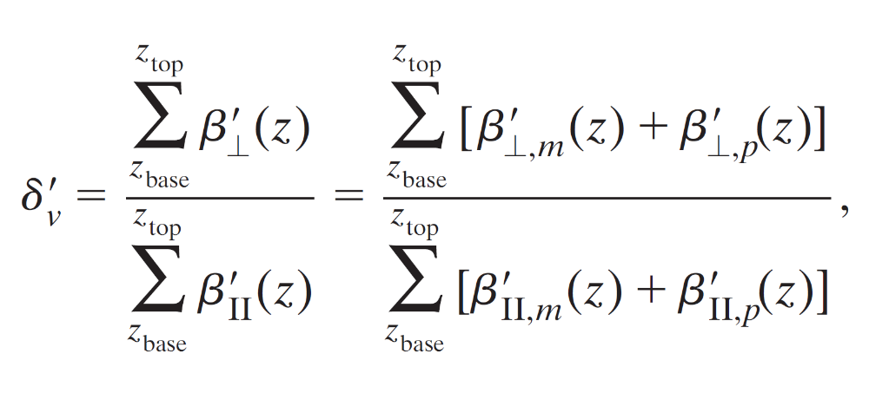
Algorithm Design
The sum of the perpendicular channel signal within a feature divided by the sum of the parallel channel (i.e., the volume depolarization ratio δ_{v}’) is defined as
where z is altitude and the subscripts ‘‘top’’ and ‘‘base’’ refer to the top and base of the feature as determined by the feature finder (Vaughan et al. 2009).
The subscripts || and ⊥ refer to the polarized and depolarized attenuated backscatter β’ signals, respectively

Slide 21
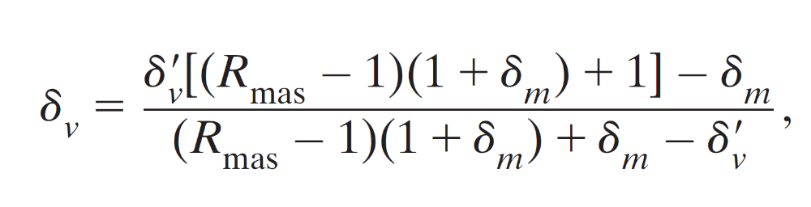
Algorithm Design
In the algorithm, δ_{v}’ has been corrected to account for the molecular contribution as follows:
where δ_{v} is the corrected depolarization ratio (or estimated particulate depolarization ratio)
R_{mas} is the mean attenuated scattering (mas) ratio (the ratio of the total attenuated backscatter to the molecular backscatter)
δ_{m} is the molecular depolarization ratio.
Because of this dependence on the layer R_{mas}, the distributions of the depolarization ratios will spread beyond the threshold values.

Slide 22
Algorithm Design
Aerosol type is identified by using γ’ and δ_{v} to the extent possible from among one of the six types.
However, γ’ and δ_{v} are not sufficient to fully constrain the model selection.
Surface type is used to exploit differences in aerosol classes over the oceans, deserts, and snow/tundra regions.
Information about aerosol layer elevation is also utilized to determine aerosol type, because conditions that favor lifting mechanisms for dust and smoke are more likely than for other aerosol types.

Slide 23
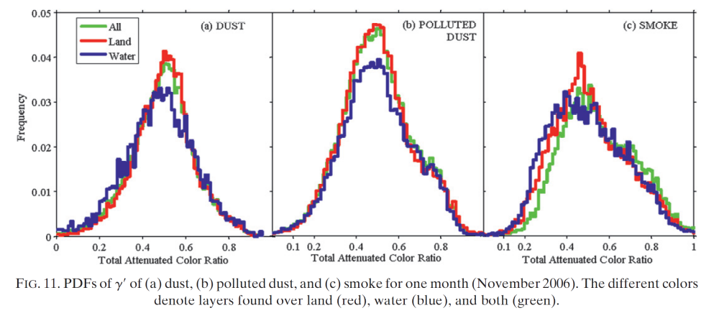
Algorithm Design
There is a significant overlap between the distributions of the color ratio χ’ (defined as the ratio of the attenuated 1064- and 532-nm backscatter).
The overlap between χ’ distributions for several aerosol types does not allow it to be used directly as an aerosol subtyping tool.

Slide 24
Algorithm Design
To identify the type (following one of 12 pathways in the Algorithm Flowchart (see next slide) input parameters are used:
  altitude
  location
  surface type
  volume depolarization ratio
  integrated attenuated backscatter measurements
The surface types are from the International Geosphere-Biosphere Programme (IGBP).
The threshold values of δ_{v} and γ’ in the Algorithm Flow chart are estimates based on Lidar In-space Technology Experiment (LITE) measurements
  in the case of depolarization, they are based on a limited set of observations and models (Barnaba and Gobbi 2004; Gobbi et al. 2000; Murayama et al. 1999; Reagan et al. 2001; Sakai et al. 2003).

Slide 25
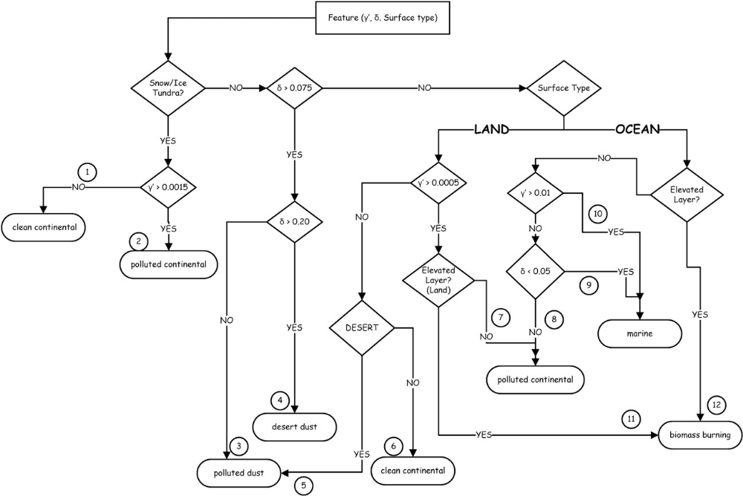
Algorithm Flowchart
(Omar et al., JTech, 2009)

Slide 26
Algorithm Design
Aerosol layers over polar regions can either be clean continental or arctic haze, depending on the magnitude of γ’ (see pathways 1 and 2 in in the Flowchart).
Arctic haze is similar to continental pollution and, in some cases, it is continental pollution transported to the Arctic region.
  Arctic haze has a low depolarization ratio ~2% (Ishii et al. 1999), and it is modeled as polluted continental.
As currently written, the algorithm does not allow dust and smoke types in polar regions.

Slide 27
Algorithm Flowchart
(Omar et al., JTech, 2009)

Slide 28
Algorithm Design
δ_{v} is used to identify aerosol types that have a substantial mass fraction of non-spherical particles (e.g., a mixture of smoke and dust in pathways 3 and 5).
γ’ is used to discern instances of transient high aerosol loading over surfaces where this is not usually expected (e.g., a smoke or dust layer over land or the ocean in pathways 10 and 11, respectively).
In pathway 4, aerosol layers that have δ_{v} > 0.2 are identified as dust everywhere but at the poles.
Thin aerosol layers over land (other than dust) are identified as clean continental (pathway 6) unless these layers are elevated, in which case they are identified as smoke (pathway 11).

Slide 29
Algorithm Flowchart
(Omar et al., JTech, 2009)

Slide 30
Algorithm Design
If, however, they are not elevated but still scatter more strongly than the clean continental threshold (γ’ = 0.0005), then we identify them as polluted continental (pathway 7).
Over the ocean, all elevated non-dust aerosol layers are identified as smoke.
In the marine boundary layer (MBL), aerosol layers can either be clean marine characterized by optically thick layers consisting of spherical particles (pathways 9 and 10) or optically thin layers with some non-spherical particles, as would be found near coastal regions and classified as polluted continental (pathway 8).
Once the type is identified, Sa is chosen from a lookup table that currently consists of the six pairs of 532- and 1064-nm values shown in Table 1.

Slide 31
Algorithm Flowchart
(Omar et al., JTech, 2009)

Slide 32
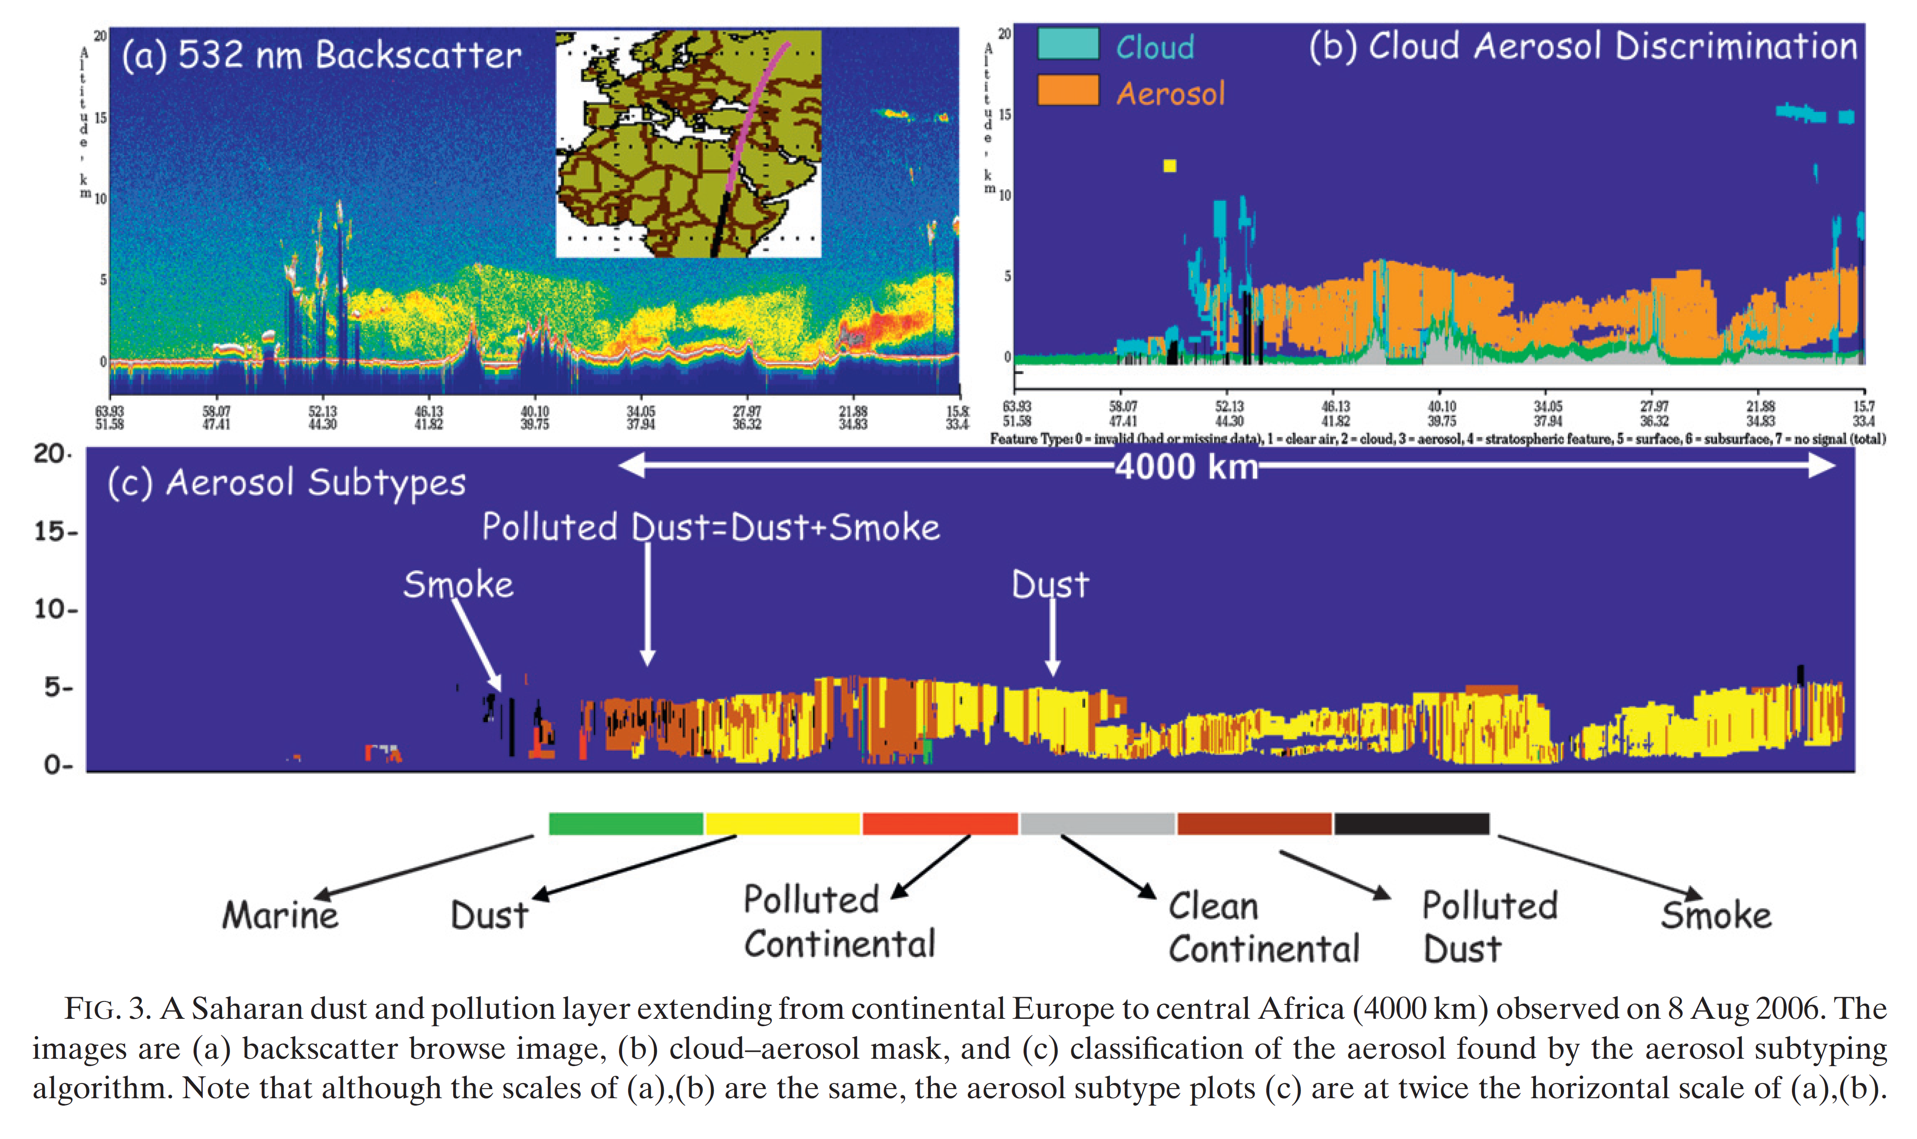
Case Studies
The subtyping algorithm captures the evolution of the aerosol from smoke and polluted dust to pure dust in the Sahara.

Slide 33
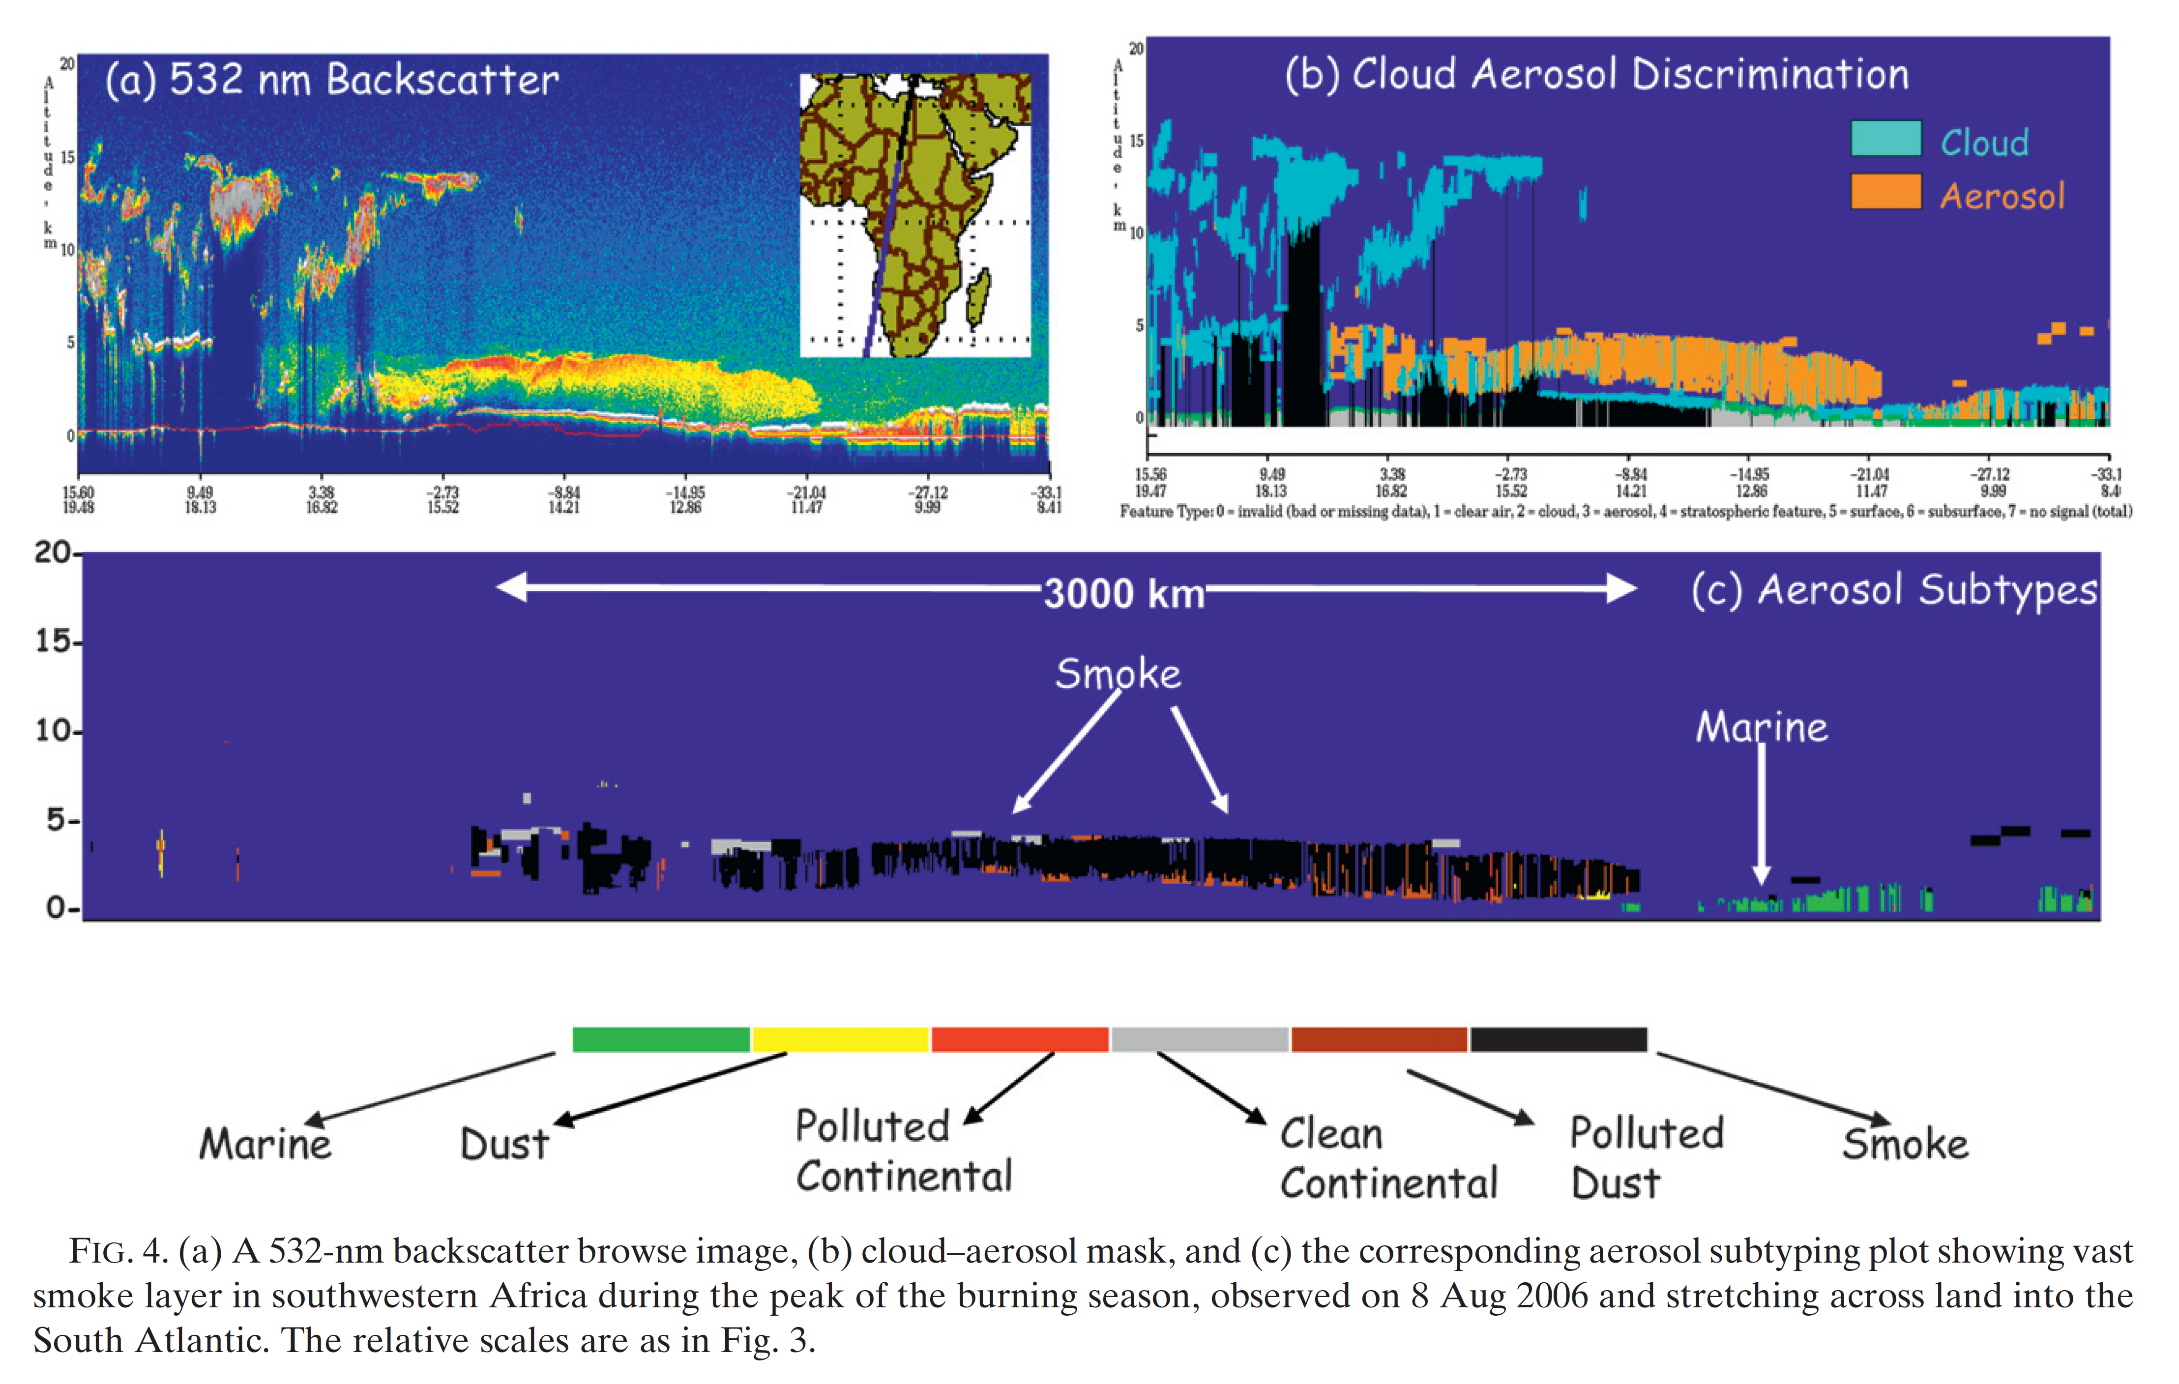
Case Studies
Figure 4 is another example of the subtyping result showing an aerosol layer that has been classified as predominantly smoke extending from land to the deep ocean. Note that the aerosol type on the ocean surface is classified as marine aerosol.

Slide 34
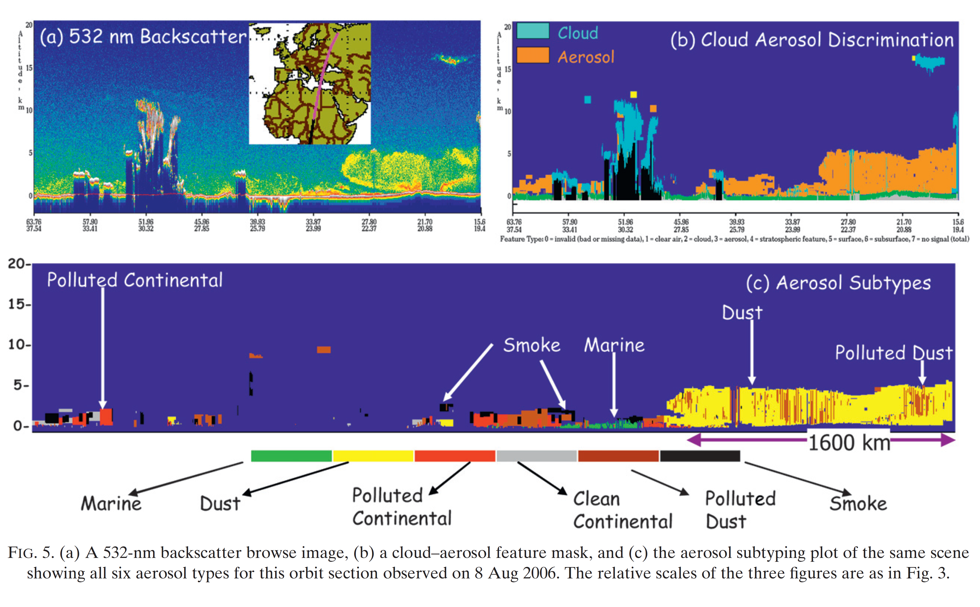
Case Studies
All six aerosol types: Europe is primarily polluted continental in the north and smoke and polluted dust in the south near the Mediterranean Sea. Cean marine aerosol near the surface of the sea and a 5-km-deep dust layer stretching across the Sahara.

Slide 35
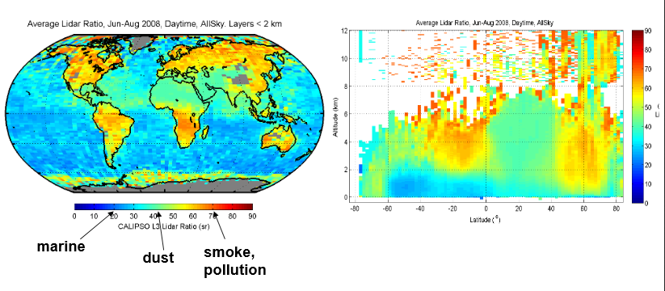
Aerosol Type JJA 2008
You can clearly see the difference between marine, dust and smoke.

Slide 36
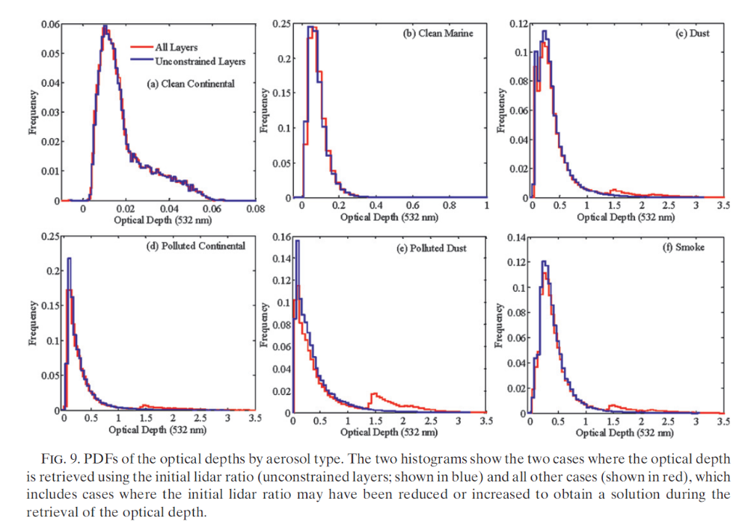
Optical Depth by Aerosol Type

Slide 37
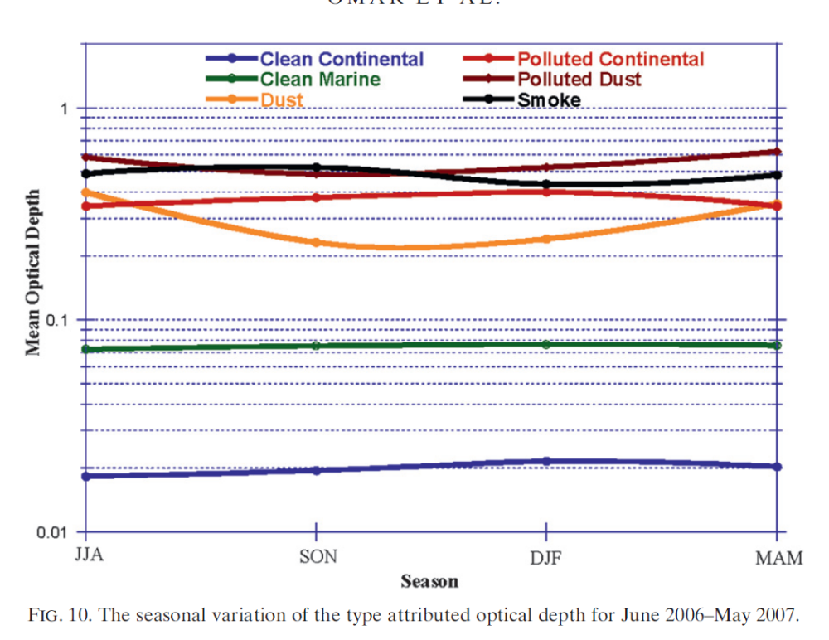
Optical Depth by Season and Type

Slide 38
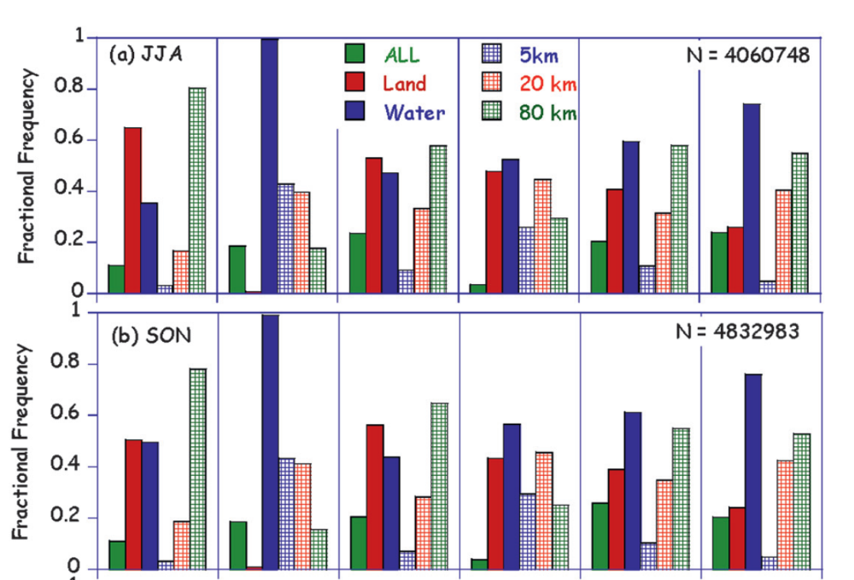
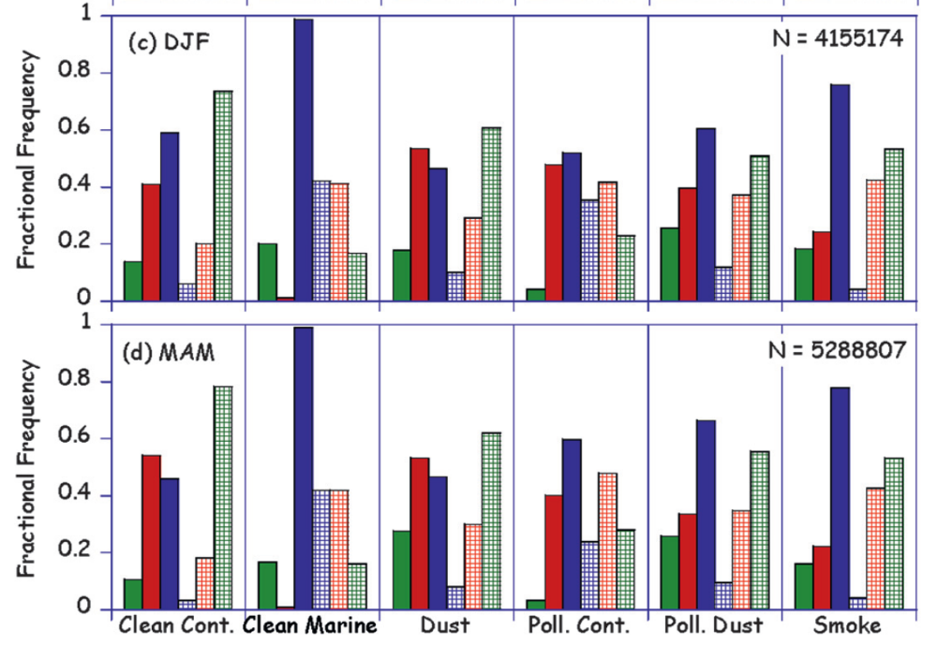
Fractional Frequency by Season

Slide 39
Fractional Frequency by Season

Slide 40
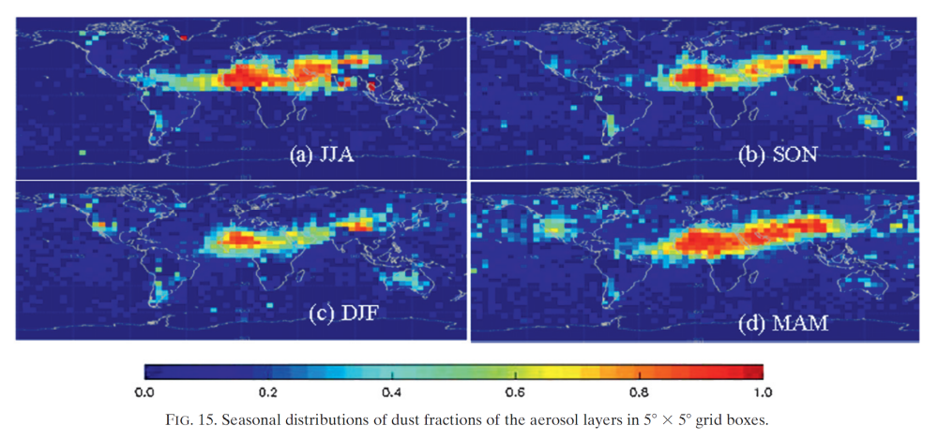
Seasonal Distributions of Dust

Slide 41
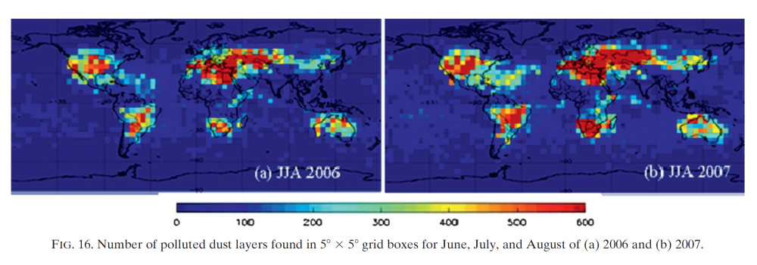
Polluted Dust Inter-annual Distribution
The figure is a plot of the number of layers of polluted dust found in 5°x 5° grid boxes in JJA 2006 and 2007.
Notwithstanding slight differences in the number of sampling days for these two periods, distributions are remarkably similar, an expected outcome for these aerosols.

