Slide 1

MODIS Land Overview
MET 611 – Satellite Data Applications
Jennifer D. S. Griswold

Slide 2
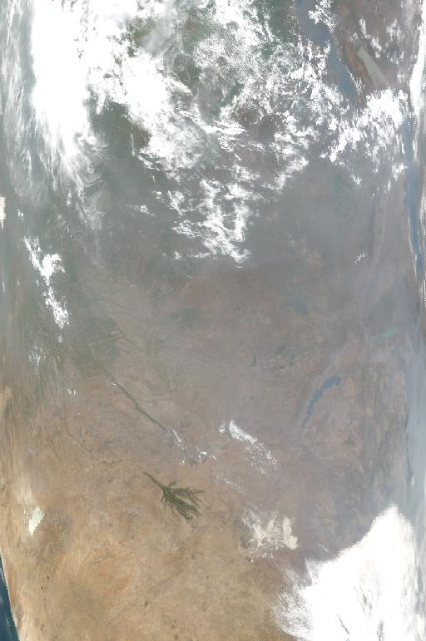
MODIS Granule over Southern Africa
(Sept 13,2001, 8:45 to 8:50 GMT)
Red, Green, Blue MODIS top of atmosphere reflectance
No atmospheric correction
Surface Reflectance: Atmospheric effect has a strong impact on remotely sensed data

Slide 3
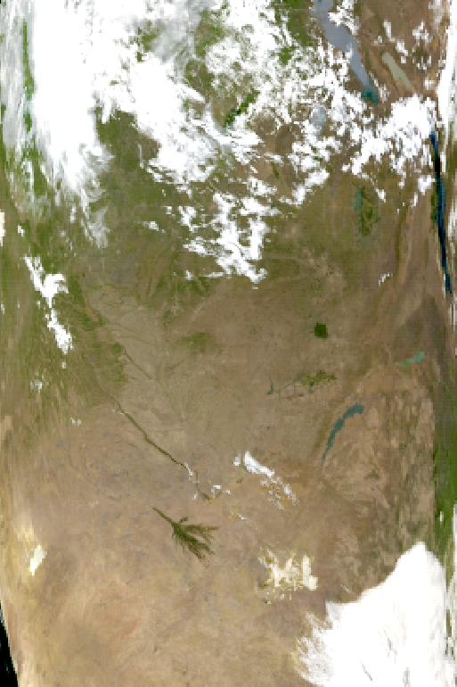
MODIS Granule over Southern Africa
(Sept 13,2001, 8:45 to 8:50 GMT)
Red, Green, Blue MODIS surface reflectance
With atmospheric correction

Slide 4
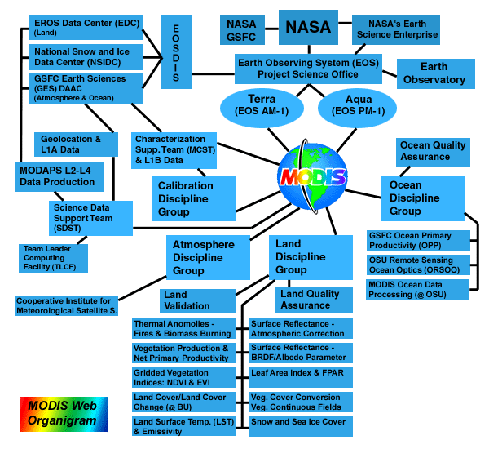

Slide 5
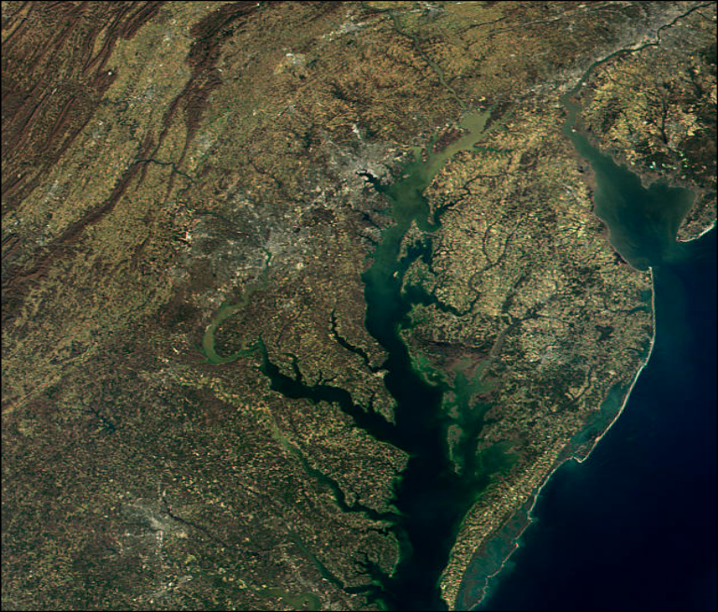
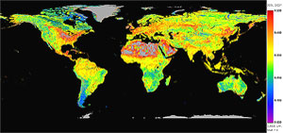
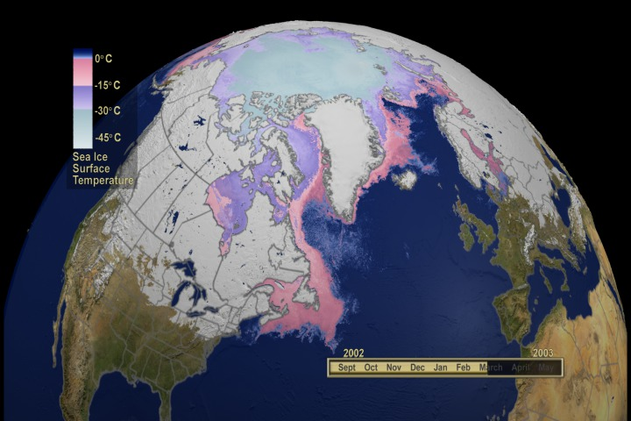
MODIS Land Product Overview
Radiation Budget Variables
  Surface Reflectance
  Surface Temperature and Emissivity
  Snow and Ice Cover
  BRDF and Albedo

Slide 6
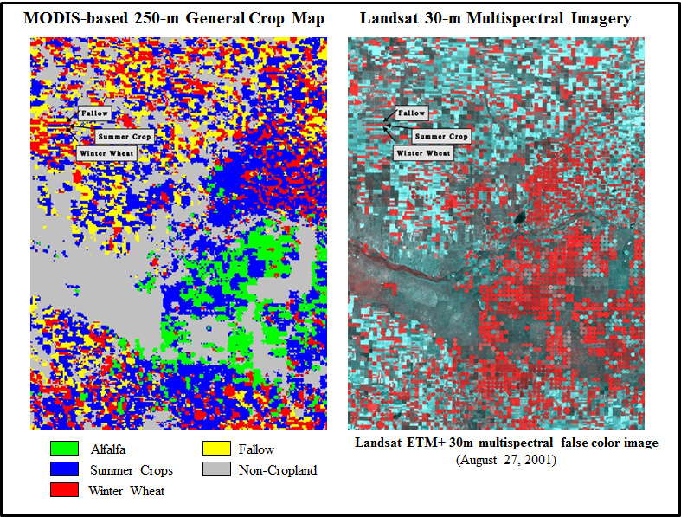
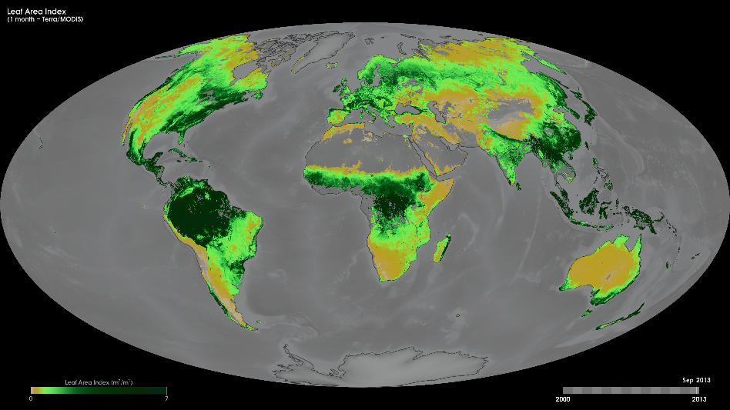
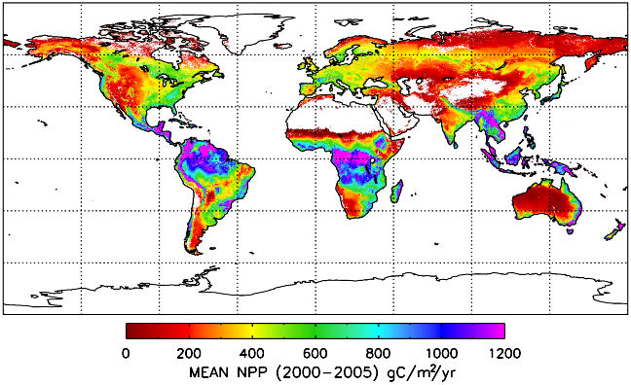
MODIS Land Product Overview
Ecosystem Variables
  Vegetation Indices
  Leaf Area Index (LAI) and Fractional
  Photosynthetically Active Radiation (FPAR)
  Vegetation Production
  Net Primary Productivity (NPP)

Slide 7
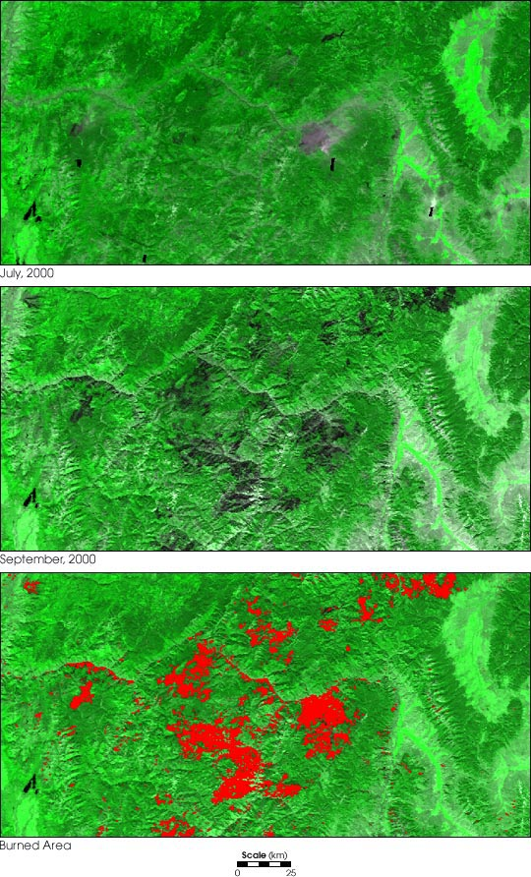
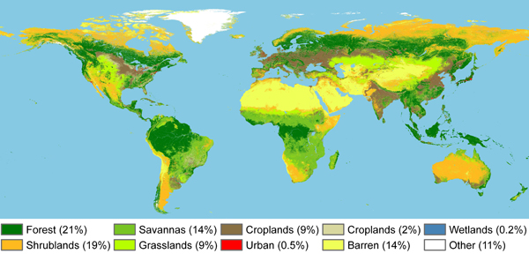
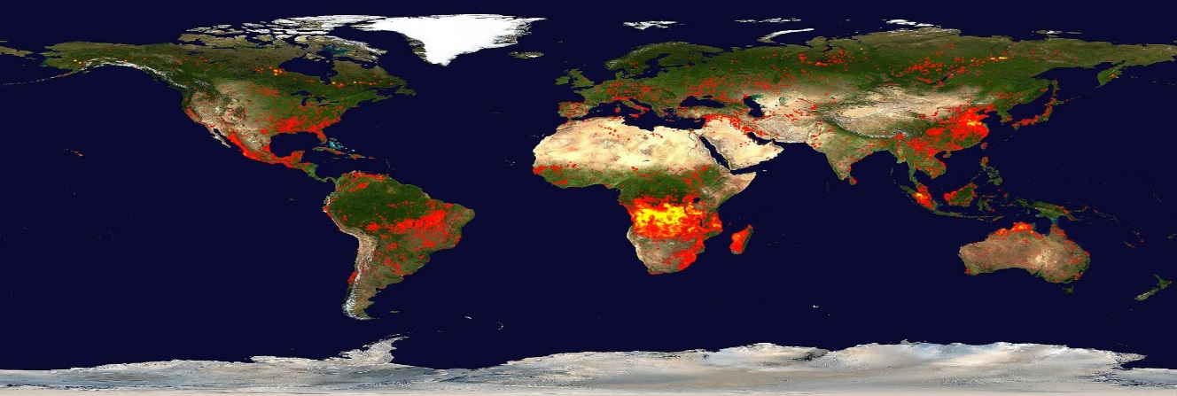
MODIS Land Product Overview
Land Cover Characteristic
  Fire and Thermal Anomalies
  Land Cover
  Vegetation Cover Conversion

Slide 8
List of MODIS Land Products
https://lpdaac.usgs.gov/dataset_discovery/modis/modis_products_table
MOD01 Level-1A Radiance Counts
MOD02 Level-1B Calibrated Relocated Radiances
MOD03 Relocation Data Set
MOD04 Aerosol Product
MOD05 Total Precipitable Water
MOD06 Cloud Product
MOD07 Atmospheric profiles
MOD08 Gridded Atmospheric Product (Level-3)
MOD09 Atmospherically-corrected Surface Reflectance
MOD10 Snow Cover
MOD11 Land Surface Temperature & Emissivity
MOD12 Land Cover/Land Cover Change
MOD13 Vegetation Indices
MOD14 Thermal Anomalies, Fires & Biomass Burning
MOD15 Leaf Area Index & FPAR
MOD16 Surface Resistance & Evapotranspiration
MOD17 Vegetation Production, Net Primary Productivity
MOD18 Normalized Water-leaving Radiance
MOD19 Pigment Concentration
MOD20 Chlorophyll Fluorescence
MOD21 Chlorophyll_a Pigment Concentration
MOD22 Photosynthetically Active Radiation (PAR)
MOD23 Suspended-Solids Conc, Ocean Water
MOD24 Organic Matter Concentration
MOD25 Coccolith Concentration
MOD26 Ocean Water Attenuation Coefficient
MOD27 Ocean Primary Productivity
MOD28 Sea Surface Temperature
MOD29 Sea Ice Cover
MOD31 Phycoerythrin Concentration
MOD32 Processing Framework & Match-up
Database
MOD35 Cloud Mask
MOD36 Total Absorption Coefficient
MOD37 Ocean Aerosol Properties
MOD39 Clear Water Epsilon
MOD43 Albedo 16-day L3
MOD44 Vegetation Cover Conversion
MODISALB Snow and Sea Ice Albedo

Slide 9
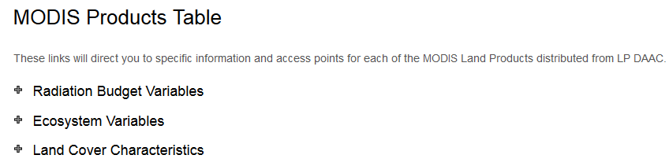
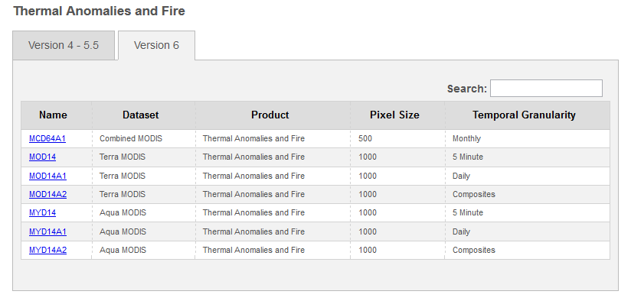
Current MODIS Land Products
https://lpdaac.usgs.gov/dataset_discovery/modis/modis_products_table

Slide 10
MODIS Land Production Processing Chart Atmospheric Correction Product (MOD09) crucial input to the MODIS land products
Level 1 Geo.,
L1B, Cld. Mask,
Atmos. Prof.
Level 3 8
-
day
Polar
Land Surf. Refl.,
Level 3 daily,
Level 2 Snow,
Level 2G
/3 Daily
Fire (+daily),
8
-
day GPP
Sea Ice, Fire
Snow
, Sea Ice
Land Surf.
Temp./Emiss.
Snow,
Sea Ice,
Level 2G/3 Daily
LAI/FPAR
Level 3 yearly
Level 2 Land
Geoang, Pointers,
NPP
Surf. Refl.
Agg./Text.,
Land Surf. Refl.,
Level 3 16
-
day
Fire, Snow
VI, BRDF,
CC
Level 3 32
-
day
Level 2/3 Daily
Land Cov. DB,
Land Surf.
, VCF
Temp./Emiss.
Level 3 96
-
day
Ancillary Data
Land
(GMAO, NMC)
Cover/Dynamics

Slide 11
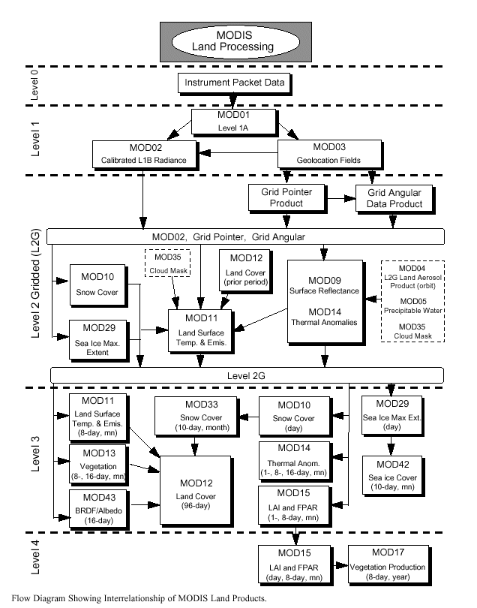

Slide 12
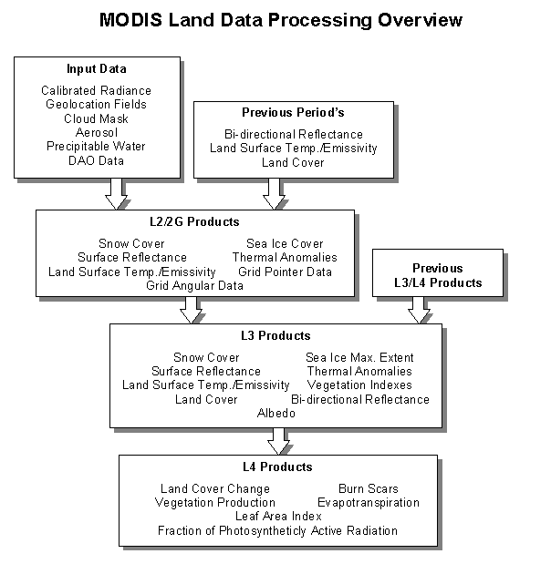

Slide 13
Level 1 - Level 4 Data
Level 1B
= Raw, Un-calibrated Swath Data (Scene), Not projected
= Includes radiometric and calibration coefficients and
parameters, but not applied
Level 2
= Derived geophysical variables at the same resolution and
location as the Level 1 source data
Level 2G
= Calibrated, IS Map Projection*, Tiled
= Multiple Coincident Swaths (e.g. overlapping pixels)
*Integerized Sinusoidal
Level 3 Data
= Variables mapped on uniform space-time grid scales
= “MODIS Land End User”
= Usually composite data
= Tiled, IS Projection, “Best” pixel selection (e.g. one value/pixel)
Level 4 Data
= Model output or results from analysis of lower level data
= LAI/FPAR, PSN/NPP

Slide 14
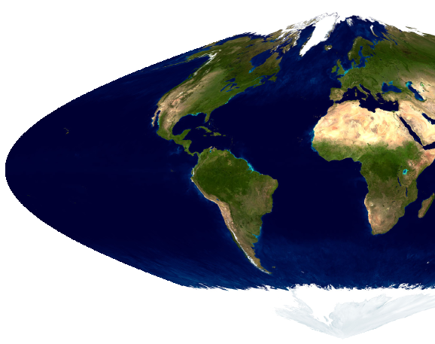
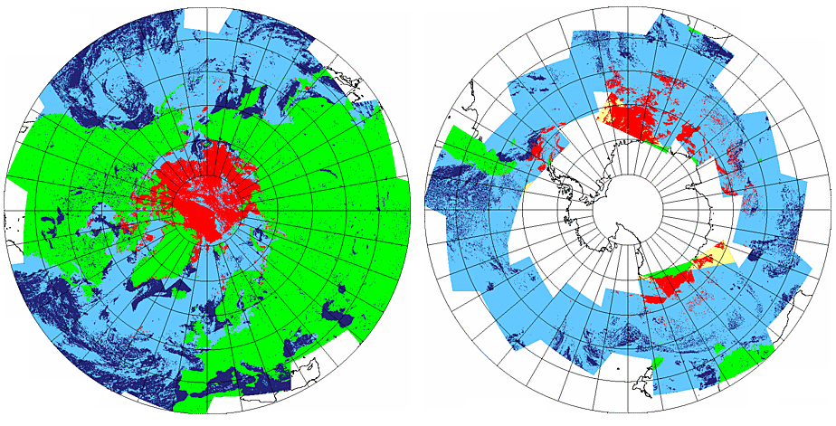
Level 2G, 3 and 4 Products (fine resolution)
Level 2G/3: earth-gridded geophysical parameters
Level 4: earth-gridded model outputs
Daily, 8-day, 16-day, 32-day, monthly and yearly products
10º x 10º Tiles ( )
Sinusoidal (equatorial);
7.5, 15 and 30 arcsec. resolution (roughly 250m, 500m and 1 km)
LAEA (sea-ice products, polar projection)
Sinusoidal
Lambert Azimuthal Equal Area (LAEA)
IS Projection
1 km tile = 1200 x 1200
500 m tile = 2400 x 2400
250 m tile = 4800 x 4800

Slide 15
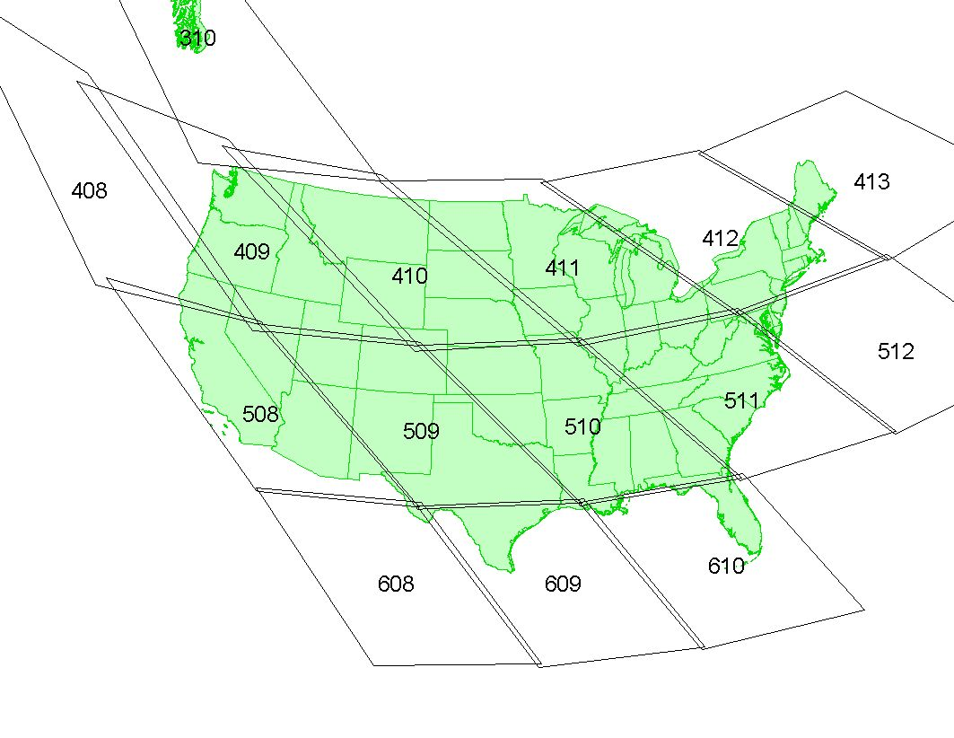
MODIS Land Tiles for U.S.
Lambert Azimuthal Equal Area

Slide 16
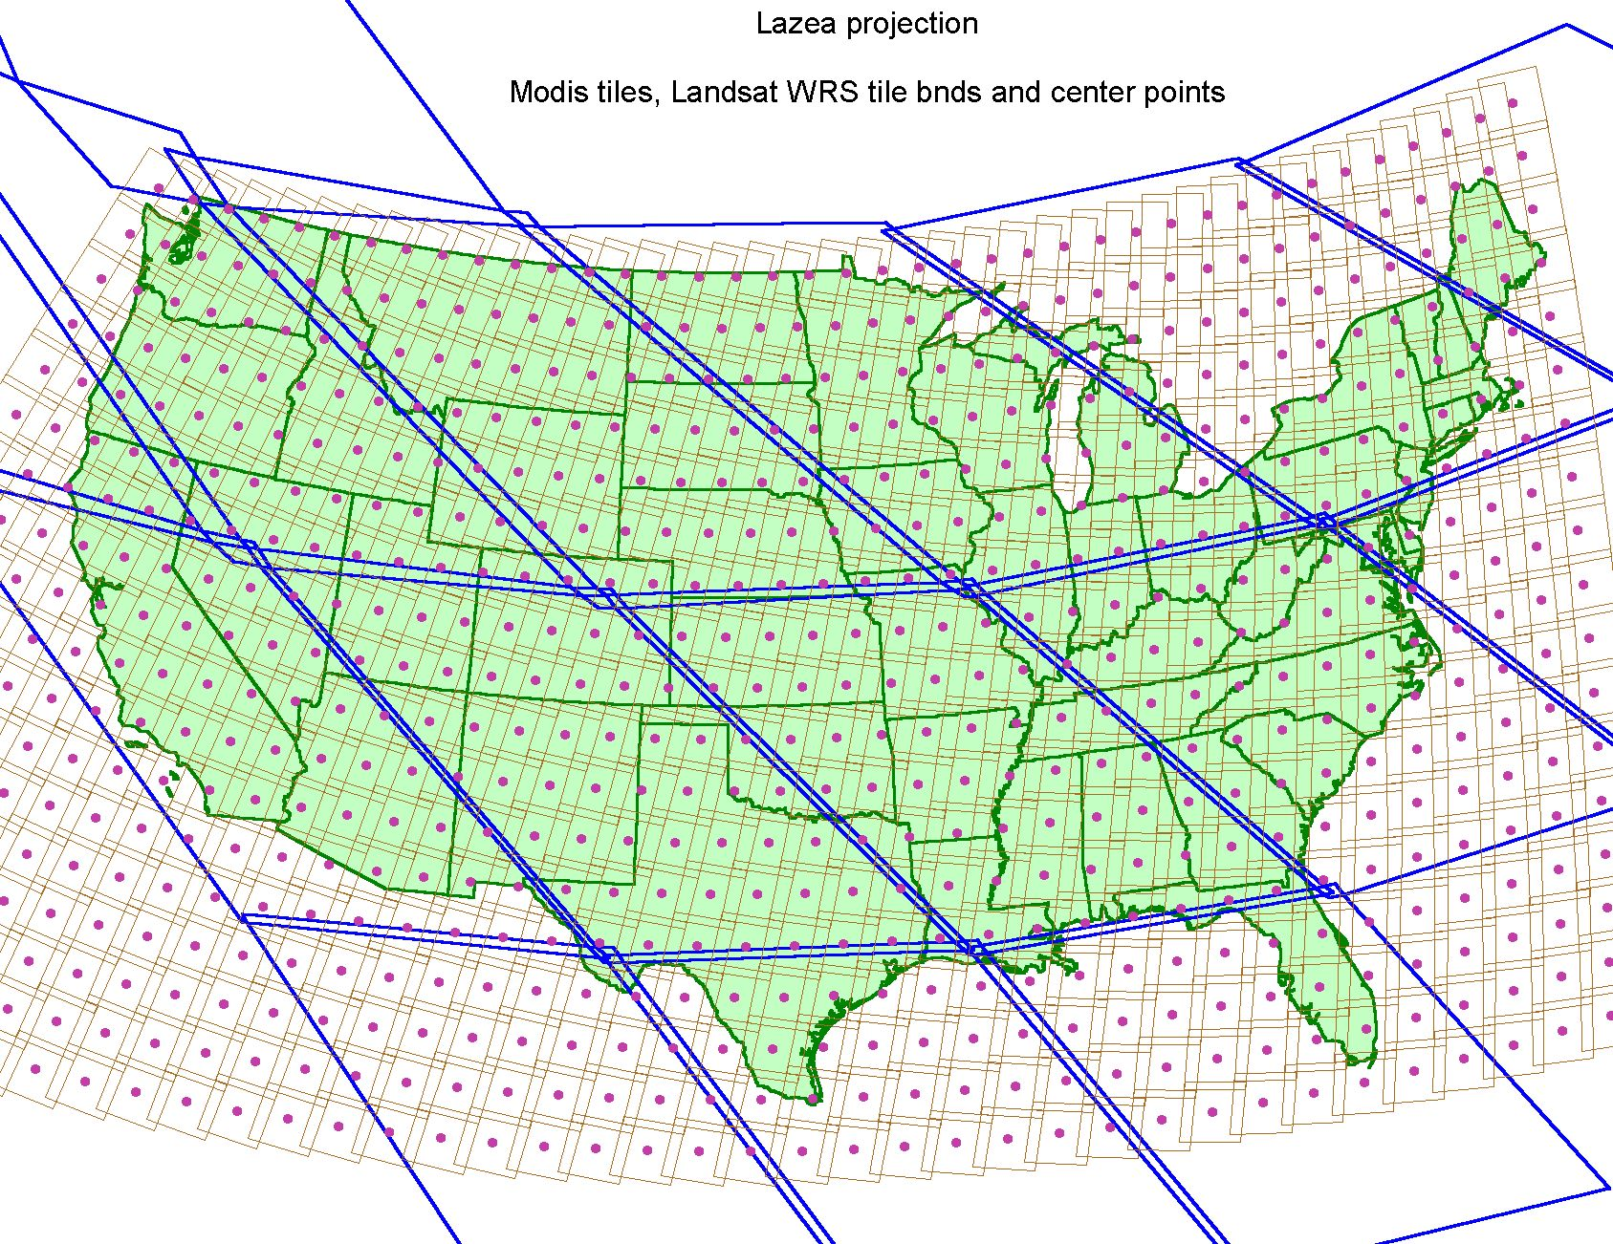
Relationship of MODIS tiles to TM scenes

Slide 17
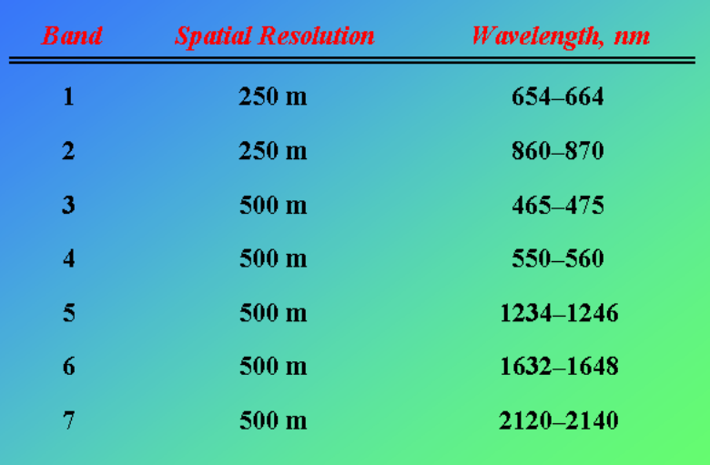
MODIS Land Bands

Slide 18
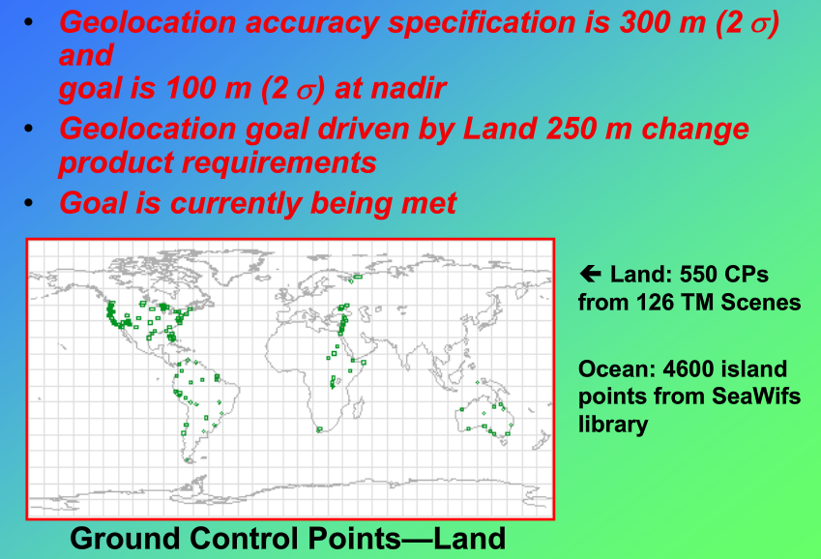
MODIS Geolocation
Notes:
TM = thematic matpper

Slide 19
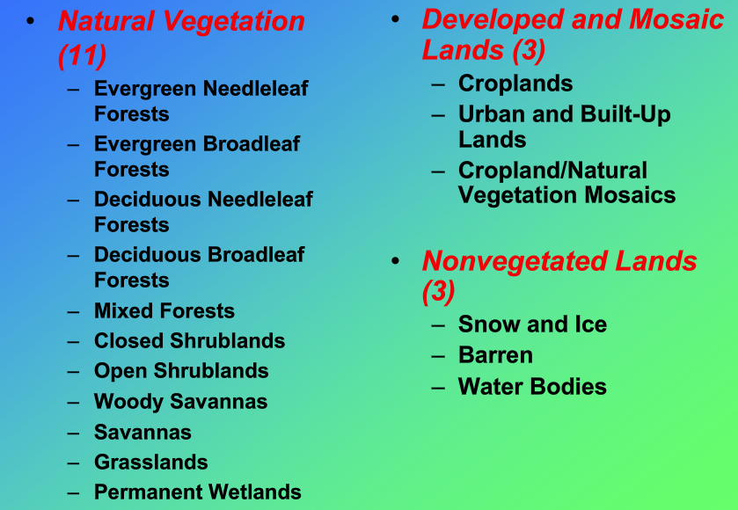
IGBP Land Cover Units (17)
International Geosphere‑Biosphere Programme

Slide 20
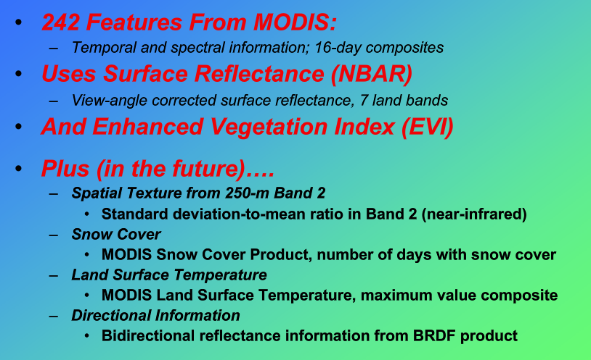
Land Cover Input Database

Slide 21
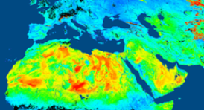
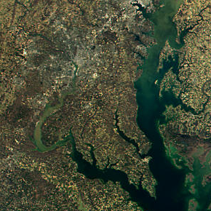
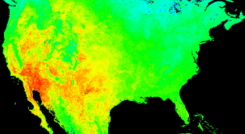
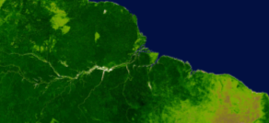
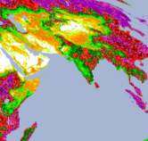
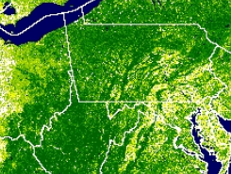
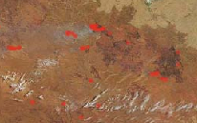
MODIS Land Products
Energy Balance Product Suite
  Surface Reflectance
  Land Surface Temperature, Emmisivity
  BRDF/Albedo
  Snow/Sea-ice Cover
Vegetation Parameters Suite
  Vegetation Indices
  LAI/FPAR
  GPP/NPP
Land Cover/Land Use Suite
  Land Cover/Vegetation Dynamics
  Vegetation Continuous Fields
  Fire and Burned Area

Slide 22
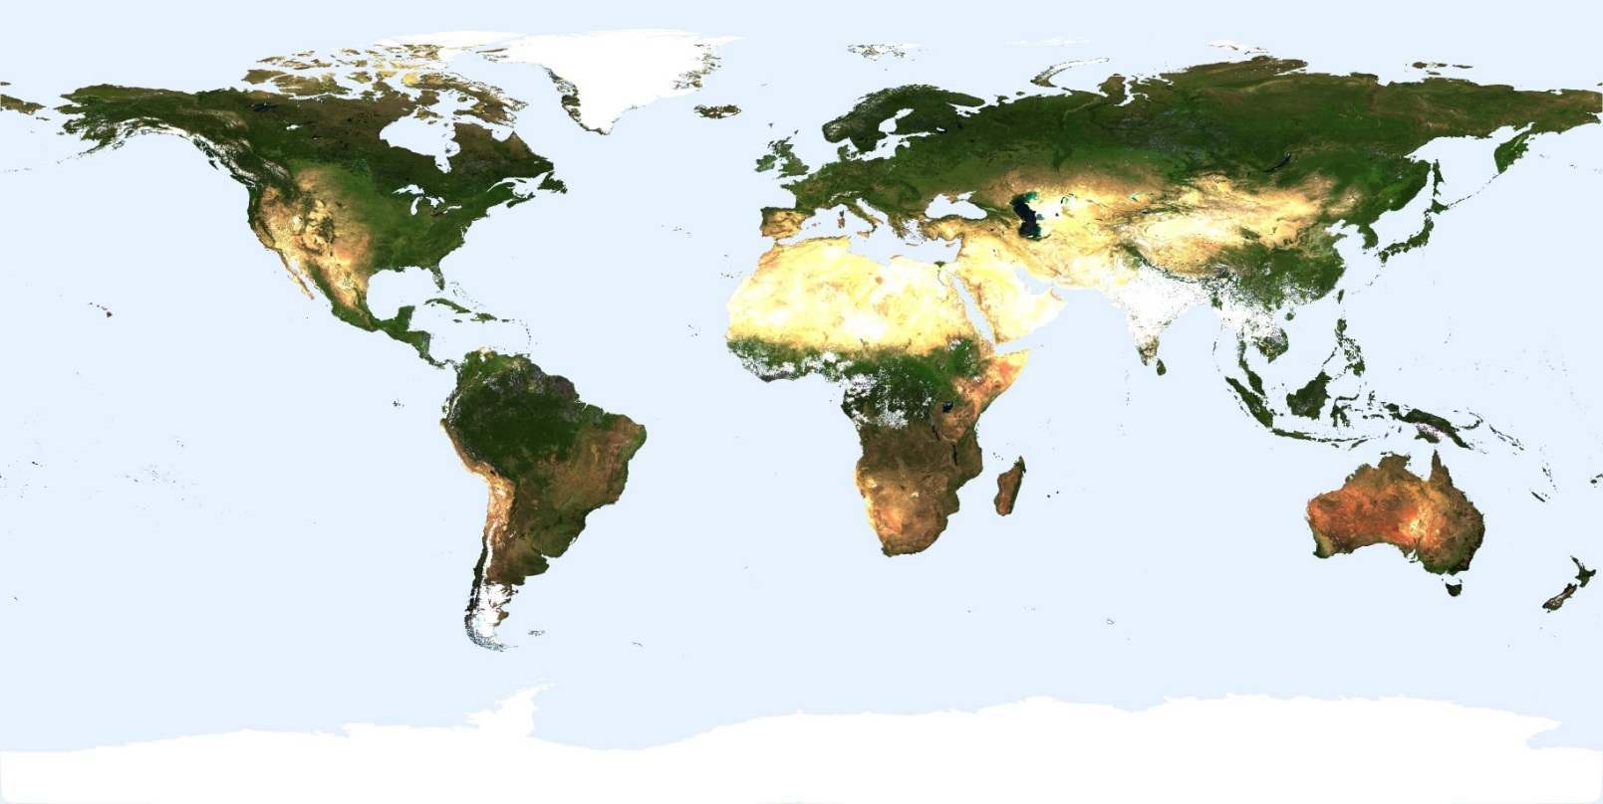
Climate modeling grid products
The land products were driven in large part by the modeling community through ATBD (Algorithm Theoretical Basis Documents) review
  At the outset most ‘land’ models were not using satellite data
Resolution: 0.05º and 0.25º degrees
Almost all products are lat/long
  sea-ice is current exception – in polar grid (snow in C5)
(from BU – NBAR CMG – days 193-208, 2001)

Slide 23
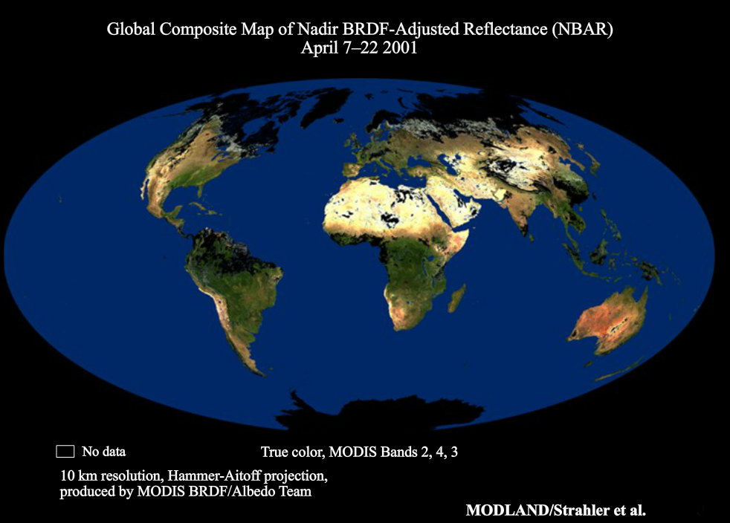
Nadir Bidirectional Reflectance Distribution Function

Slide 24
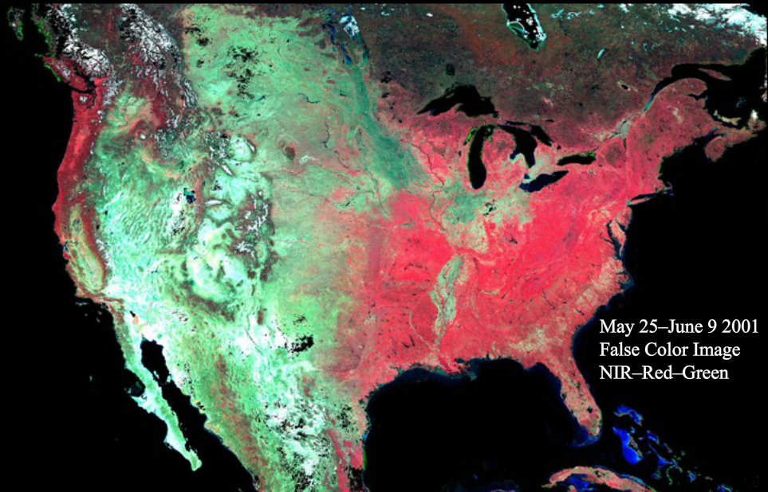
MODIS Nadir BDRF-Adjusted Reflectance

Slide 25
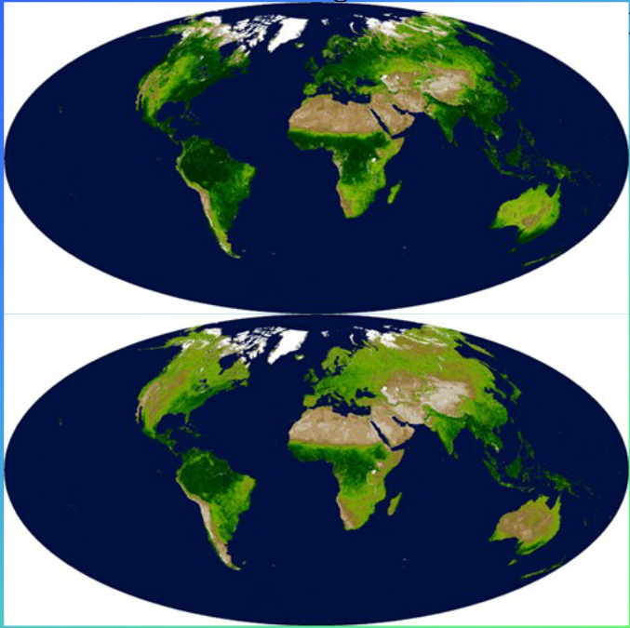
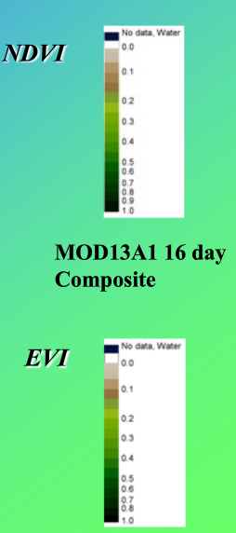
MODIS 500 m Vegetation Indicies

Slide 26
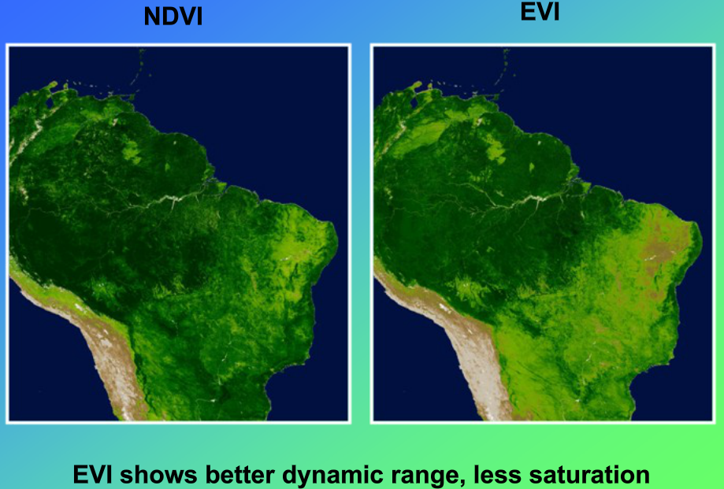

Slide 27
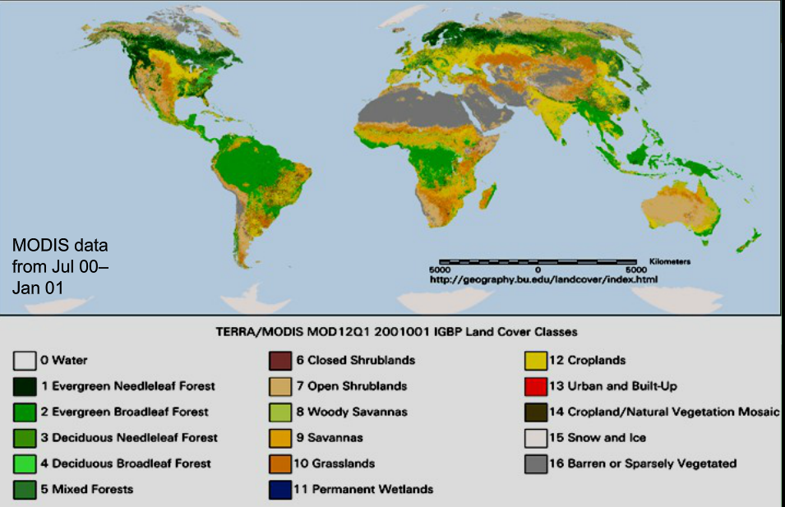
Provisional Land Cover Product

Slide 28
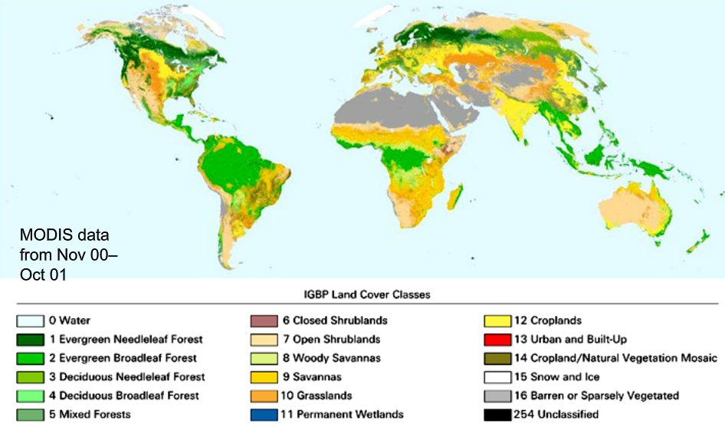
Consistent Year Land Cover Product

Slide 29
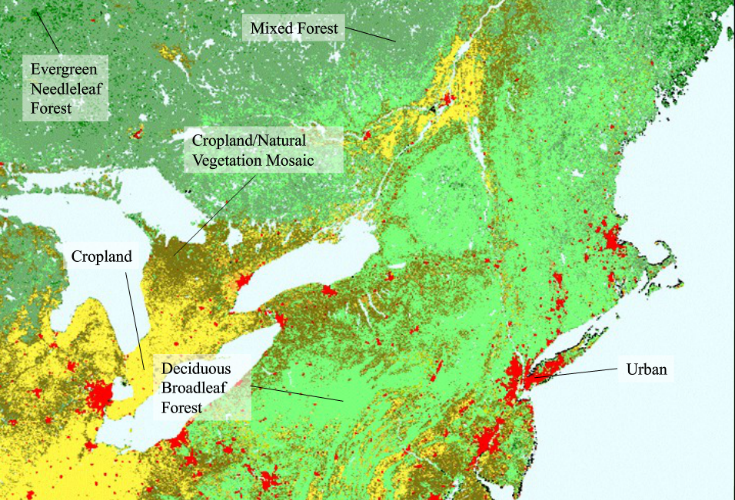
Consistent Year Land Cover Product

Slide 30
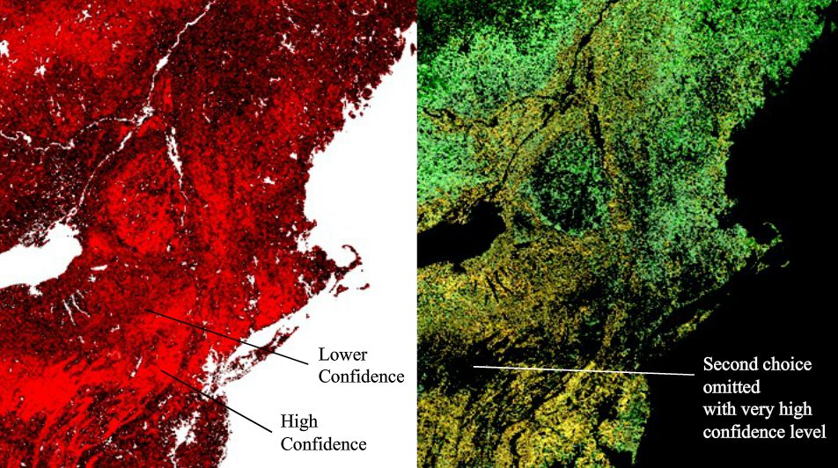
Classification Confidence Mask
Second Most-Likely Class

Slide 31
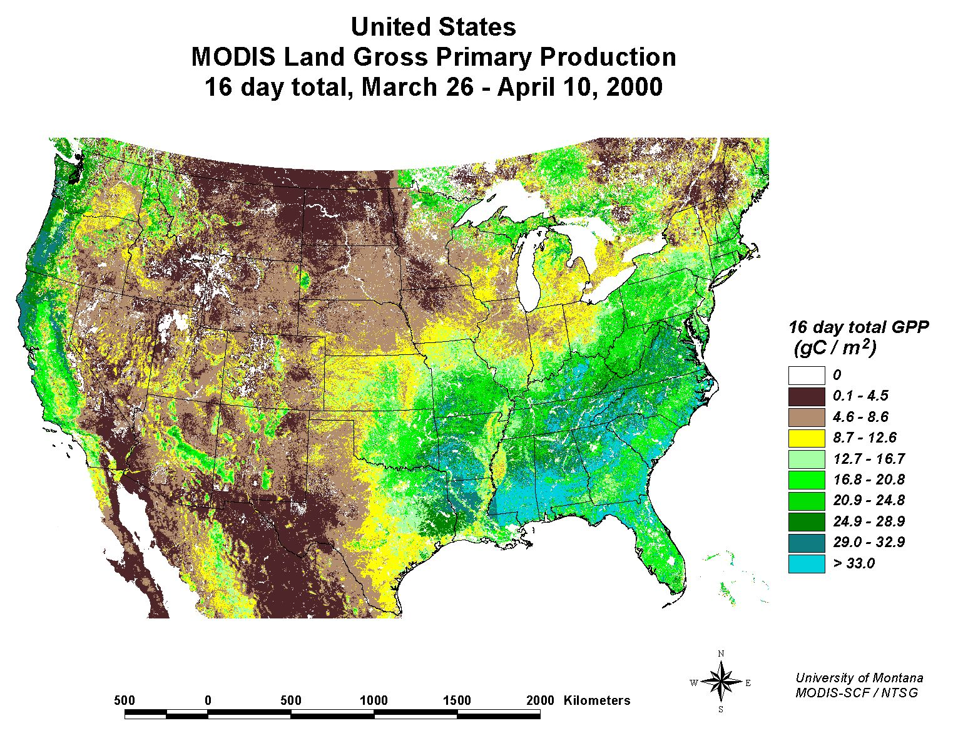

Slide 32
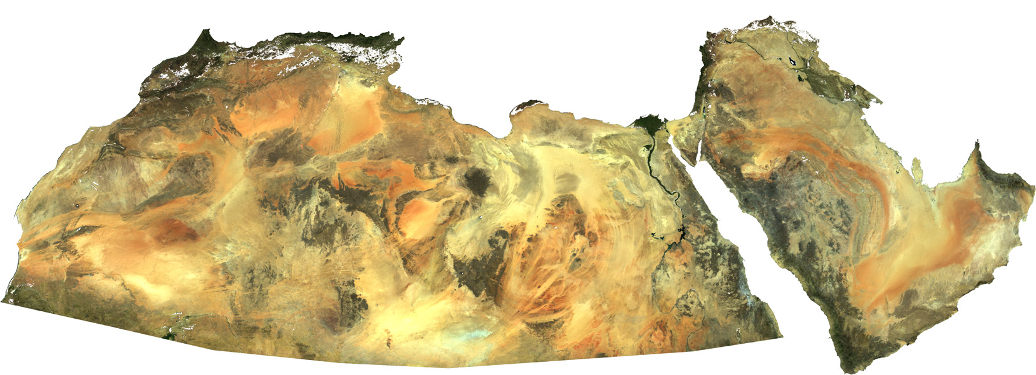
Nadir BRDF-adjusted Reflectance (NBAR) North Africa
RGB true color

Slide 33
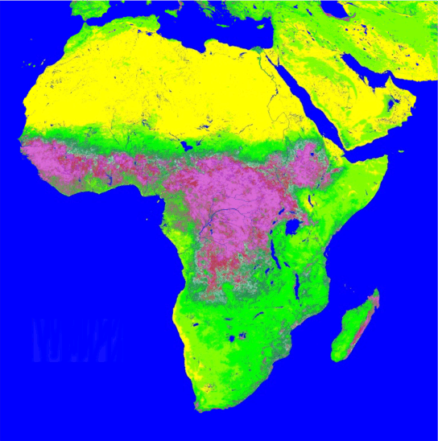
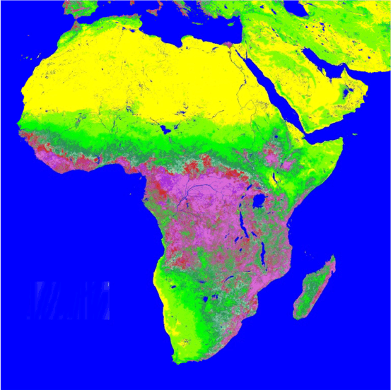
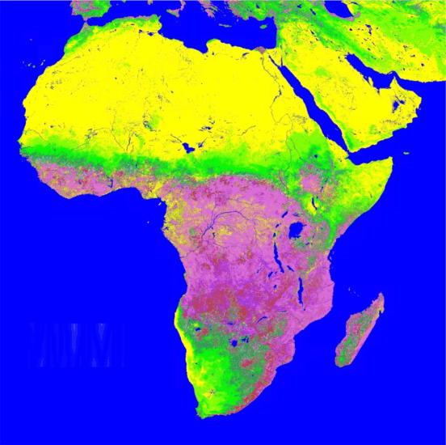
MODIS Leaf Area Index
September 2000
December 2000
Myneni et al
April 2001
0
3
6
Leaf area index is the biomass equivalent of FPAR, and is also a dimensionless ratio (m²/m²) of leaf area covering a unit of ground area.

Slide 34
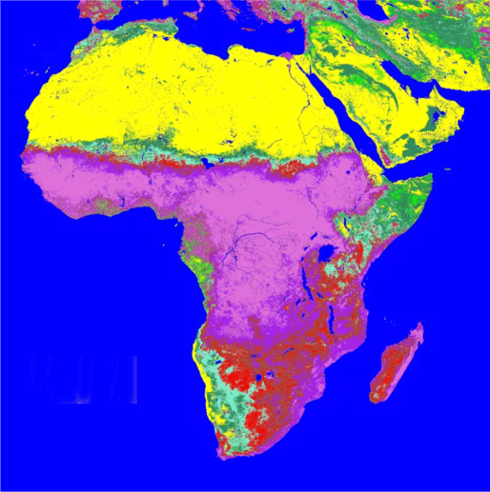
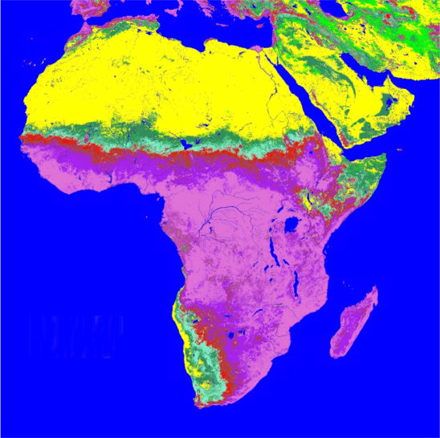
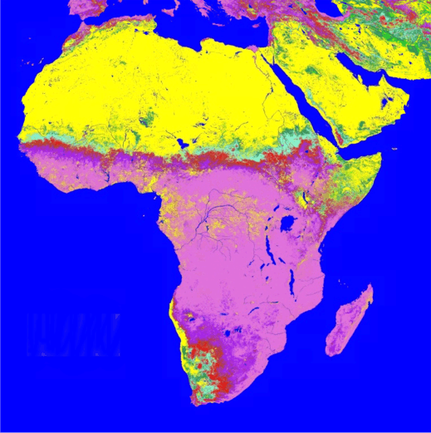
MODIS FPAR
September 2000
(Fraction of absorbed Photosynthetically Active Radiation)
December 2000
April 2001
0
0.5
0.9
is expressed as a unitless fraction of the incoming radiation received by the land surface

Slide 35
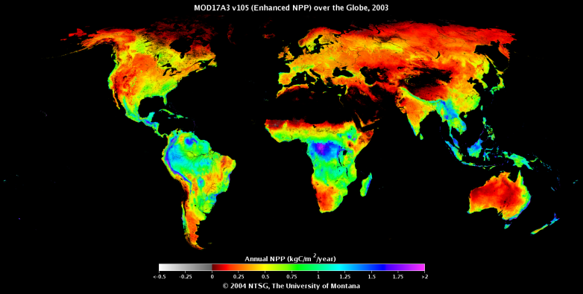



MODIS NPP = Annual GPP - Autotrophic Respiration
NPP = GPP – (R_{m}+ R_{g})
Biome
Properties
Look-Up
Table
NPP
GPP
LAI
S. Running Univ. Montana
Temperature

Slide 36

Vegetation Continuous Fields produced by year from MODIS at 250 m
Vegetation Continuous Fields Percent tree cover from MODIS year 2001.
Slide from J. Townshend, UMd
Notes:
36

Slide 37

MODIS Global Burned Area
Burned Area algorithm run globally for first time in MODIS C5 - purposefully running to map burned areas conservatively
Burned areas are characterized by deposits of charcoal and ash, removal of vegetation, and alteration of the vegetation structure (Pereira et al. 1997, Roy et al. 1999).
The MODIS algorithm used to map burned areas takes advantage of these spectral, temporal, and structural changes (Roy et al. 2005a).
It detects the approximate date of burning at 500 m by locating the occurrence of rapid changes in daily surface reflectance time series data. The algorithm maps the spatial extent of recent fires and not of fires that occurred in previous seasons or years.

Slide 38

Snow Cover Cloud-Gap Filled (CGF) Product
Notes:
The slide shows our new cloud-gap-filled (CGF) product. CI refers to the confidence index which tells the user how much confidence he or she can have in each cell's snow/no-snow decision based on how many days have elapsed since the last clear view of that cell. We are currently validating this product. Initial validation in the land information system (LIS) model shows up to 15% improvement in the bias using the CGF product as compared to using the model alone to calculate snow extent.

Slide 39

Land Climate Data Record
Multi instrument/Multi sensor Science Quality Data Records used to quantify trends and changes
81
82
83
84
85
86
87
88
89
90
91
92
93
94
95
96
97
98
99
00
01
02
03
04
05
06
07
08
09
10
11
N16
N17
N07
N09
N11
N09
N14
N16
AVHRR
VEGETATION
Terra
MODIS
Aqua
  AVHRR (GAC) 1982-1999 + 2003-2006
  MODIS (MO(Y)D09 CMG) 2000-present
  VIIRS 2011 – 2025
  SPOT VEGETATION 1999-2000
NPP
VIIRS
NPOESS
  Emphasis on data consistency – characterization rather than degrading/smoothing the data
Eric Vermote et al.

Slide 40

Fire Information for Research Managers
Active fires
Email alerts
Subsets
https://earthdata.nasa.gov/earth-observation-data/near-real-time/firms
http://modis-fire.umd.edu/pages/ActiveFire.php?target=GetData
Notes:
40

Slide 41

Active Fire Data Products:
https://earthdata.nasa.gov/earth-observation-data/near-real-time/firms/active-fire-data
https://firms.modaps.eosdis.nasa.gov/firemap/
https://earthdata.nasa.gov/worldview
https://lance-modis.eosdis.nasa.gov/cgi-bin/imagery/firemaps.cgi
Notes:
41

