Slide 1

MODIS Fire and Burned Area
MET 611 – Satellite Data Applications
Jennifer D. S. Griswold

Slide 2
Level 2 Fire Products: MOD14 (Terra) and MYD14 (Aqua)
This is the most basic fire product in which active fires and other thermal anomalies, such as volcanoes, are identified.
The Level 2 product is defined in the MODIS orbit geometry covering an area of approximately 2340 × 2030 km in the along-scan and along-track directions, respectively.
It is used to generate all of the higher-level fire products, and contains the following components:

Slide 3
Level 2 Product
An active fire mask that flags fires and other relevant pixels (e.g. cloud)
A pixel-level quality assurance (QA) image that includes 19 bits of QA information about each pixel
A fire-pixel table which provides 19 separate pieces of radiometric and internal-algorithm information about each fire pixel detected within a granule
Extensive mandatory and product-specific metadata
A grid-related data layer to simplify production of the Climate Modeling Grid (CMG) fire product (later)

Slide 4
Level 2 MOD14 Input
MOD021KM
  Bands 1,2,7,21,22,31,32
MOD03
Based upon the Temperature Sensitivity difference between 4 and 11 microns
Contextual Fire Detection Algorithm
  Infrared static Brightness Temperature thresholds
  Dynamic thresholds compare pixel to surrounding background
Variety of output product temporal and spatial resolutions

Slide 5
Level 2 Product
Product-specific metadata within the Level 2 fire product includes the following, occurring within a granule to simplify identification of granules containing fire activity:
fire_mask (8 bit unsigned integer)
  0 missing input data
  3 water
  4 cloud
  5 non-fire
  6 unknown
  7 fire (low confidence)
  8 fire (nominal confidence)
  9 fire (high confidence)
Line and element of fire pixel
Latitude and longitude of fire pixel
Fire pixel confidence (one value for each fire detected per scene)

Slide 6
Detection Confidence
A detection confidence intended to help users gauge the quality of individual fire pixels is included in the Level 2 fire product.
  This confidence estimate, which ranges between 0% and 100%, is used to assign one of the three fire classes to all fire pixels within the fire mask:
  low-confidence fire
  nominal-confidence fire
  high-confidence fire

Slide 7
Output Products
Product | Level | Temporal Resolution | Spatial Resolution
MOD14 | 2 | 5 minute granules | 1 km
MOD14GD MOD14GN | 2G | 5 minute tiles | 1 km
MOD14A1 | 3 | Daily | 1 km Sinusoidal Grid
MOD14A2 | 3 | 8 Day | 1 km Sinusoidal Grid
Global Daily Browse Product
Rapid Response Product ~ 4 hours behind real time
  Goal: To provide rapid access to MODIS data globally

Slide 8
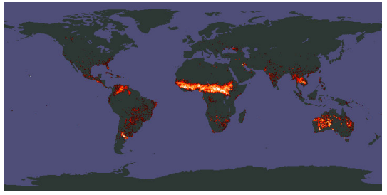
Climate Modeling Grid Fire Products (MOD14CMH, MYD14CMH, etc.)
The CMG fire products are gridded statistical summaries of fire pixel information intended for use in regional and global modeling.
The products are currently generated at 0.5◦ spatial resolution for time periods of one calendar month (MOD14CMH and MYD14CMH) and eight days (MOD14C8H and MYD14C8H).
Higher resolution 0.25◦ CMG fire products will eventually be produced as well. An example of the corrected fire pixel count layer of the product is shown above.

Slide 9
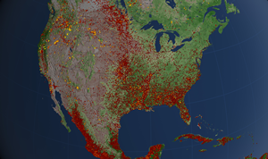
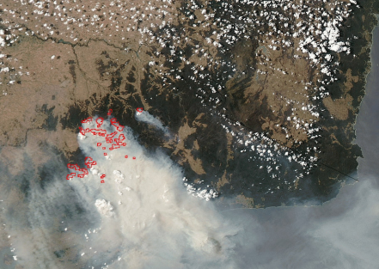
Global Monthly Fire Location Product (MCD14ML)
For some applications it is necessary to have the geographic coordinates of individual fire pixels.
Collection 5 includes the global monthly fire location product (MCD14ML), which contains this information for all Terra and Aqua MODIS fire pixels in a single monthly ASCII file.

Slide 10
Algorithm Description
MODIS bands 21 and 22 (3.99 micron)
  Band 22 saturates at 331 K
  Band 21 “fire channel” saturates at ~ 500 K
    12 bit range broader – less sensitive
    The calibration of B21 uses fixed calibration coefficients and not using the scan-by-scan onboard black body
MODIS band 31 (11 micron)
  Saturates at ~ 400 K for Terra
  Saturates at ~ 340 K for Aqua
Potential Fire Pixel identified
  BT4 > 310 K
  BT4-11 > 10 K
  .86 μm reflectance < .3

Slide 11
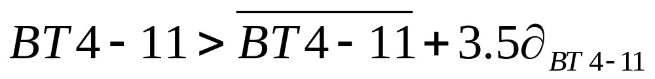
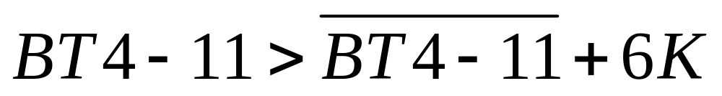
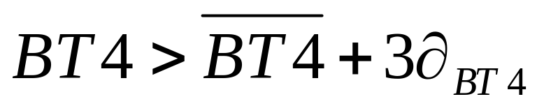
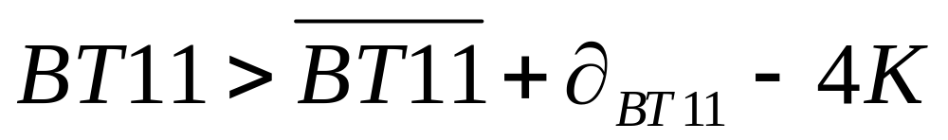
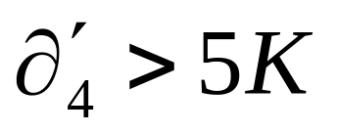
Screening Potential Fire Pixels
(1) BT4 > 360 K
Contextual Tests: Performed on as many as 21 x 21 box surrounding potential fire pixel to separate out from background
(2)
(3)
(4)
(5)
(6)

Slide 12
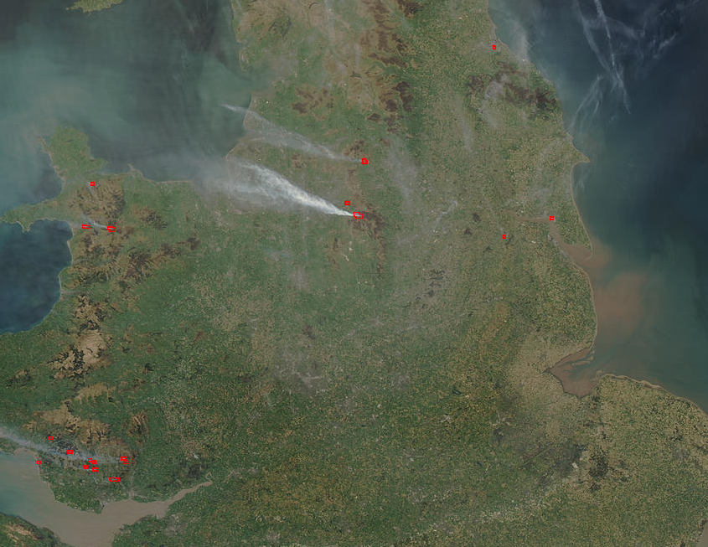
Algorithm Description (cont.)
Aqua MODIS true color image 18 April 2003 12:45 UTC

Slide 13
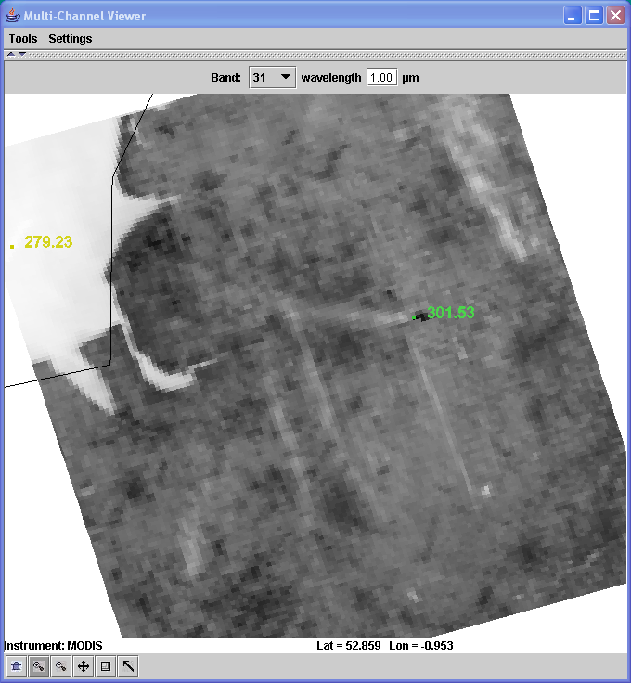
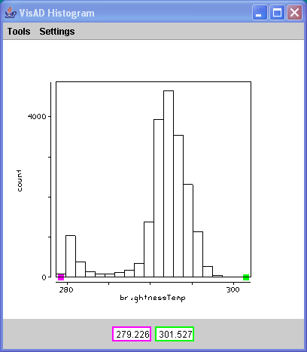
Algorithm Description (cont.)

Slide 14
Problem Areas
Lots of fires – hard to get representative background temperature
Sunglint – Affects 4 micron band radiance
Transition areas – contextual tests pick up boundary
Coastal areas – need really good geolocation so no mixed pixels are included
Clouds – BT4-11 large over water and thick ice cloud

Slide 15
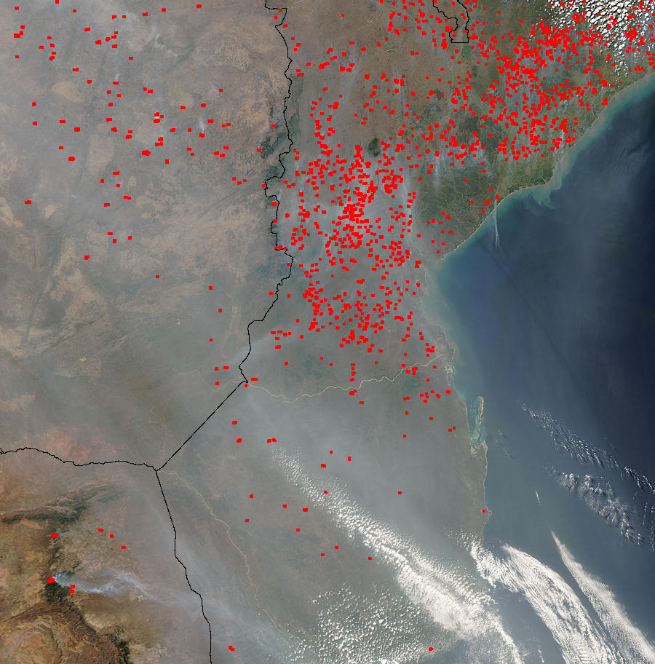

Slide 16
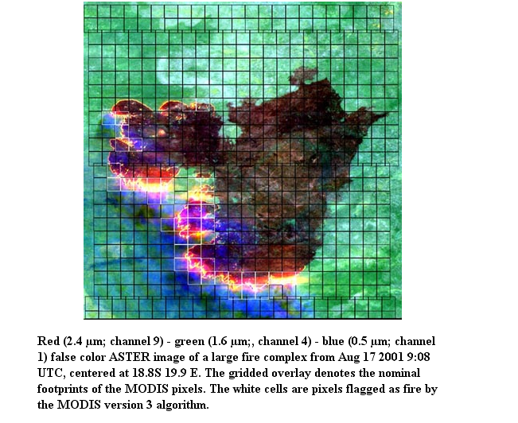

Slide 17
Caveats and Known Problems
Fire Pixel Locations vs. Gridded Fire Product
  Use caution in using fire pixel locations in lieu of the 1-km gridded MODIS fire products.
    The former includes no information about cloud cover or missing data and, depending on the sort of analysis that is being performed, it is sometimes possible to derive misleading (or even incorrect) results by not accounting for these other types of pixels.
    It is also possible to grossly misuse fire pixel locations, even for regions and time periods in which cloud cover and missing observations are negligible.

Slide 18
Caveats and Known Problems
    Some caveats to keep in mind when using MODIS fire pixel locations:
  The fire pixel location files allow users to temporally and spatially bin fire counts arbitrarily.
    Severe temporal and spatial biases may arise in any MODIS fire time series analysis employing time intervals shorter than about eight days.
    Known fires for which no entries occur in the fire-pixel location files are not necessarily missed by the detection algorithm.
    Cloud obscuration, a lack of coverage, or a misclassification in the land/sea mask may instead be responsible, but with only the information provided in the fire location files this will be impossible to determine.

Slide 19
Known Problems
Pre-November 2000 Data Quality
  Prior to November 2000, the Terra MODIS instrument suffered from several hardware problems that adversely affected all of the MODIS fire products.
  Some detectors were rendered dead or otherwise unusable in an effort to reduce unexpected crosstalk between many of the 500 m and 1 km bands.
  The dead detectors are known to introduce at least three specific artifacts in the pre-November 2000 fire products:
    striping
    undetected small fires
    undetected large fires.
  In some very rare instances severe miscalibration of band-21 in the first weeks of the MODIS data archive (February and March 2000) will cause entire scan lines to be identified as fire.

Slide 20
Known Problems
Detection Confidence
  intended to help users gauge the quality of individual fire pixels is included in the Level 2 fire product.
    This confidence estimate, which ranges between 0% and 100%, is used to assign one of the three fire classes to all fire pixels within the fire mask:
      low-confidence fire
      nominal-confidence fire
      high-confidence fire
  C4 fire product this confidence estimate did not adequately identify highly questionable, low confidence fire pixels.
    Such pixels, which by design should have a confidence close to 0%, were too often assigned much higher confidence estimates of 50% or higher.
  C5 code partially mitigated this problem, some highly questionable fire pixels are still classified as nominal-confidence fires.
  A more substantial adjustment that fully corrects this problem has been implemented in the C6 algorithm.

Slide 21
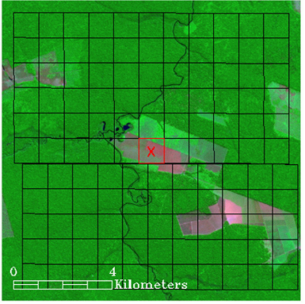
Known Problems
False Alarms in Small Forest Clearing
Small clearings within rainforest were a source of persistent false alarms in the Amazon.
Efforts were made to reduce the frequency of this type of false alarm for Collection 6.

Slide 22
Fire FAQ
What is the smallest fire size that can be detected with MODIS? What about the largest?
  MODIS can routinely detect both flaming and smoldering fires ∼1000 m² in size.
  Under very good observing conditions (e.g. near nadir, little or no smoke, relatively homogeneous land surface, etc.) flaming fires one tenth this size can be detected.
  Under pristine (and extremely rare) observing conditions even smaller flaming fires ∼50 m² can be detected.
  Unlike most contextual fire detection algorithms designed for satellite sensors that were never intended for fire monitoring (e.g. AVHRR, VIRS, ATSR), there is no upper limit to the largest and/or hottest fire that can be detected with MODIS.

Slide 23
Fire FAQ
Why didn’t MODIS detect a particular fire?
  This can happen for any number of reasons.
  The fire may have started and ended in between satellite overpasses.
  The fire may be too small or too cool to be detected in the 1 km² MODIS footprint.
  Cloud cover, heavy smoke, or tree canopy may completely obscure a fire.
  Occasionally the MODIS instruments are inoperable for extended periods of time (e.g. the Terra MODIS in September 2000) and can of course observe nothing during these times.

Slide 24
Fire FAQ
I don’t want to bother with strange file formats and/or an unfamiliar ordering interface and/or very large data files. Can’t you just give me the locations of fire pixels in plain ASCII files and I’ll bin them myself?
  You can use the MCD14ML monthly fire location product, or obtain MODIS fire pixel locations via the Web Fire Mapper, but this doesn’t necessarily mean that fire pixel locations are the most appropriate source of fire-related information.
  The fire pixel location files include no information about cloud cover or missing data, and depending on the sort of analysis you are performing, it is sometimes possible to derive misleading (or even incorrect) results by effectively ignoring these other types of pixels.
  In many cases it is more appropriate to use one of the 1-km Level 3 or CMG fire products.

Slide 25
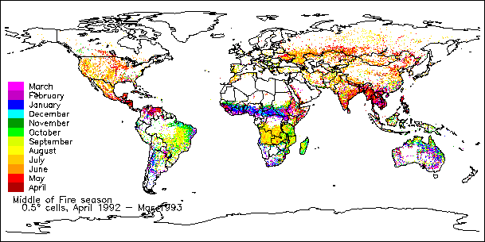
Why Map Burned Area?
Vegetation burning is a global scale phenomena
Global change research
  estimates of trace gas and particulate emissions for climate modeling:
    Biomass burned (g) = burned are (m²) * fuel load (g/m²) * completeness of combustion.
Dwyer et al., 1999, J. of Biogeography

Slide 26
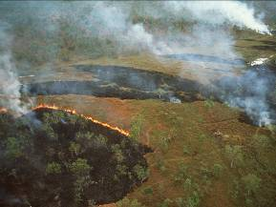
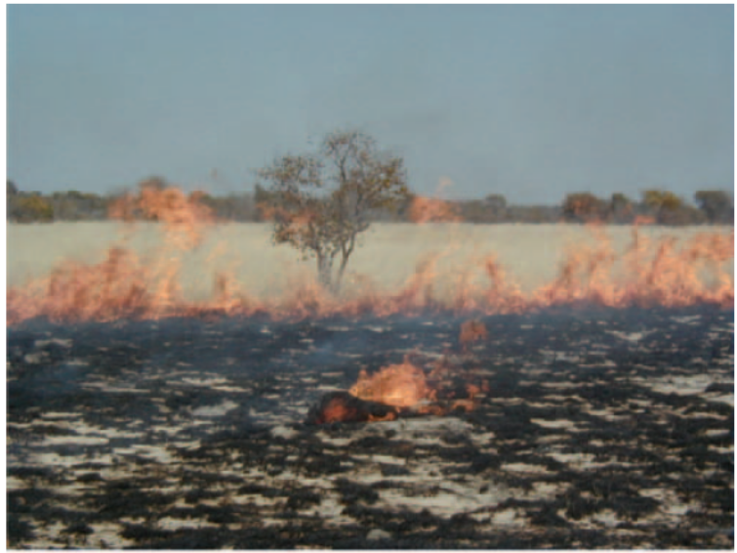
Burned Areas
Characterized by
  The removal of vegetation and change of its structure
  deposits of charcoal and ash on surface
  exposure of the soil layer

Slide 27
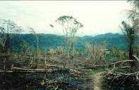
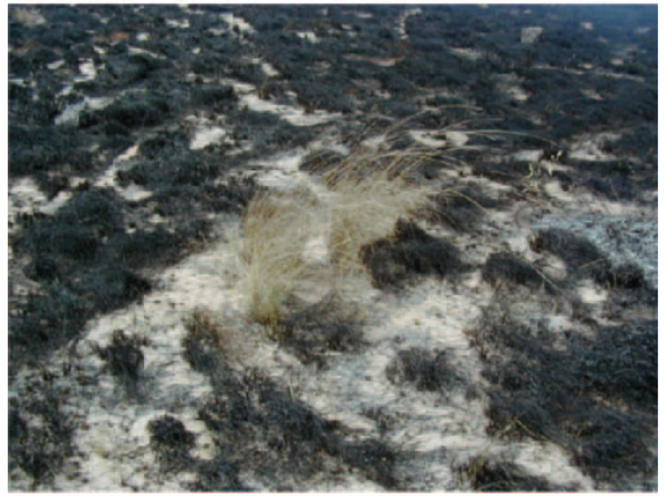
Burned Areas
Vary temporally and spatially due to
  The type of vegetation that burns( land=cover)
  The completeness of the combustion process
  The rate of charcoal and ash dissipation by wind/rain
  The post fire evolution and re-vegetation of the burned area

Slide 28
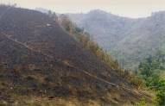
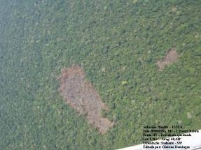
Burned Areas
Remote sensing (MODIS): Key monitoring tool due to:
  The usually large extent of the area affected by fire
  The very dynamic nature of the processes
  The low accessibility of many fire regions

Slide 29
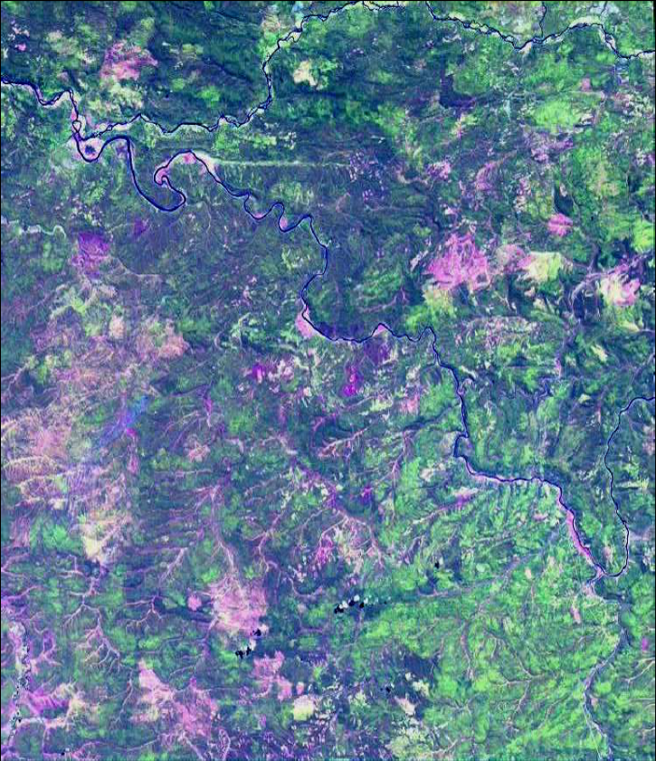
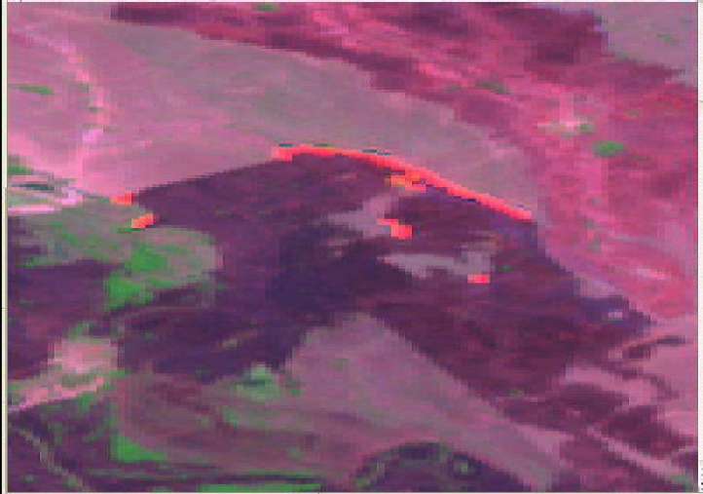
When to Detect Burned Areas
Remote sensing of burned areas in tropical regions should be performed during the fire season
Recently burned area and attenuated signal, just a few days old, in the Colombian savanna.
Scars of variable ages in the Siberian boreal forest.

Slide 30
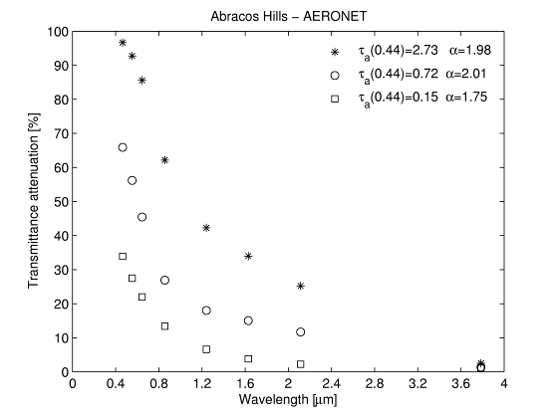


During the dry season, in an atmosphere contaminated by smoke (*)….
the VIS channels will be useless for Earth surface observation
the SWIR region will also be very attenuated.
the MIR domain is practically not
affected by smoke, allowing for an unperturbed surface observation
Angstrom parameter, characterizes aerosol particle size distribution.
Aerosol optical depth at 0.44 m, measures the attenuation of radiation propagating through the atmosphere.
Retrieving middle-infrared reflectance for burned area mapping in tropical environments using MODIS. Libonati, R.; DaCamara, C.C.; Pereira, J.M.C.; Peres, L.F. Remote Sensing of Environment vol. 114 issue 4 April 15, 2010. p. 831-843

Slide 31
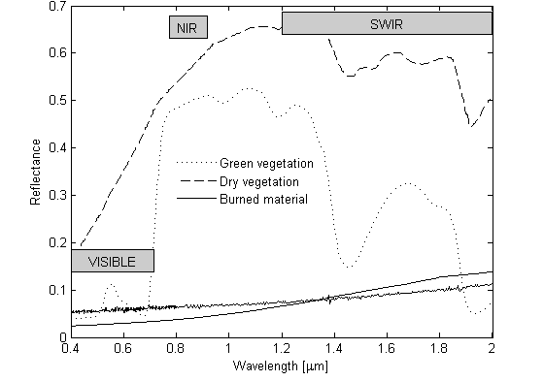
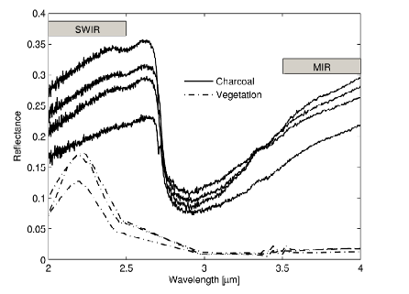
Why MIR/NIR domain?
In VIS, charcoal is mixed up with dense dark vegetation, water, dark soils, wetlands, cloud and terrain shadows.
Similar problems occur in the SWIR region, especially at 2.0-2.5 um.
The MIR/NIR is, unquestionably, the best bi-spectral region to discriminate between burned areas and other types of surfaces
Retrieving middle-infrared reflectance for burned area mapping in tropical environments using MODIS. Libonati, R.; DaCamara, C.C.; Pereira, J.M.C.; Peres, L.F. Remote Sensing of Environment vol. 114 issue 4 April 15, 2010. p. 831-843

Slide 32
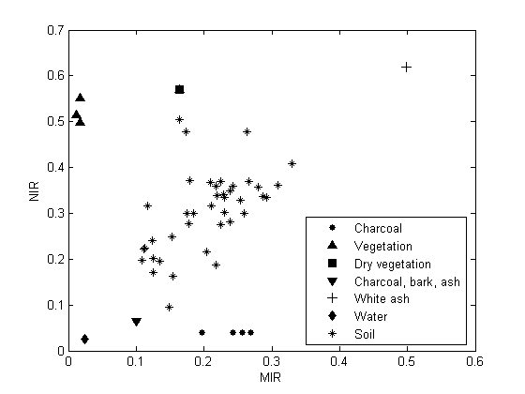
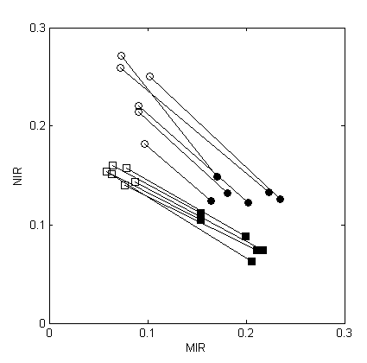
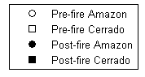
Development of a new index
Laboratory measurements
MODIS pixels
Pre-fire
Post-fire
Different materials/surfaces tend to form clusters on the MIR/NIR space
There is an overall displacement along the diagonal of the graph, from vegetation, down to burned materials across the soil surfaces.
On a new coordinate system for improved discrimination of vegetation and burned areas using MIR/NIR information. Libonati, R.; DaCamara, C.C.; Pereira, J.M.C.; Peres, L.F. Remote Sensing of Environment vol. 115 issue 6 June 15, 2011. p. 1464-1477

Slide 33

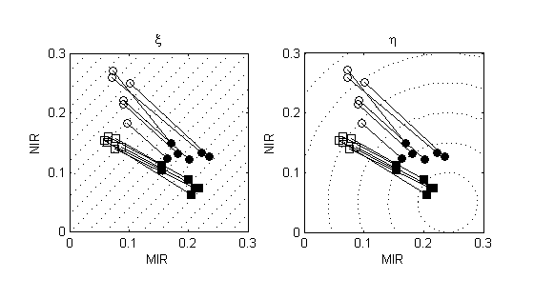


Towards an optimal index
(Martín, 1998)
(Pereira, 1999)
Verstraete and Pinty (1996): the more perpendicular a displacement vector is to the contour lines of a given index, the better the sensitivity of the index to the observed change at the surface.
It seems that η is especially sensitive to burning events in the Amazon forest, whereas ξ is more appropriated in Cerrado.
On a new coordinate system for improved discrimination of vegetation and burned areas using MIR/NIR information. Libonati, R.; DaCamara, C.C.; Pereira, J.M.C.; Peres, L.F. Remote Sensing of Environment vol. 115 issue 6 June 15, 2011. p. 1464-1477

Slide 34
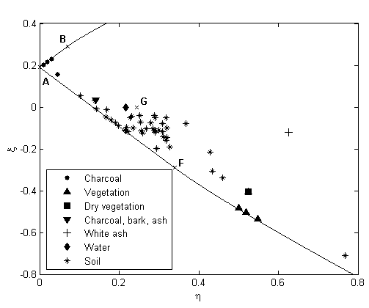
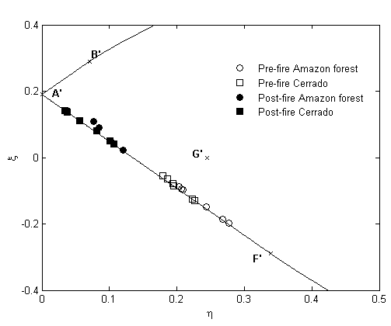
Development of a new space
Natural constrain in η/ξ space
Surfaces related to vegetation (green, dry, mixture, burned) tend to align
Other kind surfaces are dispersed inside this limits
On the order hand, the surfaces related to vegetation seems to be aligned accordingly to water content.
On a new coordinate system for improved discrimination of vegetation and burned areas using MIR/NIR information. Libonati, R.; DaCamara, C.C.; Pereira, J.M.C.; Peres, L.F. Remote Sensing of Environment vol. 115 issue 6 June 15, 2011. p. 1464-1477

Slide 35
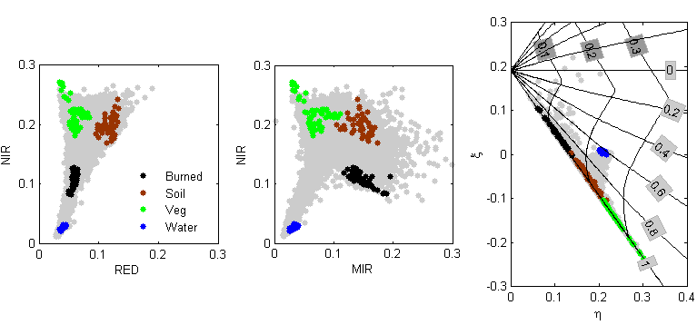
Development of a new index
V
W
V – WATER AND CLOUD MASK
W – BURNED/UNBURNED

Slide 36
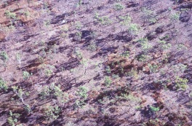
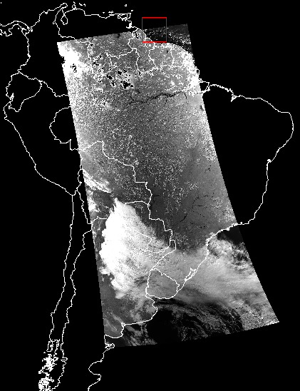
Algorithm – Burned Area
https://lpdaac.usgs.gov/products/modis_products_table/mcd45a1
MCD45A1
  monthly Level-3 gridded 500m
  burning and quality information on a per-pixel basis.
  Available for Terra and Aqua MODIS
    Based on derived daily surface reflectance inputs
Algorithm analyzes:
  daily surface reflectance dynamics to locate rapid changes
  uses that information to detect the approximate date of burning
  maps only the spatial extent of recent fires

Slide 37
Algorithm – Burned Area
MCD45A1 - Algorithm
  Varied quality assessment information and a single summary quality assessment score for each pixel.
  Improves on previous methods by using a bidirectional reflectance distribution function (BRDF) model-based change detection approach to handle angular variations in the data.
  Uses a statistical measure to identify change probability from a previously observed state.

Slide 38
Algorithm – Burned Area
MCD45A1 - Algorithm
  The monthly MCD45A1 product is based on three months of atmospherically- and geometrically-corrected, cloud-screened daily reflectance data.
  Based on Multi-temporal thresholds applied to a spectral index specifically designed to burnt area identification, namely, V, W index (Libonati et al. 2011)
  Based on MIR (3.9 um) and NIR (0.8 um) reflectances – (V,W burned index)

Slide 39
Product Format
The product is produced in the standard MODIS Land tile format in the sinusoidal projection (Wolfe et al. 1998).
Each tile has fixed earth-location, covering approximately 1200 x 1200 km (10° x 10° at the equator).
The product is distributed in the standard Hierarchical Data Format, and includes the following data layers, defining for each 500m pixel:

Slide 40
Product Format
Burndate: Approximate Julian day of burning from eight days before the beginning of the month to eight days after the end of the month, or a code indicating unburned, snow, water, or insufficient data to make a decision.
Burn quality assessment: Confidence of the detection; 1 (most confident) to 4 (least confident).
Number of Passes: Number of MODIS observations where the temporal consistency test is passed.
Number Used: Number of MODIS observations used in the temporal consistency test.

Slide 41
Product Format
Direction: Direction in time in which burning was detected (forward, backward or both).
Surface Type: Information describing the land and atmospheric properties (e.g. water, snow, high aerosol, high view and solar zenith angles).
Gap Range 1 and 2: Information describing the two largest numbers of consecutive missing/cloudy days (if any) in the time series and their start day.

Slide 42
Detection Algorithm
Daily Reflectances (MIR/NIR)
Daily
(V,W) indexes
Cloud Mask, Solar/view
angles masks
Temporal composities
Fixed thresholds
Contextual thresholds
Hotspot information
Burned area map

Slide 43
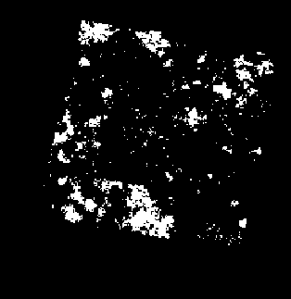
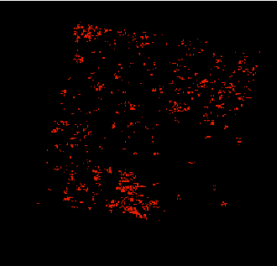
Comparison – hotspots locations
Burned area map
MODIS hotspots
MODIS hotspots

Slide 44

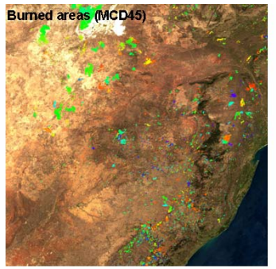
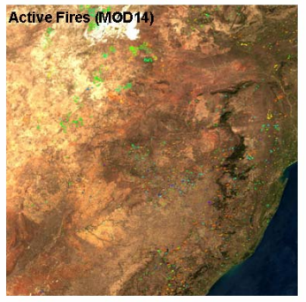
Example Product
Comparison between MODIS 500m Burned Areas (left) and cumulative 1km day and night MODIS active fires (right) for August 2001 over the 1200x1220km MODIS land tile h20v11 (Southern Africa).
The approximate day of burning is overlain on MODIS surface reflectance to provide geographic context.

