Slide 1

MODIS Ocean Products Introduction
(SST, Ocean Color and Chlorophyll)
MET 611 – Satellite Data Applications
Jennifer D. S. Griswold

Slide 2
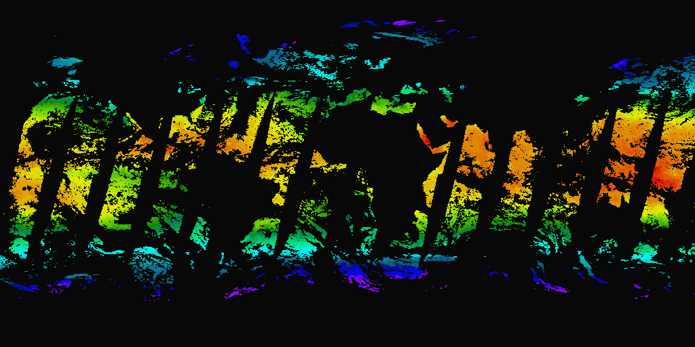
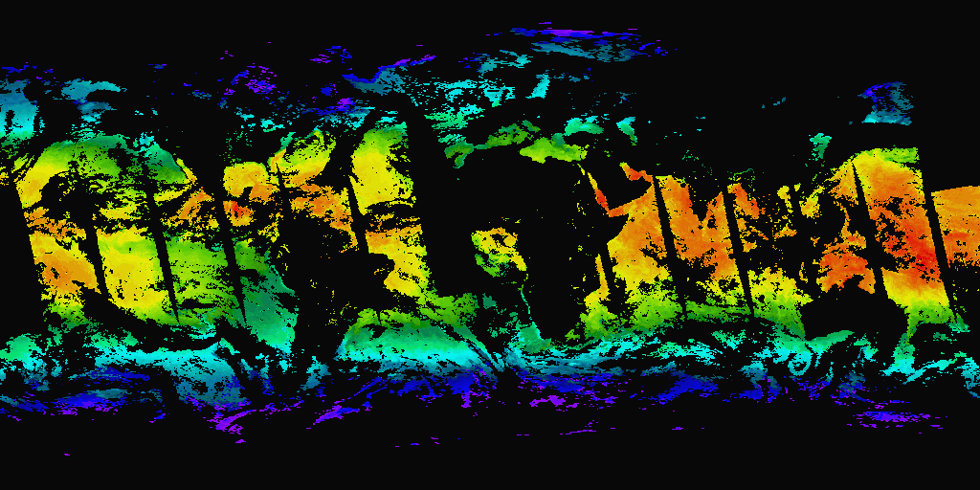
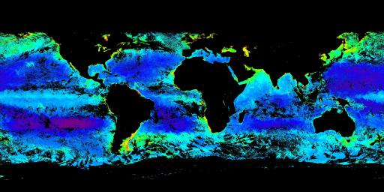
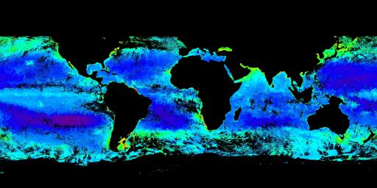
MODIS Instrument Considerations
MODIS Ocean Product algorithms are based on heritage instruments.
AVHRR Pathfinder SST Nov 1, 2000-306 Night (24 hours) MODIS Thermal SST
SeaWiFS Chl-Oc4v4 Nov 1, 2000 Weekly Composite MODIS Chl-MODIS

Slide 3
MODIS Comparison to AVHRR, SeaWiFS
12 bit digitization vs 10 bit → improved precision
Lower noise detectors → subtle features better resolved
Global 1 km data stream vs 4km → larger data sets but spatial features better resolved
Additional spectral channels → improved and additional product algorithms, better quality determination
Equatorial crossing time → significant impact on atmospheric correction
Shared calibration sources:
  Optical - MOBY buoy
  Infrared - MAERI interferometer, buoys

Slide 4
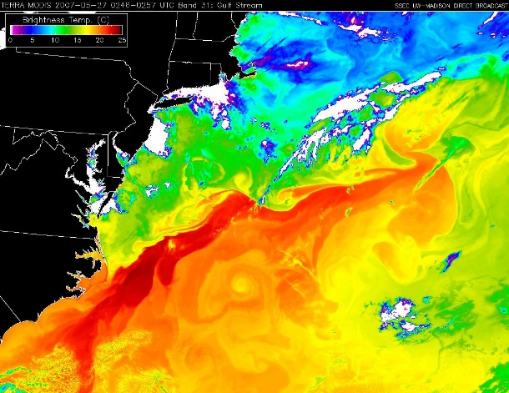
Why does MODIS oceans have so many files and why is everything so BIG!
1 km global resolution every day
Many more products
Meeting the needs of a diverse user community (pleasing all the people all the time)
  Pretty pictures/quick looks; Medium quality, low resolution
  Tracking fronts and features; all pixels, high resolution
  High quality climate data; High quality, medium resolution
  Modelers; high quality, various projections not maps
  Algorithm developers; underlying raw values

Slide 5
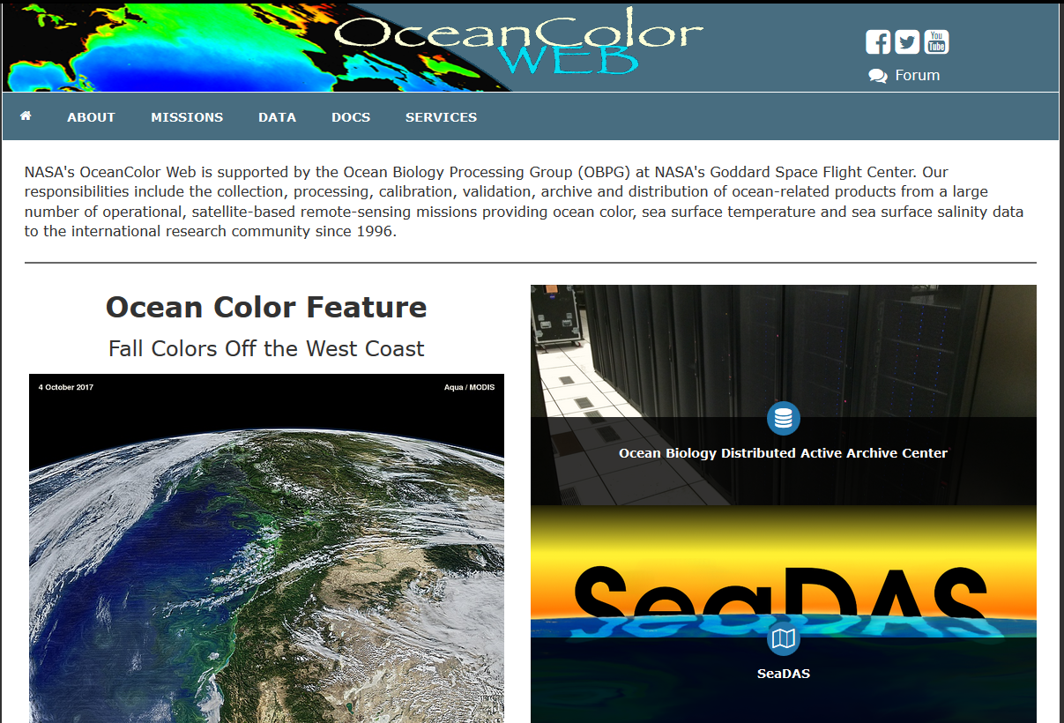
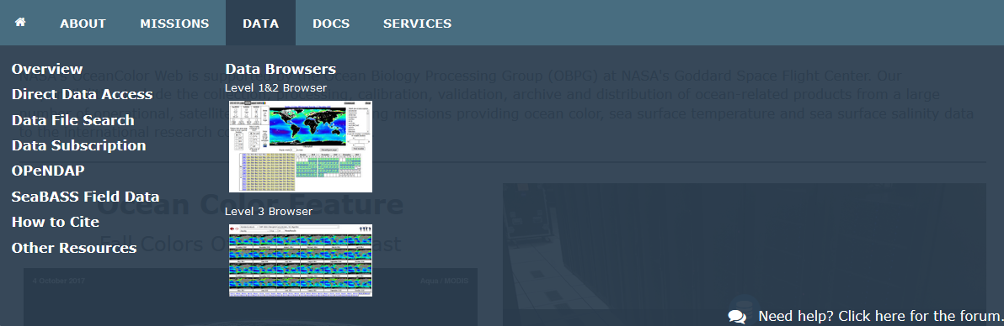
Where to get data and more information
https://oceancolor.gsfc.nasa.gov/

Slide 6
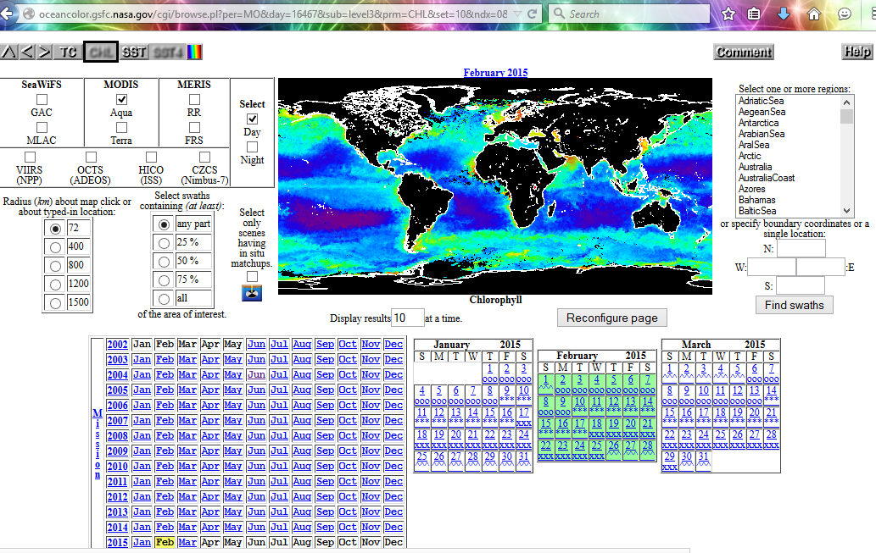
L1 and L2 Browser

Slide 7
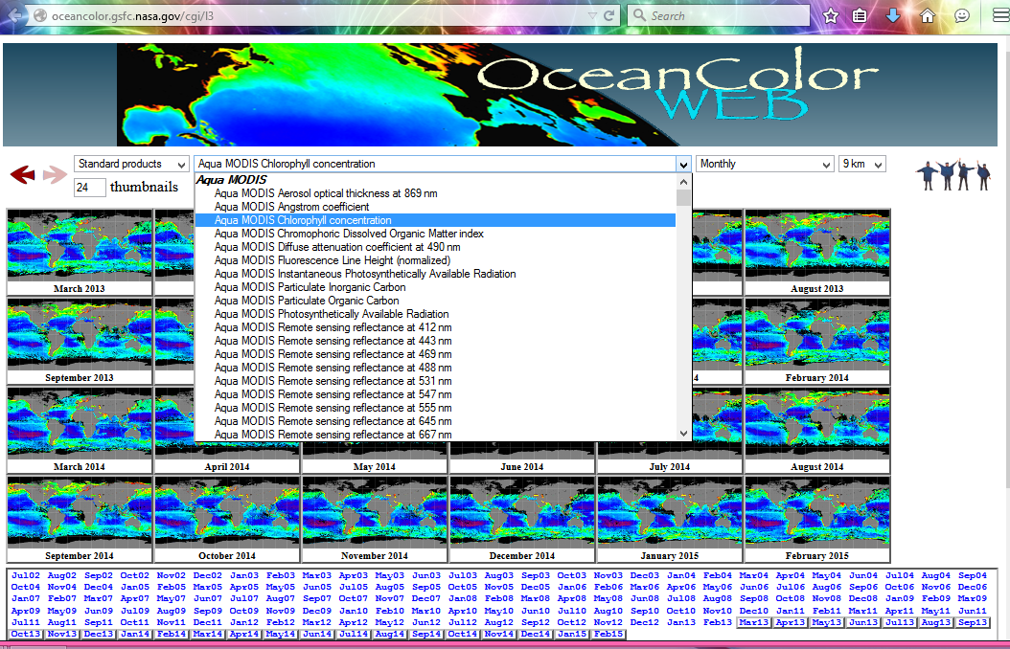
L3 Browser

Slide 8
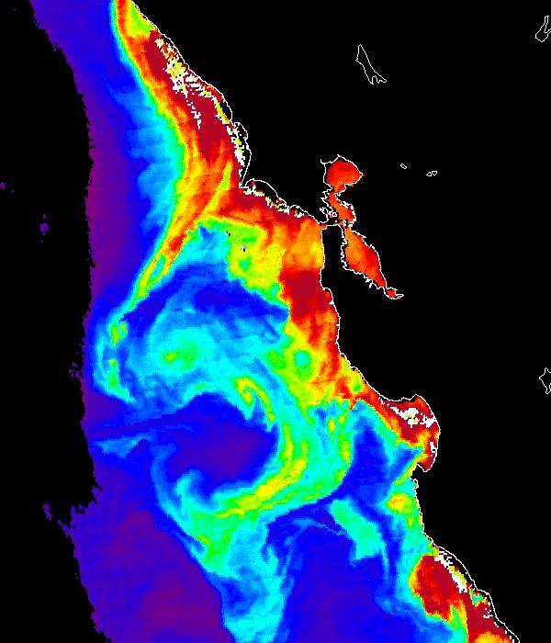
MODIS Ocean Products
MODIS Instruments:
  Terra (1030 morning), MO*
  Aqua (1330 afternoon) MY*
Resolution:
  Spatial:
    Level 2 – 1 km swath , ~2030 km x 1354 km
    Level 3 – 4 km, 36km, 1 deg [all products are global]
  Temporal Resolution:
    Level 2 - 5 minute granule;
    Level 3 - daily, 8 day week, monthly, yearly
Other data sets:
- SST matchups database (kkilpatrick@rsmas.miami.edu)
- ocean color diagnostic data sites

Slide 9
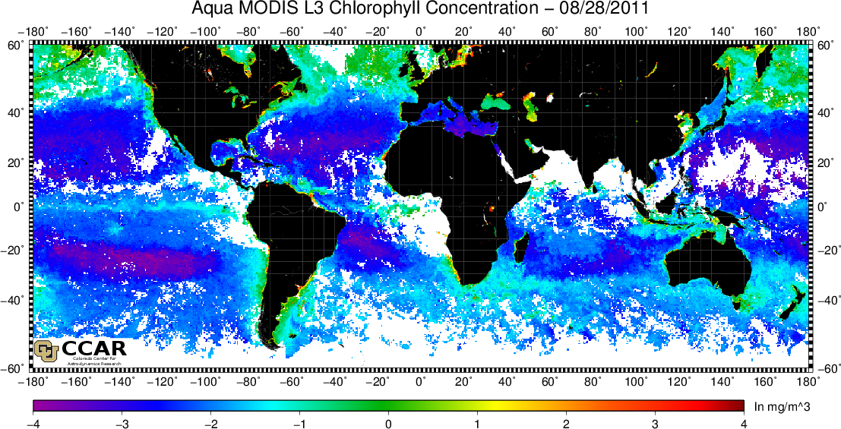
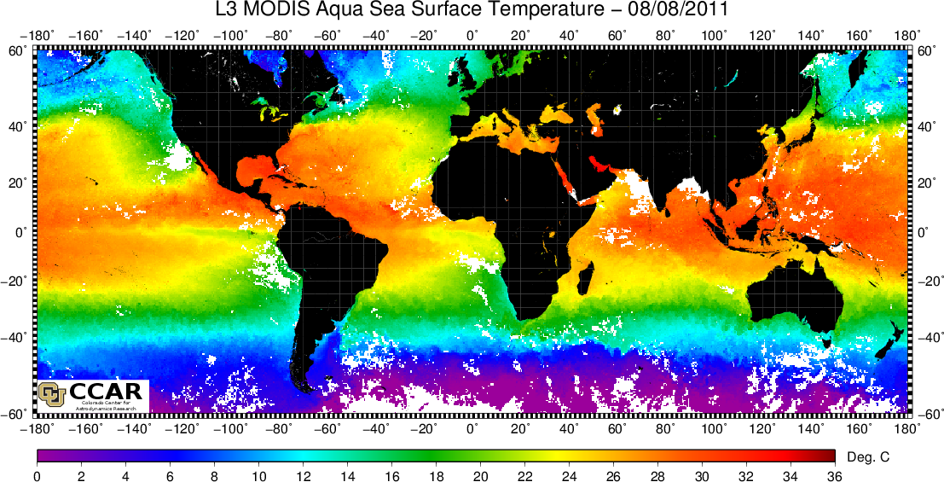
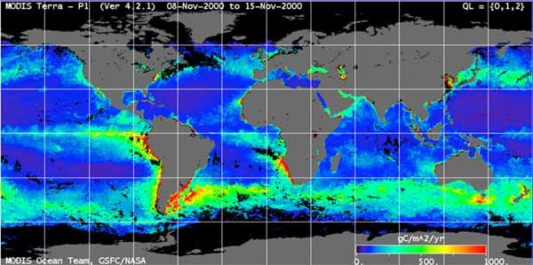
MODIS Ocean data products
There are 86 ocean parameters available in over 100 categories of MODIS Ocean data types archived by (and may be obtained from) the NASA Goddard Distributed Active Archive Center.
The three basic groupings of MODIS ocean data parameters are:
  ocean color
  sea surface temperature
  ocean primary production

Slide 10
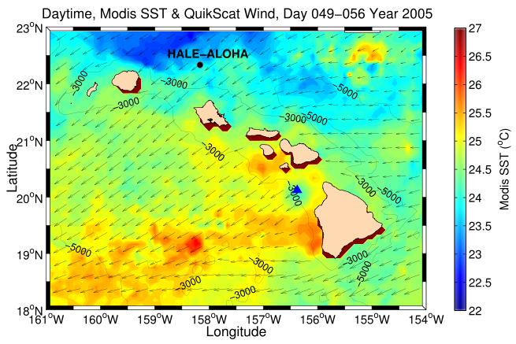
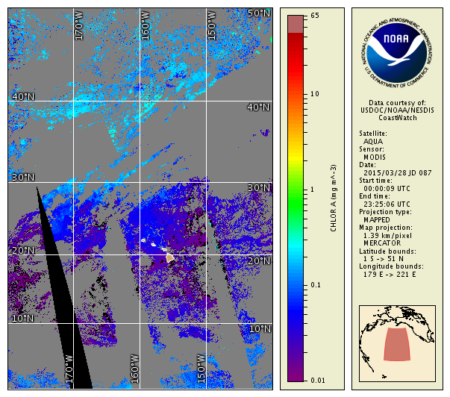
Parameters
36 Ocean Color parameters
3 Sea Surface Temperature parameters
8 Primary Productivity parameters
      (including 2 Primary Production indices)
38 Quality Control parameters

Slide 11
Processing Levels
Level 1 - Unprocessed top of the atmosphere radiance/reflectance
  At 1-km spatial resolution
  5 minute granule time resolution; 288 granules/day
Level 2 swath data
  At 1-km spatial resolution
  5 minute granule time resolution; color 144/day, SST 288/day
Level 3 global binned or mapped data
  Spatial resolutions of 4.63km, 36km, or 1 degree
  Time resolutions of one day, 8 days, a month or a year.
  The Binned data use the integerized sinusoidal equal area grid
  The Standard Mapped Images are in a cylindrical Equidistant Projection Centered at 0,0.

Slide 12
DATA BINNING PATHWAYS
Ocean Color & SST
Ocean Primary Productivity
YEARLY
PGE74
L3
L3
L3
L3
L4
L4
L4
L4
L4
PGE52
MONTHLY
PGE73
L3
L3
L3
L3
8-DAY
PGE54
L3
L3
L3
L3
L4
L4
L4
L4
PGE51
DAILY
PGE20
L3
L3
L3
L3
L2
L2 Sat 1 km
OPP stat model (opp_hv)
Binned Maps
ISEAG 4.63 km
OPP s.a. model (opp_wk)
1 km 4.6 km 4.9km 39km 1° =111 km
CED 4.88 km
OPP mapping (opp_map)
CED 39 km
Time binning (mtbin)
Swath ISEAG Linear Linear Linear
CED 1º
L3 binning (mspc/mmap)
L2→L3 binning (msbin)
Notes:
Sources and destinations of data in the binning and mapping process.

Slide 13
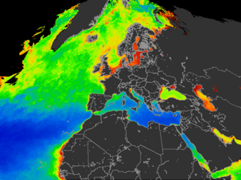
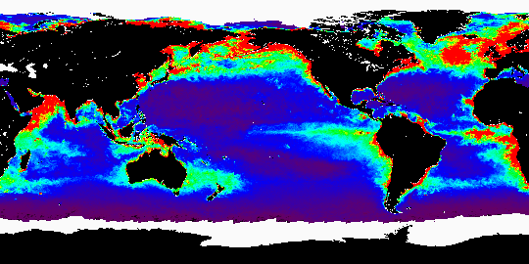
Level 4 Productivity
Ocean primary production data is available only as binned or mapped Level 4 (i.e. L4) data.
Ocean Productivity outputs are averaged weekly or yearly.
Like the L3 data, the L4 data is organized spatially as either 4km ISEAG gridded bins or as maps using a Cylindrical Equidistant Projection.
The mapped data products are available in a choice of 4km, 36km, or 1 degree spatial resolutions.
More than one model is used for deriving these data products and some quality statistics are available.

Slide 14
L2 filenames
2 night and 6 day ocean files for each 5 minutes
M*DCL2 - water leaving radiance products
M*DCL2A - derived products group 1
M*DCL2B- derived products group 2
M*DOCQC - ocean color QC parameters
M*D28L2 -SST products
M*D28QC- SST QC parameters
File size ~80-100MB/file
  * = “Y” for AQUA or “O” for Terra

Slide 15
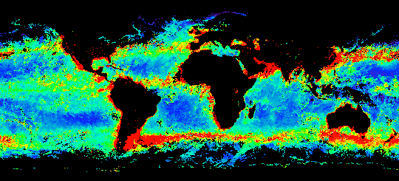
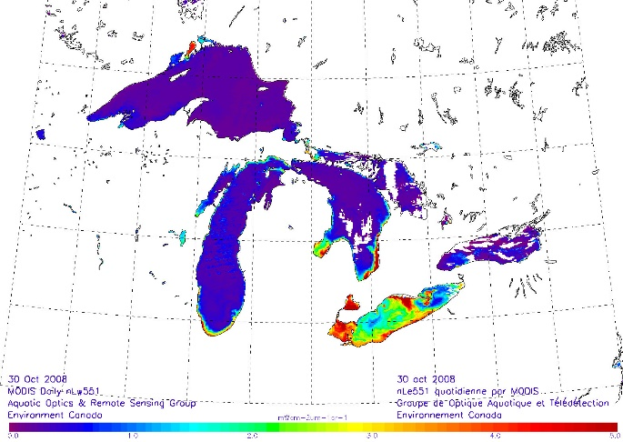
Water leaving radiance products
M*DOCL2 water leaving radiance (parameters 1-12)
  7 bands:
    nLw412
    nLw443
    nLw488
    nLw531
    nLw551
    nLw667
    nLw678
  Tau 865 Aerosol Optical thickness 865
  Epsilon 765/865
  Aerosol model 1
  Aerosol model 2
  Epsilon of clear water
nLw = water leaving radiance
The water-leaving radiance is defined as the upwelling radiance just above the sea-surface.

Slide 16
Derived products group 1
M*DOCL2A- 13 products (parameters 13-25)
  CZCS_pigment Chlorophyll-a + pheopigment (fluorometric,empirical)
  Chlor_MODIS Chlorophyll-a concentration (HPLC, empirical)
  Pigment_c1_total Total pigment concentration (HPLC, empirical)
  Chlor_flur_ht Chlorophyll fluorescence line height
  Chlor_fl_base Chlorophyll fluorescence baseline
  Chlor_fluor_effic Chlorophyll fluorescence efficiency
  Susp-solids-conc Total suspended matter concentration in ocean
  Cocco_pigment_conc Pigment concentration in coccolithophore blooms
  Cocco_conc_detached Detached coccolithophore concentration
  Calcite_conc Calcite concentration
  K_490 Diffuse attenuation coefficient at 490 nm
  Phycoeryth_conc Phycoerythrobilin concentration
  Phycou_conc Phycourobilin concentration

Slide 17
Derived products group 2
M*DOCL2A -11 products (parameters 26-36)
  chlor_a2 Chlorophyll-a concentration (SeaWiFS analog)
  chlor_a3 Chlorophyll-a concentration (semianalytic)
  ipar Instantaneous photosynthetically available radiation
  arp Instantaneous absorbed radiation by phytoplankton for fluorescence
  absorp_coef_gelb Gelbstoff absorption coefficient at 400 nm
  chlor_absorb Phytoplankton absorption coefficient at 675 nm
  tot_absorb_412 Total absorption coefficient at 412 nm
  tot_absorp_443 Total absorption coefficient at 443 nm
  tot_absorb_488 Total absorption coefficient at 488 nm
  tot_absorb_531 Total absorption coefficient at 531 nm
  tot_absorb_551 Total absorption coefficient at 551 nm

Slide 18
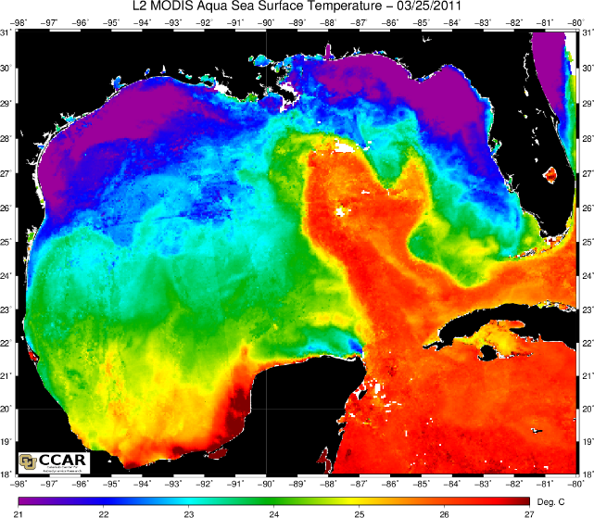
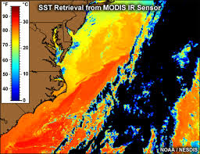
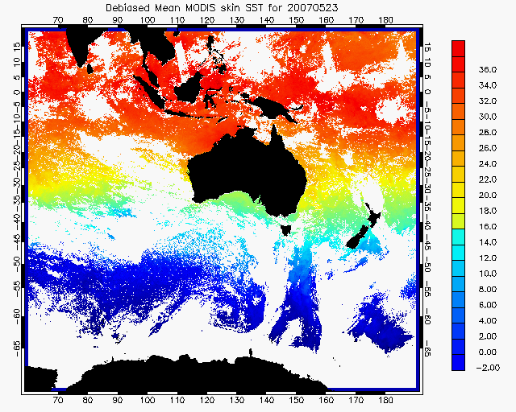
SST L2 products
M*28L2 - 3 products (parameters 36 to 40)
  SST_D1 - Sea surface temperature (daytime), 11 um
  SST_D2 - Do not use Sea surface temperature (daytime), 4 um
  SST_N1 - Sea surface temperature (nighttime), 11um
  SST_N2 -Sea surface temperature (nighttime), 4um

Slide 19
L2 Ocean color QC file
M*DOCQC -
  U_Wind m/s
  V_Wind m/s
  Pressure mBar
  Humidity kg/m2
  Ozone dobson
  Latitude degree
  Longitude degree
  SolarZenith angle
  SolarAzimuth angle
  SatelliteZenith angle
  SatelliteAzimuth angle
  nLw670 W/m2/um/sr
  Aerosol radiance 765 W/m2/um/sr
  Rayleigh radiance 443 W/m2/um/sr
  Glint radiance W/m2/um/sr
  Whitecap radiance W/m2/um/sr

Slide 20
L2 SST QC file
M*D28QC
  D1,N1 Channel 20 brightness temperature degrees C
  D2.N2 Channel 22 brightness temperature degrees C
  D3,N3 Channel 23 brightness temperature degrees C
  D4,N4 Channel 31 brightness temperature degrees C
  D5,N5 Channel 32 brightness temperature degrees C
  D6,N6 Channel 20 radiance W/m2/um/sr
  D7,N7 Channel 22 radiance W/m2/um/sr
  D8,N8 Channel 23 radiance W/m2/um/sr
  D9,N9 Channel 31 radiance W/m2/um/sr
  D10,N10 Channel 32 radiance W/m2/um/sr

Slide 21
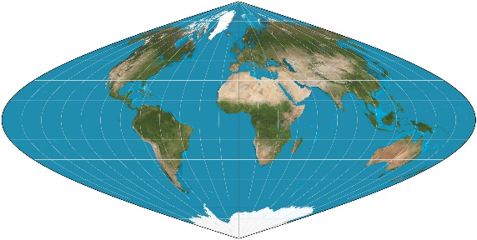
L3 Binned global files
Binned files M*DOC{D,W,M,Y}{prod#}.parameter
M*D28{D,W,M,Y}{prod#}.parameter
Only available at 4km resolution
Intergerized Sinusoidal Equal Area Grid (ISEAG)
Only bins with data values are present
  land bins and bins with no data are not in the files
  Each file is self contained with sums, weights and quality levels, and all flags
  Useful if you need to do statistics or your own averaging/compositing algorithms.
  File size ~640MB

Slide 22
L3 Mapped Files
Various time and space resolutions
Cylindrical equidistant projection
All bins present, including fill values (255) for land and missing data
8 map files for each product
  Mean, Count,Stdev, Common flags,Quality flags,Flag byte 1, Flag byte 2, Flag byte 3
  Files sizes : 4km =67MB, 36km=1MB,1deg= .2MB

Slide 23
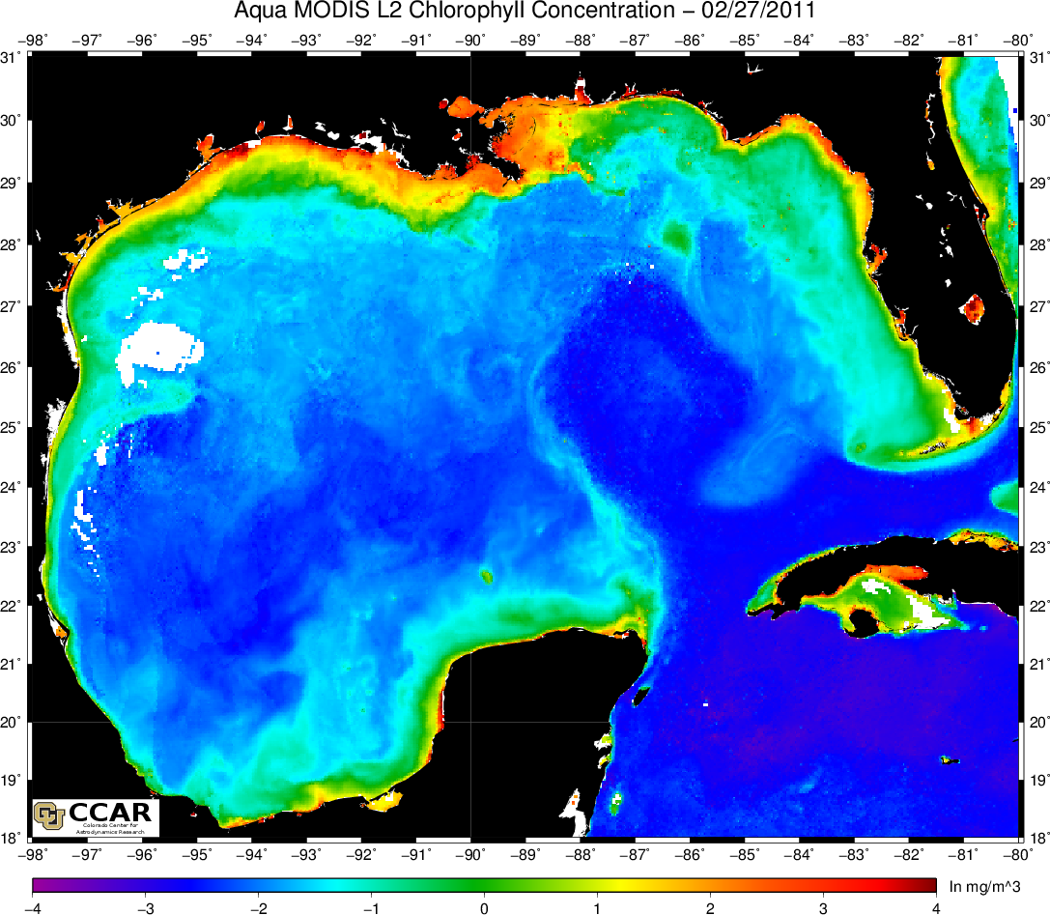
File Formats
All Ocean products are in EOS HDF format
Values are stored as counts
Scaling information to convert from counts to real numbers is located in the file metadata for each parameter (SDS)
  Scale_type
  Slope
  Intercept

Slide 24
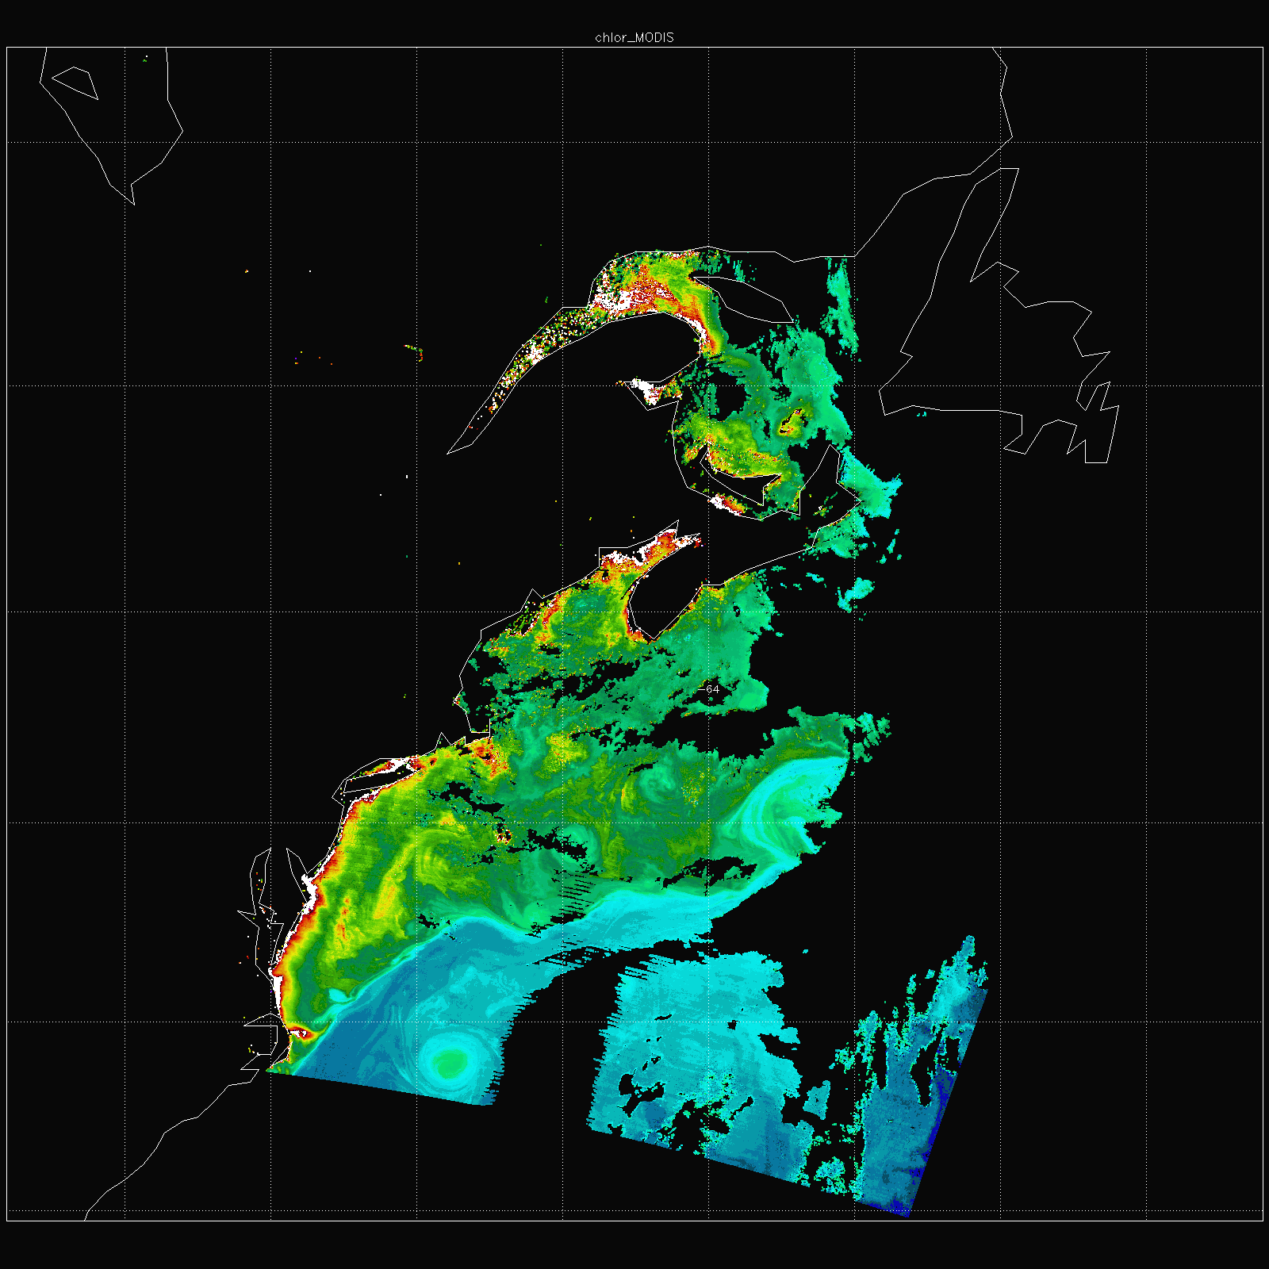
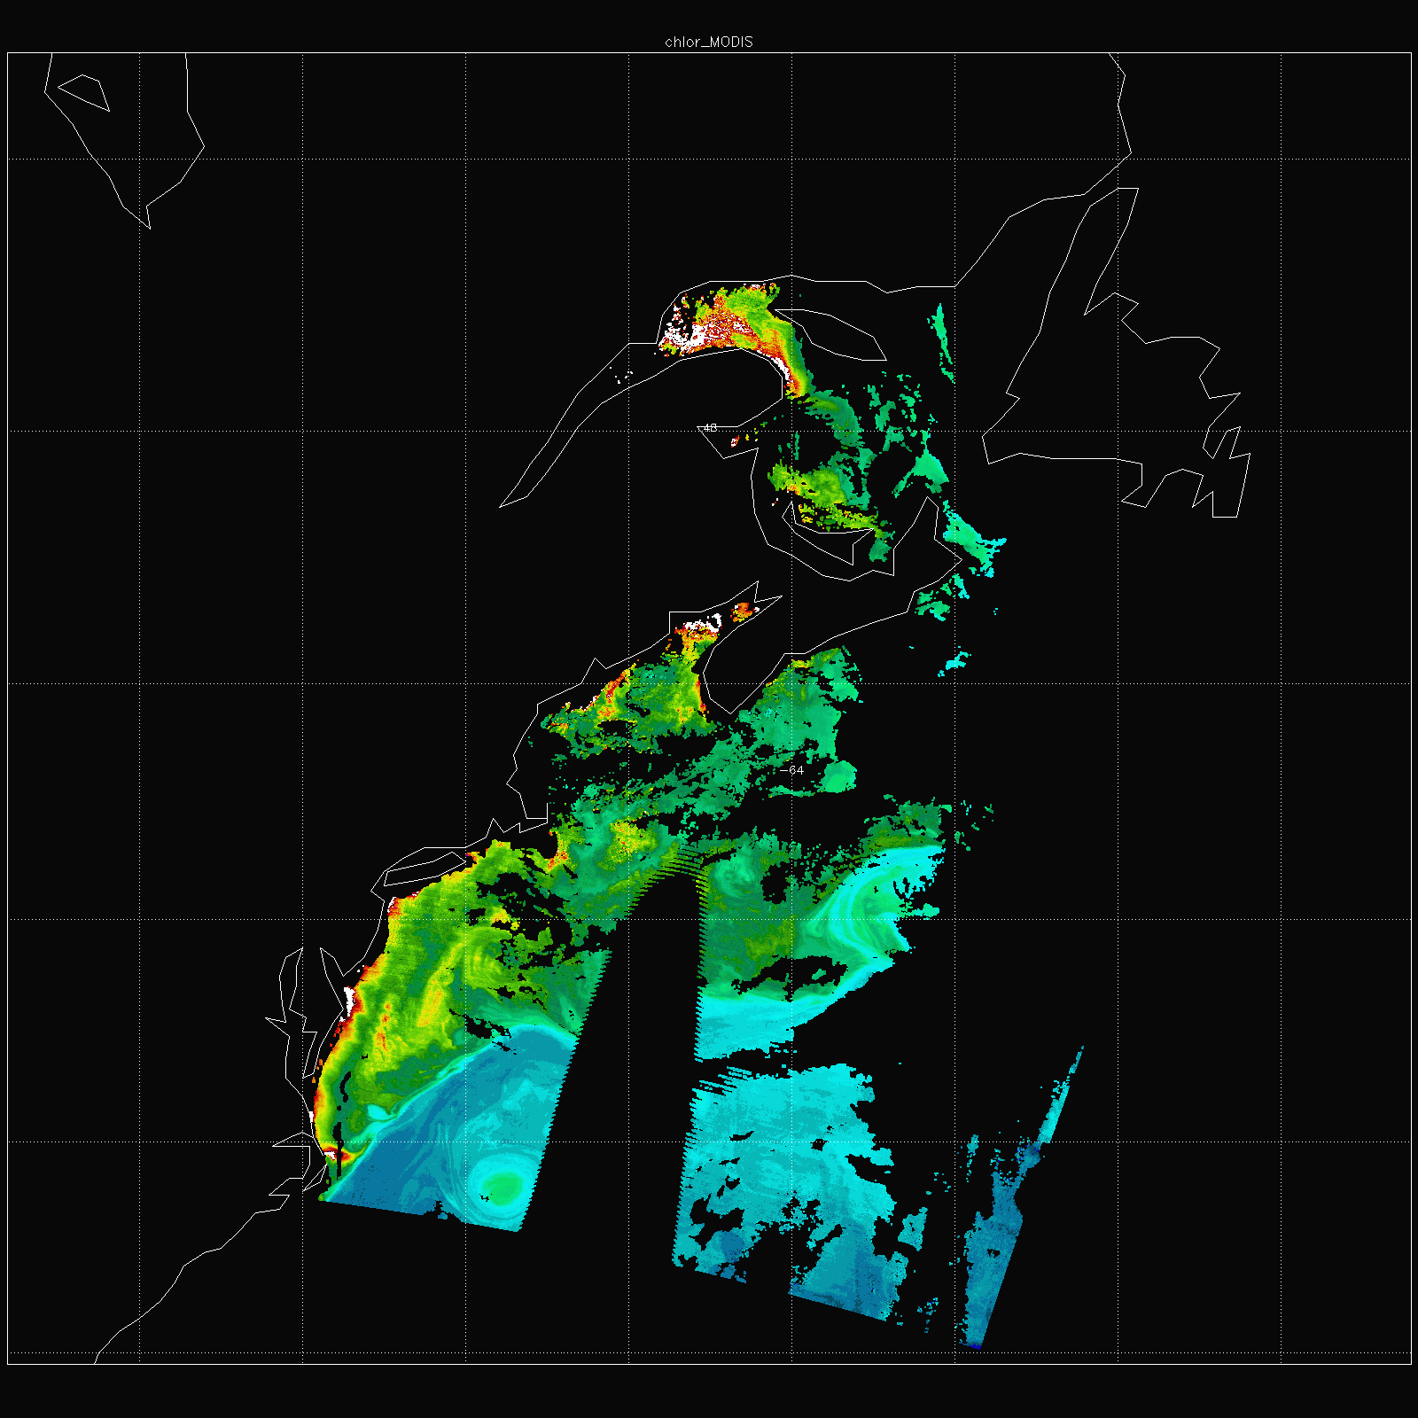
Pixel Quality Flags
QL=<=3
QL=0
Each product contains all values at all levels of quality you must filter the data for your application using the quality flag.
Each pixel is associated with a quality level stored as a 2 bit value (0,1,2,3) in the “quality” SDS.
  The position of the quality level within the byte is given in the metadata attributes for each parameter (“Quality_Bits”).
  Example: MODCL2A: Chlor_MODIS quality is in bit position 11-12, while Chlor_Fluor_ht is in position 19-20. (note: 1-based numbering convention)

Slide 25
Quality level definitions
There are four quality levels
    0=good
    1=questionable/suspect
    2= sun glint or possible cloud contaminated
    3=bad, thick cloud or other failure
These levels are derived by evaluating various combinations of threshold tests common to all products and specific to individual products. Other sets of flags, known as common and product specific flags, are used to store the results of these threshold tests.

Slide 26
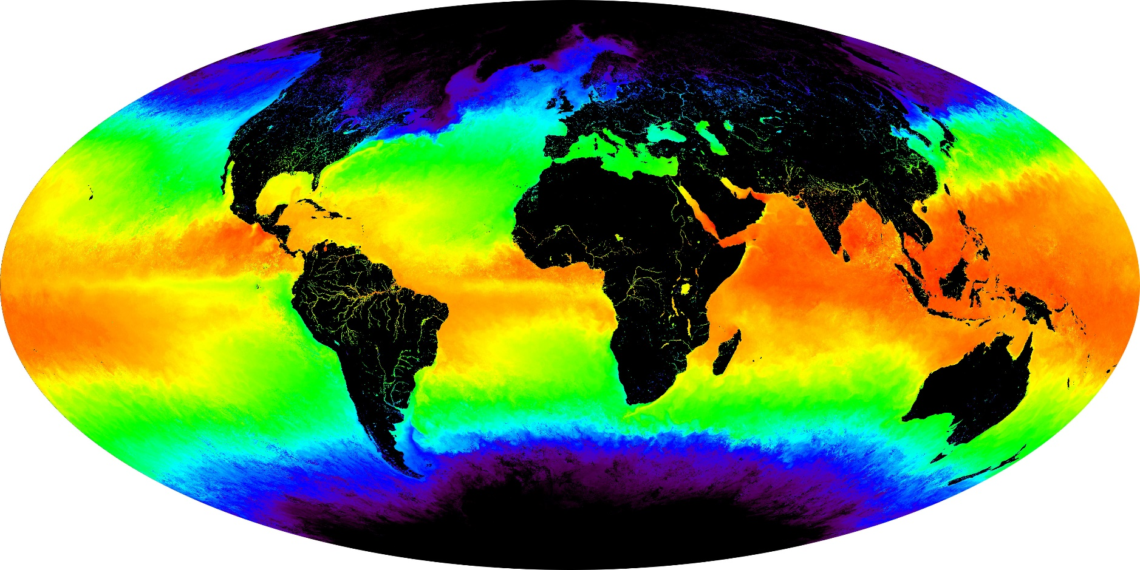
MODIS Ocean SST

Slide 27
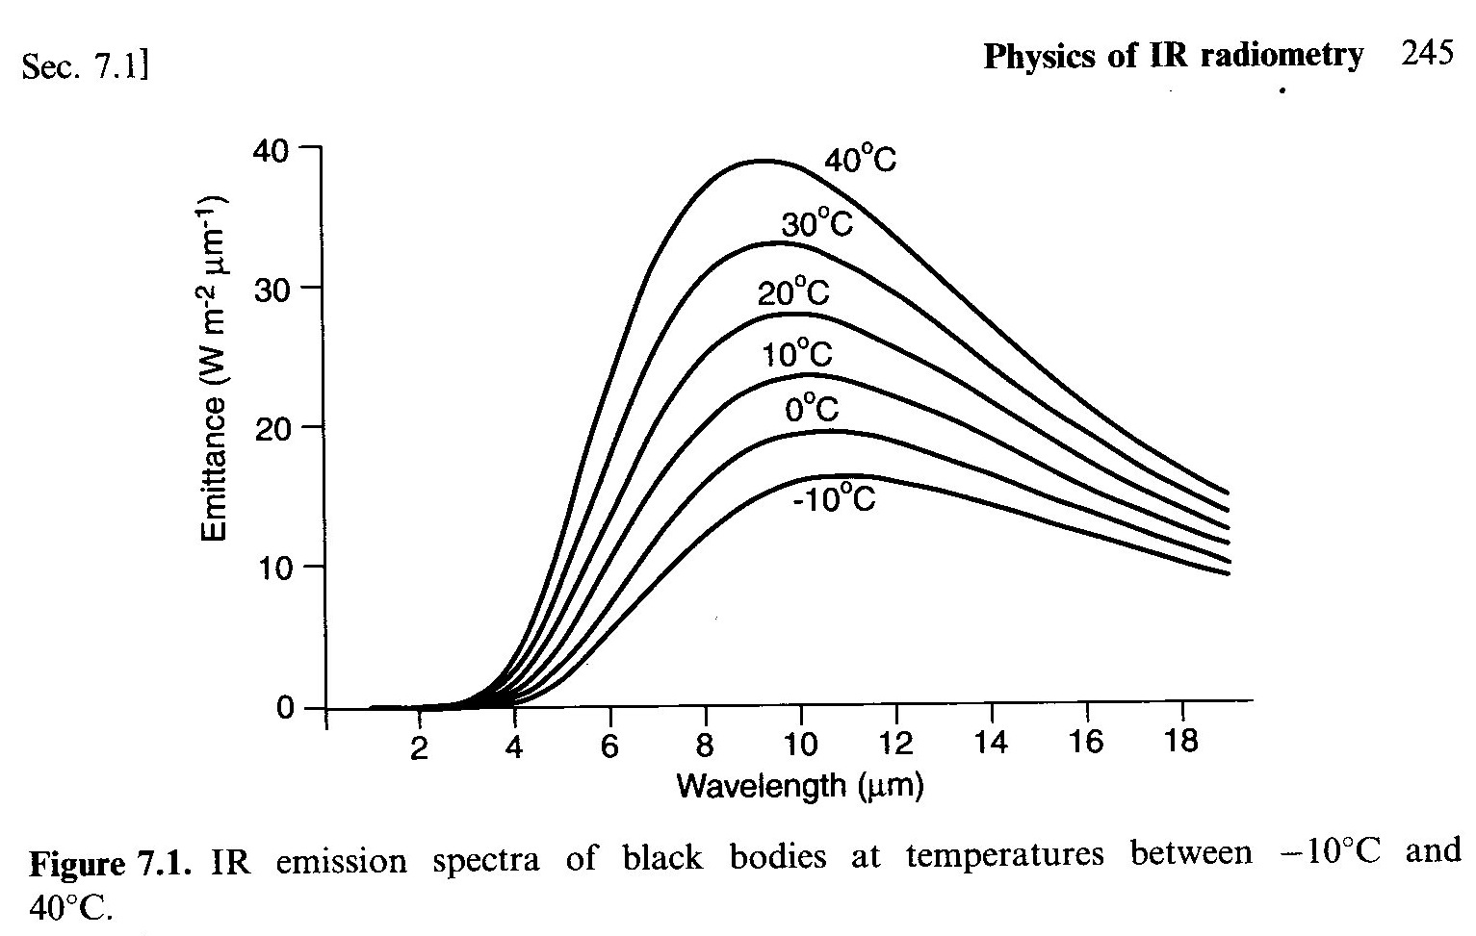
SST: What wavelengths are used?
sst4
sst
Plank’s Law
2 bands used
to estimate
sst and sst4
sst4 usable only at night (solar contributions)
sst usable day and night (negligible solar contributions)

Slide 28
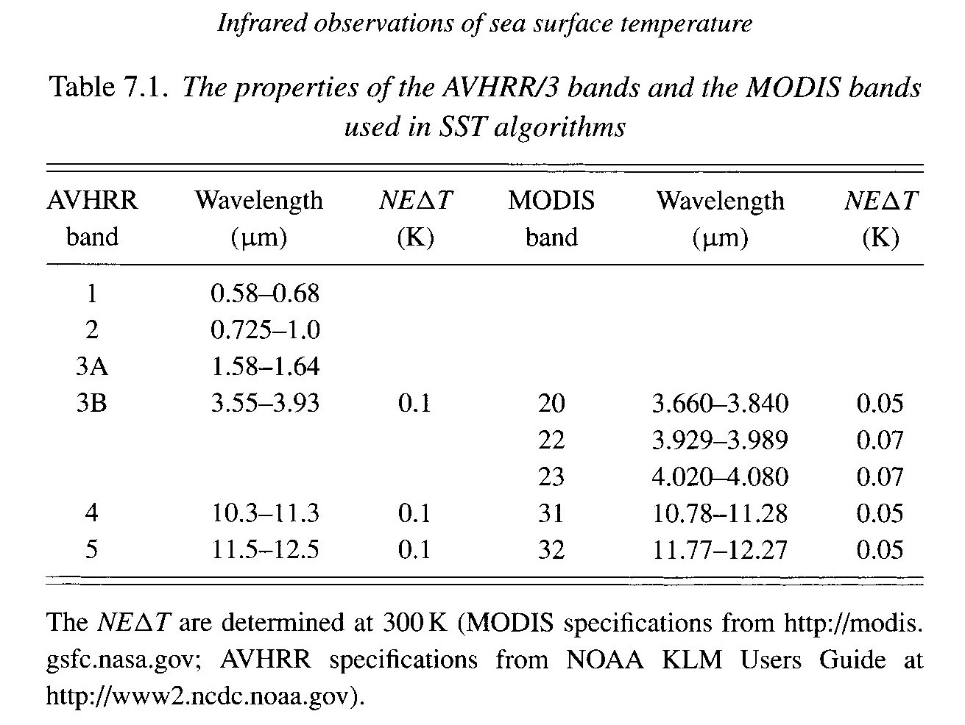
SST: What wavelengths are used?
sst4
sst

Slide 29
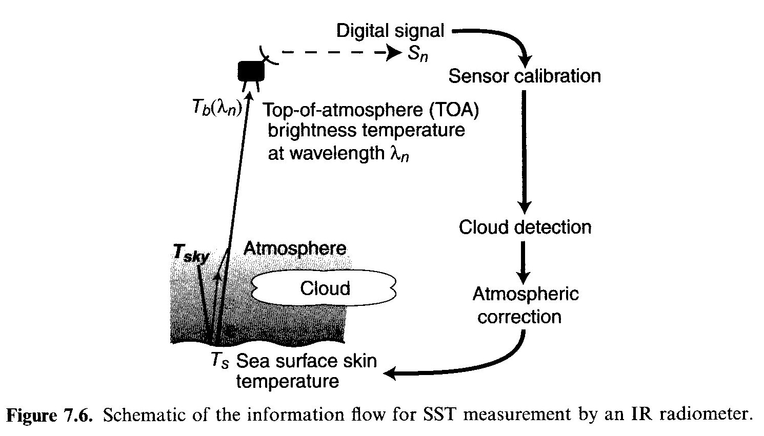
SST Determination from Space
[from Robinson, 2004]

Slide 30
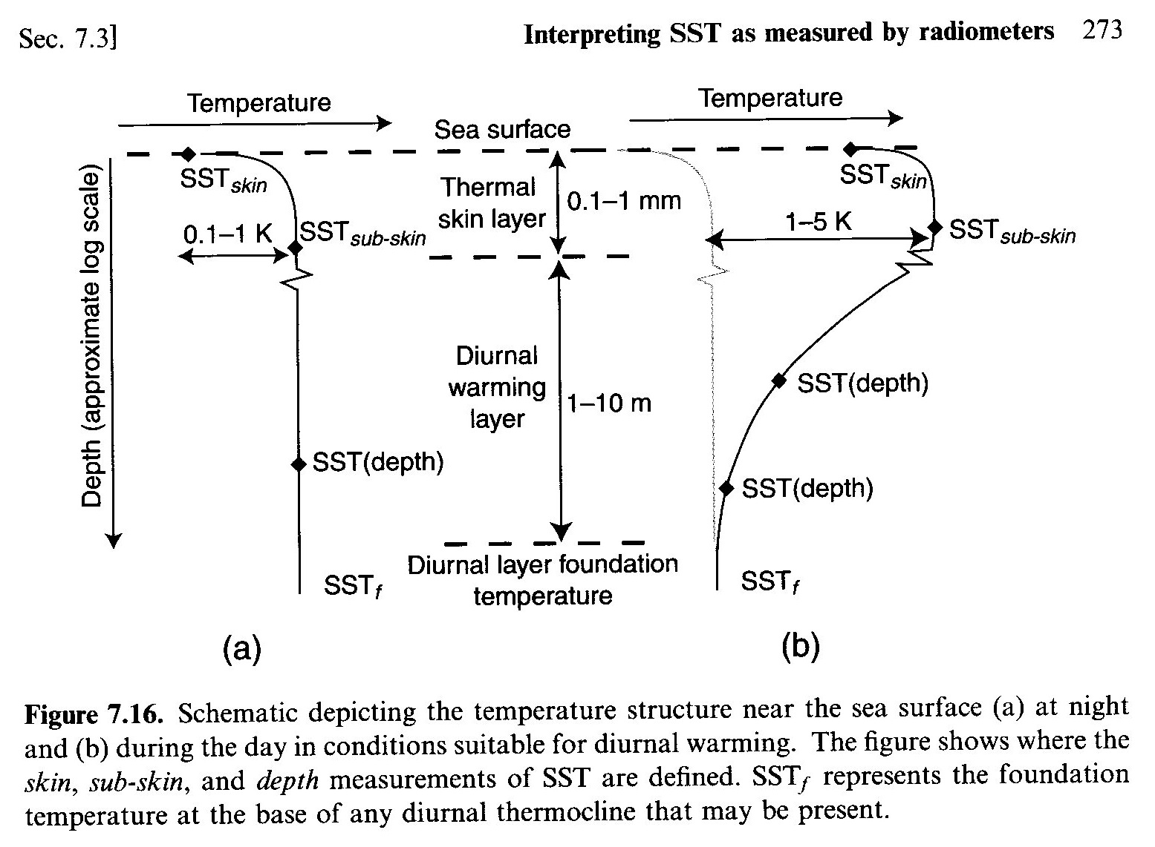
SST Determination from Space
Night
Day
[from Robinson, 2004]

Slide 31
SST Determination from Space
[from Robinson, 2004]

Slide 32
Sensor Calibration
Band-integrated radiance as a function of temperature (Planck’s Law) at detector:
L(T_{b}) = ∫ C₁ φ(λ) / [λ⁵ π exp(C₂/ λT_{b})-1] d λ
where:
T_{b} blackbody temperature
φ(λ) detector response function (determined pre-launch)
C₁, C₂ constants
Calibration finds gain and offset to relate the digital output signal S to radiance at detector L:
L = gain*S + offset or T_{b} = A + B ln(L)
** Need 2 known points to find gain and offset for each detector

Slide 33
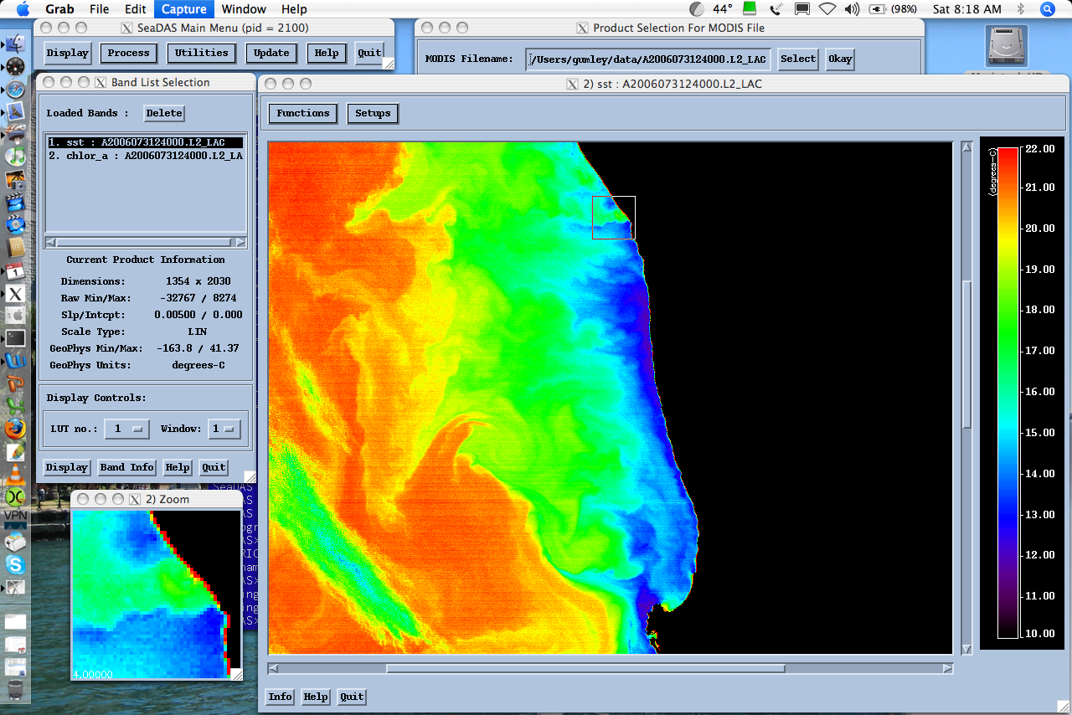
MODIS has 10 detectors scanned by 2 mirror-sides --> 20 calibrations
SST
Striping due
to imperfect
inter-detector
calibrations
[from Gumley, 2006]

Slide 34
SST – Cloud Detection
[from Robinson, 2004]

Slide 35
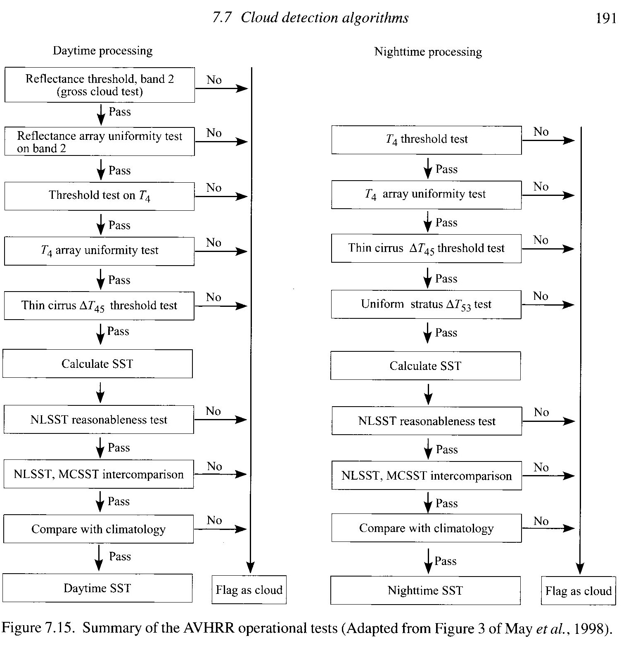
[from Robinson, 2004]

Slide 36
SST - Atmospheric Correction
[from Robinson, 2004]

Slide 37
MODIS Atmospheric Correction for Ocean Bands
Statement of the problem:
  Total radiance observed by the satellite is composed of 5-10% ocean signal and 90-95% atmosphere signal.
  The atmospheric and ocean surface scattering effects must be accurately modelled and removed.
  Desired parameter is normalized water leaving radiance (nLw) for MODIS bands 8, 9, 10, 11, 12, 13 (0.412, 0.443, 0.488, 0.531, 0.551, 0.667 microns)

Slide 38
MODIS Atmospheric Correction for Ocean Bands
Aerosol model selection:
  Assume zero (or negligible) water leaving radiance in the NIR bands (15 and 16; 0.750 and 0.865 microns); remainder is from aerosols.
  This is extrapolated to visible wavelengths using aerosol models. For case 1 waters, NIR bands are used to select aerosol model.
  Where this assumption is not valid, water-leaving radiance in NIR bands is estimated and removed prior to aerosol model selection.

Slide 39
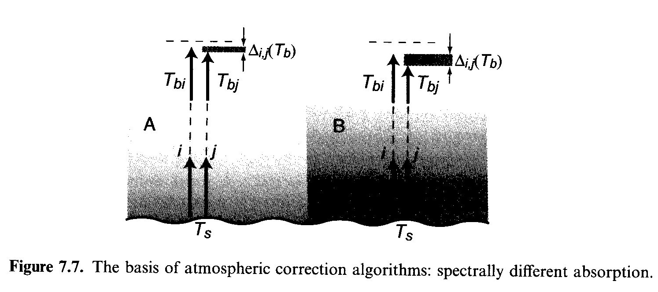
Atmospheric Correction Algorithms
SST = a + b*T₄ + c*(T₄-T₅) + d* (T₄-T₅)*(secθ-1)
Atmosphere-A:
Atmosphere-B
[from Robinson, 2004]
T_{bi} brightness temperature channel “i”, e.g, T₄ (Band-31 in MODIS)
T_{bj} brightness temperature channel “j”, e.g, T₅ (Band-32 in MODIS)

Slide 40
Is atmospheric correction always appropriate?
SST = a + b*T₄ + c*(T₄-T₅) + d* (T₄-T₅)*(secθ-1)
Is anything lost by applying atmospheric corrections?
Image noise may be enhanced
Includes noise from 2 channels
Thermal gradients are modified
If spatial structures, patterns, fronts, eddies, plumes are studied:
Use brightness temperatures T_{i}, not SST

Slide 41
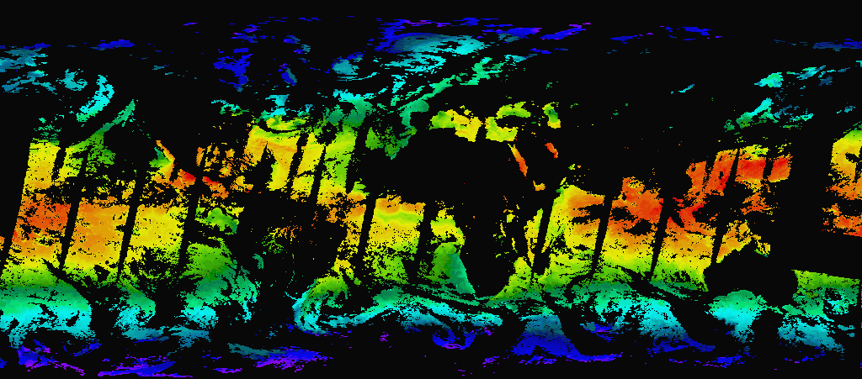

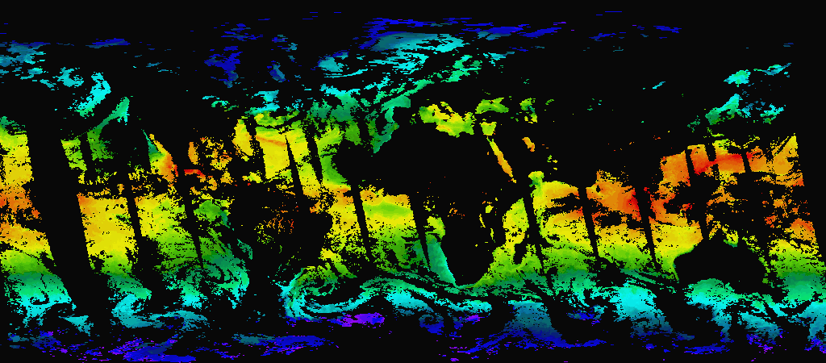
MODIS Thermal SST - 25June02
Terra
Separate
image for
each
satellite
Aqua

Slide 42
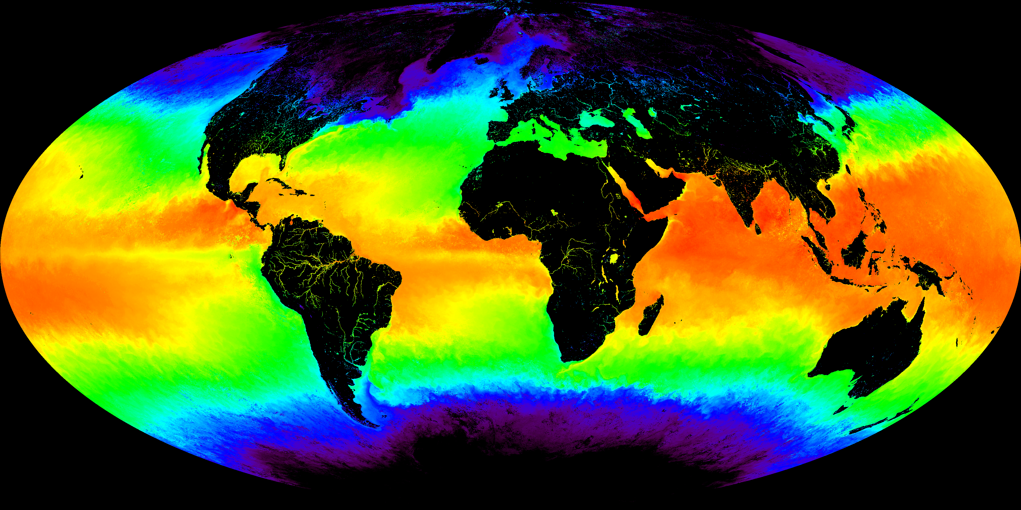

TERRA MODIS NIGHTTIME 4μm SST
MAY 2001
V 3.3.1
-2 5 10 15 20 25 30 35
Cº
MODIS/OCEAN GROUP
GSFC, RSMAS

Slide 43
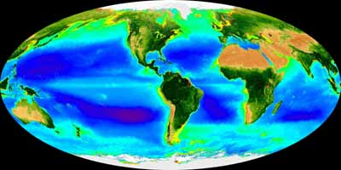
MODIS Ocean Color

Slide 44
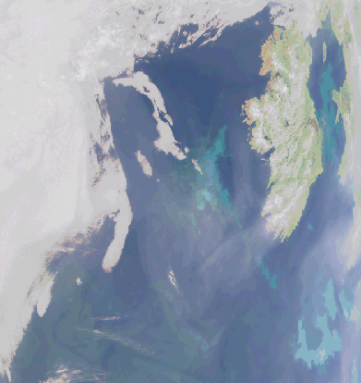
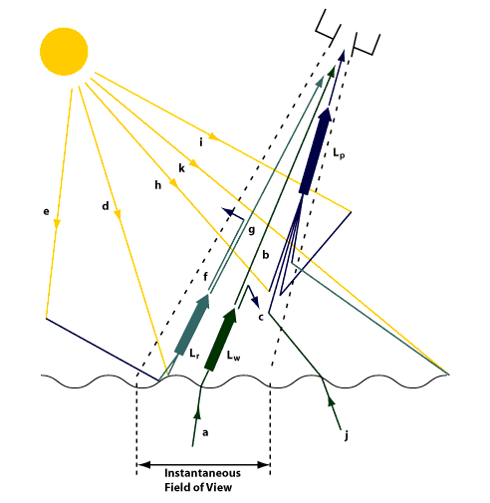
Atmospheric correction for Ocean Color
Clouds
Clouds
L_{w} is only 5-10% of signal reaching satellite: rest due to L_{p}
L_{p} components: molecular (Rayleigh) & aerosols

Slide 45
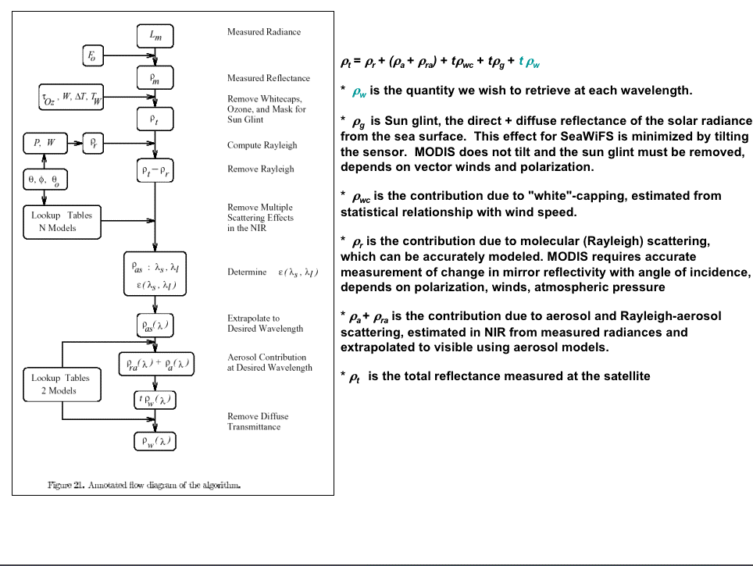
Reflectance at water surface

Slide 46
MODIS Chlorophyll Algorithm
Semi-analytical algorithm⁽¹⁾
Chl_a = 10**(0.283 - 2.753*R + 1.457*R² + 0.659*R³ - 1.403*R⁴)
where:
  R = log₁₀((R_{rs}443 > R_{rs}488) / R_{rs}551)
  R_{rs} = nLw / F₀ (remote sensing reflectance)
  F₀ = extraterrestrial solar irradiance
  nLw = water leaving radiance at 443, 488, 551
⁽¹⁾ Performance of the MODIS Semi-analytical Ocean Color Algorithm for Chlorophyll-a Carder, K.L.; Chen, F.R.; Cannizzaro, J.P.; Campbell, J.W.; Mitchell, B.G. Advances in Space Research. Vol. 33, no. 7, pp. 1152-1159. 2004

Slide 47
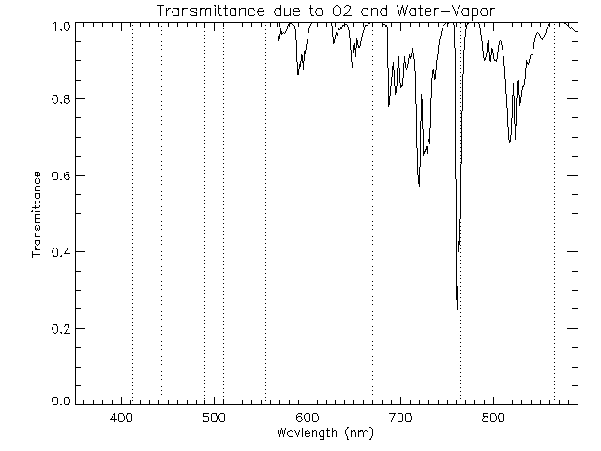
Gaseous Absorption – Transparency Windows
MODIS
SeaWiFS
Wavebands
443 488 531 551 MODIS 667 678 749 869
412 443 490 510 555 SeaWiFS 667 765 865

Slide 48
MODIS - SeaWiFS Atmospheric
Correction Differences
Glint - Spectral diffuse glint term, modified Cox-Munk distribution with spectral weighting, must be removed for MODIS (non-tilting), SeaWiFS minimizes glint by tilting
Rayleigh - Polarization varies with satellite and solar zenith angles, MODIS mirror angle of incidence (AOI) affects reflectivity, SeaWiFS has constant AOI mirror
Multiple (10) detectors per spectral band - Affects Rayleigh, especially near nadir, SeaWiFS 1 detector/band
Equatorial crossing time - SeaWiFS noon, MODIS Terra 1030, Aqua 1330. Effects sun glint, bi-directional reflectance

Slide 49
Atmospheric correction enhancements for MODIS
Instruments effects - detector and mirror side banding
Polarization
Sun-glint
Sun-satellite-observation point viewing geometry, overpass time and BRDF -bidirectional reflectance

Slide 50
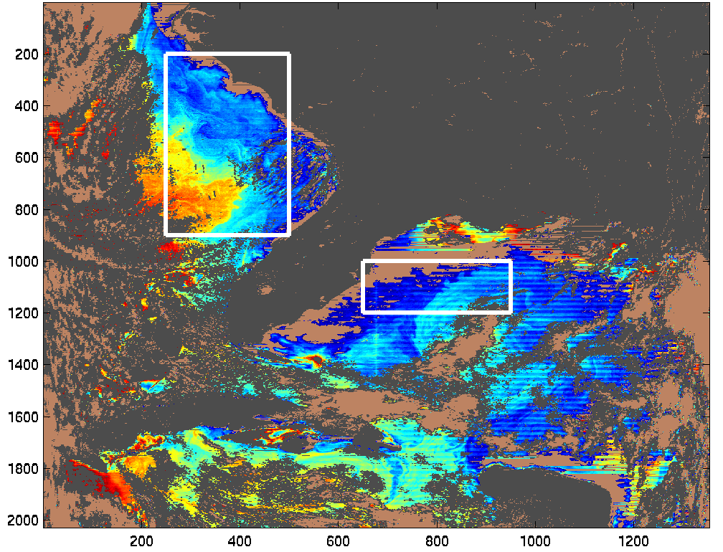
Southeastern North America nLw 412nm
November 1, 2000
Examples
of detector
and mirror
side banding
before correction

Slide 51
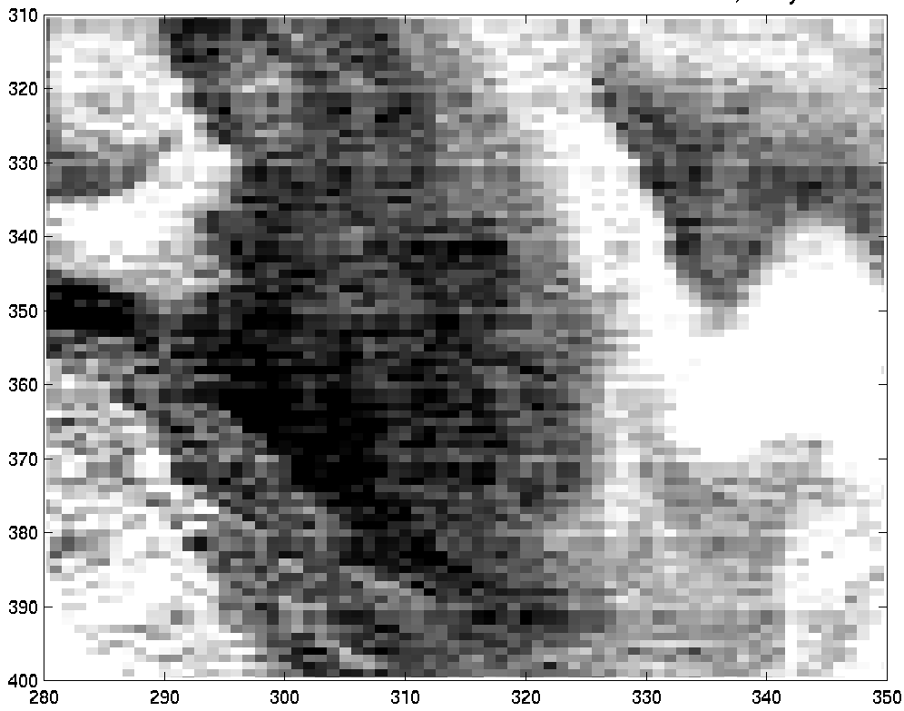
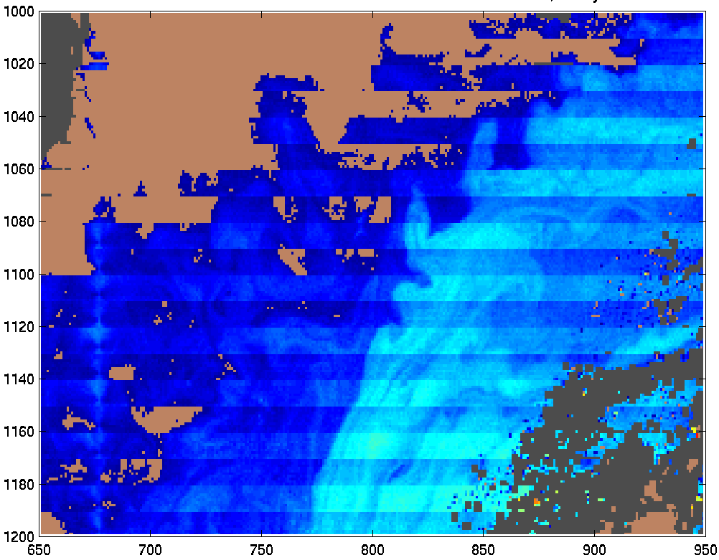
Northeastern Gulf of Mexico nLw 412 nm
November 1, 2000
Detector Striping
Mirror Side Banding
Scan Line
Pixel Number
Pixel Number

Slide 52
Sun glint correction
Sun glint influences large portions of the image. Several approaches to correcting the glint problem were investigated.
Shape of sun glint determined from Cox-Munk distribution, wind speed dependent.
  We assumed sun glint was direct, include only Rayleigh scattering
  Added an aerosol component to the sun glint.
    Result: improved Lw retrievals in regions of sun glint contamination with reasonable spectral behavior.
  Include polarization.
Sun glint correction currently a workable approximation but is limited both by differences in shape between real sun glint spatial distribution and the shape provided by Cox-Munk and by the accuracy of the NCEP wind fields.

Slide 53
Calibration Approach
Use at surface nLw, atmospheric and surface reflectance corrected
Validation site for in situ reference is MOBY @ Hawaii, more extensive validation for other regions will require completion of reprocessing
Cross-scan: Referenced to pixel 500, minimum of sun glint
Detector Balance: Referenced to detector 5, low noise, center of detector array
Mirror side Balance: reference to side 1
Remove time trends: Compare modal peak for area surrounding MOBY to MOBY, high temporal density, not dependent on cloud free conditions
Calibration: Adjust MOBY-MODIS single pixel match-ups to remove bias

Slide 54
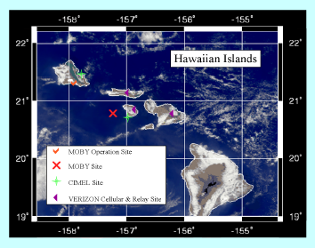
MOBY Calibration Site – Hawaii
(Dennis Clark)

Slide 55
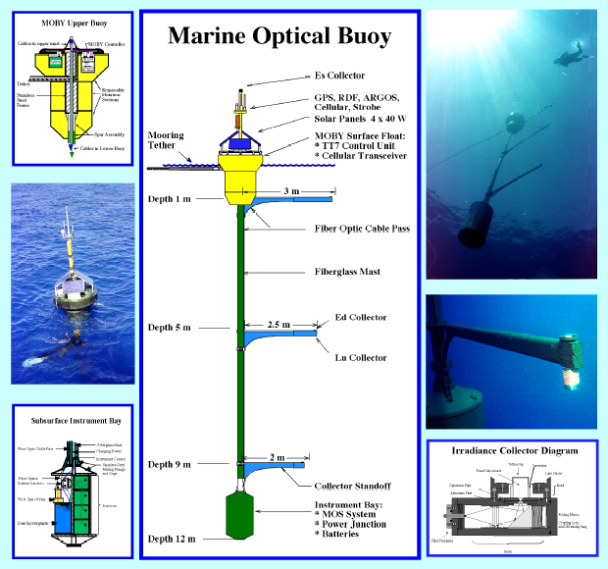
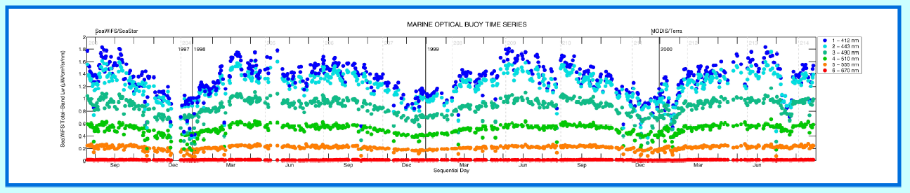
MOBY Instrument and spectral
Time Series of MODIS ocean color bands

Slide 56
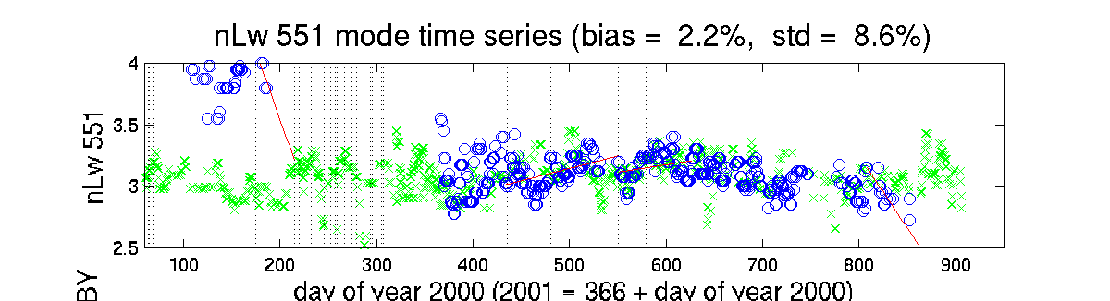
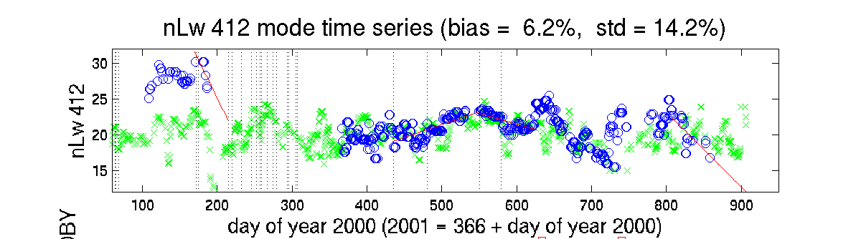
nLw Modal Terra MODIS-Moby
Time Series
Modal time series
of area around Hawaii
used to remove time
trends in MODIS
calibration
Before removal of time trend
After removal of time trend
Moby
Terra
Overall bias must be removed with MOBY matchups
New Forward
Col 4, V4 L1b

Slide 57
What’s the difference between MODIS Chlorophylls?
  “Case 1” waters: Chlor_MODIS (Clark) This is an empirical algorithm based on a statistical regression between chlorophyll and radiance ratios.
  “Case 2” waters: Chlor_a_3 (Carder) This is a semi-analytic (model-based) inversion algorithm. This approach is required in optically complex “case 2” (coastal) waters.
A 3rd algorithm was added to provide a more direct linkage to the SeaWiFS chlorophyll:
  “SeaWiFS-analog” Chlor_a_2 (Campbell)
  SeaWiFS algorithm OC4.v4 (O’Reilly)

Slide 58

Comparison of MODIS Chlorophyll Products with SeaWifs Chlorophyll

Slide 59



MODIS Chl-MODIS - 25June02
Terra
Separate
image for
each
satellite
Aqua

Slide 60

Terra - Daytime Descending Orbits

Slide 61

Aqua - Daytime Ascending Orbits

Slide 62


8 Day
(Weekly)
Composites
Terra
Aqua

