Slide 1

Topex/Poseidon – Sea Surface Height
MET 611 – Satellite Data Applications
Jennifer D. S. Griswold

Slide 2
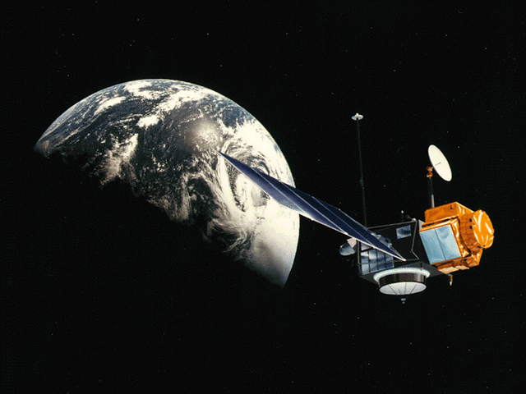
Lecture Outline
Basic principles of satellite altimetry
TOPEX/Poseidon satellite
Sea Surface Height:
  Geoid
  Tides
  Geostrophic circulation
TOPEX/Poseidon Data Access an Structure

Slide 3
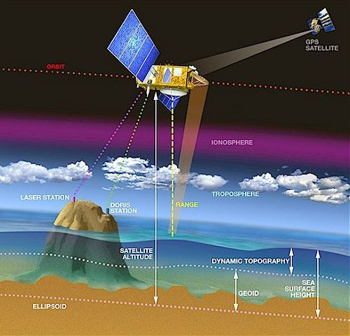
Basic Principles of Satellite Altimetry
Radar altimeters on board the satellite permanently transmit signals at high frequency (Topex/Poseidon - over 1700 pulses per second) to Earth, and receive the echo from the sea surface.
This is analyzed to derive a precise measurement of the round-trip time between the satellite and the sea surface.
The time measurement, scaled by the speed of light (at which electromagnetic waves travel), yields a measurement of the satellite-to-ocean range.

Slide 4
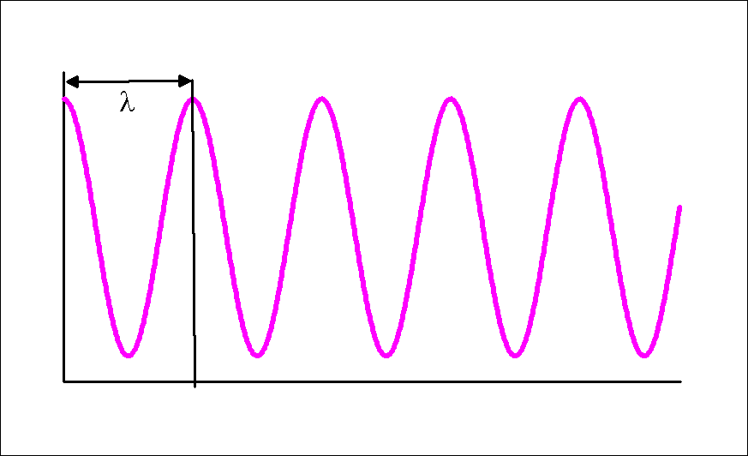
Basic Principles of Satellite Altimetry
Each signal pulse produced by a radar altimeter consists of coherent electromagnetic energy.
Receiving the echo signal, the sensor measures not only the amplitude but also the phase of the reflected signal and the travel time of the pulse.
Measuring the phase of the signal reflected from the earth surface enables measuring the travel time with very high accuracy.

Slide 5
Basic Principles of Satellite Altimetry
As electromagnetic waves travel through the atmosphere, they can be decelerated by water vapor or by ionization.
Once these phenomena are corrected for, the final range “R” is estimated within 2 cm.
The ultimate aim is to measure the sea level.
This requires independent measurements of the satellite orbital trajectory:
  exact latitude
  exact longitude
  exact altitude coordinates.

Slide 6
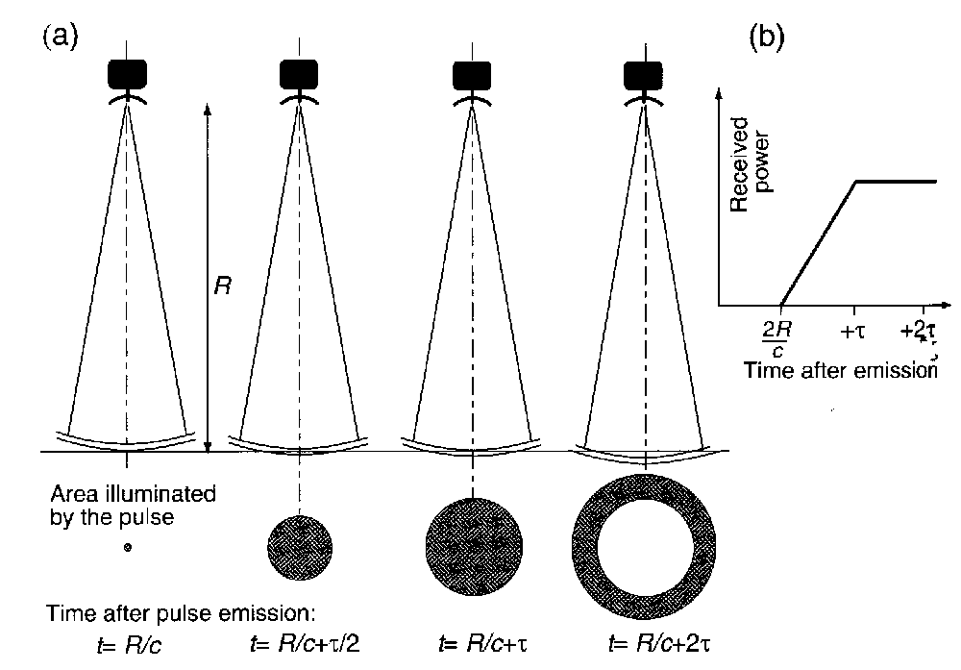
Basic Principles of Satellite Altimetry
Interaction of the pulse of duration τ with a smooth sea surface.
For an altimeter in a 1000-km orbit a pulse duration of about 3 ns would lead to a footprint of diameter 2.8 km.

Slide 7
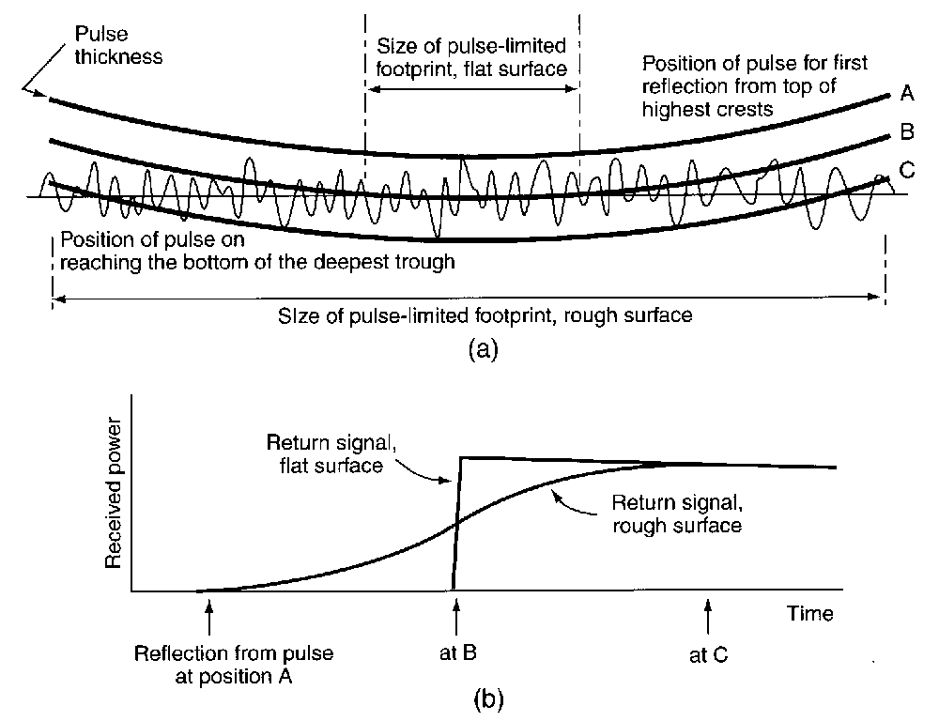
Basic Principles of Satellite Altimetry
In practice sea surface is rough rather than flat.
As a result, the first reflection of energy commences when the leading edge of the pulse reaches the topmost crests of the waves, earlier than for the flat surface
The reflected energy does not achieve its maximum until the trailing edge reaches the lowest wave trough.
In this way, the altimeter is able to average out the effect of the ocean waves. This parameter is called a Significant Wave Height (SWH)

Slide 8
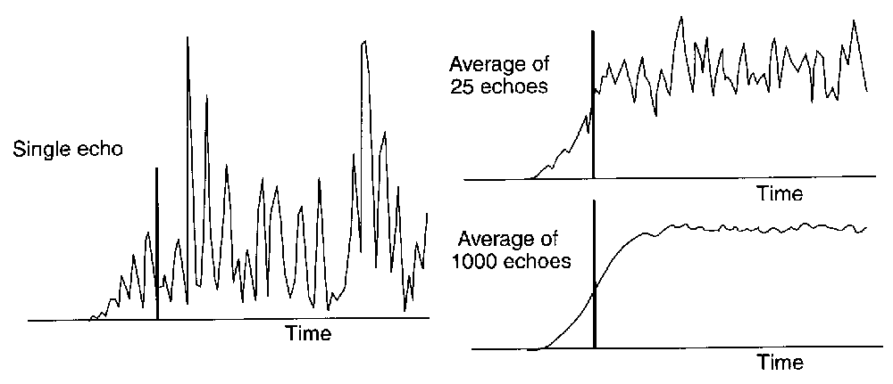
Basic Principles of Satellite Altimetry
As a result of random distribution of the ocean wave facets at any instant, each individual return signal is very noisy!
but averaging many successive pulses can reduce this.

Slide 9
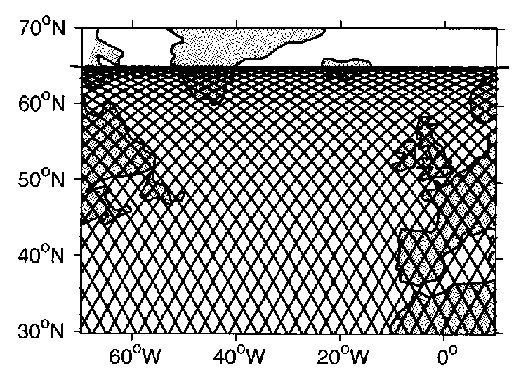
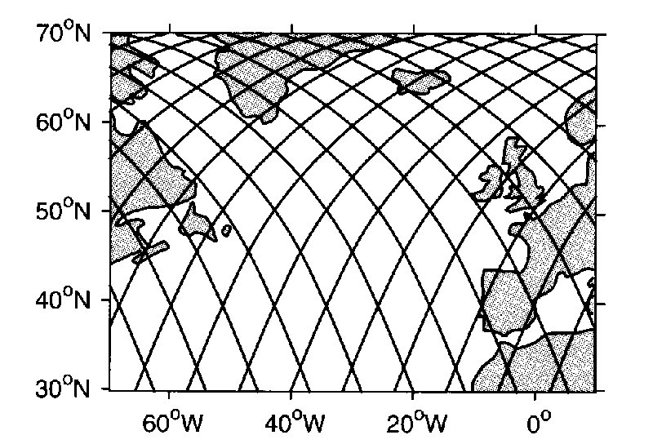
Basic Principles of Satellite Altimetry
Of all sensors carried on satellites, the altimeter is most dependent upon its orbit to be capable of successful calibration and interpretation.
An altitude over 1300 km is advised, because:
  the atmospheric drag there is an order of magnitude less than at 800 km
  ground stations can much better track the satellite
  the satellite orbit error resulting from irregularities of the Earth gravitation field at a high orbit is less than at a lower one.
Different inclination results in different repeat cycles and track separation:
  Topex/Poseidon (10 days/316 km at equator)
  Seasat (3 days/800 km).

Slide 10
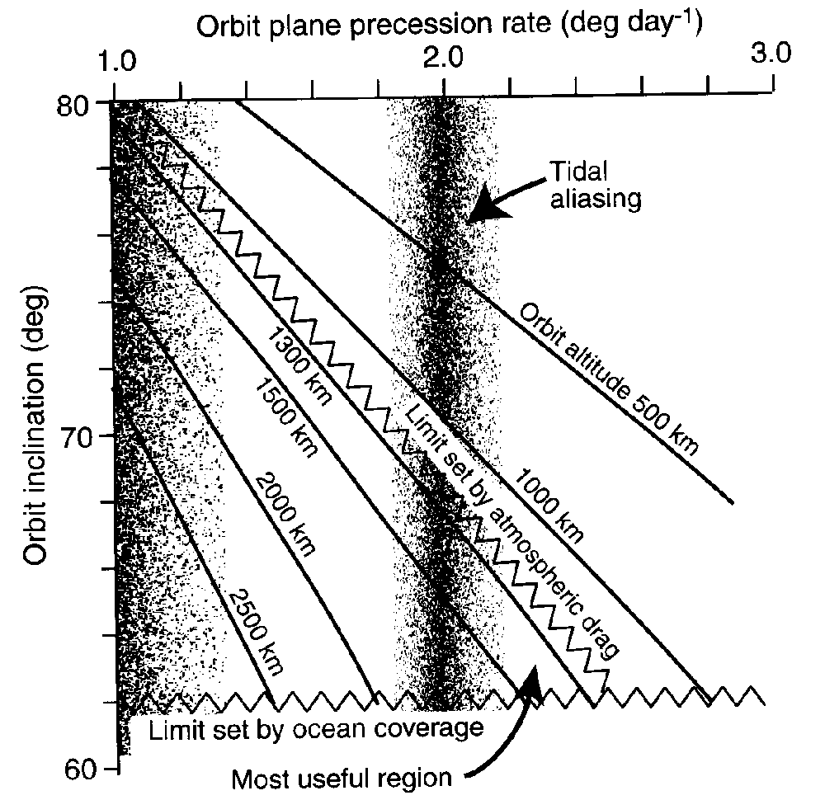
Basic Principles of satellite Altimetry
Selecting a proper inclination, we should take into account that the precession of satellite orbit should not coincide with the harmonics of tidal cycle.
As a result, Topex / Poseidon and Jason-1 satellites have altitude 1300 km and inclination 66º.

Slide 11
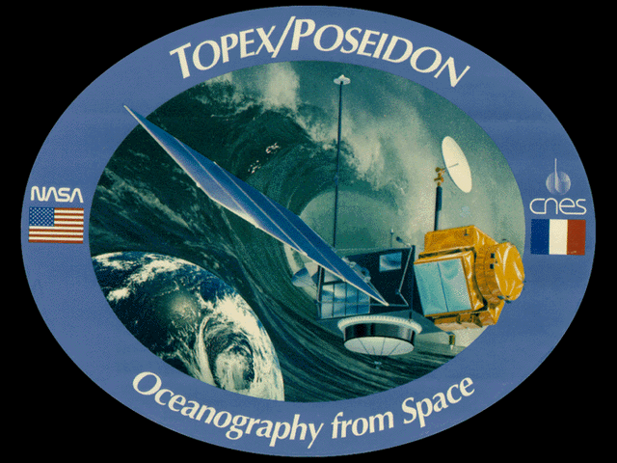
TOPEX/Poseidon Satellite
TOPEX/Poseidon is a result of cooperation between the NASA and the CNES (France's space agency, the Centre National d'Etudes Spatiales)

Slide 12
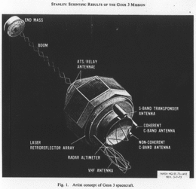
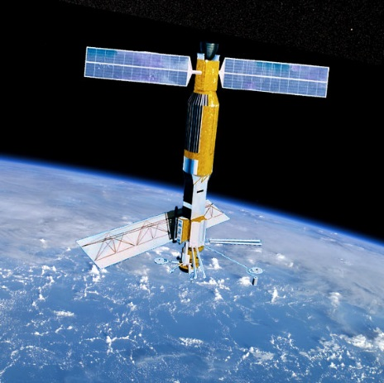
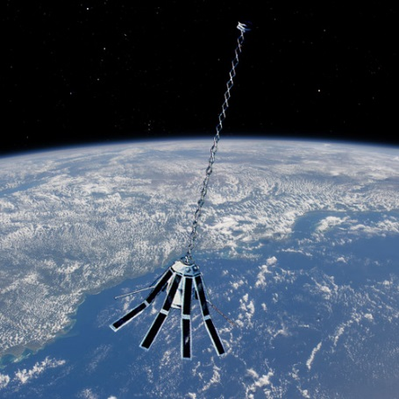
TOPEX/Poseidon Satellite
TOPEX/Poseidon is based on three earlier earth-orbiting satellite missions.
  GEOS-3 was launched in 1975. Its altimetric system measured sea level with a precision of approximately 20 centimeters and an accuracy of better than 50 centimeters.
  SEASAT was launched in 1978. It measured the sea level with a precision of 10 centimeters at an accuracy of better than 30 centimeters. Unfortunately, the mission ended prematurely after about 100 days of operation.
  GEOSAT was launched in 1985. Its accuracy and precision were comparable to SEASAT. The mission lasted for approximately 4 years.

Slide 13
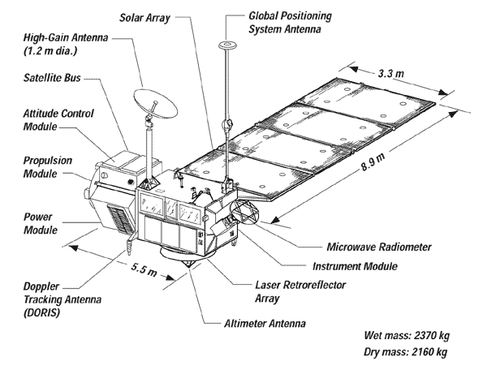
TOPEX/Poseidon Satellite
In 1979, NASA's Jet Propulsion Laboratory began planning TOPEX
  Ocean Topography Experiment that would use a satellite altimeter to measure the surface of the world's oceans.
At the same time the French space agency CNES was designing an oceanographic mission called Poseidon, named for the Greek god of the sea.
The two space agencies decided on a cooperative effort and pooled their resources to form a single mission.

Slide 14
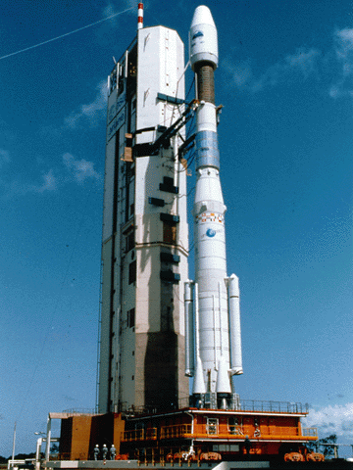
TOPEX/Podeidon Launch
The Ariane 42P carrying the TOPEX/Poseidon spacecraft was launched from the European Space Agency's Guiana Space Center in Kourou, French Guiana, on August 10, 1992.
Mass (kilograms) with dry/full tanks: 2169.4 / 2388.4
Dimensions (meters): length: 5.5 /span: 11.5 / height: 6.6
Solar Array: size: 29.4 sq. meters; power output (watts): 3385 (at start); 2100 (at 5 years)
Data Storage:
type: 3 tape recorders, 500 Mb each; record rate: 16 kb/s

Slide 15
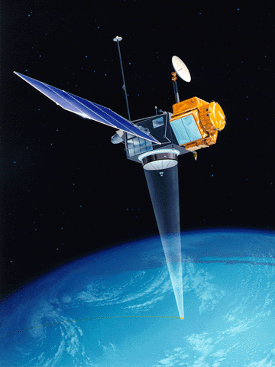
TOPEX/Poseidon Orbit
The TOPEX/Poseidon spacecraft uses a high-precision radar altimeter to take measurements of sea-surface height over 90% of the world's ice-free oceans.
The satellite orbits at an:
  altitude of 1336 kilometers above the earth
  inclination of 66 degrees
In approximately 10 days TOPEX/Poseidon completes 127 orbits.

Slide 16
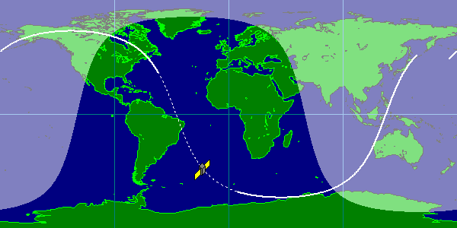
TOPEX/Poseidon Satellite Cycle
The satellite cycles consist of 127 orbits each. The 128th orbit repeats the 1st one, etc.

Slide 17
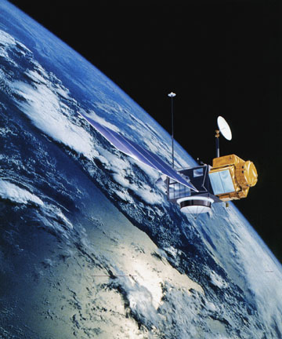
TOPEX/Poseidon Accuracy
At the time TOPEX/Poseidon carried improved instrumentation and has the most accurate precision orbit determination of any earth-orbiting satellite.
Its altimeter has a measurement precision of approximately 2.5 centimeters.
After correction the resulting sea level observations are accurate to 5 centimeters.

Slide 18
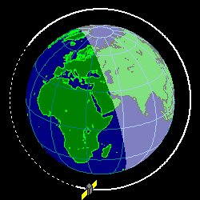
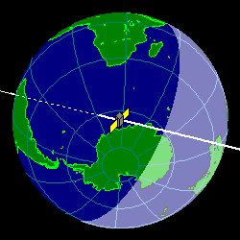
TOPEX/Poseidon Orbit Views
View from above orbital plane
View from above satellite

Slide 19
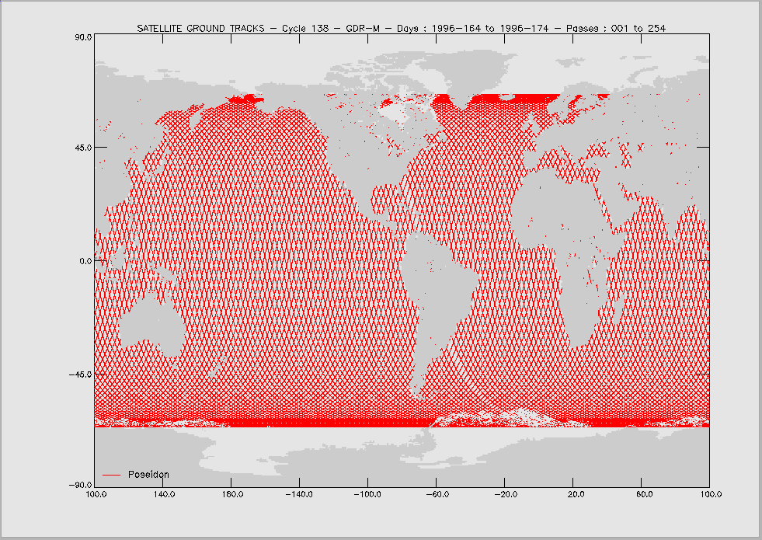
TOPEX/Poseidon Satellite Cycles
Repeat period
= 9.915624999999977 DAYS
= 856710 seconds
CYCLE 1 267 48888.1516204 WED 1992-SEP-23 3:38
CYCLE 2 277 48898.0672454 SAT 1992-OCT- 3 1:36
CYCLE 3 286 48907.9828704 MON 1992-OCT-12 23:35
CYCLE 4 296 48917.8984954 THU 1992-OCT-22 21:33, etc.

Slide 20
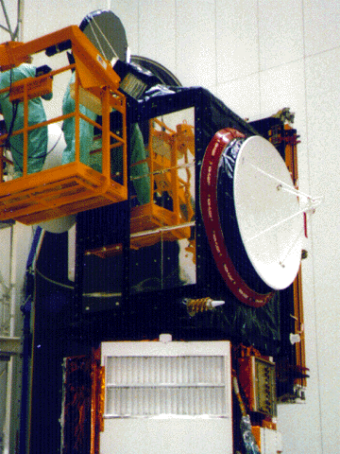
TOPEX/Poseidon Satellite
TOPEX/Poseidon's primary instrument for measuring ocean topography is an altimeter, measuring the distance between the satellite and the ocean surface.
Air, water vapor, clouds, and rain slow down the return of the microwave signal.
A second instrument, a radiometer, is used to correct for the influence of water in the atmosphere.

Slide 21
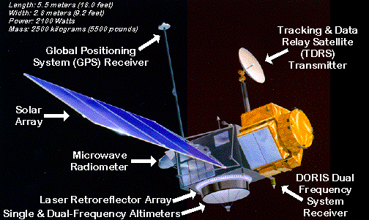
TOPEX/Poseidon Satellite Info
TOPEX/Poseidon carries two radar-altimeters:
  The dual-frequency NASA radar altimeter is the primary instrument aboard the spacecraft. It works by sending radio pulses at 13.6 GHz and 5.3 GHz toward the earth and measuring the characteristics of the echo.
    By combining this measurement with data from the microwave radiometer and with other information from the spacecraft and the ground, scientists can calculate the height of the sea surface.
  The single-frequency CNES altimeter is classified as an experimental sensor because TOPEX/Poseidon is the first flight to utilize this technology.
    The CNES altimeter is a low-power, low-mass sensor which works in much the same way as the NASA altimeter. Its precision is also comparable with that of the NASA altimeter.

Slide 22
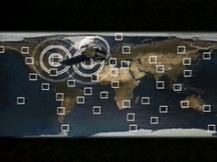
TOPEX/Poseidon Satellite
The altimeter measurement obtained by TOPEX/Poseidon would not be very useful if the satellite's position in space were not well known.
Different systems measure the position of TOPEX/Poseidon in space.
Data from the SLR (Satellite Laser Ranging) and DORIS (Doppler Orbitography and Radiopositioning Integrated by Satellite) systems are used to determine the orbit of TOPEX/Poseidon.
  Together these systems provide all-weather, global tracking of the satellite. There are however, some limitations in land-based systems.

Slide 23
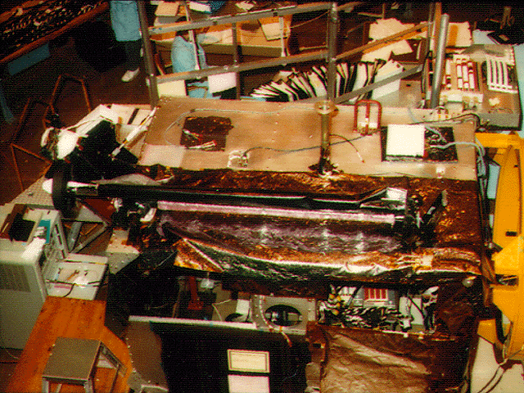
TOPEX/Poseidon Satellite
To develop more accurate and less expensive methods of calculating orbits, the project installed a Global Positioning System or GPS receiver on the spacecraft as a flight experiment.
The experiment proved a great success. During testing the GPS receiver simultaneously tracked signals from as many as 8 of the 21 GPS satellites that orbit the earth and provided the spacecraft's radial position with an accuracy of better than 3 centimeters.

Slide 24
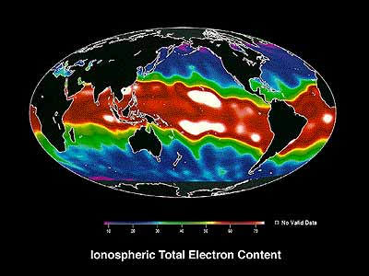
TOPEX/Poseidon Satellite
Free electrons are present in the earth's ionosphere.
As with water vapor, these electrons delay the return of the radar pulse from the altimeter and thus interfere with the accuracy of sea-level measurements.
To correct for this delay the altimeter takes measurements at two radio frequencies.
  The difference between the two measurements provides both a measure of the electron content and a correction for the range delay.

Slide 25
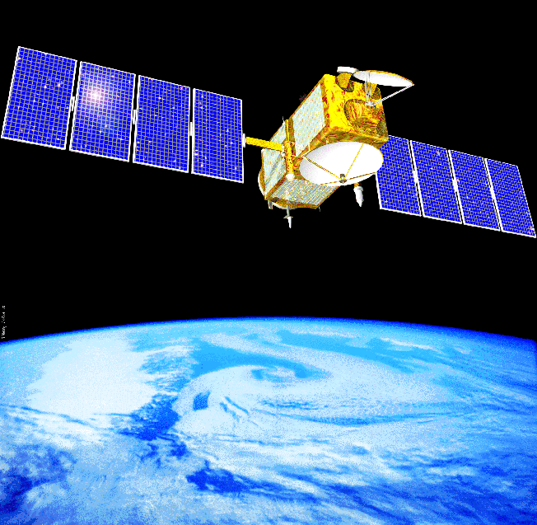
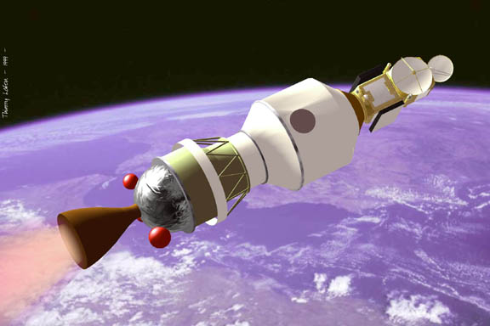
TOPEX/Poseidon Satellite
In addition to TOPEX/Poseidon satellite, in December 7 2001 Jason-1, another satellite with radar-altimeter, was launched.
Jason-1 is much smaller that TOPEX/Poseidon (weight 500 kg vs. 2400).
All other characteristics of Jason-1 are similar to TOPEX/Poseidon.

Slide 26
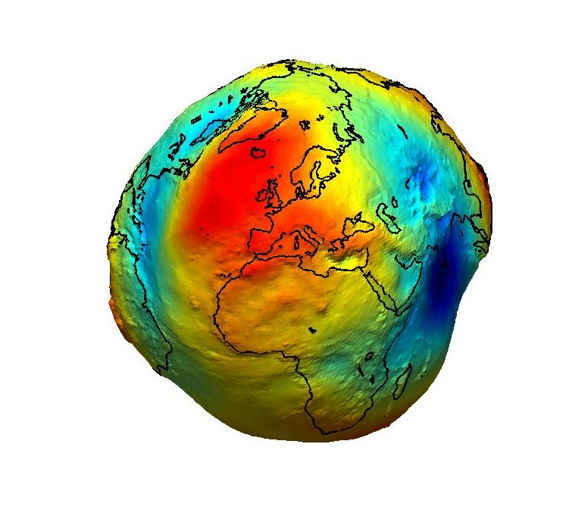
Sea Surface Height Determination
Sea Surface Height, i.e., the distance between the satellite and the ocean surface, depends on five principle factors:
  Geoid
  Ocean Tides
  Atmospheric pressure
  Geostrophic circulation
  Ocean Waves
The geoid is the shape that the surface of the oceans would take under the influence of Earth's gravitation and rotation alone, in the absence of other influences such as winds and tides. This surface is extended through the continents (such as with very narrow hypothetical canals).

Slide 27
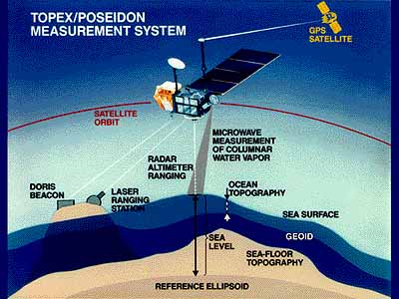
Sea Surface Height: Geoid
We describe the Earth as an ellipsoid
  however, in practice it is not an ellipsoid and the distribution of the mass within the Earth is not uniform.
  The resulting gravitation field of the Earth is also not uniform.
These subtle variations of the gravitation field influence both the ocean surface and the satellite orbit.

Slide 28
Sea Surface Height: Geoid
The deviations of the geoid from the reference ellipsoid range from -104 m to +64 m.
In areas where there are ocean trenches or ridges the geoid height can vary by several meters over a few kilometers.
At present the shape of geoid is not known.
Measuring the distance between the satellite and the Earth surface we can estimate the influence of the gravitation field over land, but not over the ocean. Therefore, sea surface height is referenced to geoid.

Slide 29
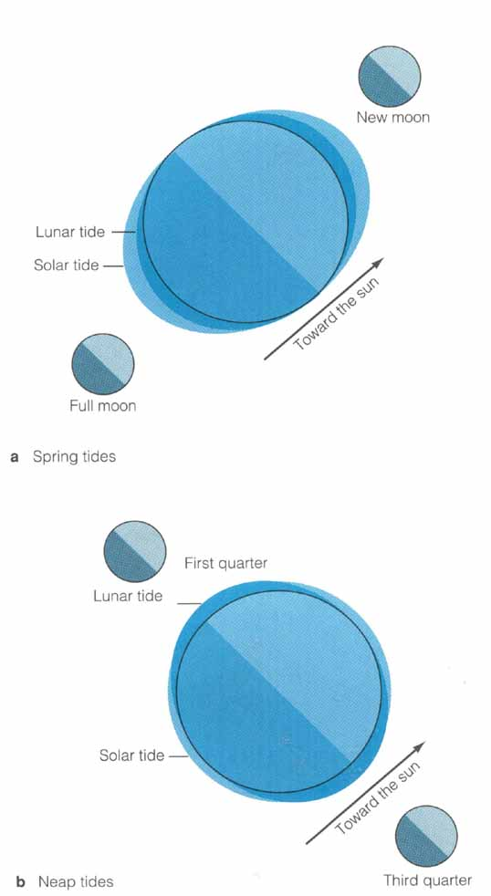
Sea Surface Height: Ocean Tides
Tides are periodic short-term changes in the height of the ocean surface caused by a combination of the gravitational force of the moon and the sun and the motion of the Earth.
When the directions of the moon and sun gravitation coincide (full moon or new moon), the tidal range is maximum (spring tide, above).
When the direction of the sun gravitation is perpendicular to the moon gravitation (first quarter of third quarter), the tidal range is minimum (neap tide, below).

Slide 30
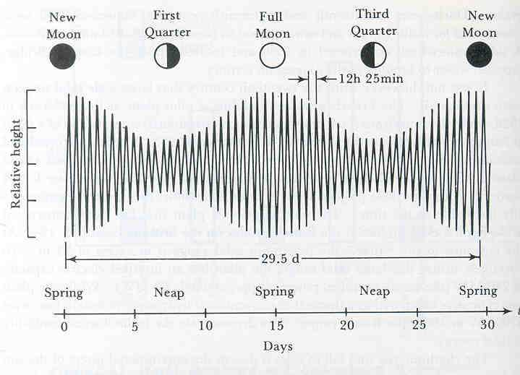
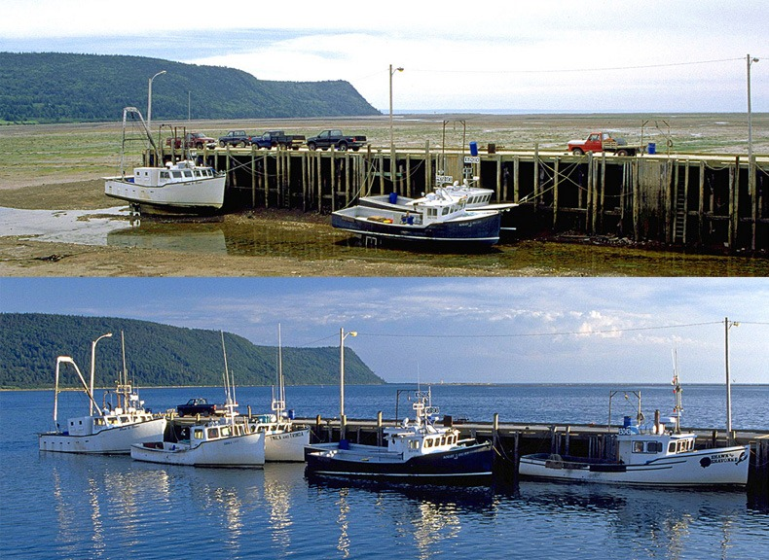
Sea Surface Height: Ocean Tides
Maximum tidal range is up to 15 m (the Bay of Fundy near Moncton, New Brunswick, Canada.
Tides can be estimated from mathematical models and removed from the altimetric measurements.
Altimetric measurements provided a comprehensive information on tidal cycles.

Slide 31
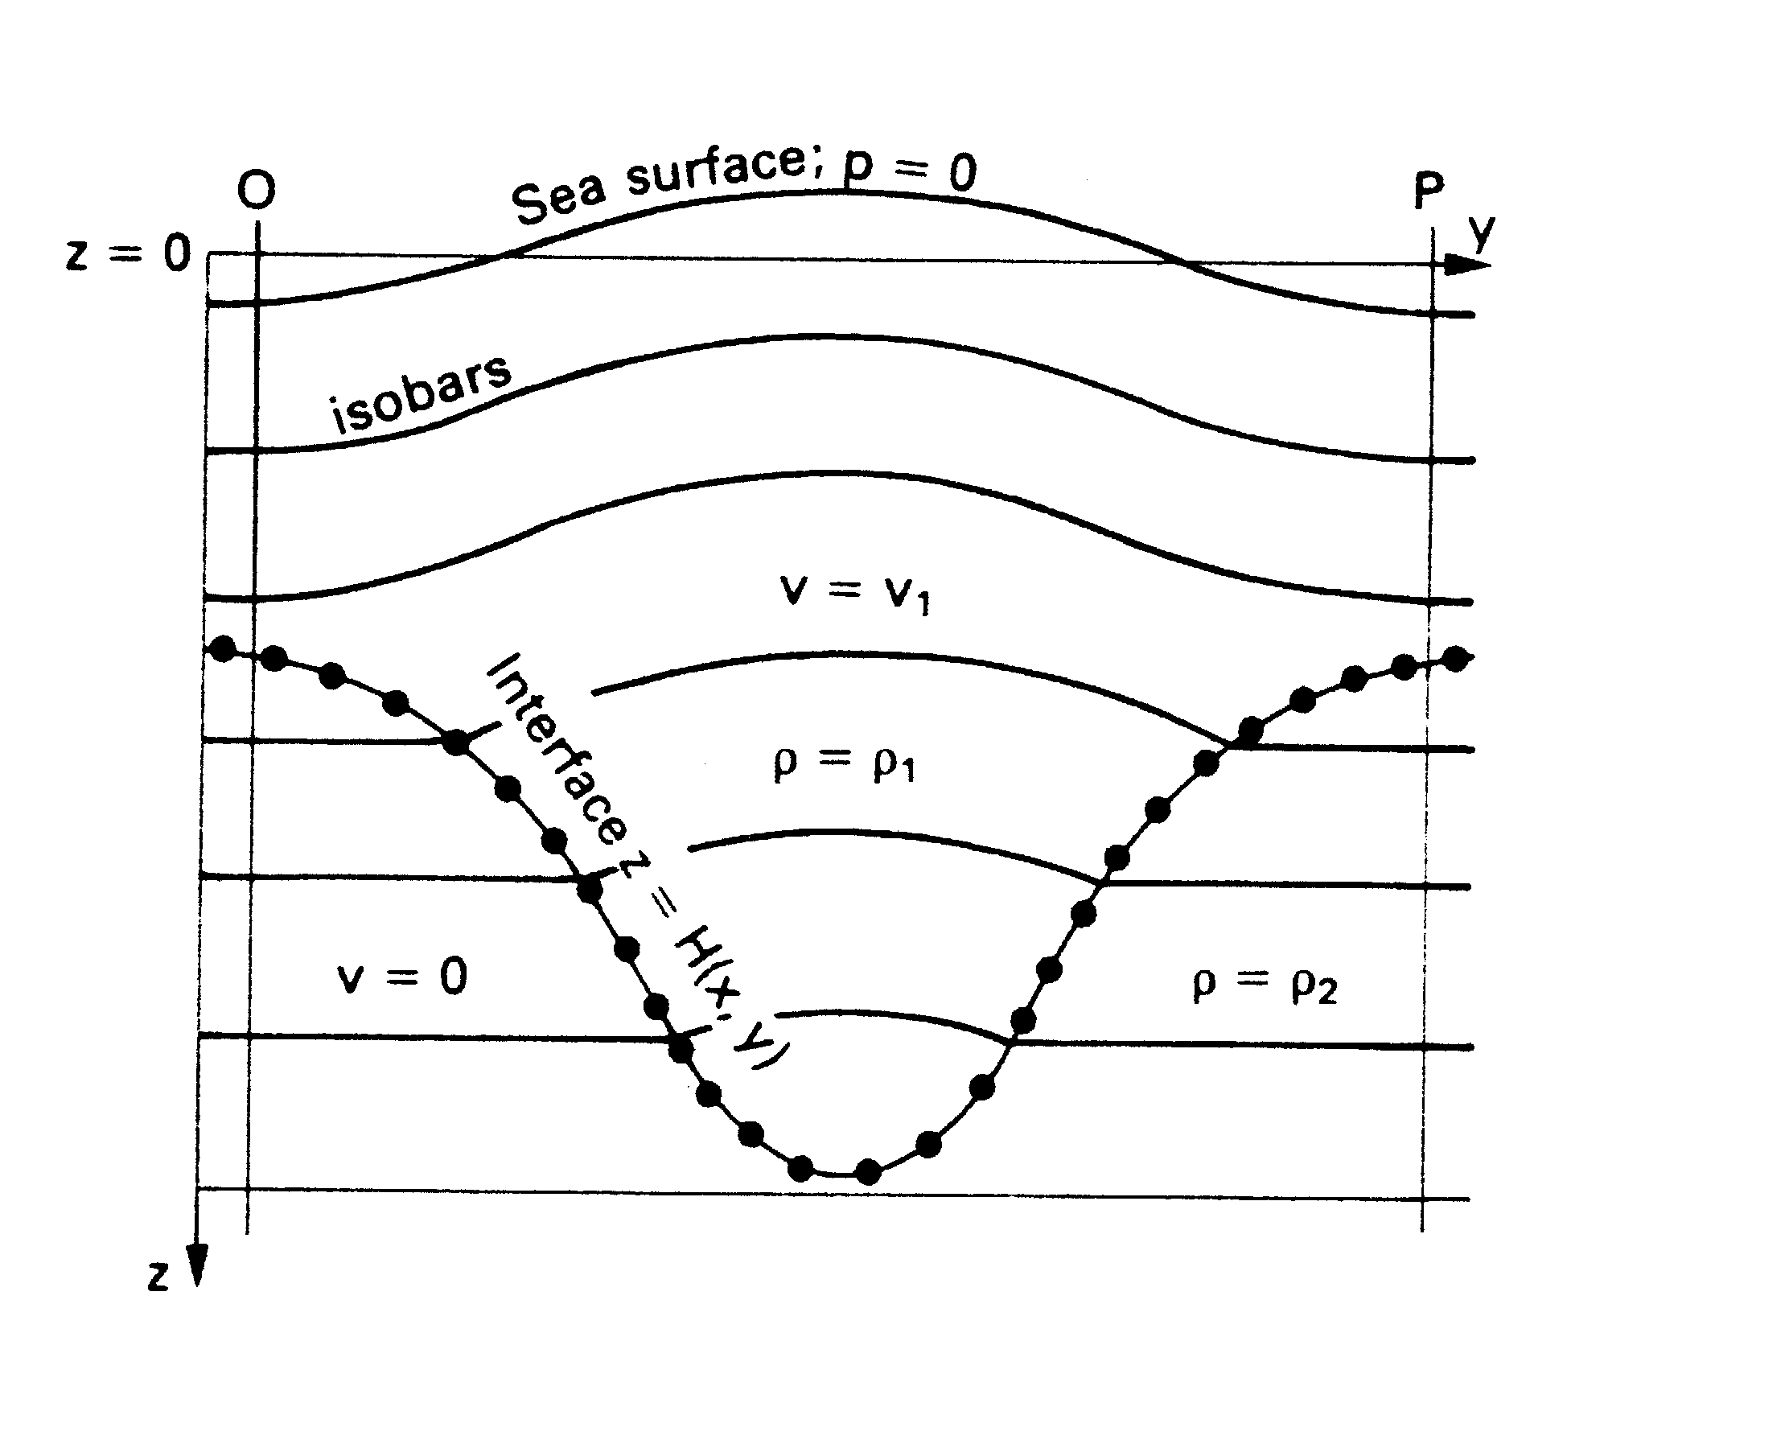
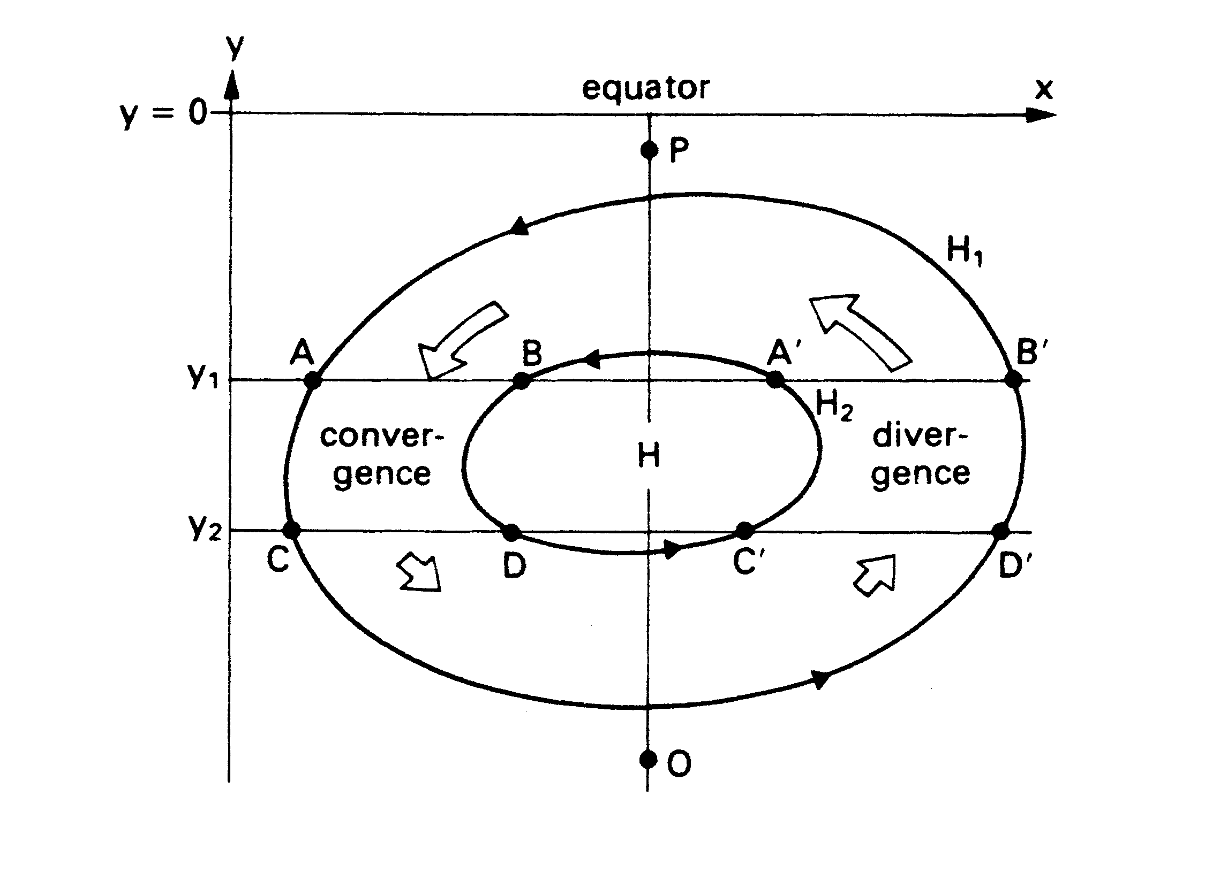
Sea Surface Height: Geostrophic Circulation
Sea Surface Height estimated after removal of tidal variability is attributed to steric height resulting from the differences in the ocean column density (refers to global changes in sea level due to thermal expansion and salinity variations).
From the horizontal gradients of steric height we can estimate geostrophic circulation.
In practice we cannot obtain from altimetry the estimations of steric height because instead of geoid mean ocean surface which includes both geoid and the elements of steady ocean circulation is used.
The most productive way of analysis of sea surface topography is mathematical modeling with data assimilation.

Slide 32
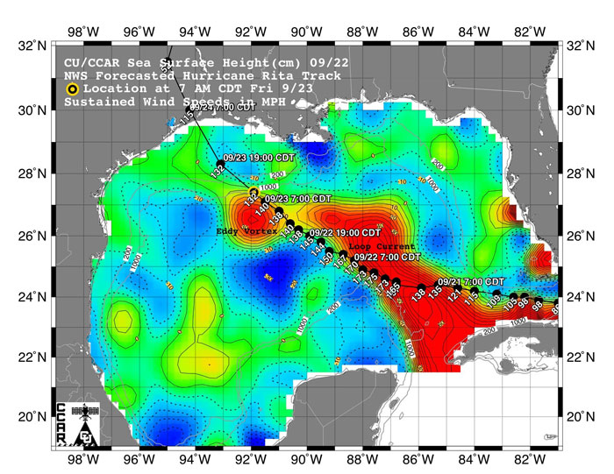
Sea Surface Height- Hurricane
Hurricane Rita in the Gulf of Mexico.

Slide 33
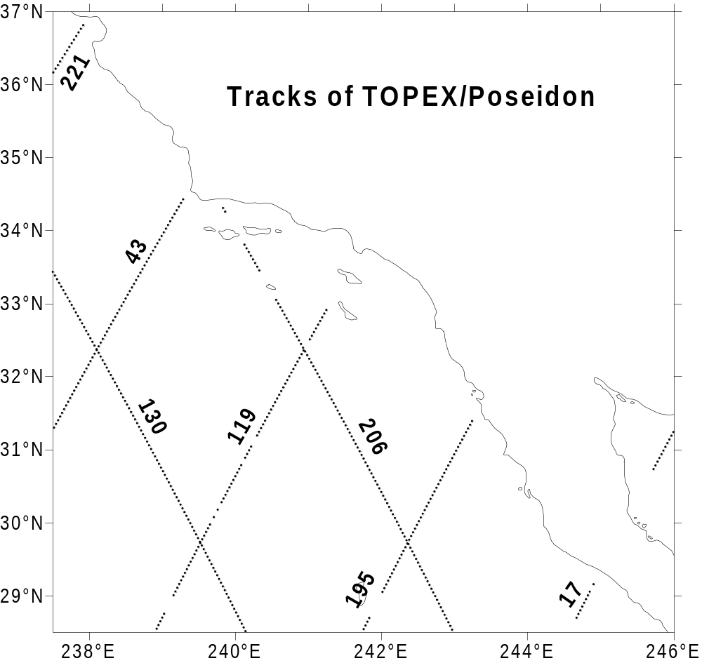
Sea Surface Height
The TOPEX/Poseidon truck numbers off southern California

Slide 34
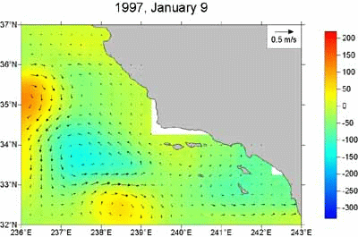
Sea Surface Height
Example of sea surface topography dynamics off California.

Slide 35
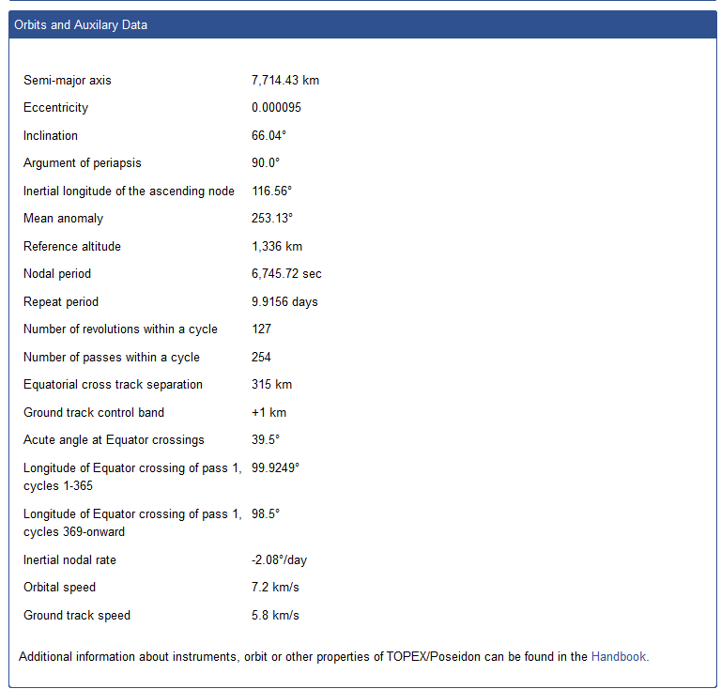
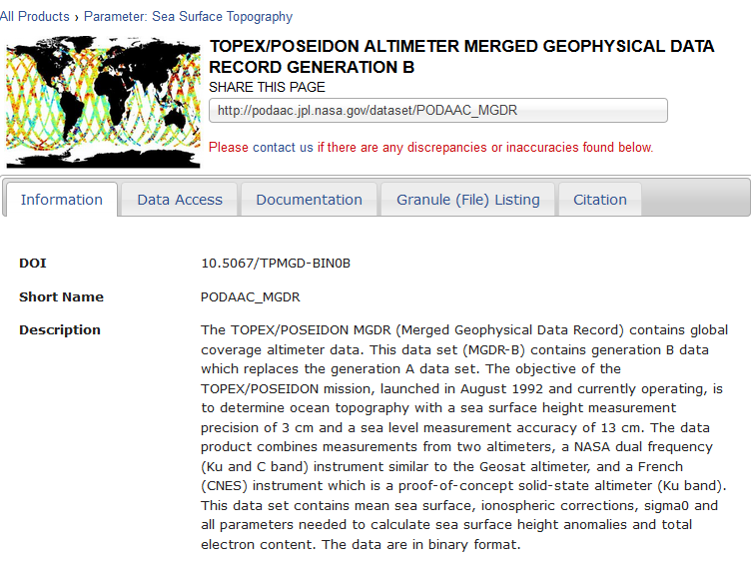
Data Access
The data collected by TOPEX/Poseidon and Jason-1 can be obtained from various sites but the “PODAAC” site is the best:
http://podaac.jpl.nasa.gov/datasetlist?ids=Measurement&values=Sea+Surface+Topography#
There are many ways to access the data and different formats.
https://podaac.jpl.nasa.gov/TOPEX-POSEIDON

Slide 36
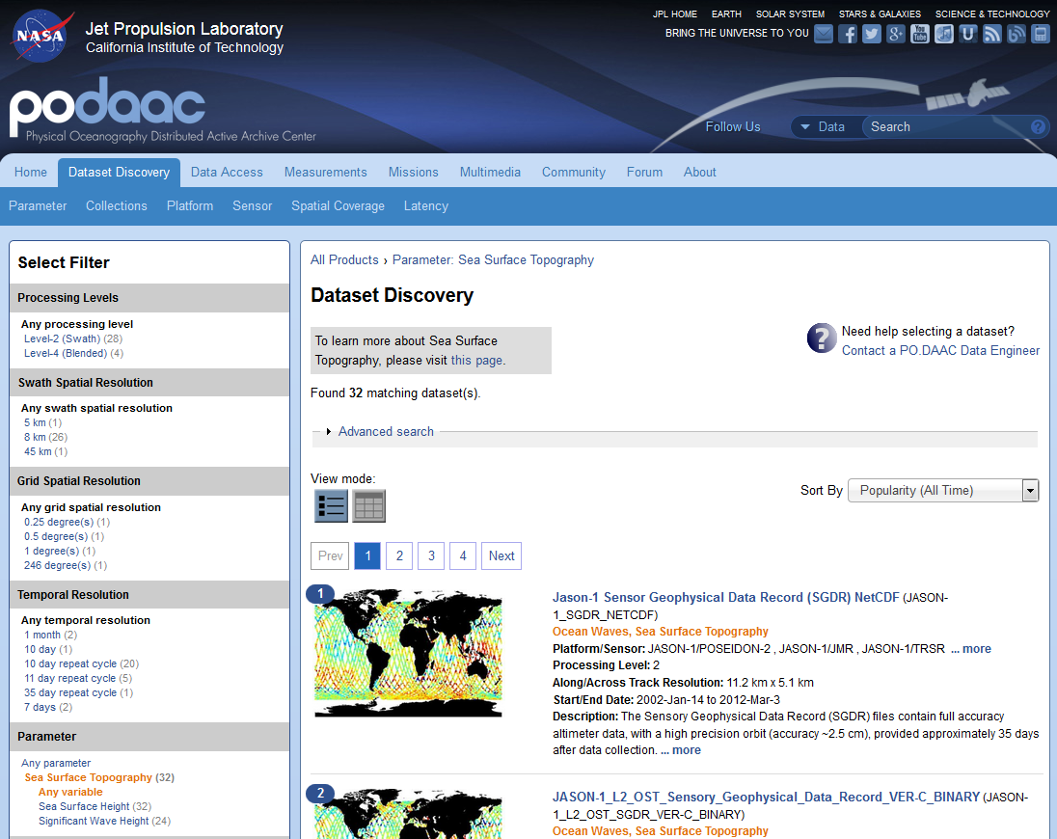

Slide 37
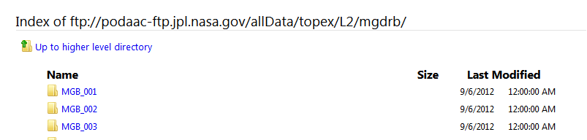
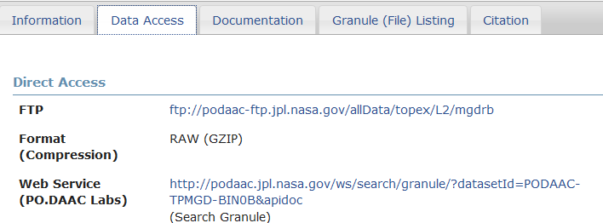
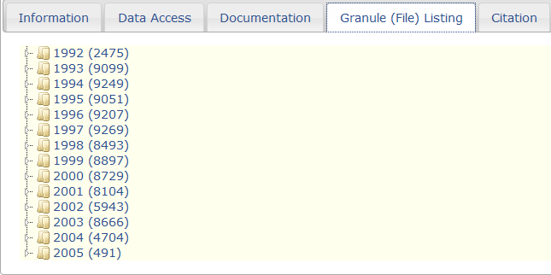
Data Access

