Slide 1

TRMM Introduction
MET 611 – Satellite Data Applications
Jennifer D. S. Griswold

Slide 2

TRMM Background
Joint mission between NASA and JAXA
Launched on November 27, 1997 from Tanegashima, Japan
Monitors rainfall in the TROPICS
Part of the NASA Mission to Planet Earth
After over 17 years of productive data gathering, the instruments on TRMM were turned off on April 8, 2015. The spacecraft re-entered the Earth’s atmosphere on June 15, 2015, at 11:55 p.m. EDT, over the South Indian Ocean

Slide 3
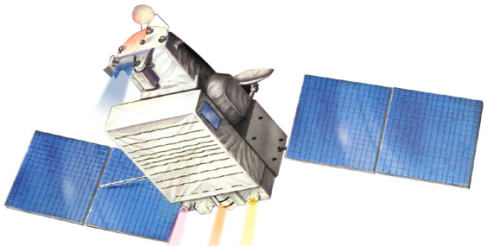
TRMM
TMI
VIRS
PR
CERES
LIS
Launched November 27, 1997

Slide 4
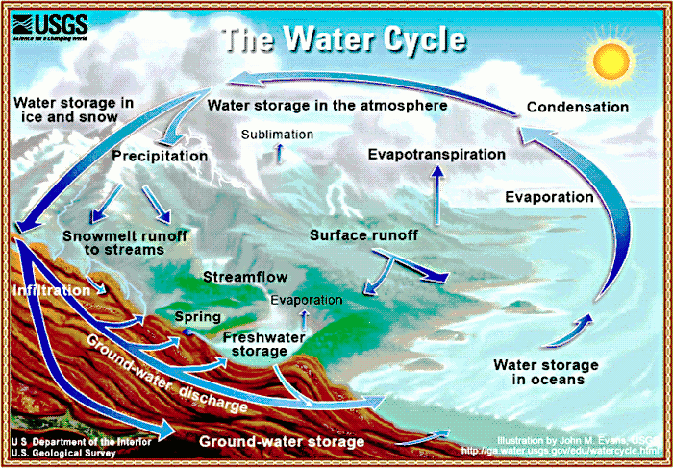
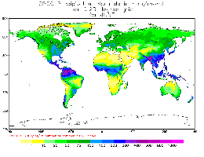
Why TRMM?
Accurate measurements of rain are crucial
  rain is extremely important for weather, climate, and energy cycle of the earth
Tropical rainfall plays a critical role in driving atmospheric motion releasing latent heating
  2/3rd of the global rainfall occurs in the tropics
Information on intensity and amount of rainfall in the tropics was incomplete – especially over oceans prior to satellite coverage
Rain gauge coverage over Land

Slide 5
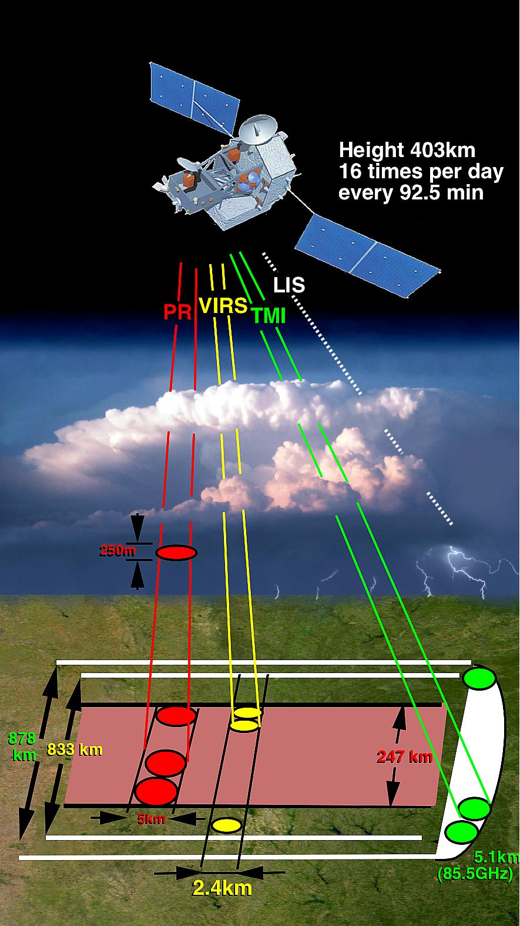
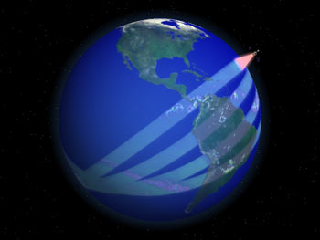
TRMM Specifications
Orbit: 350 km
Inclination Angle: 35˚
Non-sun-synchronous
    Revisit Frequency: 11-12 hours
Track Speed: 6.9 km/s
Area covered: 35˚N to 35˚S

Slide 6
Active and Passive Microwave Remote Sensing of Precipitation:
Overview of tropical rainfall science objectives
  The Tropical Rainfall Measuring Mission (TRMM)
TRMM sensors and status of TRMM rainfall products
  Spacecraft, spatial resolution, swath width, sensor characteristics, and unique characteristics
Science results – Some examples of using TRMM

Slide 7
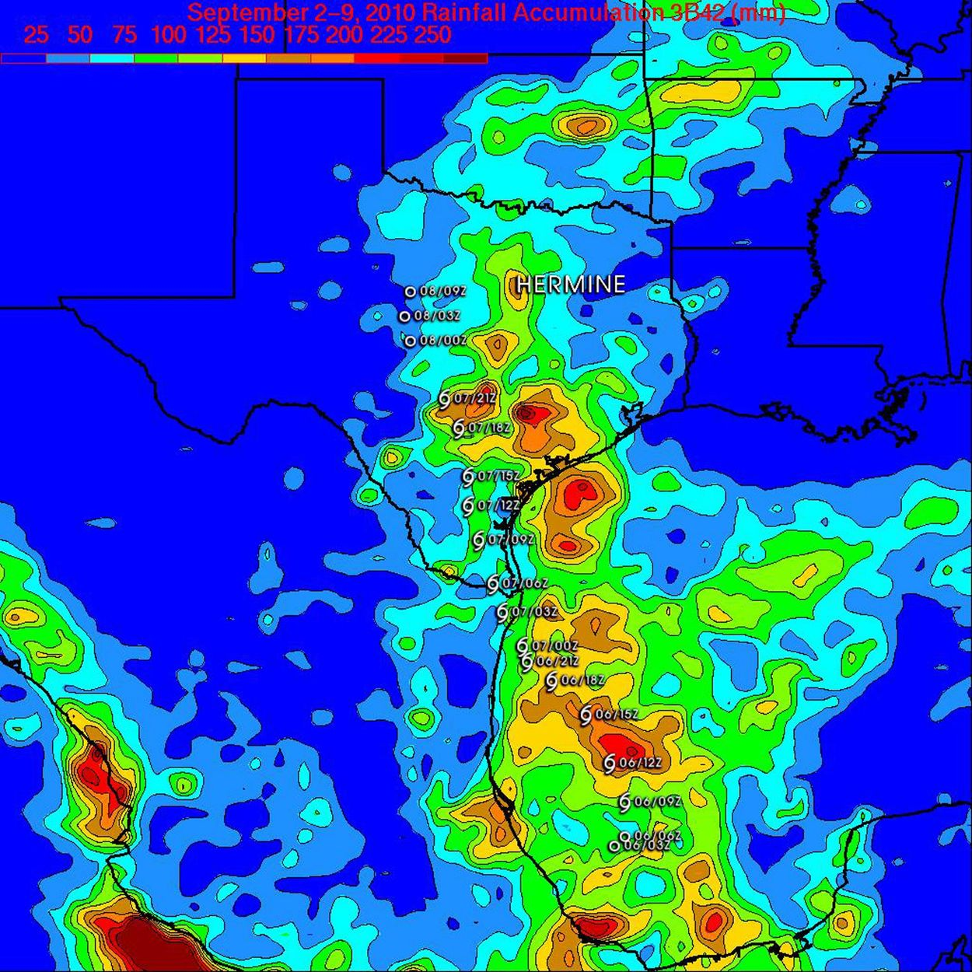
Tropical Rainfall Goals
Advance the understanding of the global energy and water cycles, climate and weather by providing observations of tropical rainfall and latent heating distributions
Understand the mechanisms by which tropical rainfall influence global circulation to
  improve ability to model these processes and
  predict global circulation and rainfall variability at monthly or longer time scales
Obtain a quantitative description of the diurnal variability of tropical rainfall

Slide 8
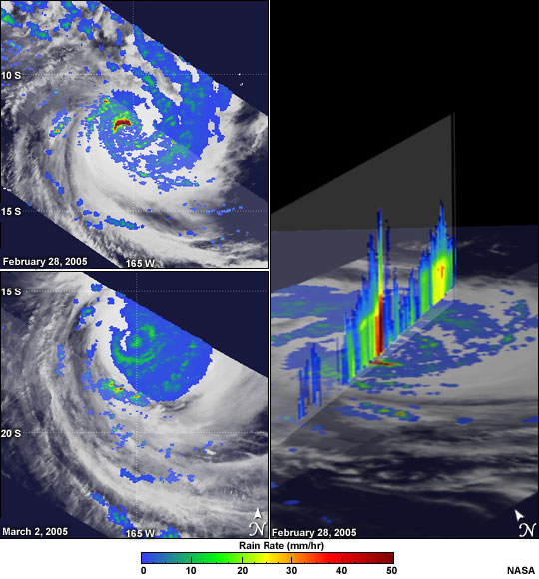
Tropical Rainfall Goals
Provide cross-calibration between TRMM and other sensors to produce long-term rainfall analysis
Demonstrate the science benefits of a space-borne system for measuring rainfall and build strong consensus algorithms for future missions

Slide 9

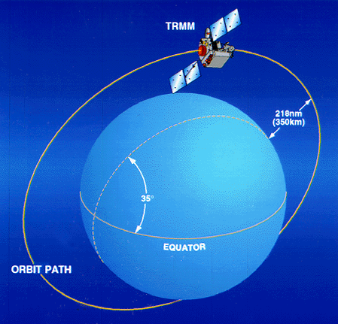
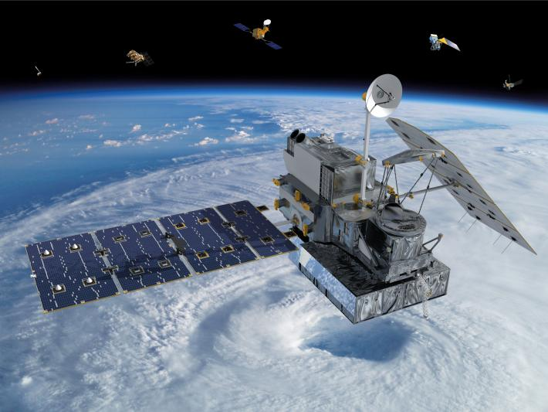
TRMM Orbit
A precessing Low-Inclination (35°)
Low-altitude (350 km) orbit
Designed to achieve high spatial resolution and capture the diurnal variation of tropical rainfall
Notes:
Before we can justify flying a fleet of satellites to observe rainfall from space, we must first demonstrate that we can achieve high-quality rainfall measurements from space. TRMM was meant to provide that proof-of-concept demonstration using one satellite. The necessary compromise was reduced global coverage and temporal sampling.
The issue of limited sampling had, no doubt, been a factor in promoting TRMM as a climate observation program, but that was before using these observations in data assimilation. We now know that we can derive tremendous from space-based rainfall observations even with limited sampling, a point that I will return to later.

Slide 10
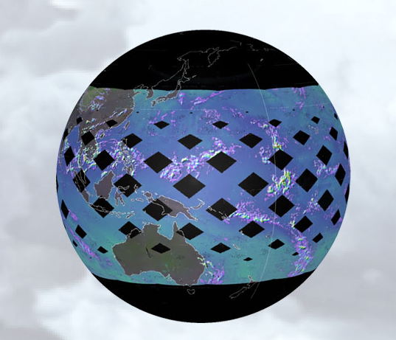
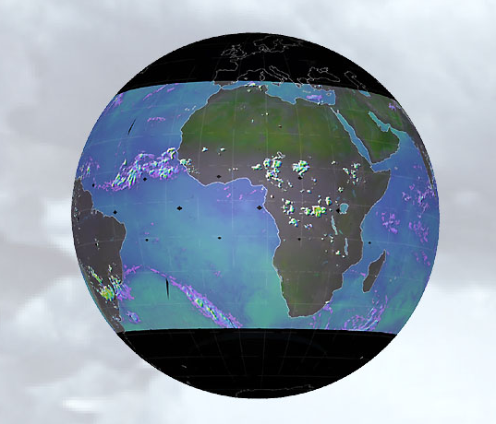
TRMM Coverage
1 day coverage
2 day coverage
Notes:
Before we can justify flying a fleet of satellites to observe rainfall from space, we must first demonstrate that we can achieve high-quality rainfall measurements from space. TRMM was meant to provide that proof-of-concept demonstration using one satellite. The necessary compromise was reduced global coverage and temporal sampling.
The issue of limited sampling had, no doubt, been a factor in promoting TRMM as a climate observation program, but that was before using these observations in data assimilation. We now know that we can derive tremendous from space-based rainfall observations even with limited sampling, a point that I will return to later.

Slide 11
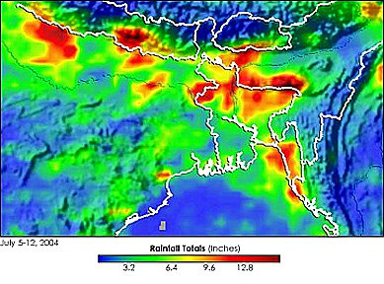
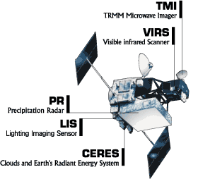
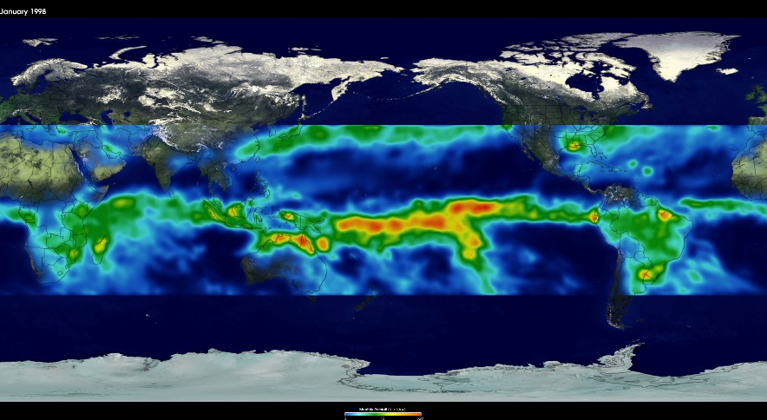
Instruments on Board
TRMM Microwave Imager (TMI)
Precipitation Radar (PR)
Visible and Infrared Scanner (VIRS)
Cloud and Earth’s Radiant Energy System (CERES)
Lightning Imaging Sensor (LIS)

Slide 12
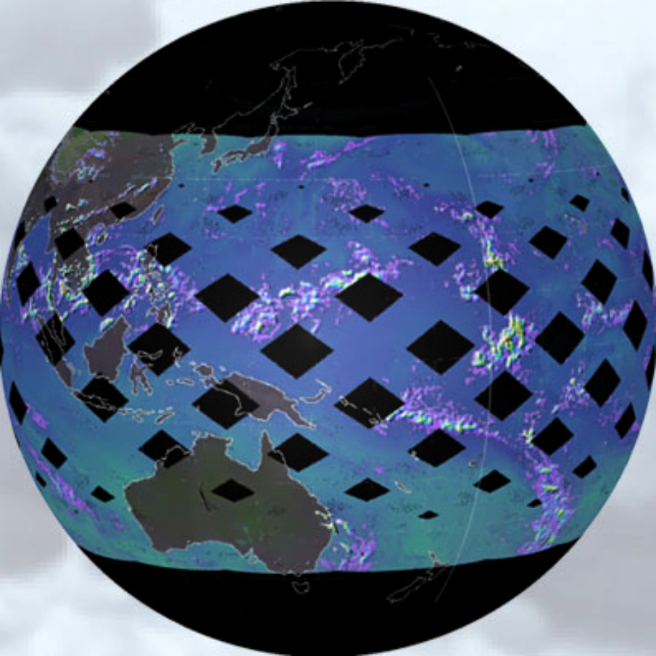
TRMM’s Tropical Perspective
Precipitation Radar (PR)
  13.8 GHz radar with 215 km swath width and 4.3 km footprint
TRMM Microwave Imager (TMI)
  Conically scanning, passive microwave radiometer with 760 km swath (10.7-85.5 GHz)
Visible & Infrared Scanner (VIRS)
  Medium-resolution, 5 spectral band imager with 2.2 km resolution
Lightning Imaging Sensor (LIS)
  Rate, location, and radiant energy of lightning flashes
CERES
  Measures Earth’s shortwave, longwave, and net radiant energy budget with a swath width of 720 km

Slide 13
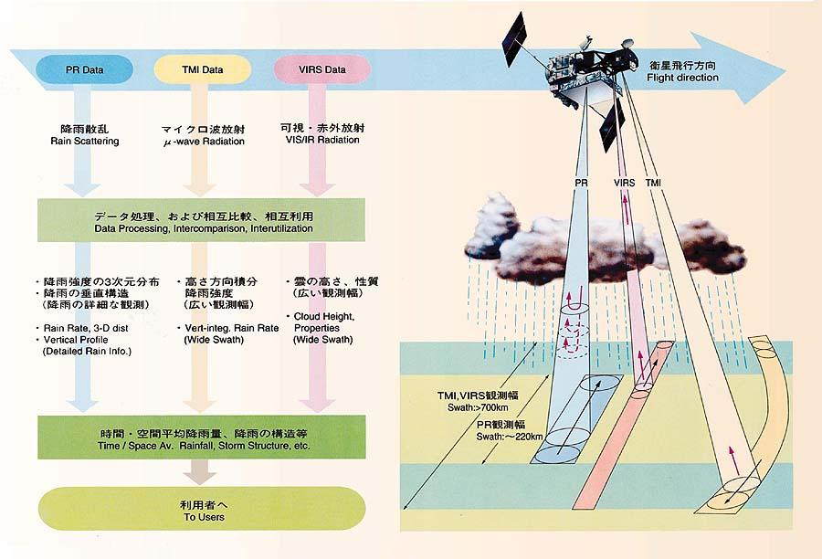
TRMM Sensors
Notes:
TMI is conical scanning. PR and VIRS are cross-tracking.
PR provides detailed rain structure information. One drawback of the PR is the low sensitivity at small rain rates, with an 18 dBZ threshold (0.5 mm/hr). But it is very good at identifying convective and stratiform rain separation.
The combination of active and passive sensors allows investigation of constraining parameters such as the Drop-Size-Distribution (DSD).
One of TRMM’s objectives is to use the microwave sensors as flying rain gauges to test and calibrate geosynchronous satellite rainfall estimates. The purpose of VIRS is to enable TRMM to establish the connection between microwave and operational geostationary measurements thus serving as a flying rain gauge.
Calibrated and Earth located data are referred to as Level 1 data. Level 2 data are retrieved geophysical parameters at the satellite footprint level. Level 3 data are either time or space averaged geophysical parameters.
Versions 1 & 2 were pre-launch test codes. Data have been reprocessed to V4 beginning on Sept 1, 1998 and to V5 on Oct 1, 1999. Two additional reprocessing are planned.

Slide 14
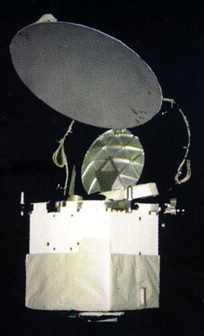
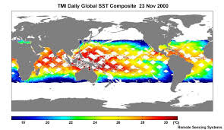
TRMM Microwave Imager (TMI)
9-channel passive microwave radiometer
  Frequencies: 10.65, 19.35, 21.3, 37, 85.5 GHz
  Horizontal and vertical polarizations
  Reads rainfall, water vapor, and cloud water
  mass of 65 kg
  power of 50 W
Scan Geometry
  Swath: 758.5 km
  Off-nadir: 52.8 Incident Angle
  Conical Scan: 130˚
    55 incident angle at Earth’s surface
Spatial Resolutions:
  4.4 km (85.5 GHz)
  45 km (10.7 GHz)

Slide 15
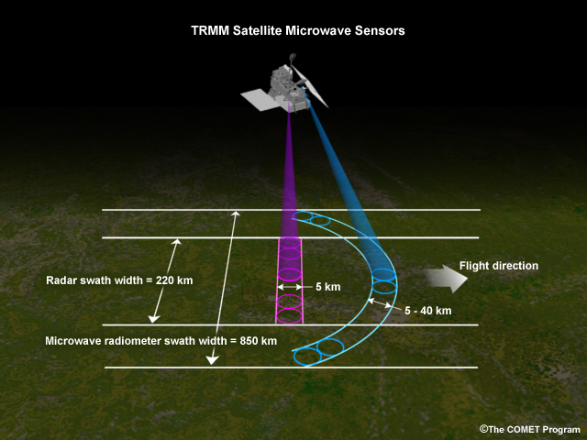
Scan Geometry of TMI

Slide 16
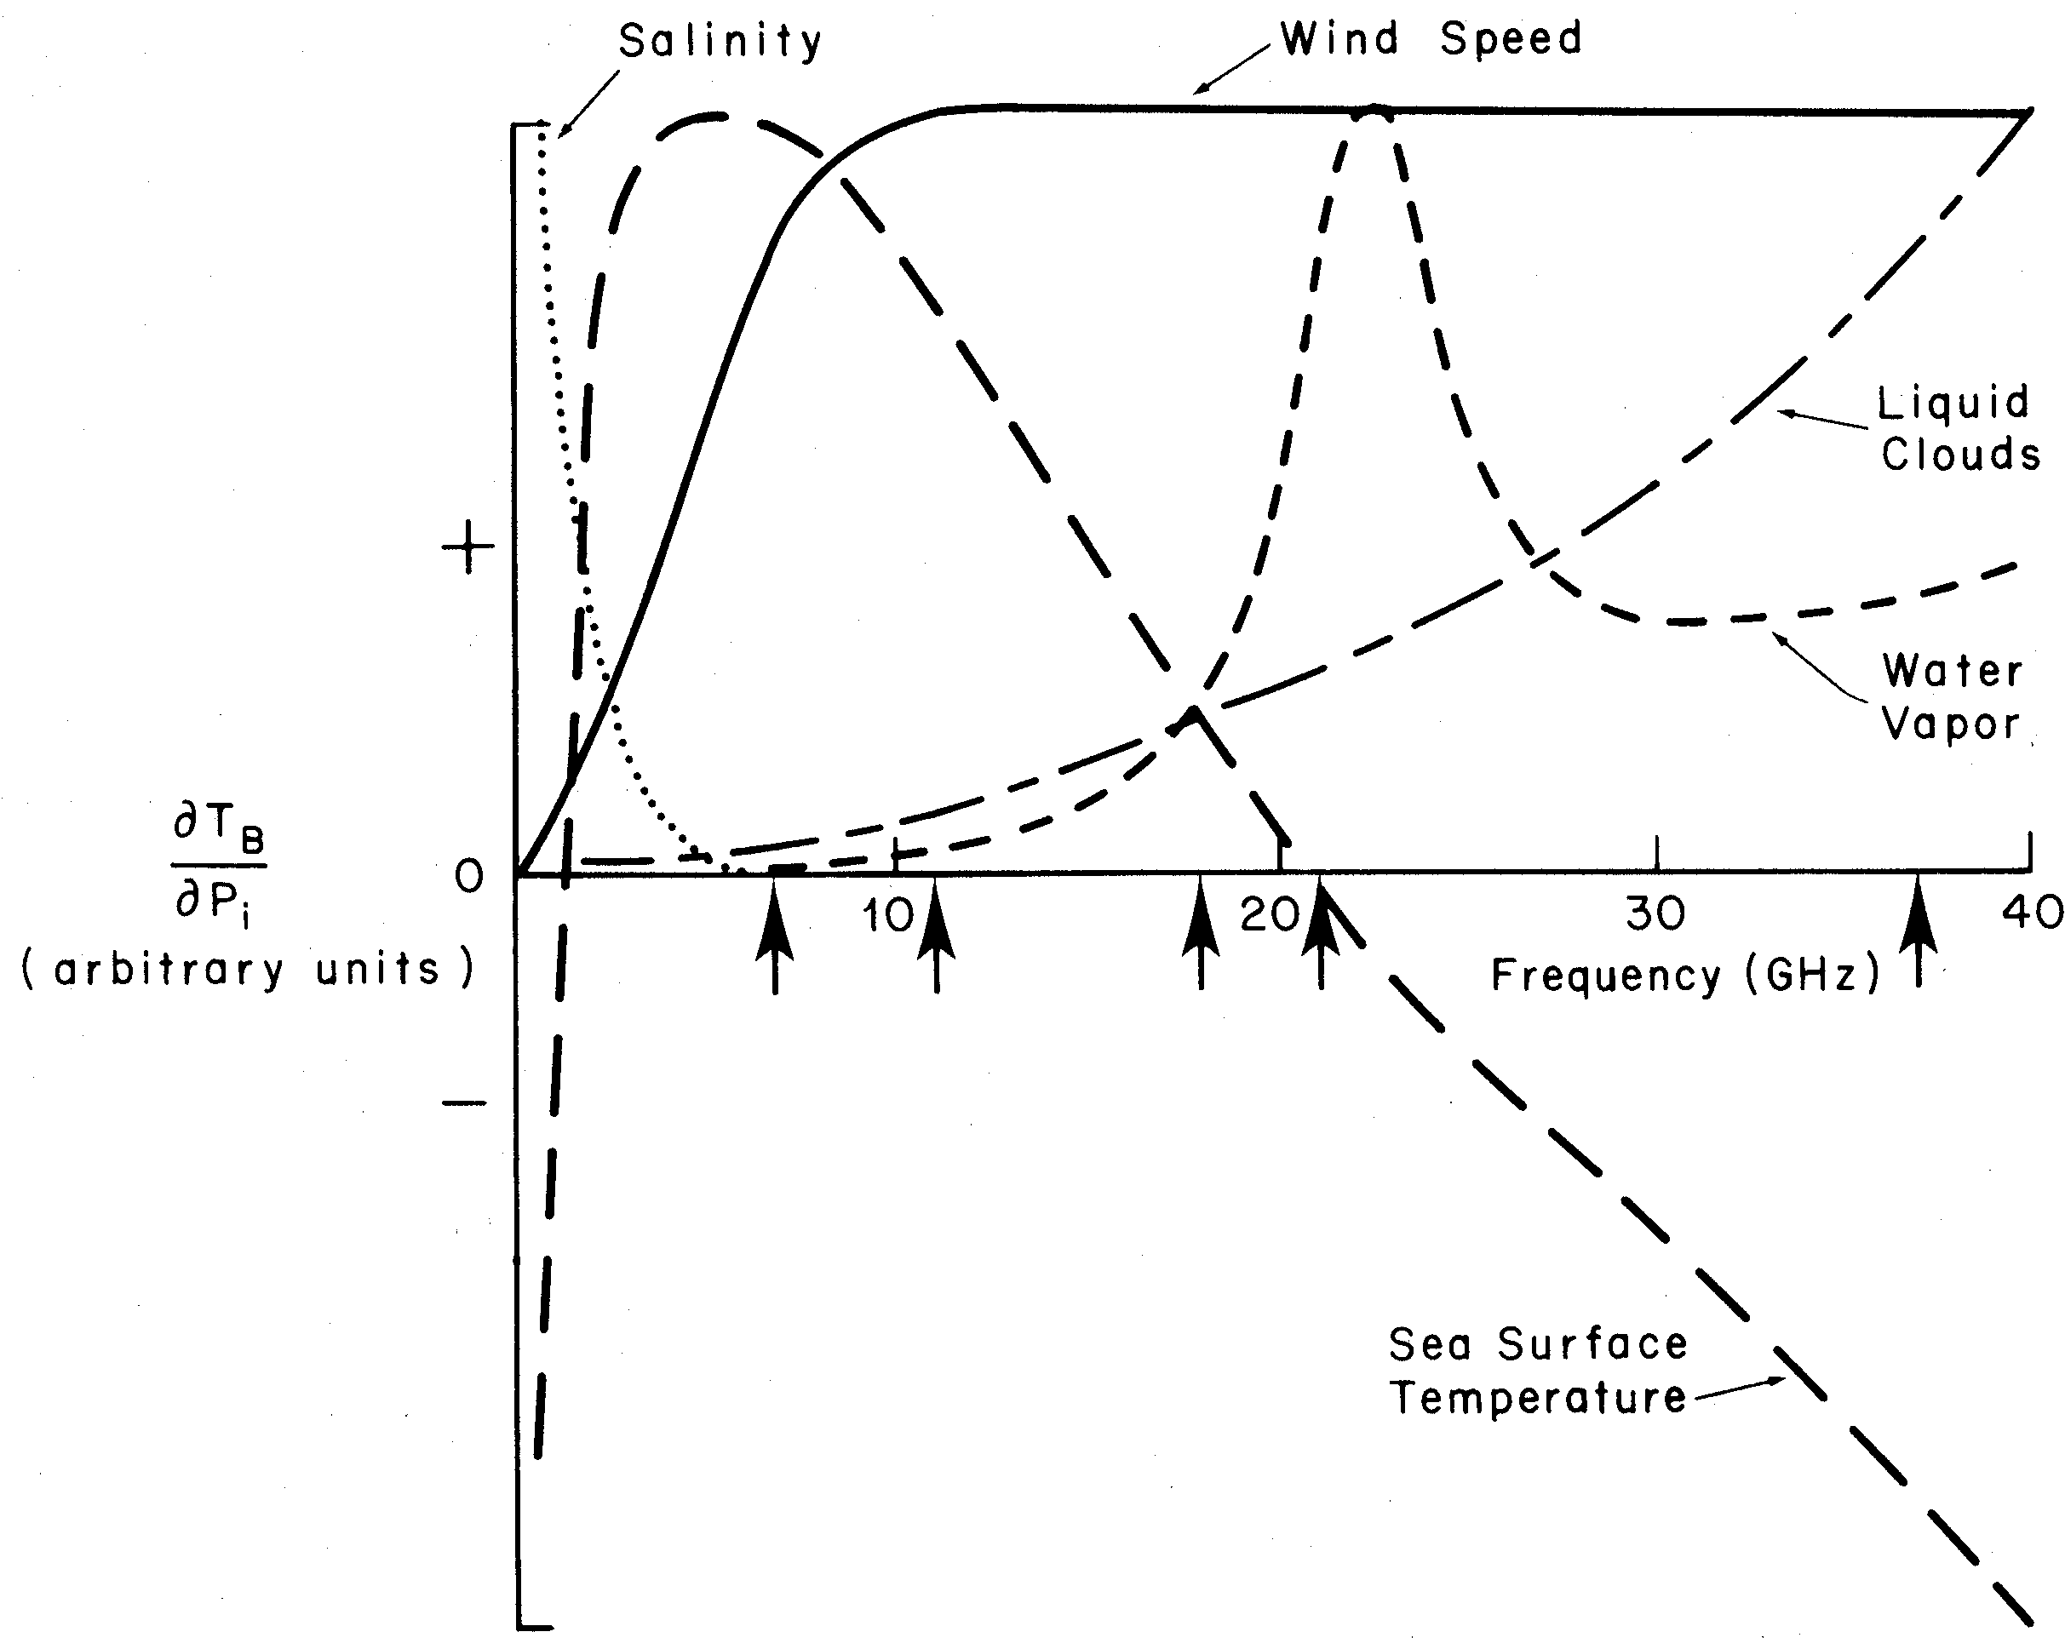
TRMM Microwave Imager
Passive microwave imager
  Day and night, clear and cloudy
  Brightness temperature of ocean and atmosphere (“T_{b}”)
  SST, roughness, foam, salinity
  Oxygen, water (vapor, liquid)
Multiple frequencies (GHz)
  10.7, 19.35, 37.0, 85.5
  10.7 GHz used for SST
Geophysical Parameters (accuracy)
  Wind speed (~1-1.6 m/s)
  Column water vapor (~1.2 mm)
  Column liquid water (~0.025 mm)
  Column rain rate (0.3 km*mm/hr)

Slide 17
Radiative Transfer in the Microwave
The intensity of radiation I_{λ} is defined by
I_{λ} =
where
  P_{λ} = power within wavelength range dλ coming from a surface area dA and propagating into the solid angle dΩ
  θ_{i} = incident zenith angle with respect to the normal to surface area dA
From blackbody radiation, the emitted radiation follows Planck’s law
I_{λ} = ~
where
  c = speed of light (2.998 x 10¹⁰ cm s⁻¹)
  h = Planck’s constant (6.626 x 10⁻²⁷ erg s)
  k = Boltzman’s constant (1.381 x 10⁻¹⁶ erg K⁻¹)
P_{λ}
cosθ_{i} dλ dA dΩ
2hc²
2kcT_{b}
λ⁵ [exp(hc/λkT) – 1]
λ⁴
Rayleigh Jeans Approximation
λ ˘ hc/kT

Slide 18
Sea Surface Temperature from TMI
The measured radiance (intensity) is proportional to brightness temperature in the microwave
At 10.7 GHz (λ = 3 cm), the microwave brightness temperature is a strong function of sea surface temperature
High-resolution SST measurements through clouds from TMI data provided early detection of the 1998 La Niña and instability waves (Wentz, Science, 1999)
Improved prediction of tropical cyclone track

Slide 19
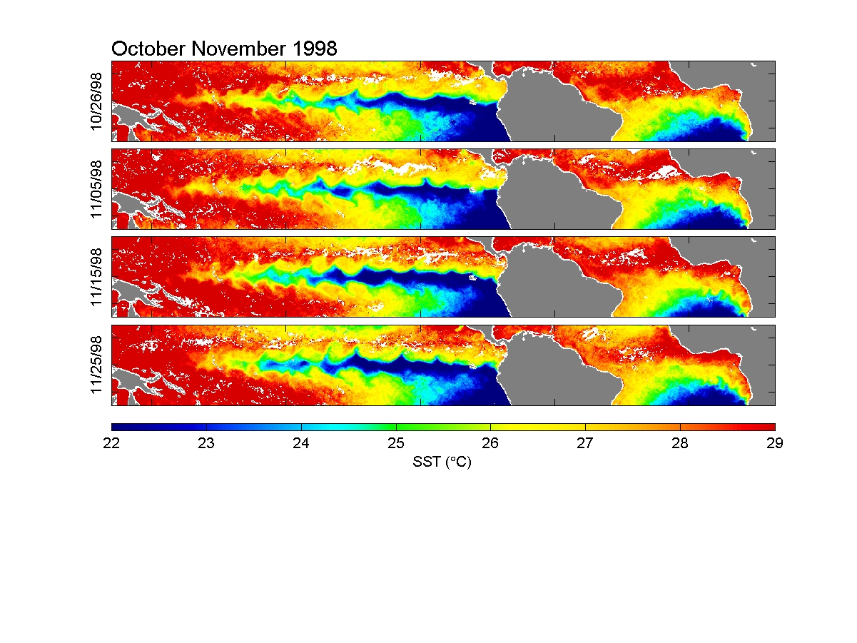
Sea Surface Temperature from TMI Led to Early Prediction of La Niña

Slide 20
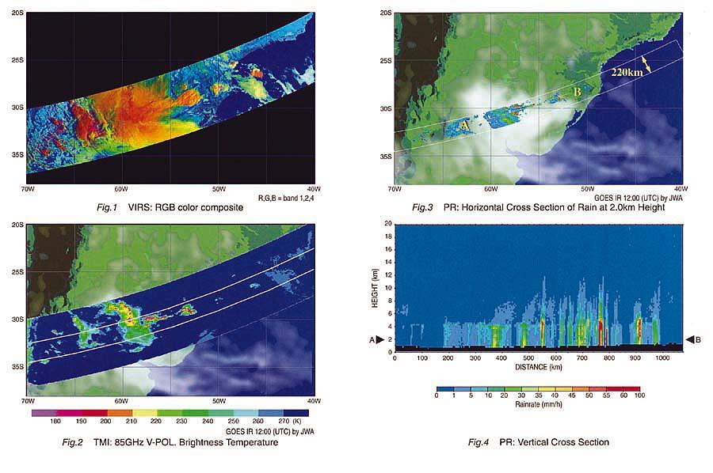
Microwave Brightness Temperature Observed by TMI over Argentina
TMI- 85 GHz V-polarization
GOES IR background image
Notes:
PR for validation. Peter Bauer produces PR-adjusted TMI data.

Slide 21
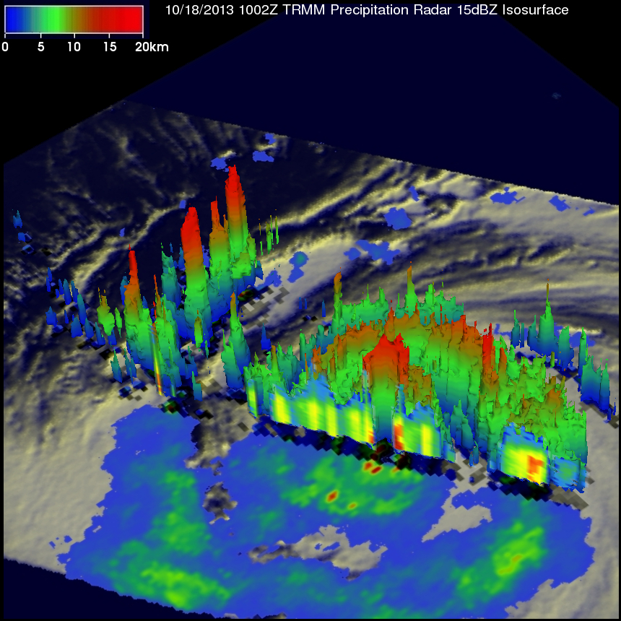
Precipitation Radar (PR)
Active Rain Radar
Frequency: 13.8 GHz
Scan Geometry:
  Nadir
  Spatial Resolution: 4.3 km
  Range Resolution: 250 m
  Swath: 215 km
  vertical profile from surface to 15 km
  128 element active phased array radar
  13.796 and 13.802 GHz
Sensitivity
  minimum measurable rain rate of 0.5 mm hr⁻¹

Slide 22
Scan Geometry of PR

Slide 23
PR Image and Cross Section of Precipitation over Argentina
Horizontal Cross section of rain at 2 km height
Vertical Cross section of rain
Notes:
PR for validation. Peter Bauer produces PR-adjusted TMI data.

Slide 24
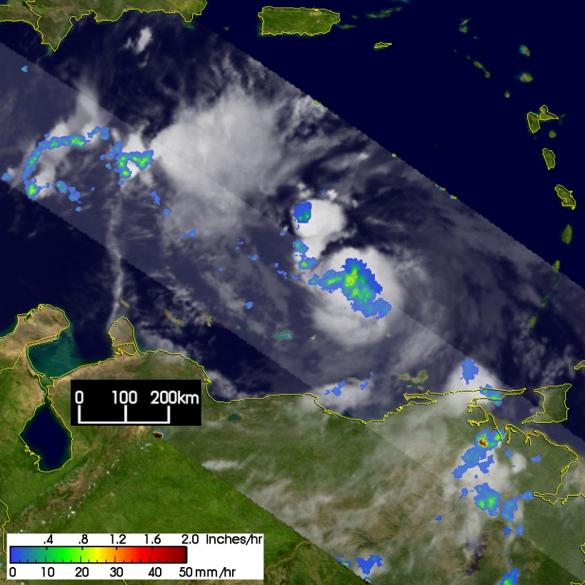
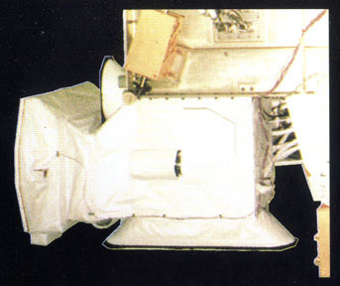
Visible Infrared Scanner (VIRS)
5-channel visible and infrared passive radiometer
  Wavelengths: 0.6-12μm
  Reads brightness and temperature
Scan Geometry – Cross Track
  Swath: 720 km
  IFOV: 2.11 km nadir
  Spatial resolution of 2 km
Radiometric Properties:
  Channels 1 and 2 read solar energy
  Channels 3-5 read thermal energy
Main purposes
  Cloud distribution and height
  Rain estimates from brightness temperature

Slide 25
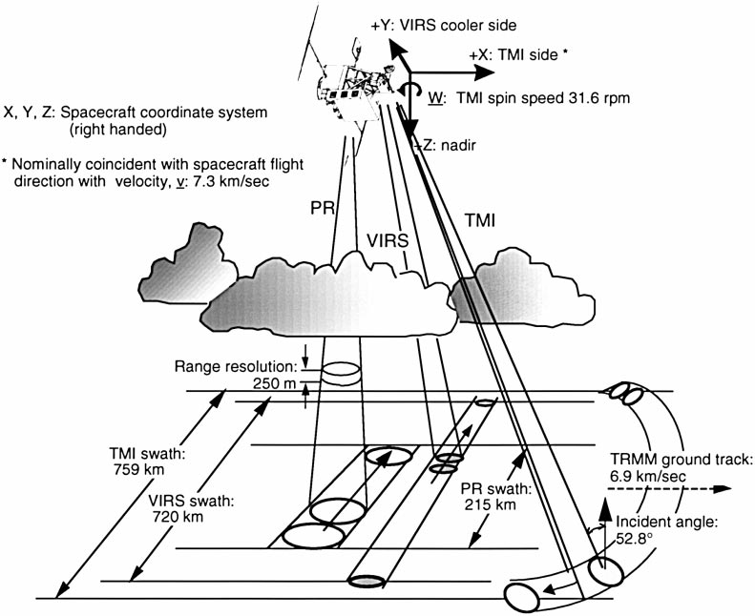
Scan Geometry of VIRS
Reference: Kummerow et al 1998

Slide 26
Clouds over Argentina from VIRS
R = 0.63 µm G = 1.6 µm B = 10.7 µm
Notes:
PR for validation. Peter Bauer produces PR-adjusted TMI data.

Slide 27
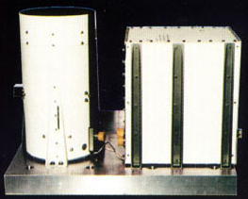
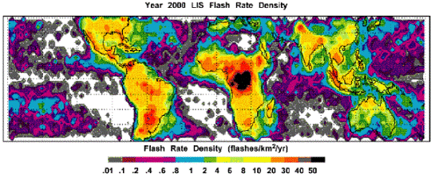
Lightning Imaging Sensor (LIS)
Sensor Characteristics
  uses 128 x 128 element CCD-based camera
  one narrow-band filter at 0.777 µm
  swath of 600 x 600 km
  spatial resolution of 5 km
Lightning detection:
  event processor to subtract out the bright background during daylight
    instrument takes data day and night

Slide 28
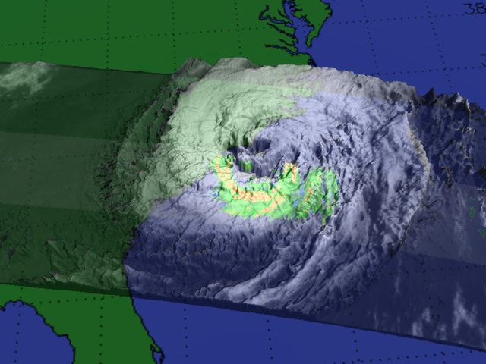
TRMM: Unprecedented Views of Hurricanes

Slide 29
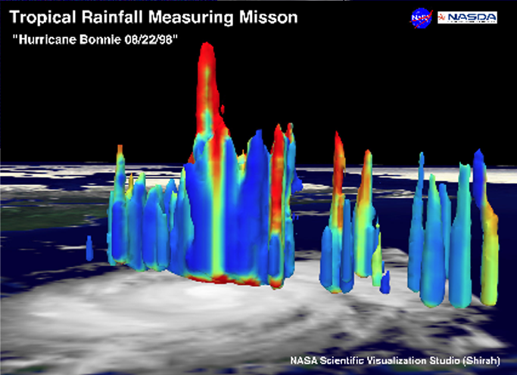
TRMM Provides Unprecedented Insight into Hurricane Structure
Hurricane Bonnie
  Tall Clouds (59,000 ft) observed during Hurricane Bonnie
  These observations were circulated in NY Times & Washington Post
  Animations played in virtually every television market around the country

Slide 30
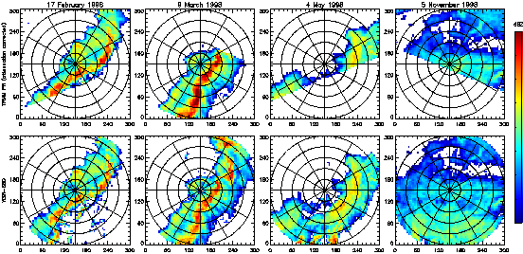
PR and Melbourne Radar Comparison
Reflectivity & RR comparisons over 4x4x1.5 km cells for 24 overpass cases
Good agreement in area-averaged rain rates with correlation coefficient = 0.95
TRMM PR
Pixel-avg. rain rate
Melbourne, FL radar
Radar Reflectivity (dBZ)
Notes:
Despite the different DSD and C/S classifications, the comparison shows good agreement.

Slide 31
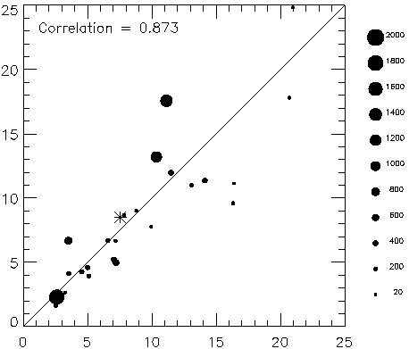
PR and Melbourne Radar Comparison
Pixel-averaged rain rate
Rain rate from TRMM PR (mm/h)
Rain rate from WSR-88D (mm/h)
Notes:
Despite the different DSD and C/S classifications, the comparison shows good agreement.

Slide 32
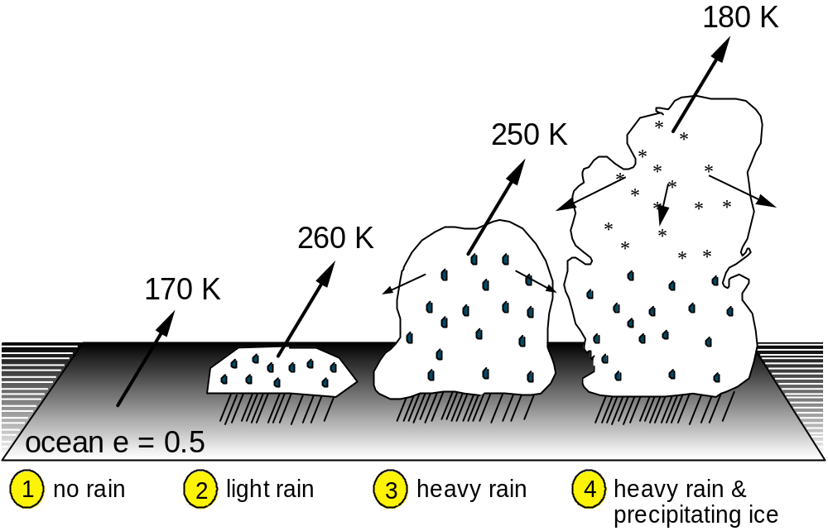
Passive Microwave Sensing of Rainfall
In the microwave region, the ocean emits radiation proportional to its temperature and emissivity (ε₃₇ ~ 0.5)
Cloud water and cloud ice scatter this radiation both upwards to the satellite and backwards to the surface
Microwave radiance at 37 GHz
Notes:
Useful info about rain (not saturated) between 1 and 2.
When signals become dominated by ice (3 to 4), it becomes a less direct measure of rain.
But over land the background is high, the contrast between liquid water emission and land emission is small (between 1 and 2).
No rain: the ocean surface has a low emissivity (~0.5), so even though the surface temp is ~300 K, the upwelling radiance is only 170 K.
(2) Light rain: cloud with few mm/hr rain rate produces strong absorption and emission. The cloud behaves almost as a blackbofy, obscuring the surface, and emitting with a temp close to the temp near the cloud top (260 K).
(3) Heavy rain: cloud absorbs and emits as in (2), but with the greater proportion of large raindrops weakly scattering the upwelling radiance, depleting it somewhat (250 K).
(4) Heaving rain with precipitating ice: precipitation-size ice particles scatter the upwelling radiance significantly, greatly reducing the radiance emerging from cloud top (180 K).
Uncertainties in GPROF rain estimates result from (a) systematic errors in the cloud/radiative models, and (b) random errors associated with a lack of information in the microwave radiance data (i.e., more than one rain rate associated with a given set of observations).
The errors due to (a) can be reduced using more representative cloud models, including improved DSD and melting physics. Also better radiative transfer models, such as reverse Monte Carlo, would help our simulations at higher frequencies for which scattering by precipitation is important. Errors due to (b) we almost have to live with, unless we cab bring additional information. The addition of C/S information led to significant improvements in rain estimates from GPROF. Higher-resolution data at low frequencies would help but this technology is difficult.
Information from channels over ocean:
10 GHz: emission from liquid precipitation only, but low resolution compromises information content.
19 GHz: emission from liquid precipitation, resolution twice as good as at 10 GHz. “Saturates” at relatively high rain rates
(see 37 GHz below).
21 GHz: emission from liquid precipitation, but also information on TPW in rain-free areas because it is close to the 22.235 GHz
water vapor line.
37 GHz: emission/scattering from liquid precipitation and scattering from ice precipitation in strong convection. Resolution
is twice as good as at 19 GHz, but rain signal saturates (rain cloud starts looking like a blackbody) at low rain rates,
and so the effective dynamic range of rain measurement is limited.
85 GHz: primarily scattering by precipitation-sized ice particles, which is indirectly related to rain intensity.
Over land, only ice-precipitation scattering at 85.5 GHz produces a signal, since upwelling emission is not distinguishable from relatively high surface emission. TPW retrieval, which depends on water vapor emission, is not possible using 21 GHz data over land.

Slide 33
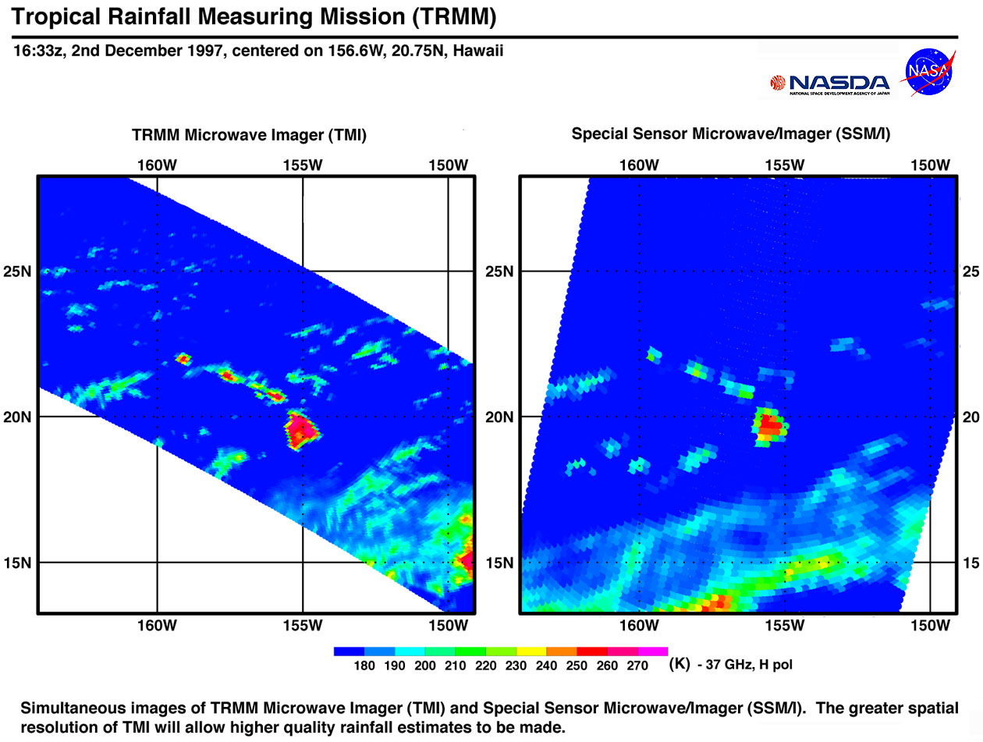
Comparison of TMI and SSM/I Brightness Temperatures at 37 GHz
Simultaneous images of TRMM Microwave Imager (TMI) and Special Sensor Microwave Imager (SSM/I)
  The greater spatial resolution of TMI allows higher quality rainfall estimates to be made
SSM/I
TMI
Microwave radiance at 37 GHz
Notes:
Useful info about rain (not saturated) between 1 and 2.
When signals become dominated by ice (3 to 4), it becomes a less direct measure of rain.
But over land the background is high, the contrast between liquid water emission and land emission is small (between 1 and 2).
No rain: the ocean surface has a low emissivity (~0.5), so even though the surface temp is ~300 K, the upwelling radiance is only 170 K.
(2) Light rain: cloud with few mm/hr rain rate produces strong absorption and emission. The cloud behaves almost as a blackbofy, obscuring the surface, and emitting with a temp close to the temp near the cloud top (260 K).
(3) Heavy rain: cloud absorbs and emits as in (2), but with the greater proportion of large raindrops weakly scattering the upwelling radiance, depleting it somewhat (250 K).
(4) Heaving rain with precipitating ice: precipitation-size ice particles scatter the upwelling radiance significantly, greatly reducing the radiance emerging from cloud top (180 K).
Uncertainties in GPROF rain estimates result from (a) systematic errors in the cloud/radiative models, and (b) random errors associated with a lack of information in the microwave radiance data (i.e., more than one rain rate associated with a given set of observations).
The errors due to (a) can be reduced using more representative cloud models, including improved DSD and melting physics. Also better radiative transfer models, such as reverse Monte Carlo, would help our simulations at higher frequencies for which scattering by precipitation is important. Errors due to (b) we almost have to live with, unless we cab bring additional information. The addition of C/S information led to significant improvements in rain estimates from GPROF. Higher-resolution data at low frequencies would help but this technology is difficult.
Information from channels over ocean:
10 GHz: emission from liquid precipitation only, but low resolution compromises information content.
19 GHz: emission from liquid precipitation, resolution twice as good as at 10 GHz. “Saturates” at relatively high rain rates
(see 37 GHz below).
21 GHz: emission from liquid precipitation, but also information on TPW in rain-free areas because it is close to the 22.235 GHz
water vapor line.
37 GHz: emission/scattering from liquid precipitation and scattering from ice precipitation in strong convection. Resolution
is twice as good as at 19 GHz, but rain signal saturates (rain cloud starts looking like a blackbody) at low rain rates,
and so the effective dynamic range of rain measurement is limited.
85 GHz: primarily scattering by precipitation-sized ice particles, which is indirectly related to rain intensity.
Over land, only ice-precipitation scattering at 85.5 GHz produces a signal, since upwelling emission is not distinguishable from relatively high surface emission. TPW retrieval, which depends on water vapor emission, is not possible using 21 GHz data over land.

Slide 34
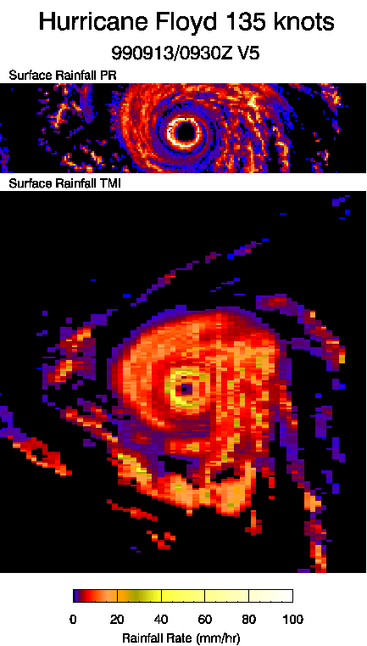
PR and TMI Instantaneous Rain Rate Comparison over Hurricane Floyd
PR
TMI
September 13, 1999

Slide 35
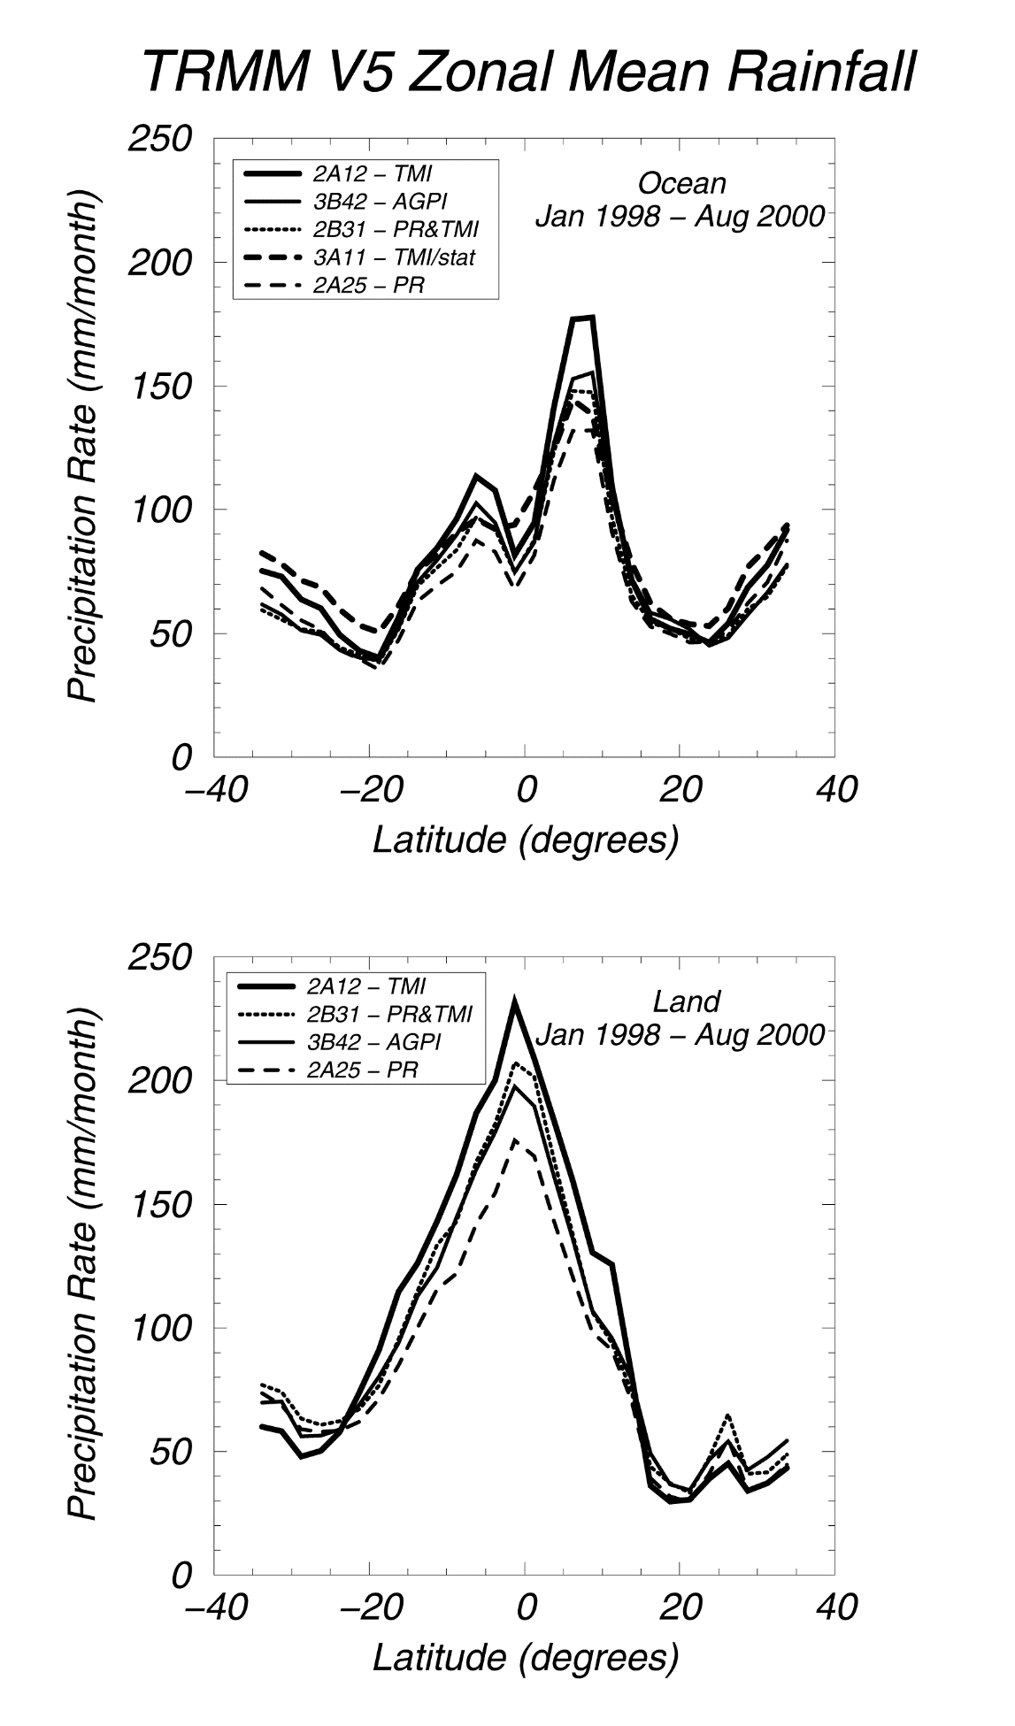

TRMM Zonal Mean Rainfall
Ocean
Land

Slide 36
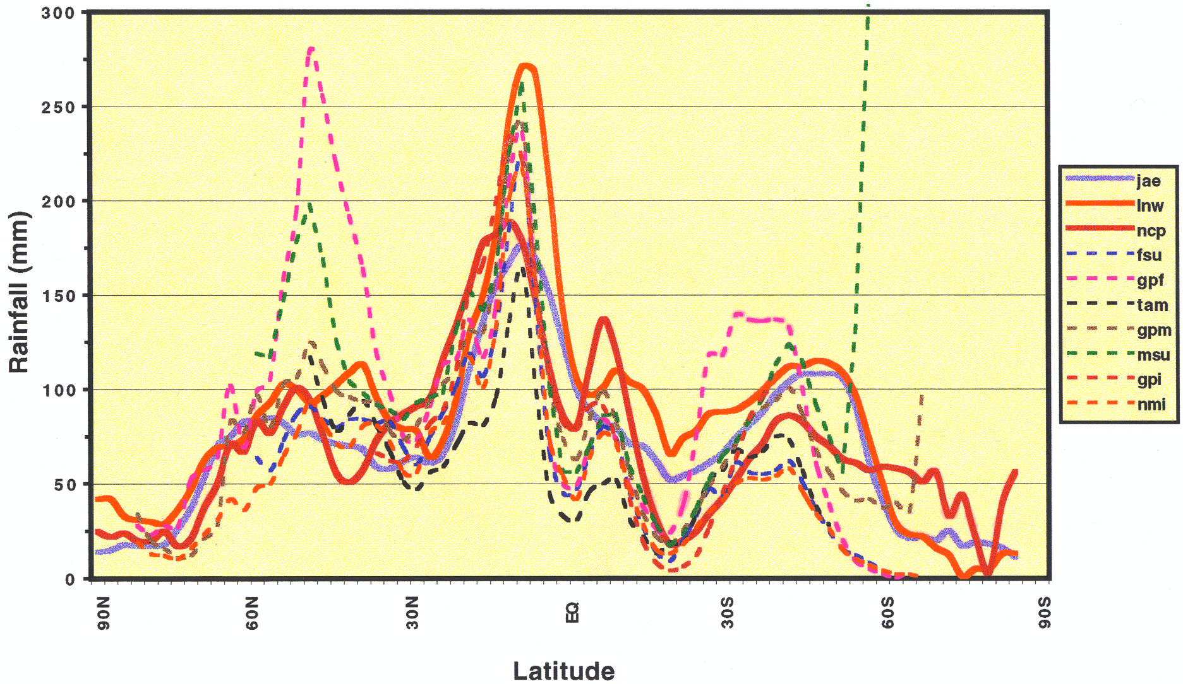
Zonally-Averaged Rainfall over Ocean
September

Slide 37
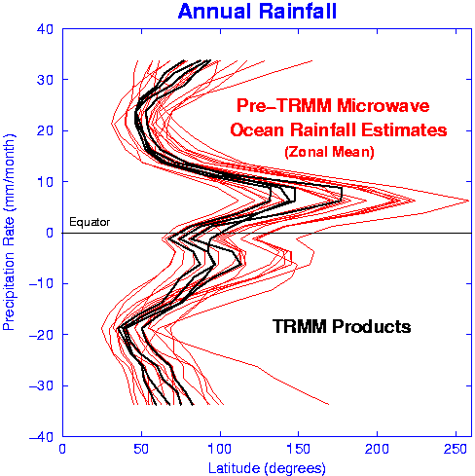
Ocean Rainfall Estimates with TRMM
Latitude (°)
Precipitation Rate (mm/month)

Slide 38
Status of TRMM Rainfall Products
TRMM V5 rainfall algorithms are within:
  24% for tropical monthly averages
  20% for zonal-mean averages
  30-40% bias for instantaneous rain rates
The uncertainty among TRMM satellite algorithms is comparable to the differences between TRMM rainfall products and ground-based estimates
Ground-based rainfall estimates are not used to evaluate satellite products as uncertainties in data gaps, Z-R relations, calibration errors, rain-type classification, and representativeness errors need be significantly reduced
Further agreement between the spaceborne and ground-based sensors will require improved understanding of precipitation physics through field experiments
TRMM Multi-Satellite Precipitation Analysis (TMPA-RT) is currently in Version 7 and will only be produced until early 2018.
Notes:
PR sensitivity studies show a difference of 20% in RR depending on choice of DSD, Z-R relations, etc. DSD seems to be spatially-dependent. How to parameterize and validate becomes an issue. More research is needed.
GPROF is built upon the assumption that all clouds are fully represented (and that the retrieval is not too sensitive to cloud models?)
Tremendous improvements between V4 and V5: mainly in correcting that stratiform rain does not decrease fast enough with distance compared with PR.
TMI RR are consistently higher than PR RR over oceans, suggesting systematic assumptions retrieval algorithms. As to which is right, compelling evidence is needed to determine which is correct. What we do know is that at Kwajelein pixel-by-pixel comparisons show that:
Sat & GV both indicate “rain”: 126 cases
Sat & GV both say “no rain”: 144 cases
Misclassified: 13 cases
Work in progress: (1) Dissect 2A25 to examine the effect of Total Path Attenuation on DSD. (2) Determine the mean vertical profiles of convection from cloud models, the PR-retrieved and TMI retrieved rainfall. Assess how well GPROF performs. (3) Quantify the effect of cloud model data base vs. observations on retrievals. (4) Add Bright band melting layer in the cloud resolving model simulations. Will only correct things that we know to be wrong.

Slide 39
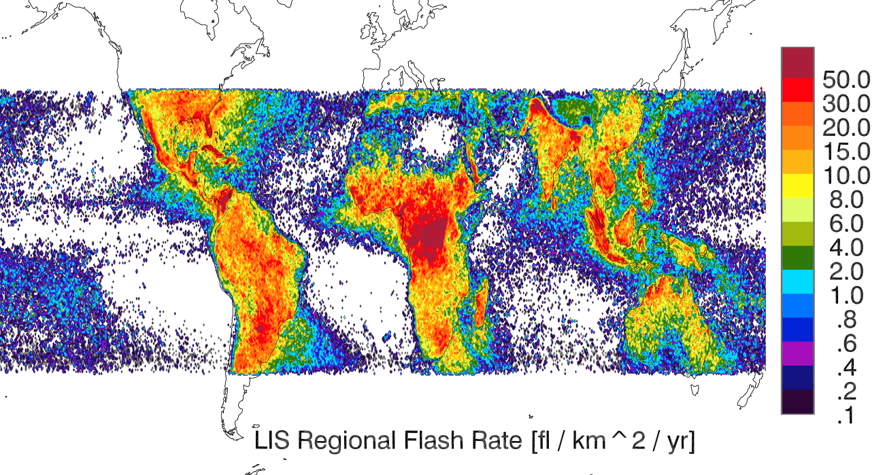
The Lightning Imaging Sensor (LIS) Observes 3 Years of Lightning
Land/Ocean differences are pronounced
Consistent with NASA Optical Transient Detection (OTC) climatology in both spatial distribution and rates
Island Effects are pronounced
Significant orographic signals (Himalayas, Colombia, Congo, Indonesia).
LIS Regional Flash Rate (flashes km⁻² yr⁻¹)

Slide 40
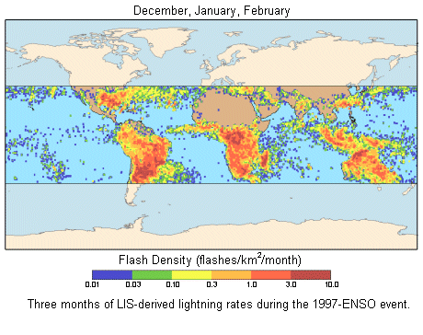
LIS-derived Lightning Rates during the 1997 El Niño-Southern Oscillation Event

Slide 41
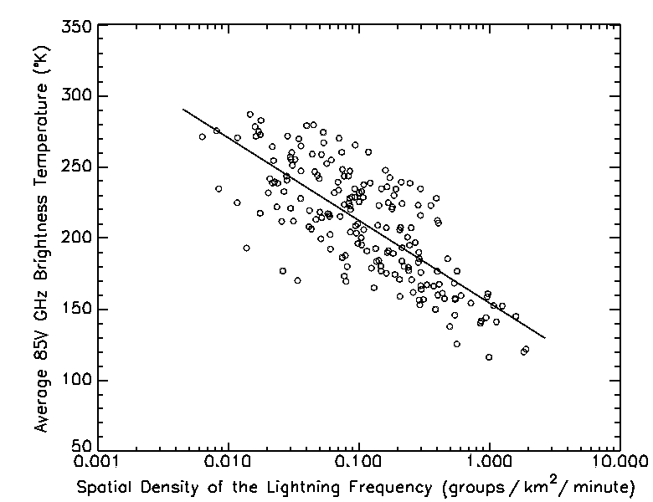
LIS-derived Lightning Rates during the 1997 El Niño-Southern Oscillation Event
Lightning/Precipitation Ice relationships demonstrated with (LIS/TMI)

Slide 42
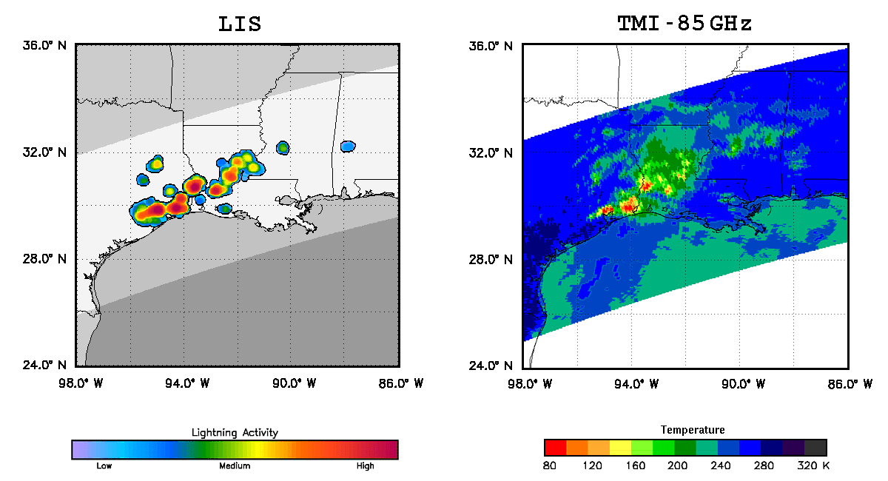
Lightning Events are Associated with Strong Convective Activity in Heart of Severe Storms

Slide 43
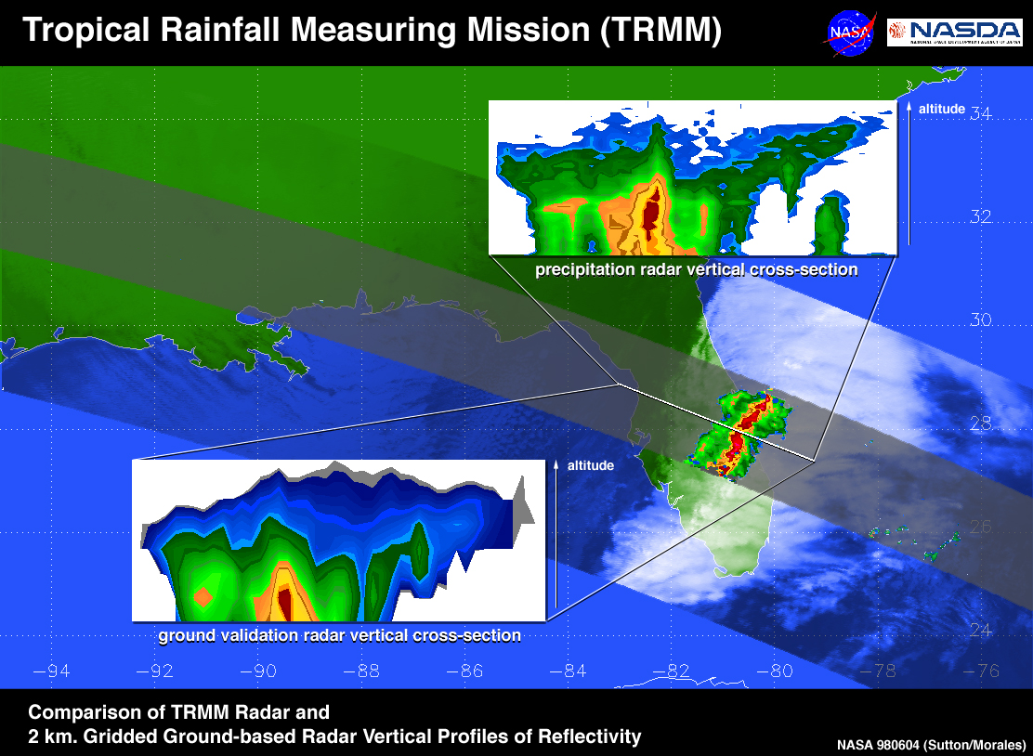
Comparison of TRMM and Ground-based Radars over Florida T-Storm

Slide 44
TRMM Views El Niño/La Niña Evolution (1998-2000)
January 1998
  Height of El Niño
  Positive anomalies in the equatorial Pacific
  Negative values to the north and west
January 1999
  Height of La Niña
  Negative anomalies in the western Pacific
  Positive values over the Maritime Continent

Slide 45
Rainfall Products from TRMM PR
Level 1 & 2: Orbital Data
Swath: 220 km (247 km after orbit change)
Resolution: 4-5 km horizontal, 250 m vertical
Data Format: Compressed HDF
Name Quantity
1B21 Radar Power
1C21 Radar Reflectivity
2A21 Radar Surface
Cross Section
2A23 Radar Rain Characteristics
(rain type, storm, freezing, and bright band heights)
2A25 Radar Rain Rate, Reflectivity, and Attenuation Profile

Slide 46
Rainfall Products from TRMM PR
Level 3: Gridded Data
Resolutions: - 0.5°x 0.5° and 5°x 5° latitude-longitude
(for a latitude band from 40°N to 40°S)
- Monthly
- 2, 4, 6, 10, 15 km vertical levels
Data Format: Compressed HDF
Name Quantity
3A25 Total and conditional Rain Rate, Radar Reflectivity, path-integrated attenuation for rain Type, Freezing and Bright Band Heights, and
Snow-ice Layer Depth
3A26 Rain Rate Probability Distribution at surface, 2 km,
and 4 km

Slide 47
Rainfall Products from TRMM TMI
Level 1 & 2 : Orbital Data
Swath: 760 km (870 km after orbit boost)
Resolution: 5 to 45 km horizontal (channel dependent),
14 vertical levels up to 18 km
Data Format: Compressed HDF
Name Quantity
1B11 Microwave Radiances and Brightness
Temperatures with Geolocation Information
2A12 Hydrometeor (cloud, rain, ice/snow particles)
Profiles, Latent Heating Profiles

Slide 48
Rainfall Products from TRMM TMI
Level 3: Gridded Data
Resolutions: - 0.5°x0.5° latitude-longitude, 14 Levels
(for a latitude band from 40°N to 40°S)
- Monthly
Data Format: Compressed HDF
Name Quantity
3A12 Temperature Profiles, Water Vapor Profiles, Rain, Precipitation Rate, Cloud Liquid Water/Ice Water, Atmospheric Heating

Slide 49
Rainfall Products from Combined PR-TMI
Level 2 :
Resolutions: Swath (5 Km x 247 Km)
(for a latitude band from 40N to 40°S)
Data Format: Compressed HDF
Name Quantity
2B31 Surface precipitation Rate, Latent heating Profile
Level 3 :
Resolution : 5°x 5° (for a latitude band from 40°N to
40°S), Monthly
Data Format: Compressed HDF
Name Quantity
3B31 Surface precipitation Rate, Latent heating Profile

Slide 50
TRMM Multi-satellite Merged Product
Level 3: Gridded Data
Resolutions: - 0.25°x0.25° latitude-longitude
(for a latitude band from 50°N to 50°S)
- 3-hourly, Daily, Monthly
Data Format: Compressed HDF
Name Quantity
3B42 3-hourly and daily rain rates(also called TMPA –
TRMM Multi-Satellite Precipitation Analysis)
3B43 Monthly averaged rain rates
Monthly climatology and anomalies

Slide 51
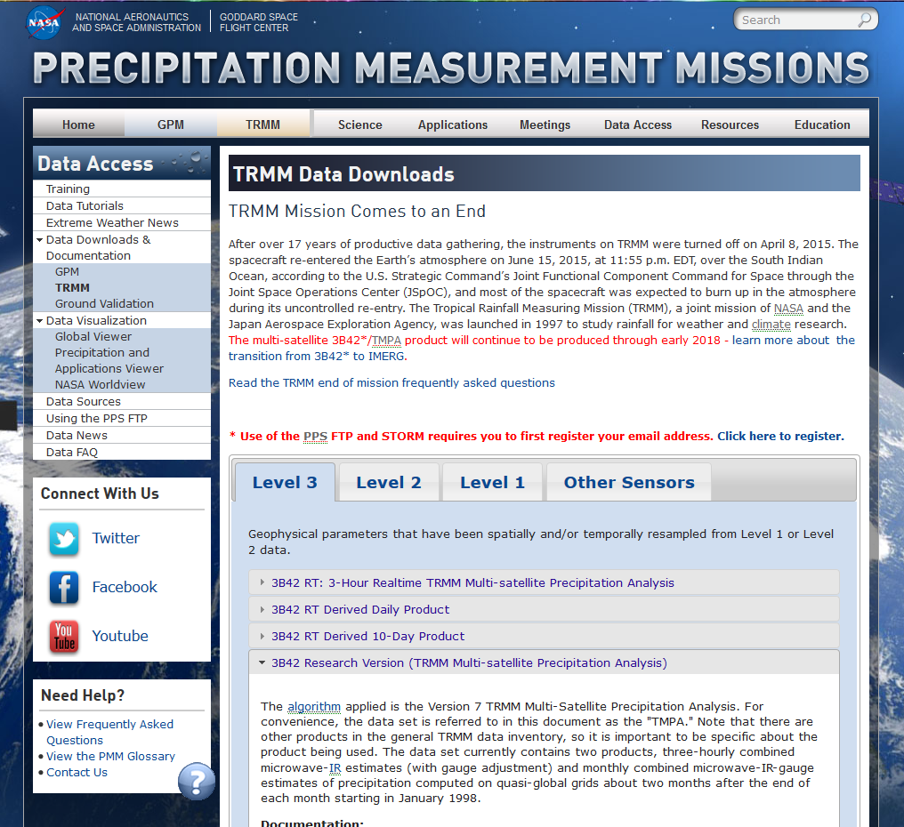
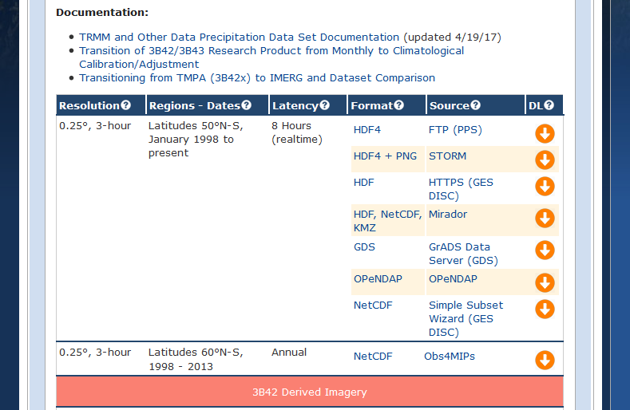
Obtain TRMM Products
https://pmm.nasa.gov/data-access/downloads/trmm
Here you can download Level 1-3 TRMM data
Each data product has a description
And different ways of accessing the data.

Slide 52
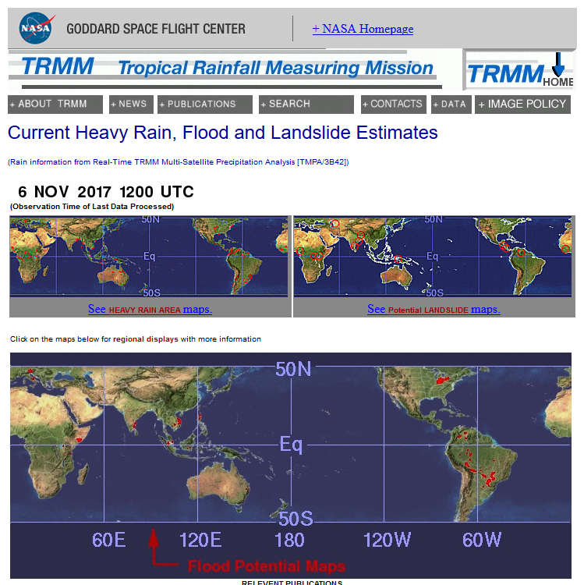
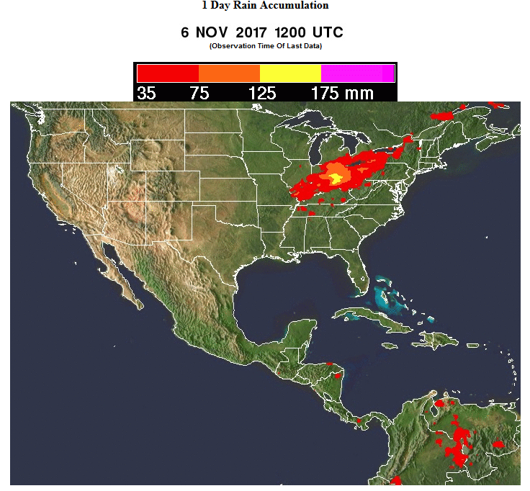
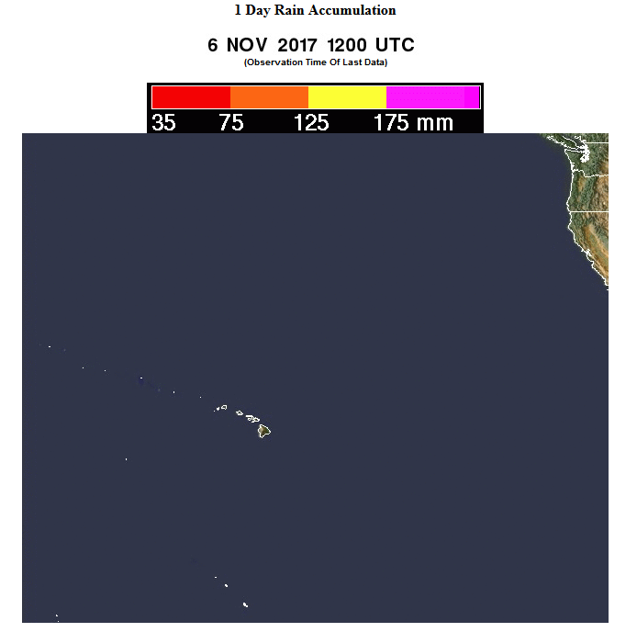
TRMM Near-real Time Flood and Landslide Information Tool
(http://trmm.gsfc.nasa.gov/publications_dir/potential_flood_hydro.html )

