Slide 1

Course Introduction
Lecture 1: History of Remote Sensing
ATMO 611 – Satellite Data Applications
Jennifer D. S. Griswold

Slide 2
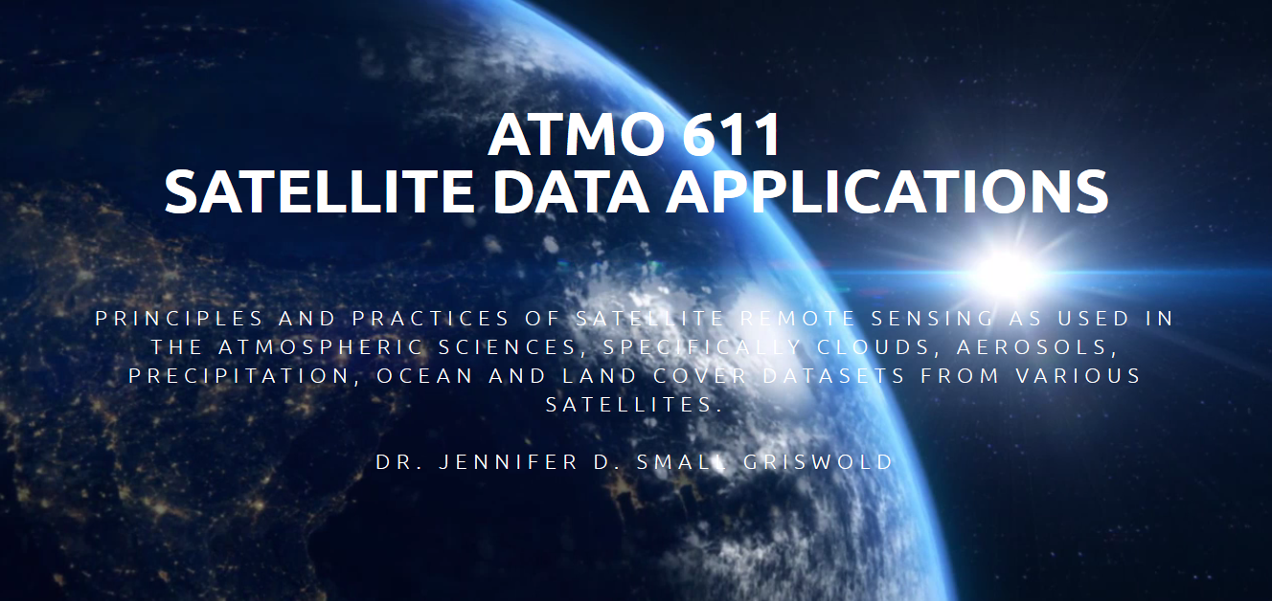
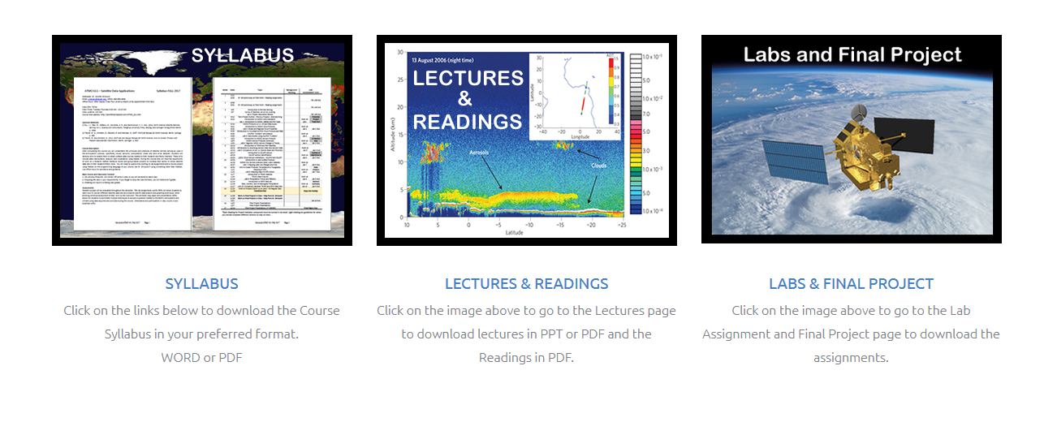
Class Website
http://jenniferdsmallphd.com/ATMO_611.htm

Slide 3
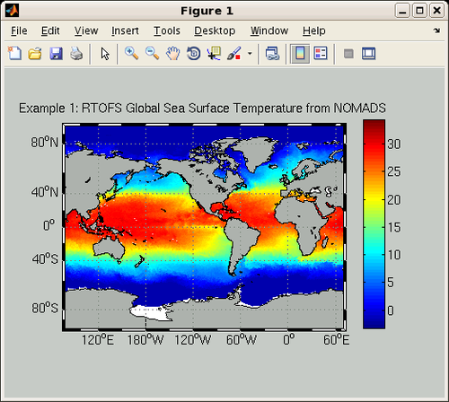
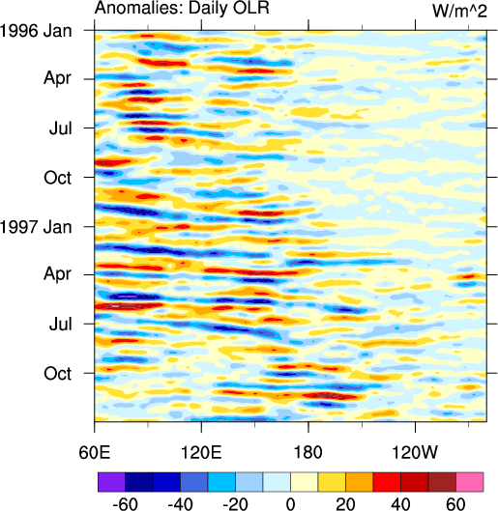
Purpose of ATMO 611
Enable practical use of remote sensing data through
  Familiarization with various satellites and data products
  Background theory and understanding of different satellites
  Practical experience manipulating satellite data
  Understand quality controls and data limitations
Use of MatLab to:
  Extract Data
  Manipulate Data
  Plot Data
  Conduct Statisitical Tests

Slide 4
Syllabus - Course Expectations
10 Laboratory Assignments
  Labs will be due one week after they are assigned.
One Semester Long Project
  Final Paper
  Oral Presentation
No Exams
Reading Material (PDFs)
  journal articles related to individual satellites or data sets to support your understanding of the data and to provide resources for your final projects.

Slide 5
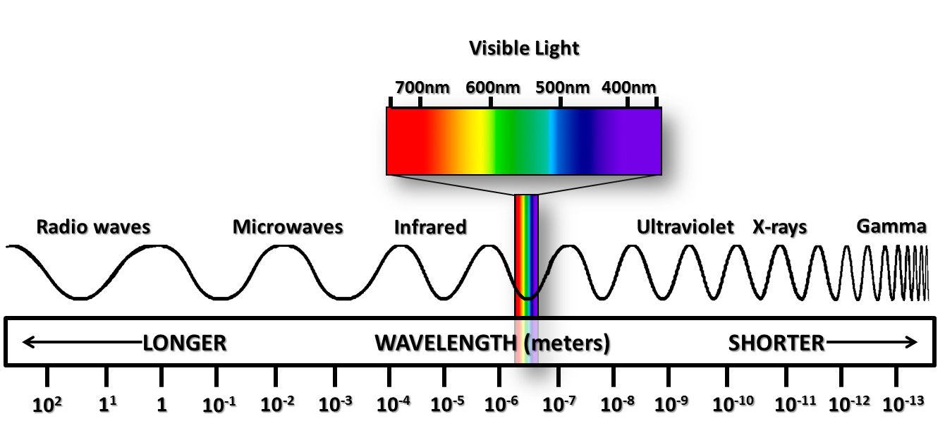
What is Remote Sensing?
Remote Sensing: remote sensing is science of
  acquiring
  processing
  and interpreting
images and related data that are obtained from ground-based, air-or space-borne instruments that record the interaction between matter (target) and electromagnetic radiation.
Current Remote Sensing: using electromagnetic spectrum to image the land, ocean, and atmosphere.

Slide 6
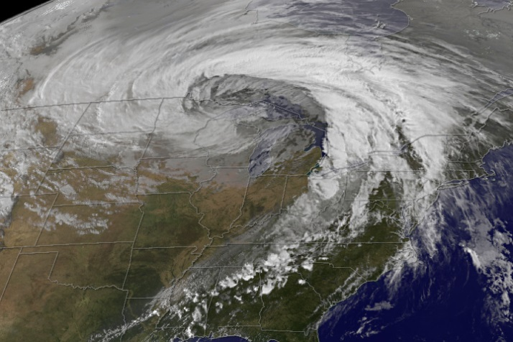
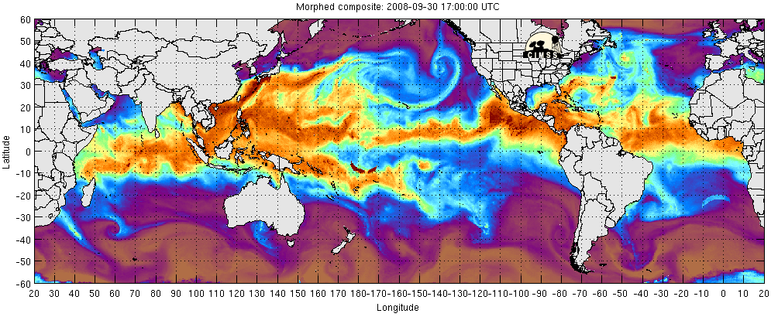
Why do we need/use Remote Sensing?
Source of spatial and temporal information
  land surface, oceans, atmosphere, ice
Monitor and develop understanding of environment
Information can be accurate, timely, consistent and large (spatial) scale
Move to quantitative applications
  data for climate (temperature, atmospheric gases, land surface, aerosols, clouds, precipitation….)
Some ‘Commercial' applications
  Weather, agricultural monitoring, resource management

Slide 7
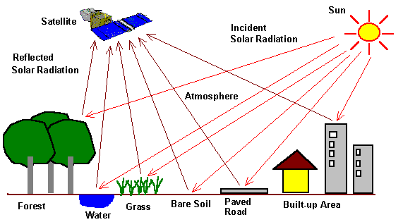
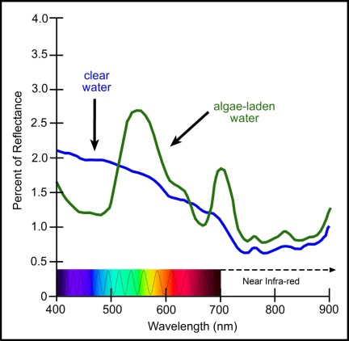
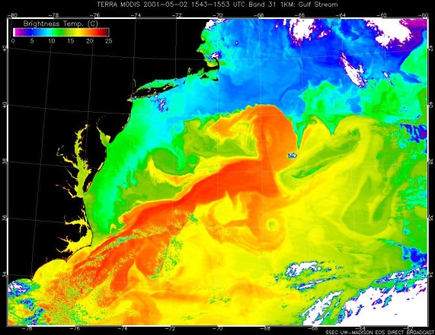
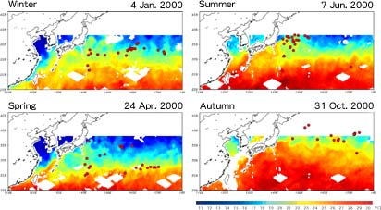
Issues with Remote Sensing
Remote sensing has various issues
  Can be expensive
  Can be technically difficult
  NOT direct
    measure surrogate variables
      reflectance (%)
      brightness temperature (Wm⁻² ⇒ ºK)
      backscatter (dB)
    RELATE to other, more direct properties.
http://www.eorc.jaxa.jp/TRMM/channel/earth/agriculture_e.htm
http://lms.seos-project.eu/learning_modules/
marinepollution/marinepollution-c03-p05.html
http://earthobservatory.nasa.gov/IOTD/view.php?id=1393

Slide 8
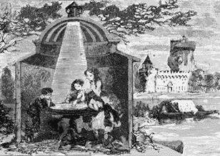
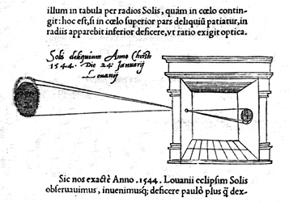
Historical Perspective
1038 AD - Al Hazen an Arabian mathematician explained the principle of the camera obscura to observe sun eclipse.

Slide 9
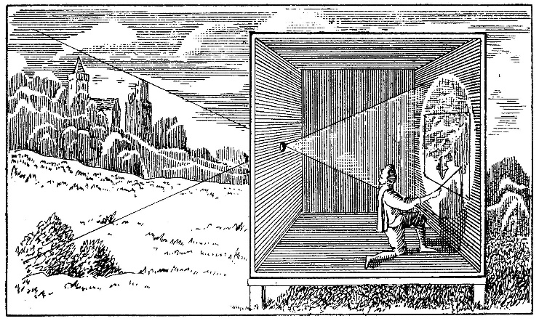
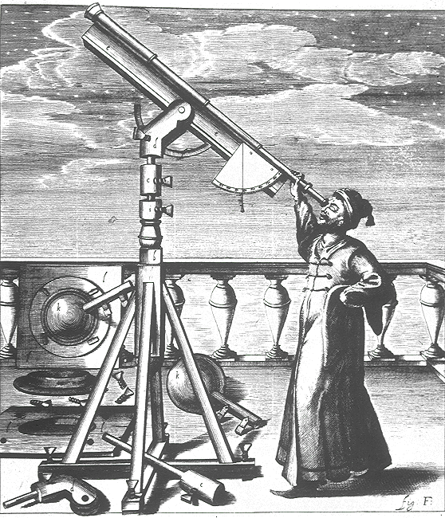
Historical Perspective
1490 - Leonardo da Vinci describes in detail the principles underlying the CAMERA OBSCURA (literally DARK ROOM).
1550- Gerolamo Cardano put optics on a camera obscura for obtaining a better quality image.
1608 – Description of first telescope (Galileo made his in 1609)
1614 - Angelo Sala discovers that silver salts darken when exposed to sunlight.

Slide 10
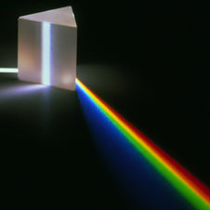
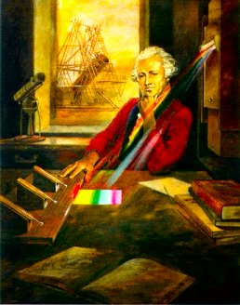
Historical Perspective
1666 - Sir Isaac Newton
  experimenting with a prism, found that he could disperse light into a spectrum
  utilizing a second prism, he found that he could re-combine the colors into white light.
1800 - Sir William Herschel
  measures the temperatures of light split with a prism into the spectrum of visible colors. He had discovered thermal infrared electromagnetic radiation.

Slide 11
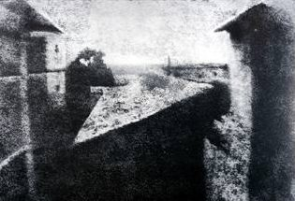
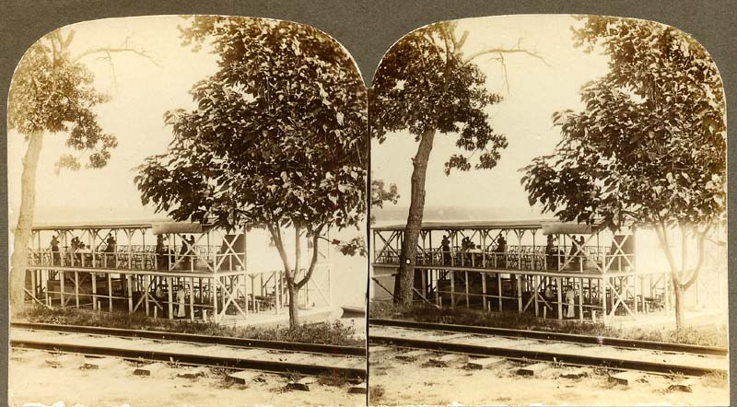
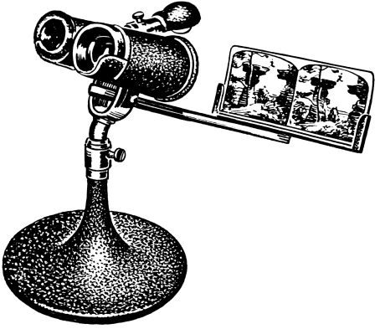
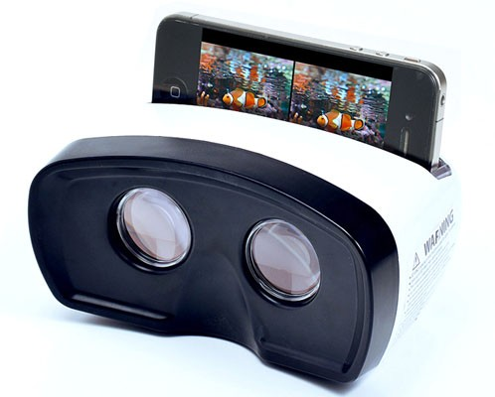
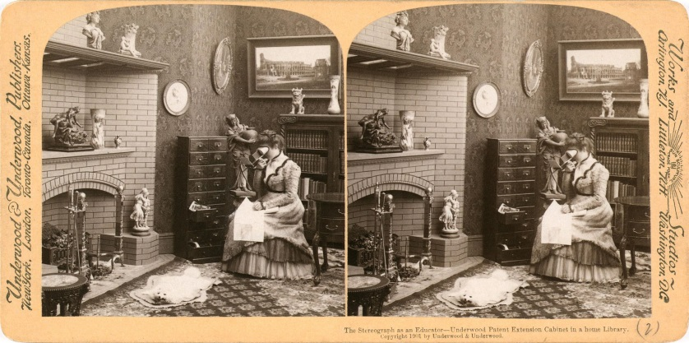
Historical Perspective
1827 - Niepce takes first picture of nature from a window view of the French countryside
  camera obscura and an emulsion using bitumen of Judea, a resinous substance, and oil of lavender
  it took 8 hours in bright sunlight to produce the image
1830s – Invention of the Stereoscope

Slide 12
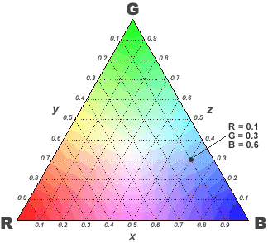
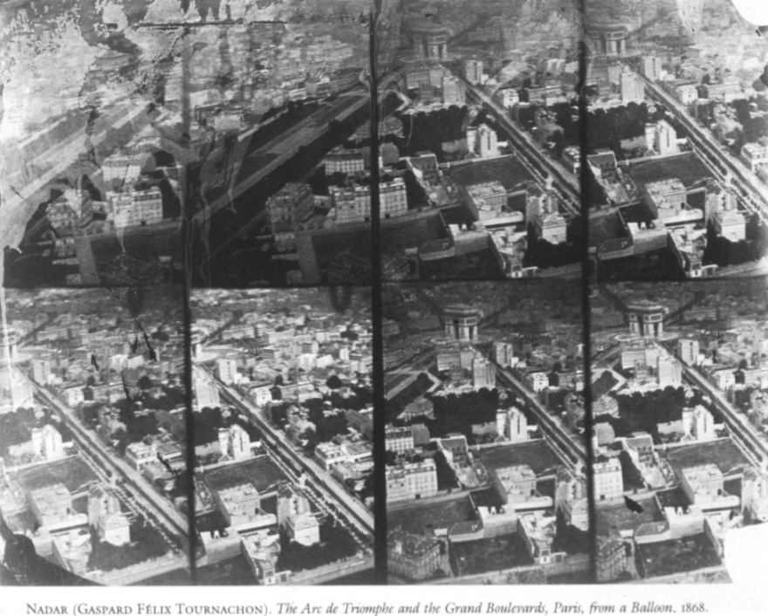
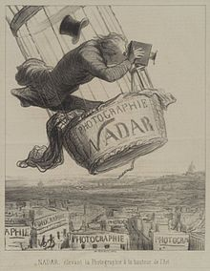
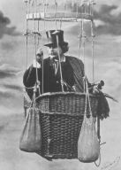
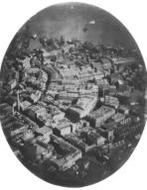
Historical Perspective
1855 - John Clerk Maxwell describes color additive theory.
  The color additive theory describes how we perceive color and how they are created (true color images)
1858 - Gasper Felix Tournachon “Nadar"
  takes the first aerial photograph from a captive balloon from an altitude of 1,200 feet over Paris.

Slide 13
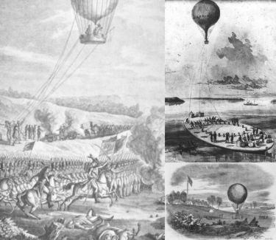
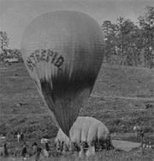
Historical Perspective
1860's - Aerial observations, and possible photography, for military purposes were acquired from balloons in the Civil War.
1862 – US Army Balloon Corp for aerial reconnaissance
  Photos?
  Maybe.

Slide 14
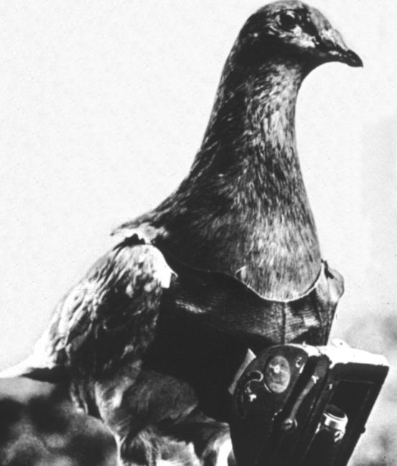
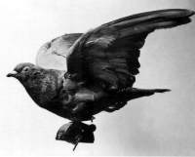
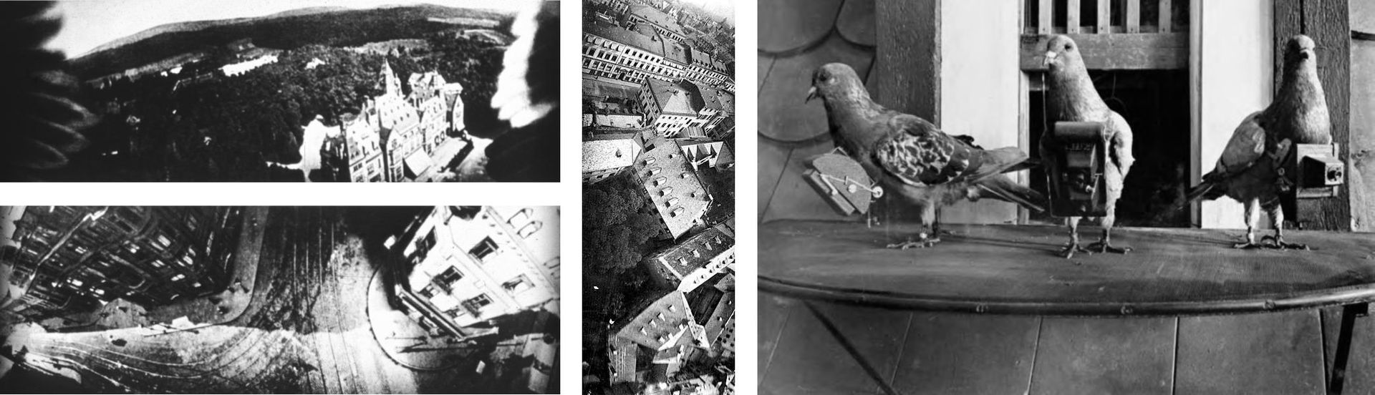
Historical Perspective
1903 - The Bavarian Pigeon Corps uses pigeons to transmit messages and take aerial photos.
  Pigeon photography is an aerial photography technique invented in 1907 by the German apothecary Julius Neubronner, who also used pigeons to deliver medications.
  A homing pigeon was fitted with an aluminum breast harness to which a lightweight time-delayed miniature camera could be attached.

Slide 15
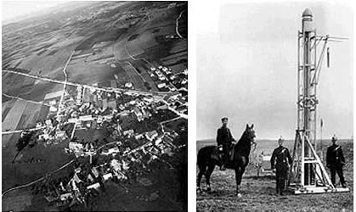
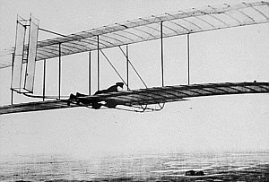
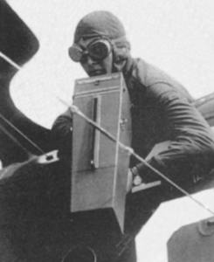
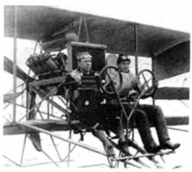
Historical Perspective
1906 - Albert Maul, using a rocket propelled by compressed air, took an aerial photograph from a height of 2,600 feet, the camera was ejected and parachuted back to earth.
1908 – First photographs from an airplane
1914 - WWI provided a boost in the use of aerial photography,
  but after the war, enthusiasm waned

Slide 16
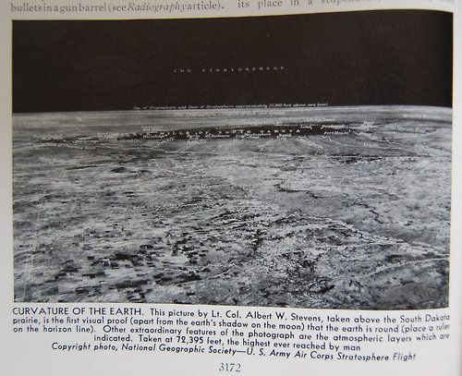
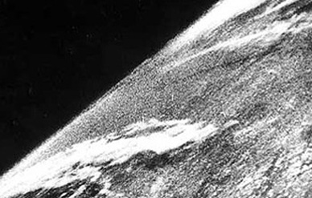
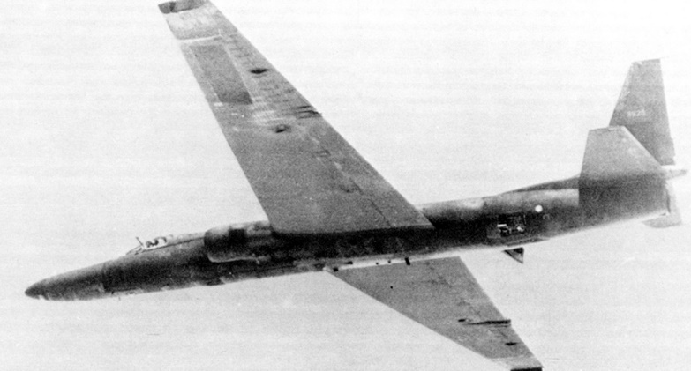
Historical Perspective
1936 - Albert W. Stevens takes the first photograph of the actual curvature of the earth - taken from a free balloon at an altitude of 72,000 feet.
1946 - First space photographs from V-2 rockets.
1956 - U-2 high altitude aircraft takes first flight.
  Max altitude 21300 meters at a speed of about Mach 0.75
  about 800 kilometers per hour at its altitude

Slide 17
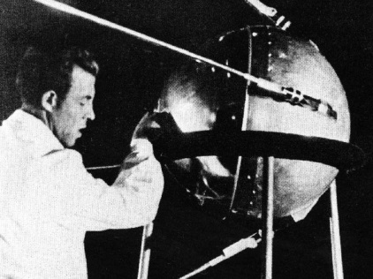
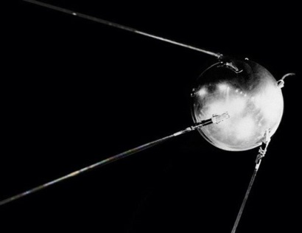
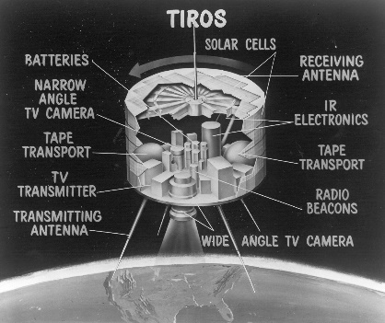
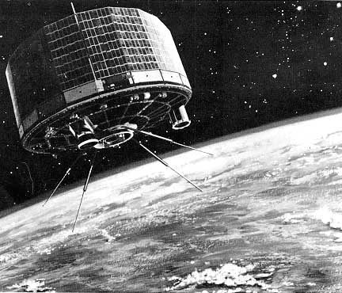
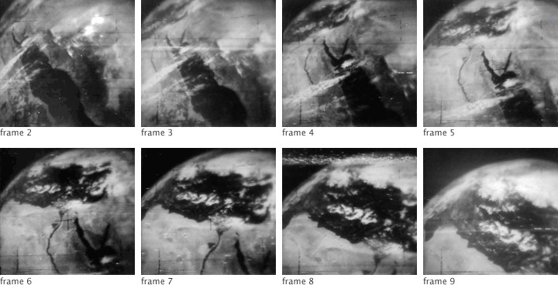
Historical Perspective
1957 – Sputnik-1 is launched in Russia
  Unexpected
  Encouraged our government to make space exploration a priority.
1960 - TIROS-1 launched by US as first meteorological satellite.
  Television InfraRed Observation Satellite
  Two tiny television cameras (2lbs)
    One camera captured a wide view of the Earth about 450 miles below, the other recorded a narrower, more detailed view.
  Polar orbiter – with photos every 30 sec
  The TIROS program provided the first accurate weather forecasts based on data from space
  The satellite has a long legacy. TIROS-1 led to:
      9 more TIROS satellites
      7 Nimbus-series meteorological research satellites
      14 GOES
      19 NOAA Polar Orbiting Satellites
      and many more meteorological satellites maintained by the Department of Defense and other nations.
http://earthobservatory.nasa.gov/IOTD/view.php?id=43401

Slide 18
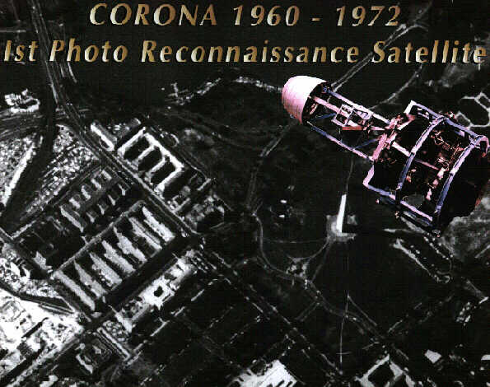
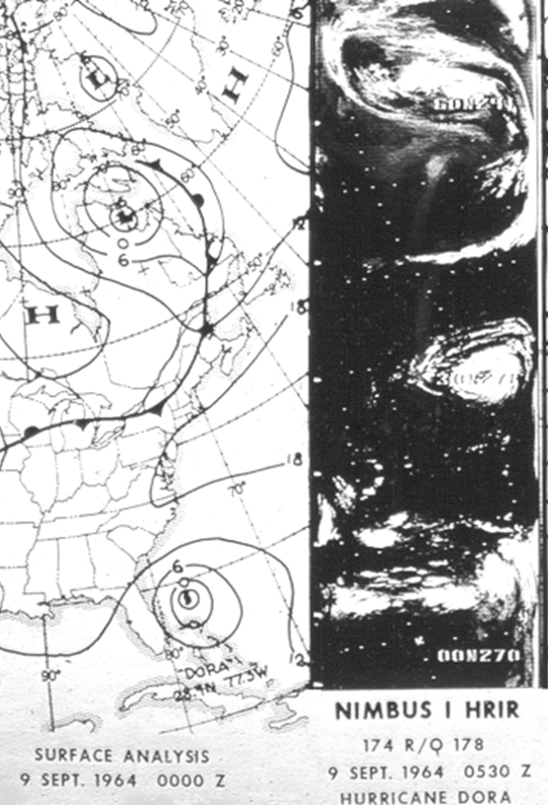
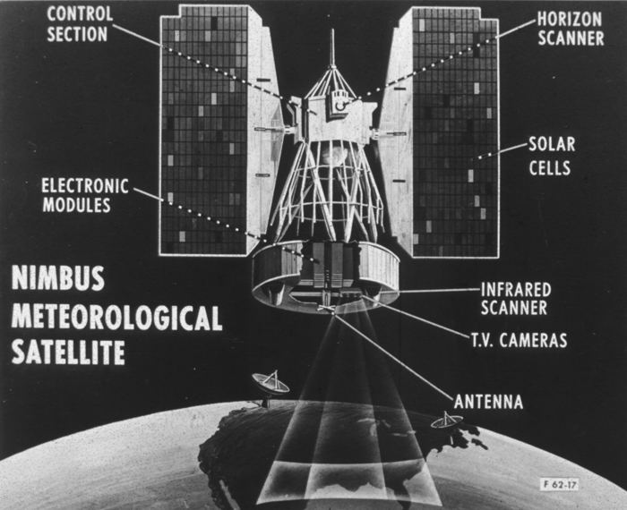
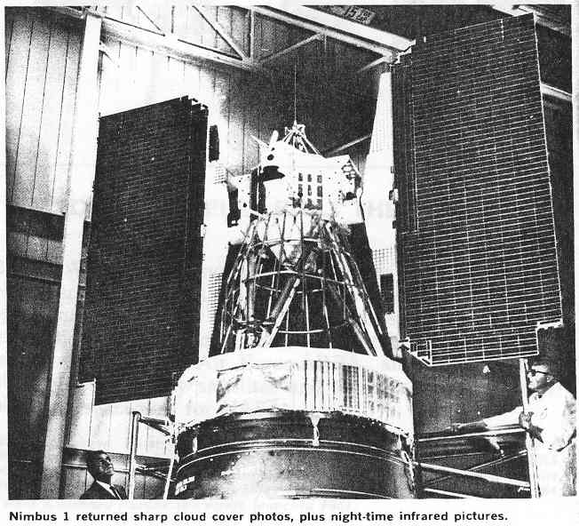
Historical Perspective
1960's - US begins collection of intelligence photography from Earth orbiting satellites, CORONA.
1964- Nimbus Weather Satellite Program begins with the Launch of Nimbus-1.

Slide 19
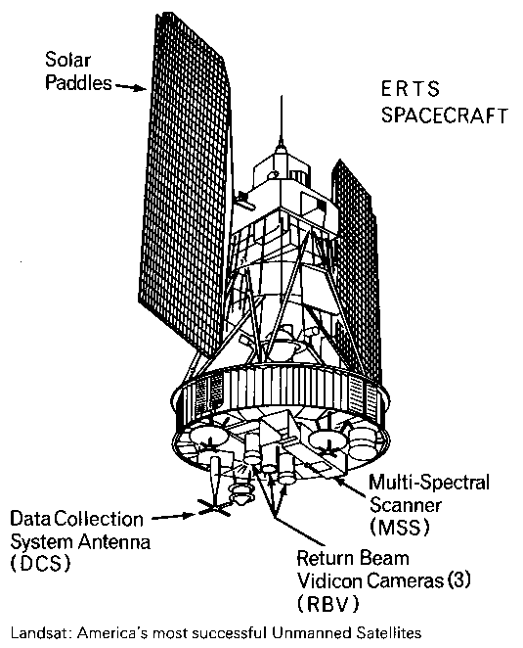
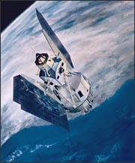






Historical Perspective
1972 - Launch of ERTS-1 (the first Earth Resources Technology Satellite ,later renamed Landsat 1).
1975 - Landsat 2, GOES
1977 - Meteosat-1 the first in a long series of European weather satellites
1978 - Landsat 3
1978 - Seasat, the first civil Synthetic Aperture Radar (SAR) satellite.

Slide 20




Historical Perspective
1978 - Launch of Nimbus-7 with Total Ozone Mapping Sensor (TOMS) and the Coastal Zone Color Scanner (CZCS),GOES-3.
1981 - Space-Shuttle Imaging Radar (SIR-A), Meteosat-2
1982 - Landsat-4
1984 - SIR-B
1984 - Landsat-5
1988 - Meteosat 3
1989 - Meteosat-4
1991 - ERS (Euro Radar Satellite), Meteosat-5
1992 - JERS-1,Topex/Poseidon.
1993 - Meteosat-6
1994 - SIR-C/X-SAR flys on the space shuttle.
We’ll be using Nimbus-7 data in this class.

Slide 21





Historical Perspective
Terra
1995 - Launch of ERS-2, Radarsat-1
1997 - Orbview-2 with SeaWiFS, GOES-10, Meteorsat-7
1998 - Launch of JERS-1
1999 - Launch of Landsat 7, QuickSCAT, CBERS-1, Terra (MODIS, ASTER, CERES, MISR, MOPITT)
2000 - Jason-1
2002 – Aqua (MODIS, CERES, AIRS), ENVISAT
2003 - Launch of ICESat
2004 – Aura (HIRDLS, OMI, MLS, TES)
2006 – CloudSat and CALIPSO
CALIPSO
We’ll be using data from Terra, Aqua, Aura, CloudSat and CALIPSO
CloudSat

Slide 22

A-Train
Earth observation satellites of varied nationality in sun-synchronous orbit at an altitude of 705 kilometers above the Earth.
  The orbit, at an inclination of 98.14°, crosses the equator each day at around 1:30 pm solar time, and crosses the equator again on the night side of the Earth, at around 1:30 am.
"A" stands for "afternoon”

Slide 23


Electromagnetic Spectrum
Wavelength (ג) is the length of one wave cycle, is measured in meters (m) or some factor of meters
Velocity is the speed of light, c=3 x 10⁸ m/s
Frequency (v) refers to the number of cycles of a wave passing a fixed point per unit of time.
  Unlike c and ג changing as propagated through media of different densities, v remains constant.

Slide 24



Electromagnetic Radiation (EMR)
James Clerk Maxwell first formally postulated electromagnetic waves (Confirmed by Heinrich Hertz.
  Maxwell derived a wave form of the electric and magnetic equations
1884 – Relationship between temperature and radiant energy
  deduced by J. Stefan in 1884 and theoretically explained by Boltzmann about the same time. It states:
Max Planck - energy of the oscillators must be quantized,
  the energies can not take any value but must change in steps, the size of each step, or quantum is proportional to the frequency of the oscillator and equal to hv, where h is the Planck constant.
  The brightness distribution of a black body it is defined by its temperature.
Total Energy = σT⁴
Planck Curve

Slide 25

Particle model of EMR
Sir Isaac Newton (1704) was the first person stated that the light had not only wavelike characteristics but also light was a stream of particles, traveling in straight lines.
Niels Bohr and Max Planck (20’s) proposed the quantum theory of EMR:
Energy content: Q (Joules) = hv (h is the Planck constant 6.626 x 10 –34 J s)
λ= c/v=hc/Q or Q=hc/ λ
The longer the wavelength, the lower its energy content, which is important in remote sensing because it suggests it is more difficult to detect longer wavelength energy
Newton’s experiment in 1966

Slide 26


Remote Sensing Systems
{
Remote sensing systems which measure energy that is naturally available are called passive sensors.
Human eye
Camera
Radiometer
Passive
{
Active sensors, on the other hand, provide their own energy source for illumination.
Radar
Sonar
Laser
Active

Slide 27







Four Properties
Image depends on the wavelength response of the sensing instrument and the emission or reflection spectra of the target (the signal)
  Radiometric resolution
  Spectral resolution
Image depends in the size of the objects that can be discerned
  Spatial Resolution
Knowledge of the changes in the target depends on how often the target is observed
  Temporal Resolution
TM Band 3
TM Band 4
Atlanta, 1973
1987

Slide 28

Pixels
Grid boxes are assigned number values for whatever variable you are looking at.

Slide 29

Spectral Resolution
Example: Black and White Image
  Single sensing device
  Intensity is the sum of intensity of all visible wavelengths
0.4 μm
0.7 μm
Black &
White
Images
Blue + Green + Red
Can you tell the color of the platform top?
The color of her Sash?

Slide 30

Spectral Resolution
Example: Color Image
  Color images need at least three sensing devices, e.g. Red, Green, and Blue (RBG)
0.4 μm
0.7 μm
Color
Images
Blue Green Red
Using increased spectral resolution (three sensing wavelengths) adds information
In this case by “sensing” RBG you can combine them to get full color rendition

Slide 31
Spectral Resolution
What do you believe the image would look like if you used a BLUE only sensitive film?
A GREEN only?
A RED only?

Slide 32


Heat-Energy Transfer
Thermal Infrared View
Warmer Objects are Brighter

Slide 33



Example of Sampling Wavelengths
Alaska, Near-IR
Superstorm Sandy

Slide 34

Data Acquisition – Satellite Orbits
200-1000km
35,900km

Slide 35




Satellite Orbit Determines
HEO
What part of the globe can be viewed
The size of the field of view.
How often the satellite can revisit the same place
The length of time the satellite is on the sunny side of the planet
LEO
MEO
Geostationary

Slide 36
Some (not all) Data Access Sites
GLOVIS (USGS Global Visualisation Viewer)
  http://glovis.usgs.gov/
  All global Landsat data now available – hugely useful resource
  Plus ASTER, MODIS (moderate/coarse resolution but global coverage)
NASA Distributed Active Archive Centres – huge range of free NASA data:
  http://nasadaacs.eos.nasa.gov/about.html (overview)
  https://lpdaac.usgs.gov/ (land)
  http://podaac.jpl.nasa.gov/ (oceans)
  http://www.nsidc.org/daac/ (snow and ice)
UK/NERC
  NERC National Centre for Earth Observation (NCEO)
  http://www.nceo.ac.uk
  Earth Observation Data Centre
  http://www.neodc.rl.ac.uk/ (UK/European focused, with ESA data, airborne, various campaign surveys etc. – may require registration)

Slide 37


NASA
Research
Spacecraft

