Slide 1

TRMM Precipitation Radar & GPM
MET 611 – Satellite Data Applications
Sections of take from Toshio Iguchi (iguchi@nict.go.jp)
Achieving Satellite Instrument Calibration for Climate Change (6-18 May 2006)
Jennifer D. S. Griswold

Slide 2
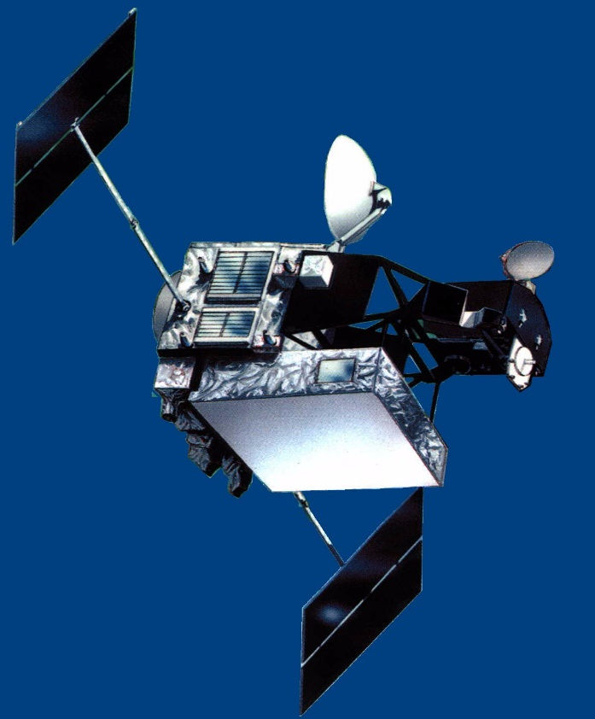
Tropical Rainfall Measuring Mission: TRMM
Solar paddle
High-gain antenna
Observation of tropical rainfall (Driving engine of global atmosphere)
US-Japan joint mission (Japan: PR, Launch, US: Bus, 4 sensors, operation)
Launched in Nov., 1997, turned off in April 2015
First space-borne precipitation radar developed by CRL and NASDA
TMI
VIRS
LIS
PR
CERES
Orbit Altitude Inclination | Circular（Non-Sun Synchronous） 350km (402.5km since Aug. 2001) (±1.25km) 35 deg.
Sensor | Precipitation Radar (PR) TRMM Microwave Imager (TMI) Visible and Infrared Scanner (VIRS) Clouds and the Earth’s Radiation Energy System (CERES) Lightning (LIS)

Slide 3
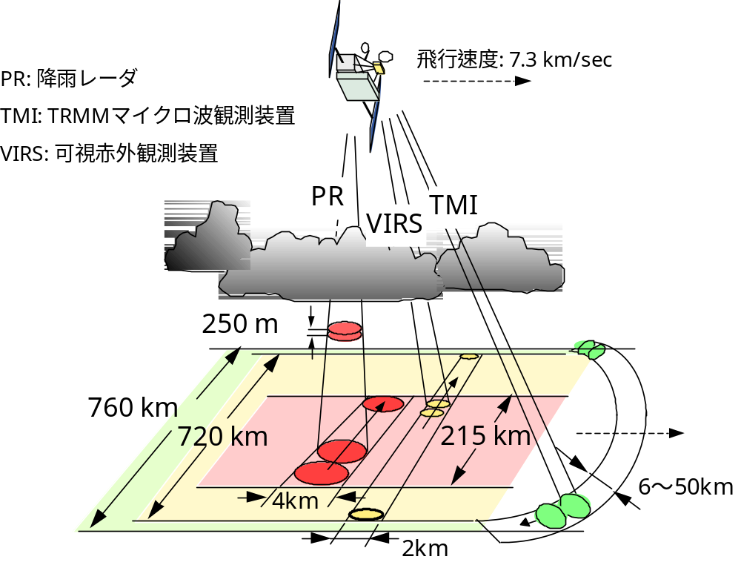
Concept of TRMM Rain Observation
Flight Speed: 7.3 km/sec
PR: Precipitation Radar
TMI: TRMM Microwave Imager
VIRS: Visible/IR Scanner

Slide 4
Mission Requirements of TRMM PR
・Sensitivity：< 0.７mm/h
・Dynamic range：> 70dB
・Horizontal resolution：< ５km
・Range resolution：< 250ｍ
・Number of independent samples：> 64
（SD of fading noise ＜ 0.7 dB）
・Swath width：> 200km
・Observable range：Surface to 15km

Slide 5
Major Parameters of TRMM PR
Radar type Pulse radar
Antenna type 128-elem. WG slot array
Beam scanning Active phased array
Frequency 13.796, 13.802 GHz
Polarization Horizontal
TX/RX pulse width 1.57 / 1.67 μsec
RX band width 0.6 MHz
Pulse rep. freq. 2776 Hz
Data rate 93.5 kbps
Mass 460 kg
Life time 3 years
TX peak power > 500 W (708 W)
Antenna gain > 47.4 dB (47.5 dB)
Beam width 0.71±0.02 deg ( 0.71 deg)
Min det. lv. < -110 dBm (-110.3 dBm)
Min detectable RR < 0.7 mm/h (0.48 mm/h)
Power cons. < 250 W (215 W)
Lasted
17
Years!!
All numbers are designed values. The numbers in parentheses are the measured values.

Slide 6
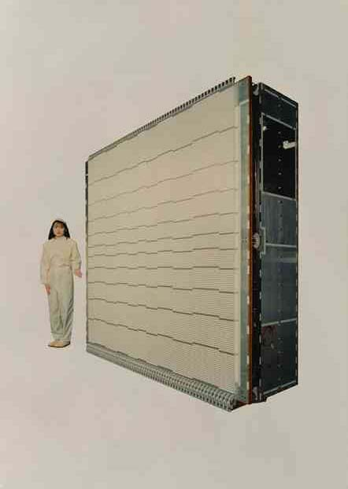
Precipitation Radar
in more detail!
Introduction:
  The Precipitation Radar is the first active space borne radar designed to provide three-dimensional maps of storm structure
PR provides valuable information on:
  Rain size, speed, and altitude
  Intensity and distribution of the rain
  Rain type
  Storm depth
  Melting layer altitude: The height at which snow melts into rain

Slide 7
Precipitation Radar Specifications
Specifications:
  Frequency : 13.8 GHz (Ku-band)
    More than four times higher than that of a typical ground based radar (NEXTRAD ~ 3 GHz, S-band)
    Horizontal Resolution: 4.3 km
    Swath Width: 215 km
    Vertical Profile of Rain and Snow: 19.3 km
      Able to detect rainfall rate down to .7 millimeters/hr
      Able to separate vertical rain echo samples of 250 meters
  Power Consumption: 224 W
    Solid state power amplifiers (128) are used to conserve power
  Target Area:
    phased array antenna that steers the beam electronically

Slide 8
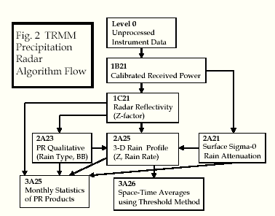
TRMM Precipitation Radar Algorithm
Level 1
  IB21
  IC21
Level 2
  2A21
  2A23
  2A25
Level 3
  3A25
  3A26

Slide 9
TRMM Precipitation Radar Algorithm
Level 1 (IB21, IC21)
  IB21
    Calculates received power by performing extensive internal calibrations
  Data in IB21 include:
    Location of Earth surface and surface clutter
    System noise level
    Land/Ocean Flag
    And many more…
Location of earth is useful to identify whether the echo is rain or surface
Notes:
Location of earth is useful to identify whether the echo is rain or surface

Slide 10
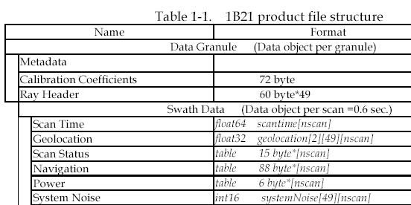
TRMM Precipitation Radar Algorithm
Some Examples of IB21 Data:
  Navigation
    X, Y, Z Components of Space Craft Velocity and Position
    Latitude
    Longitude
    Altitude
    Sensor Orientation
  Min. Echo Flag
    0 : No Rain
    10: Rain possible but maybe noise
    20: Rain Certain
  Land / Ocean Flag
    0: Water
    1: Land
Notes:
water*: surface peak is not correctly detected b/c of high attenuation

Slide 11
TRMM Precipitation Radar Algorithm
Level 1 (IB21, IC21)
    Output: Radar Reflectivity Factor
    Almost same file format as that of IB21:
      Power replaced by Radar Reflectivity Factor
      Noise replaced by Dummy Variable
Level 2 (2A21, 2A23, 2A25)
    Primary Objective:
      Compute Path Integrated Attenuation (PIA) using the Surface Reference Techniques (SRT).
    Input Data: IB21
    Output used by: 2A25, 3A25, and 3A26
attenuation: refers to any reduction in the strength of a signal (digital or analog)
The extent of att. is usually expressed in units of dB, but sometimes Voltage
Notes:
attenuation: refers to any reduction in the strength of a signal (digital or analog)
Natural consequence of signal transmission over long distance. The extent of att. is usually expressed in units of dB, but sometimes Voltage

Slide 12
TRMM Precipitation Radar Algorithm
Level 2 (2A21, 2A23, 2A25)
    Main Objectives:
      Classification of Rain Types
      Output of Rain / No Rain Flag
      Computation of estimated height of freezing level
      Output of the height of storm top
    Input Data: IC21
    Output used by: 2A25, 2B31, 3A25, 3A26
Level 2 (Cont’d) (2A21, 2A23, 2A25)
    Input Data: IC21, 2A21, 2A23
    Output used by: 3A25, 3A26
      Correct for the Rain Attenuation in measured Radar Reflectivity
      Estimate instantaneous 3-D distribution of rain

Slide 13
TRMM Precipitation Radar Algorithm
Level 3 (3A25, 3A26)
  Objective:
    calculate various statistics over a month from the level 2
  Four types of statistics are calculated:
    probabilities of occurrence
    means and standard deviations
    histograms
    correlation coefficients
Level 3 (3A25, 3A26)
  Objective:
    Compute rain rate statistics
  Compared to 3A25
    statistics produced from 3A25 are conditioned either on the presence of rain or on the presence of a particular type of rain but statistics from 3A26 are unconditioned.
compute rain rate statistics over 5 degree (latitude) x
5 degree (longitude) x 1 month space-time regions.
Notes:
compute rain rate statistics over 5 degree (latitude) x
5 degree (longitude) x 1 month space-time regions.

Slide 14
Flow of Rain Profile Estimation
Hardware Calibration
Received Power (Pr)
Conversion of Pr to Zm (Apparent measured radar reflectivity factor) using calibration factor of PR
  Pr →Zm
Retrieval Algorithm
Correction of attenuation due to CLW, WV, and O2
  Zm→Zm'
Correction of attenuation due to precipitating particles (rain att. correction assuming k-Ze relation (DSD))
  Zm'→Ze
Conversion of Ze to R (rain rate)
  Ze→R
Assumptions: distribution of CLW as a function of R, distribution of WV, type of precipitating particles as a function of height, DSD model, homogeneity of rain distribution within an IFOV, vertical profile of rain in surface cluttered range, stable surface scattering cross sections

Slide 15
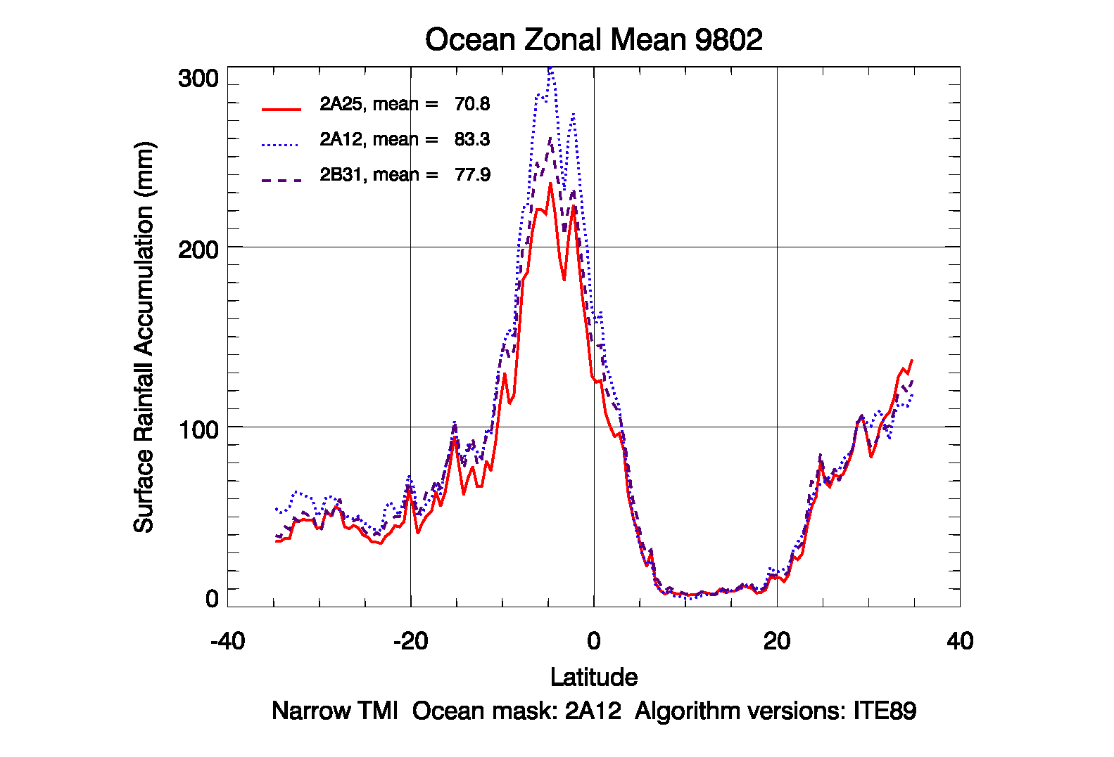
Comparison of rain estimates from different algorithms (PR and TMI)
(Essentially the same as V6)

Slide 16
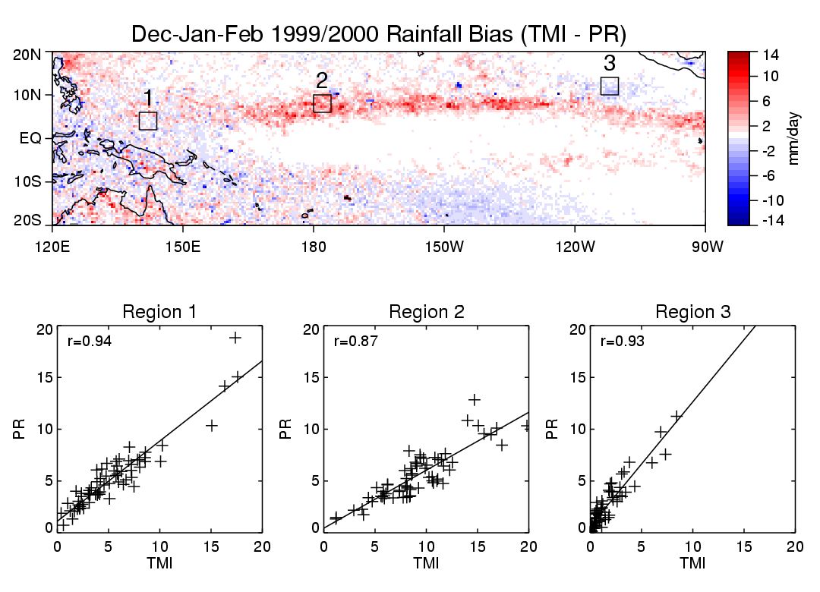
PR and TMI Regional Validation
TMI V6, PR V5
(W. Berg, et al.)

Slide 17
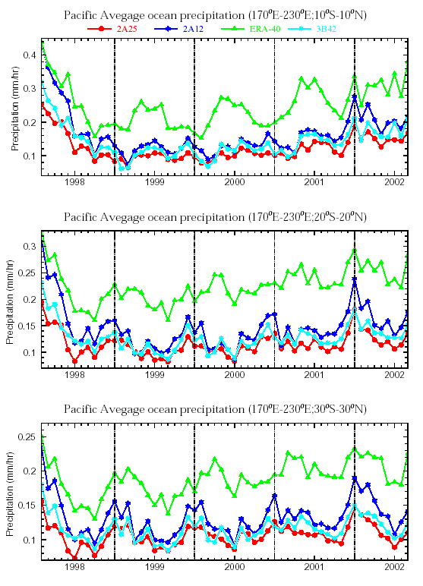
Differences in Rain Estimates
170E-230E
2A25
2A12
ERA-40
3B42
10S-10N
20S-20N
30S-30N
1998
1999
2000
2001
2002

Slide 18
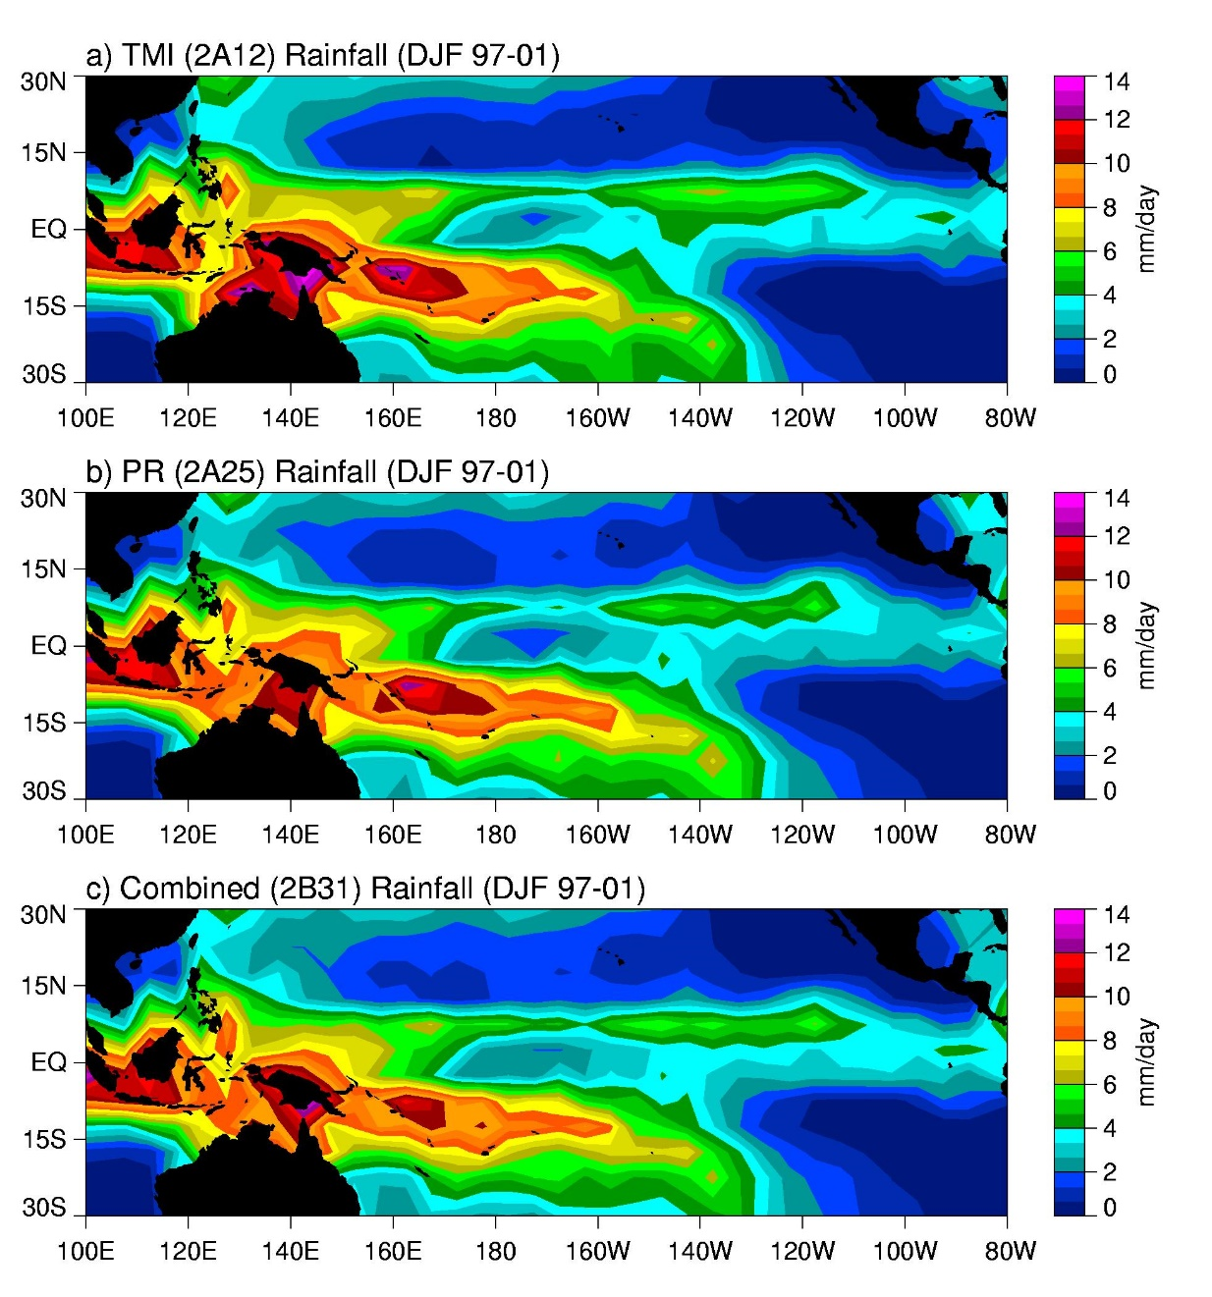
Bias Adjusted Mean DJF Rainfall

Slide 19
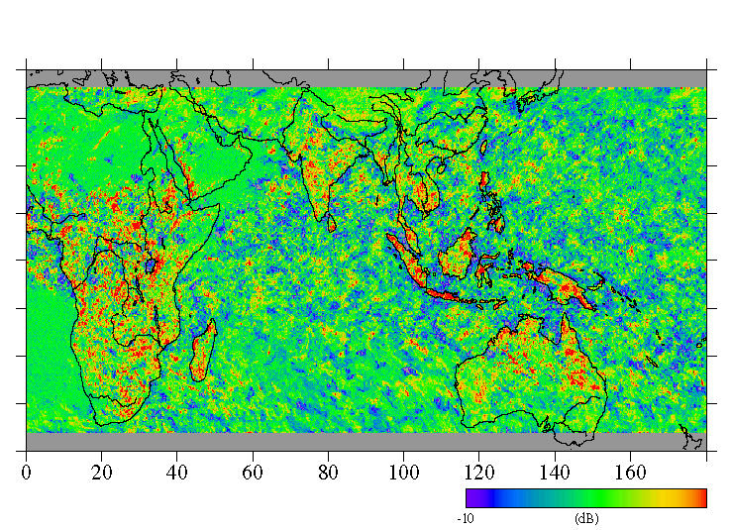
Diurnal Variation of Rain from PR
Morning rain dominant
Afternoon rain dominant
Afternoon rain (local time: 12-18 h)
Morning rain (local time: 6-12 h)
-10
10
(March 1998 - February 1999)

Slide 20
PR Summary
TRMM PR uses three kinds of calibration methods.
  internal calibration
  external calibration with ARC (active radar calibrators)
  calibration with natural targets
All calibration methods indicate an extremely stable performance of PR.
  Housekeeping data are all very stable
  overall long-term stability < 0.05dB
The largest error in rain rate estimation probably comes from the retrieval algorithms and not from the radar calibration.

Slide 21
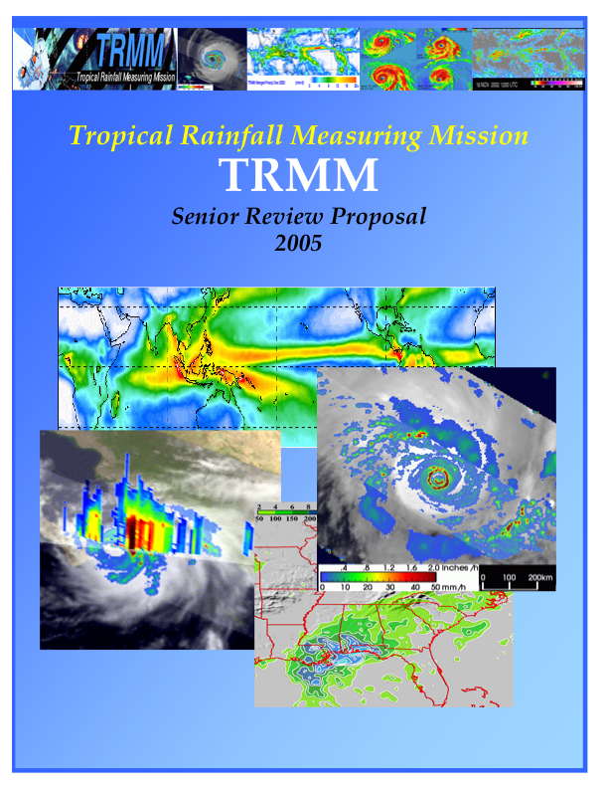
TRMM Major Science Results
Space standard for measuring precipitation
Improved climatology of tropical rainfall and variations
Convection intensity observations and variations
Climatology of lightning over land and ocean
Vertical heating structure and diurnal variations
Improved climate and weather modeling
Impact of humans on precipitation
Hurricane/typhoon structure/evolution
Multi-satellite (~3-hr) rainfall analyses using TRMM+other satellites
Flood and agricultural applications
Operational use of data by weather agencies.
Senior Review Proposal

Slide 22
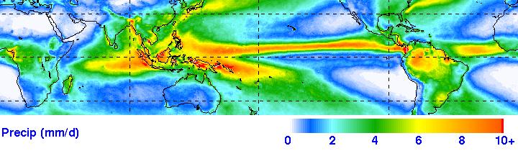
Eight-Year TRMM Climatology
January 1998-December 2005
TRMM Multi-satellite product (TMPA--3B43)

Slide 23
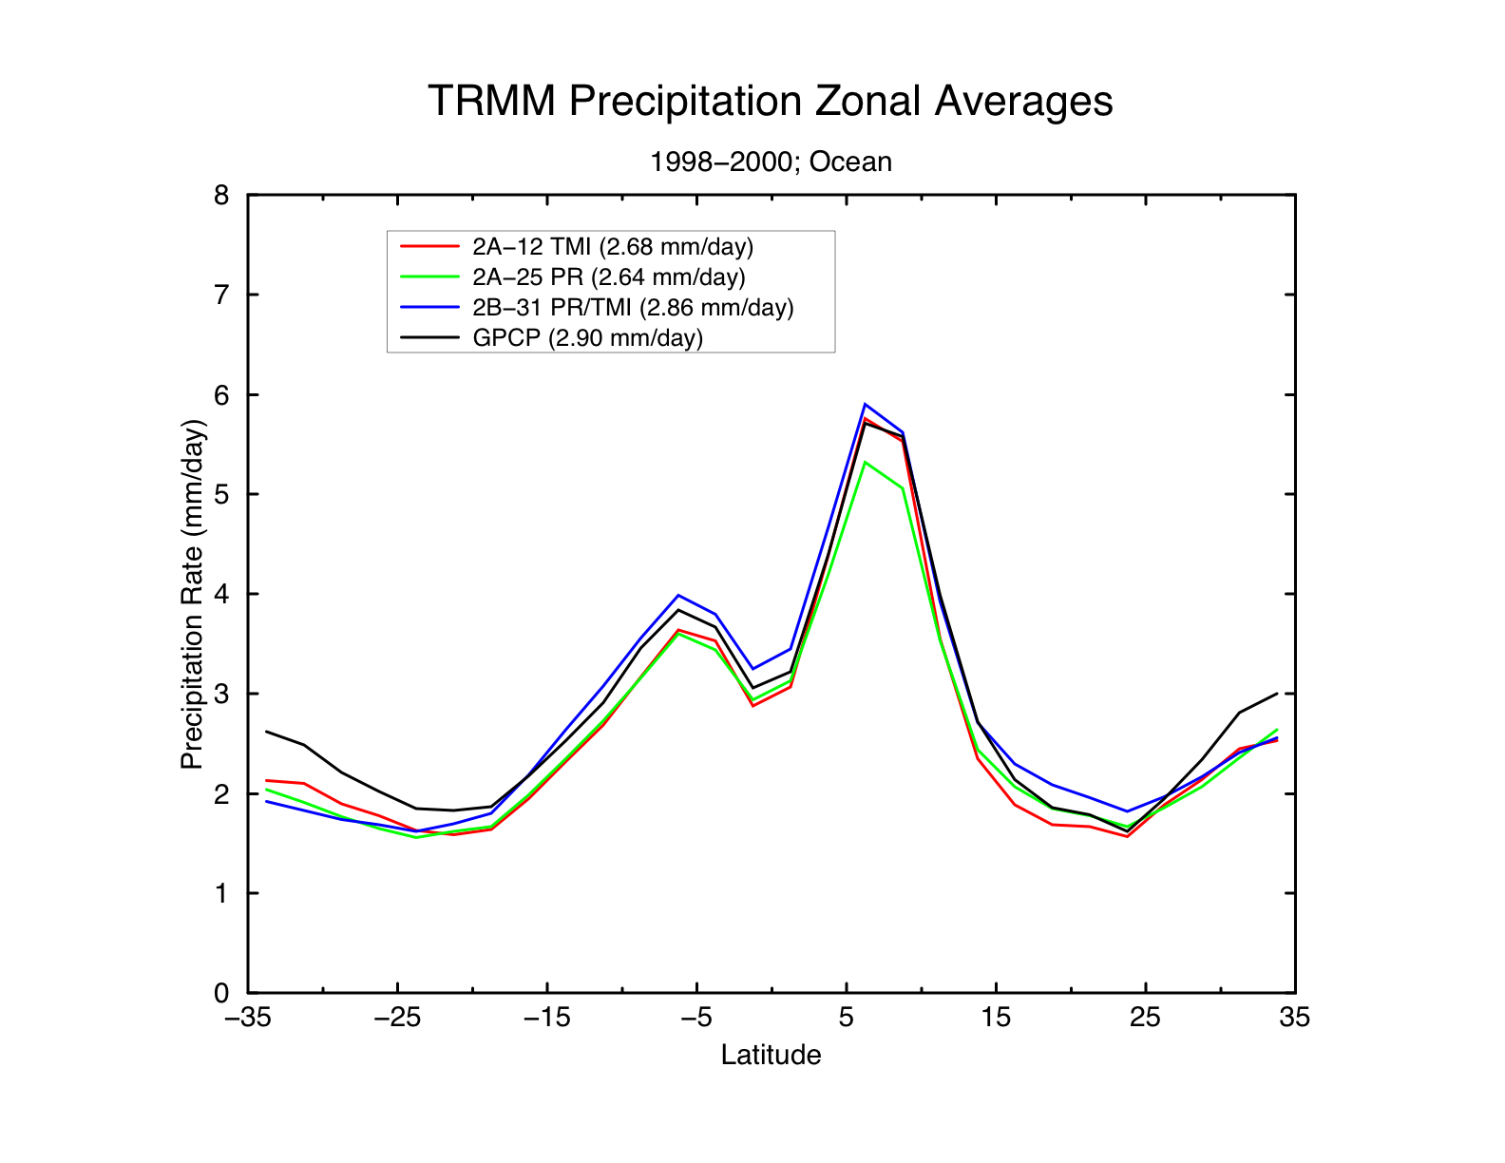
TRMM Precip Zonal Averages
TRMM reduces uncertainties in tropical ocean rainfall to ~5%

Slide 24
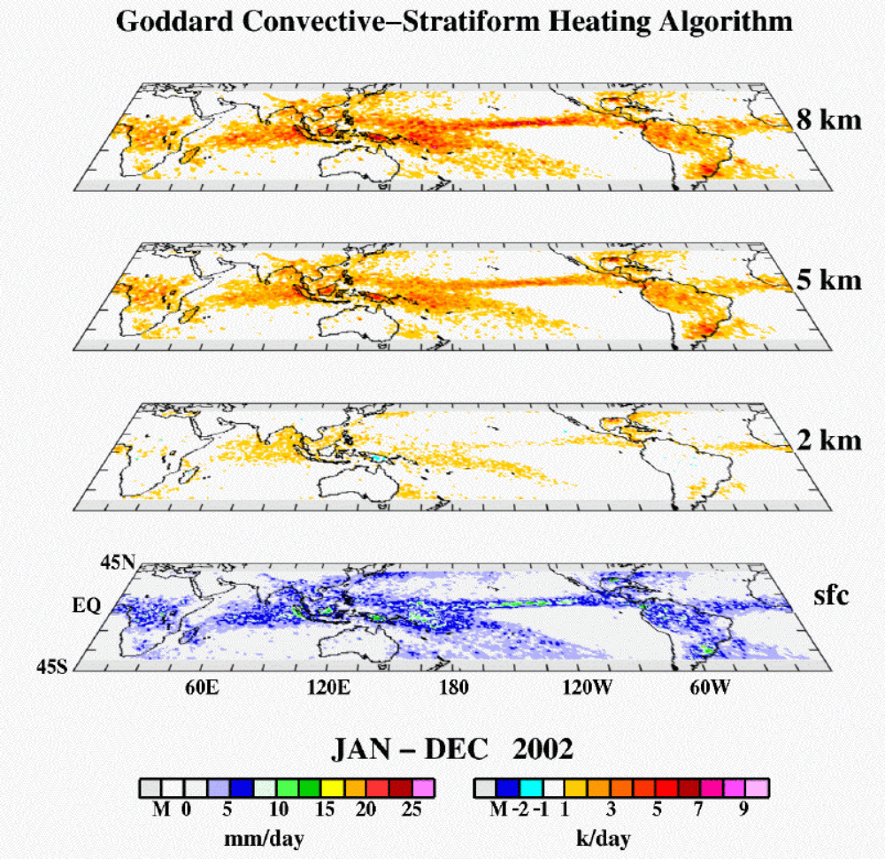
TRMM Derived Latent Heating Distribution
Latent heating in convective and stratiform clouds drives the tropical Hadley Cell – plays crucial role in poleward heat transport by Earth’s atmospheric and oceanic fluid system.
A primary mission objective of TRMM is to quantify the 4D distribution of tropical latent heat release.
Accurate estimates of heating are crucial for climate models and their cumulus parameterization schemes.
Areas of largest rain rates map to the greatest in-cloud heating.
Annual average latent heating is maximized across the Pacific, over the Maritime Continent, and is largest at high altitudes (~ 8 km).

Slide 25
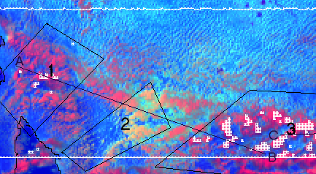
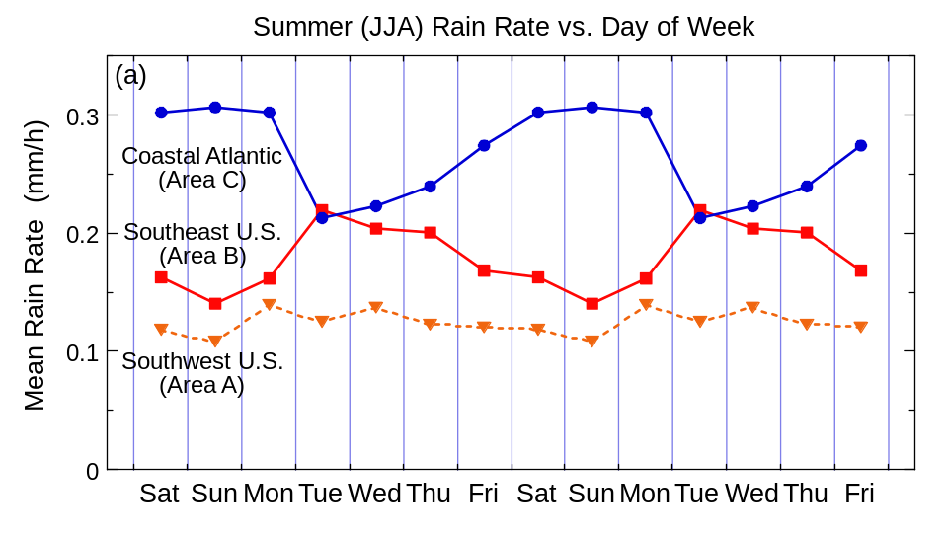
Impact of Humans of Precipitation
Impact of Cities on Rainfall
Effect of Pollution on Rainfall Over Ocean
1
3
2
Houston downwind rainfall maximum (Shepherd)
Lack of PR-detected rain in polluted clouds (Rosenfeld)
Pollution Impact on Land Rainfall
Increase in Summer Rain over SE U.S. during week (red curve)--Increase offshore on weekend (blue curve)--(Bell)

Slide 26
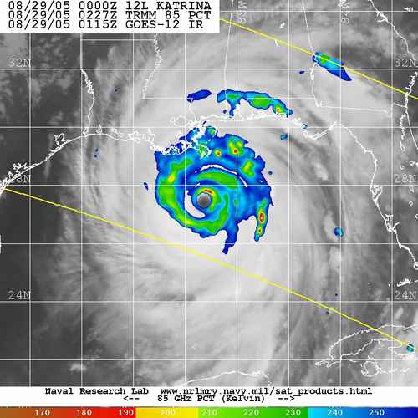
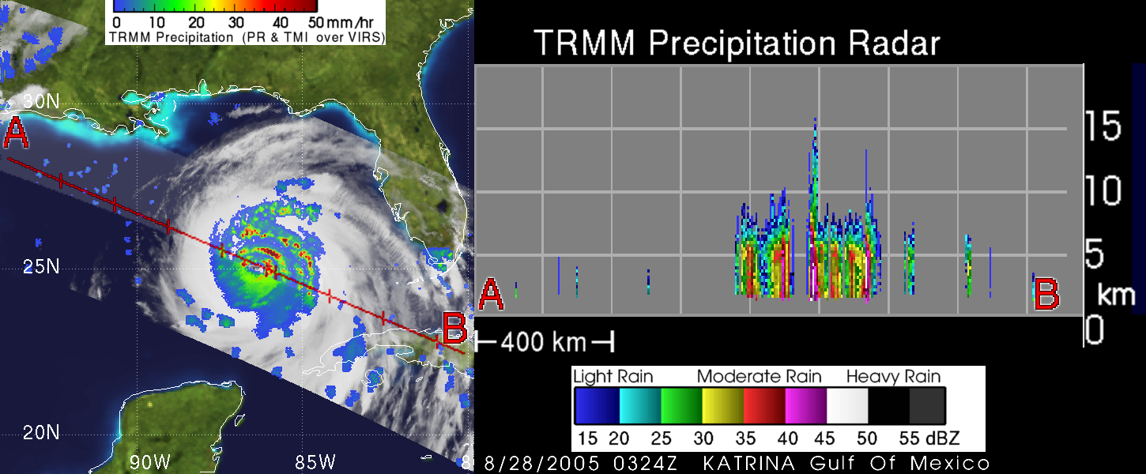
TRMM & Hurricanes
TRMM orbit advantageous for tropical cyclone monitoring
despite narrow swath it is always in tropics
TRMM sampling best in 10-35º latitude storm band.
TMI resolution twice as good as SSM/I, about same as AMSR.
Precessing orbit provides off-time observations relative to sun-synchronous microwave observations.
Hurricane Katrina
TRMM image from NRL Tropical Cyclone web site
TRMM radar (PR) cross-sections of hurricanes used to be available in real time via operational analysis from TRMM website

Slide 27
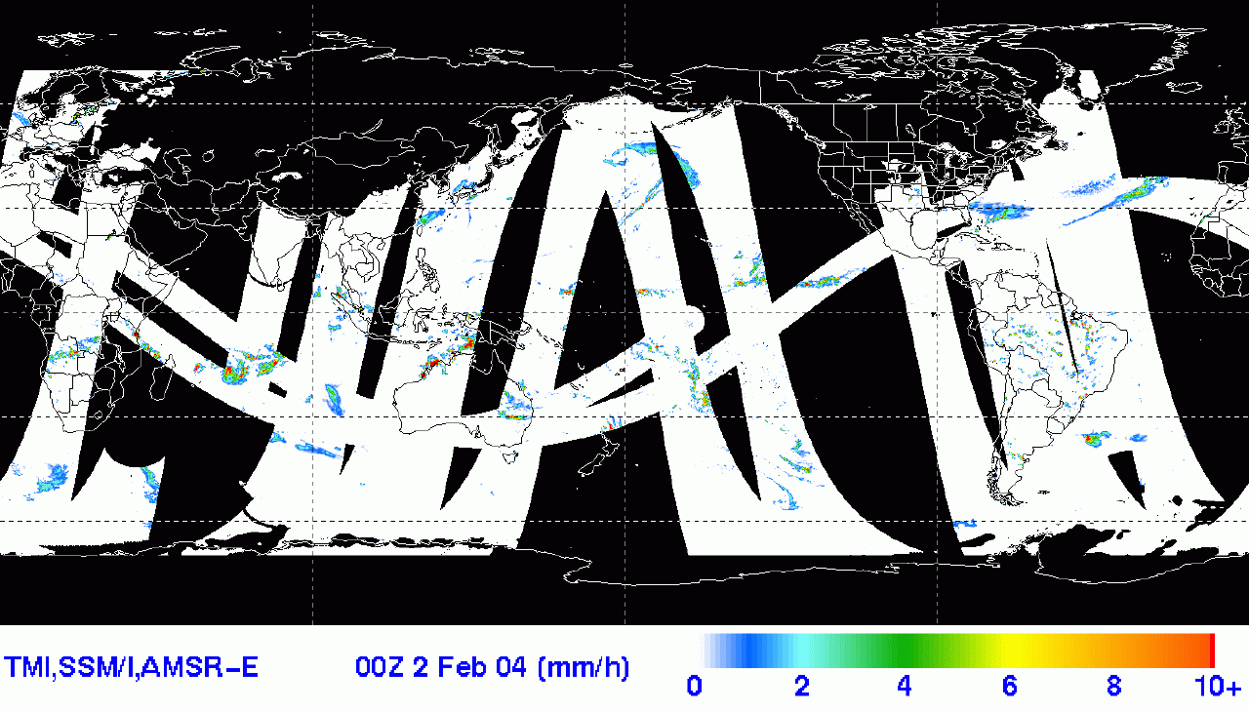
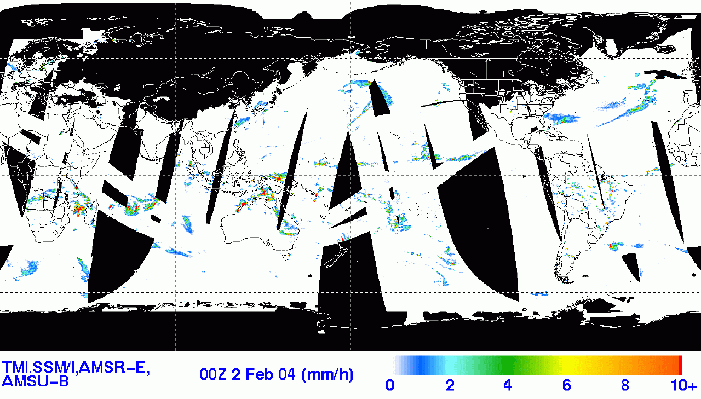
TRMM Calibrating Other Satellites
(TRMM Multi-satellite Precipitation Analysis (TMPS 3-hr)
Combined “high quality” (conical scanning) microwave data coverage: Averages 55% with TRMM, AMSR-E and 3 SSM/I’s
Addition of 3 AMSU-B’s (lower quality over ocean): Total coverage averages ~ 85%
Remaining gaps filled by Geo-IR precipitation estimates
Version 6 3B42: Eight year, 3-hr data set

Slide 28
TRMM – Past, Present, Future
TRMM Experimental Phase (Jan. 1998-August 2001[~3.5 years]). 350 km altitude. (better PR sensitivity)
TRMM Extended Phase (August 2001-April 2015). 402 km altitude. (reduced PR sensitivity[5+ years]). Fuel sufficient to ~2012
Version 6 TRMM products improved, but impact of boost evident;
Version 7 will address boost issue and transition toward GPM era as TRMM has been decommissioned (in 2015)
TRMM extension decision allowed for continuation of TRMM-based science and applications, up to and overlapping GPM core (also at ~400 km altitude).
GPM will add critical microphysical information, expand latitude range to middle and high latitudes, provide improved microwave sampling, and lengthen important radar/radiometer record started by TRMM.

Slide 29
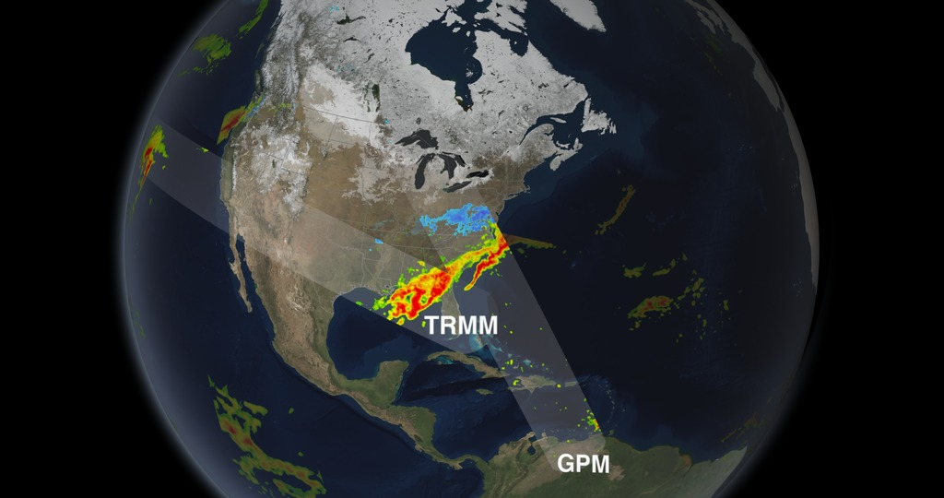
From TRMM to GPM

Slide 30
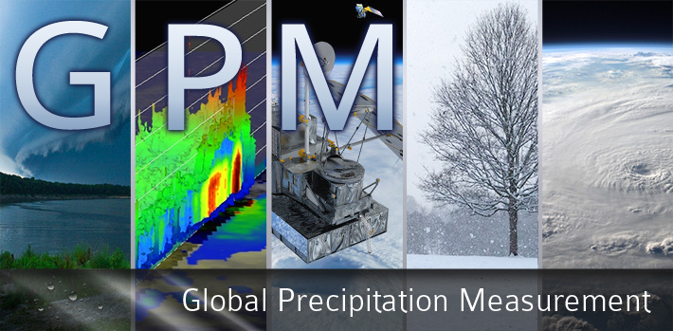

Slide 31
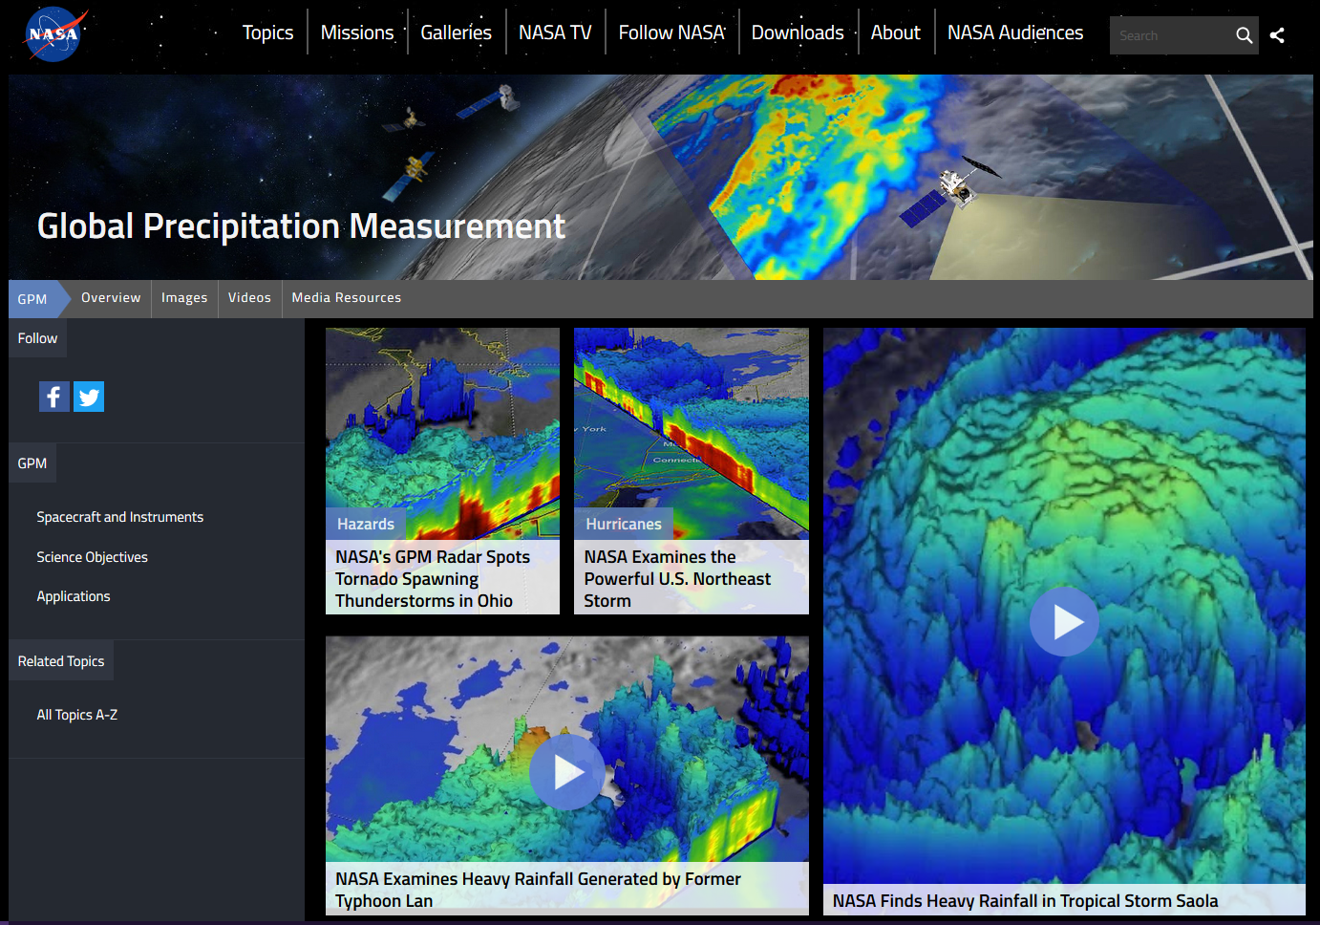
GPM Main Description Page
https://www.nasa.gov/mission_pages/GPM/main/index.html

Slide 32
GPM Objective
The Global Precipitation Measurement mission is an international network of satellites that provide the next-generation global observations of rain and snow to advance our understanding of Earth's water and energy cycle, improve forecasting of extreme events, and provide accurate and timely information to directly benefit society.
Improve ongoing efforts to predict climate
  by providing near-global measurement of precipitation
Improve the accuracy of weather and precipitation forecasts
  through more accurate measurement of rain rates and latent heating.
Provide more frequent and complete sampling of the Earth's precipitation.
  This will provide better prediction of flood hazards and management of life-sustaining activities dependent upon fresh water

Slide 33
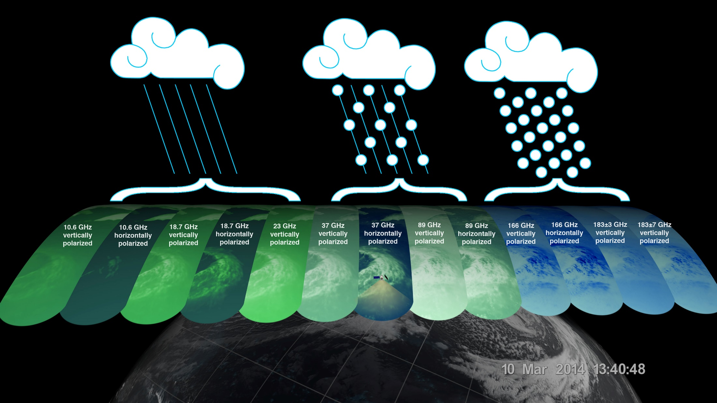
GPM Channels
The GPM Microwave Imager has 13 channels, each sensitive to different types of precipitation. Channels for heavy rain, mixed rain and snow, and snowfall are displayed of the extra-tropical cyclone observed March 10, off the coast of Japan. Multiple channels capture the full range of precipitation.

Slide 34
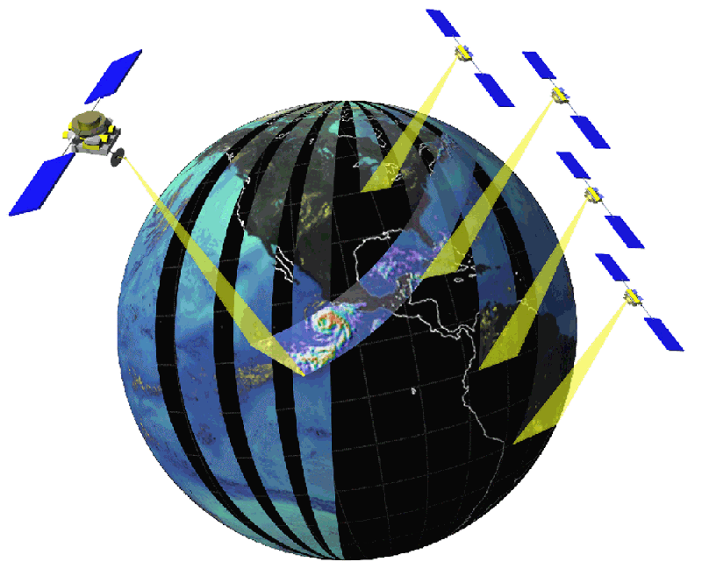
GPM Reference Concept
OBJECTIVE: Understand the Horizontal and Vertical Structure of Rainfall and Its Microphysical Element. Provide Training for Constellation Radiometers.
OBJECTIVE: Provide Enough Sampling to Reduce Uncertainty in Short-term Rainfall Accumulations. Extend Scientific and Societal Applications.
Core Satellite
Dual Frequency Radar
Multi-frequency Radiometer
H2-A Launch
TRMM-like Spacecraft
Non-Sun Synchronous Orbit
~70° Inclination
~400 - 500 km Altitude
~4 km Horizontal Resolution
250 m Vertical Resolution
Constellation Satellites
Small Satellites with Microwave Radiometers
Aggregate Revisit Time,
3 Hour goal
Sun-Synchronous Polar Orbits
~600 km Altitude
Global Precipitation Processing Center
Capable of Producing Global Precip Data Products as Defined by GPM Partners
Precipitation Validation Sites
Global Ground Based Rain Measurement

Slide 35
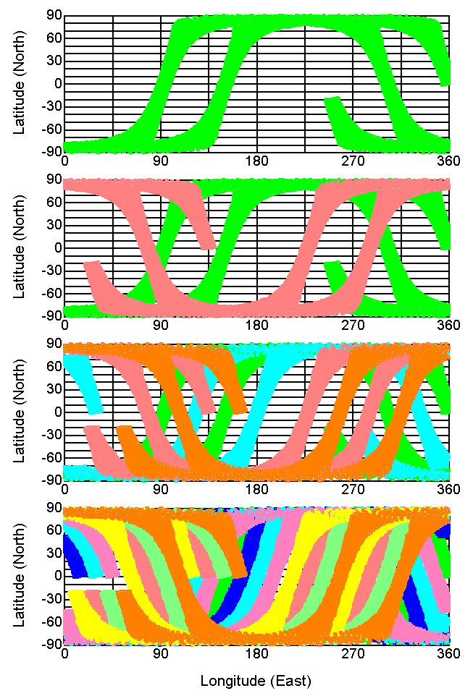
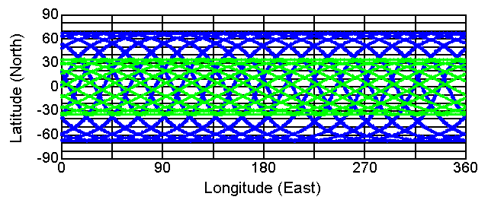
Observation by a fleet of satellites with microwave radiometer
１
Observation area with MWRs in 3 hours
(1, 2, 4 and 8 satellites from top to bottom)
２
Coverages by TRMM PR and GPM DPR in a day
４
８

Slide 36
3-hour Global Coverage
The observation area covered in 3 hours by
Single satellite
Two Constellation
Four Constellation
Eight Constellation
satellites

Slide 37


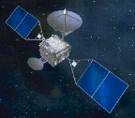
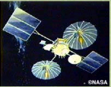
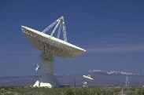




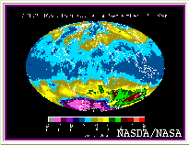




Concept of GPM Data Network
EGPM
Megha-Tripique
GPM CORE
NPOESS
FY3
GCOM-B1
ARTEMIS
TDRS
DRTS
Users
Toolkit, SW
NASA Ground Systems
ESA Ground Systems
NASDA Ground Systems
GPM Data Network
Users
Application SW
French Ground Systems
Chinese Ground Systems
Indian Ground Systems
Users
Science & Research
Weather
Disaster Monitoring
Education
Public & Business

Slide 38
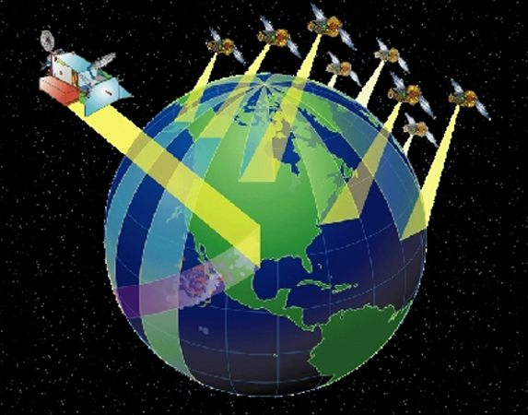
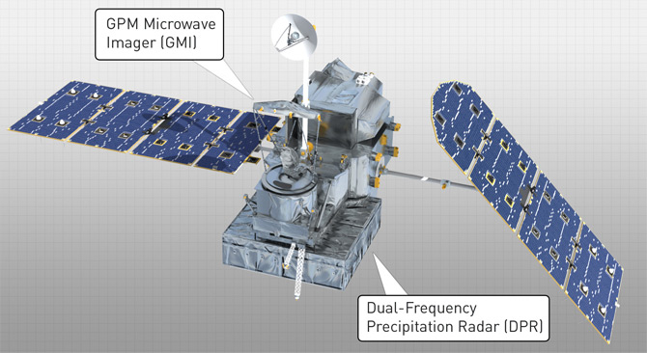
Brief GPM Summary
GPM important key is Data Utilization
  Important : data exchange
    High performance network
      To collect high-frequent observation data immediately
      To distribute them for users
  Easy Utilization
    To standardize for handling MWRs data which have different characteristics for their data mapping and their statistics.
    Varied and diverse user group

Slide 39
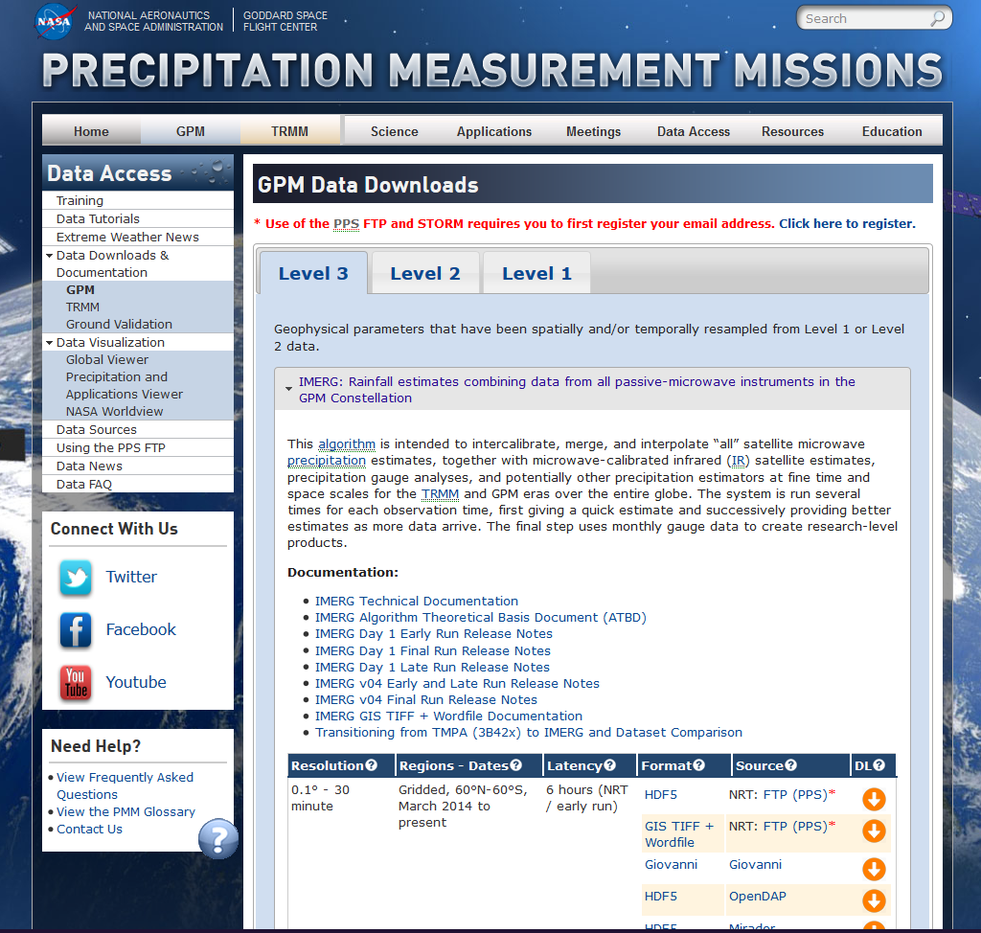
GPM Data Downloads
https://pmm.nasa.gov/data-access/downloads/gpm

