Slide 1

GPCP Introduction
MET 611 – Satellite Data Applications
Jennifer D. S. Griswold

Slide 2
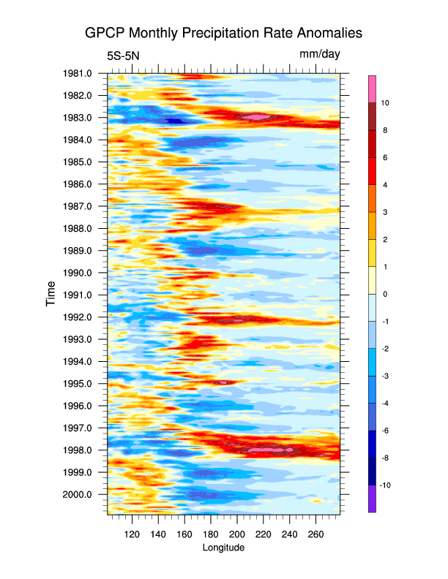
Global Precipitation Climatology Project
Organized in 1986
http://www.gewex.org/gpcp.html
http://precip.gsfc.nasa.gov/
http://www.esrl.noaa.gov/psd/data/gridded/data.gpcp.html
Component of the Global Energy and Water Cycle Experiment (GEWEX) of WCRP
Objectives:
  Improve understanding of seasonal to inter-annual and longer term variability of the global hydrological cycle
  Determine the atmospheric heating needed for climate prediction models
  Provide an observational data set for model validation and initialization and other hydrological applications

Slide 3
GPCP Strengths
Key Strengths:
  Provides global coverage
  Is one of the most-used precipitation data sets for climate variability studies.
  Provides estimates of uncertainty due to random errors (but not systematic errors).
  Regularly updated.
  Useful for validation of global precipitation in climate models, provided that care is taken to put the data on comparable grids using conservative re-gridding.

Slide 4
GPCP Limitations
Key Limitations:
  Complex algorithms are required to translate indirect and infrequent satellite measurements into high-resolution gridded precipitation estimates at regular time intervals.
  Debate about whether the global-mean precipitation amount is under-estimated, due possibly to missing light rain over ocean (especially the Southern Ocean) and missing orographic precipitation over land.
  Different satellites are used at different latitudes, leading to some spatial heterogeneity.

Slide 5
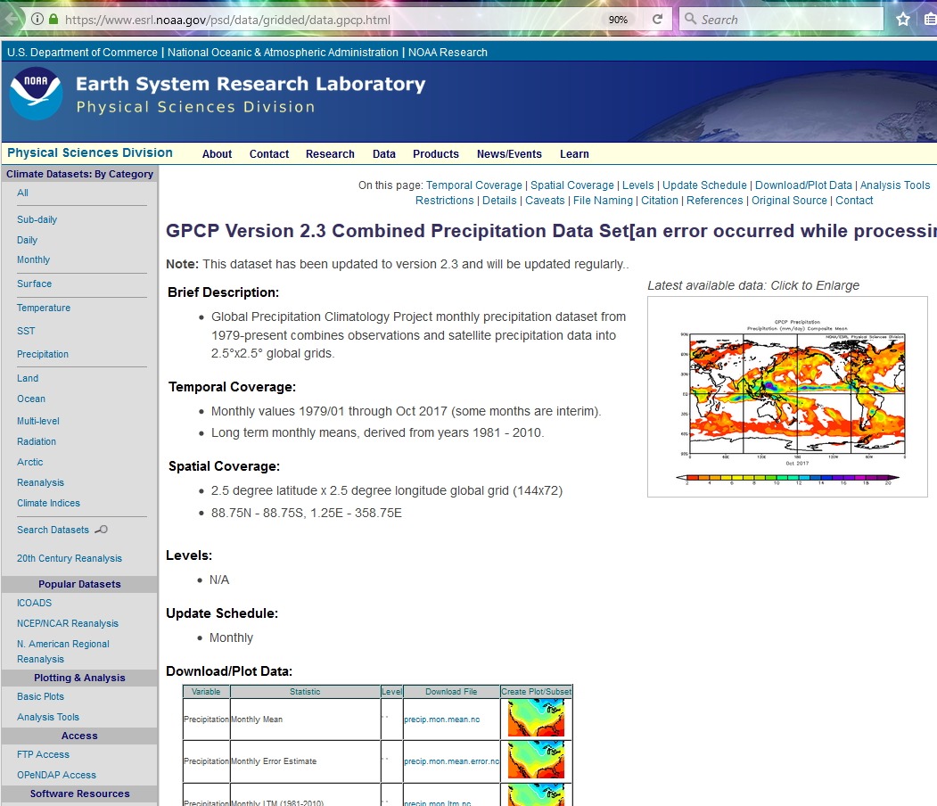
GPCP NOAA Data Website
Notice Data is in NetCDF Format!
2.5 x 2.5 degree
  144 x 72 grid
Not -90 to 90 and -180 to 180!!
  You’ll need new latitude and longitude files
Data are Pacific Centered
  Need to change orientation to compare to MODIS

Slide 6
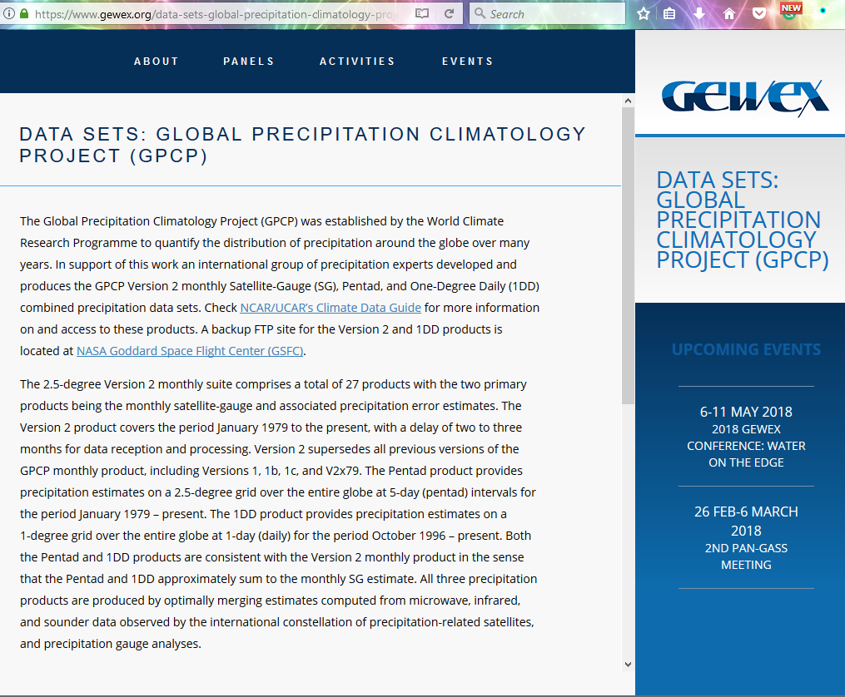
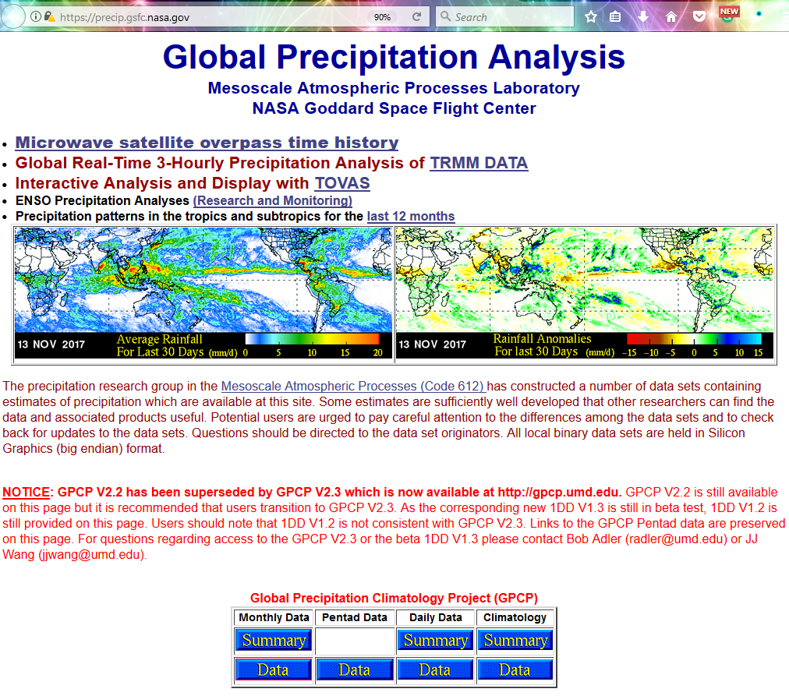
GPCP GEWEX Website
GPCP GSFC Website (V2.2)

Slide 7
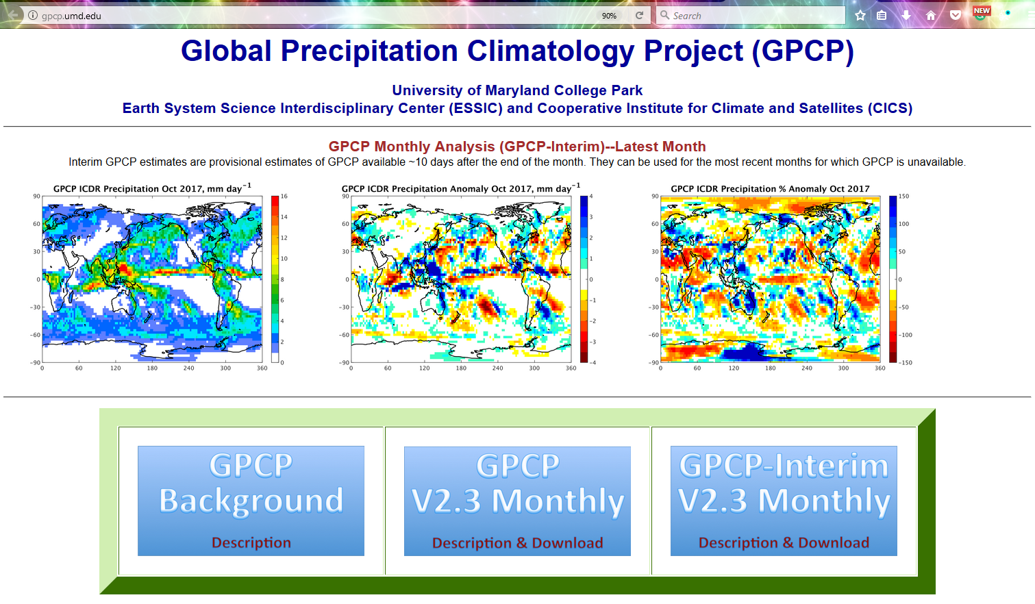
UMD Website (V2.3)

Slide 8
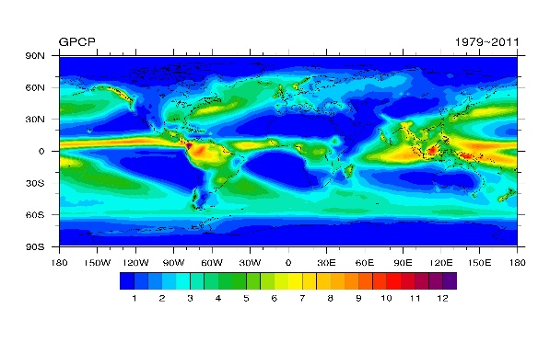
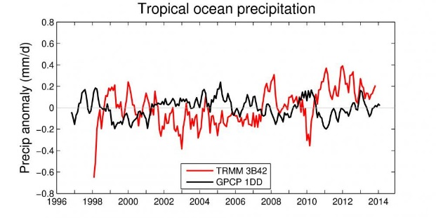

GPCP Heritage
GPCP Project
  Use then-new satellite passive microwave instruments to estimate “global” precipitation
  Develop at 2.5deg climatology
  Characterize El Niño Precipitation
  Prior development work in Adler precip group quickly led to an operational data set
Subsequent development work made the product fully global on three different time scales
  Different algorithms, but, 1DD, Pentad forced to sum to the monthly mean.
AGPI
SGM
GPCP V1
GPCP V2,2.1,2.2, 2.3 SG
thin arrows
denote
heritage
GPCP V1,1.1,1.2 1DD
GPCP V1,1.1,1.2 Pentad
Time

Slide 9
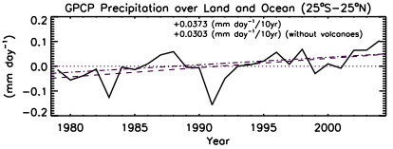
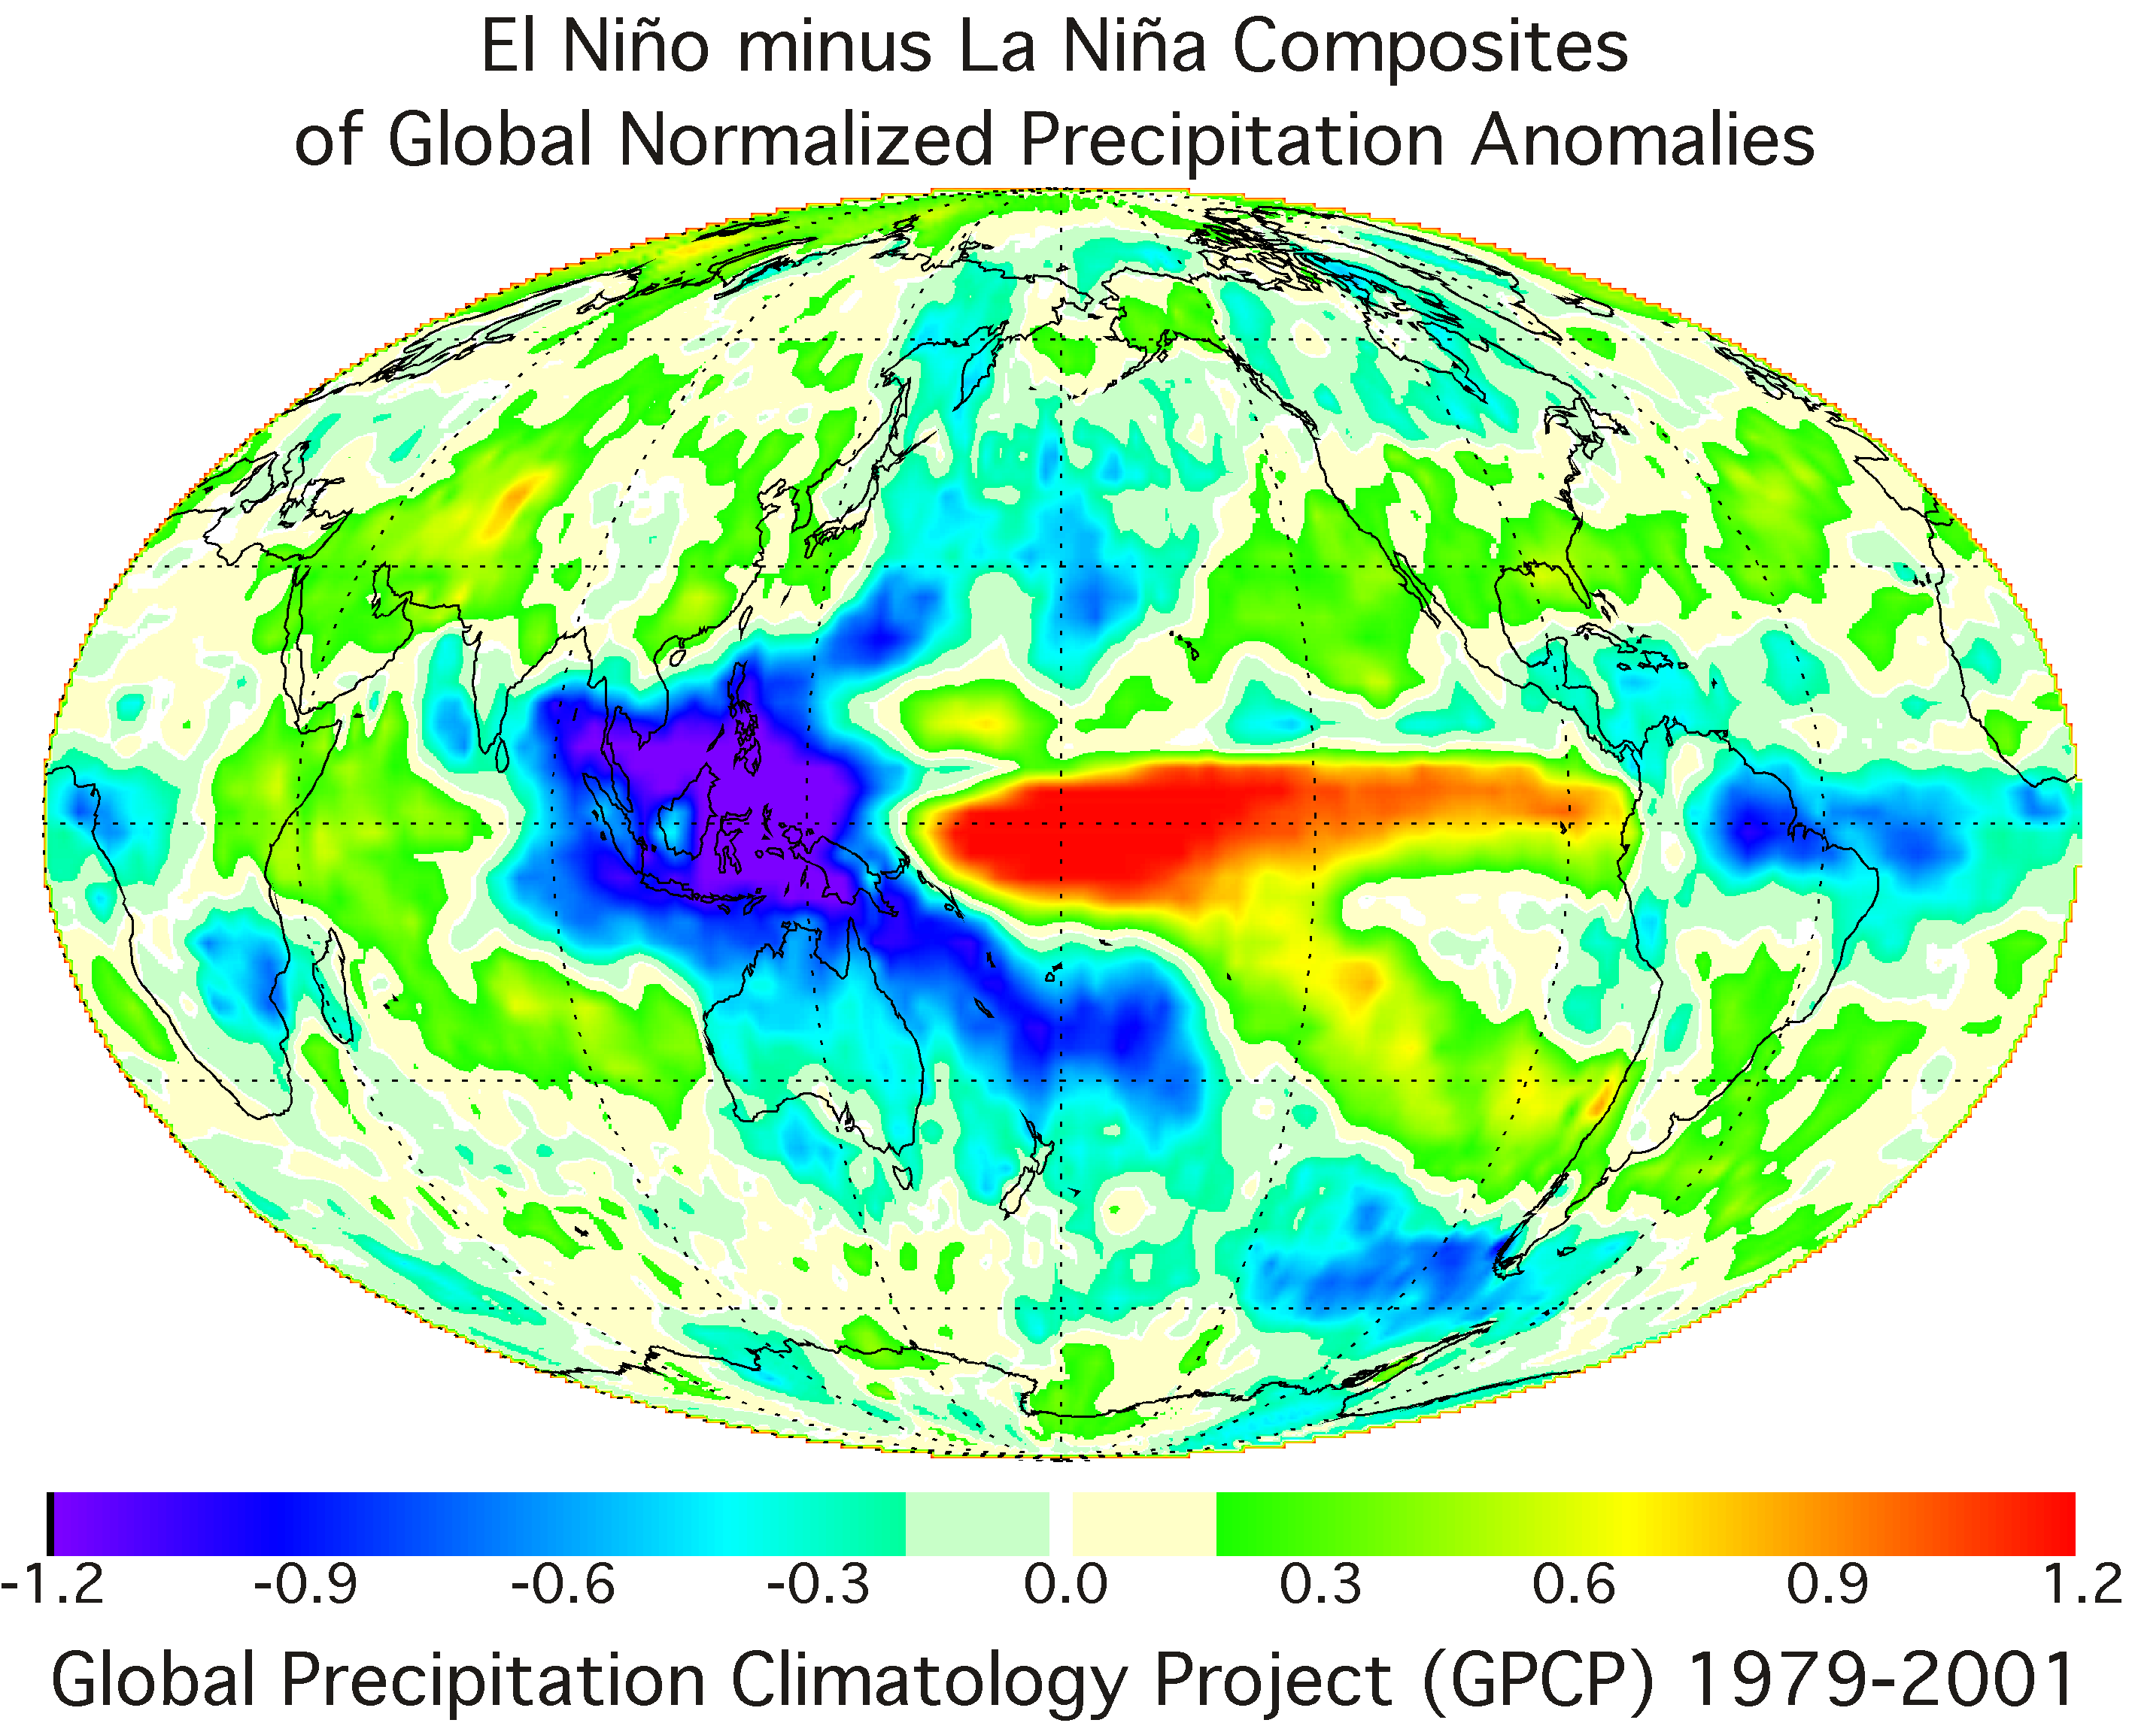
GPCP Objectives
A WMO/WCRP/GEWEX activity
Develop, produce long-term, global precipitation analyses at monthly and finer time scales for use in studies of weather and climate variations
Characterize quality of estimates
Improve the analyses by incorporating new data, improved analysis techniques, etc.
Analyze the data sets – precipitation alone or in combination with other components of the hydrological cycle

Slide 10
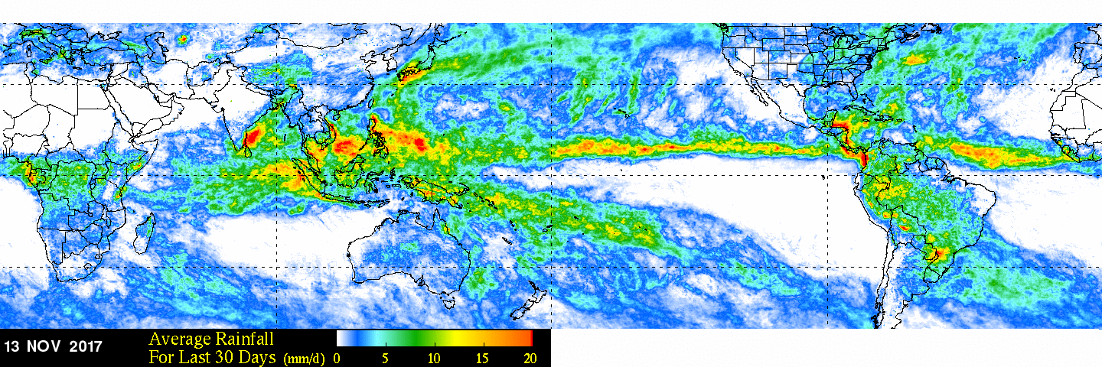
Success of Basic Objectives
Yes, the long-term climatology validates well (more later)
  Intelligent-guess fill-ins are no longer necessary
  Highest latitudes still have issues (more later)

Slide 11
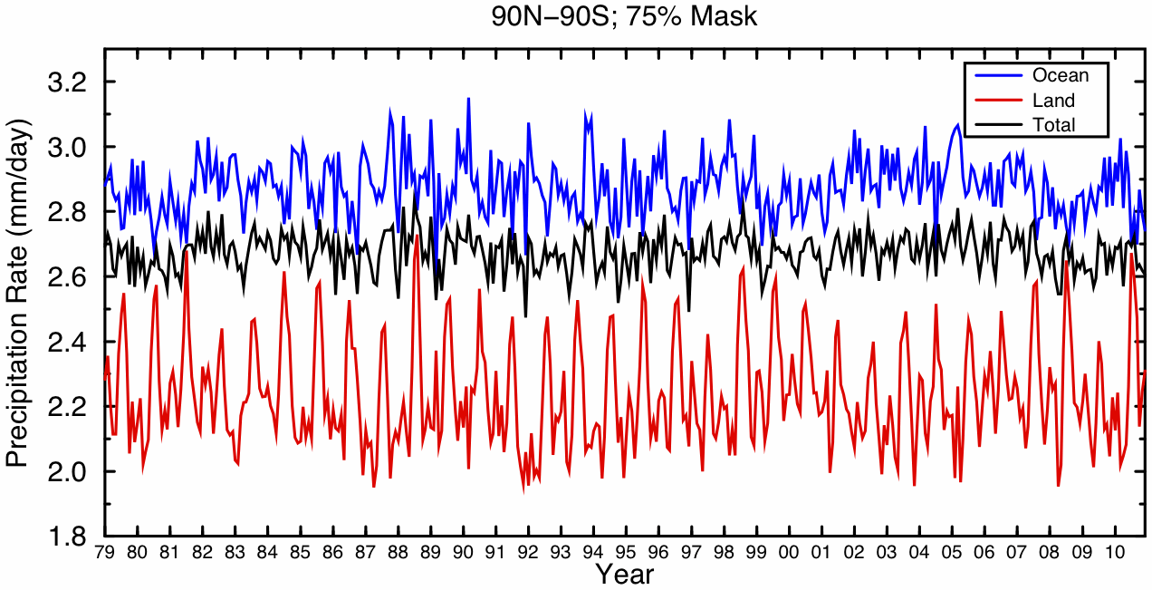
Success of Basic Objectives
Yes, we (quantitatively) see the annual cycle and ENSO events
  Variations in the land and ocean time series largely offset each other

Slide 12
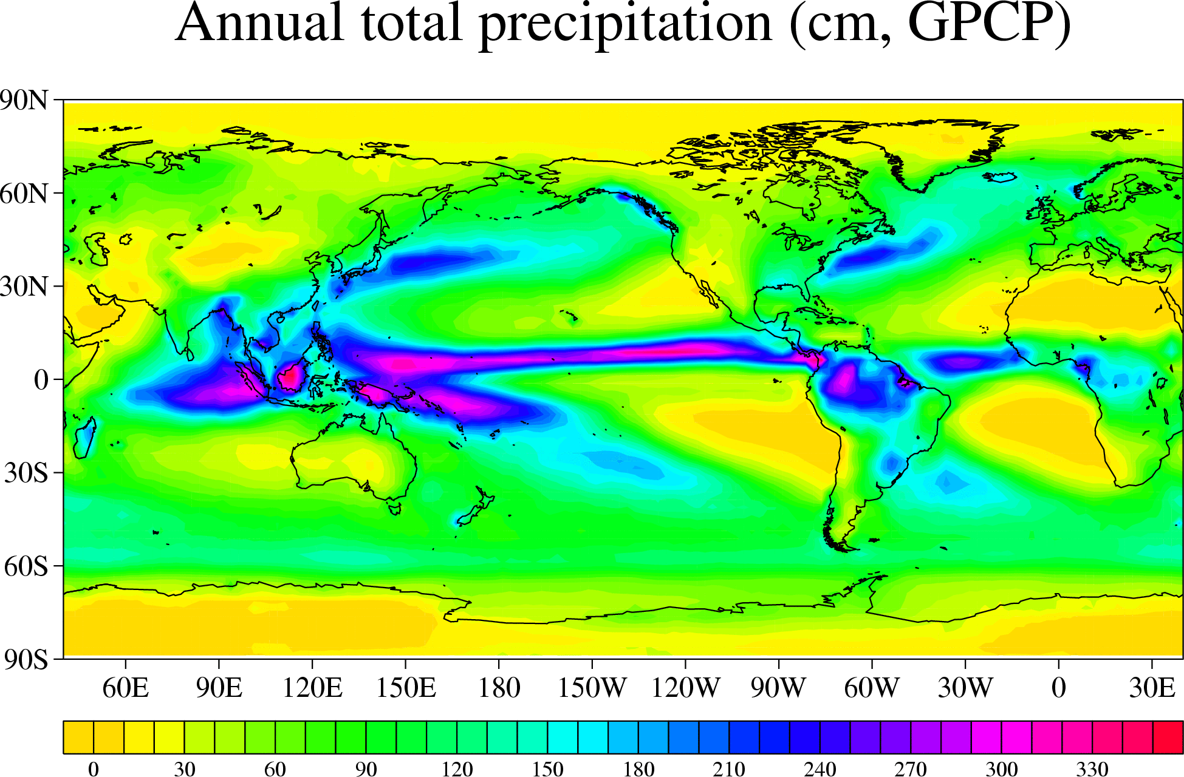
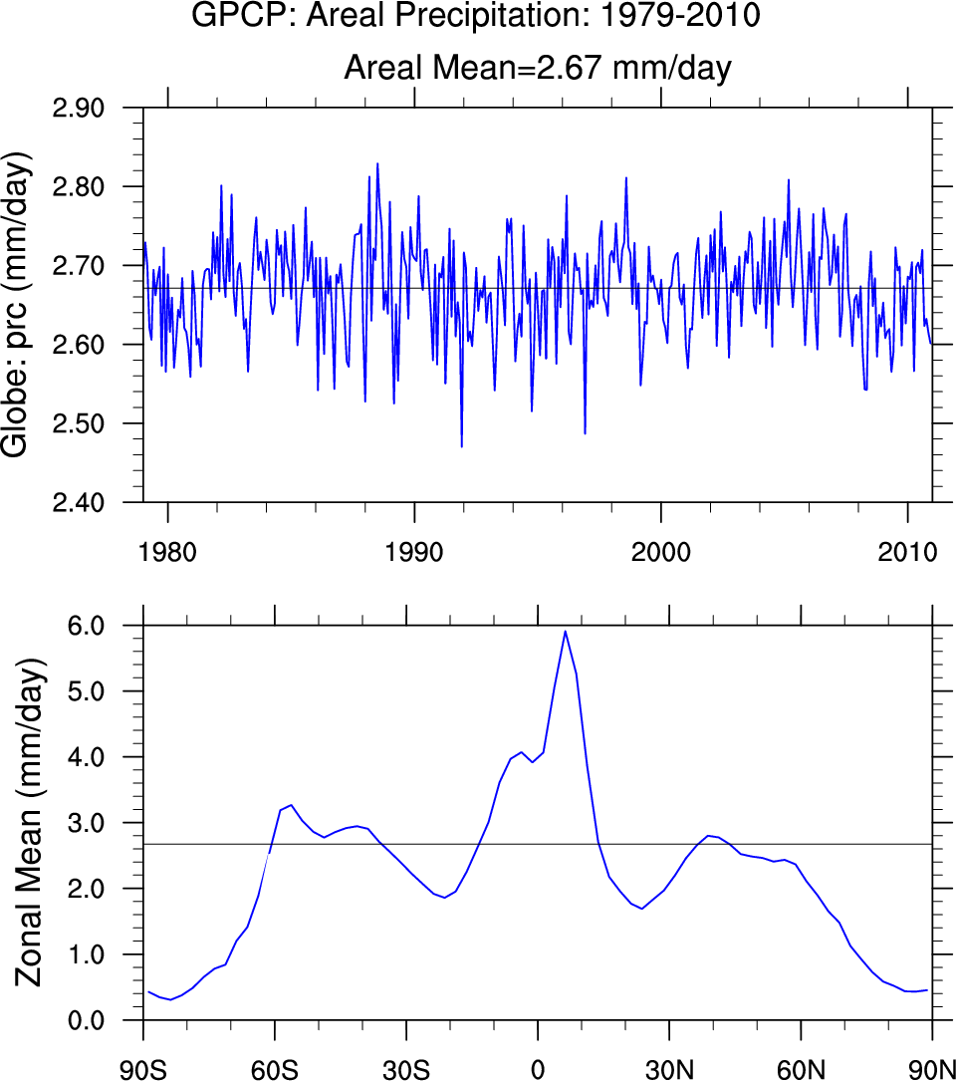
Characteristics of the GPCP Data Set
Global Complete Monthly Precipitation Analysis
January 1979 to Present
2.5º latitude by 2.5º longitude
Input data
  Satellite Infrared (geostationary0
  Microwave (from mid-1987)
  Gauge data (Global Precipitation Climatology
  Center (GPCC) operated by the DWD
Output Data
  Satellite only
  Merged gauge and satellite
  Monthly, pentad, daily

Slide 13
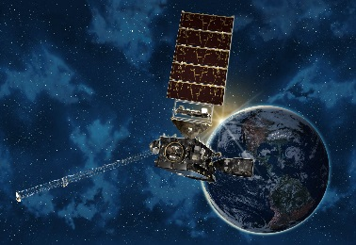
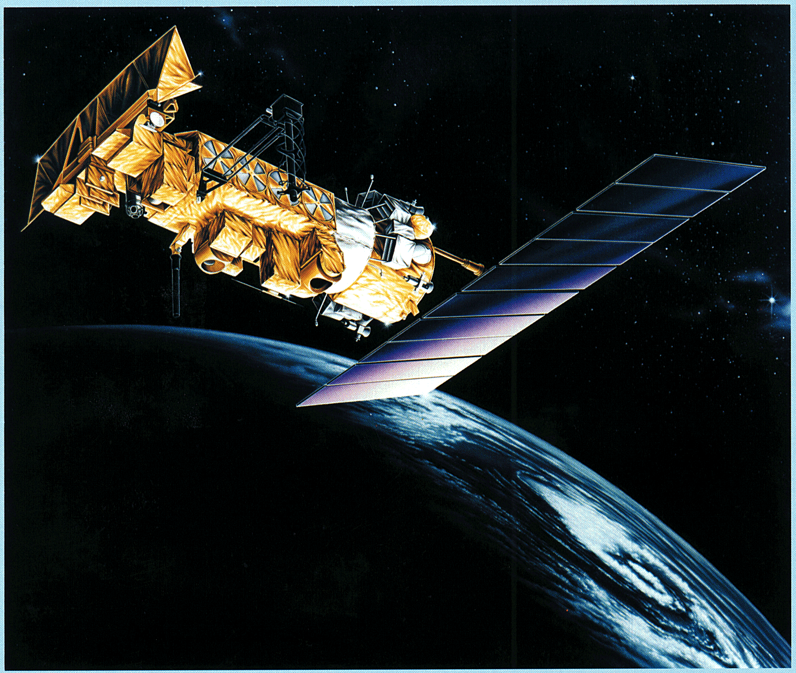
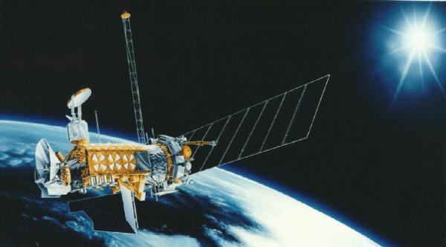
Remote Sensing Estimates used in GPCP
Infra –red
  GOES
  Rain Rate linearly related to fractional pixels Tcld < 235K
  Most effective for deep convective clouds, used only in 40N,S zone
  High spatial and temporal resolution
  false signatures, insensitive to warm top rain
  TOVS
  TIROS Operational Vertical Sounder
  Regression between cloud parameters and rain gauges
  Used in high latitudes where MW and GPI techniques is poor
  OPI
  OLR precipitation Index
  http://rain.atmos.colostate.edu/CRDC/datasets/NCEP_OPI.html
Microwave (SSM/I)
  Closely related to hydrometeors
  Emission from cloud drops (29 GHz).
  Most effective over water surfaces ( Tsfc <<Tcld)
  Scattering by ice particles over land over land ( 89, Tcld< Ta)
  only ice clouds over land, low resolution, no estimate over snow and ice

Slide 14
Global Precipitation Climatology Project
IR Component
Data Processing Centers
GMS
Meteosat
GOES
NOAA
MW Component
JAPAN
EUROPE
UNITED STATES
CAL/VAL Component
Polar satellite precipitation data
Geostationary Satellite
Precipitation Data Centre
Surface Reference Data Centre
Emission
scattering
(EVAC- UOK- M.Morrissey)
(ocean)
(land+ocean)
Global Tropics
Algorithm Intercompararison Program
NASA-GSFC
NOAA-NESDIS
NOAA - NWS – J. Janowiak
R. Ferraro
Validation Program
A. Chang
A. Chang
GPC Merge Development Center
Merged Global Analysis
NASA - GSFC –R.Adler
Station Observations
(CLIMAT, SYNOP National Collections)
Gauge - Only Analysis
Global Precipitation Climatology Center
DWD - GERMANY, B. Rudolf

Slide 15
Version 2 Monthly Satellite-Gauge (SC)
Emission
Microwave
Scattering
Microwave
TOVS
OPI
1986-87
Microwave/Other
Fusion
Various input data depending on era
Sequential calibration and combination of input data
1987-present
Matched
3-hr
Geo-IR
“Microwave”/IR
Calibration
Geo
1979-85
Merged IR
(GPI)
AGPI
Low-Orbit
Adj. Low-
Orbit IR
Multi-Satellite
• High-latitude and cold-season precipitation estimates provided by gauge, TOVS, OPI
1986-present
Gauge-Adjusted
Satellite
Gauge
Satellite/Gauge
Notes:
TOVS - The TIROS Operational Vertical Sounder (TOVS) equipped aboard NOAA's TIROS series of polar orbiting satellites consists of three instruments: the High Resolution Infrared Radiation Sounder (HIRS), the Microwave Sounding Unit (MSU) and the Stratospheric Sounding Unit (SSU). The MSU and SSU have been replaced with improved instruments, the AMSU-A and AMSU-B, on the newer satellites.
OPI - OLR Precipitation Index from NCEP - The Outgoing Longwave Radiation (OLR) Precipitation Index (OPI) is computed from NOAA polar-orbiting IR window channel data using the technique developed by Xie and Arkin [1998]. The OPI is produced by calibrating OLR values using rain estimates from the CPC Merged Analysis of Precipitation (CMAP) data [Xie and Arkin [1996]. The OPI dataset is one of the component rainfall estimates used in the merged CAMS-OPI dataset [Janowiak and Xie, 1999].

Slide 16
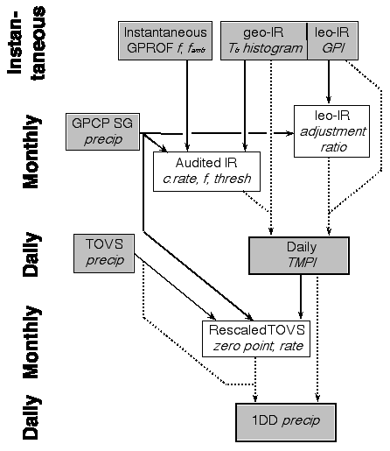
One Degree Daily (1DD)
1DD Algorithm
Similar input data
Treated Differently
• High-latitude and cold-season precipitation estimates provided by TOVS, scaled by SG

Slide 17
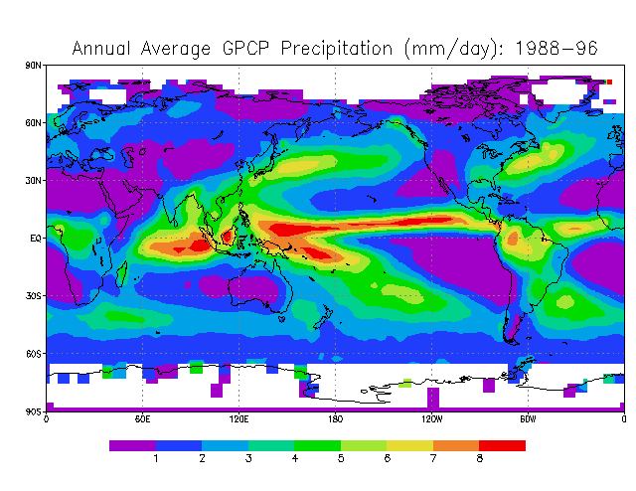
Monthly Mean Analysis Procedures
All products sum to monthly means
Monthly, 2.5° Merged Analysis
  1979-present (Oct 2017)
  Adler et al. (2003)
  stepwise bias corrections; i.e., IR, adjusted to MW, satellite, adjusted to gauges, final blending uses inverse error weighting (Huffman, et al 1995 and Huffman et al, 1997)
Pentad, 2.5° Merged Analysis
  1979-present (Oct 2017)
  Xie et al. (2003)
  combines satellite estimates by maximum likelihood estimates, then bias removal by solving a Poisson equation with gauges as boundary conditions. ( Xie and Arkin, 1996,1997)
Daily, 1° Merged Analysis
  1997-present (Oct 2017)
  Huffman et al. (2001)
IMPORTANT POINT
Algorithms are designed for liquid precipitation
Gauges Used to produce a gridded analysis, incorporates water equivalent of solid precipitation
Final GPCP Precipitation Field satellite estimates adjusted to large scale gauge analysis (water equivalent of solid precipitation incorporated in this stage)
http://www.esrl.noaa.gov/psd/data/gridded/data.gpcp.html

Slide 18
GPCP Version 2.3 (initiated in April l2016)
New version of GPCP V2.3 monthly
  Working with NOAA to streamline the multi-organization data streams, processing procedures and associated computer code to make the current GPCP Version 2 (V2.3) part of NOAA’s Climate data Record [now Reference Environmental Data Record] program.
  Small changes and shifts (decreases) in mean precipitation were noted for the post-2003 period over oceans that did not seem natural.
    These were determined to be related to subtle shifts in input satellite precipitation estimates due to transitioning from one satellite to the next using inadequate overlap and cross calibration procedures.
  New cross calibration procedures were developed, tested and applied to correct the problems and have been incorporated into the new V 2.3, which will become part of the NOAA program
  In addition to changes in satellite inputs, new sets of gauge analyses became available from the Global Precipitation Climatology Center which were also integrated into the analysis record.

Slide 19
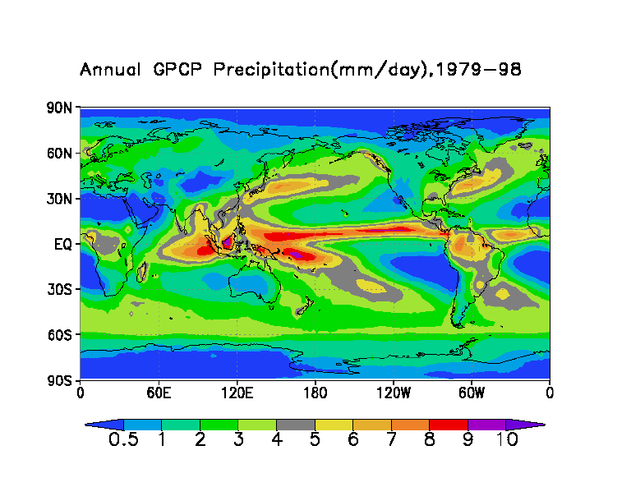
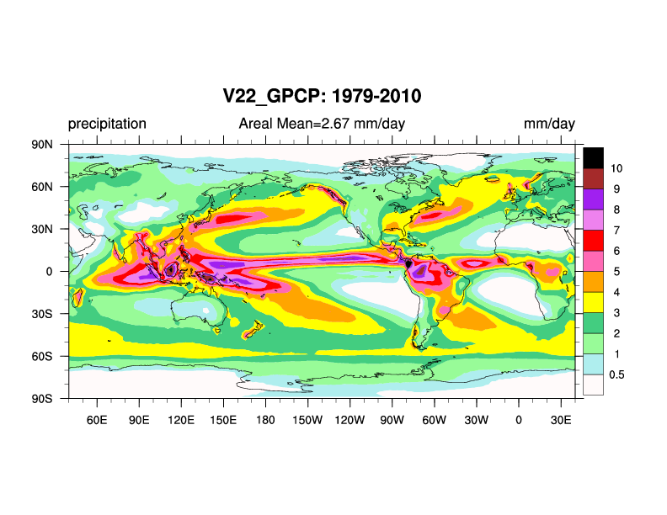
Climatology - Annual Mean Precipitation
All available months in the period January 1981--December 2010 are used to compute monthly climatological values.
The data set archive consists of unformatted REAL*4 binary files. Each file occupies about 40 KB, and the whole data set contains about 486 KB.
The grid on which each field of values is presented is a 2.5°x2.5° latitude--longitude (Cylindrical Equal Distance) global array of points. It is size 144x72, with X (longitude) incrementing most rapidly West to East from the Prime Meridian, and then Y (latitude) incrementing North to South.
mm/day

Slide 20
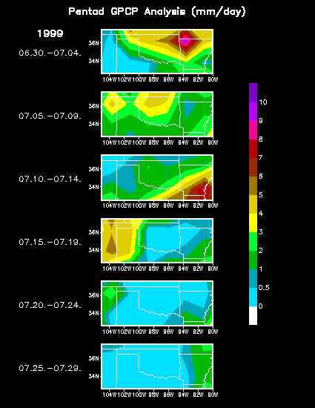
Pentad (5-day) Data
An analysis of global pentad (5-day) precipitation has been constructed for the Global Precipitation Climatology Project (GPCP).
The pentad analysis is a companion to the V 2.3 product of the GPCP global monthly precipitation analysis.
Users are recommended to use this pentad data set only for studies where sub-monthly and intra-seasonal phenomena are involved.

Slide 21
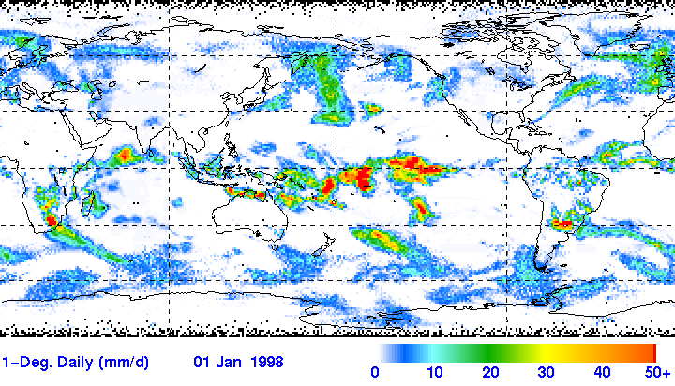
1-Degree Daily Data
1 x 1 degree, daily precipitation
January 1, 1998
The 1DD uses the "best" quasi-global observational estimators of underlying statistics to adjust quasi-global observational datasets that have desirable time/space coverage. Specifically:
  Special Sensor Microwave Imager and SSMI Sounder (SSMI, SSMIS)
    0.5°x0.5° by orbit & GPROF algorithm
    Provides fractional occurrence of precipitation
  GPCP V2.3 Satellite-Gauge (SG) combination (2.5 by 2.5 monthly) accumulation of precipitation to algorithms applied to:
    Geosynchronous-orbit IR (geo-IR) T_{b} histograms (geo-IR) T_{b} histograms (1°x1° grid in the band 40°N-40°S, 3-hourly)
    Low-orbit IR (LEO-IR) Goes Precipitation Index (GPI; same time/space grid as geo-IR)
    TIROS Operational Vertical Sounder and Atmospheric Infrared Sounders (TOVS, AIRS; 1°x1° on daily nodes, Susskind algorithm)
mm/day
http://precip.gsfc.nasa.gov/gpcp_daily_comb.html
Although microwave precipitation estimates and gauge analyses are not explicitly used due to sampling limitations, the calibration of the 1DD to the monthly Version 2.2 SG ensures that they do have a strong influence on the overall scaling.
The differences between the IR and TOVS (AIRS) datasets required that the 1DD be formulated in two parts, with smoothing over the latitude band 40° to 50° in each hemisphere to patch the data boundary.

Slide 22
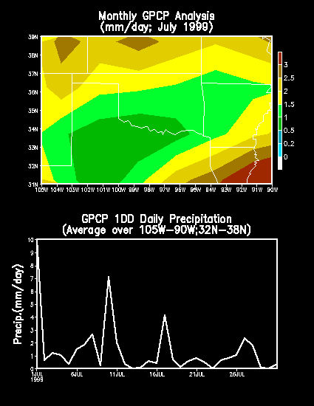


Slide 23
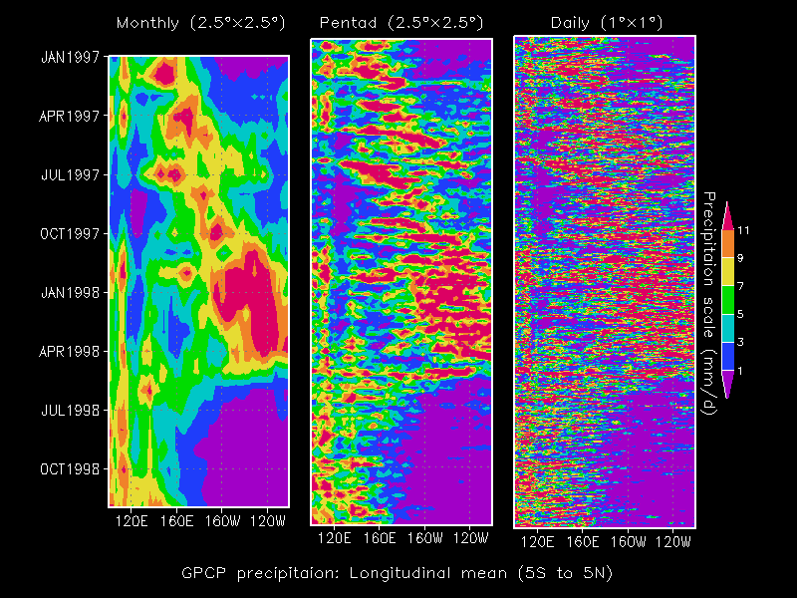
Notes:
An application to a storm system from 1/31/02.
Top is the NEXRAD reflectivity image. Here, we have a major storm system, with rain to the south (TX to IN) and snow to the north (CO, NE, IA, MI, plus in NY area).
Below is the AMSU snow fall product for approximately the same time. Fairly good agreement in many parts of the country (some false signatures; here is where that threshold needs to be tuned, but again, very preliminary, but promising).

Slide 24
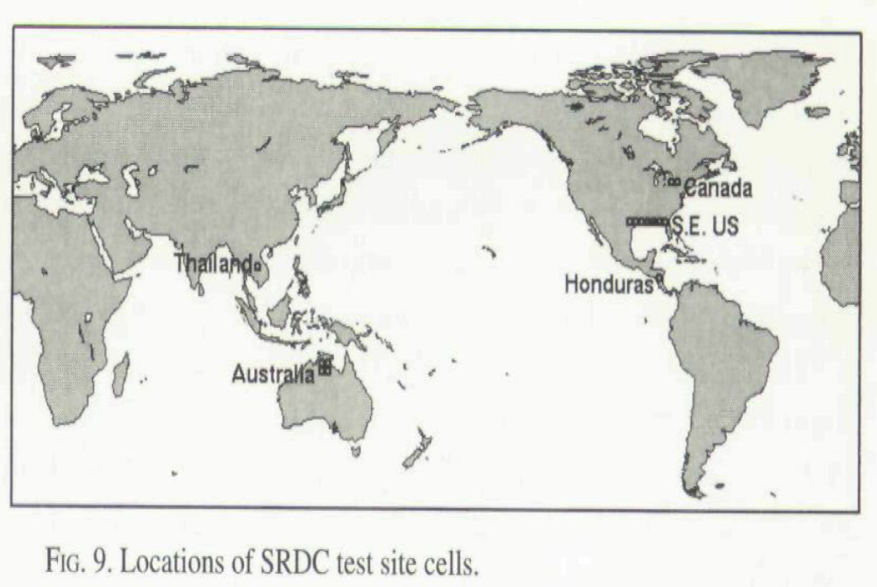
Validation
Even though the limited applicability of prior datasets prevents complete global validation of the SG precipitation product, it is possible to make some quantitative comparisons.
The GPCP Surface Reference Data Center (SRDC) at the National Climatic Data Center (NCDC) has constructed monthly area average precipitation for fifteen 2.5° x 2.5° cells located in five test site areas (Fig. 9) during the period July 1987-December 1991.
Notes:
Algorithm flow chart. Pretty self explanatory.
First, we use the AMSU snow cover product as a starting point. Next, we use a discriminant function based on TB150 and TB176 that predicts falling snow. We have used a preliminary threshold of 0.6 (but this is under investigation).
Final step is to remove false signatures, which compares the TB176 and TB180.

Slide 25
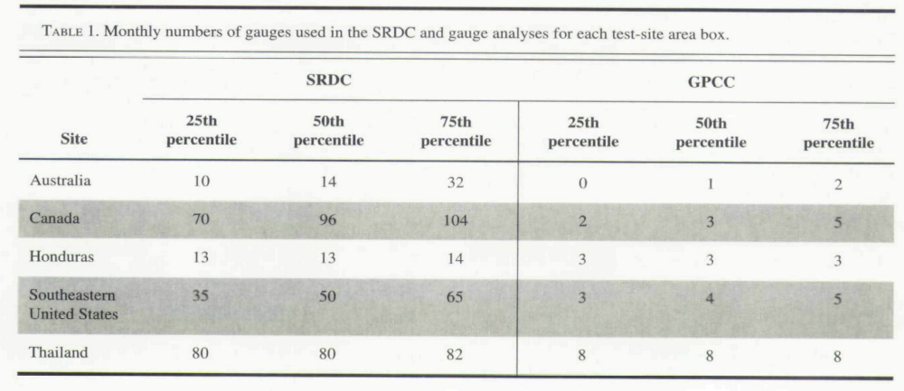
Validation Gauges

Slide 26
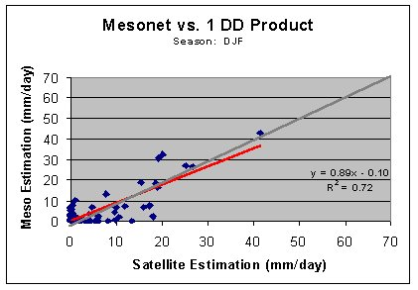

Slide 27
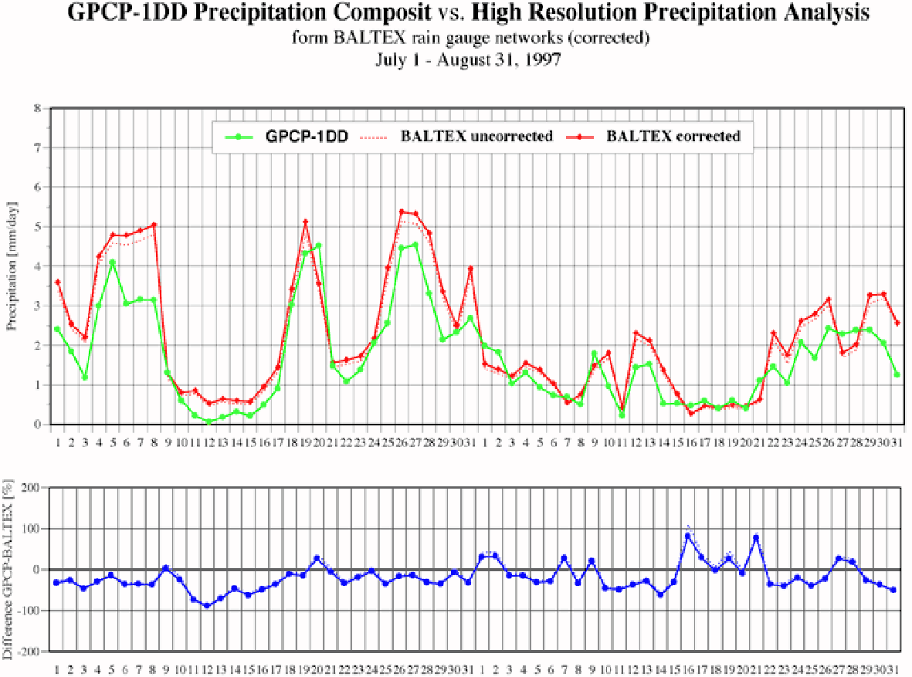

Slide 28
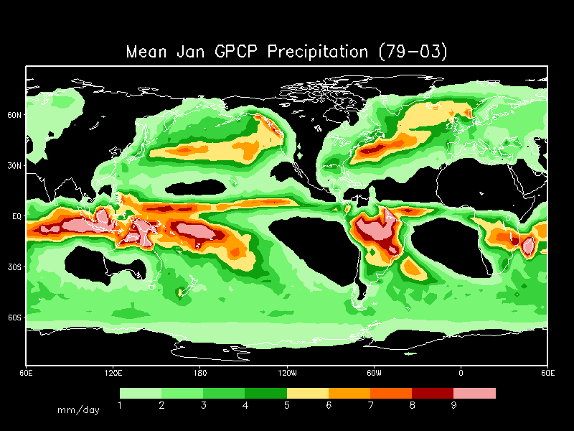
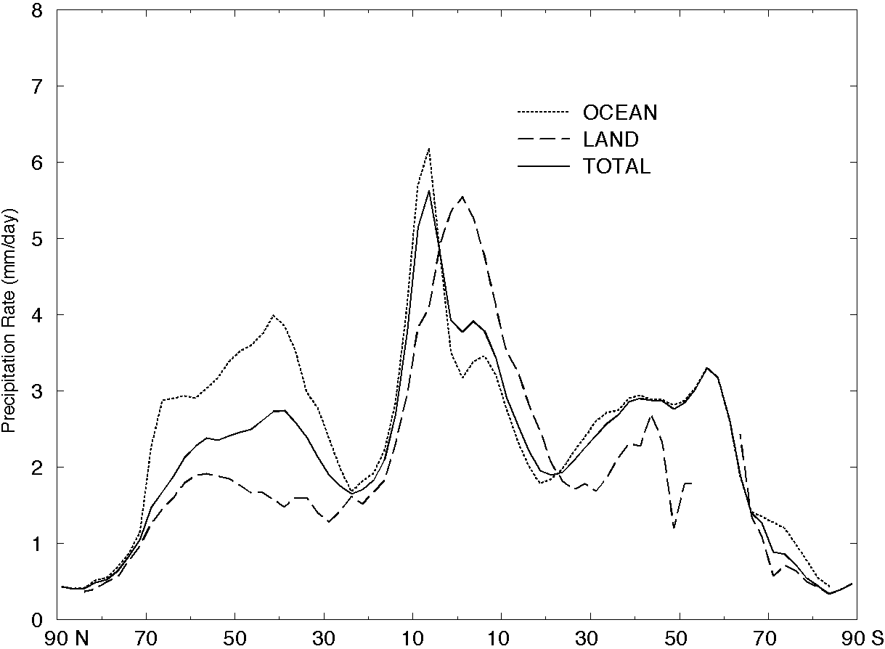
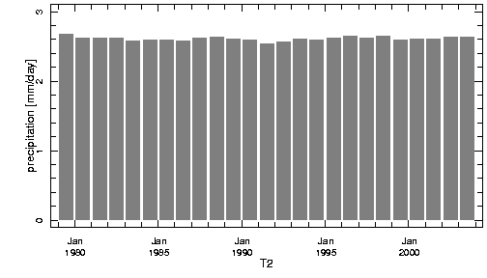
Applications and GPCP Contributions
Examples:
  Estimates of global precipitation patterns
  Estimated mean global rainfall rates
  Zonal Mean Precipitation
Figure 1a. Zonal mean precipitation, land versus ocean, 1979-2003, after Adler et al, (2003)
P estimated a 2.61 mm/day
Yearly Standard Deviation 0.03mm/day

Slide 29
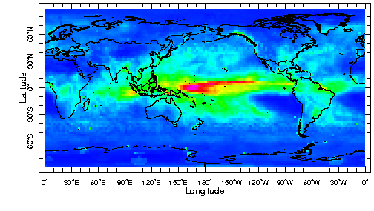
Standard Deviations of Annual Mean Precipitation

Slide 30
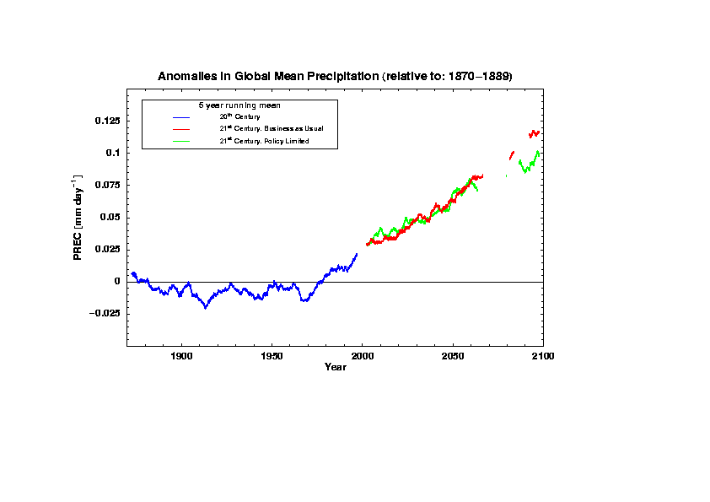
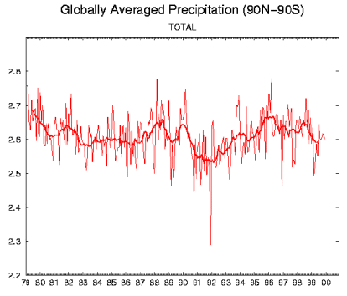
GPCP in a
Climate Context
Long Time Span!
1979-2017
Perfect for comparing to Global Climate Models
PREDICTED
OBSERVED

Slide 31
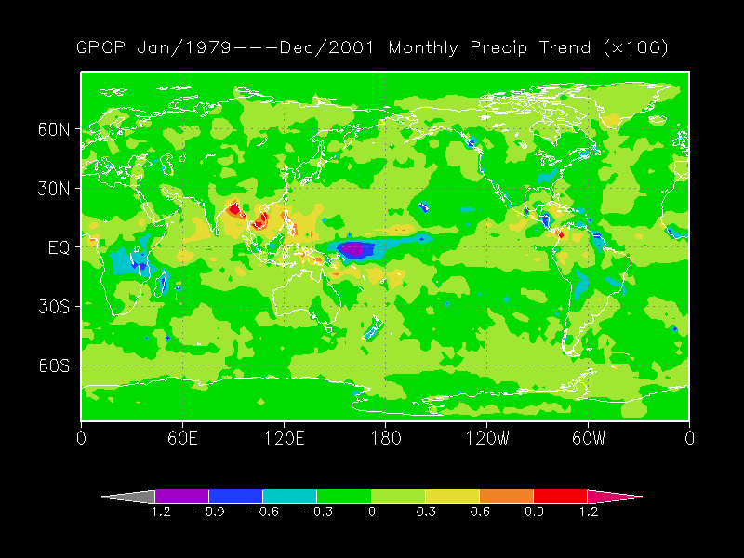
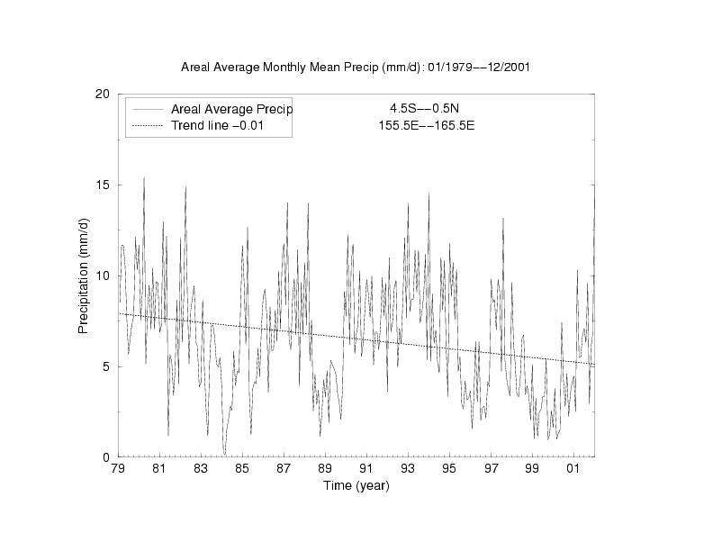
Trends
Global Patterns of increasing and decreasing precipitation
Can zoom in and look at trends in specific locations.
Again, great for comparing to climate models (past & future prediction)

Slide 32
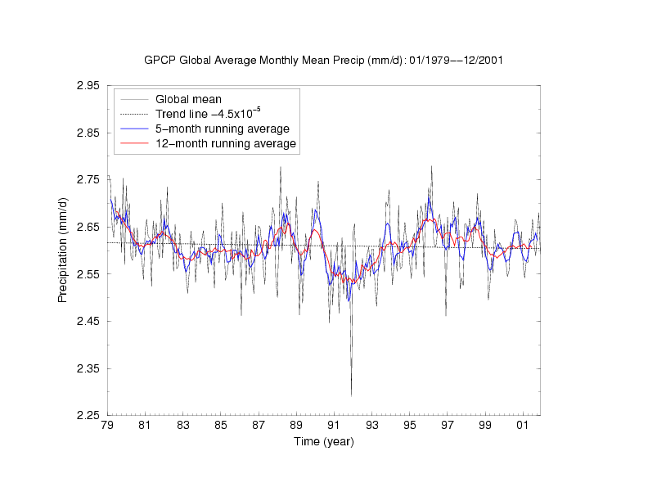

Slide 33
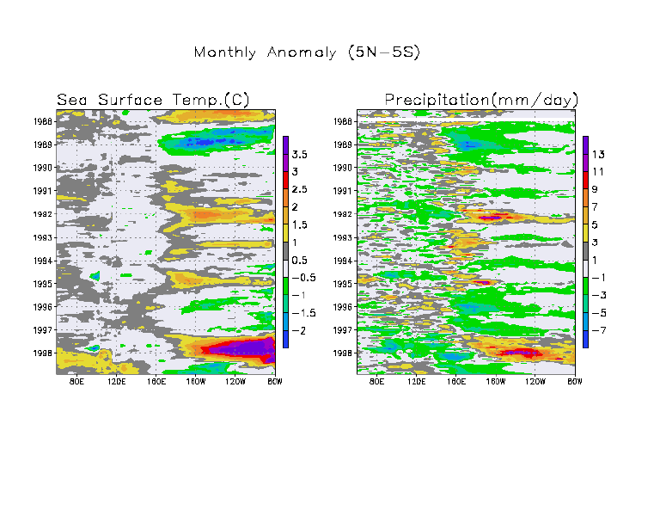
Hovmoller Diagrams
Monthly Anomaly (5N-5S)

Slide 34
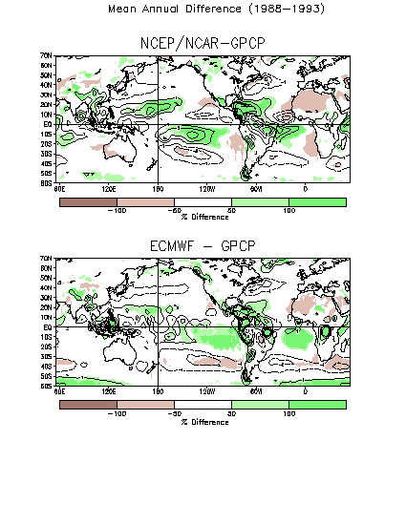
Comparisons with Reanalysis
Mean Annual Difference

Slide 35
Future Outlook/Issues
New Instruments/Improved Algorithms
  TRMM: a calibration source
  AMSR: improved MW algorithm
  Eventually GPM Since TRMM is dead
Use of Multiple Satellites
  Operational and research satellites e.g. multiple microwave observations from AMSU, AMSR, SSM/I, TRMM…. GPM
Solid precipitation
  Snow rate
Precipitation in complex terrain
  A challenge - microphysical cloud properties to detect “warm top rain”

Slide 36
Future Outlook/Issues
Use of Multiple Satellites
  Currently GPCP uses IR data from Geostationary and Polar orbiting data and MW data from one SSM/I. We now have MW data available from multiple SSM/I orbits, AMSU data, TRMM data and soon will have AMSR data. The challenge is to utilize these data effectively. They are proposing to utilize these data to develop a three hourly 1 x 1 degree product. This would be Version 3.
Solid Precipitation
  Solid precipitation is not measured explicitly but is included over land through use of gauges.
  Liu and Curry have done some early work on solid precipitation over the oceans and recently Ferraro has been studying the use of AMSU 150 and 176 GHz data to help identify solid precipitation over land.

Slide 37
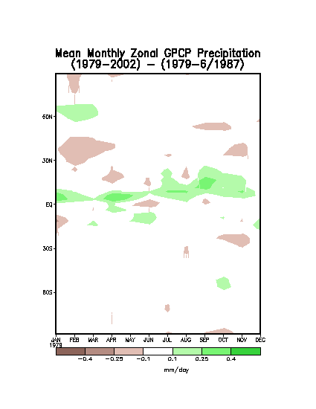
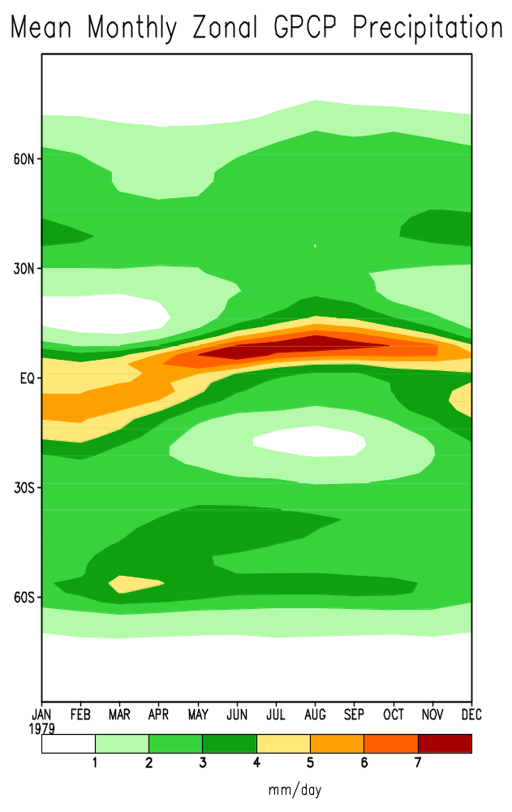
Annual cycle of zonal mean GPCP Precipitation (mm/day) and
b) the difference between total period zonal mean 1979 – 2002
and 1979-86/87.

Slide 38
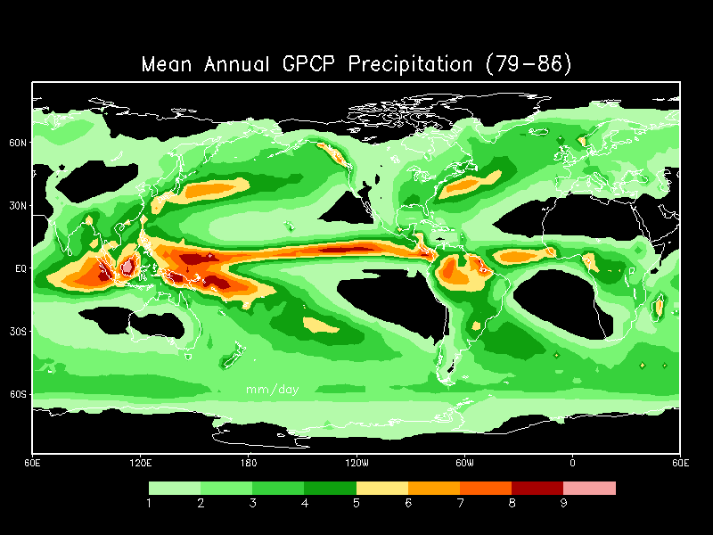
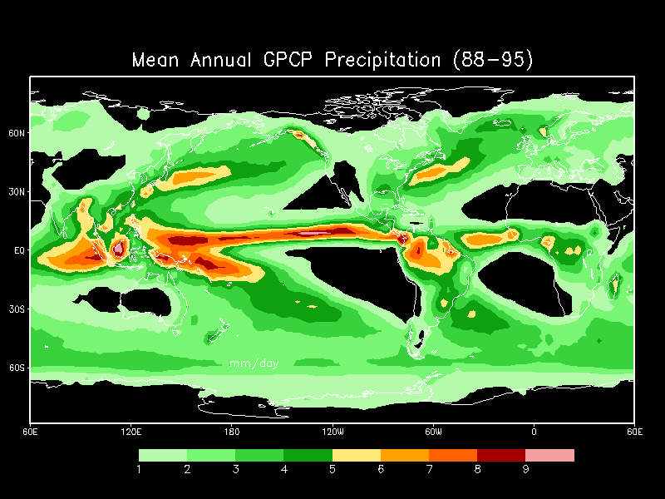
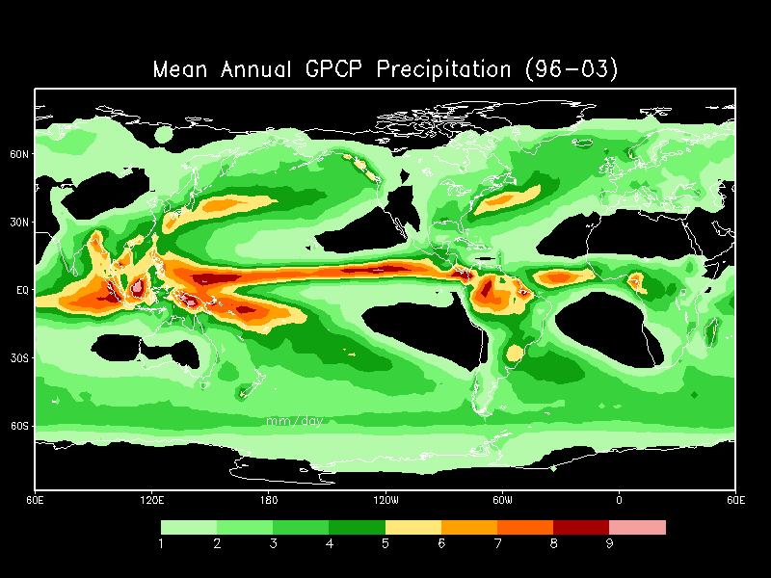
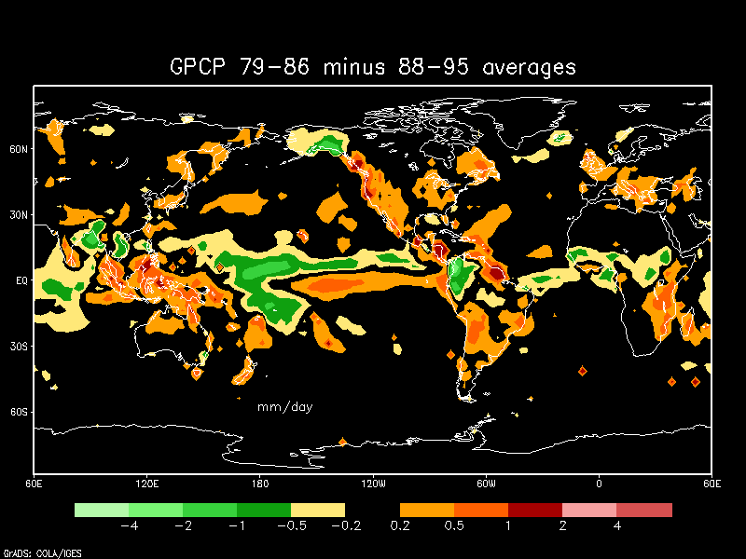
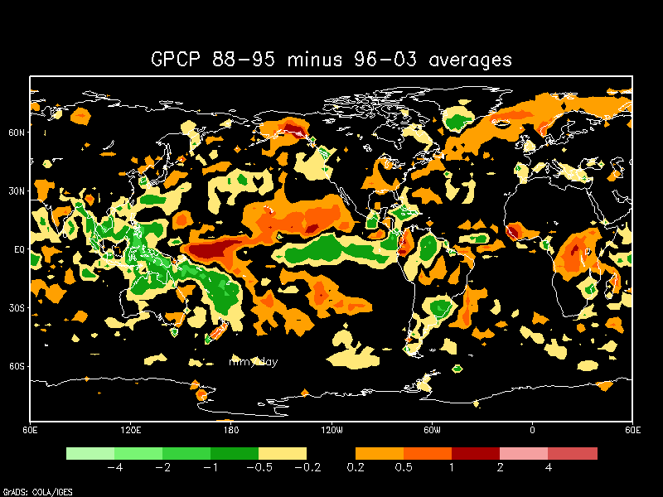
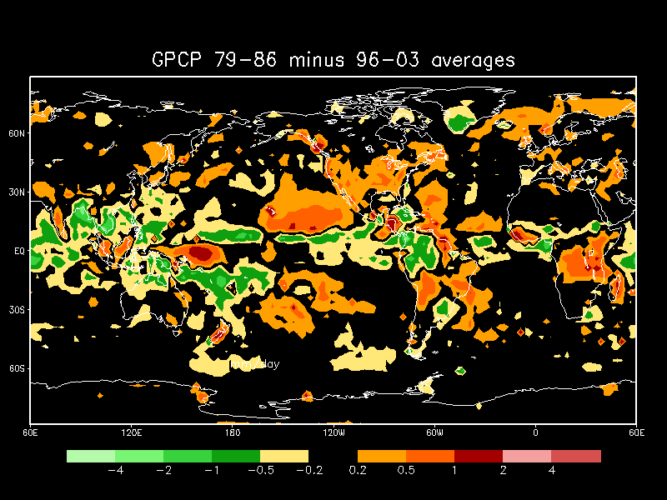
(top) Mean GPCP Precipitation
P1-1979-86 (left)
P2 -1988-95 (middle)
P3- 1996-2003 (right)
Mean Differences
P1 minus P2 left-middle
P2minus P3 rt-middle
P1 minus P3 bottom
Notes:
This is candidate Fig 3 for the paper

Slide 39
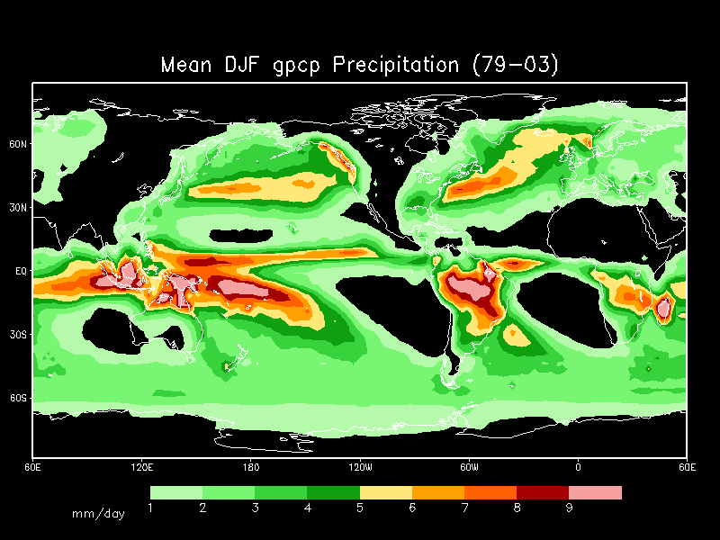
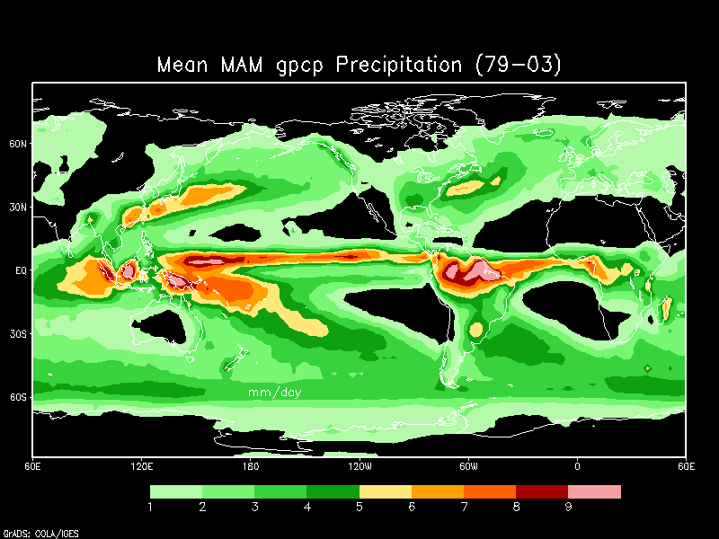
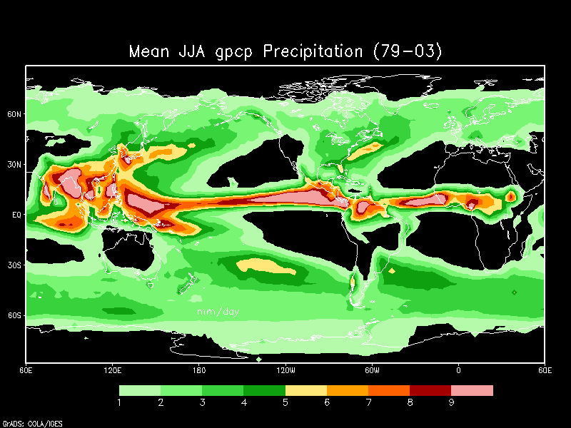

Seasonal mean precipitation (mm/day) for a) DJF, b) MAM, c) JJA and d) SON

Slide 40

Fig. 9b) Tropical (30ºN-30ºS) averages of monthly precipitation anomalies (mm day⁻¹) for (top) total, (middle) ocean, and (bottom) land. Vertical dashed lines indicate the months of significant volcanic eruptions. The thin black curves indicate the Niño-3.4 SST index (ºC). After Adler et al 2003.

Slide 41








a
e
b
f
c
g
d
h
Fig 10. Time series of zonally averaged GPCP estimates over land (left hand panels) and over the ocean (right hand panels). Zonal averages are for 50N to 90N (a,e); 25N to 50N (b,f); 25S to 25N (c,g) and 50S to 25S (d,h). The introduction of microwave data in 1987 is evident for the data over land.
Notes:
Fig 10. Time series of zonally averaged GPCP estimates over land (left hand panels) and over the ocean (right hand panels). Zonal averages are for 50N to 90N (a,e); 25N to 50N (b,f); 25S to 25N (c,g) and 50S to 25S (d,h). The introduction of microwave data in 1987 is evident for the data over land.

Slide 42

Linear Trend Fit – Zonal Average
Zonal averages of 25-year linear trend show quite different trends in
different lat. bands
Note regional
coherence.
Land and Ocean are not uniformly related.
Linear trends in the zonally averaged GPCP estimated precipitation.

Slide 43

Map of linear changes in GPCP precipitation anomalies from January 1979 to December 2003. The thin black contour outlines the local 1% significance level.

Slide 44
Summary
The GPCP Data provide (relatively) consistent and complete global precipitation estimates from (1979) to the present.
These data identify features of the large-scale precipitation fields not (well) known before.
  e.g. oceanic precipitation patterns, storm tracks, individual ENSO patterns
Global precipitation shows no significant trends over the period of record … however regional “trends” are evident in the tropics.
  These aren’t easily untangled from instrumental differences and differences in ENSO in the record.
These are research data!!
  For real-time monitoring go to CAMS-OPI or other “operational” estimates such as CMORPH

