Slide 1

GPCP Continued – V3
MET 611 – Satellite Data Applications
Jennifer D. S. Griswold

Slide 2
High Latitude/Cold Season Data Issues
Besides the classic polar regions, this issue dominates in the wintertime
  U.S., episodically to the Gulf Coast
  “temperate” mountains – Rockies, Andes, Himalayas, Tibetan Plateau, Alps
  Europe and Siberia
Still uncertain about the possible information content of the various sensors:
  sensing precip over ice, snow, frozen surface
  sensing light precip (everywhere) and/or precip in a cold, dry environment
Need to choose the best data sources for calibration and validation.
  GPM DPR will eventually play a key role, but what to use in the meantime?
  It is critical to interact with high-latitude researchers on surface precipitation data.
Lower quality estimates tend to have longer periods of record; what is “good enough” for operational global data?
Error estimation in high latitudes is at least as challenging as in the tropics.
Key GPCP goals
  devise a quality globally complete, fine-scale precipitation algorithm system
  provide estimates for a substantial part of the available satellite record

Slide 3
High-Latitude Data Sources
Accurate input data are less plentiful at high latitudes
Data Set | Advantages, Disadvantages
Window-channel microwave | long record detectability problems; interference by surface ice/snow
Current NESDIS AMSU-B | operational footprint size; interference by surface ice/snow
NOAA/CPC OLR Precip Index (OPI) | long record; apparent sensitivity at all latitudes short development history; problems in early data record; need for independent climatology; problems in application for extremes
Gauge | “ground truth”; long record severe, location-dependent undercatch; sparse spatial sampling
NASA/SRT TOVS and AIRS; NESDIS ATOVS | long record; apparent sensitivity at all latitudes short development history; problems in early TOVS data record; high fractional coverage/low rain rate; footprint size
High-frequency microwave | reasonable retrievals over surface ice/snow short record; short development history
Less useful
More useful

Slide 4
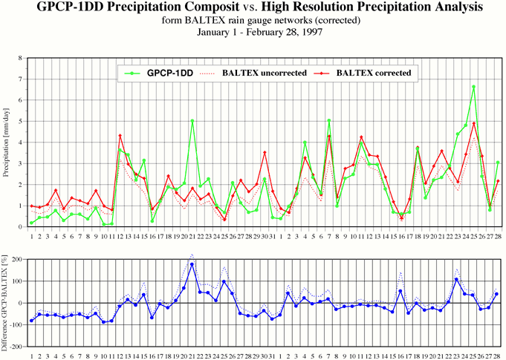
High-Latitude Data Quality
Comparisons of 1DD to BALTEX gauge analysis averaged over Baltic Sea drainage basin
January
February

Slide 5
Lessons Learned
Community now recognizes two styles of precipitation data sets
  High Resolution Precipitation Product (HRPP)
    focus on “best” instantaneous answer TMPA, IMERG, CMORPH, PERSIANN, GSMap, …
  Climate Data Record (CDR)
    Focus of homogeneity
GPCP follows CDR standards
  GPCP Version 2 now in the NOAA CDR program
User do analyses not originally imagined by the creators
  Extremes - Analysis schemes in current GPCP algorithms don’t focus on preserving extremes
  Intermediate Products – Originally released to show processing steps, but getting used for science.

Slide 6
Lesson Learned – Users Want new things!!
Precipitation Phase (Liquid/Solid)
  Current state of the art is a diagnostic using reanalysis T and R.H.
File Formats
  Heritage binary format seen as unfriendly (as is HDF!)
  Non-expert users tent to use off-the-shelf applications
  May of these have highly restrictive set of formats for inputting data
  NetCDF, WorldTFF, KMZ, KML, text, CSV, shapefile-average
File Services
  area/parameter subsetting,data rods, WMS, GDS, THREDDS, ….
“Rapid” availability of data desired
All this raise the bar for introducing a “modern” data set
  Archive centers have mostly taken the role of providing formats and services.
VERSION 3!!!!

Slide 7
Heritage → Version 3
AGPI
SGM
GPCP V1
GPCP V2,2.1,2.2, 2.3 SG
GPCP V3
GPCP V1,1.1,1.2 1DD
GPCP V1,1.1,1.2 Pentad
http://pmm.nasa.gov/category/keywords/imerg
TRMM V4,5 3B43
V6,7 TRMM 3B43
IMERG final
TRMM V4,5 3B42
V6,7 TRMM 3B42
IMERG late
thin arrows
denote
heritage
IMERG early
TRMM 3B42RT
TRMM 3B42RT
TRMM 3B42RT
TRMM 3B42RT
Time
CMORPH
KF-CMORPH
PERSIANN
PERSIANN-CCS

Slide 8
Getting to the Future?
Current
  Monthly estimates from selected data sets
  Pentad and daily scaled to (approx.) add up to the monthly
Planned
  Use “all” available data to get fine time/space resolution estimates
  Rescale fine-scale to account for monthly input data (gauges)
  System needs to gracefully degrade/improve as satellite complement evolves
Design choices
  Satellite data are calibrated to a single standard
  Data are combined sequentially; less-certain data are used to fill voids in more-certain data
  Combinations done after calibration
Much-improved precipitation algorithms are needed at high latitudes and for cold seasons

Slide 9
GPCP Version 3
New GPCP Version 3 will have:
  Monthly 0.5 deg Resolution
    1979-present
    GPROF microwave algorithm applies to SSMI, SSMIS data as satellite calibrator
  Daily 0.5 deg Resolution
    1998-present
    possibility of extension to back in time
  Pentad o.5 deg Resolution
    for whole 1979-present period
  3-hr 0.5 deg Resolution
    1998-present
    Match with ISCCP and SRB products

Slide 10
GPCP Product Plan con’t
V3 still in development
REPROCESSING like MODIS “Collections”
Continuation of current production
  heritage products at least for 4-5 years
Minimization of data set time boundaries (or other) boundaries
Higher time and space resolutions
  3 hr, 25 km for more recent part of the period (1998-present)
New passive microwave algorithm (GPROF, Goddard profiling algorithm (GPROF) is the current operational rainfall algorithm for both TRMM TMI and AMSR-E, → More on GPROF later…
Integration of high time/space resolution period with longer period with coarser time/space resolution
Rain/snow discrimination (by temperature)

Slide 11
Goals for GPCP V3
In V3 they want to take advantage of
  advanced merger schemes
  improved level 2 (swath) retrievals
    GPROF
    PERSIANN
    IMERG
    TRMM Composite Climatology
  Fine time-space resolution
  Stronger quality control and validation
  Next-generation uncertainty estimates
But Still Maintain:
  Consistency among the various products
  CDR standards
Datasets should be compatible with other water and energy cycle variables prepared by GDAP (GEWEX Data and Assessments Panel) members.

Slide 12
Readiness and Issues for V3
Development and testing V3 now re-starting
  example products are generated, but slowed by problems with V2 and readiness of input data sets for V3
Required switch from SSMI to SSMIS also need to be solved for V3
  the GPROF algorithm for SSMIS is not in its final form
Geo-IR data (B1) not in final form
  Development being done with early version of B1 and GPROF for testing though final versions will likely require adjustments
Questions remain related to 3-hr input product and daily precipitation product to be used before 1998
Initiation of production requires ~10 year data record minimum
  Completion of production requires consistent, full data record.
  Completion dependent on reprocessing of GPROF SSMI/SSMIS

Slide 13
GPROF Algorithm Description
GPROF rainfall estimates from SSM/I are used in the Global Precipitation Climatology Project (GPCP) merged rainfall product [Huffman et al., 1997].
GPROF retrieves both the instantaneous rainfall and the rainfall vertical structure by using a Bayesian approach to match the observed brightness temperatures to hydrometeor profiles derived from cloud resolving models (CRMs).
A radiative transfer model based on a one-dimensional Eddington approximation [Kummerow, 1993] is used to compute brightness temperatures from the CRM hydrometeor profiles at the observed satellite frequencies.
More information on the retrieval algorithm is available from Kummerow et al. [1996, 2001]

Slide 14
GPROF Description
GPROF aims to retrieve the instantaneous rainfall and the rainfall vertical structure.
This is made possible by the response functions for different channels peaking at different depths within the raining column.
  There are, however, more independent variables within raining clouds than there are channels in the observing system.
  The solution to this problem therefore requires additional assumptions or constraints.
Radiative transfer calculations can be used to determine:
  brightness temperature vector, Tb, given a:
  vertical distribution of hydrometeors represented by R.

Slide 15
GPROF Description
An inversion procedure, however, is needed to find the hydrometeor profile, R, given a vector Tb.
  The present retrieval method has its foundation in Bayes' theorem.
In Bayes' formulation, the probability of a particular profile R, given Tb can be written as:
Pr(R | Tb) = Pr(R) × Pr(Tb | R)
where:
  Pr(R) is the probability with which a certain profile
  R will be observed and
  Pr(Tb | R) is the probability of observing the brightness temperature vector, Tb, given a particular rain profile R.
The first term on the right-hand side the equation is derived using cloud-resolving models (CRM).

Slide 16
GPROF 2010
GPROF 2010 continues to be a Bayesian algorithm consisting of:
P(R|Tb) = P(Tb|R)•P(R)/P(Tb)
No more rain screens. All pixels are compared to database. Bayes’ theorem determines rain or no rain. Consequence: almost all pixels have a very small probability of rain.
No more convective/stratiform separation. Only necessary because CRM database was skewed to convective pixels. Entire code is now exceedingly simple.
Pixels are classified only by background SST and Total Precipitable Water (TPW). Database entries within ± 1K in SST and ± 2 mm in TPW are searched for potential solutions. Error covariances are established from fit between observed and simulated Tb in the a-priori database.

Slide 17
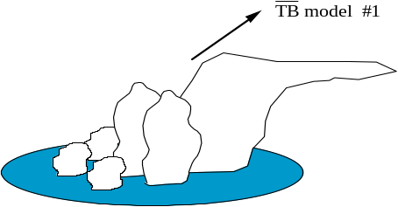
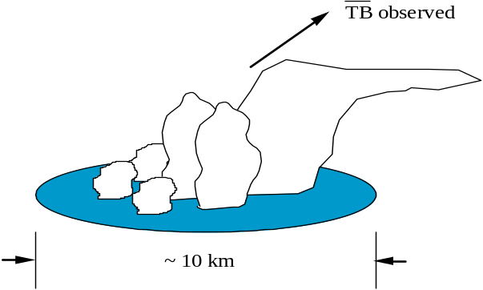
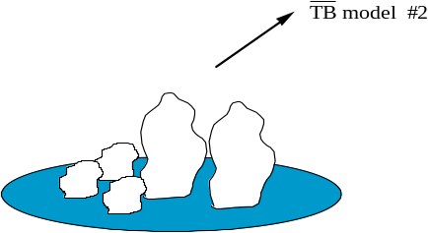
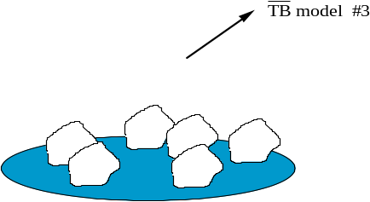
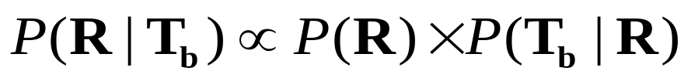
GPROF Algorithm Description
TRMM PR/TMI & Model Database
Bayesian Inversion
TB model #1
TB observed
TB model #2
~10 km
TB model #3

Slide 18
GPROF 2010 Processing Algorithm
Pre-Processors
Ancillary Info
Sensor Data
TMI_L1C
TMI_1B11
AME_L1B
AME_L2A
SSMI_L1C
SST directory spec Ancillary dir spec Sat, Sensor Info Channel Freqs, Errs Profile dbase names
Spacecraft position Pixel Location Pixel Time, Tbs, EIA
GPROF10 input file
Profile Databases
Ancillary Datasets
Land - All Coast – SSM/I Ocean - Each Sensor
Elevation Land masks Sea Surface Temp Clustered Profiles
GPROF2010
Native Binary Output
Input Data
Temporary Files
Programs
Format Converter*
HDF HDF-EOS NetCDF
Output Files

Slide 19
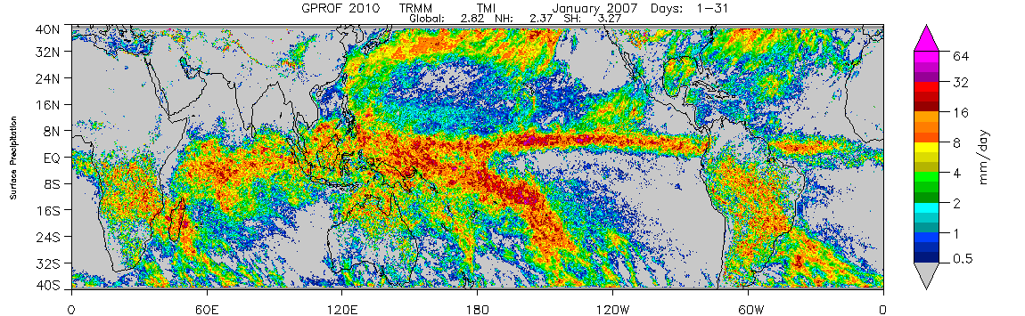
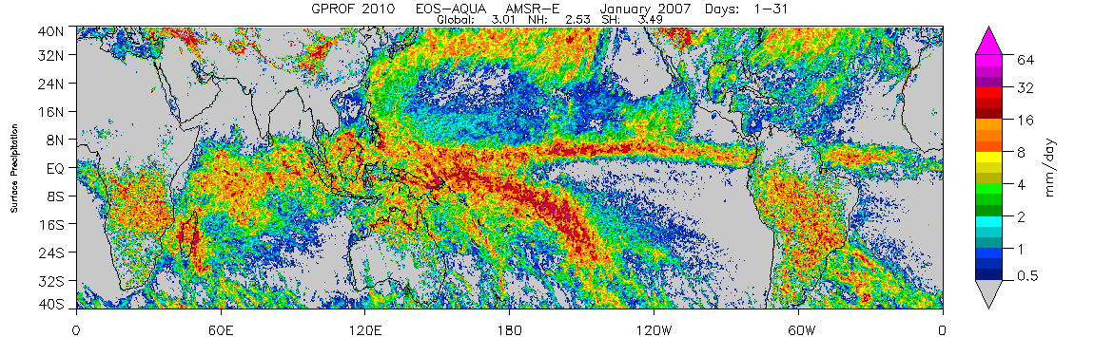
Jan 2007
TMI
TMI
AMSR-E

Slide 20
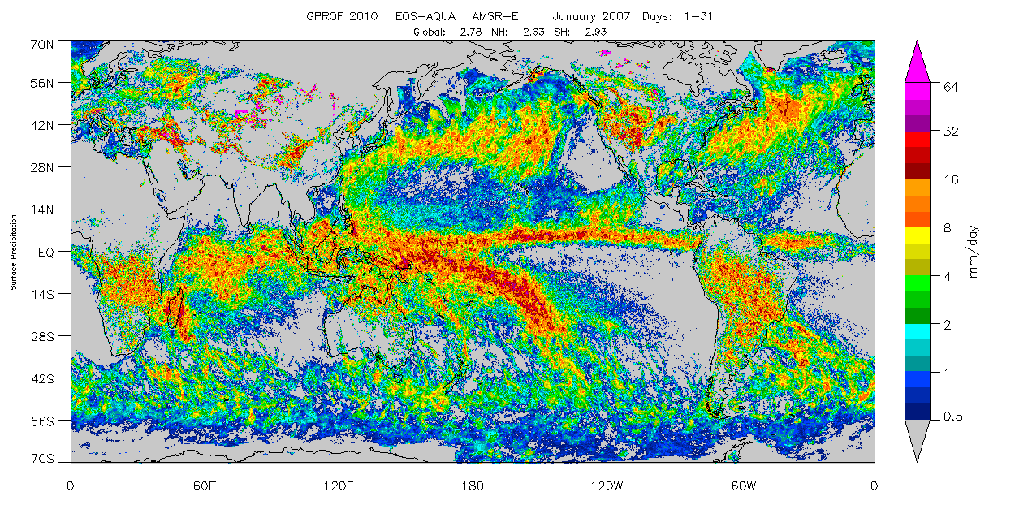
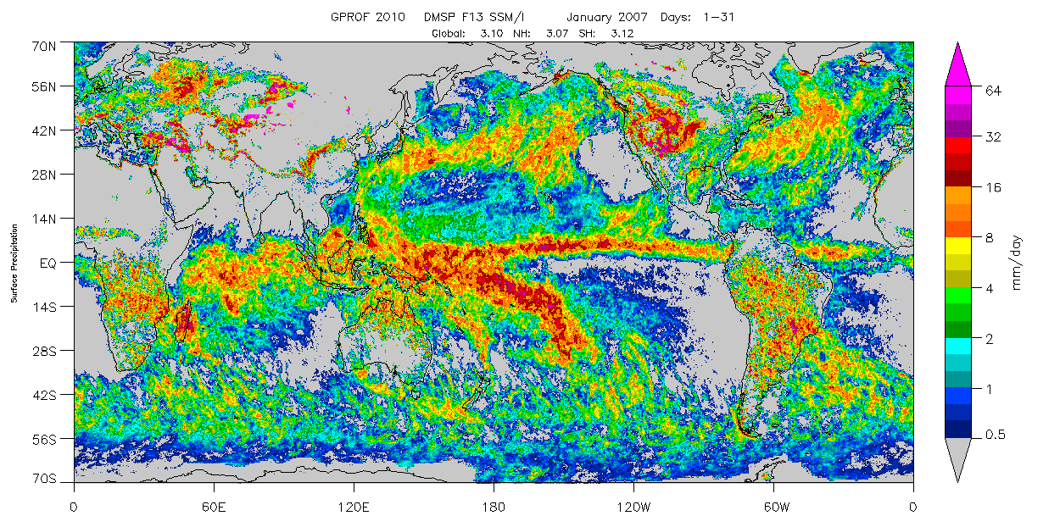
Jan 2007
AMSR-E
SSMI F13

Slide 21

Jan 2007
GPROF 2010 Surface Precipitation (Liquid+Frozen)

Slide 22
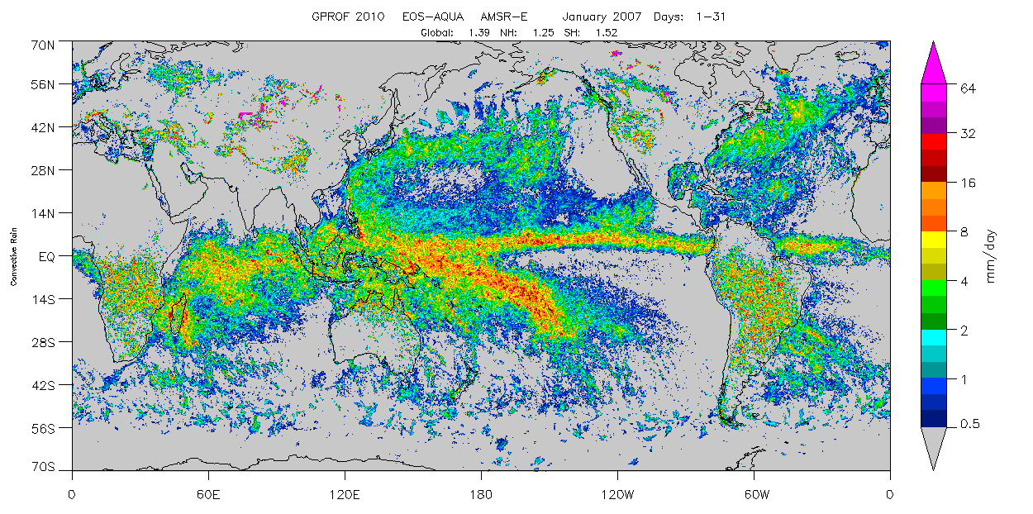
Jan 2007
GPROF 2010 Convective Rain

Slide 23
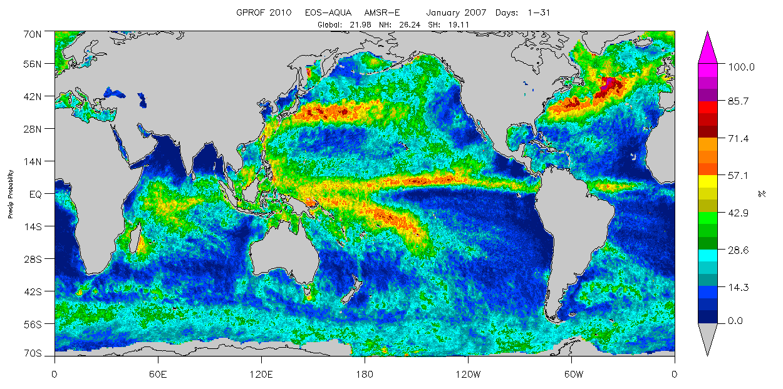
Jan 2007
GPROF 2010 Probability of Precipitation

Slide 24
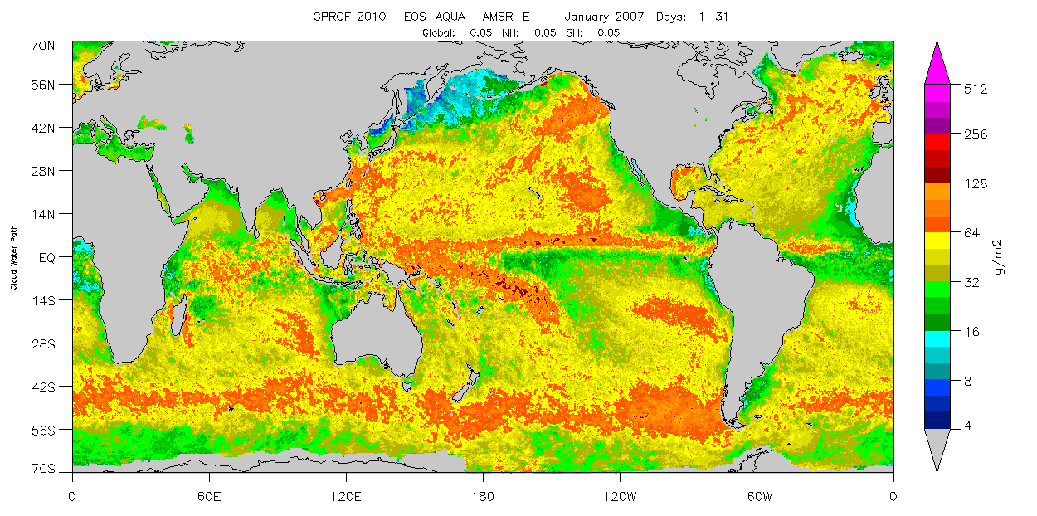
Jan 2007
GPROF 2010 Cloud Water Path

Slide 25
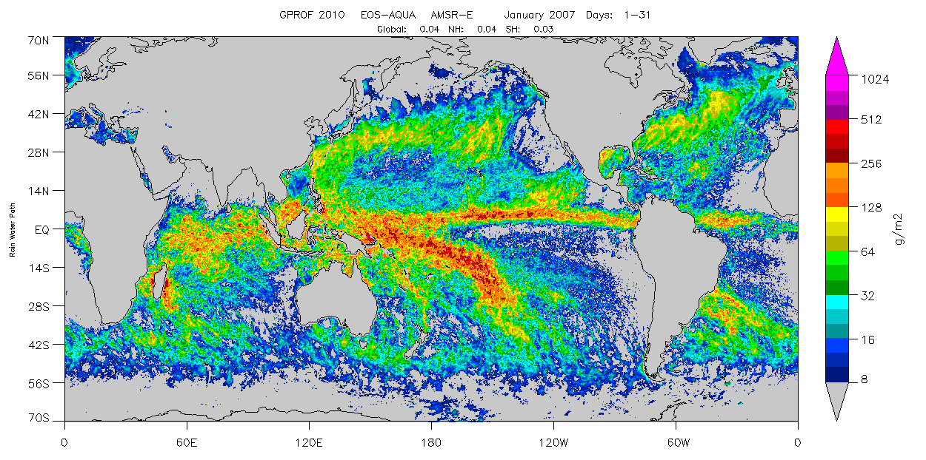
Jan 2007
GPROF 2010 Rain Water Path

Slide 26
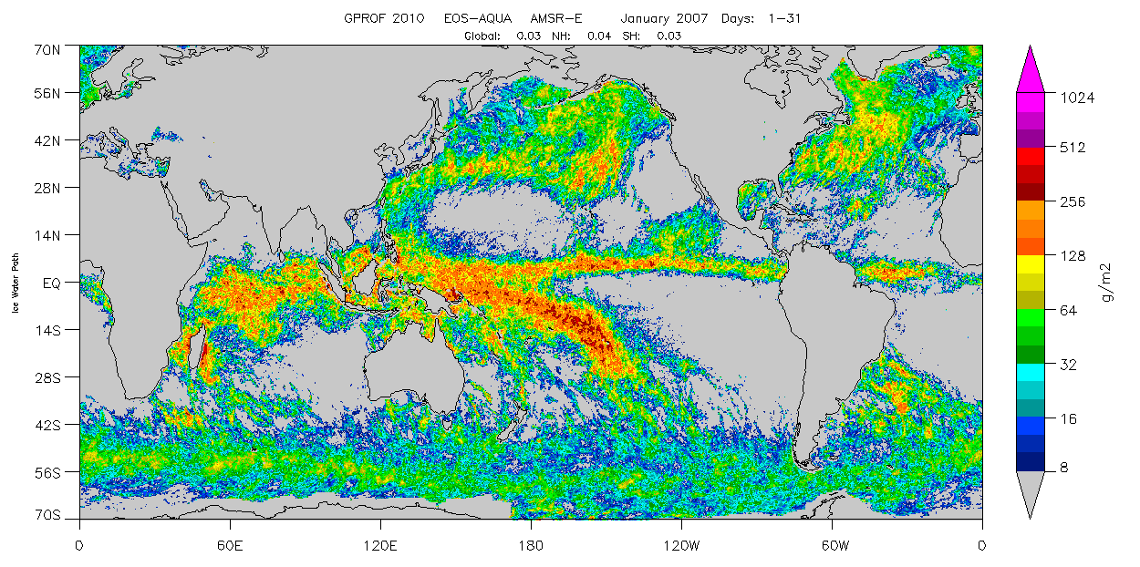
Jan 2007
GPROF 2010 Ice Water Path

Slide 27
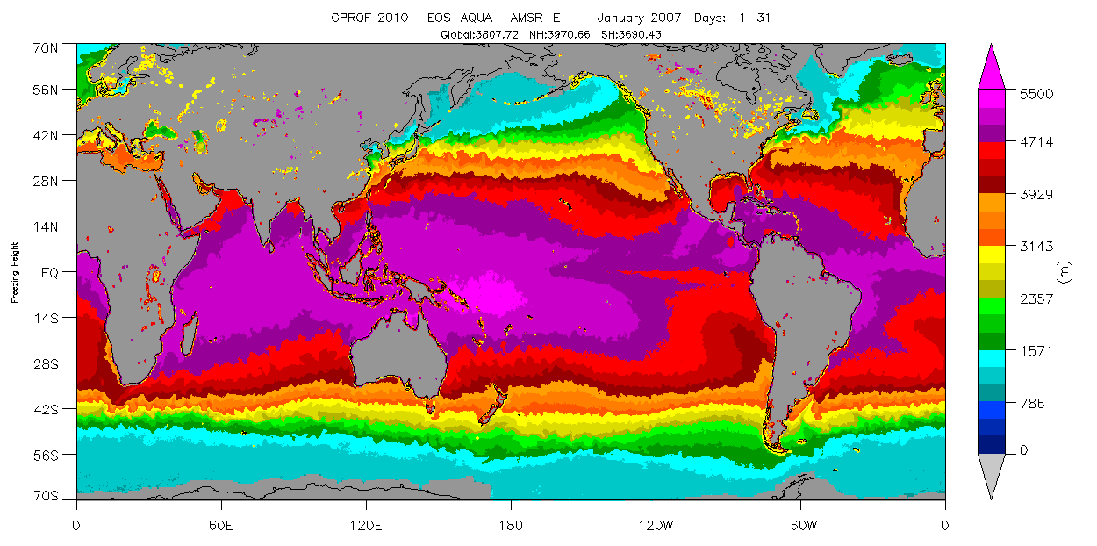
Jan 2007
GPROF 2010 Freezing Height

Slide 28
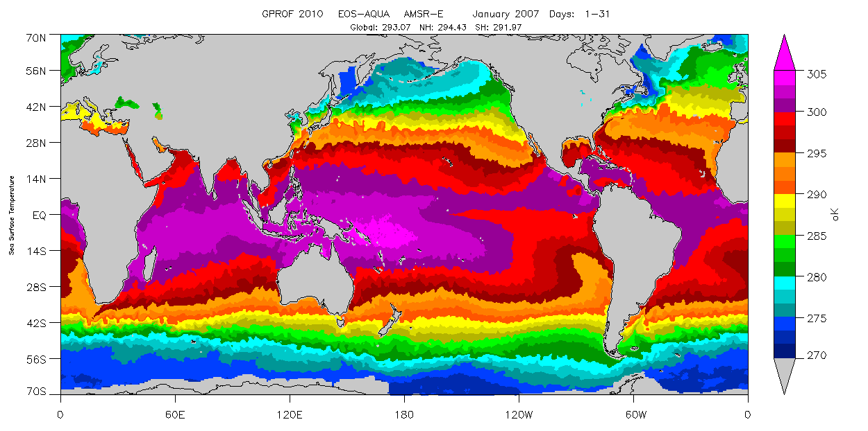
Jan 2007
GPROF 2010 Sea Surface Temperature

Slide 29
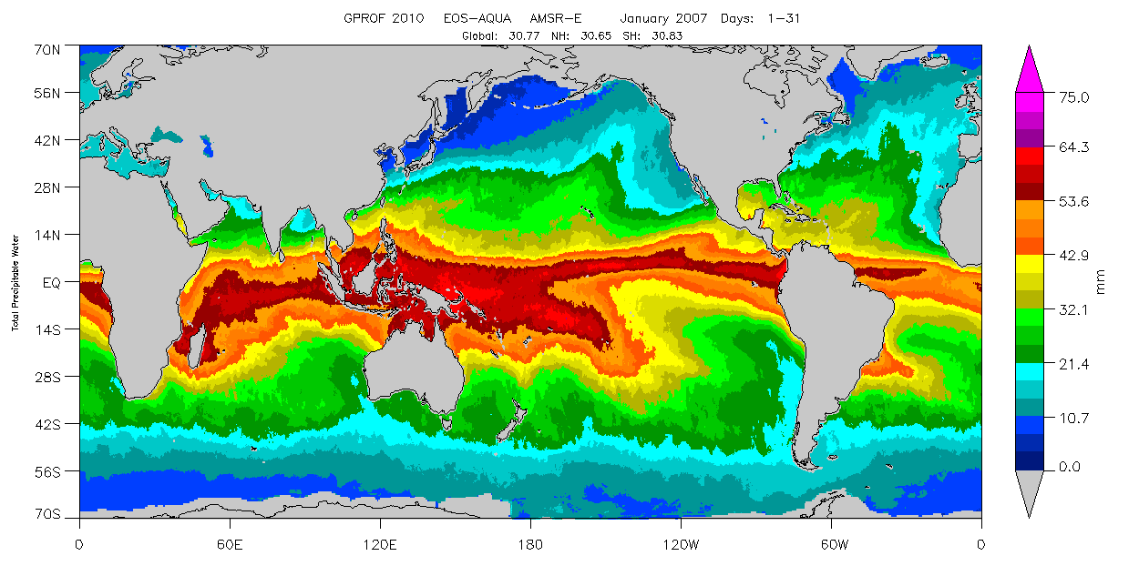
Jan 2007
GPROF 2010 Total Precipitable Water

Slide 30
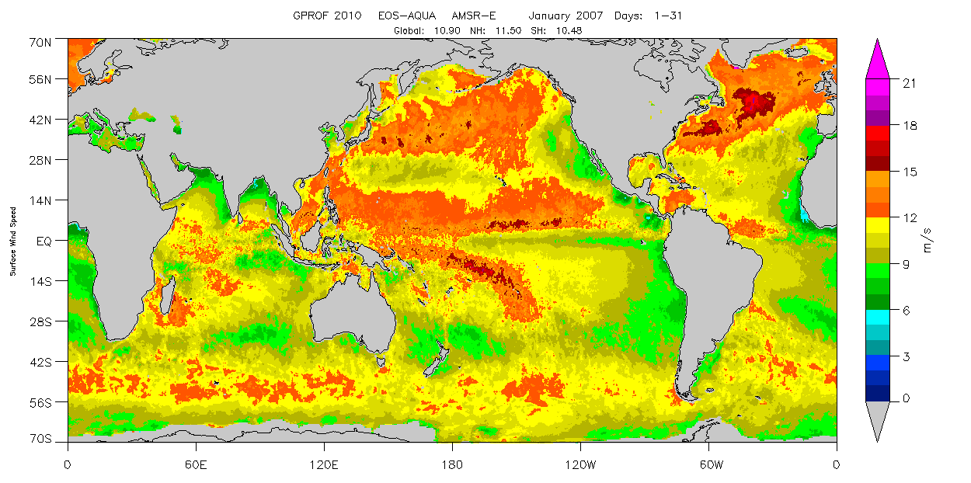
Jan 2007
GPROF 2010 Wind Speed

Slide 31
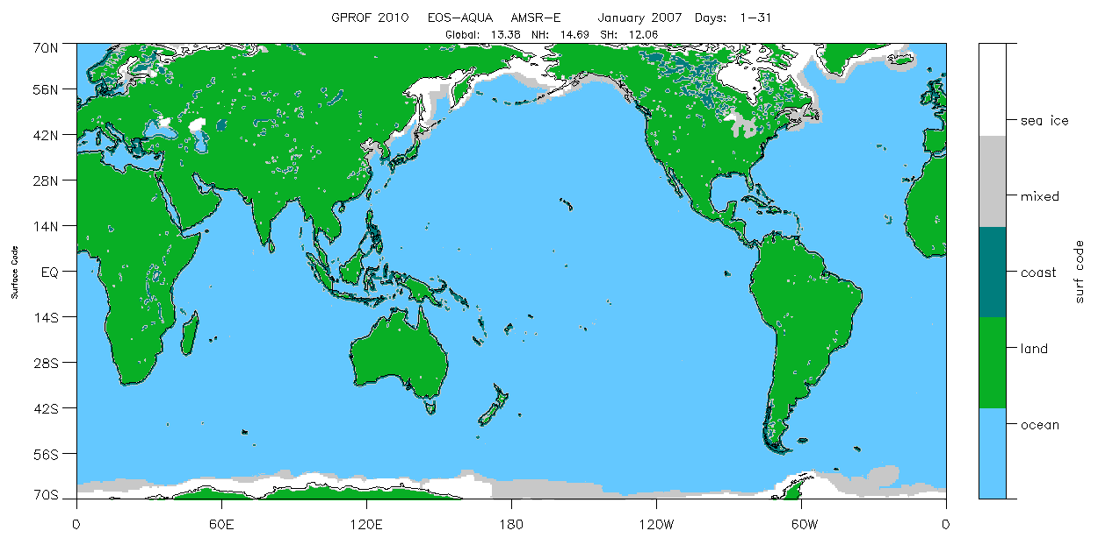
Jan 2007
GPROF 2010 Surface Type

Slide 32
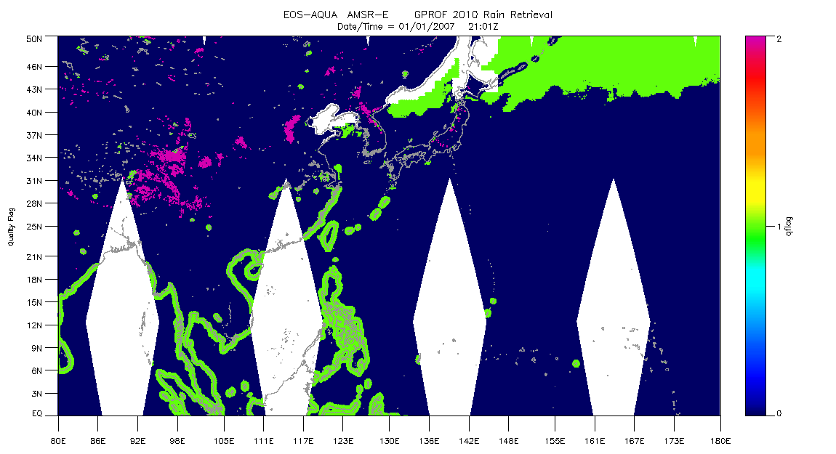
Jan 1st, 2007
GPROF 2010 Quality Flag
0 = Best Quality
1 = Sun-glint, Bayesian Expansion, Coastal contamination, database expanding
2 = Ambiguous over Land

Slide 33
GPCP V3 Products and Inputs
Product scale and coverage | Input data
 | 6 a.m./p.m. GPROF-SSMI/SSMIS August 1987–present
 | Monthly Susskind TOVS/AIRS August 1987–present
 | GridSat-B1 1982–2010 (to be extended)
Monthly 1979–present | CPC 4-km Merged IR 2011–present
0.5° global | OPI 1979–present
 | GPCC Full Gauge Analysis 1979–2010 (to be extended)
 | GPCC Monitoring Gauge Analysis 2011–present
 | TRMM Composite Climatology
 | nnHIRS reanalysis data (T, RH, sfc p)
Pentad 1979–present | CMAP Pentad Precipitation 1979–present
0.5° global | GPCP Daily 1982–present
 | GPCP Monthly 1982–present
Daily 1982–present | 6 a.m./p.m. GPROF-SSMI/SSMIS August 1987–present
0.5° 60°N-S 1982–1996 | Daily Susskind TOVS/AIRS October 1996–present
0.5° global 1996–present | Gridsat-B1 1982-2010 (to be extended)
 | CPC 4-km Merged IR 2011–present
 | GPCP 3-hr 1998–present
3-hr 1998–present | GPCP Monthly 1998–present
0.1° 60°N-S (to be extended) | GPM IMERG 1998–present

Slide 34
GPCP V3 Output Data Fields
The standard monthly precipitation estimate will be a satellite-gauge combination
The shorter-interval products will be calibrated to the monthly satellite-gauge product
Data fields in al products:
  Accumulated precipitation (mm/d)
  Estimated error
  Precipitation phase (percentage probability of liquid)
The Monthly dataset will also provide:
  Multi-satellite accumulated precipitation (e.g., without month-to-month gauge information; mm/d)
  gauge relative weighting in the final satellite-gauge product
The 3-hourly dataset will also provide
  snapshot precipitation rate (expressed in mm/d)

Slide 35
GPCP V3 Observation-Model Products
Numerical models are more skillful than observational products for cold-season mid- and high-latitude precipitation
  This is a moving target as both sides improve!
In parallel with (not replacement of) the observational products, this project plans to create monthly observation-model products:
  start work using the NASA Modern-Era Retrospective Analysis for Research and Application (MERRA)
  blend the GPCP multi-satellite and MERRA precipitation fields following Sapiano et al (2008)
  The combine the gauges with the blended satellite-model field
Shorter-interval combinations currently lack a good framework
  Note the recent word by Xie and collaborators on merging daily satellite, gauge, and radar data

Slide 36
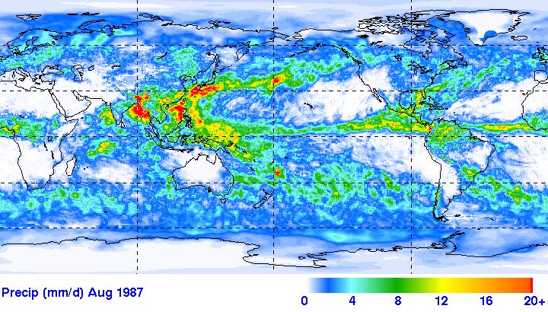
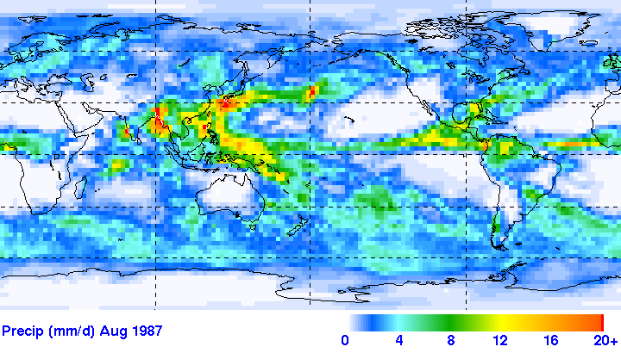
Prototype Monthly V3 vs. V2.2
0.5° resolution
Microwave-adjusted IR extends 60°N-S
TOVS/AIRS dominates 60-90° N and S
Proto. V.3 Monthly (mm/d) Jun 2012
microwave-only 40-60° N and S
Microwave-adjusted IR extends 40°N-S
2.5° resolution
V.2.1 Monthly (mm/d) Jun 2012

Slide 37
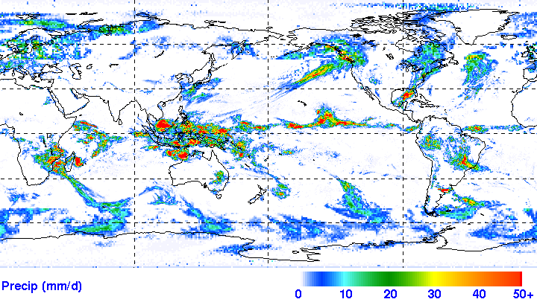
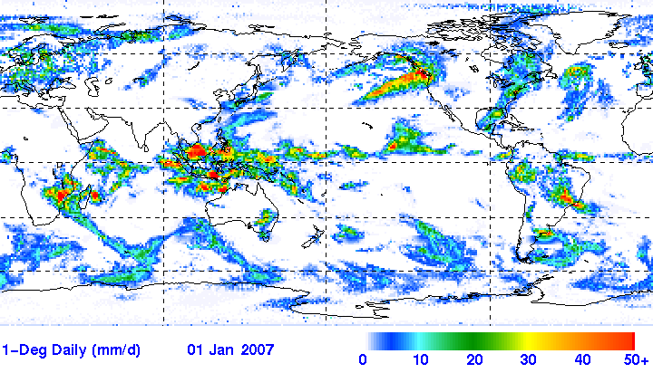
Simulated Daily V3 compared to 1.1
0.5° resolution
Microwave-adjusted IR extends 60°N-S
TOVS/AIRS used 60-90° N and S
Sim. V.3 Daily (mm/d) 1 Jan 2007
TOVS/AIRS used 40-90° N and S
Microwave-adjusted IR extends 40°N-S
1° resolution
V.1.1 Daily (mm/d) 1 Jan 2007

Slide 38
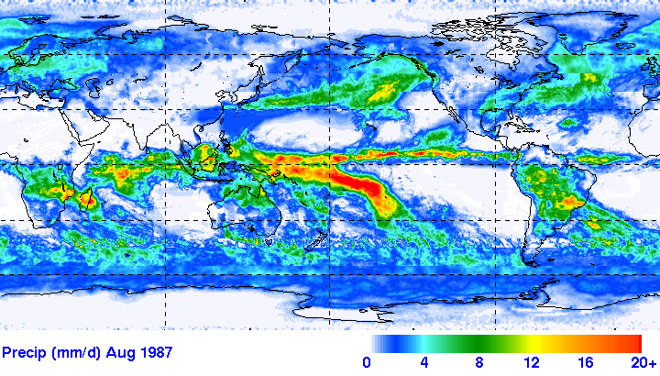
Example GPCP Version 3 Monthly
January 2007

Slide 39
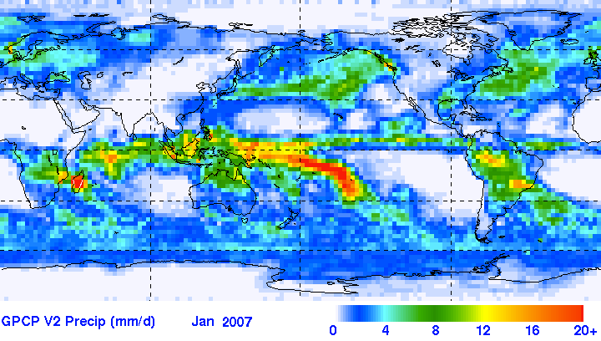
Example Monthly V3 s. V2.1
Version 3
January 2007
Version 2.1

Slide 40
Example GPCP Version 3 Daily
1 January 2007

Slide 41
Daily Example GPCP V3 vs. V2.1
NEW Version 3
Mostly microwave
50°N-50°S
[1998-present]
0.5° resolution
1 January 2007
Version 2.1
IR adjusted by microwave 40°N-40°S
1.0° resolution
Polar regions (>60°) the same in both versions

Slide 42
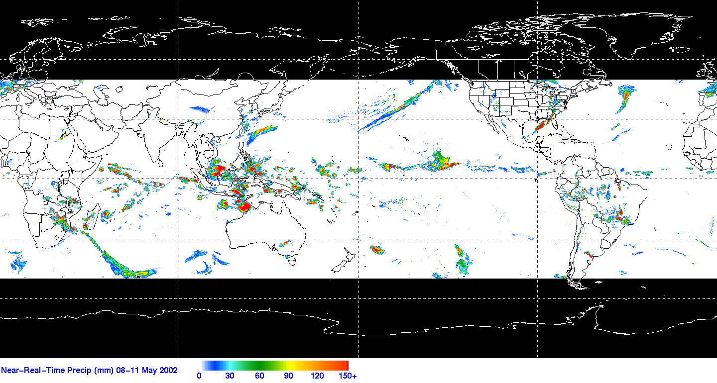
Example GPCP Version 3 3-hr Product (50N-50S)
January 1, 2007 00 GMT
mm/d

Slide 43
Summary
GPCP products are intensely used by the community
  they received many questions/complaints when they fell behind due to SSMIS issue (inconsistency of data)
  Be patient for release of new products, it’s worth the wait.
NOAA is supporting transfer of GPCP Version 2 (V2.3) set of products for operational processing at NOAA/NCDC
Version 3 development way behind GRP schedule due to delays in input data sets and V2 problems

Slide 44
Standard references for the combined precipitation data sets include the following:
Satellite-Gauge:
  Adler, R.F., G.J. Huffman, A. Chang, R. Ferraro, P. Xie, J. Janowiak, B. Rudolf, U. Schneider, S. Curtis, D. Bolvin, A. Gruber, J. Susskind, P. Arkin, 2003: The Version 2 Global Precipitation Climatology Project (GPCP) Monthly Precipitation Analysis (1979-Present). J. Hydrometeor., 4,1147-1167.
Pentad:
  Xie, P., J.E. Janowiak, P.A. Arkin, R.F. Adler, A. Gruber, R.R. Ferraro, G.J. Huffman, S. Curtis, 2003: GPCP Pentad Precipitation Analyses: An Experimental Dataset Based on Gauge Observations and Satellite Estimates. J. of Climate, 16, 2197-2214.
1DD:
  Huffman, G.J., R.F. Adler, M. Morrissey, D.T. Bolvin, S. Curtis, R. Joyce, B McGavock, J. Susskind, 2001: Global Precipitation at One-Degree Daily Resolution from Multi-Satellite Observations. J. Hydrometeor., 2, 36-50.

