Slide 1

Course Introduction
Lecture 2: Satellite Overview
ATMO 611 – Satellite Data Applications
Jennifer D. S. Griswold

Slide 2
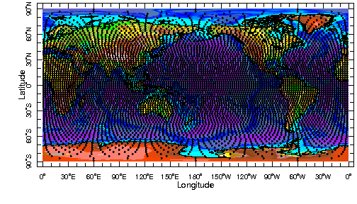
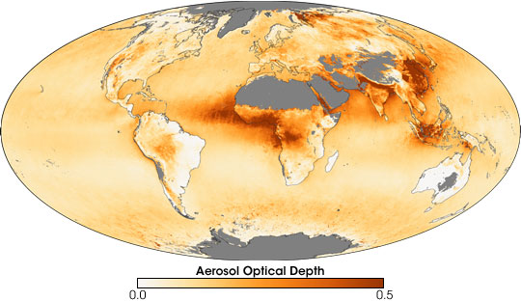
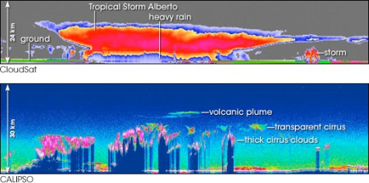
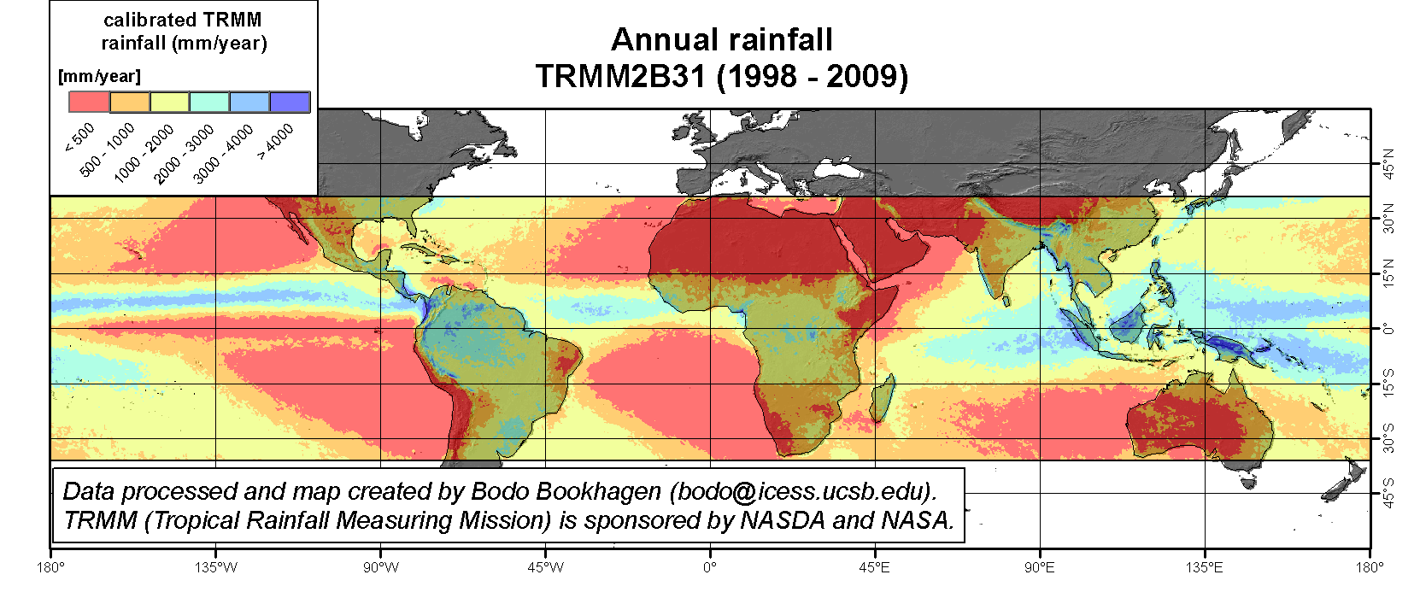
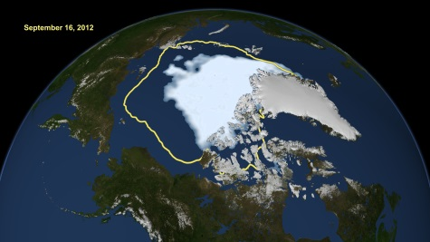
Lab Topics & Satellites Data Covered
A-Train
  Polar Orbiting
  MODIS
  OMI
  CloudSat/CALIPSO
Other Data
  TRMM
  GPCP
  TOMS
Types of Data
  Clouds
  Aerosol
  Land Products
  Ocean Products
  Precipitation
Reanalysis Data
  Meteorology
Introduction to Remote Sensing
Survey of Satellites we will be covering
Lab 0: Project Description Review
Term Project Outline – Previous Projects - Brainstorming
Introduction to MODIS Instrumentation
Lab 1: Introduction to MODIS, Matlab and File Types
MODIS Products (L2 vs. L3) and Data Access
Introduction to MODIS Cloud Products
LAB 2: Global and Regional Cloud Properties
Introduction to CloudSat/CALIPSO Cloud Products and Data
CALIPSO “Curtains” and Analysis
LAB 3: Case Studies using CALIPSO “Curtains”
Introduction to MODIS Aerosol Products
MODIS Aerosol Products Continued
LAB 4: Regional MODIS Aerosol Changes & Trends
Introduction to TOMS and OMI Satellites
Introduction to Absorbing Aerosol Index and Aerosol Index
LAB 5: Comparison of AAI, AI, Optical Depth and Thickness
Introduction to CALIOP Aerosol
CALIOP Aerosol identification
LAB 6: Cloud Aerosol Interactions - CALIPSO and CALIOP
Introduction to Land Surface Products
MODIS Fire, Burned Area and other Useful Datasets
LAB 7: Mapping Land Use Changes and Fires
Intro to Ocean Products: Temperature & Topography
Mapping El Niño
LAB 8: Mapping Major El Niño Events
Introduction to TRMM Satellite
TRMM Data Products
LAB 9: Precipitation Trends and Patterns
Introduction to GPCP Data Set
Daily, Monthly, and Climatological Precipitation
LAB 10: Comparison between TRMM and GPCP Data Sets

Slide 3
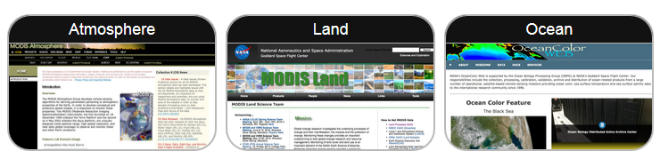
MODIS Satellite Overview
Different MODIS teams produce the various products that we use, each with their own websites
  ATMOSPHERE – Cloud and Aerosol Properties
  LAND – Albedo, Surface Reflectance, Burned Area Index
  OCEAN – Ocean Color, SST, Chlorophyll

Slide 4
MODIS Atmosphere Time Resolution
Data is available at different time resolutions.
Level 2 data (L2) are called Granules and represent 5 minutes of data (also high spatial resolution).
Level 3 (L3) are available in three different time resolutions (lower spatial resolution, 1 x 1 degree)
  Daily (08_D3)
  Eight Day (08_E3)
  Monthly (08_M3)
It is necessary to choose the time resolution (and spatial resolution) that suits your research needs.

Slide 5
Atmosphere Products
https://modis-atmos.gsfc.nasa.gov/products
There are six Level-2 (Orbital Swath/Granule) MODIS Atmosphere products collected from two platforms: the Terra platform and the Aqua platform.
  Aerosol - MOD04_L2 (Terra) and MYD04_L2 (Aqua)
  Cloud - MOD06_L2 (Terra) and MYD06_L2 (Aqua)
  Water Vapor - MOD05_L2 (Terra) and MYD05_L2 (Aqua)
  Atmospheric Profile - MOD07_L2 (Terra) and MYD06_L2 (Aqua)
  Cloud Mask - MOD35_L2 (Terra) and MYD35_L2 (Aqua)
  Joint Atmosphere - MODATML2 (Terra) and MYDATML2 (Aqua)

Slide 6
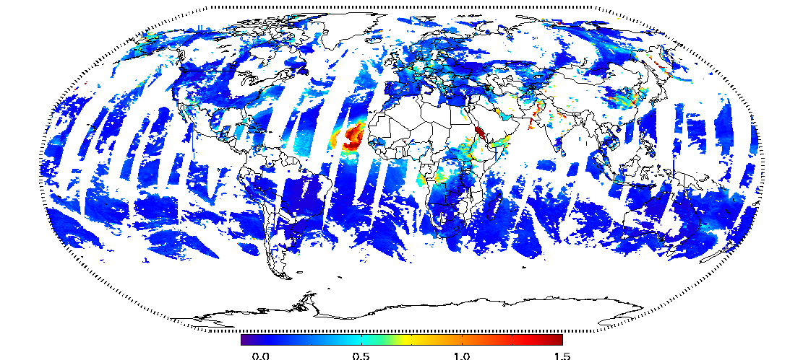
MODIS Aerosol
04_L2
Global Aerosol
  ambient aerosol optical thickness and depth (AOT; AOD)
  non-cloudy conditions during the day, not over ice and snow
  Primary Products 10 x 10 km.
  AOT is derived over ocean and dark vegetated surfaces at 3 km resolution, and contained in MOD04_3K and MYD04_3K product files for Terra and Aqua.
  There are two ‘flavors’ of Aerosol retrieval algorithms:
    Dark Target and Deep Blue

Slide 7
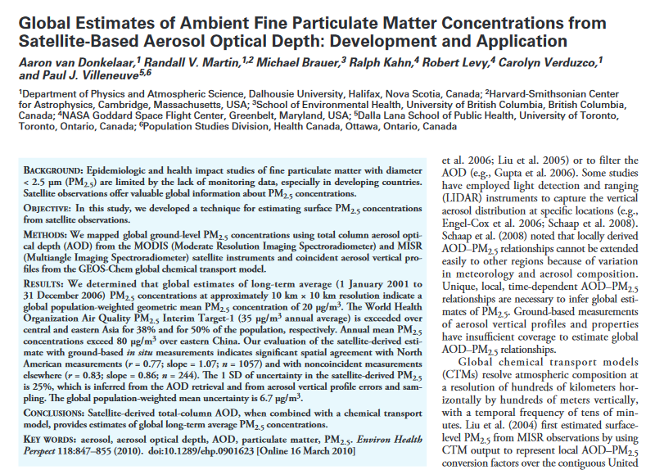
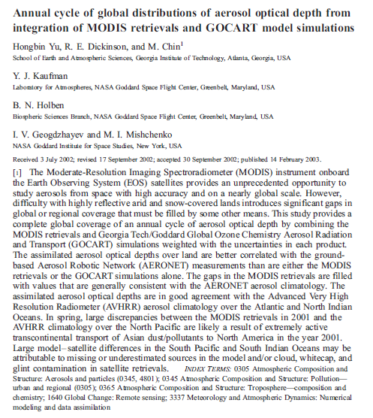
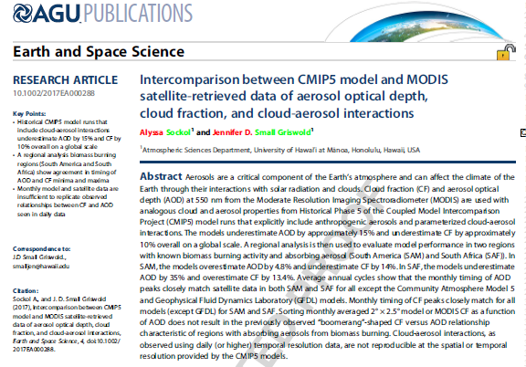
MODIS Aerosol Research Examples

Slide 8
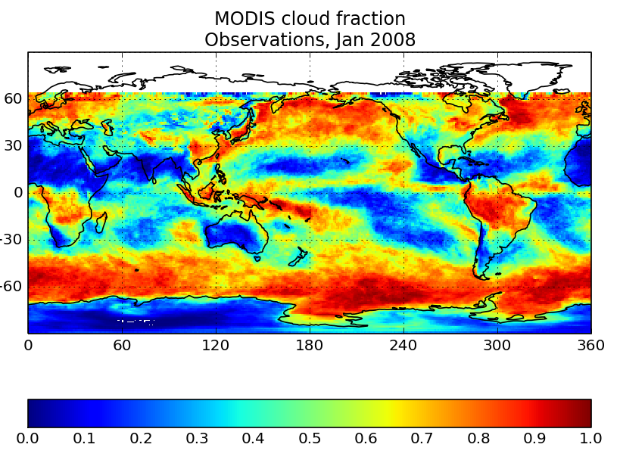
MODIS Cloud
06_L2
Global Cloud
  Monitors the physical and radiative properties of clouds
    cloud fraction
    effective cloud particle radius
    cloud optical thickness
    cloud shadow effects
    cloud top temperature and height
    effective emissivity
    cloud phase (ice vs. water, opaque vs. non-opaque)
    cloud particle phase (ice vs. water, clouds vs. snow)
  both daytime and nighttime conditions

Slide 9
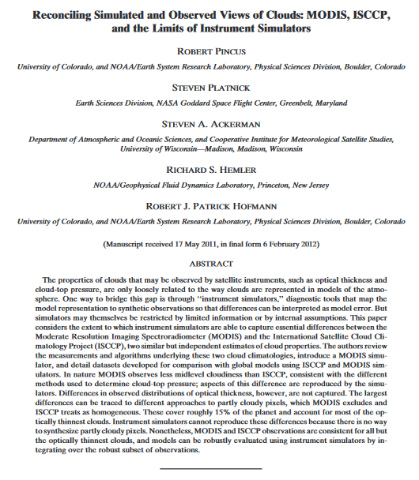
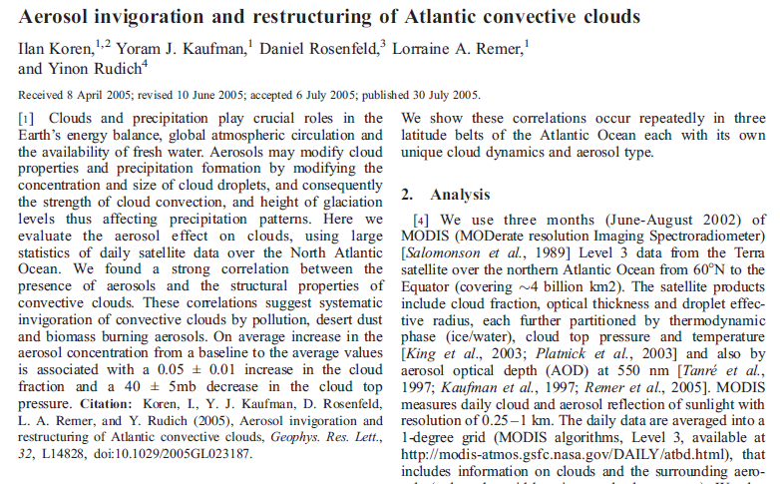
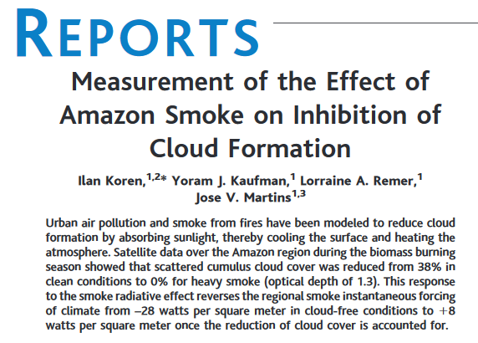
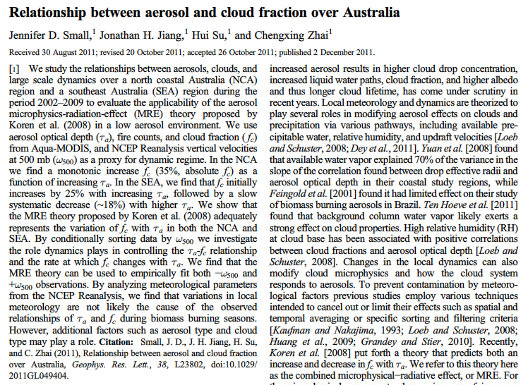
MODIS Cloud Research Examples

Slide 10
Other MODIS Atmosphere Products
Water Vapor
  During the daytime, a near-infrared algorithm is applied over clear land areas of the globe and above clouds over both land and ocean. Over clear ocean areas, water-vapor estimates are provided over the extended glint area.
Atmospheric Profile
  Total-ozone burden, atmospheric stability, temperature and moisture profiles, and atmospheric water vapor. All of these parameters are produced day and night for Level 2 at 5x5 1-km pixel resolution when at least 9 FOVs are cloud free.
Cloud Mask
  Indicates whether a given instrument field of view (FOV) of the Earth's surface is unobstructed by clouds or affected by cloud shadows.
Joint Atmosphere
  The post-launch Joint Atmosphere Product contains a spectrum of key parameters gleaned from the complete set of standard at-launch Level 2 products stored at 5-km and 10-km

Slide 11
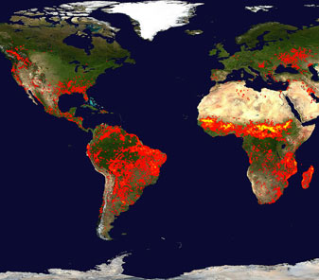

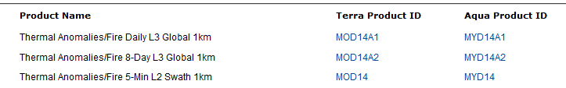
MODIS Land Products
https://modis-land.gsfc.nasa.gov/#
Land Products
  Surface Reflectance – Atmospheric Correction
  Surface Reflectance BRDF/Albedo Parameter
  Burned Area
  Thermal Anomalies/Fire
  Leaf Area Index – FPAR
  Vegetation Cover Conversion, Continuous Fields
  Snow and Sea Ice cover

Slide 12
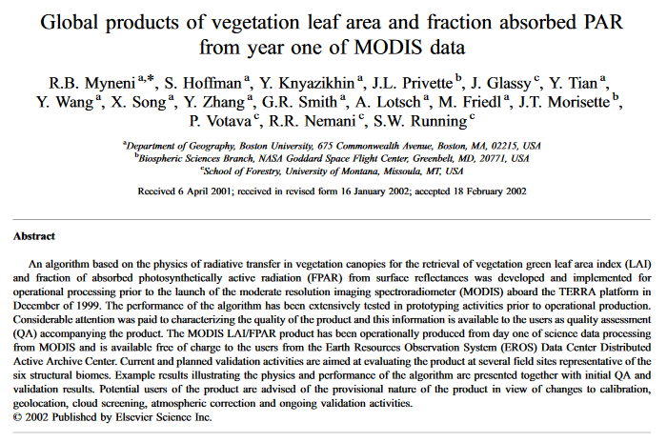
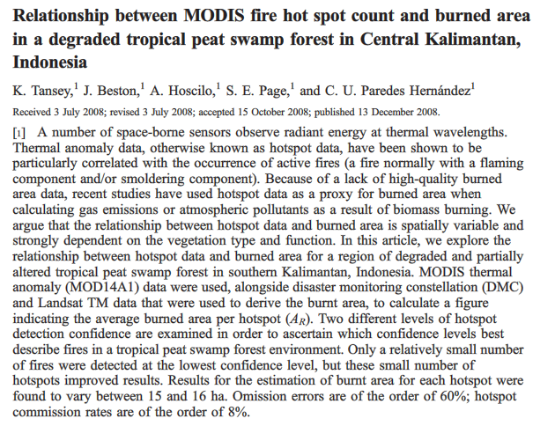
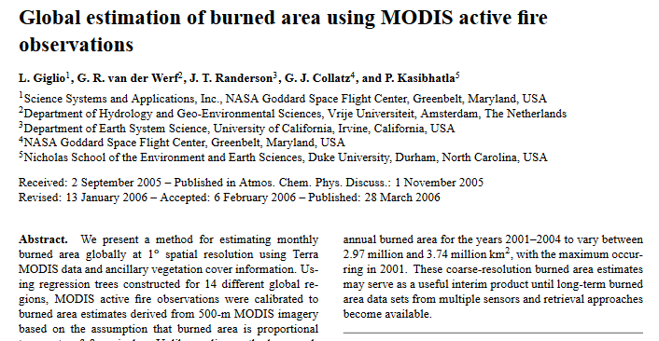
MODIS Land Research Examples

Slide 13
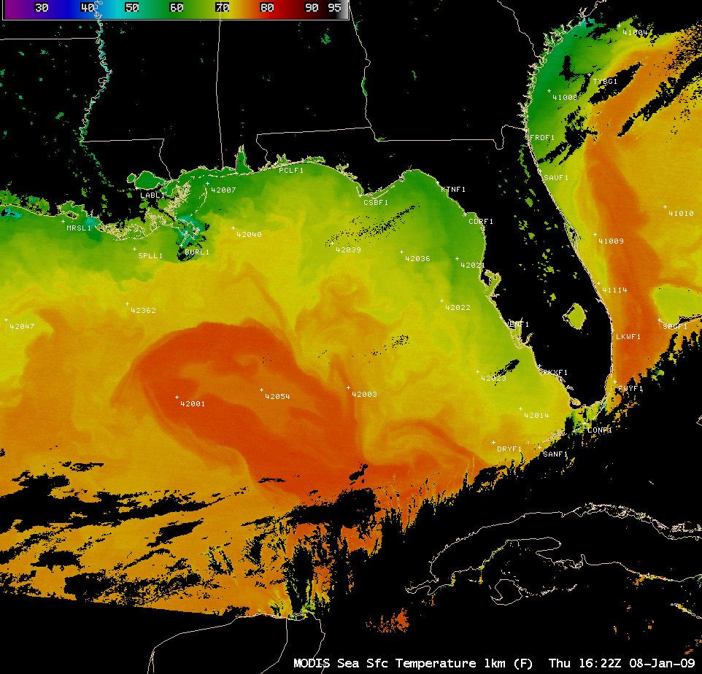
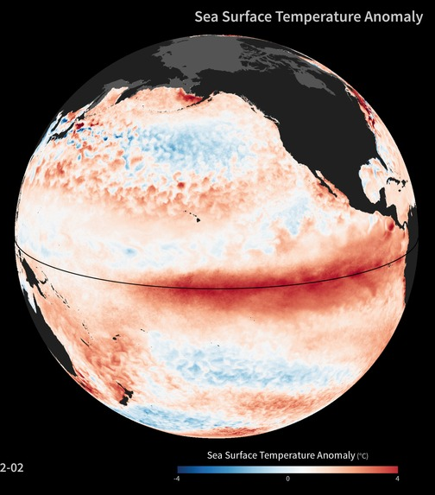
MODIS Ocean Products
https://oceancolor.gsfc.nasa.gov/about/
Ocean Products – (for both Terra and Aqua)
  Ocean Color
  Sea Surface Temperature
  Chlorophyll Concentration (two algorithms)
  Absorption due to gelbstoff, detrital material and phytoplankton
  Calcite Concentration
  Diffuse attenuation
  Flourescence Line Height
  Instantaneous Photosynthetically Available Radiation
  Particulate Organic Carbon
  Particulate backscattering
  Reflectance (at a bunch of wavelengths)
  Total Absorption
  Total Backscattering (at a bunch of wavelengths)

Slide 14
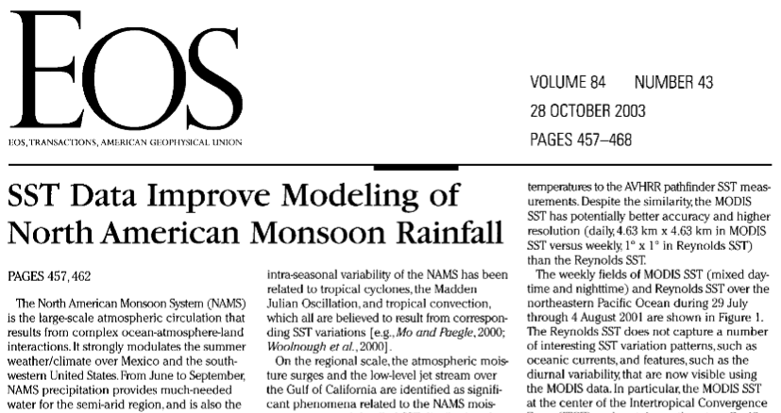
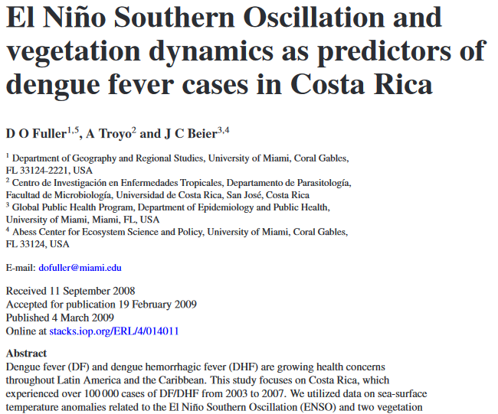
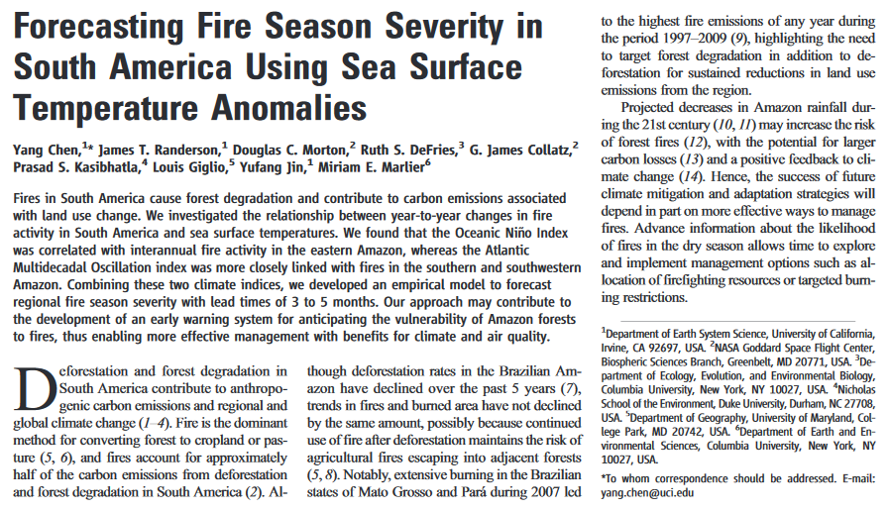
MODIS Ocean Research Examples

Slide 15
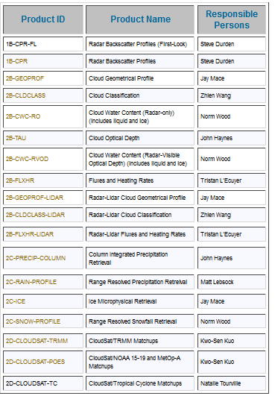
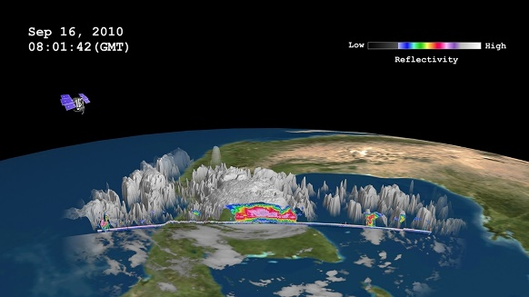
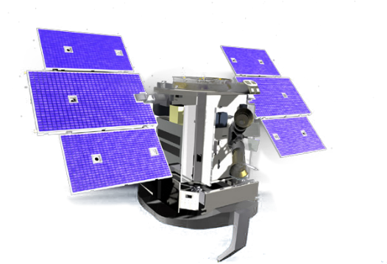
CloudSat
Cloud Profiling Radar
http://cloudsat.atmos.colostate.edu/
The Cloud Profiling Radar (CPR) is a 94-GHz nadir-looking radar which measures the power backscattered by clouds as a function of distance from the radar and produces detailed images of cloud structures.

Slide 16
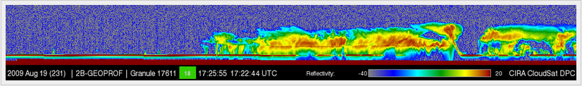
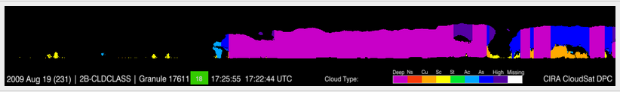
CloudSat Cloud Profiling Radar
Temporal Coverage:
  June 2006 - Present
  Swath data made up of Granules
  Granules are 1 full orbit or 40, 022 km
Spatial Coverage:
  125 vertical bins with approximately 240 m vertical spatial resolution
  There are 31 Subsets for each granules
  Each granule is made up of profiles
    1.4 km x 2.5 km footprint, 1.1km along track interval

Slide 17
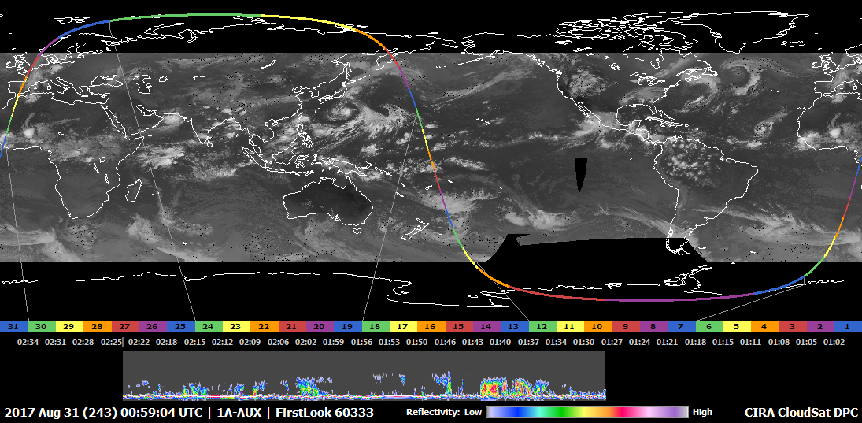
CloudSat Cloud Profiling Radar
Quick Looks help you choose a Granule
Good for specific events
Climatologies, when looking at full data set averaged over long time periods.

Slide 18
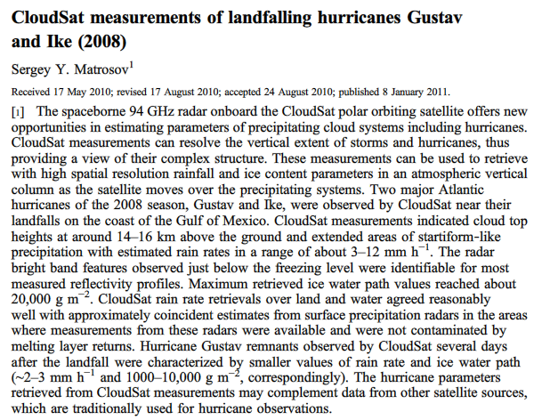
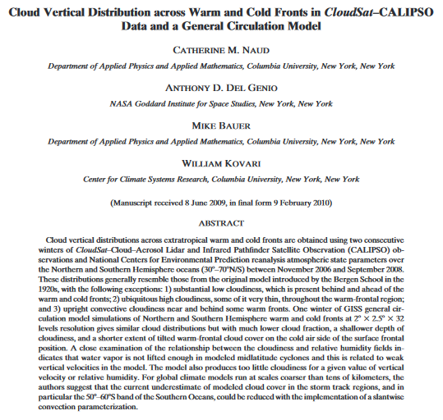
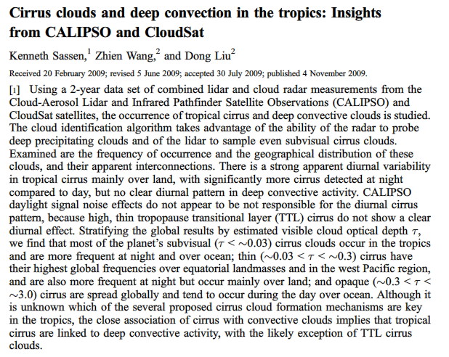
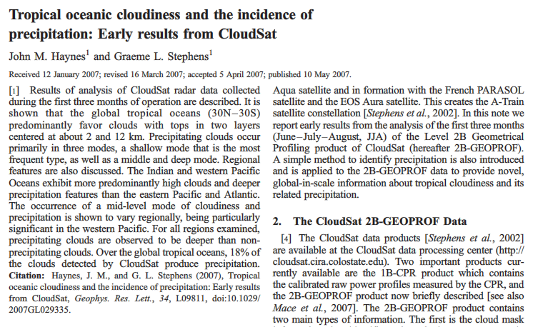
CloudSat Research Examples

Slide 19
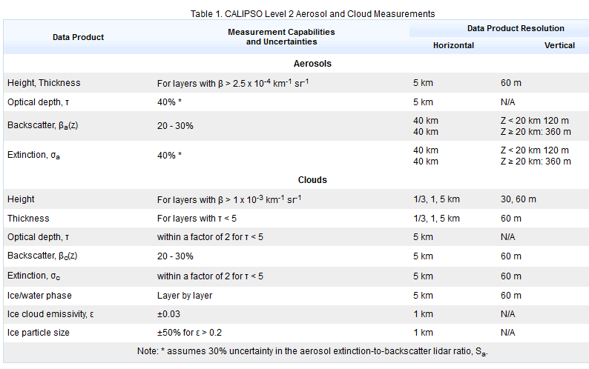
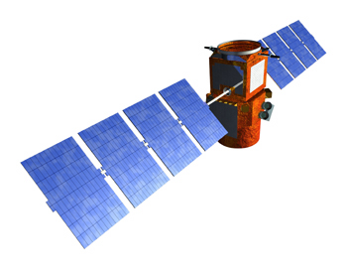
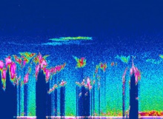
CALIPSO
https://www.nasa.gov/mission_pages/calipso/main/index.html
Cloud-Aerosol Lidar and Infrared Pathfinder Satellite Observation combines an active lidar instrument with passive infrared and visible imagers to probe the vertical structure and properties of thin clouds and aerosols over the globe.

Slide 20
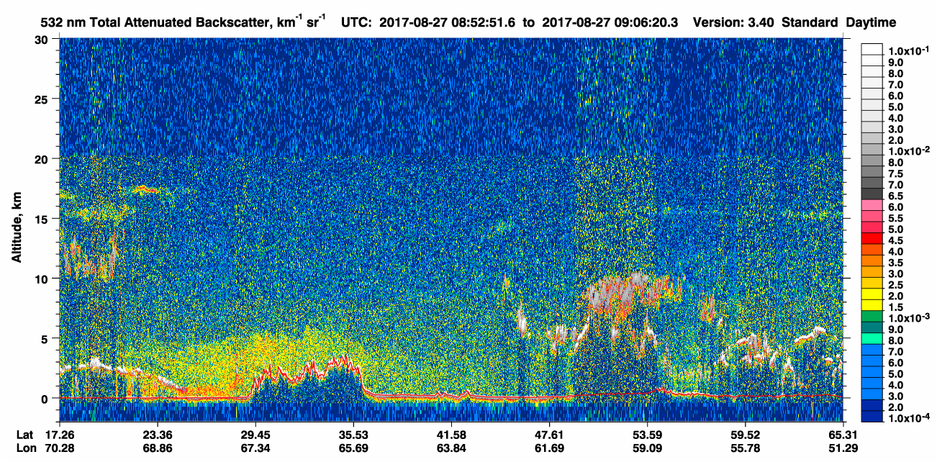
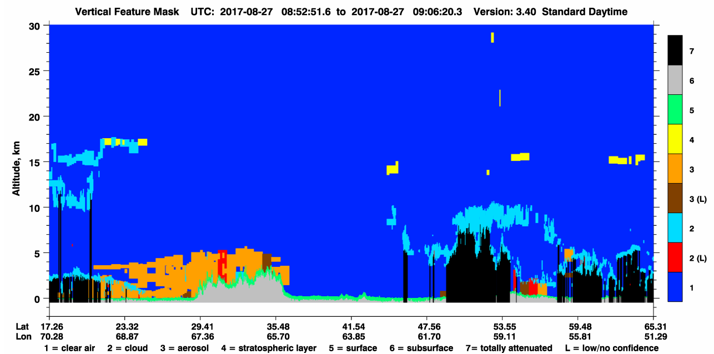
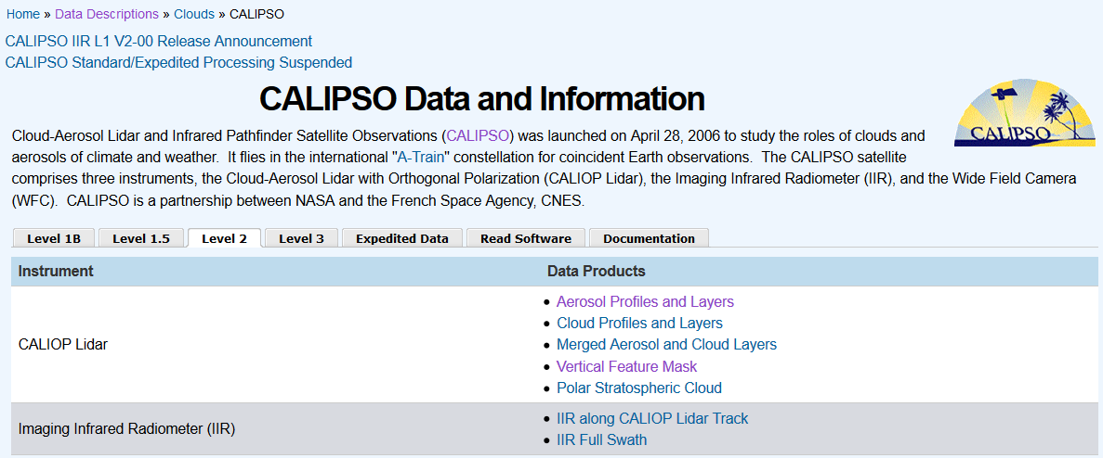
CALIPSO
Temporal Coverage:
  June 13, 2006 - Present
  Swath data made up of Profiles and Layer Data
Spatial Coverage:
  Global (-90 x 90 and -180 x 180)
  Spatial Resolution - 5 km

Slide 21
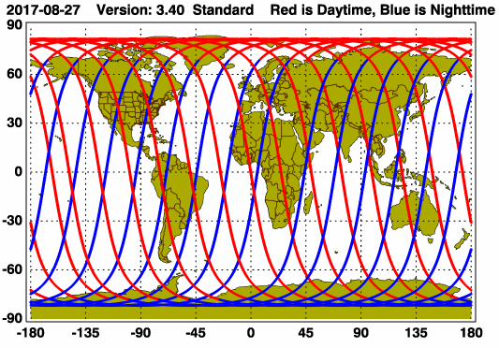
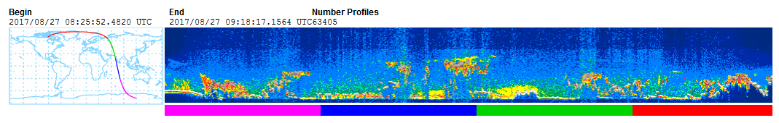
CALIPSO
There are a maximum of 4 scaled images per granule.
The orbit tracks plotted on the maps show the measurement locations for each granule.
For each granule, the scaled images are ordered from left to right and their locations along the orbit tracks are color coded as: image one, image two, image three, image four.

Slide 22
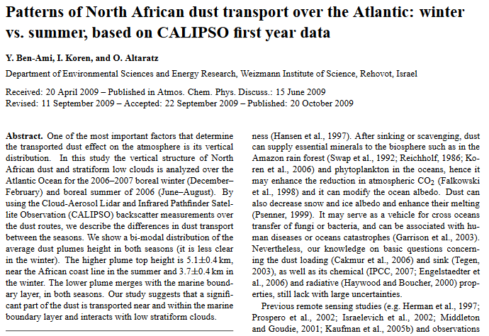
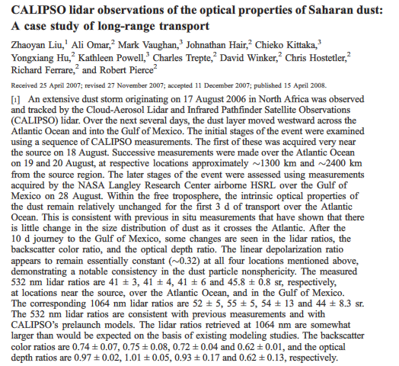
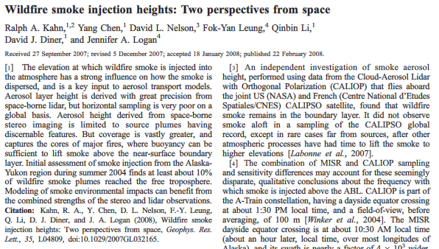
CALIPSO Research Examples

Slide 23
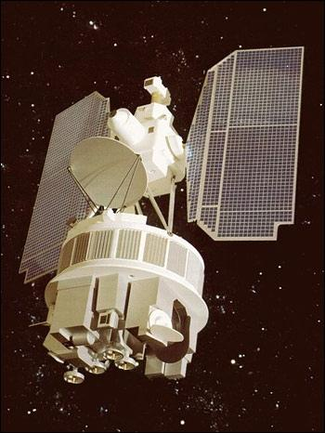
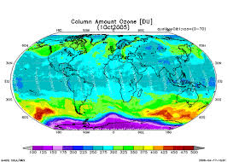
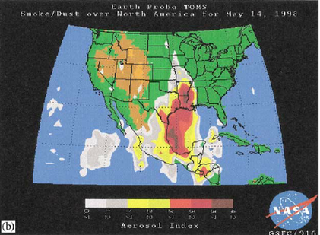
TOMS
https://eospso.gsfc.nasa.gov/missions/total-ozone-mapping-spectrometer-earth-probe
Total Ozone Mapping Spectrometer – Two different satellites
Temporal Coverage:
  DAILY Data
  Nimbus 7 (N7) – December 1978 to May 1993
  Earth Probe (EP) – July 1996 to June 2006
Spatial Coverage (note products are at a lower resolution):
  N7 - The ground resolution is 47 km x 47 km at nadir and 62 x 62 km overall
  EP - Nadir - 50 km x 50 km; average: 62 km x 62 km

Slide 24
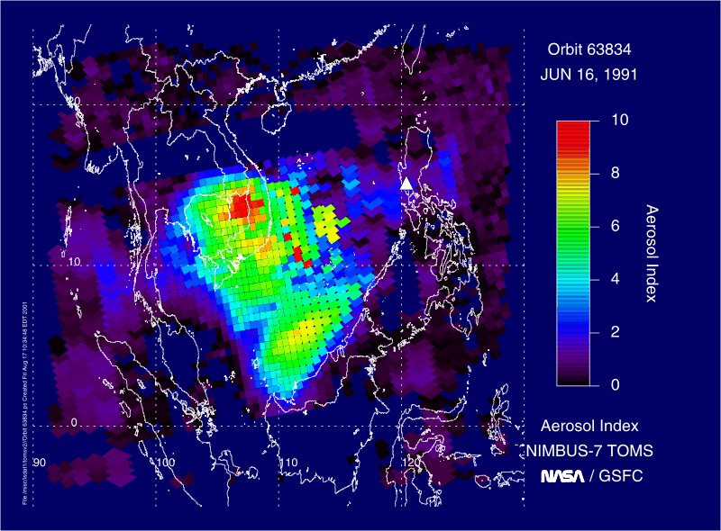

TOMS
Important data set for studying Ozone and Ozone Holes in the past.
Useful for calculating climatologies of aerosol (specifically absorbing aerosol like smoke and dust).
Useful for evaluating historical events involving aerosol such as volcanic eruptions, large dust storms and biomass burning.
Aerosol from Mt. Pinatubo in 1991

Slide 25



TOMS Research Examples

Slide 26
OMI
https://aura.gsfc.nasa.gov/omi.html
Ozone Monitoring Instrument
  Distinguishes between aerosol types, such as smoke, dust, and sulfates, and measures cloud pressure and coverage, which provides data to derive tropospheric ozone.
  OMI continues the TOMS record for total ozone and other atmospheric parameters related to ozone chemistry and climate. OMI measurements are highly synergistic with the other instruments on the Aura platform.
  Measures atmospheric constituents including O₃, NO₂, SO₂, and aerosols such as dust, smoke and ash (especially absorbing aerosols), BrO, formaldehyde, and OClO (for chemistry in the stratosphere and troposphere).

Slide 27


OMI
Temporal Coverage:
  Swaths (fraction of day)
  Daily Data
  October 2004 – Present
Spatial Coverage (note products are various resolutions):
  Varies based on format (Level 2 swath vs. Level 3 map)

Slide 28



OMI Research Examples

Slide 29



TRMM
https://pmm.nasa.gov/precipitation-measurement-missions
The Tropical Rainfall Measuring Mission (TRMM)
  Turned off on April 8. The spacecraft re-entered the Earth’s atmosphere on June 15, 2015, at 11:55 p.m. EDT, over the South Indian Ocean
Good for investigating historical events (from 1997-2015)
Had 5 instruments
  Precipitation Radar (PR)
  TRMM Microwave Imager (TMI)
  Visible Infrared Scanner (VIRS)
  Lightning Images Sensor (LIS)
  Cloud’s and Earth’s Radiant Energy System (CERES)

Slide 30



TRMM
A Variety of Data Products are Available
  3B42 Real Time Derived Daily Product and 10-Day Product
  3B42 Research Version and Derived Daily Product
  3B41 Real Time Rain rate estimated from geosynchronous infrared instruments
  3B40 Real Time Rain rate estimated from passive microwave radiometers
  3B43 Multi-satellite Precipitation
  3A46 SSM/1 Rain
  3B31 Combined Rainfall
  3A25 Surface Rain Total
  3A25 Spaceborne Radar Rainfall
  3A12 Mean 2A12, profile and surface Rainfall
  3A11 Oceanic Rainfall
Some products at 0.5 by 0.5 degrees (map)
Some products – vertical structure

Slide 31



TRMM Research Examples

Slide 32

GPCP
https://precip.gsfc.nasa.gov/ or http://gpcp.umd.edu
Global Precipitation Climatology Project (V2.3)
  Global Precipitation Climatology Project monthly precipitation dataset from 1979-present combines observations and satellite precipitation data into 2.5°x2.5° global grids.
Temporal Coverage:
  Monthly values 1979/01 through Jun 2017 (some months are interim).
  Long term monthly means, derived from years 1981 - 2010.
Spatial Coverage:
  2.5 degree latitude x 2.5 degree longitude global grid (144x72)
  88.75N - 88.75S, 1.25E - 358.75E

Slide 33

GPCP
The GPCP has been in existence for over twenty years as part of the Global Energy and Water Cycle Exchanges (GEWEX) effort under the World Climate Research Program (WCRP).
The overall goal of GPCP is to provide the research and applications communities with high quality global analyses of precipitation at monthly and shorter time scales for climate analysis based on a combination of satellite and ground-based data sets.
The GPCP data sets have been used in over 1500 articles in scientific journals and have become a standard in the analysis of global precipitation.

Slide 34



TRMM Research Examples

