Slide 1

Semester Project and Brainstorming
MET 611 – Satellite Data Applications
Jennifer D. S. Griswold

Slide 2
Semester Project
Worth 400 points (40% of your grade)
In the format of a mini-mock NSF or NASA proposal that will contain specific sections:
  An Introduction to state the current problems and why you want to propose this project
  Objectives and significant of the project and hypotheses or questions you want to answer
  What kind of Data, Method and/or Modeling approach you will use to conduct the project, and usually you need to show some preliminary or previous results
  Expected Results and/or potential significance after you finished the project

Slide 3
Semester Project Time Line
Deadline | Project Component
9/15 | (Turn in by email, or in class) Potential Topic: List of three satellite data sets you plan on using in your “proposal.” The minimum is three, you can use more datasets if you choose/need.
10/6 | (Turn in by email) Draft – Literature Review: 2-3 page (or more) review of literature you plan to include in your “Introduction” section to set the stage for why you are proposing your research. A great idea is to tie your topic to your thesis research. How can you look at your thesis work using satellites? What new question/aspect could you address?
10/20 | (Turn in by email) Draft Outline: objectives, data set descriptions, specific hypotheses you like to test, methods of how you will use your data.
11/3 | By this date you should complete some data analysis using an example (a successful case-study or mini-analysis) using the three data sets. This is to show you can successfully perform the analysis you propose on a small scale.
11/17 | Work on your Abstract and Summary to tie things together.
12/5, 12/7 and 12/12 | Presentations
12/12 | Final Paper/Proposal Due (10 pages + References)

Slide 4
Semester Project Format
FORMATTING:
  Spacing: 1.5
  Page Requirement: 10 (not counting references, but including figures_
  Margins: 1 inch all around
  Font Type: Times New Roman
  Font Size: 12 (no more, no less)
  Page Numbers: Lower right hand corner.
Cover Page (1 page, doesn’t count for the 15): The cover page will have your title, name, course number and contact information
Proposal Summary (1/2 page): like a 250 work AGU or AMS abstract (this summarizes the whole paper). It can have bullets or just be solid text.
Introduction (2-3 pages): This is your background information about the topic you’ll be focusing on. This will include your scientific justification for doing the work that you’re doing. You’ll use most of your literature review here. Feel free to set up sections and sub sections. You need to make a good case for why your topic of interest is important.
Research Objectives (1/4-1/2 page): Brief description of what you propose to do and why it is important. You can set up going research topic goal(s) as bullets here to make it very clear. (you should use your case study to show an example from each goal if you have more than one).

Slide 5
Semester Project Format
Expected Significance (1/4-1/2page): Why is your idea important to people or to the research community (ocean modeling, hurricanes, etc). How do you think this will help your field of interest? You can use information from your objectives and literature review for this. Some folks included these ideas in one, the other, or both.
Technical Approach and Methodology (4-6 pages with figures and tables): Here is where you describe your data sets, study region(s), and how you will analyze them. After you describe your methodology (how you’re going to use each data set and combine them to address your research objective) include your case study to show that it is possible. Include figures and tables in the text not at the end.
Summary (1/2-1 pages): Here you summarize your case study example results and how it shows the potential of addressing your research goals described in the “Research Objectives” section. This is the “Look see, I CAN use these data sets to get information about xxxxxx (hurricane intensification, pyrocbs, vog, etc), that will help me address my goals.” Will be very similar to the project summary, that’s ok.
References: List your references. (Doesn’t count for your 10 pages)

Slide 6
Presentation Criteria
Presentation content is broken up into different criteria.
Worth 80 points out of the 100
 | Excellent | Sufficient | Bare Minimum | Insufficient | Total
Introductory Material (20, 15, 10, 5 points)
Motivation (10, 7.5, 5, 2.5 points)
Data Description (10, 7.5, 5, 2.5 points)
Example/Case Study (30, 22.5, 15, 7.5 points)
Summary/Conclusion (10, 7.5, 5, 2.5 points)

Slide 7
Presentation Criteria
Public Speaking Based Categories
Worth 20 points out of the 100
 | A | B | C | D | Total
Speaking Skills (10 points) | Poised: clear; articulate; volume; steady pacing, enthusiasm, confidence (10) | Clear on all points but not as polished (7.5) | Mumbling, lack of eye contact; uneven pace; little or no expression (5) | Inaudible or too loud; rate is to slow or too fast; seems uninterested; monotone (2.5)
Non-verbal Audience Response; Eye Contact (5 points) | Involves the audience; makes eye contact; holds audience’s attention (5) | Involves and holds audience’s attention most of the time; some eye contact (4) | Lost topic or attention; mostly presented fact without engagement; no eye contact; reads from report (3) | Incoherent audience loses interest; could not determine point of presentation (2)
Length of Presentation (5 points) | Within +/- 2 minutes of allotted time (5) | Within +/- 4 minutes of allotted time (4) | Within +/- 6 minutes of allotted time (3) | Much too long or too short (2)
Total/Score

Slide 8
Example Projects
Spaceborne Radar Observations of the Vertical Structure of Tropical Cyclones
  TRMM, GPM, and CloudSat
Detecting and Tracking Vog from Space
  MODIS L2 Aqua Aerosol Data, OMI Aerosol Data, and CloudSat/CALIPSO
Comparison of monthly station rainfall data for the U.S. Affiliated Pacific Islands to global satellite derived climatological rainfall and cloud datasets.
  GPCP, TRMM, and ISCCP Clouds
Examining the Horizontal and Vertical Distributions of Volcanogenic SO2: A case study of volcano Chaitén
  MODIS Aerosol, OMI SO₂, and CALIOP Aerosol Products
Characteristics of PyroCbs from Satellites
  GFEDv3 level 3, MODIS level 3 and level 2, and Cloudsat/CALIOP
Vertical Structure of a Kona Storm
  CloudSat/CALIPSO, Reanalysis Data, MODIS L3 Atmosphere Products, and GOES-11
Impact of Sea Salinity to Ocean Data Assimilation
  GHRSST, Sea Surface Salinity, Soil Moisture and Ocean Salinity (SMOS) sea surface salinity (SSS)

Slide 9
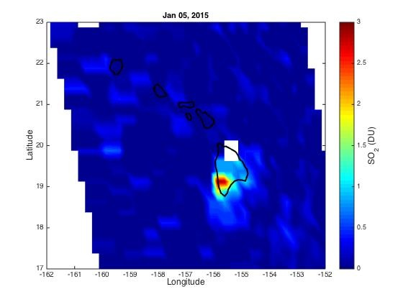
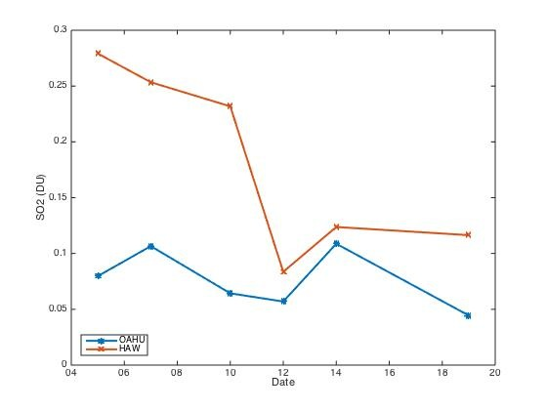
Example Figures from the Vog Project
Oahu
Haw
By analyzing daily OMI SO₂ data, and subsetting to get an average value over a specific region, this student was able to compare SO₂ concentrations in and out of the Vog plume on specific days.

Slide 10
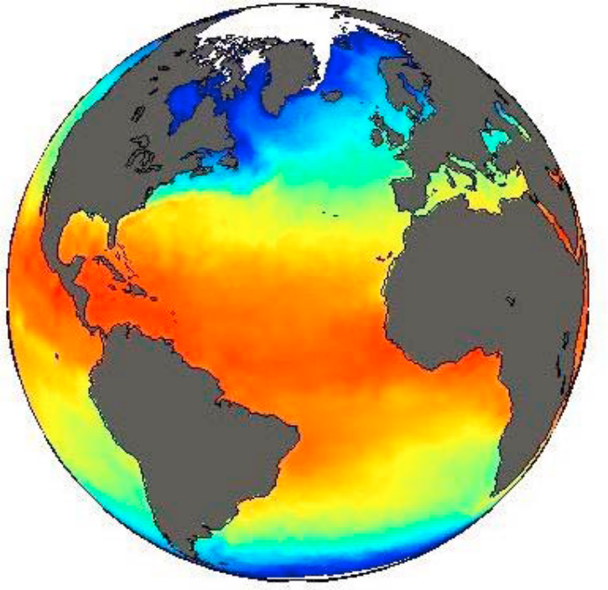
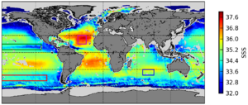
Example Figures from the Sea Salinity Project
The student combined various data sets for SST and Sea Surface Salinity (SSS) to look at how data assimilation techniques could be improved. Her overall interest was related to improving how the ocean is represented in global climate models.

Slide 11
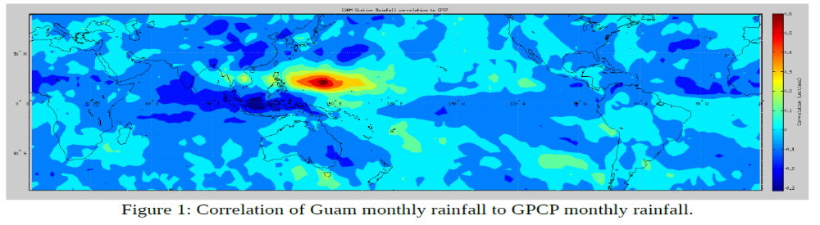
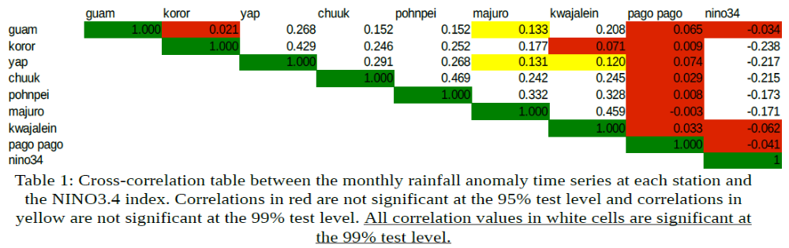
Example Figures from Rainfall Project
Student looked at rain gauge data form various Pacific Islands and compared the data to the space based observations and then performed an analysis to see if ENSO impacted precipitation.

Slide 12
BRAINSTORMING
Get into Groups of 3-4 students
Take a moment to jot down what topics you are interested in. Refer back to last weeks class where we introduced all the satellites we’ll be covering.
Discuss your interests with you group. Everyone take a turn to talk about why they’re interested in. Have the group give feedback on your ideas.

Slide 13
BRAINSTORMING
Once you have topics you’ll need to identify potential satellites that you can use to look into questions related to your topic. Consider if you will need map vs. vertical profiles, the spatial resolution of the data and the temporal range and resolution of the data. See the List Below:
  MODIS – L2 or L3 Aerosol, Cloud, Land & Ocean (Map)
  CloudSat – Clouds (Vertical Profiles)
  CALIPSO – Clouds and Aerosol (Vertical Profiles)
  OMI and TOMS – Aerosol, SO₂, O₃ (Map)
  GPCP – Global Precipitation (Map)
  TRMM – Tropical Precipitation (Map & Vertical Profiles)

Slide 14
BRAINSTORMING
Once you have a general theme or topic and potential data sets you can start to think about specific questions you can try to answer
Suggestions:
  Case Studies of single events are always a good choice, they are focused in time and a specific location
  Climatologies are also interesting, especially when comparing two different data sets for the same region (if you’re trying to see if they are related to each other).
  Combining “map” and “vertical” data for an event can give a holistic picture (e.g. a hurricane, volcanic event, dust or fire)
  Combining the project with your Thesis Research topic can help make the write up easier.

Slide 15
BRAINSTORMING
Take a few days to think about your project. Use the brainstorming sheet as a jumping off point.
Send an email by 5 pm 9/15 that includes:
  Topic – a preliminary title
  List of the THREE data sets you’ll be using
  Potential question you’ll be addressing

