Slide 1

MODIS Data Access
MET 611 – Satellite Data Applications
Jennifer D. S. Griswold

Slide 2
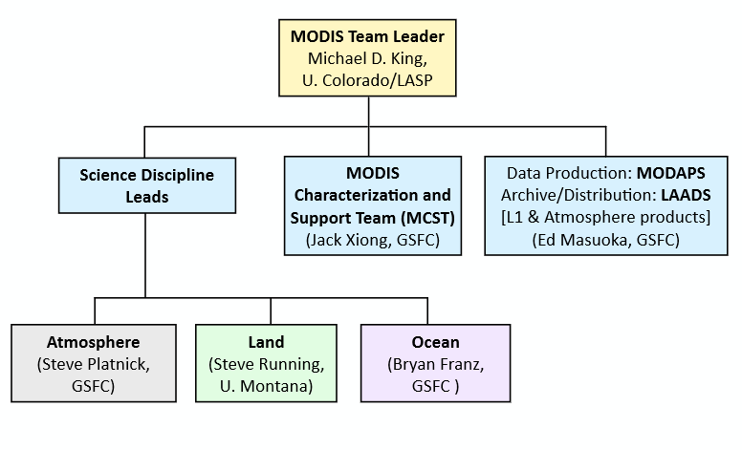
MODIS Organization and People

Slide 3
Nomenclature and Acronyms
Product “Level” designations
  Level-0 (L0): raw instrument data (digital counts)
  Level-1B (L1B): calibrated/geolocated instrument data
  Level-2 (L2): derived geophysical retrieval data (“pixel” level)
  Level-3 (L3): gridded data (spatial and/or temporal aggregation of geophysical products)
  Level-4: combination of model and measured/retrieved data (not generated by atmosphere team)

Slide 4
Nomenclature and Acronyms
MODIS “Collection”
  refers to a (re)processing production run with consistent algorithms (or nearly consistent)
  C5 production began in summer 2006, reprocessing completed about a year later.
  C51 update in late 2008. Collection 6 (C6) Aqua L2 production began in Dec 2013.
See next slide for MODIS Production Version Timelines

Slide 5
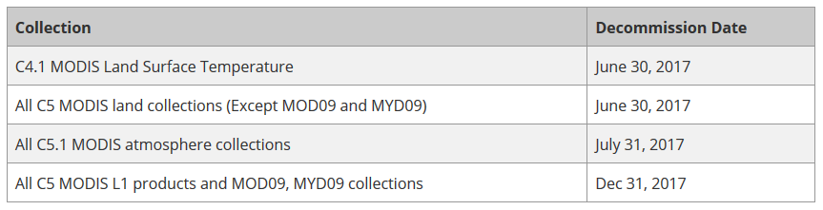
MODIS Production Versions
2000
2001
2002
2003
2004
2005
2006
2007
2008
2009
2010
2011
2012
2013
2014
2015
2016
2017
C1
Terra
Beta
C3
Terra
Provisional
Aqua
C4
Terra
Validated (Stage 1)
Aqua
C5
Terra
Validated (Stage 2)
Aqua
C6
Terra
Aqua
Now
Forward processing
Reprocessed
Each collection represents an improvement in science quality

Slide 6
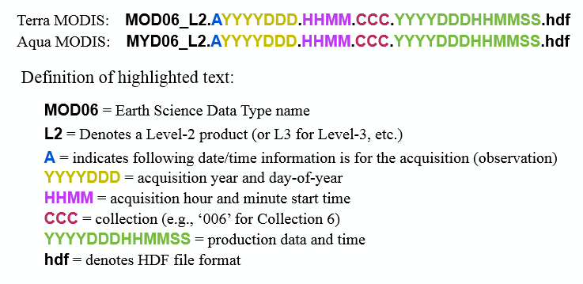
MODIS Standardized Filenaming Convention
NASA Earth Science Data filenames for MODIS

Slide 7
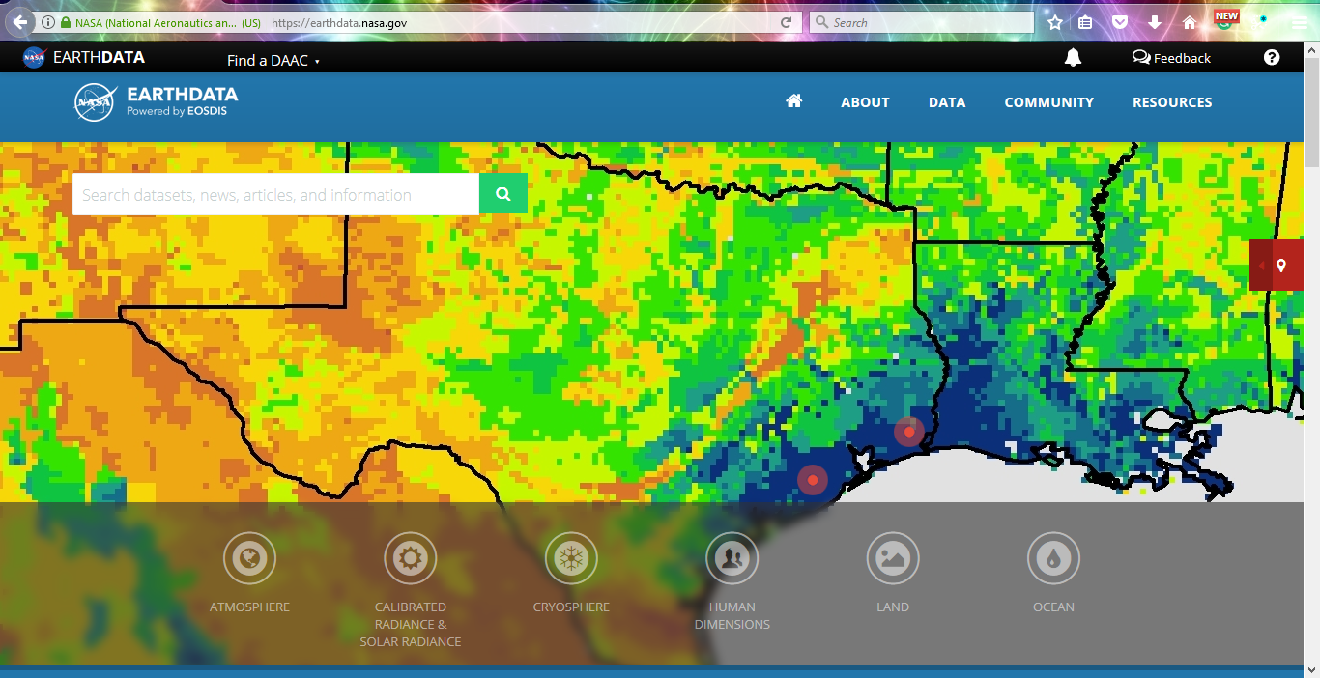
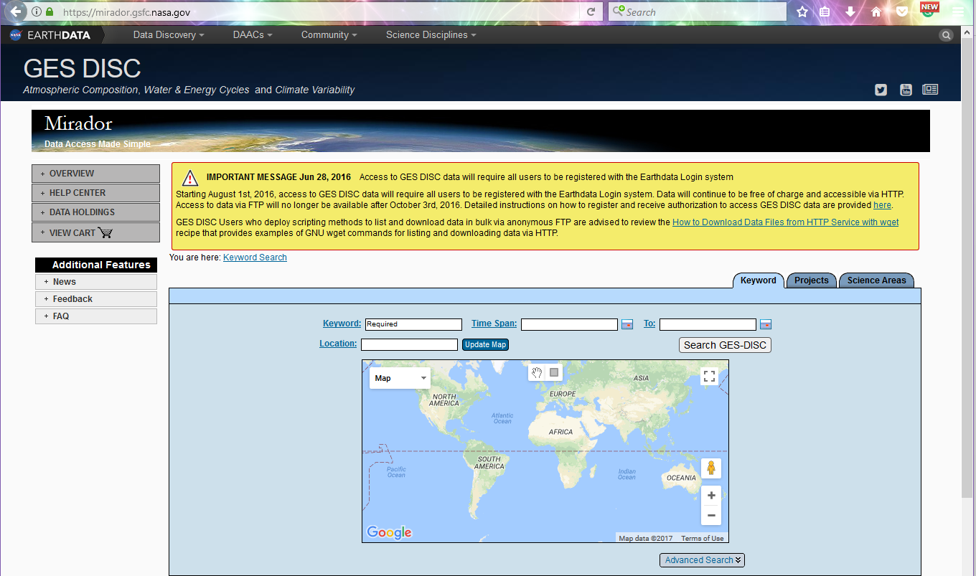
Ordering MODIS and other
Satellite Products
EarthData - https://earthdata.nasa.gov/
Mirador - https://mirador.gsfc.nasa.gov/
LAADS - https://ladsweb.modaps.eosdis.nasa.gov/

Slide 8
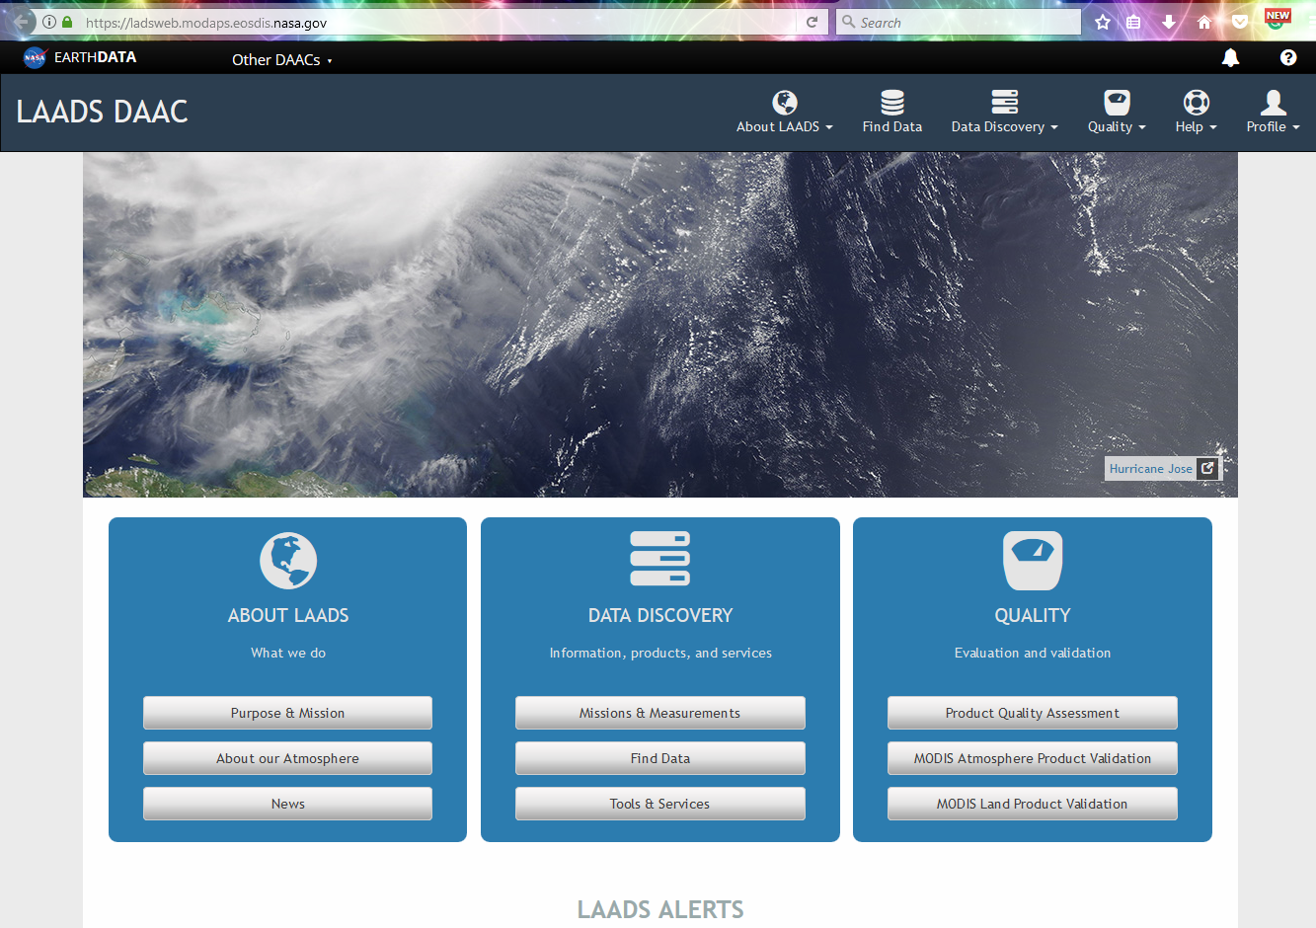
LAADS DAAC
Level-1 and Atmosphere Archive and Distribution System (LAADS) Distributed Active Archive Center (DAAC)
https://ladsweb.modaps.eosdis.nasa.gov/
LAADS is the DAAC that archives and distributes Atmosphere products from MODIS Terra, Aqua, VIIRS, and more.

Slide 9
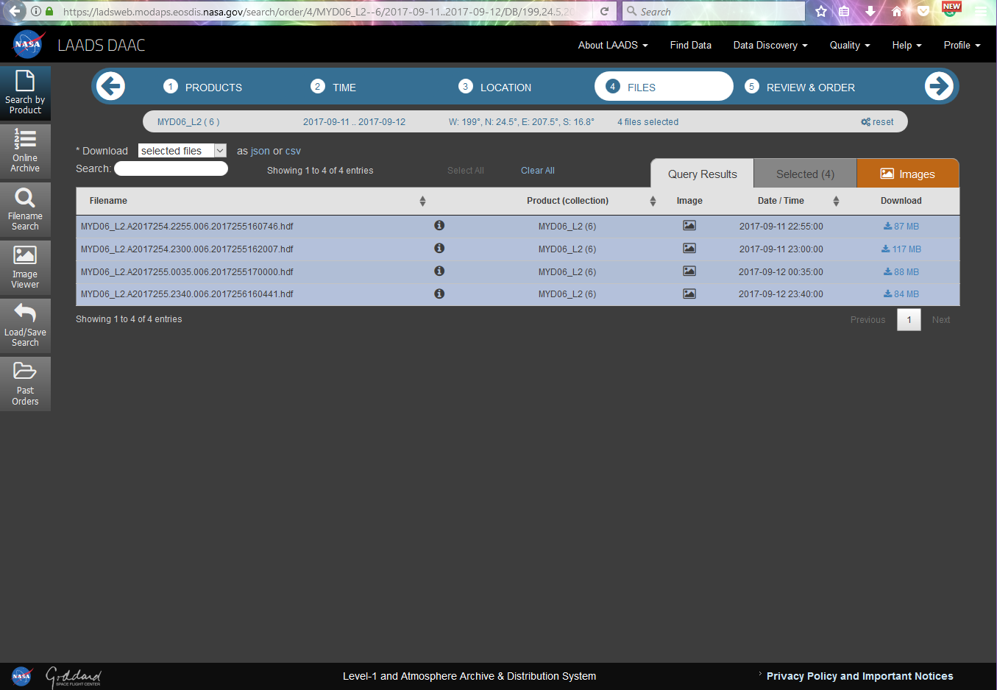
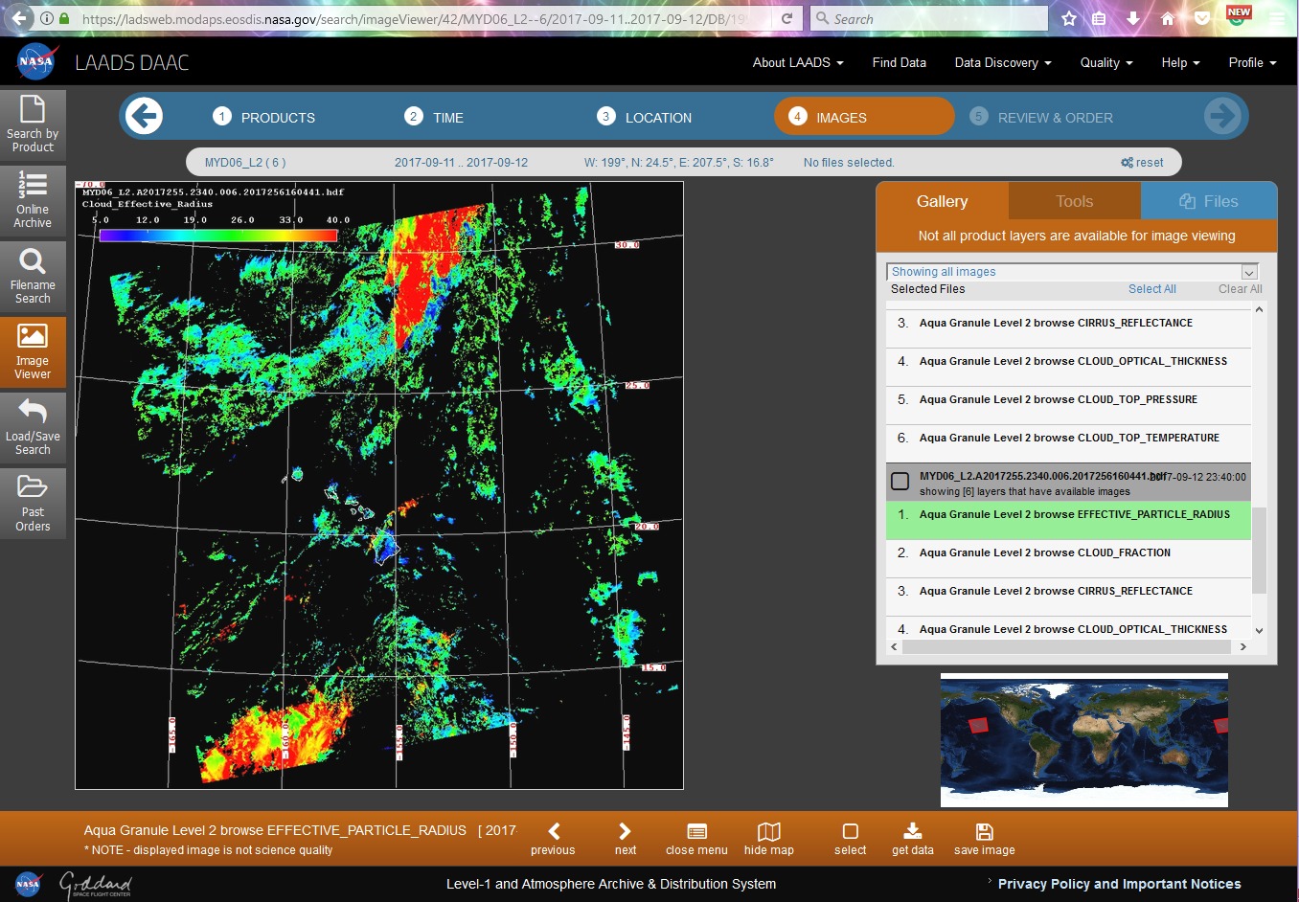
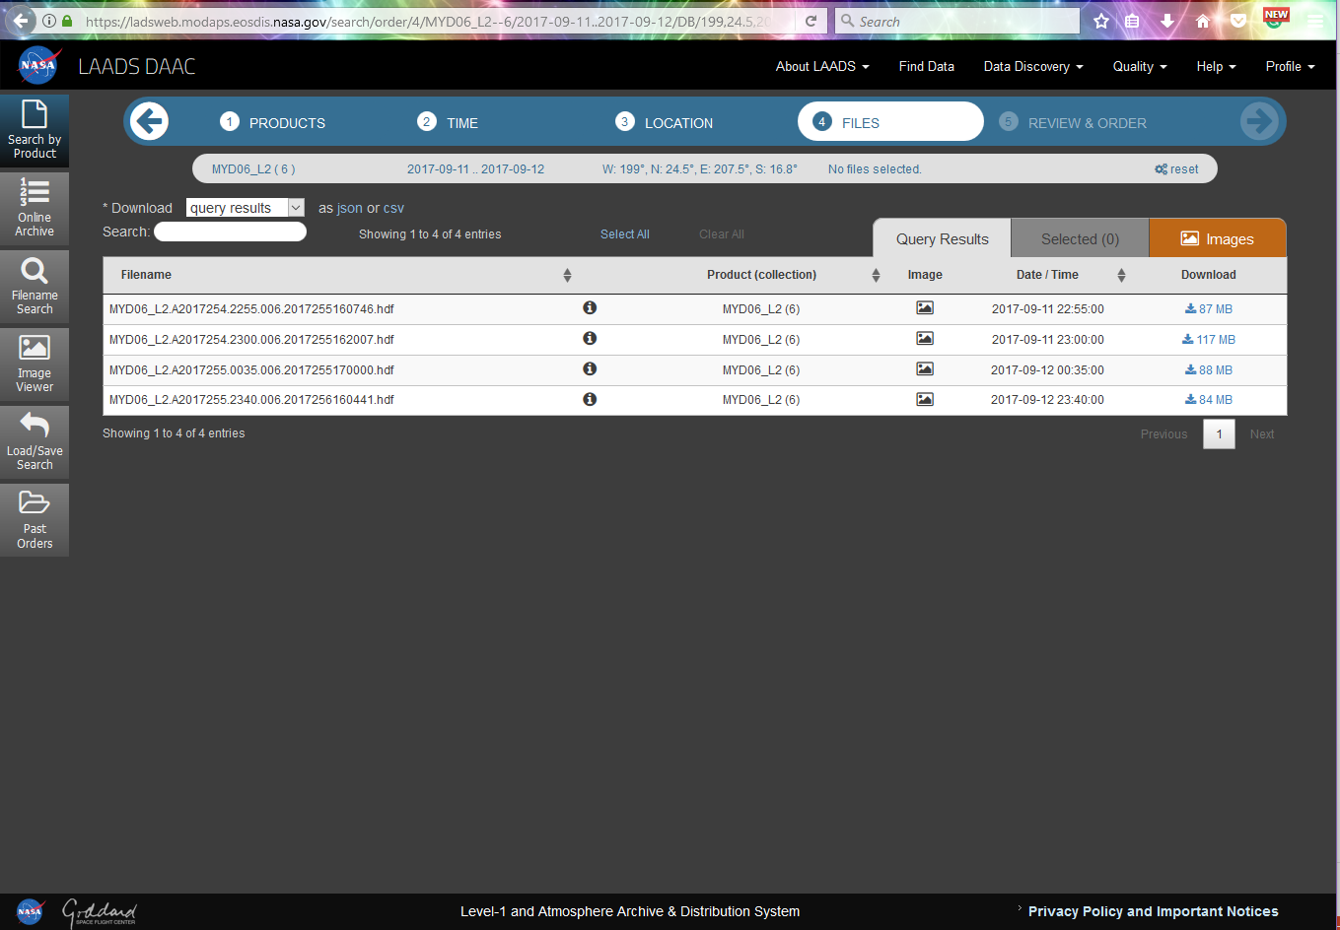
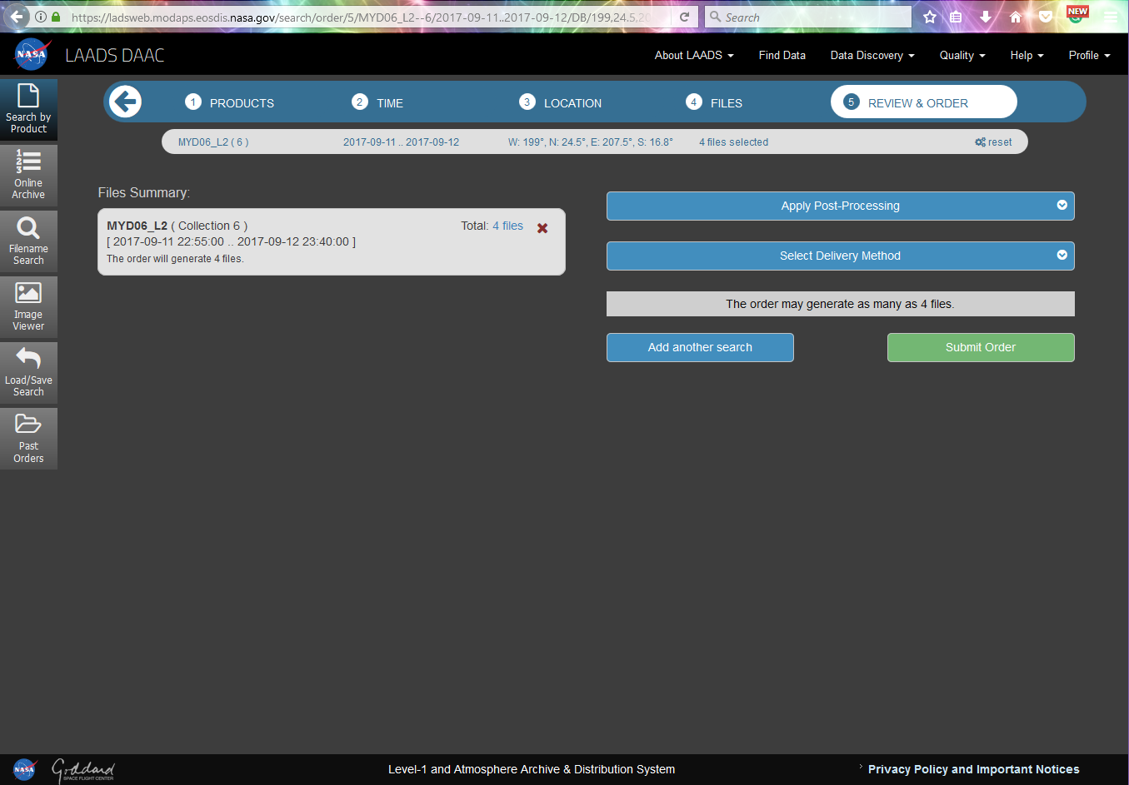
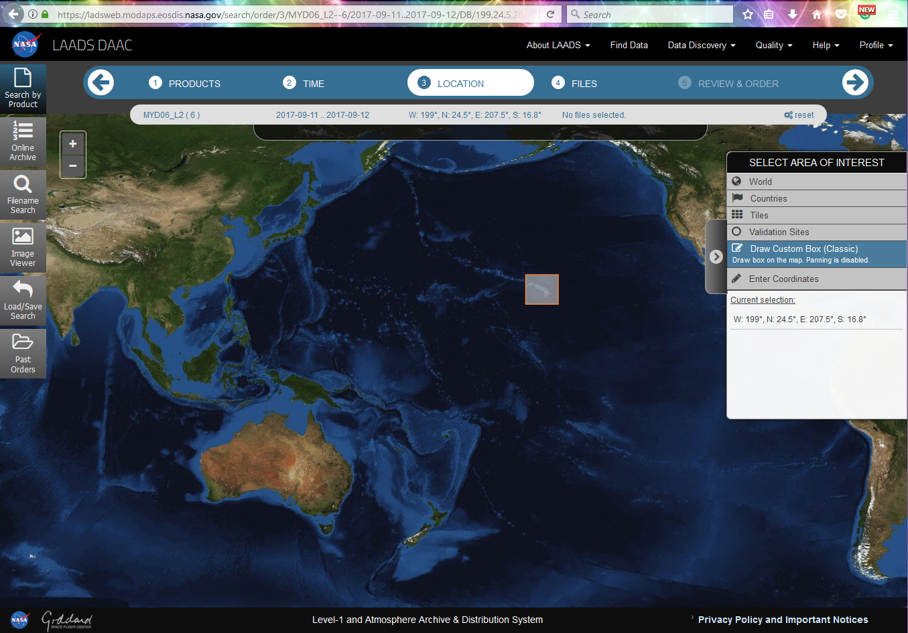
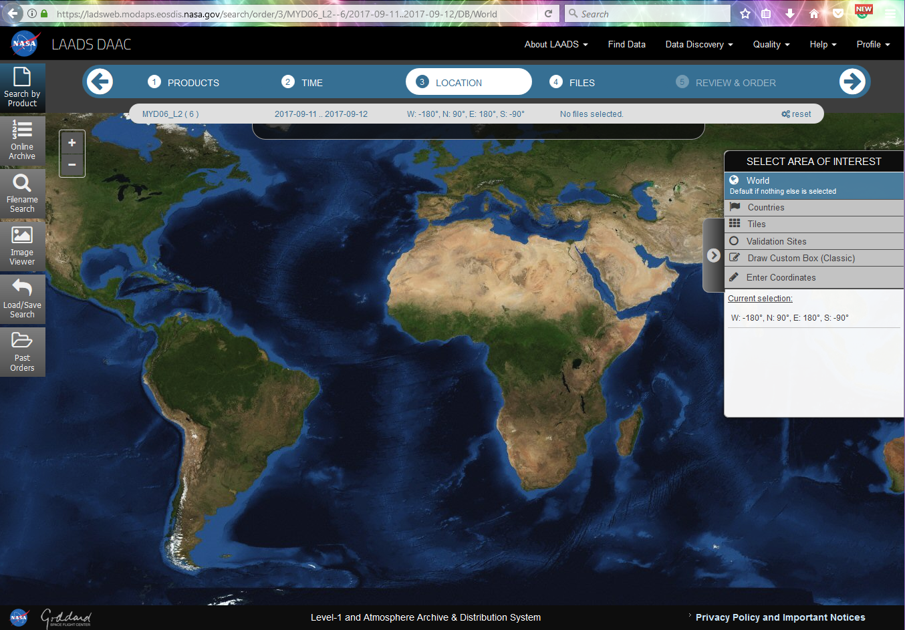
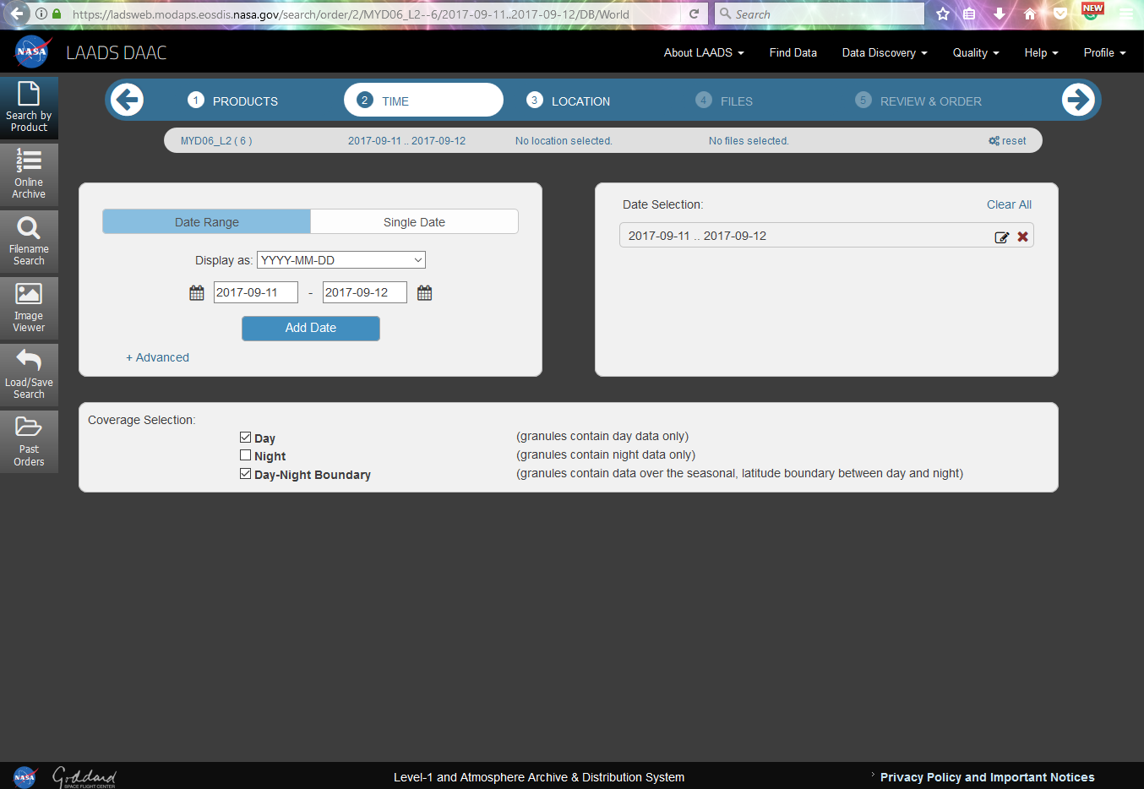
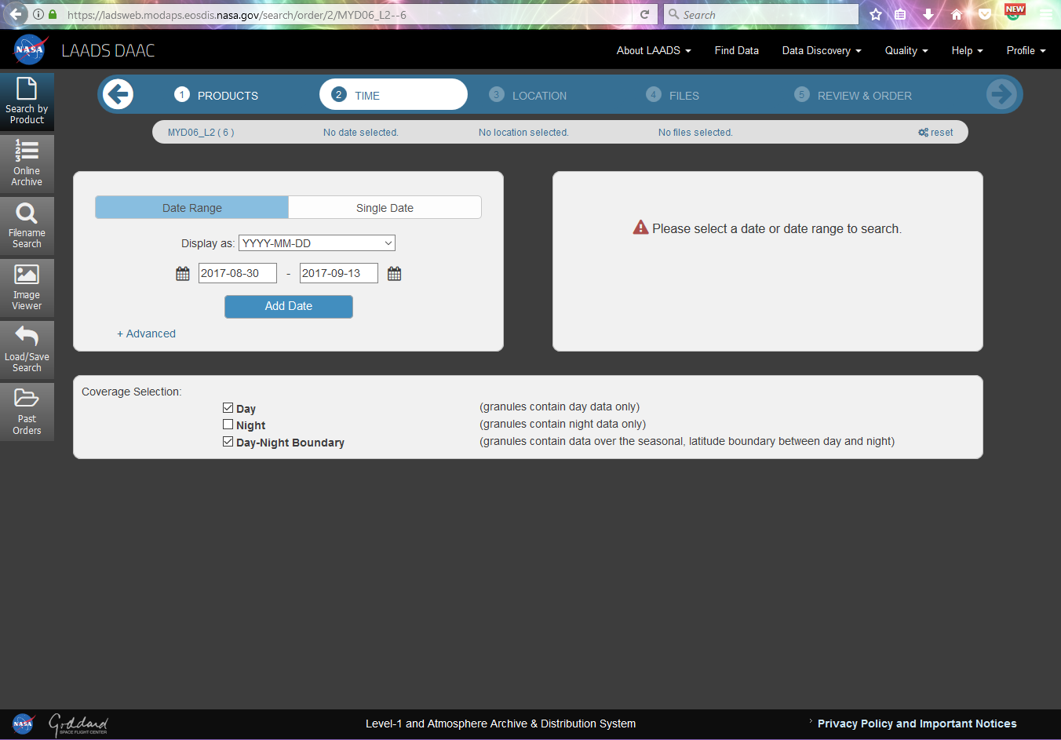
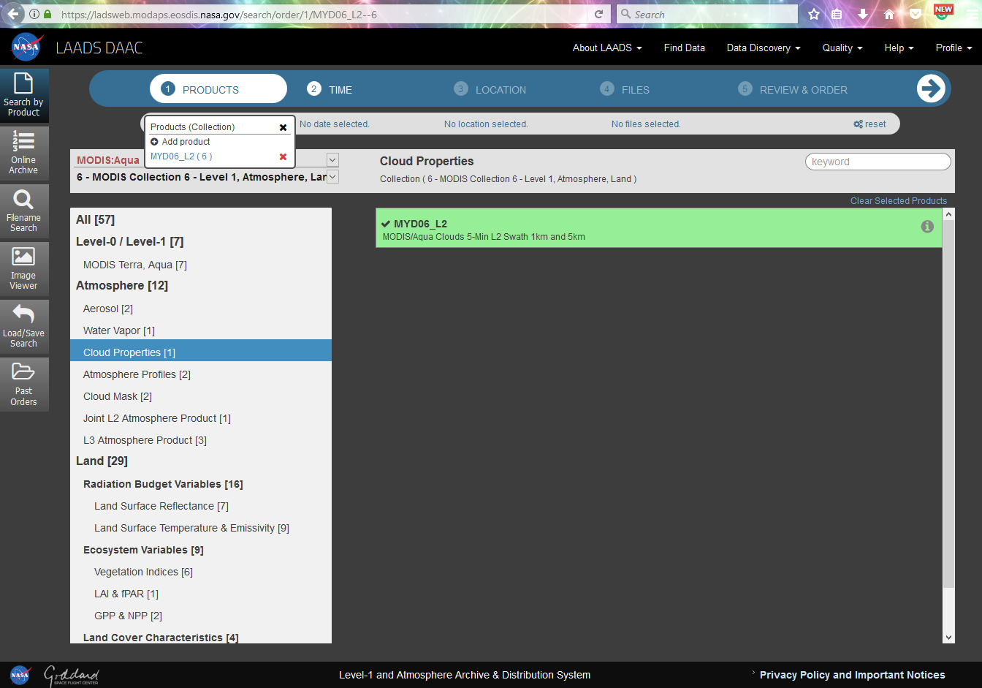
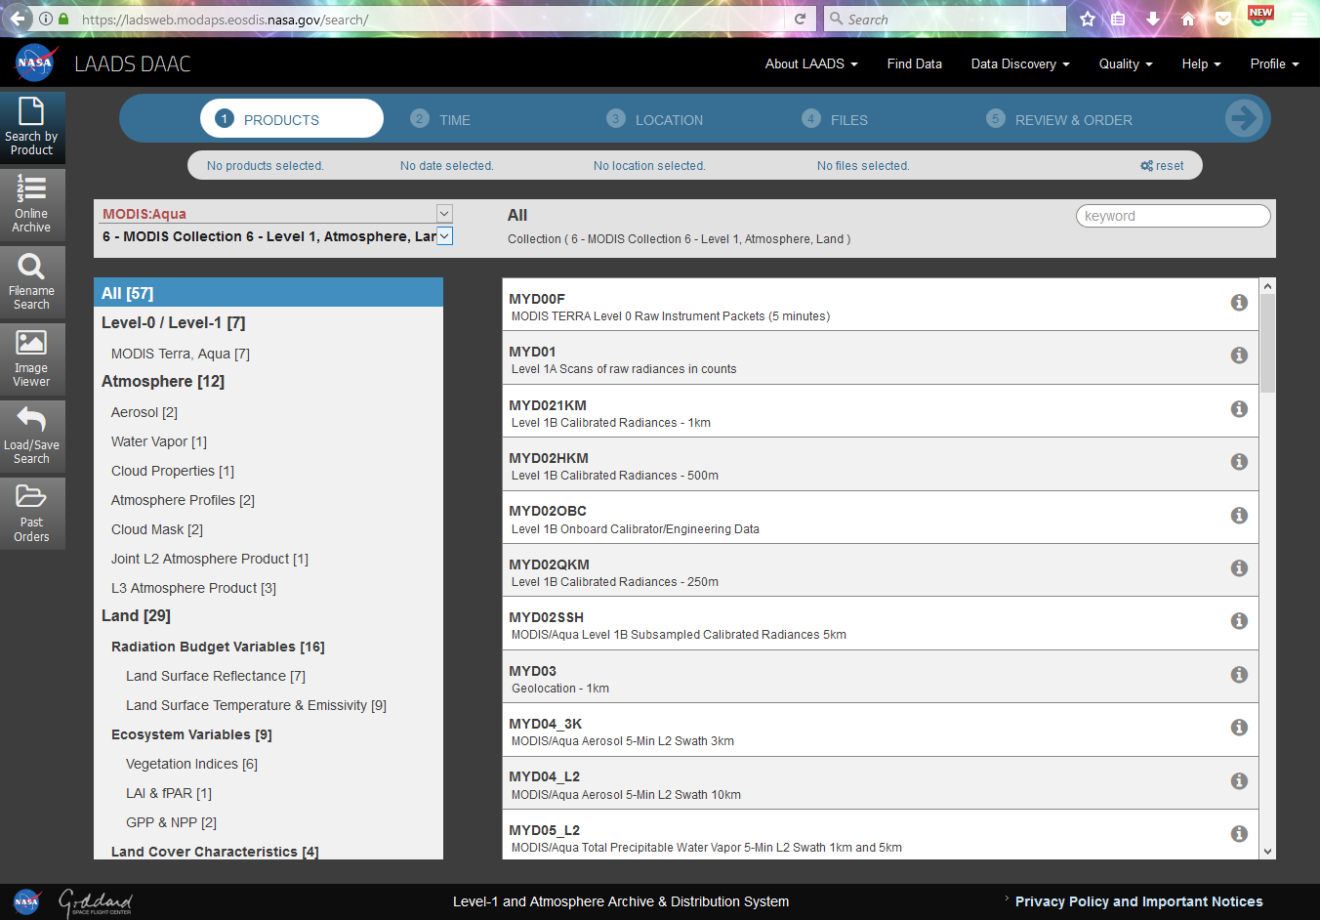

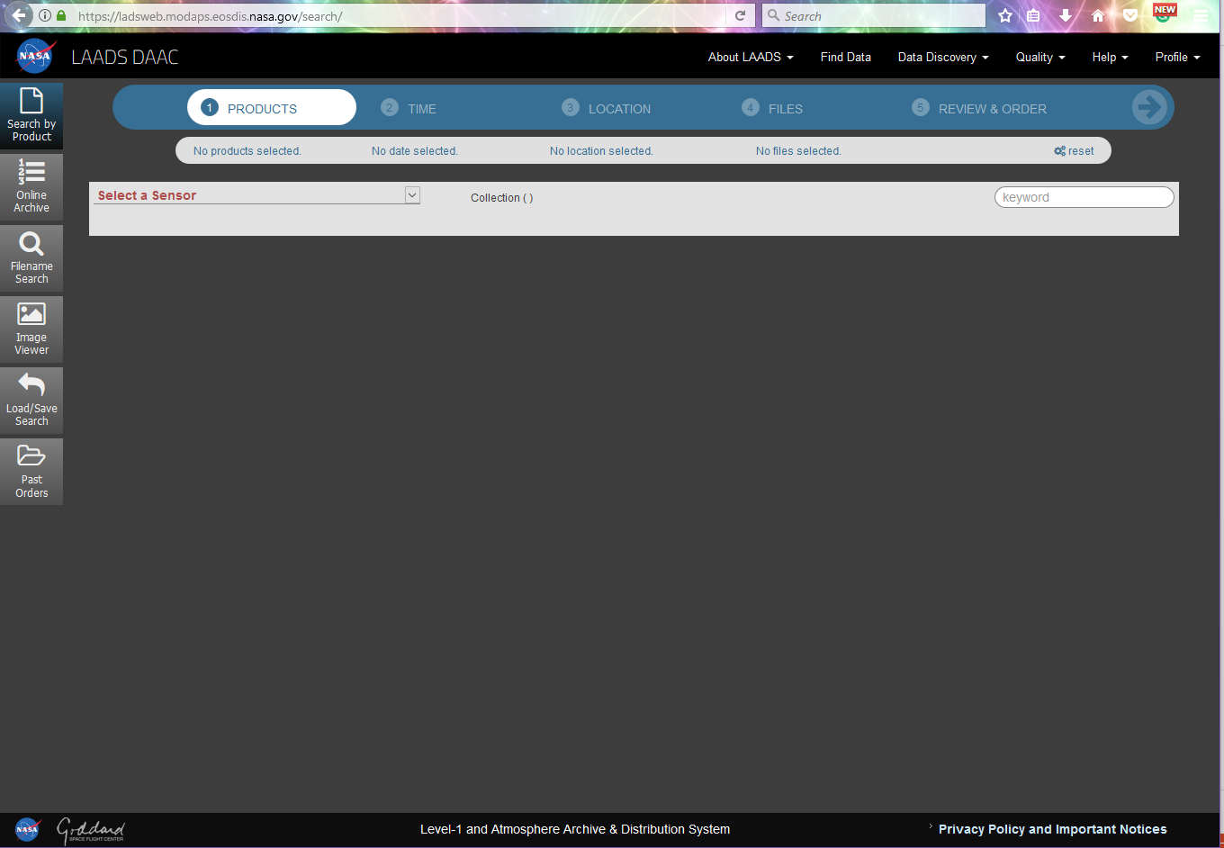
LAADS DAAC
Level-1 and Atmosphere Archive and Distribution System (LAADS) Distributed Active Archive Center (DAAC)
Select Sensor
Select Collection
Select Product
Select Time
  Single Day or a Range of Days
Select Location
  Can scroll map to choose a box or type in lat and lon values, choose a country, or the whole globe!
View Files
  You can sneak a peek at the figures.
  Click on “Search by Product” to go back to the list
  To order the files you have to “select them”
Review and Order Data
  You need to make an account

Slide 10
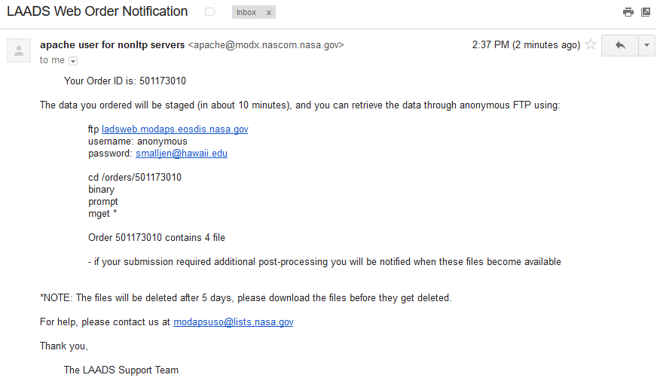
Your order notification

Slide 11
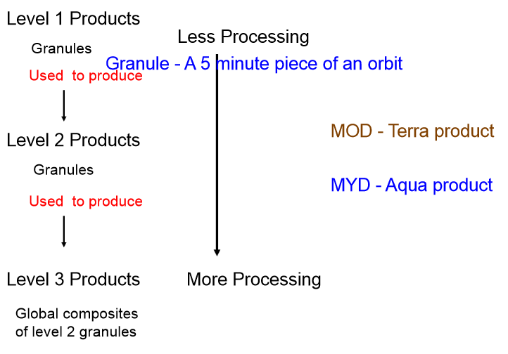
MODIS Product Hierarchy

Slide 12
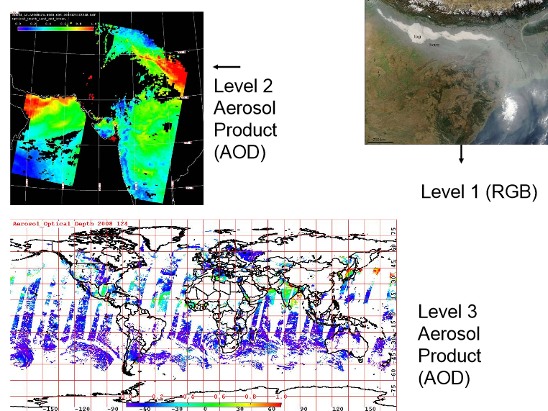

Slide 13
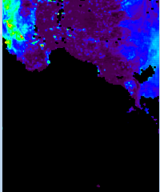
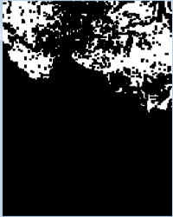
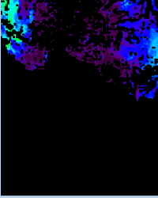
Data Quality Screening Service
Original Image
Mask
Screened Image
Mask is white (1) where data meet the quality threshold specified (in this example, Good or Very Good) and black (0) where data fall below threshold. Observations that correspond to black (0) elements in the mask are replaced with fill values in the screened product.

Slide 14
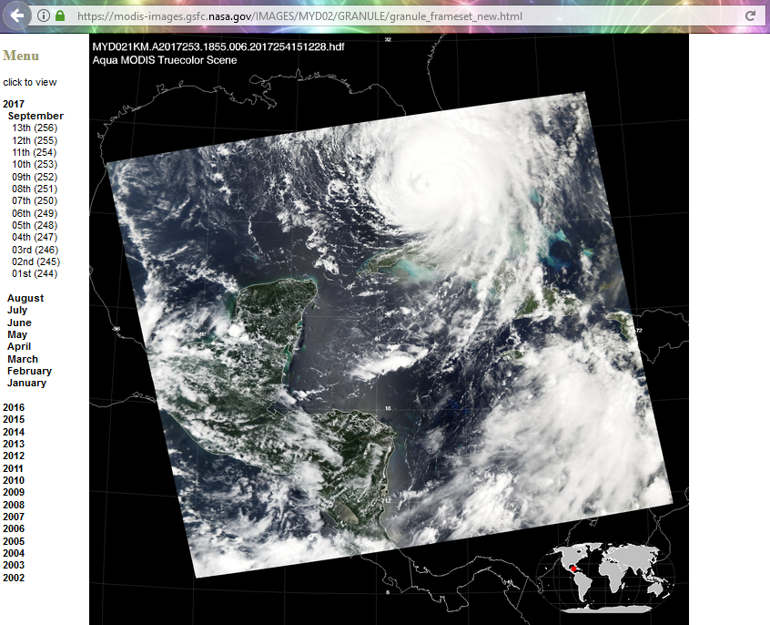
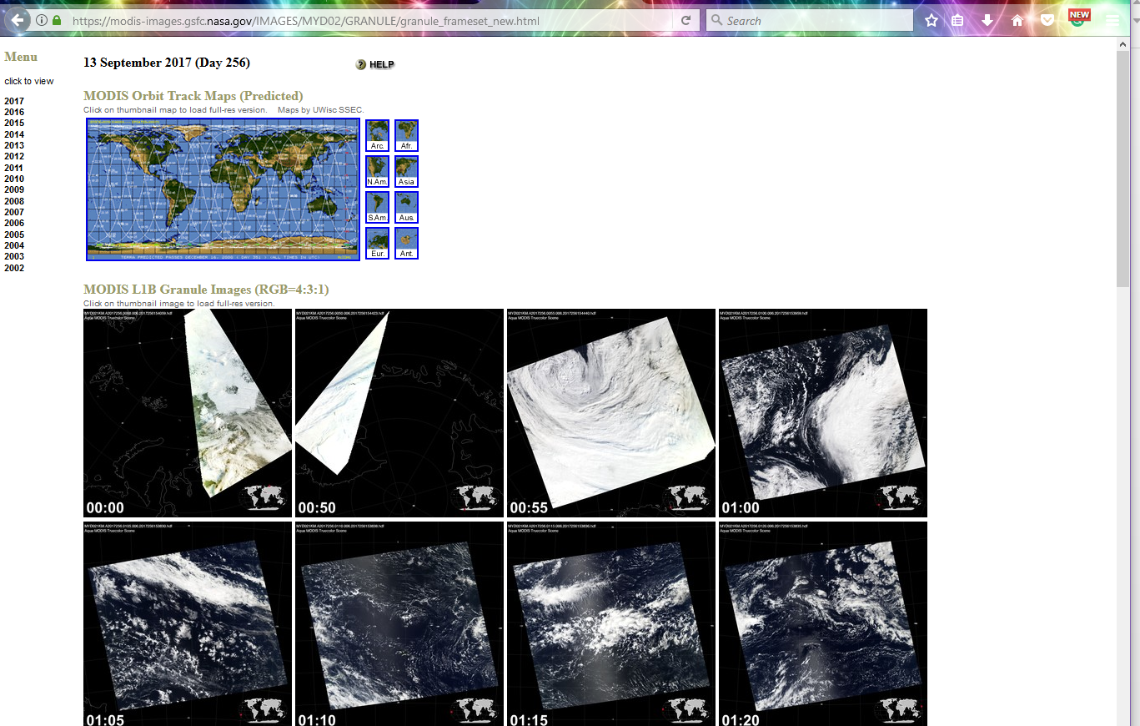
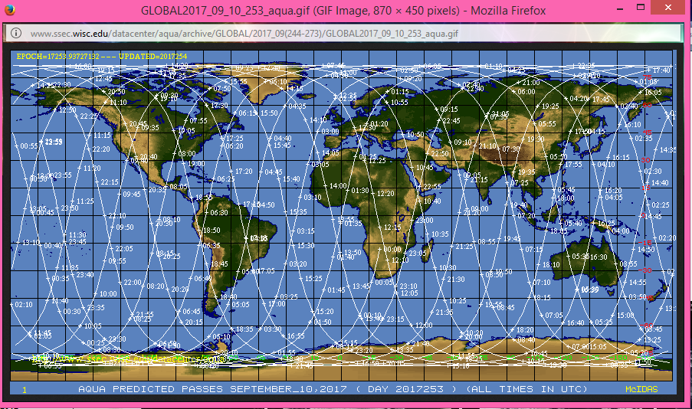
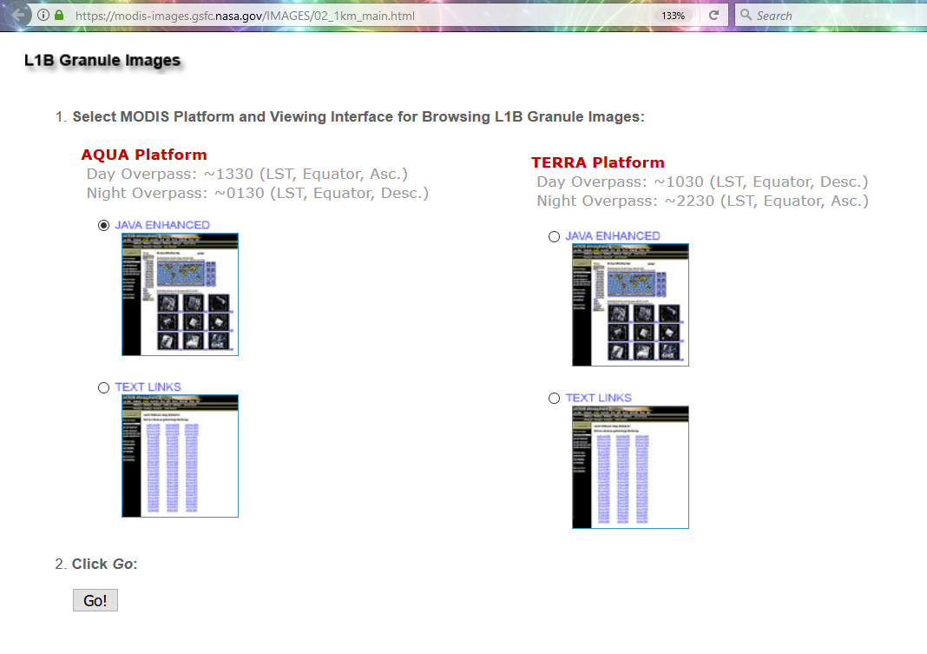
Legacy Image Search
https://modis-images.gsfc.nasa.gov/IMAGES/02_1km_main.html
Great way to preview L2 granules and help you choose the right file for a specific event!
You can choose the Year, Month and Day.
By clicking on the map it’ll help you identify the best time (HH:MM) to check

Slide 15
MODIS Level 2 Data Summary
Key Science Applications:
  Aerosol climatology
  biomass-burning aerosols
  cloud radiative properties
  hydrological cycle climatology
  effect on aerosol and clouds
  atmospheric correction
  characterization of the atmosphere
  cloud parameterization
  climate modeling & monitoring
  precipitable water
  cloud determination and screening.

Slide 16
MODIS Level 2 Data Summary
Key Geophysical Parameters:
  Atmospheric aerosol optical depth
  aerosol size distribution over oceans
  cloud particle phase
  cloud particle size
  cloud optical thickness at 0.66 µm
  cirrus reflectance at 0.66 µm
  cloud top temperature
  cloud top pressure
  clear-sky total-column precipitable water derived from both infrared and near-infrared algorithms
  and cloud fraction.

Slide 17
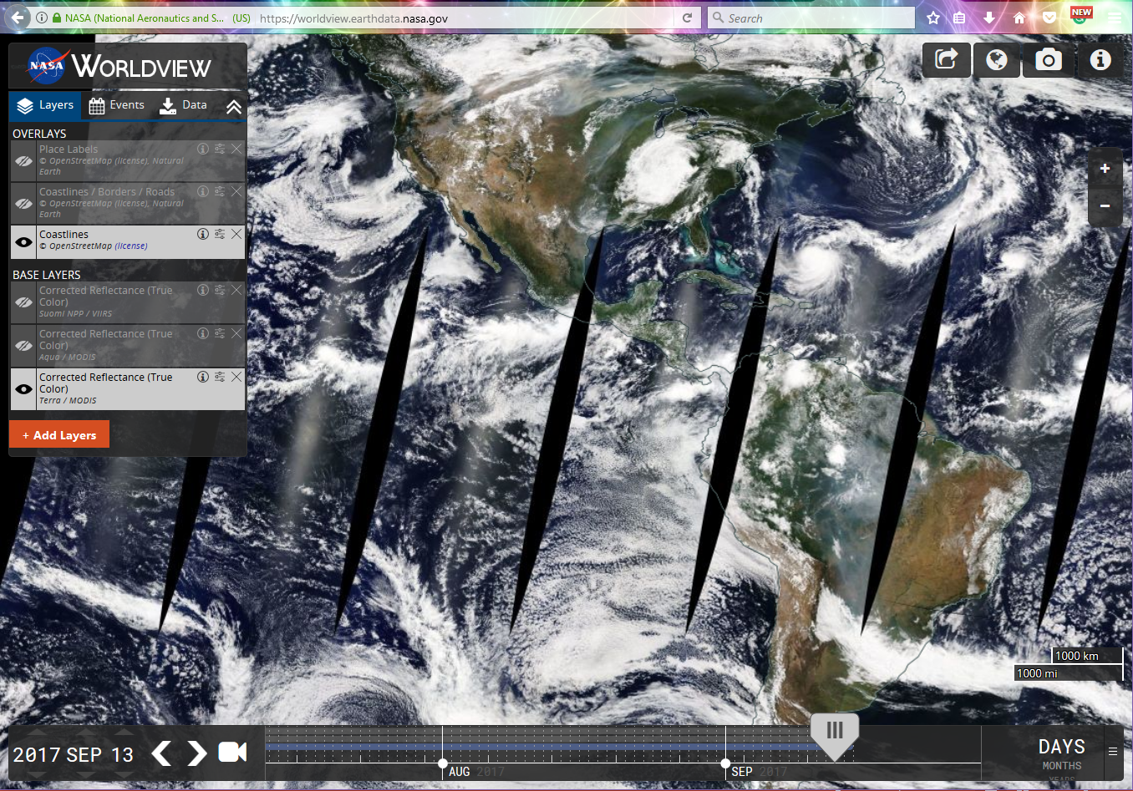
World View

Slide 18
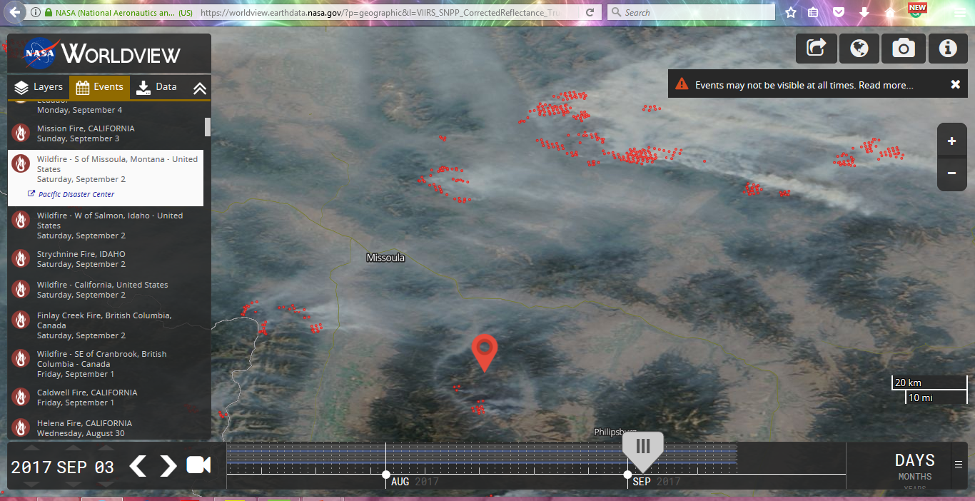
World View – Wildfires, Montana

Slide 19
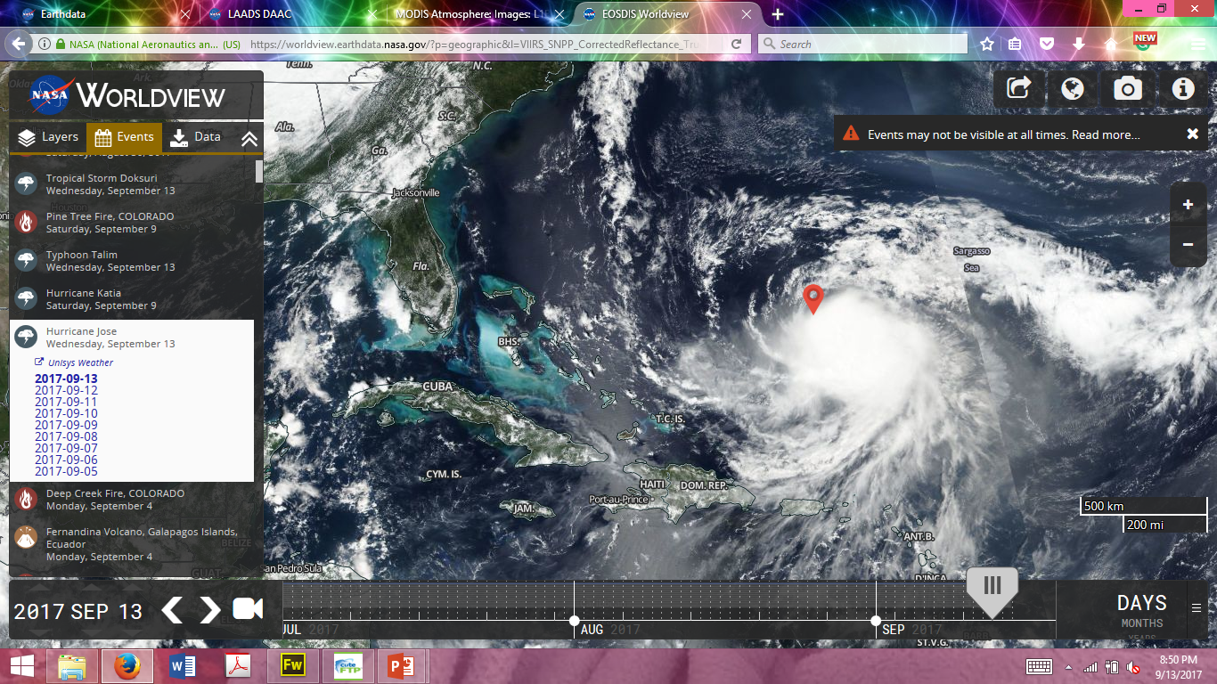
World View – Hurricane Jose

Slide 20
Why Level 3 products?
Level 2 data is difficult to work with because of:
  Formats
  Volume
  Number of files
Level 3 data are easy to use … but might lead to wrong conclusions if not being careful
Level 3 products are mostly used by modelers, application users, climate scientists

Slide 21

MODIS L3 Daily Product Descriptions
The Level-3 MODIS Atmosphere Daily Global Product contains roughly 600 statistical datasets that are derived from approximately 80 scientific parameters from four Level-2 MODIS Atmosphere Products:
  Aerosol
  Water Vapor
  Cloud
  Atmosphere Profile.
There are two MODIS Daily Global data product files:
  MOD08_D3, containing data collected from the Terra platform
  MYD08_D3, containing data collected from the Aqua platform.

Slide 22

MODIS L3 Daily Product Descriptions
A range of statistical summaries are computed, depending on the parameter being considered. Statistics for a given measurement might include:
  Simple (mean, minimum, maximum, standard deviation) statistics
  Parameters of normal and log-normal distributions
  Fraction of pixels that satisfy some condition (e.g. cloudy, clear)
  Histograms of the quantity within each grid box
  Histograms of the confidence placed in each measurement
  Histograms and/or regressions derived from comparing one science parameter to another, statistics may be computed for a subset that satisfies some condition
Statistics are sorted into 1 by 1 degree cells on an equal-angle grid that spans a 24-hour (0000 to 2400 Greenwich Mean Time) interval and then summarized over the globe.
It should be noted that browse images are available in both the native equal-angle (lat-lon) grid as well as an equal-area (hammer-aitoff) grid.

Slide 23

MODIS L3 8-Day Product Descriptions
Computed Statistics
  Statistics are sorted into 1x1 degree cells on an equal-angle grid that spans an 8-day interval and then summarized over the globe. It should be noted that the eight-day interval start date is reset to January 1st at the beginning of every new year.
  A range of statistical summaries are computed, depending on the parameter being considered. Statistics for a given measurement might include:
    Simple (mean, minimum, maximum, standard deviation) statistics
    Parameters of normal and log-normal distributions
    Fraction of pixels that satisfy some condition (e.g. cloudy, clear)
    Histograms of the quantity within each grid box
    Histograms of the confidence placed in each measurement
    Histograms and/or regressions derived from comparing one science parameter to another, statistics may be computed for a subset that satisfies some condition

Slide 24

MODIS L3 Monthly Computed Statistics
Computed Statistics
  Statistics are sorted into 1x1 degree cells on an equal-angle grid that spans a (calendar) monthly interval and then summarized over the globe.
  A range of statistical summaries are computed, depending on the parameter being considered. Statistics for a given measurement might include:
    Simple (mean, minimum, maximum, standard deviation) statistics
  Parameters of normal and log-normal distributions
    Fraction of pixels that satisfy some condition (e.g. cloudy, clear)
    Histograms of the quantity within each grid box
    Histograms of the confidence placed in each measurement
    Histograms and/or regressions derived from comparing one science parameter to another, statistics may be computed for a subset that satisfies some condition

Slide 25
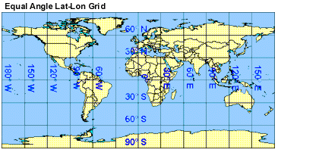
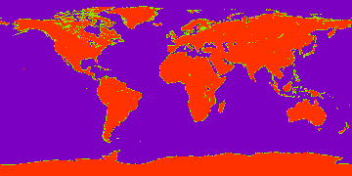
L3 Grids and Mapping
Hammer-Aitoff Projection
The MODIS Atmosphere Daily Global Product is stored on an equal angle lat-lon grid. The grid cells are 1 degree by 1 degree, which means the output grid is always 360 pixels in width and 180 pixels in height.
A Land/Ocean Mask for L3 products is provided below. The PNG image is 360 pixels in width and 180 pixels in height. Each image pixel corresponds to one L3 1x1 degree grid cell. Values of 200 represent land grid cells, values of 100 represent mixed grid cells, and values of 0 represent ocean grid cells. This image can be use with analysis programs, such as those written in IDL, to screen L3 results for ocean or land only.

