Slide 1

Introduction to MODIS Instrumentation
ATMO 611 – Satellite Data Applications
Jennifer D. S. Griswold

Slide 2
A Short History
1983 – NASA began to explore the concept of a polar-orbiting platform to complement a manned polar-orbiting space station
Beginning as System Z, the idea gained momentum with NASA’s proposed “Global Habitability” program
After Challenger disaster, polar space station disappeared as did manned servicing requirement
System Z became EOS – Earth Observing System
  Several instrument suites were developed
  Surface Imaging and Sounding Package (SISP) included the Moderate Resolution Imaging Spectrometer
MODIS soon split into 2 concepts
  MODIS-N focused primarily on land and atmosphere sensing but included some ocean bands
  MODIS-T (tilting) focused on ocean
Because of budget constraints, MODIS-T vanished, replaced by MODIS-N and EOS-Color (to follow SeaWiFS)
Further budget reductions led to replacement of EOS-Color by SIMBIOS

Slide 3
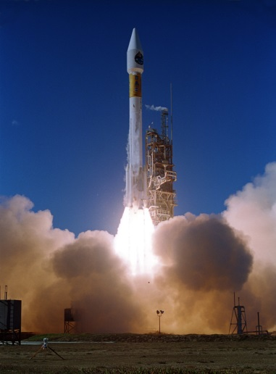
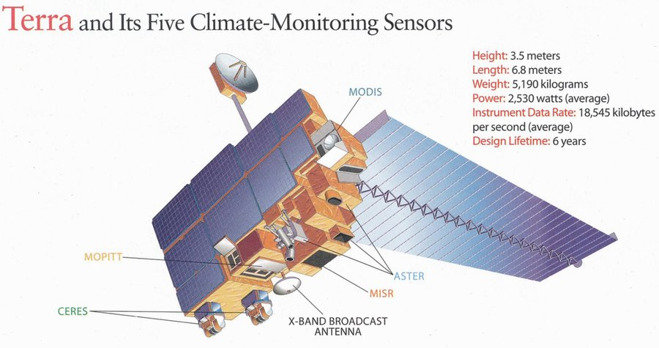
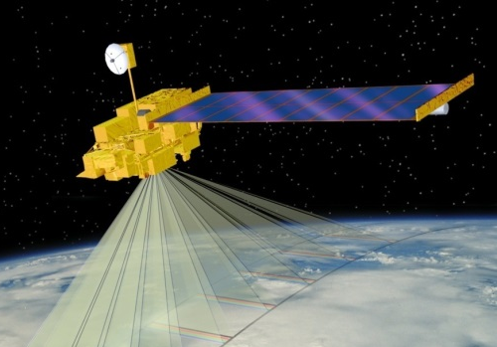
Terra (1999-present)
http://terra.nasa.gov/

Slide 4
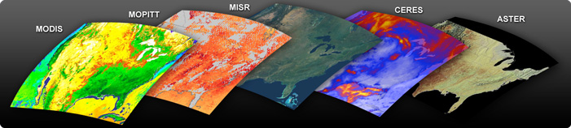
MODIS – Terra Instruments
ASTER - Advanced Spaceborne Thermal Emission and Reflection Radiometer
CERES - Clouds and Earth's Radiant Energy System
MISR - Multi-angle Imaging SpectroRadiometer
MODIS - Moderate-resolution Imaging Spectroradiometer
MOPITT - Measurements of Pollution in the Troposphere

Slide 5
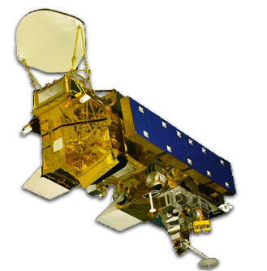
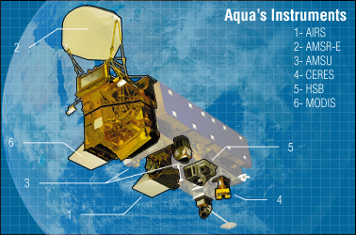
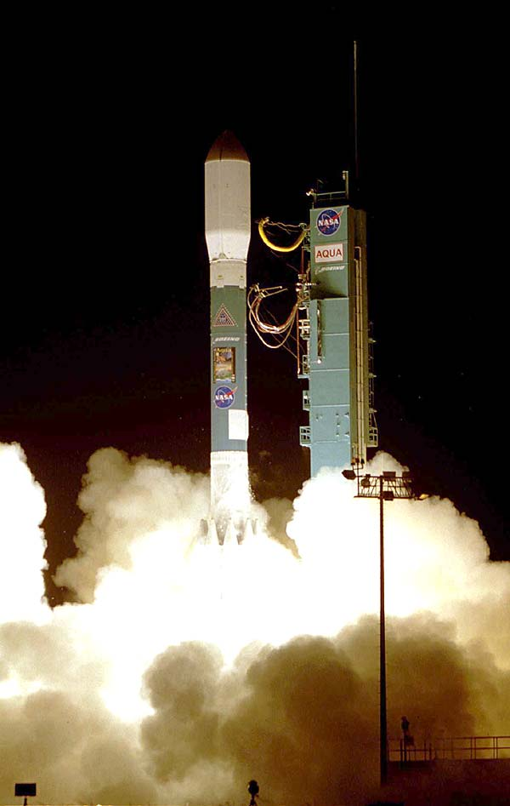
Aqua (2002-present)
http://aqua.nasa.gov/

Slide 6
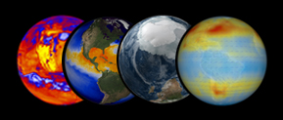
Aqua Instruments
AIRS - Atmospheric Infrared Sounder
AMSU-A – Advanced Microwave Sounding Unit
HSB – Humidity Sounder for Brazil
AMSR-E – Advanced Microwave Scanning Radiometer for EOS
MODIS - Moderate-resolution Imaging Spectroradiometer
CERES -or Clouds and Earth's Radiant Energy System

Slide 7
MODIS Terra-Aqua Summary
Responsible Center: NASA Goddard Space Flight Center
Description: Used to understand the global dynamics and process occurring on land, in the oceans and in the atmosphere.
Channels: 36-band cross-track scanning radiometer
Spectral Range: Visible to thermal infrared measurements at 0.4-14.5 μm
Spatial resolution: 250 m (bands 1-2), 500 m (bands 3-7), to 1 km (bands 8-36)
Swath width: 2330 km (cross track) by 10 lm (along track at nadir)
Global coverage every 1-2 days
Terra Launched: Dec. 18, 1999
Aqua Launched: May 4, 2002

Slide 8
Improvements on Previous Satellites
Heritage: AVHRR (land), SeaWIFS (ocean), HIRS (atmosphere)
Major differences:
More spectral bands (490 detectors)
Multiple samples along track on each earth scan
Higher spatial resolution
On-orbit radiometric, spatial, and spectral calibration
Improved radiometric accuracy and precision (12-bit)
Improved geolocation accuracy
Higher data rate requiring X-band direct broadcast

Slide 9
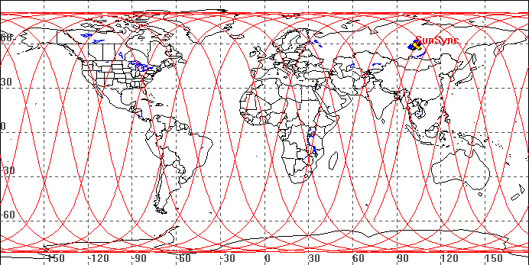
MODIS Orbital Characteristics
TERRA Orbital Characteristics
  Sun synchronous, near-polar orbit
  Equatorial 10:30 pm, descending node crossing
  Inclination 98.5°
  Altitude 705 km
  Period 99 minutes (16 orbits per day)
AQUA Orbital Characteristics
  Sun synchronous, near-polar orbit
  Equatorial 1:30 pm, ascending node crossing
  Inclination 98°
  Altitude 705 km (438 miles)
  Period 99 minutes (16 orbits per day)
A Sun-synchronous orbit (sometimes called a heliosynchronous orbit) is a geocentric orbit which combines altitude and inclination in such a way that an object on that orbit will appear to orbit in the same position, from the perspective of the Sun, during its orbit around the Earth.

Slide 10
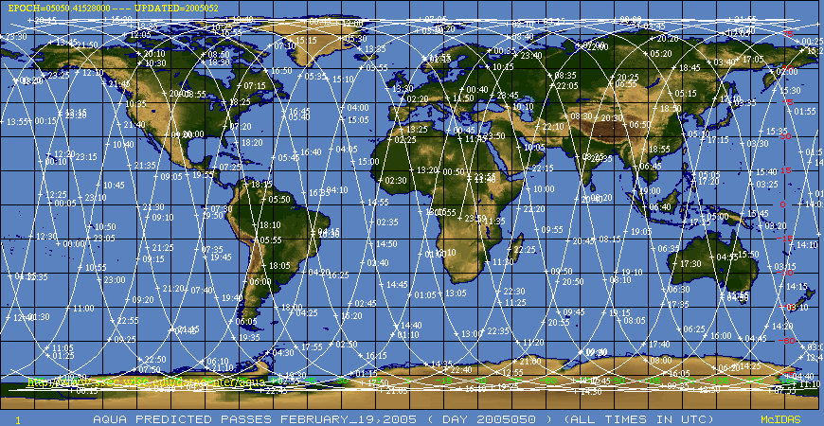
MODIS Aqua coverage (2330 km swath)
Space Science and Engineering Center (SSEC) http://www.ssec.wisc.edu/datacenter/aqua/

Slide 11
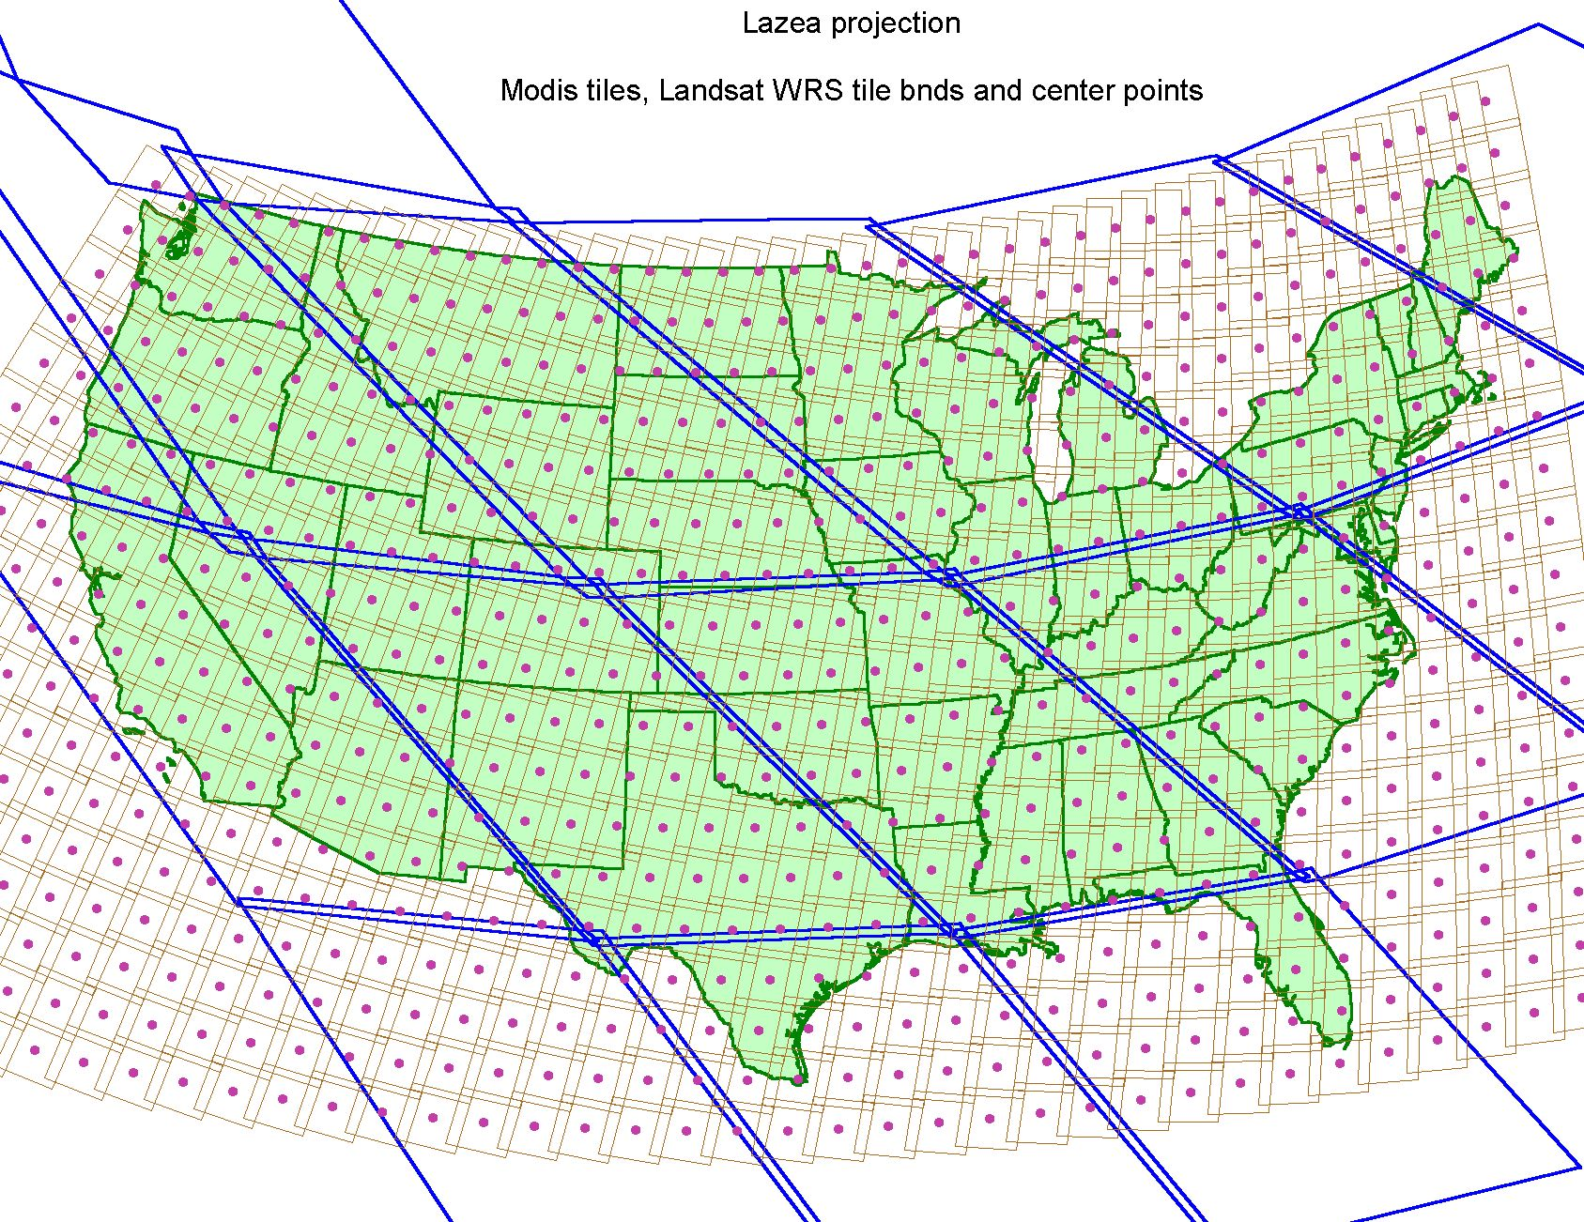

Slide 12
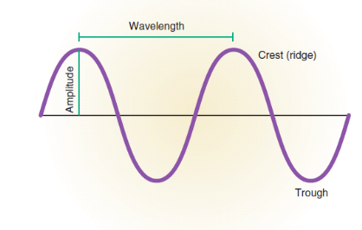
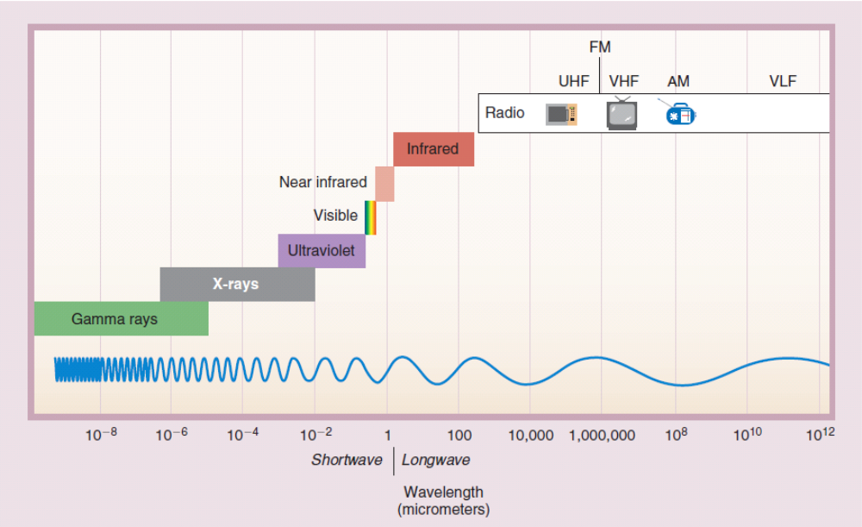
Where is the Electromagnetic Spectrum can MODIS “see”?

Slide 13
Primary Use for Reflected Solar Band
Primary Use | Band | Bandwidth¹ | Spectral Radiance² | Required SNR³
Land/Cloud/Aerosols Boundaries | 1 | 620 - 670 | 21.8 | 128
 | 2 | 841 - 876 | 24.7 | 201
Land/Cloud/Aerosols Properties | 3 | 459 - 479 | 35.3 | 243
 | 4 | 545 - 565 | 29.0 | 228
 | 5 | 1230 - 1250 | 5.4 | 74
 | 6 | 1628 - 1652 | 7.3 | 275
 | 7 | 2105 - 2155 | 1.0 | 110
Ocean Color/ Phytoplankton/ Biogeochemistry | 8 | 405 - 420 | 44.9 | 880
 | 9 | 438 - 448 | 41.9 | 838
 | 10 | 483 - 493 | 32.1 | 802
 | 11 | 526 - 536 | 27.9 | 754
 | 12 | 546 - 556 | 21.0 | 750
 | 13 | 662 - 672 | 9.5 | 910
 | 14 | 673 - 683 | 8.7 | 1087
 | 15 | 743 - 753 | 10.2 | 586
 | 16 | 862 - 877 | 6.2 | 516
Atmospheric Water Vapor | 17 | 890 - 920 | 10.0 | 167
 | 18 | 931 - 941 | 3.6 | 57
 | 19 | 915 - 965 | 15.0 | 250
2/3 of the data output comes from bands 2-7
Bands 1 to 19 are in nm; Bands 20 to 36 are in µm Spectral Radiance values are (W/m² -µm-sr)

Slide 14
Primary Use for Each Thermal Band
Primary Use | Band | Bandwidth¹ | Spectral Radiance² | Required NE[delta]T(K)
Surface/Cloud Temperature | 20 | 3.660 - 3.840 | 0.45(300K) | 0.05
 | 21 | 3.929 - 3.989 | 2.38(335K) | 2.00
 | 22 | 3.929 - 3.989 | 0.67(300K) | 0.07
 | 23 | 4.020 - 4.080 | 0.79(300K) | 0.07
Atmospheric Temperature | 24 | 4.433 - 4.498 | 0.17(250K) | 0.25
 | 25 | 4.482 - 4.549 | 0.59(275K) | 0.25
Cirrus Clouds Water Vapor | 26 | 1.360 - 1.390 | 6.00 | 150(SNR)
 | 27 | 6.535 - 6.895 | 1.16(240K) | 0.25
 | 28 | 7.175 - 7.475 | 2.18(250K) | 0.25
Cloud Properties | 29 | 8.400 - 8.700 | 9.58(300K) | 0.05
Ozone | 30 | 9.580 - 9.880 | 3.69(250K) | 0.25
Surface/Cloud Temperature | 31 | 10.780 - 11.280 | 9.55(300K) | 0.05
 | 32 | 11.770 - 12.270 | 8.94(300K) | 0.05
Cloud Top Altitude | 33 | 13.185 - 13.485 | 4.52(260K) | 0.25
 | 34 | 13.485 - 13.785 | 3.76(250K) | 0.25
 | 35 | 13.785 - 14.085 | 3.11(240K) | 0.25
 | 36 | 14.085 - 14.385 | 2.08(220K) | 0.35
*Bands 1 to 19 are in nm; Bands 20 to 36 are in µm NE(delta)T = Noise-equivalent temperature difference

Slide 15
MODIS Challenges
Multiple detectors:
Detector differences are noticeable
Dead or out-of-family detectors must be handled
Multiple samples along track introduce bowtie distortion
Spectral information:
Many interdependent bands
How to utilize all the spectral information?
Data rate:
Orders of magnitude larger than heritage sensors

Slide 16
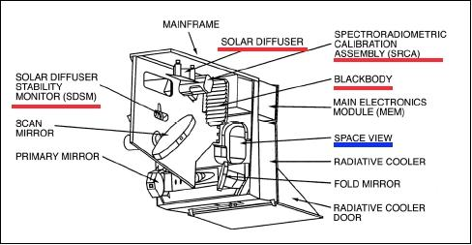
The MODIS sensor and its major subsystems

Slide 17
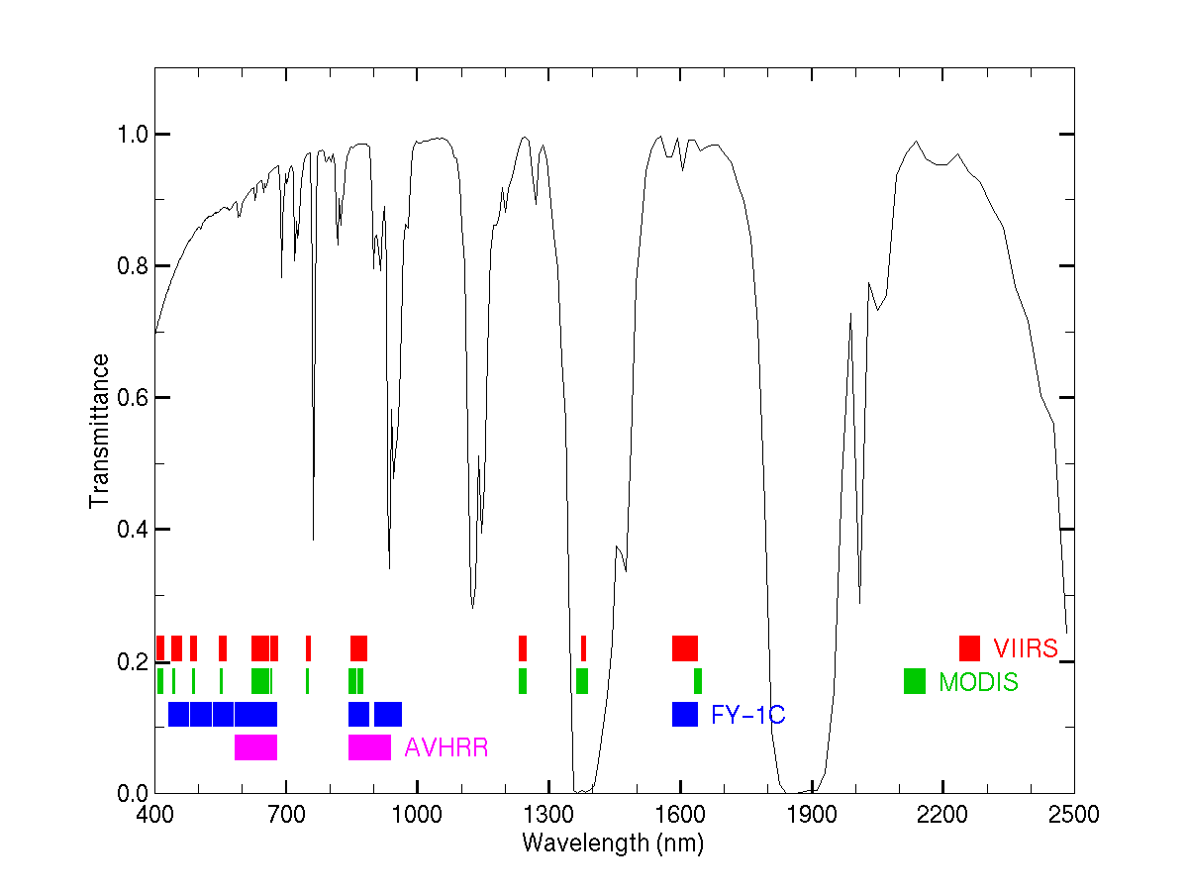
VIIRS, MODIS, FY-1C, AVHRR
CO2
O2
O3
H2O
O2
H2O
H2O
O2
H2O
H2O
H2O
CO2

Slide 18
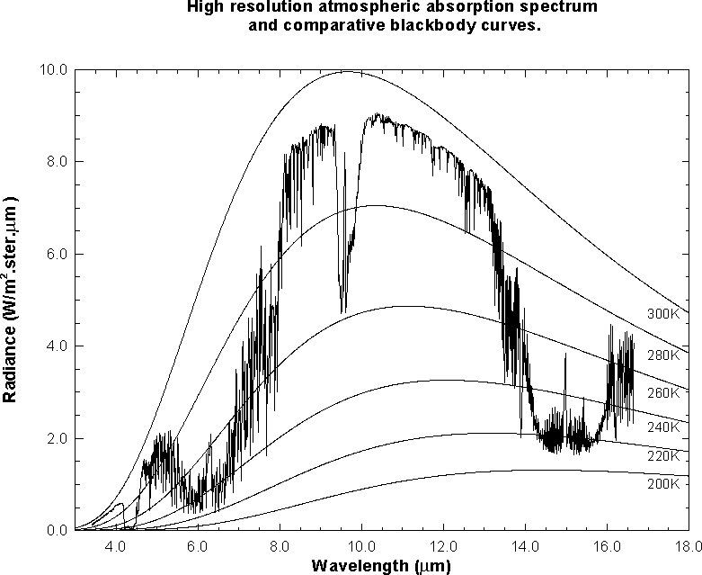
MODIS IR Spectral Bands
MODIS
Notes:
This slide shows an observed infrared spectrum of the earth thermal emission of radiance to space. The earth surface Planck blackbody - like radiation at 295 K is severely attenuated in some spectral regions. Around the absorbing bands of the constituent gases of the atmosphere (CO2 at 4.3 and 15.0 um, H20 at 6.3 um, and O3 at 9.7 um), vertical profiles of atmospheric parameters can be derived. Sampling in the spectral region at the center of the absorption band yields radiation from the upper levels of the atmosphere (e.g. radiation from below has already been absorbed by the atmospheric gas); sampling in spectral regions away from the center of the absorption band yields radiation from successively lower levels of the atmosphere. Away from the absorption band are the windows to the bottom of the atmosphere. Surface temperatures of 296 K are evident in the 11 micron window region of the spectrum and tropopause emissions of 220 K in the 15 micron absorption band. As the spectral region moves toward the center of the CO₂ absorption band, the radiation temperature decreases due to the decrease of temperature with altitude in the lower atmosphere.
IR remote sensing (e.g. HIRS and GOES Sounder) currently covers the portion of the spectrum that extends from around 3 microns out to about 15 microns. Each measurement from a given field of view (spatial element) has a continuous spectrum that may be used to analyze the earth surface and atmosphere. Until recently, we have used “chunks” of the spectrum (channels over selected wavelengths) for our analysis. In the near future, we will be able to take advantage of the very high spectral resolution information contained within the 3-15 micron portion of the spectrum. From the polar orbiting satellites, horizontal resolutions on the order of 10 kilometers will be available, and depending on the year, we may see views over the same area as frequently as once every 4 hours (assuming 3 polar satellites with interferometers). With future geostationary interferometers, it may be possible to view at 4 kilometer resolution with a repeat frequency of once every 5 minutes to once an hour, depending on the area scanned and spectral resolution and signal to noise required for given applications.

Slide 19
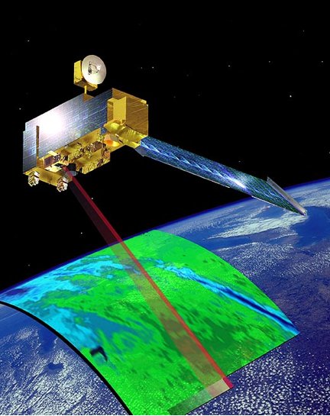
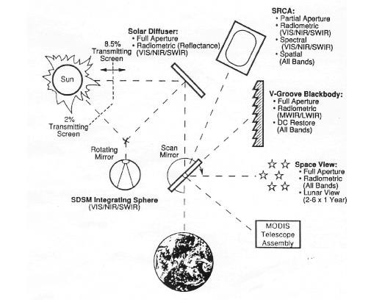
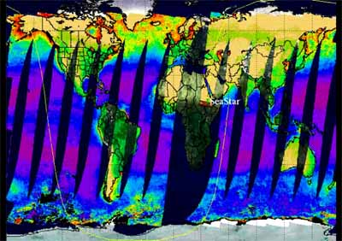
MODIS Scanner Characteristics

Slide 20
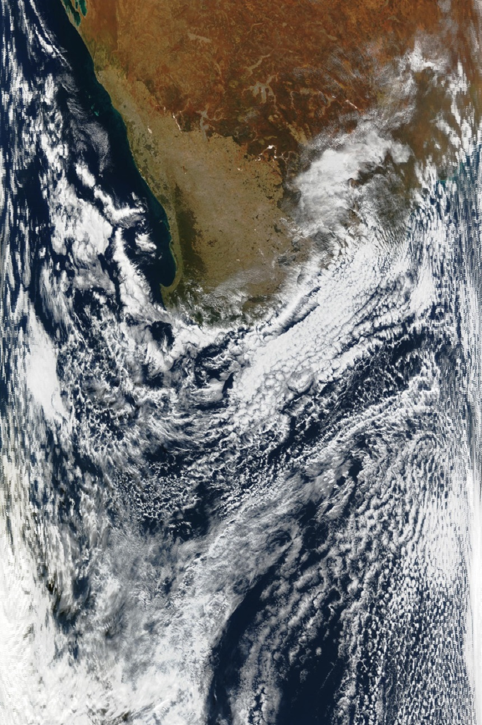
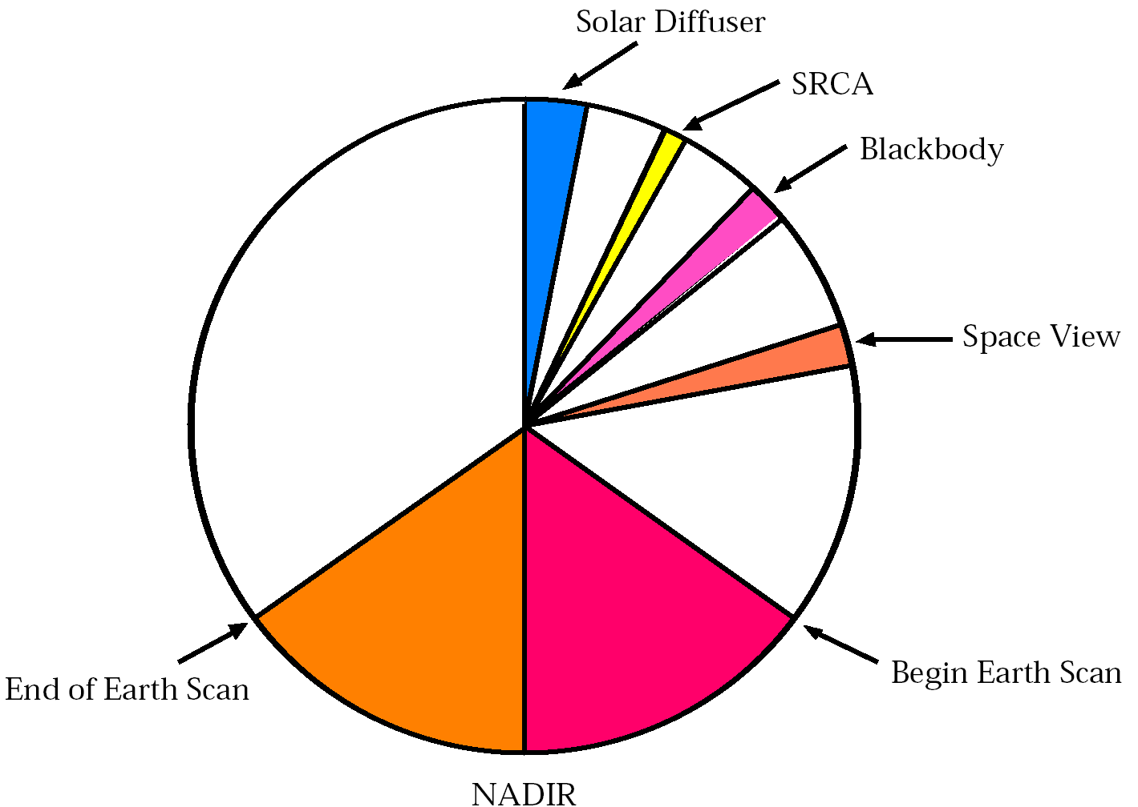
Image Acquisition Details
Scan direction
Scan sequence:
Solar diffuser
Spectroradiometric Calibration Assembly
Blackbody
Space View
Earth scan
Flight direction
1
2
3
4
5

Slide 21
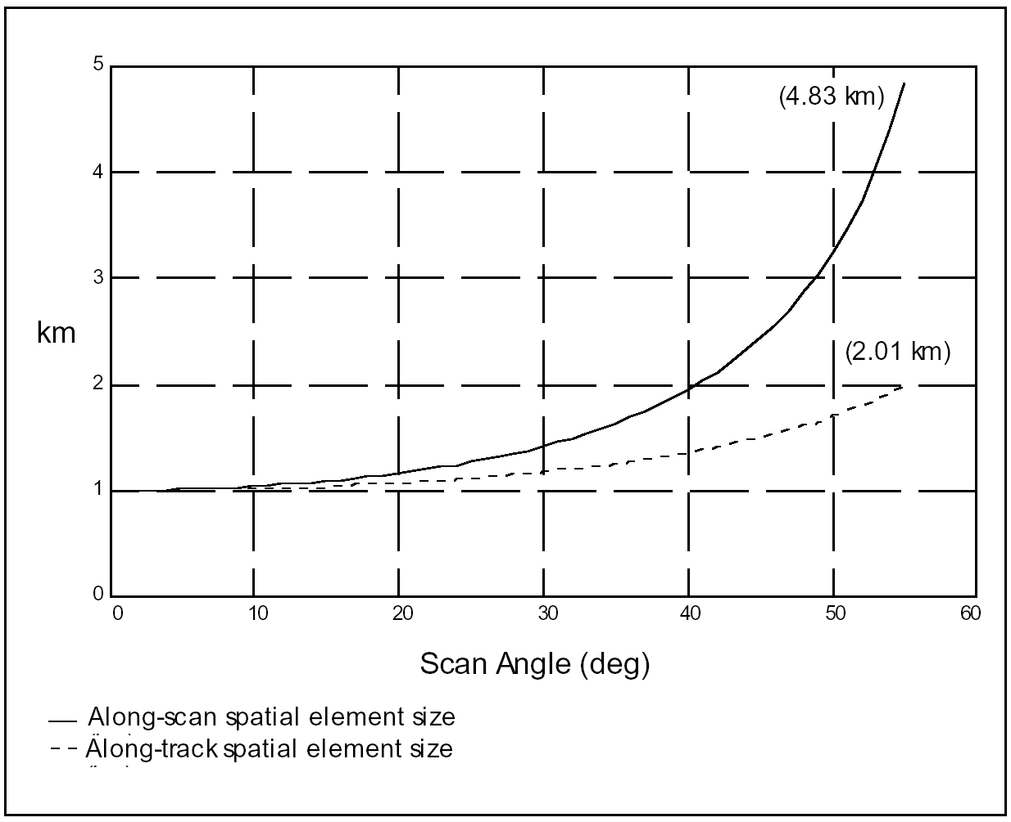
Growth of MODIS 1 km pixel with scan angle

Slide 22
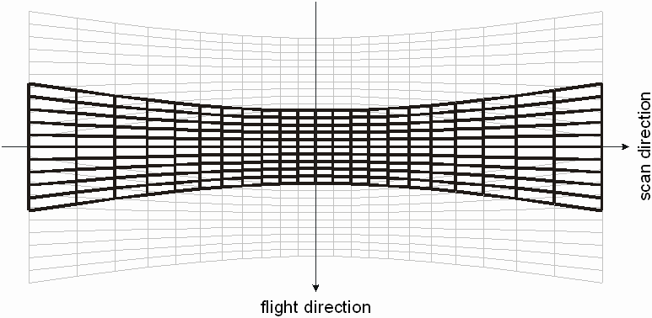
MODIS Bowtie Artifacts
Consecutive “bowtie” shaped scans are contiguous at nadir, and overlap as scan angle increases…

Slide 23
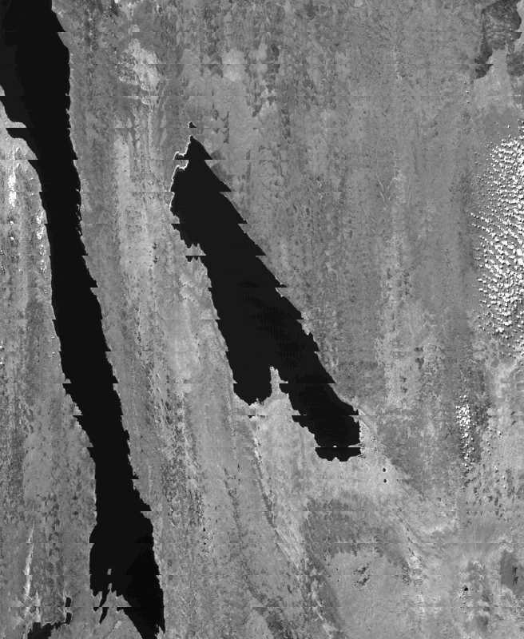
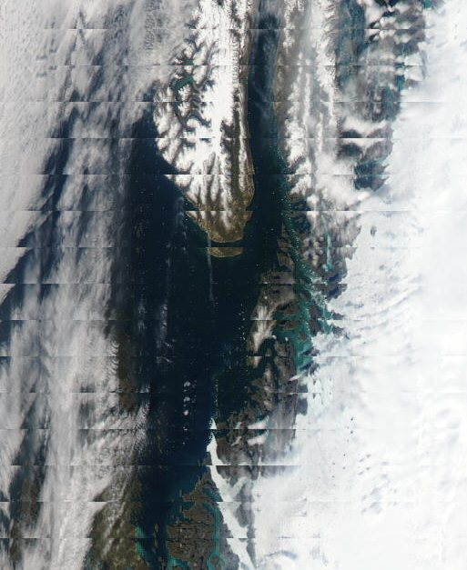
MODIS bowtie artifacts at edge of swath
Band 2 (0.87 micron)
250 meter resolution
Are not a ‘problem’: they are a consequence of the sensor design
Can be removed for visualization purposes by reprojecting the image onto a map
Do not affect science algorithms that run on a pixel-by-pixel basis or within one earth scan

Slide 24
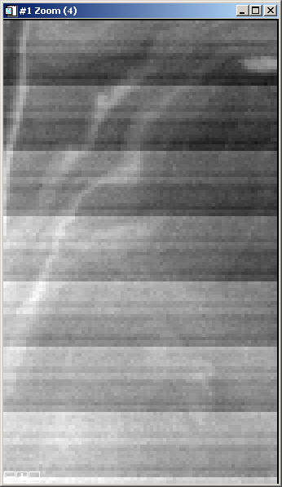
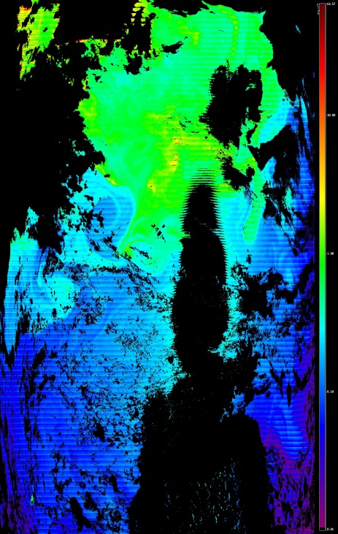
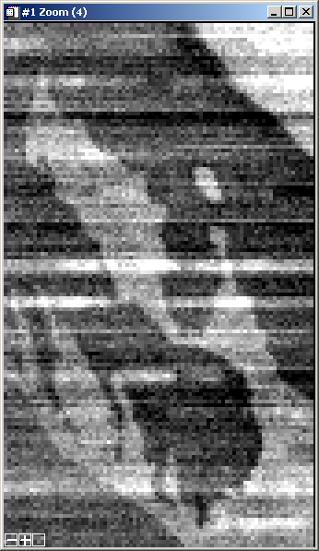
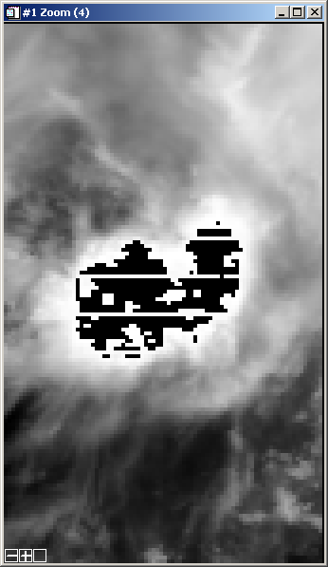
Image Artifacts
Mirror Side Striping (Band 8, 0.41 μm)
  Reflectance, emissivity, or polarization of each scan mirror side not characterized correctly.
  Can be corrected.
Noisy Detectors (Band 34, 13.6 μm)
  Detectors are noisy on a per frame basis and unpredictable from scan to scan.
  Difficult to correct.
Saturation (Band 2, 0.87 μm)
  Signal from earth scene is too large for 12 bit digitization with current gain settings.
  Workaround available.
Side 0
Side 1

Slide 25
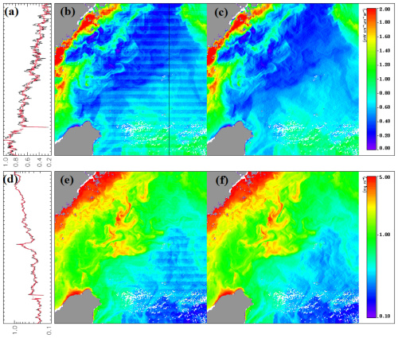
Destriping
Striping is a consequence of the calibration algorithm, where each detector is calibrated independently. If the instrument were characterized perfectly, there would be no striping.
However, it is not possible to characterize the instrument perfectly because of time, cost, and schedule constraints.
As a result, striping artifacts are introduced by
  Two-side scan mirror is not bring characterized perfectly
  Detectors behavior can change in orbit (bias, spectral response)
  Detectors may be noisy
The challenge is to design a destriping algorithm which is effective, fast, and insensitive to instrument changes.
Fig. 2 Destriping of ocean color products nL_{w}(412) (upper panels: (a)–(c)) and Chl-a concentration (lower panels: (d)–(f)) obtained by MODIS-Aqua on December 3, 2013 at around 05:05 UTC near (26°N, 123°E). The original data are shown in panels (b) and (e), while the destriped data are shown in panels (c) and (f). The values along the black line in panel (b) are plotted in panels (a) and (d) with black lines from original images (panels (b) and (e)) and red lines from destriped images (panels (c) and (f)).
Karlis Mikelsons, Menghua Wang, Lide Jiang, and Marouan Bouali, "Destriping algorithm for improved satellite-derived ocean color product imagery," Opt. Express 22, 28058-28070 (2014)
http://www.opticsinfobase.org/oe/abstract.cfm?URI=oe-22-23-28058

Slide 26
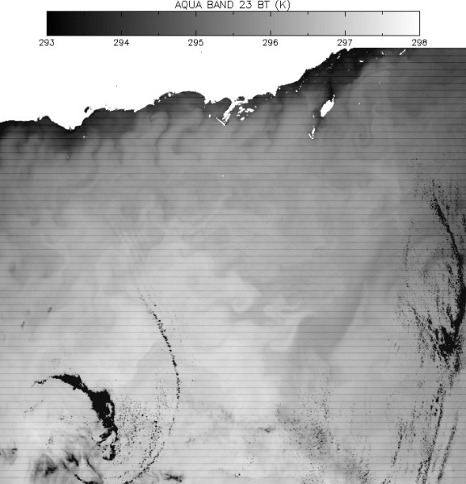

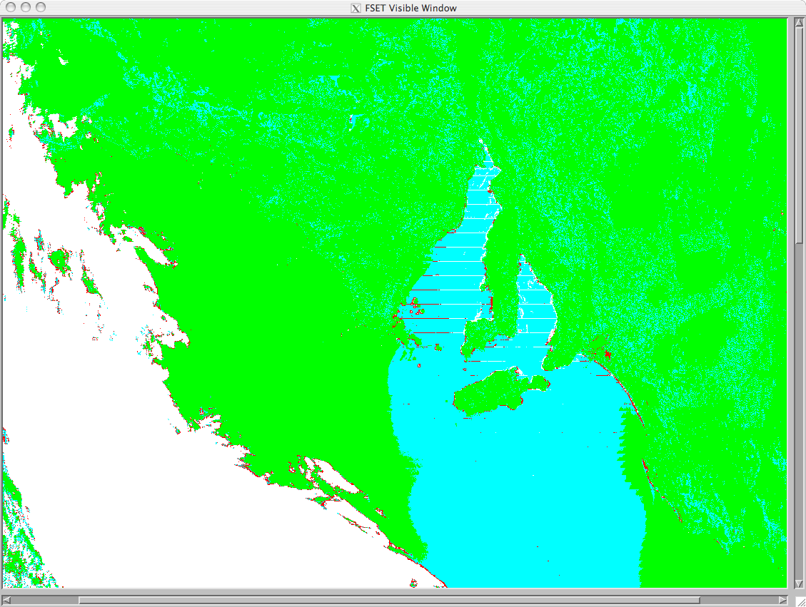

MODIS Emissive Band Destriping:
Granule vs. Daily Analysis
The Atmosphere Group products for Collection 5 and 6 include detriping of all emissive bands (20-25, 27-36) and band 26.
The destriping algorithm is granule-based, and for a small percentage of granules, the impact may be equivocal in bands 31 and 32.
Granules with sharp transitions between warm and cold scenes (e.g. hot land, cool ocean) may have artifacts in the scene transition zone.
With Stripes
Destriped
Cloud Mask Final Result,
Granule-Based Destriping
Cloud Mask Final Result, Daily-Based Destriping

Slide 27
MODIS Cloud Products
ATMO 611 – Satellite Data Applications
Jennifer D. S. Griswold

Slide 28
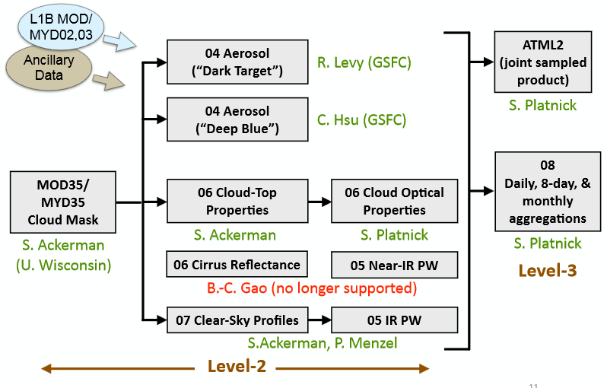
MODIS Atmosphere Team Product Organization and People
MODIS Atmosphere Team C6 Webinar

Slide 29
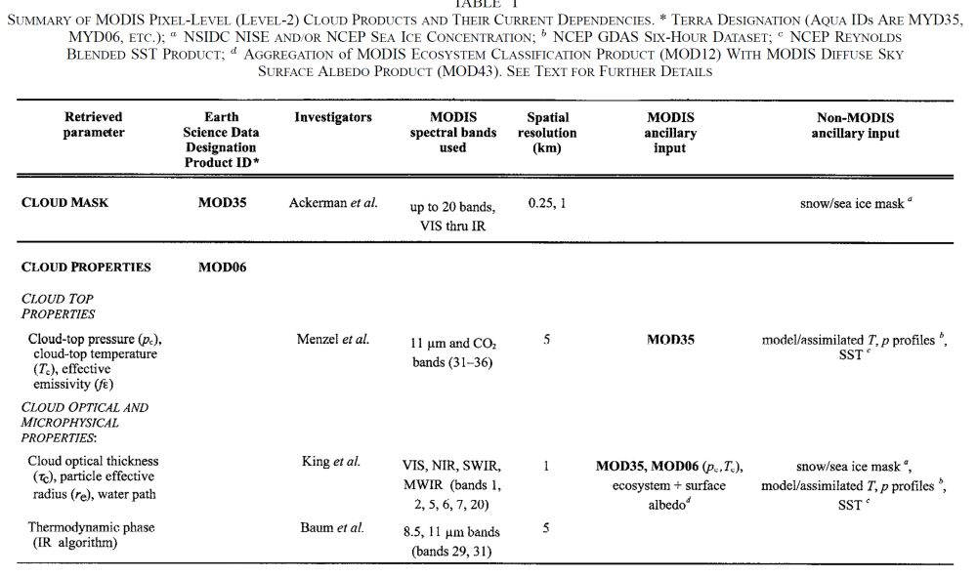
Table 1 –Platnick et al 2003
Thermal IR
Solar Reflectance
Thermal IR

Slide 30
Primary Use for Reflected Solar Band
Primary Use | Band | Bandwidth¹ | Spectral Radiance² | Required SNR³
Land/Cloud/Aerosols Boundaries | 1 | 620 - 670 | 21.8 | 128
 | 2 | 841 - 876 | 24.7 | 201
Land/Cloud/Aerosols Properties | 3 | 459 - 479 | 35.3 | 243
 | 4 | 545 - 565 | 29.0 | 228
 | 5 | 1230 - 1250 | 5.4 | 74
 | 6 | 1628 - 1652 | 7.3 | 275
 | 7 | 2105 - 2155 | 1.0 | 110
Ocean Color/ Phytoplankton/ Biogeochemistry | 8 | 405 - 420 | 44.9 | 880
 | 9 | 438 - 448 | 41.9 | 838
 | 10 | 483 - 493 | 32.1 | 802
 | 11 | 526 - 536 | 27.9 | 754
 | 12 | 546 - 556 | 21.0 | 750
 | 13 | 662 - 672 | 9.5 | 910
 | 14 | 673 - 683 | 8.7 | 1087
 | 15 | 743 - 753 | 10.2 | 586
 | 16 | 862 - 877 | 6.2 | 516
Atmospheric Water Vapor | 17 | 890 - 920 | 10.0 | 167
 | 18 | 931 - 941 | 3.6 | 57
 | 19 | 915 - 965 | 15.0 | 250
Bands 1 to 19 are in nm; Bands 20 to 36 are in µm Spectral Radiance values are (W/m² -µm-sr)

Slide 31
Primary Use for Each Thermal Band
Primary Use | Band | Bandwidth¹ | Spectral Radiance² | Required NE[delta]T(K)
Surface/Cloud Temperature | 20 | 3.660 - 3.840 | 0.45(300K) | 0.05
 | 21 | 3.929 - 3.989 | 2.38(335K) | 2.00
 | 22 | 3.929 - 3.989 | 0.67(300K) | 0.07
 | 23 | 4.020 - 4.080 | 0.79(300K) | 0.07
Atmospheric Temperature | 24 | 4.433 - 4.498 | 0.17(250K) | 0.25
 | 25 | 4.482 - 4.549 | 0.59(275K) | 0.25
Cirrus Clouds Water Vapor | 26 | 1.360 - 1.390 | 6.00 | 150(SNR)
 | 27 | 6.535 - 6.895 | 1.16(240K) | 0.25
 | 28 | 7.175 - 7.475 | 2.18(250K) | 0.25
Cloud Properties | 29 | 8.400 - 8.700 | 9.58(300K) | 0.05
Ozone | 30 | 9.580 - 9.880 | 3.69(250K) | 0.25
Surface/Cloud Temperature | 31 | 10.780 - 11.280 | 9.55(300K) | 0.05
 | 32 | 11.770 - 12.270 | 8.94(300K) | 0.05
Cloud Top Altitude | 33 | 13.185 - 13.485 | 4.52(260K) | 0.25
 | 34 | 13.485 - 13.785 | 3.76(250K) | 0.25
 | 35 | 13.785 - 14.085 | 3.11(240K) | 0.25
 | 36 | 14.085 - 14.385 | 2.08(220K) | 0.35
*Bands 1 to 19 are in nm; Bands 20 to 36 are in µm NE(delta)T = Noise-equivalent temperature difference

Slide 32
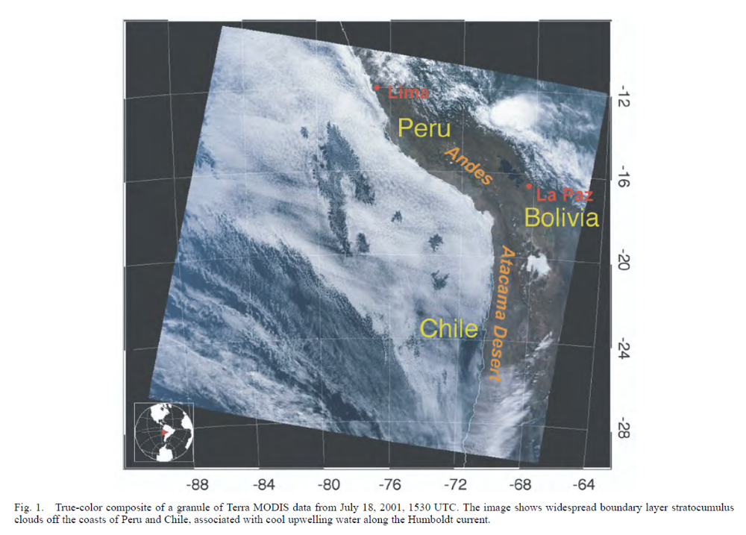
Example Granule (Platnick et al, 2003)

Slide 33
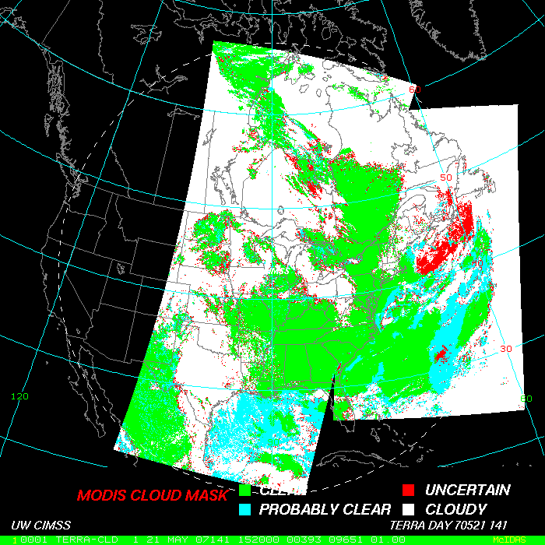
Cloud Mask
Ackerman, Frey, UW MODIS Group
Is the primary ancillary input to other algorithms
Produced globally day and night
1 km-pixel resolution
Uses as many as 20 (of 36) bands
Assesses the likelihood of a pixel being obstructed by clouds
Allows for “clear sky confidence” – i.e. varying degrees of cloudiness instead of “yes cloud-no cloud”

Slide 34
Cloud Mask - Algorithm Development
Built upon work done by others:
  ISCCP – Rossow and Garder 1993
  CLAVR – Stowe et al. 1991
  APOLLO – Saunders and Kriebel 1988
New spectral channels – new tests
  1.38 micron high cloud reflectance test
Many spectral channels (more later)
  more tests go into final product
  first platform with 8-11 (can use tri-spectral tests)

Slide 35
Cloud Mask
48 bits of output per pixel
Individual cloud test results
Processing path
Land/Sea Tag
Classification of Cloud Contamination
    Confident Clear
    Probably Clear
    Uncertain/Probably Cloudy
    Cloudy

Slide 36
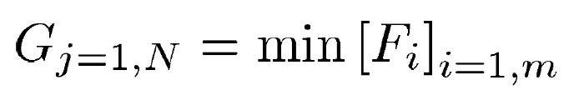
Cloud Mask
Determine surface type (both Day and Night)
  Land, water, snow/ice, desert, coast
Threshold Tests
  Clouds, aerosol in FOV
“Clear” Confidence Level
  1 = high confidence clear
  0 = low confidence clear
Different tests
  Detection of different cloud conditions
  Grouped together for detecting similar cloud conditions
Minimum Confidence of Each Group
F_{i} = the confidence level of an individual spectral test
m = number of tests in a given group
j = the group index
N = Number of groups

Slide 37
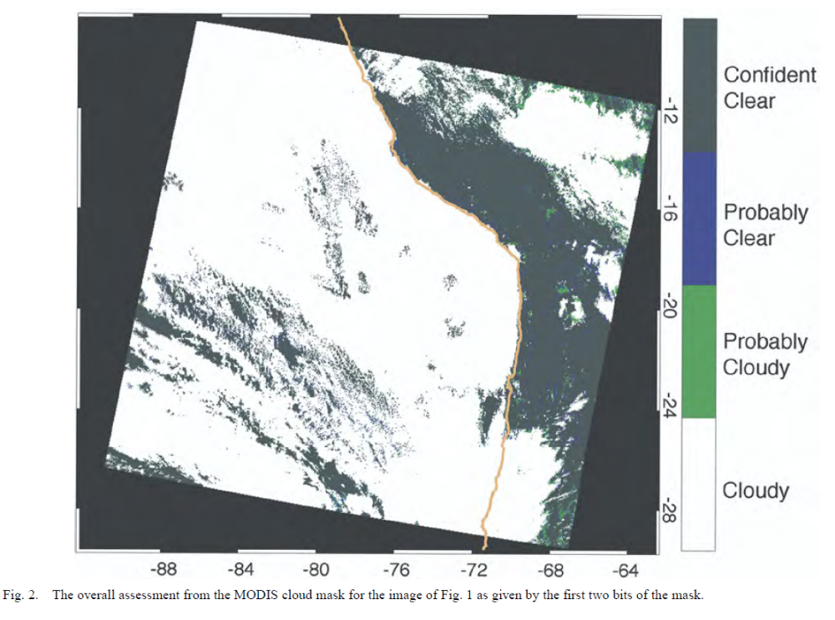
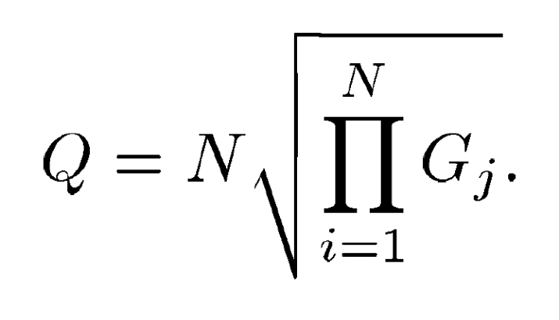
Cloud Mask
Final Cloud Mask Confidence
Q = final cloud mask confidence
N = Number of Groups
G_{j} = Minimum confidence of group
Clear-Sky Conservative
  If highly confident it is cloudy (Fi = 0) then the final clear-sky confidence is 0.
Confidence Levels (OF BEING CLEAR!!)
  Confident Clear (Q > 0.99)
  Probably Clear (Q > 0.95)
  Uncertain/Probably Cloudy (Q > 0.66)
  Cloudy (Q ≤ 0.66). (not clear)
FIRST TWO BITS of the MASK

Slide 38
Cloud Mask
Difficult Over
  Non-vegetated surfaces
  Transitional areas (Desert-Vegetation)
  High-elevations
    Mountains
    Antarctica plateau
  Sunglint regions (later)
  Nighttime masking during strong temp inversions
Uncertain/Probably Cloudy
  Usually near cloud edges
Probably Clear
  Isolated regions over land, away from cloud edges

Slide 39
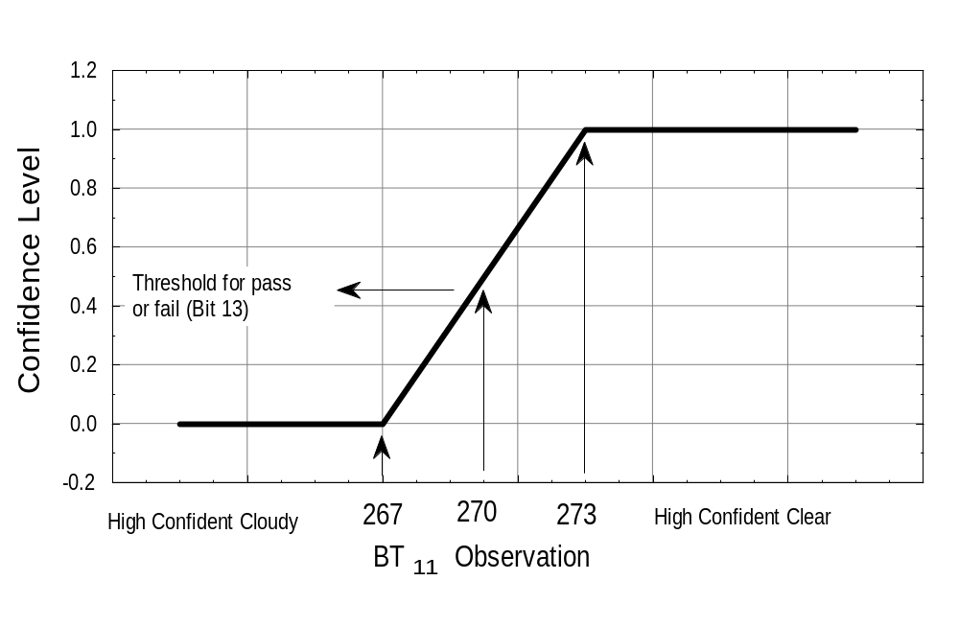
Confidence Level of Clear
Example thresholds for the simple IR window cold cloud test.
Notes:
Example of simple IR confidence test. Confidence of 1 meand high confidence clear region.

Slide 40
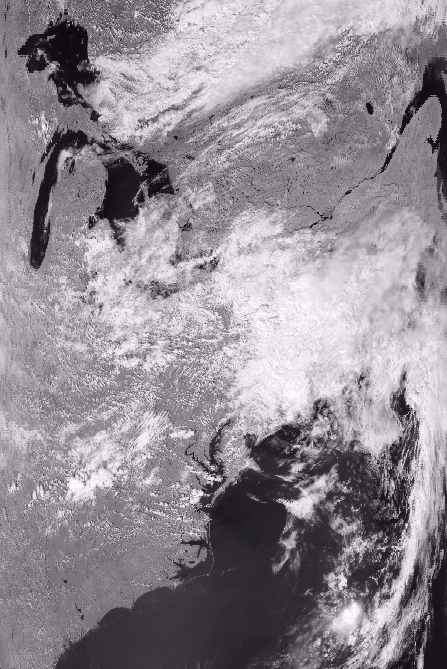
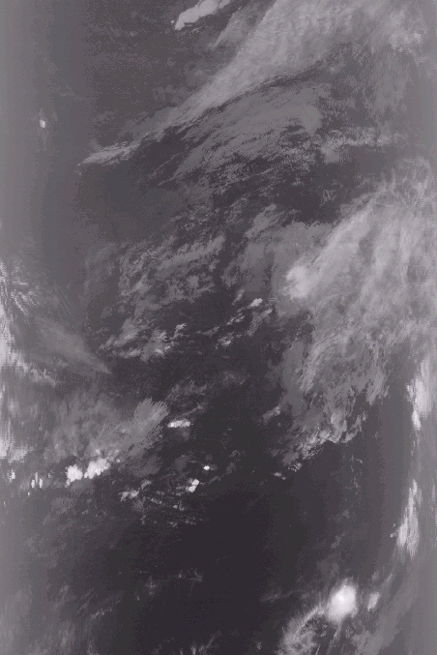
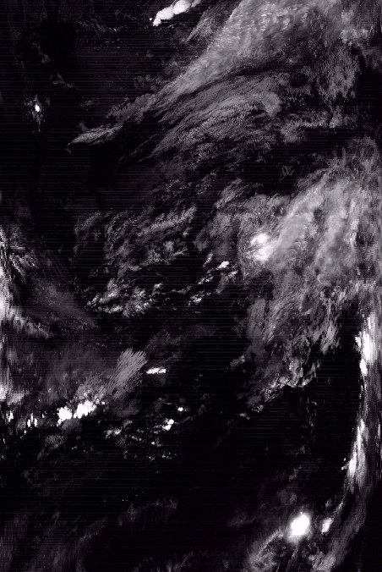
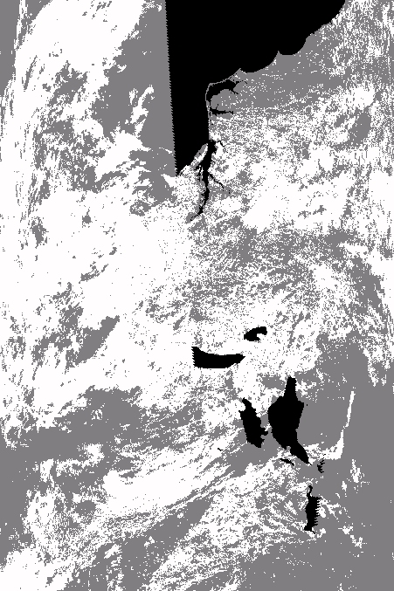
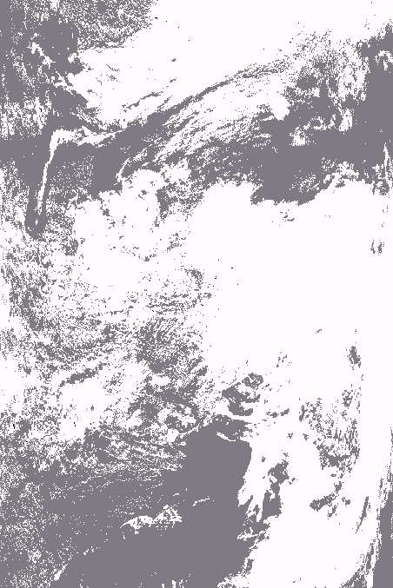

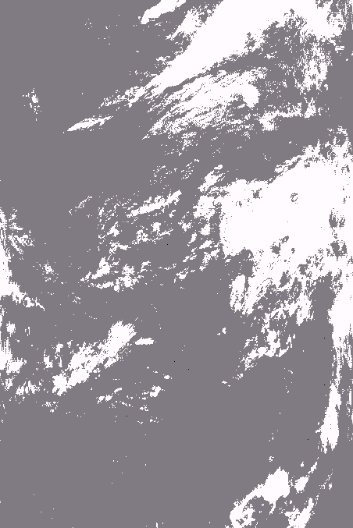
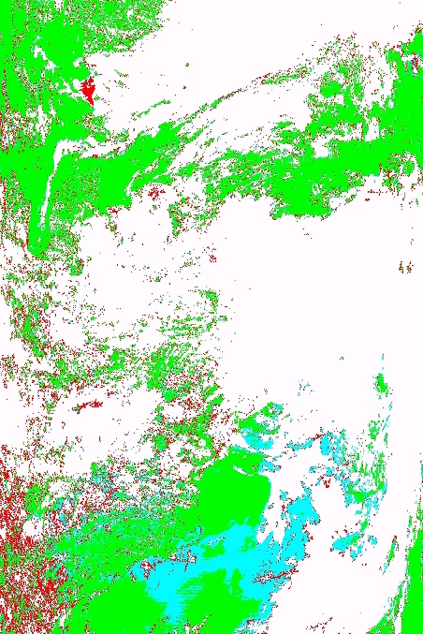
MODIS 0.86 µm
MODIS 13.9 µm
MODIS 1.38 µm
Cloud Mask 3.9-11 µm Test
Cloud Mask Visible Test
Cloud Mask 13.9 µm Test
Cloud Mask 1.38 µm Test
Final Cloud Mask

Slide 41
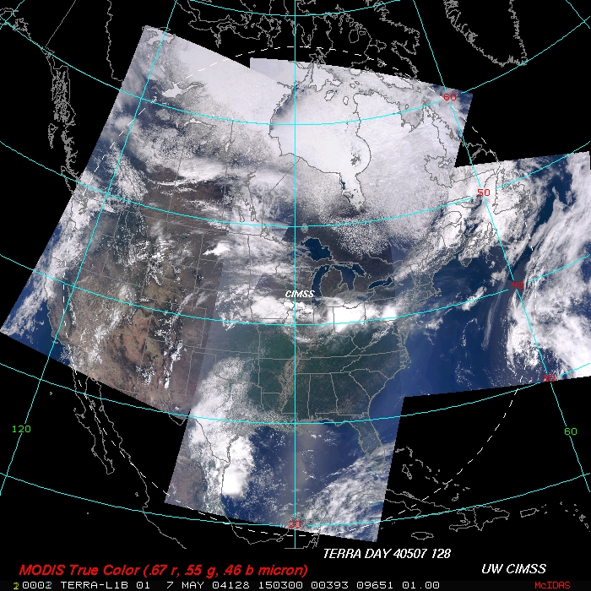

Slide 42
