Slide 1

MODIS Cloud Products
MET 611 – Satellite Data Applications
Jennifer D. S. Griswold

Slide 2
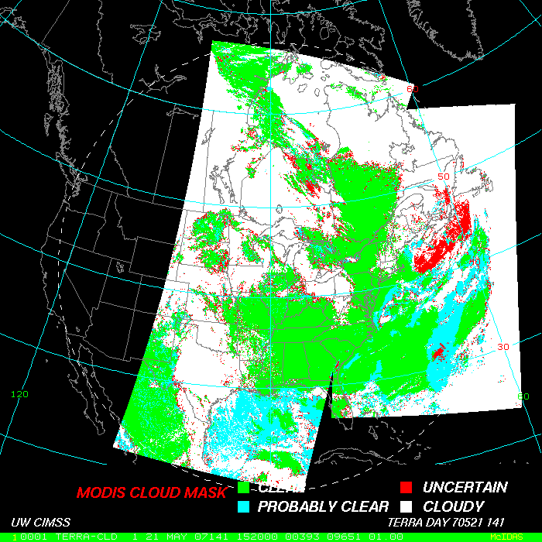
Cloud Mask
48 bits of output per pixel
Individual cloud test results
Processing path
Land/Sea Tag
Classification of Cloud Contamination
    Confident Clear
    Probably Clear
    Uncertain/Probably Cloudy
    Cloudy

Slide 3
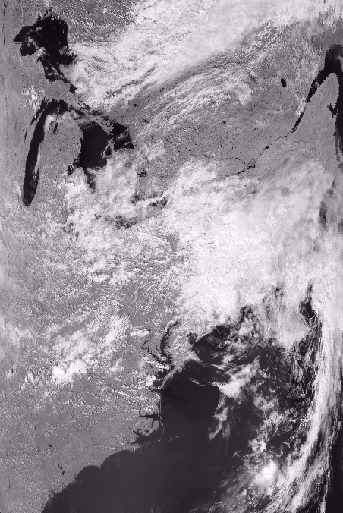
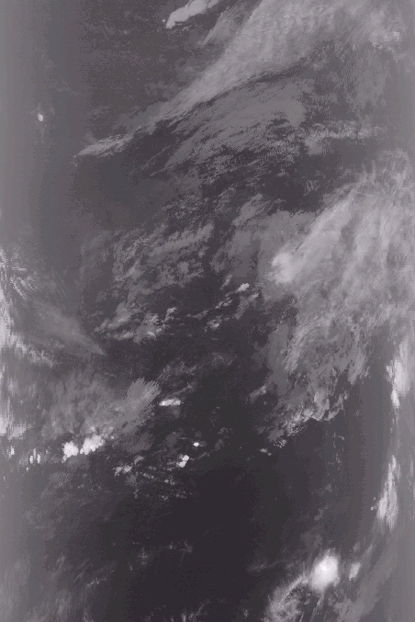
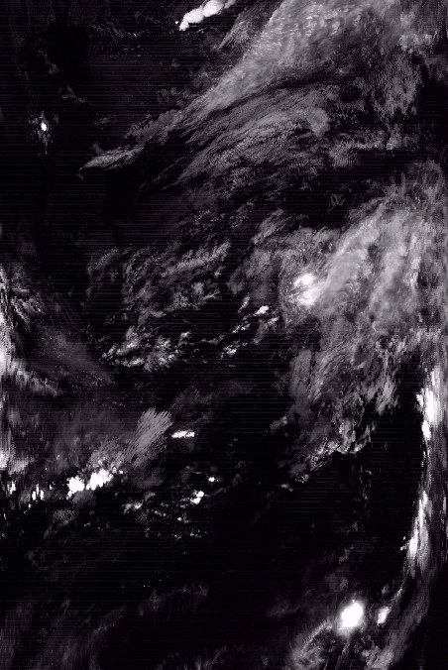
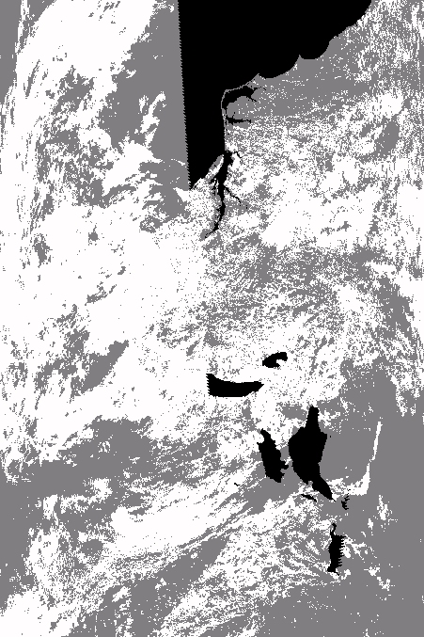
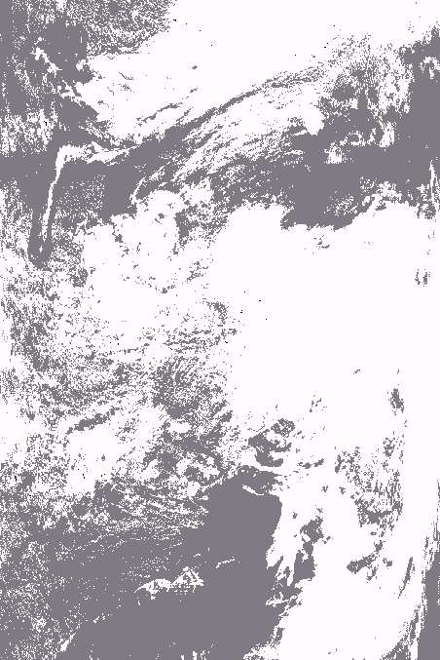

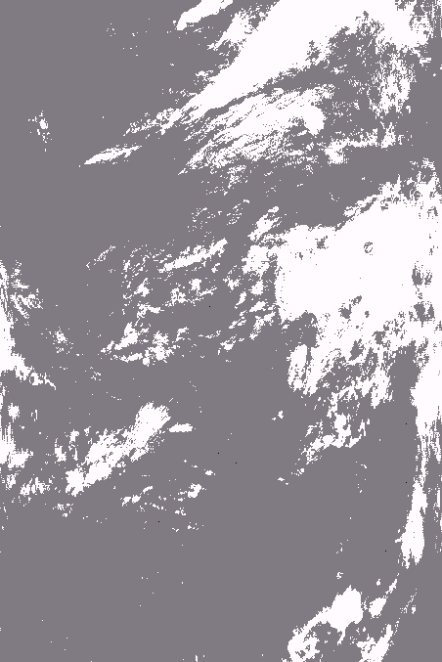
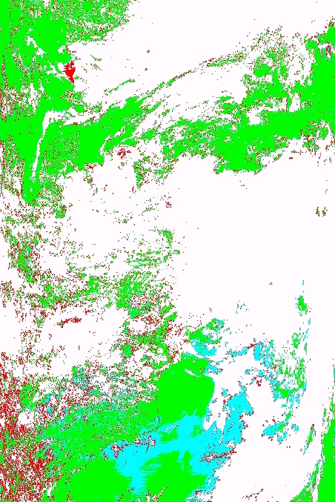
MODIS 0.86 µm
MODIS 13.9 µm
MODIS 1.38 µm
Cloud Mask 3.9-11 µm Test
Cloud Mask Visible Test
Cloud Mask 13.9 µm Test
Cloud Mask 1.38 µm Test
Final Cloud Mask

Slide 4
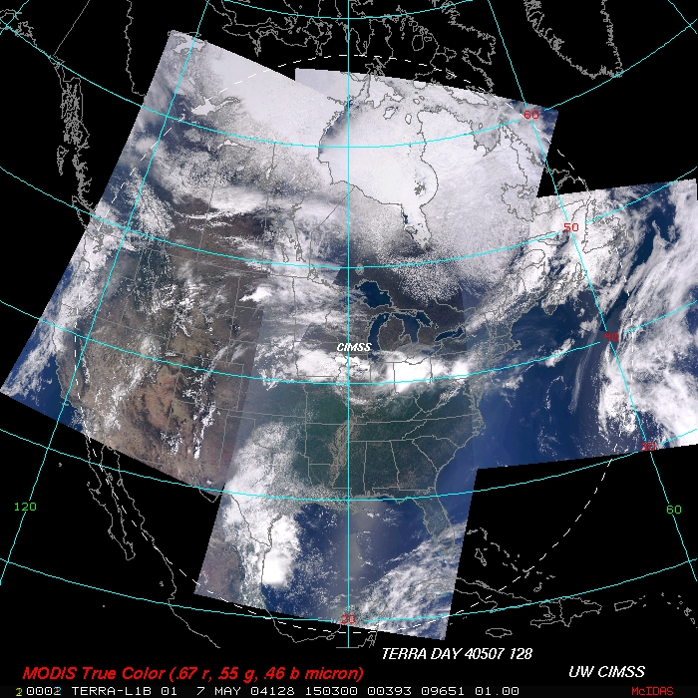

Slide 5
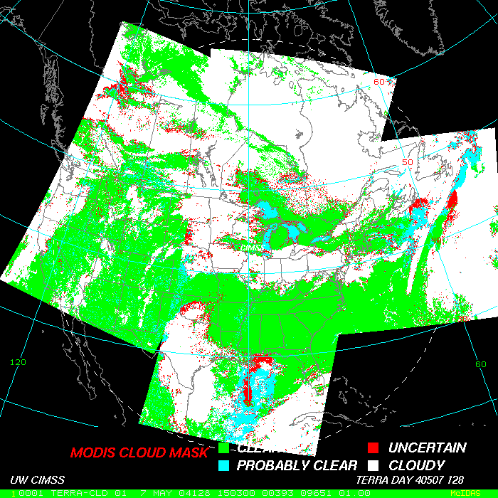

Slide 6
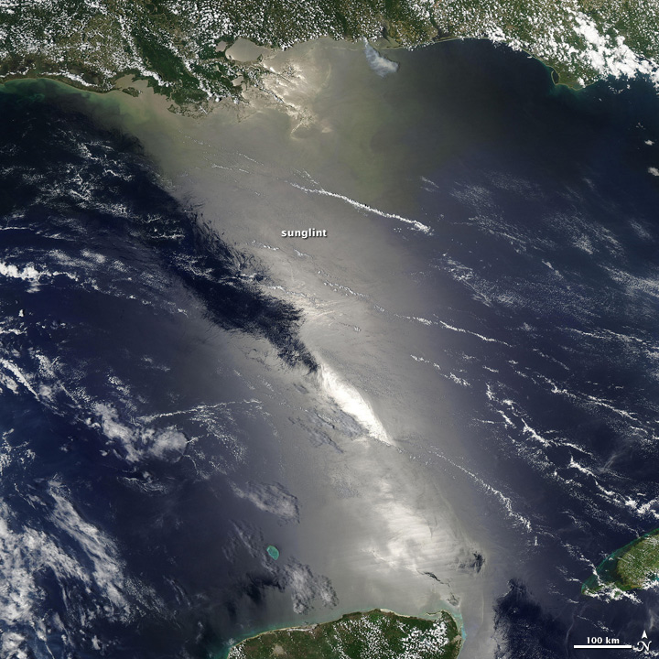
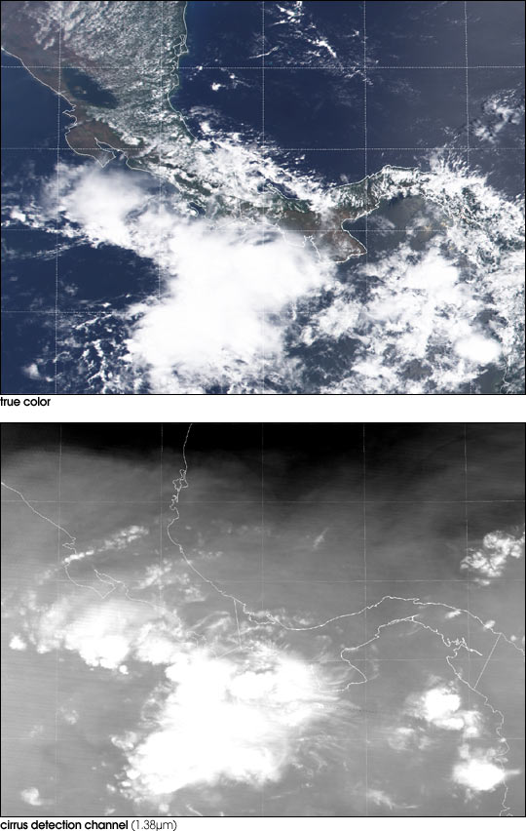
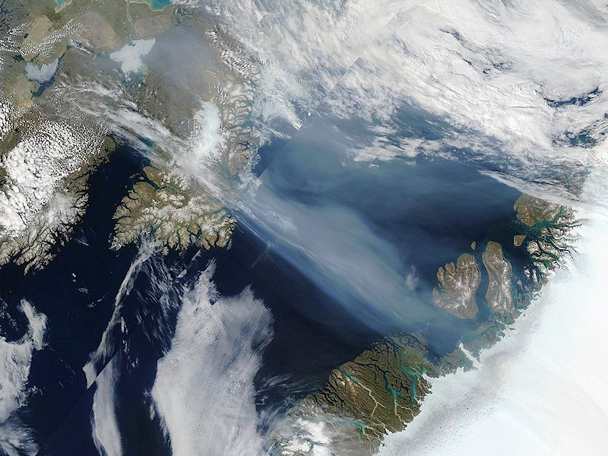
Cloud Mask Issues
Sunglint
Sub-Visible Cirrus
Non-Cloud Issues

Slide 7
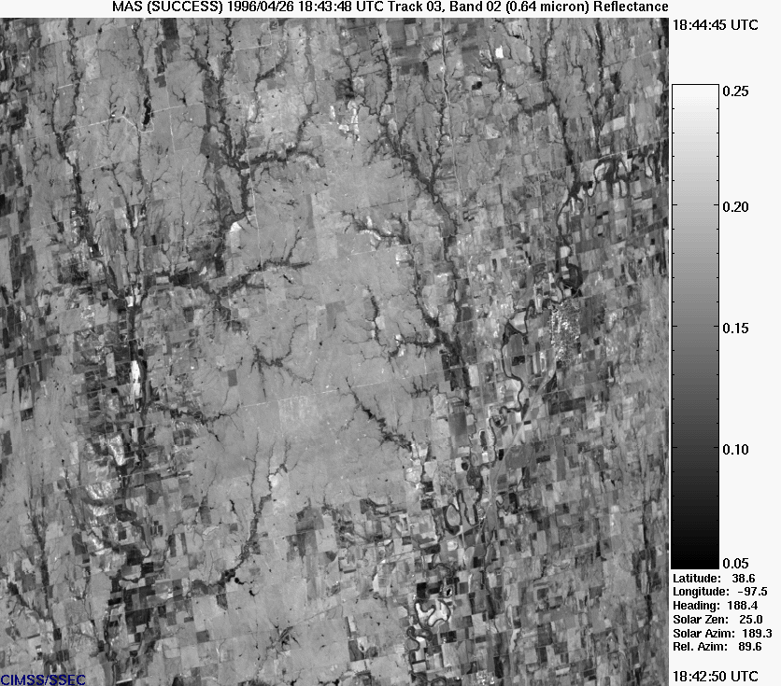
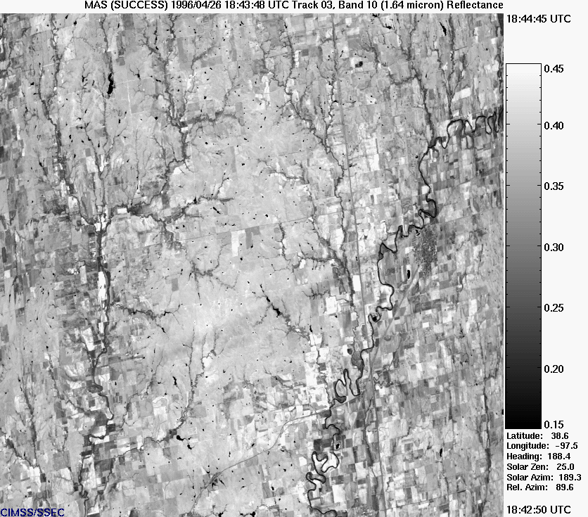
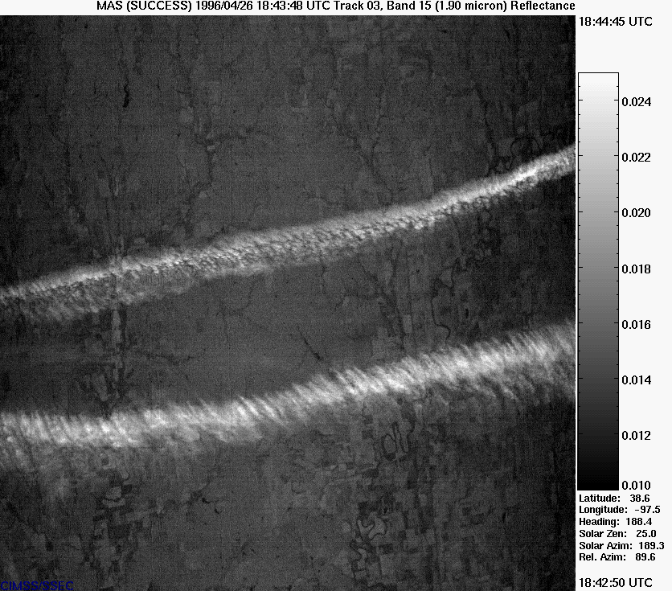
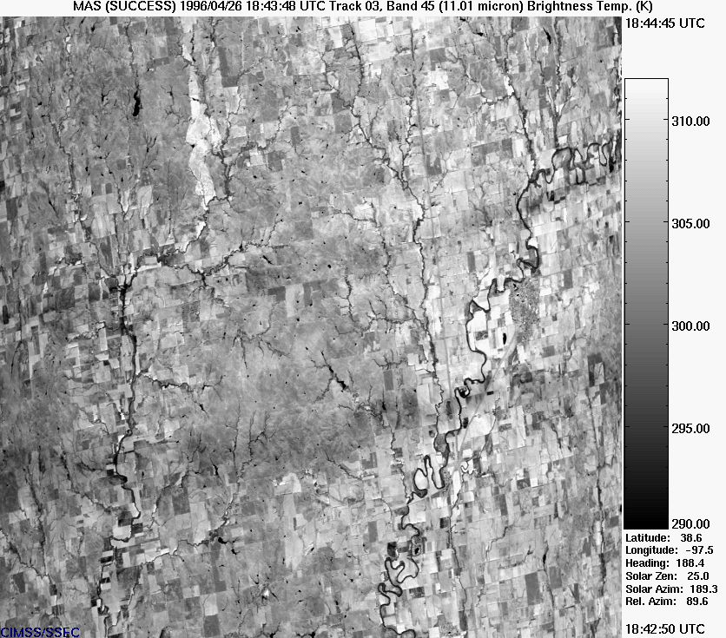
Cirrus Issues
0.64
1.64
1.38
11.01
Notes:
Cirrus often goes undetected in the IR window as well as the visible channel.
The MAS 1.90 channel (in an H2O absorption region) sees only the upper
half of the troposphere and easily reveals cirrus undetected in the vis and IR window.
MODIS has a 1.38 um channel that has the same attributes. It is considerable interest
to discover how much cirrus has gone undetected to date.

Slide 8
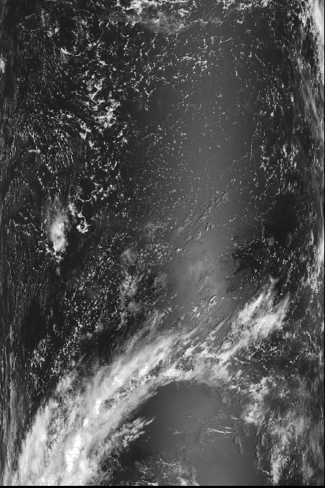
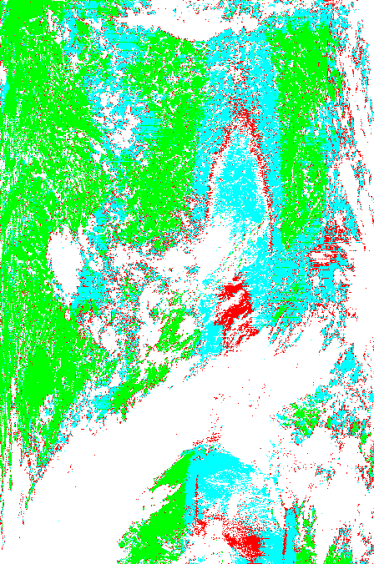
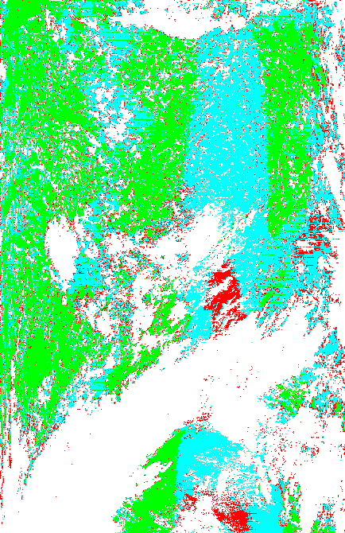
Sunglint Issues
MODIS Band 2 Image
Collection 4
Collection 5
A threshold change was made to minimize the occurrence of uncertain and cloudy “rings” around the perimeter of sun-glint regions.

Slide 9
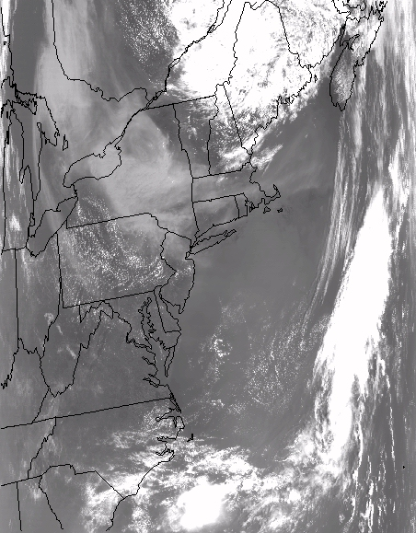
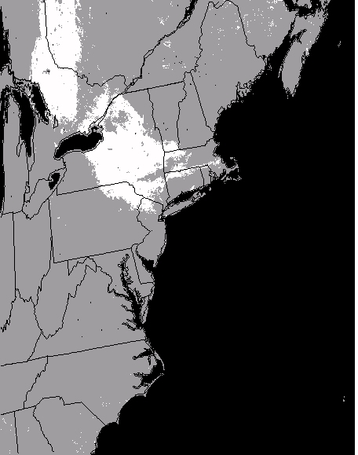
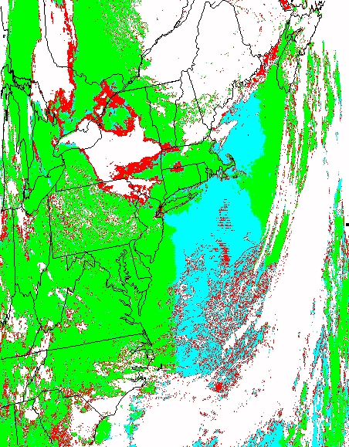
Non-Cloud Issues - “Smoke Mask”
Terra MODIS band 3, “smoke mask”, and cloud mask for 6 July, 2002, 15:50 UTC.

Slide 10
CO₂ Slicing Method
See papers (Menzel et al. 1983, Wylie and Menzel 1999).
Used to infer
  cloud-top pressure
  effective cloud amount
  Or emissivity (product of cloud fraction and cloud emissivity at 11 μm)
Ratio of deviations in cloud produced radiances and clear air radiances
Optimum Cloud Top Pressure
Effective Cloud Amount
Ratios of three CO2 spectral channels – Derive most representative cloud height

Slide 11
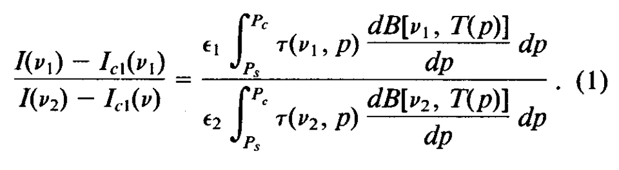
CO₂ Slicing Method
Ratio of deviations in cloud produced radiances and clear air radiances
I(v) = cloud radiances
I_{cl}(v) = clear air radiances
v₁ = spectral channel frequency one
v₂ = spectral channel frequency two
Є = cloud emittance
P_{s} = surface pressure
τ(v,p) = fractional transmittance of radiation of frequency v emitted from the atmospheric pressure level (p) arriving at the top of the atmosphere (p=0).
B_{v}[v, T(p)] = the Planck radiance of frequency v for temperature T(p).
From observed radiances and clear air radiances calculated from a temperature and moisture profile
From a temperature profile and the profiles of atmospheric transmittance for the spectral channels as a function for Pc, the cloud to pressure.

Slide 12
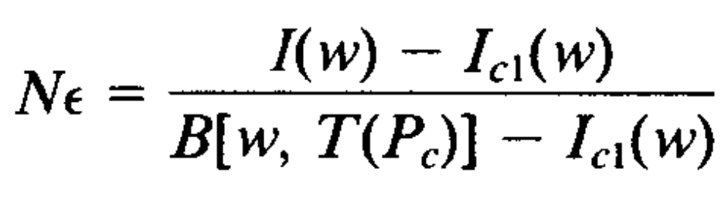
CO₂ Slicing Method
Optimum Cloud Top Pressure
When the absolute difference is a minimum.
Assumptions
  The cloud has infinitesimal thickness (Error ½ cloud thickness)
  The cloud emittance is the same for the two spectral channels
Effective Cloud Amount
Evaluated from the IR window channel using the equ to right:
N = fractional cloud cover in FOV
N_{Є} = effective cloud amount
w = window channel frequency
B[w, T(P_{c})] = opaque cloud radiance

Slide 13
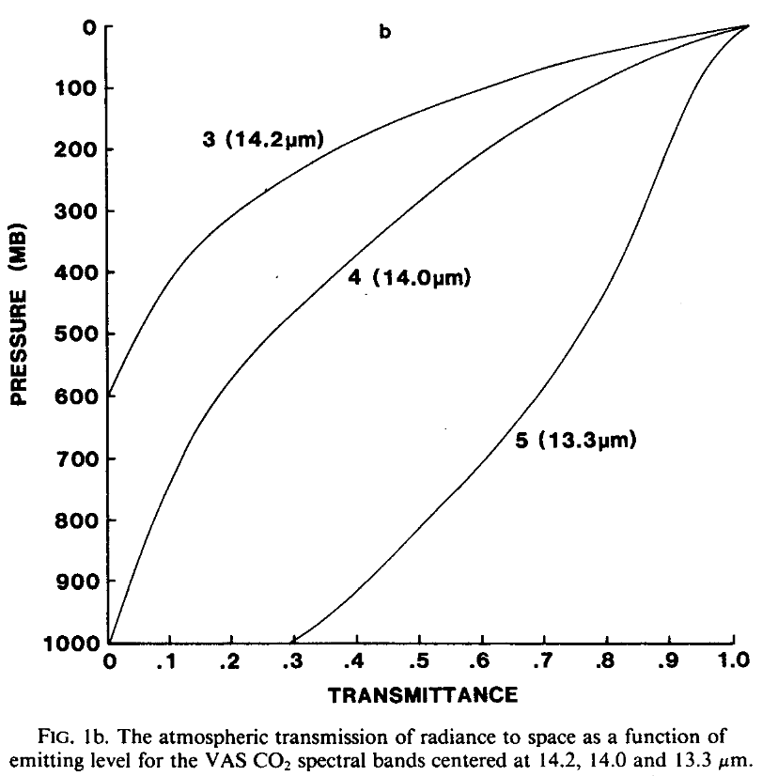
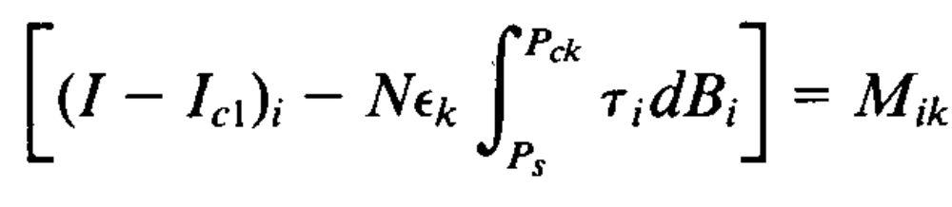
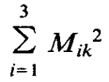
CO₂ Slicing Method
Ratios of three CO2 spectral channels – Derive most representative cloud height
Two Cloud to Pressures derived from the ratios of:
  14.2/14.0 (band 3/band 4)
  14.2/13.3 (band 3/band 5)
The algorithm checks the differences between (I-Icl) and those calculated from the radiative transfer equation.
P_{ck} is chosen when is a minimum and the sum is over the three CO2 channels used to derive the cloud top pressure values.
I = cloud radiance
I_{cl} = clear sky radiance
N_{Єk} = effective cloud amount
P_{S} = surface pressure
P_{ck} = most representative cloud height
τ_{i} = fractional transmittance
B_{i} = Planck radiance

Slide 14
MODIS CO₂ Slicing Method
Takes advantage of differing partial absorption in several of the MODIS infrared bands
  Each band is sensitive to a different level in the atmosphere
  Clouds appear in the CO2-band images according to their level in the atmosphere
    Low clouds will not appear at all in the high-absorption bands
    High clouds will appear in all bands
Has the ability to retrieve cloud pressure and effective cloud amount for:
  Opaque
  Non-opaque
Mid-High Level Clouds

Slide 15
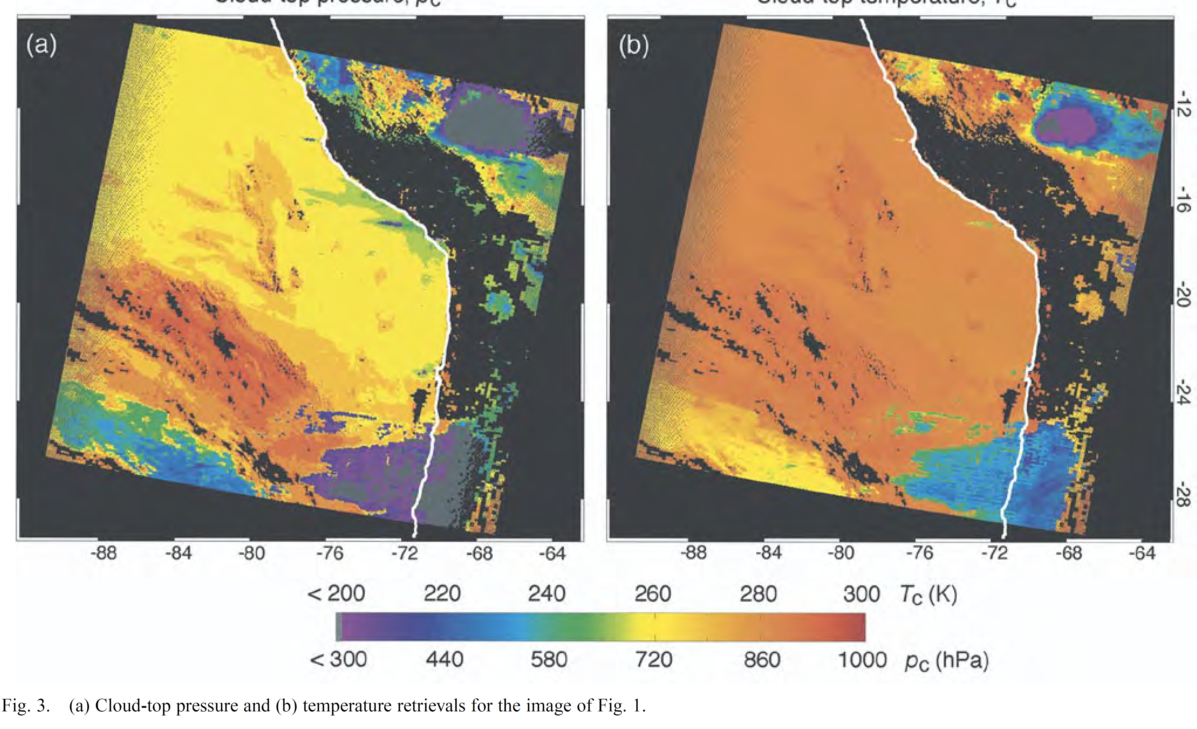
Cloud Top Pressure and Temp
MODIS Cloud-Top Pressures are calculated for (μm/μm):
  14.2/13.9 139/13.6 13.6/13.3 13.9/13.3 13.3/11
CO2 Slicing gives you pressure and emissivity at 5x5 km
GDAS met profile
NCEP blended SST
Pressure → Temperature
Algorithm run for both day and night
Uses cloud mask (4 out of 25 pixels have to be probably cloudy or cloudy)
← ICE CLOUD ONLY

Slide 16
Thermodynamic Phase
Inferences
  Bispectral IR algorithm uses the inherent difference in water and ice optical constants
  Optical constant differences between water and ice in selected SWIR (1.6, 2.1 μm)
  Logic based “decision tree” using cloud mask results, IR, SWIR, and CTT
Brightness Temperature Differences (BTD) between 8.5 and 11 μm
  Difference in the optical and microphysical properties between water drops and ice crystals
  Positive for ice clouds (visible optical thickness > 1)
  Negative for water clouds (high optical thickness)
  Lower clouds are negative (with increased water vapor)
  Can be used for both day and night
Multilayer clouds are difficult

Slide 17
Thermodynamic phase example

Slide 18
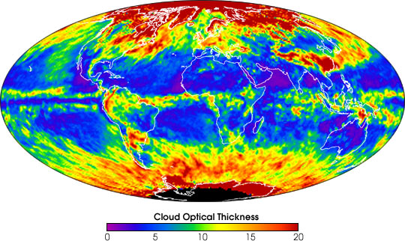

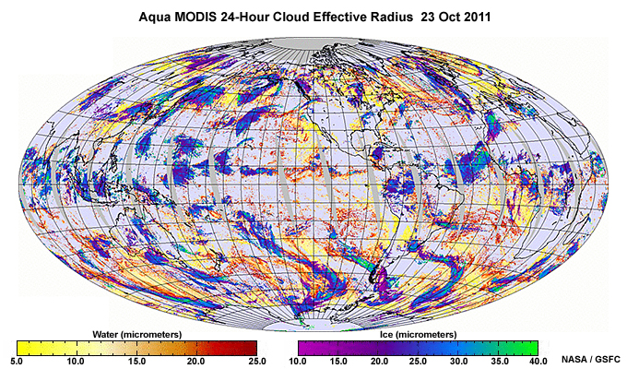
Cloud Optical Thickness &
Microphysical Properties
COT = Vertical integration of extinction over cloud thickness
Effective Radius (R_{e}) = ratio of the third moment of the size distribution to the second moment
Useful bands include
  Visible
  IR
  SWIR (1.6 and 2.1 um)
  MWIR
Retrieved at 1 km resolution
  “library calculations”
  Plane-parallel homogenous clouds overlying a black surface with no atmosphere

Slide 19
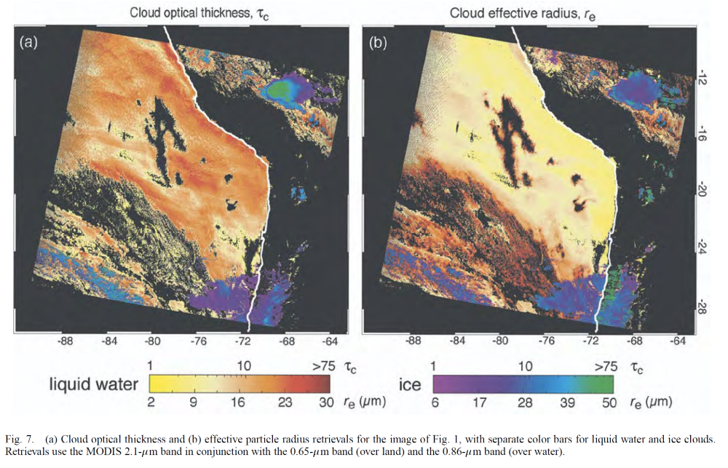
COT and R_{e} Examples

Slide 20
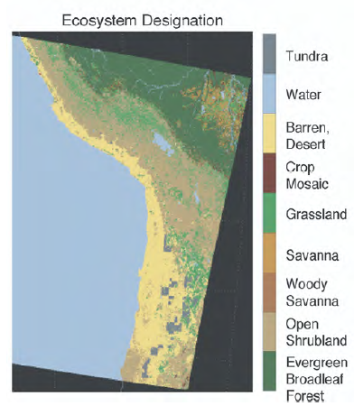
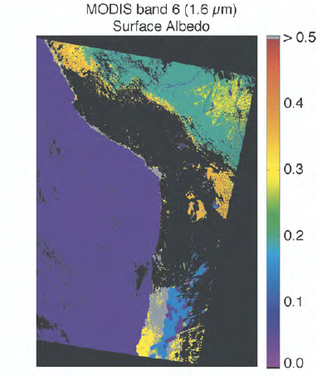
Cloud Optical Thickness & Microphysical Properties- ISSUES
When to retrieve?
  Clear vs. cloudy – “not clear” does not mean it’s suitable for retrieval of COT and Re
Surface Albedo and Ecosystem ID
  Cloud reflectance over land may be significantly affected by the underlying surface albedo!

Slide 21
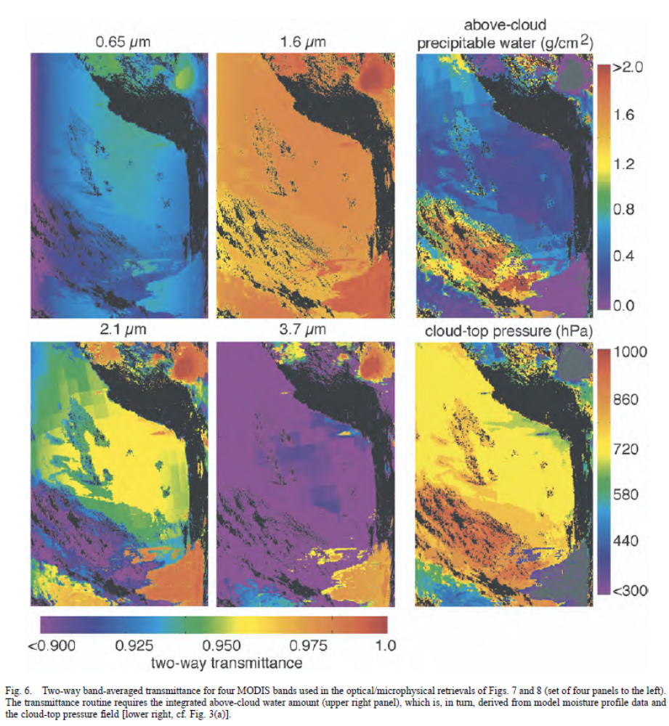
Cloud Optical Thickness & Microphysical Property- ISSUES
Atmospheric Correction
  In-cloud gaseous absorption decreases the apparent cloud particle single scattering albedo
  Above cloud water vapor
  Absorption by trace gases above cloud
Retrievals
  Derived from water absorbing bands (1.6, 2.1, 3.7 μm ) and
  Nonabsorbing bands (0.65, 0.86, 1.2 μm) to minimize surface reflectance
  0.65 and 0.86 μm for land, 1.2 μm for ocean

Slide 22
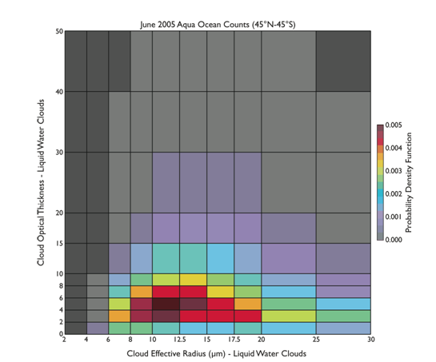
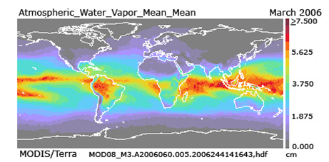
Some Strengths of Standard Level -3
Many different parameters (over 100)
Many different statistics (over 20)
Multiday files fill orbit gaps (full global coverage)
Efficient study of global statistics & longer term trends
Joint histograms show cross-parameter relationships *
Useful in quality and debug efforts of L2 inputs ** (L3 browse)
*
**
Notes:
Broad and Vast Spectrum of Information allowed by the relatively coarse grid resolution … On the fly images available on the web site … faster detection of problems

Slide 23
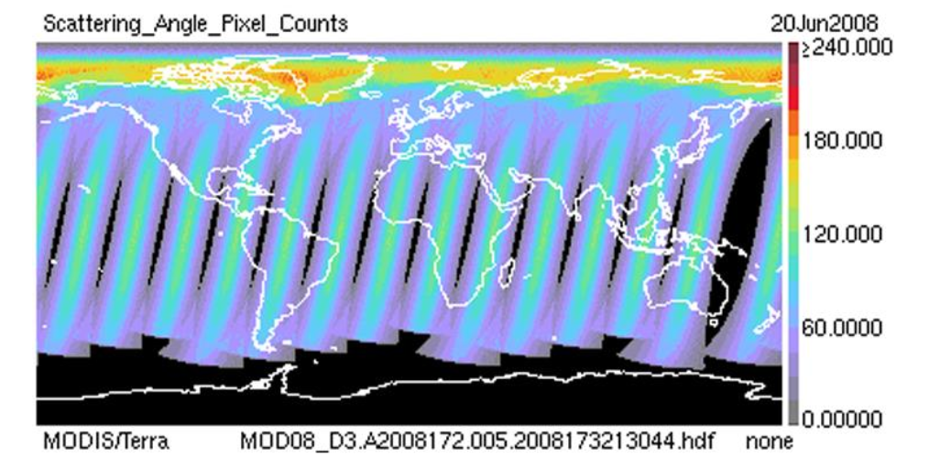
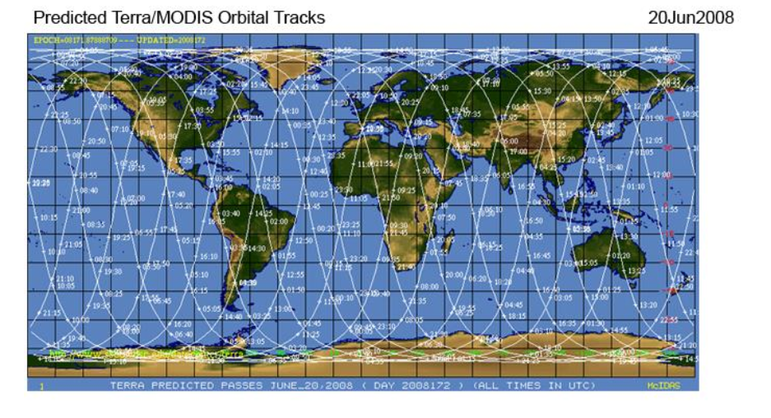
Some Limitations of Standard Level -3
Fixed map projection (Lat-Lon)
Fixed relatively coarse resolution (1˚)
Fixed parameter set (per Collection)
Limited set of joint histograms (per Collection)
Preset histogram bin boundaries (per Collection)
Overlapping orbits are averaged * (Daily)
The marked increase in pixel counts towards the pole is due to overlapping orbits causing the L3 data to become a multiple orbit average, over mid-latitudes the pattern of pixel counts is typical for a single orbit snapshot that can be assigned a single (approximate) local solar time.
*
Notes:
Unprojected lat-lon Item 3 expanded with images bottom 3 are fixed per collection

Slide 24
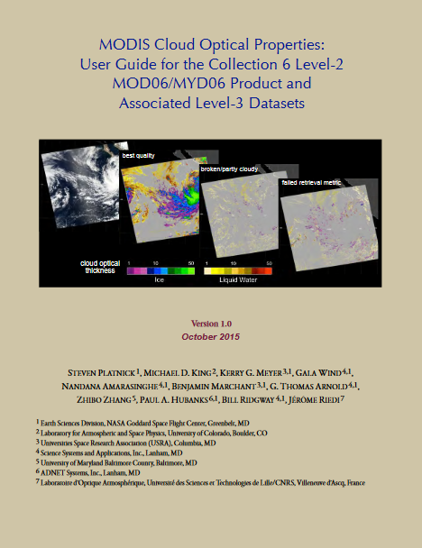
MODIS Cloud Optical Properties Guide
145 pages
Everything you ever wanted to know… and more about how the new Collection 6 L2 and L3 Cloud Data
https://modis-atmos.gsfc.nasa.gov/sites/default/files/ModAtmo/C6MOD06OPUserGuide_1.pdf

Slide 25
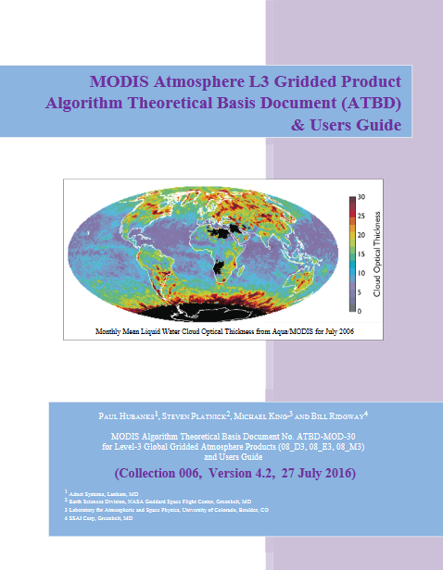
Level 3 ATBD
127 pages
Everything you ever wanted to know about Level 3 data!
  Gridding
  Sampling
  Statistics
  Computation
  Differences between C5 and C6
https://modis-atmosphere.gsfc.nasa.gov/sites/default/files/ModAtmo/L3_ATBD_C6.pdf

Slide 26
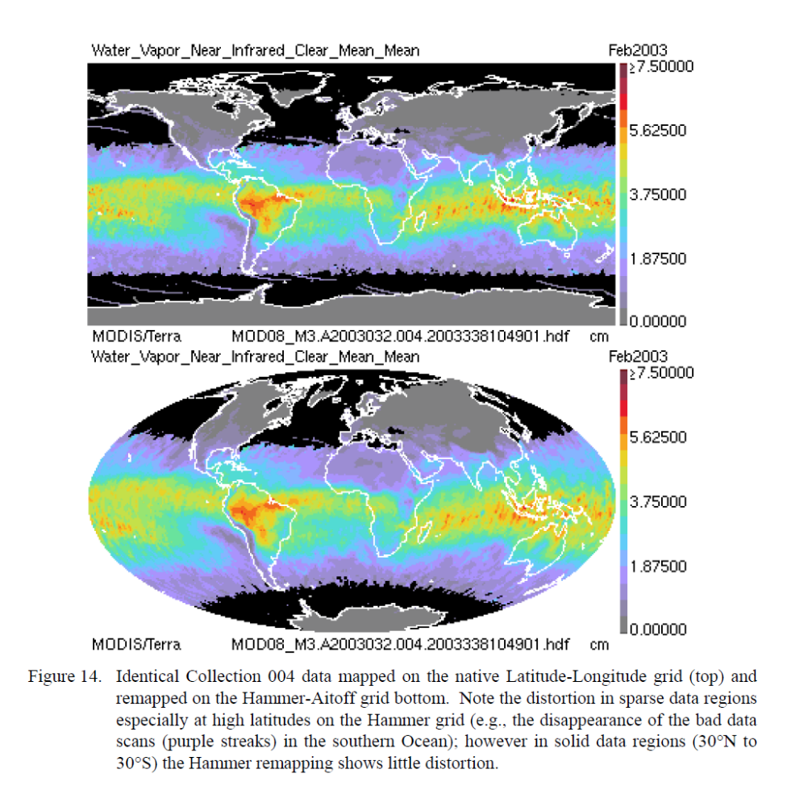
Gridding Options
Lat-Lon (sparse) but the one that is easiest to create in Matlab.
Hammer-Aitoff (equal area)
Different types of distortion for each

Slide 27
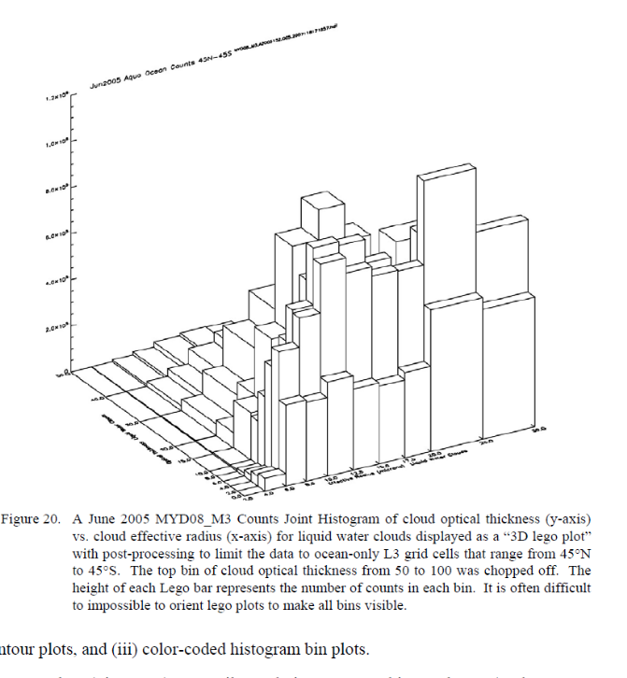
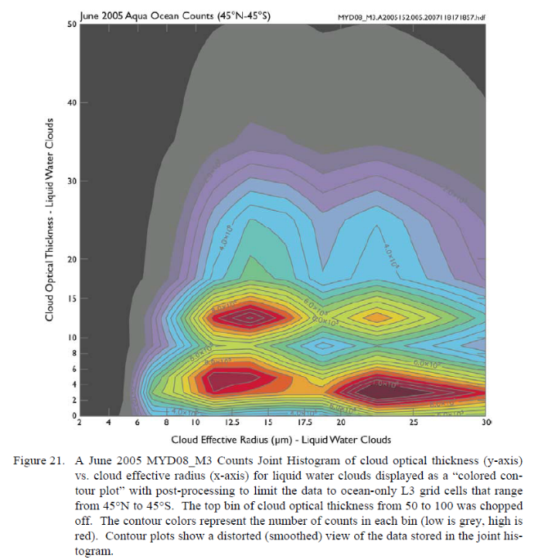
Joint Histograms
Two variables (x- and y-axes) with the height, or color indicated the number of “counts” in each bin that satisfy the combination of variables.
Examples below show Joint Histograms where the y-axis is cloud Optical Thickness and x-axis Effective Radius

Slide 28
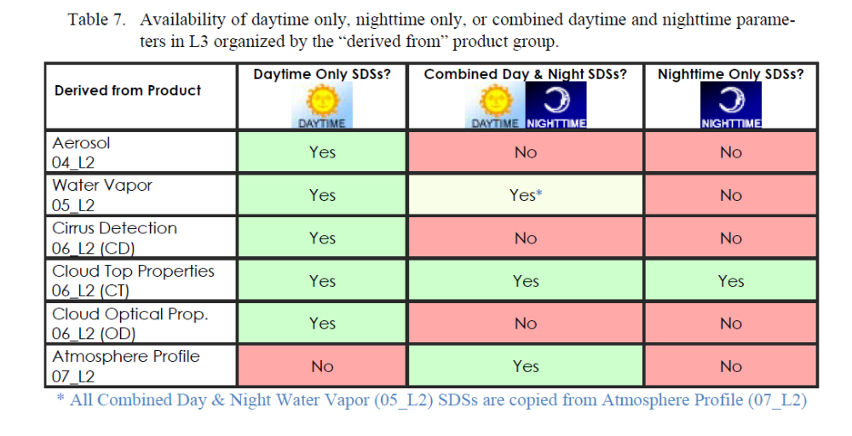
Day or Night Availability?

Slide 29
Improvements between C5 and C6
Cloud Top Properties (DONE!)
  Added Near Nadir versions of CTP, CTT, CEE, CF, and CTH (all aggregated by Day only, Night only, and Combined Day and Night). (15 parameters added)
  Added Low (>680mb), Middle(-440mb), & High Cloud (<440mb) separation of CTP, CTT, CEE, CF, and CTH through finely binned Histograms (for CTP) and Joint Histograms vs. CTP (for remaining 4 parameters). Note that this was done for both the near nadir aggregation as well as the heritage (full view angle) parameters. Also, all were aggregated by Day only, Night only, and Combined Day and Night. (24 joint histograms added & 6 marginal histograms added)
  Added eleven new Surface Type Fractions and Pixel Counts in the Cloud Top Property retrieval space. (11 parameters added)
  Added Joint Histogram of Cloud Phase (Baum) vs. CTP Near Nadir for Day and Night. (2 joint histograms added)
  Added Joint Histogram of Near Nadir CTP (5km avg) vs. CTP (1km sampled) for Day and Night. (2 joint histograms added)
  Added Joint Histogram of Cloud Phase vs. CTT (to D3 only, due to lack of space in the E3/M3)
  Change Sunglint_Fraction to Sunglint_Fraciton_Day, a daytime only parameter

Slide 30
Improvements between C5 and C6
Cloud Optical Properties: (DONE!)
  Delete all QA Confidence Flag related statistics from all Cloud Optical Property parameters. (many SDS's deleted)
  Add Partly Cloudy (PCL) versions of COT, CER, CWP, CF (for primary 2.1 retrieval) for Liquid, Ice, Undetermined, and Combined. (14 parameters added)
  Delete all Combined Effective Radius and Combined Water Path parameters. (2 parameters deleted)
  Change all "Cloud_Fraction_(Phase)" parameters to “Cloud_Retrieval_Fraction_(Phase)" (10 parameters modified)
  Add Partly Cloudy (PCL) versions of COT, CER, CWP, CF (for 1.6/2.1 retrieval) for Liquid & Ice only. (8 parameters added)
  Add Standard and Partly Cloudy (PCL) versions of COT, CER, CWP, CF (for 1.6 retrieval) for Liquid & Ice only. (16 parameters added)
  Add Standard and Partly Cloudy (PCL) versions of COT, CER, CWP, CF (for 3.7 retrieval) for Liquid & Ice only. (16 parameters added)

Slide 31
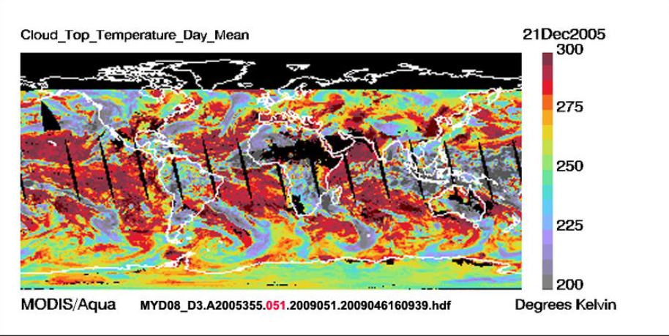
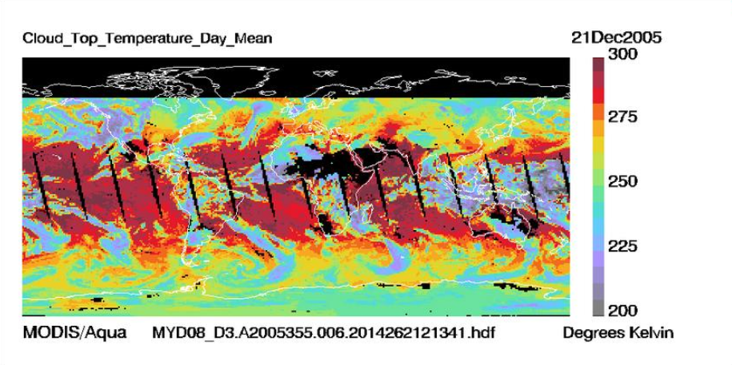
Improvements between C5 and C6
Cloud Top Temperature
Collection 5
One of the more interesting changes in C6 was a sub setting of some of the Cloud Top Property Parameters into “Near Nadir” SDSs. Near Nadir is defined as Senor Zenith Angle ≤ 32° so it’s roughly the “inner half” of the scan).
Reducing the scan angles improves the certainty and reduces errors in the algorithm providing better estimates of the various Cloud Top Property parameters computed.
Collection 6

Slide 32
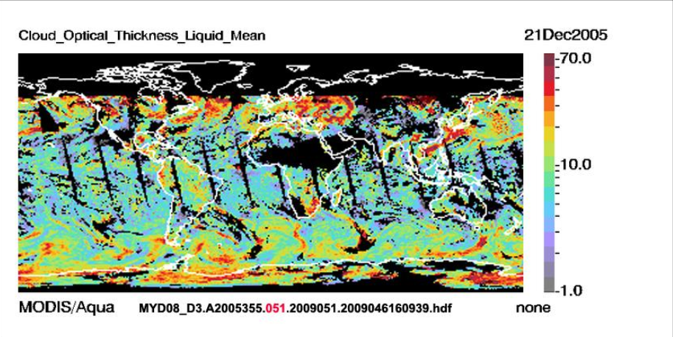
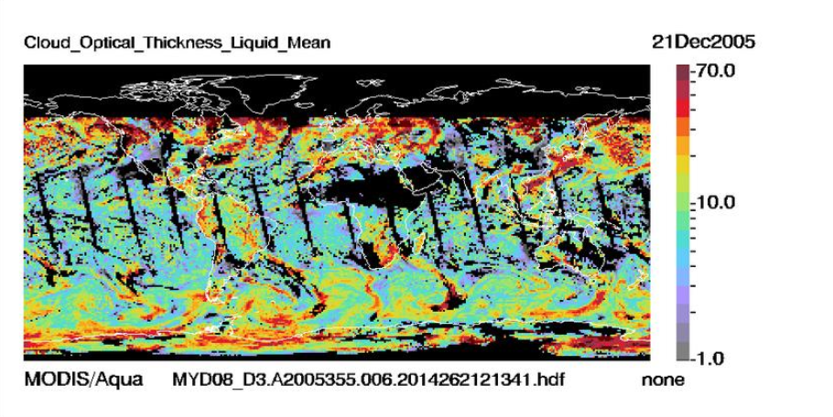
Improvements between C5 and C6
Cloud Optical Thickness
Collection 5
Improved coverage
4 different retrieval algorithms
  2.1 um primary
  3.7 um
  1,6 um
  1.6/2.1 um
All things being equal, MODIS data users should start out with the Primary 2.1 um retrieval.
Collection 6

Slide 33
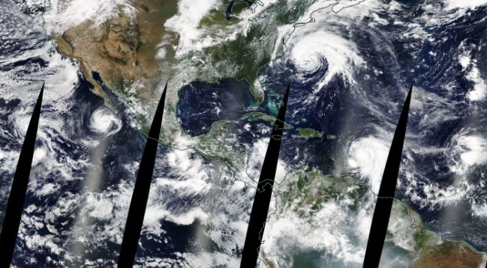
Time to work on Lab 1 or Lab 2

