Slide 1


CloudSat Introduction
MET 611 – Satellite Data Applications
Jennifer D. S. Griswold

Slide 2
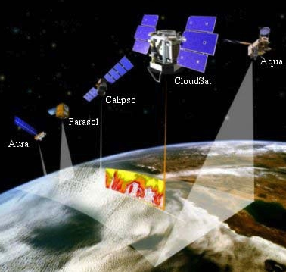
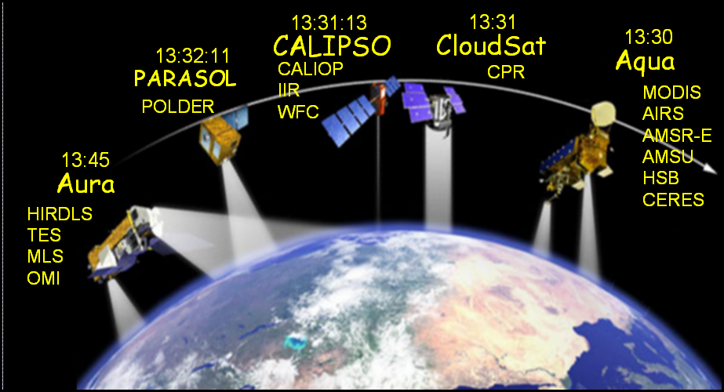
A-Train
The Afternoon or “A-Train” Satellite constellation presently consists of 5 satellites:
  NASA Aqua
  NASA Aura
  PARASOL
  CloudSat
  CALIPSO
Inserted behind Aqua in 2006
Approx equator crossing times
Approx equator crossing times
CALIPSO and CloudSat fly in formation enabling an even greater understanding of our climate system from the broad array of sensors on the same orbit.

Slide 3
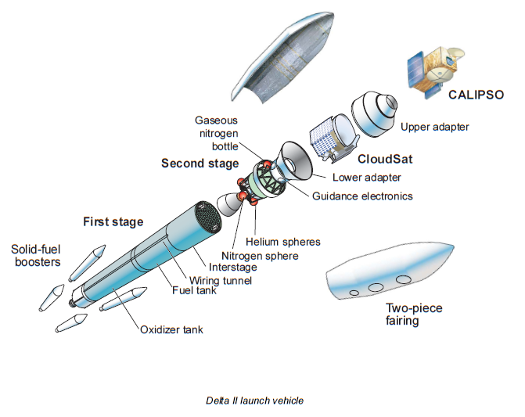
Launch Vehicle

Slide 4
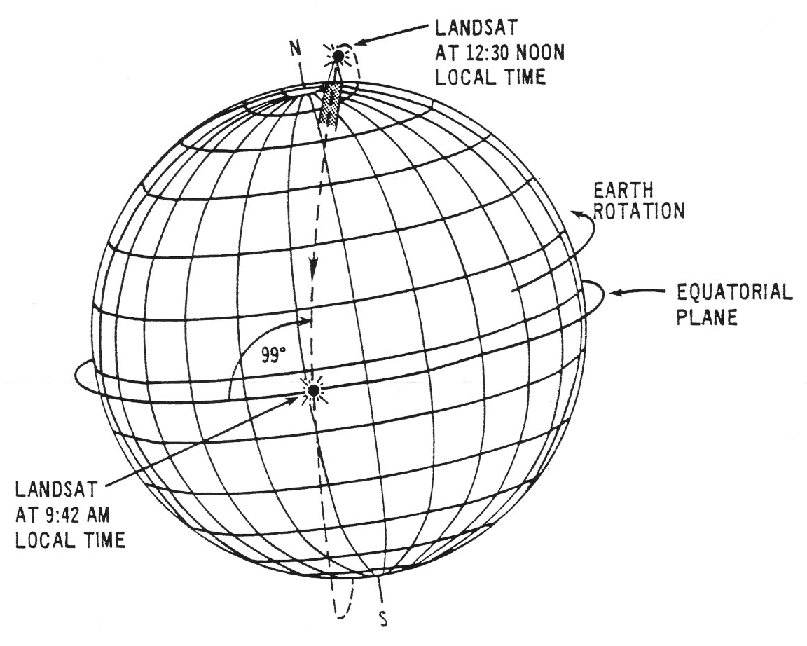
A-Train Orbit
The satellites in the A-Train are maintained in orbit to match the World Reference System 2 (WRS -2) reference grid used by Landsat
CloudSat and CALIPSO lag Aqua by 1 to 2 minutes
CloudSat and CALIPSO travel within 10-15 seconds of each other so that both instrument suites view the same cloud area at nearly the same time.
Crucial for studying clouds which have lifetimes often less than 15 minutes.
The constellation has a nominal orbit altitude of 705 km and inclination of 98 deg.
Aqua leads the A-train with an equatorial crossing time of about 1:30 pm

Slide 5
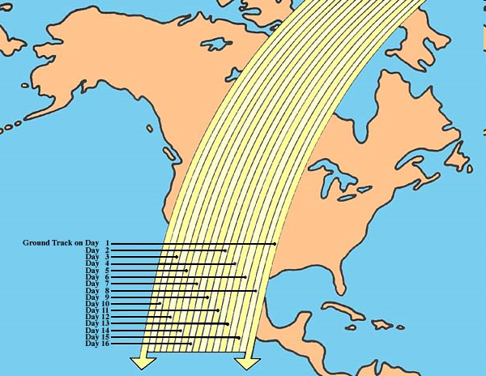
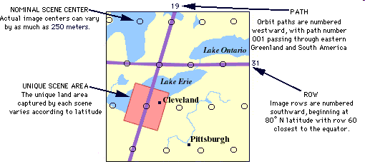
WRS-2 Reference Grid
Developed to facilitate regular sampling patterns by remote sensors in the Landsat program
Landsat-7 and Terra are “morning” satellites in the same orbit as the A-Train
Each satellite competes 14.55 orbits per day with a separation of 24.7 degrees longitude between each successive orbit at the equator.
The orbit tracks at the equator and progresses westward 10.8 degrees on succeeding days, which over a 16-day period produces a uniform WRS grid over the globe. The WRS grid pattern of 233 orbits with separation between orbits at the equator of 172 km
The aqua satellite is controlled to the WRS grid to within +/- 10 km

Slide 6
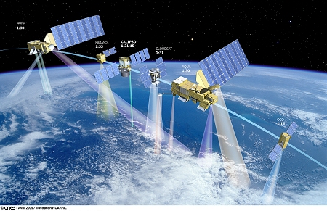
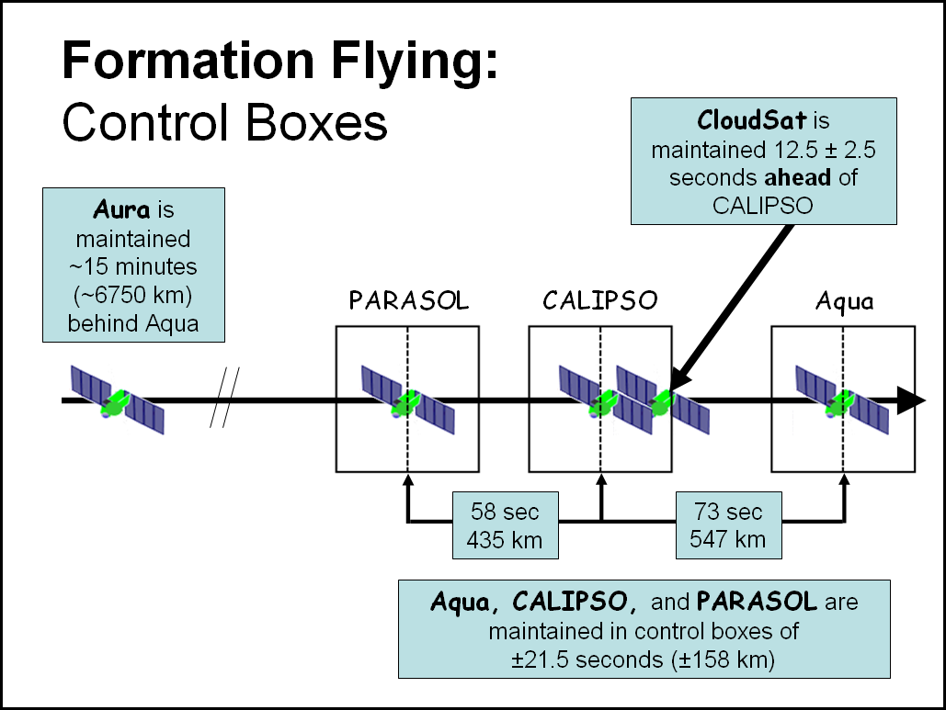
Formation Flying
Control Boxes
  Satellites are allowed to drift inside control boxes until they approach the boundaries of the box, then maneuvers are initiated to adjust the orbit.
Staying in “Boxes” is Crucial to:
  maintain the observing times
  geometries of the instruments
  avoid collisions
    which would produce a debris field that would threaten the entire formation.

Slide 7
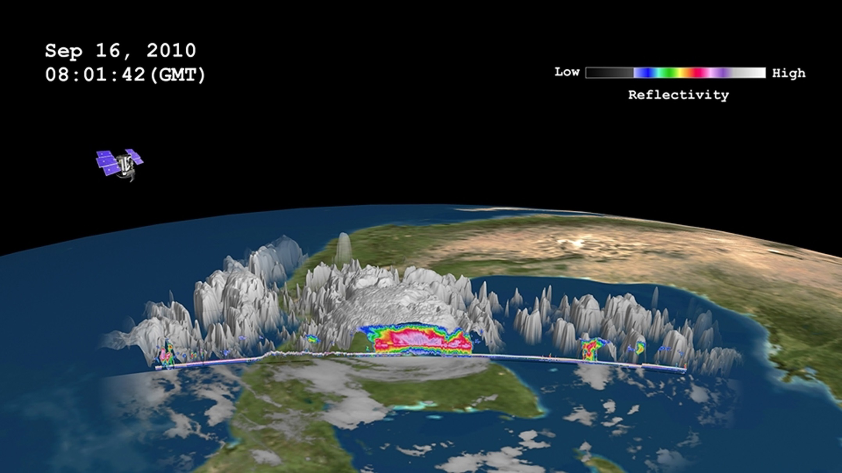
CloudSat

Slide 8
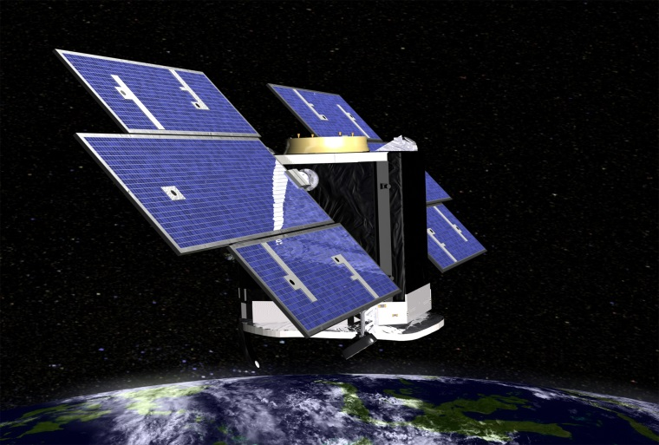
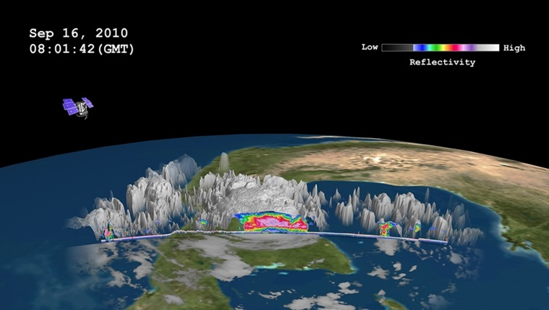
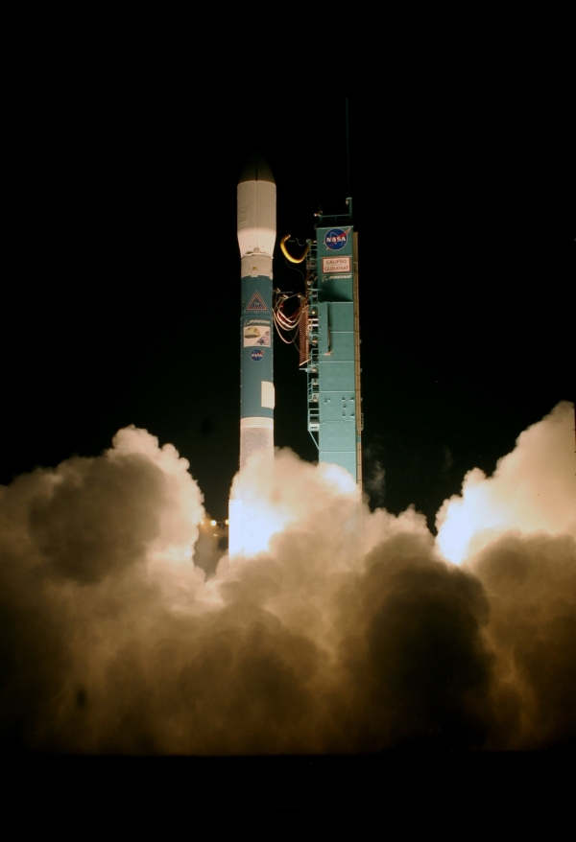
CloudSat
1999 selected as a NASA mission, launched April 28, 2006
To Study:
  Cloud Abundance
  Distribution
  Structure
  Radiative Properties
first satellite-based mm-wavelength cloud radar
more than 1000 times more sensitive than existing weather radars.
  485 m vertical resolution
  1.4 km antenna 3 dB footprint
detection of much smaller particles of liquid water and ice that constitute the large cloud masses

Slide 9
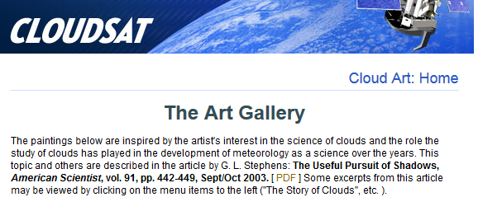
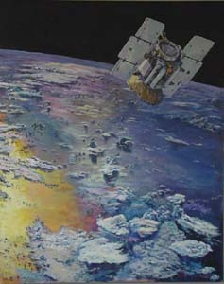
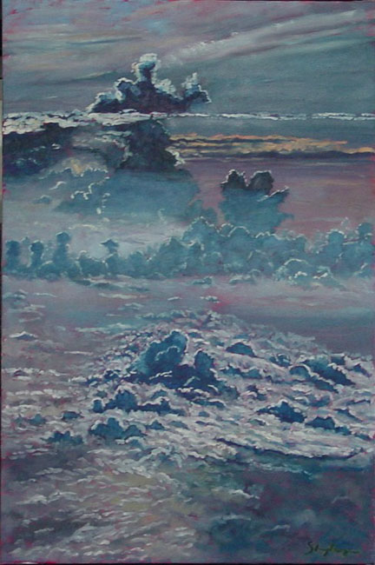
Mission Objectives
Why CloudSat?
  Unique in its ability to sense condensed cloud particles while coincidently detecting precipitation!
  It has a number of important goals in its mission, including:
    Improve the way clouds are parameterized in global models
    Quantitatively evaluate the relationship between the vertical profiles of cloud liquid water and ice and the radiative heating of the atmosphere and surface
    Evaluate cloud properties retrieved from other satellite systems
    Contribute to improving our understanding of the indirect effect of aerosols on clouds by investigating the effect of aerosol on cloud and precipitation formation.
  Other Goals Include
    improving weather prediction and water resource management
    help mitigate natural hazards
    develop critical space-born technologies
    designed to clarify the relationship between clouds and climate
    It contributes to the better understanding of cloud-climate feedback problem

Slide 10
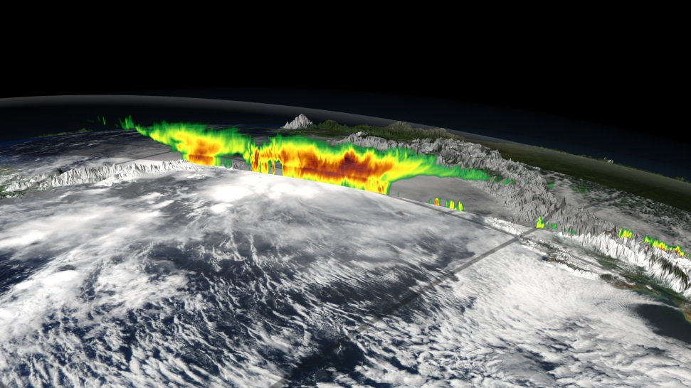
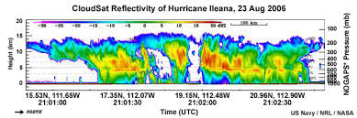
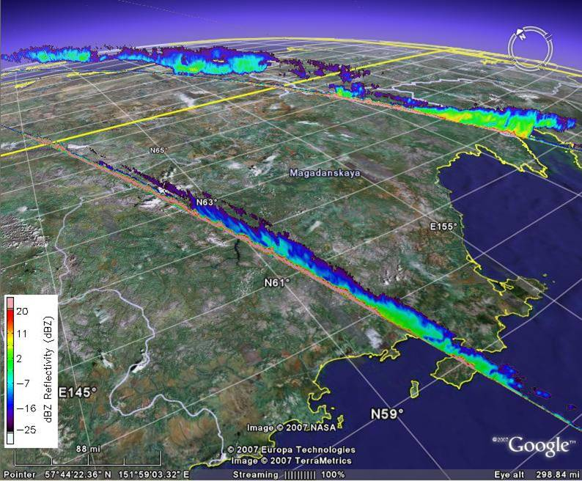
Science Questions
How much water and ice is the cloud expected to contain?
How much of that water is likely to turn into precipitation?
What fraction of the globe’s cloud cover produces precipitation that reaches the ground?
Can we quantitatively evaluate the representation of clouds and cloud processes in global atmospheric circulation models, leading to improvements in both weather forecasting and climate predication?
Can we quantitatively evaluate the relationship between the vertical profiles of cloud liquid water and ice content and the radiative heating by clouds?

Slide 11
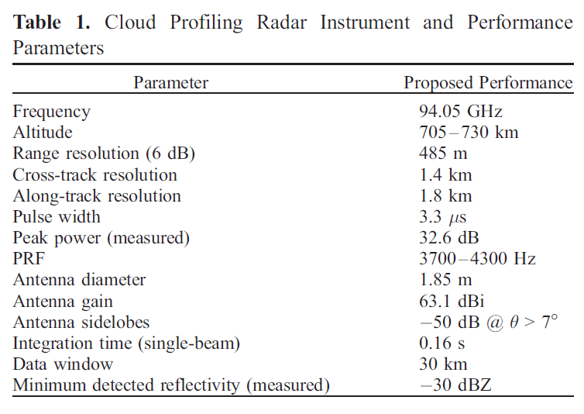
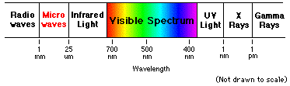
CloudSat Operations
CloudSat uses advanced radar to “slice” through clouds, (Active Sensor scenario)
It uses millimeter wave radar that operate at wavelengths of approximately 3 to 8 mm (or frequency of 94 or 35 GHz)
(Stephens et al. 2008)

Slide 12
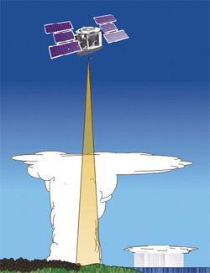
CloudSat Operations
Cloud Profiling Radar (CPR)
  CPR is 94 GHz
  Developed jointly by NASA’s JPL and the Canadian Space Agency
Why 94 GHz Radar Frequency?
  3.1 mm wavelength
  Compromise:
    Sensitivity
    Antenna Gain
    Atmospheric Transmission
    Radar Transmitting Efficiency
  Sensitivity and Antenna Gain increase with frequency
  Atmospheric Transmission and Transmitter Efficiency decrease with frequency

Slide 13
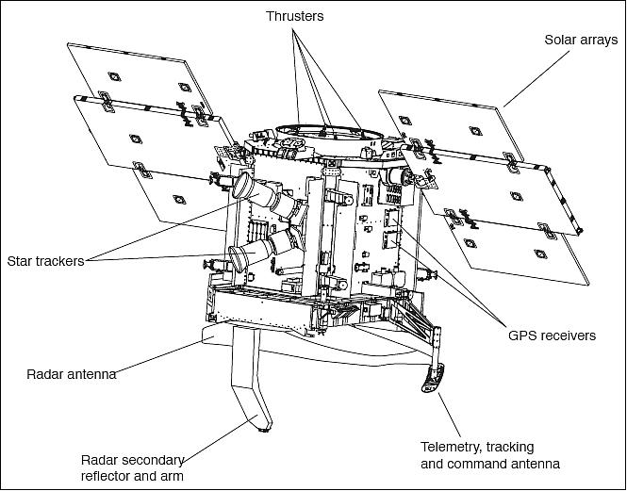
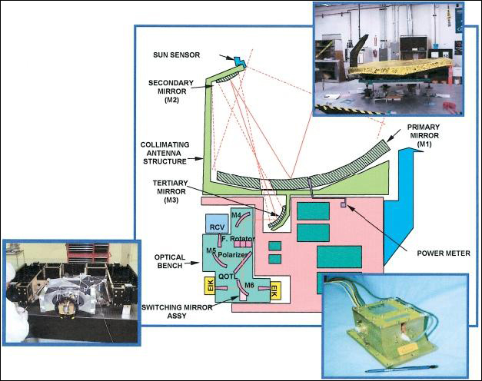
CloudSat CPR
The design of the CPR consists of the following subsystems:
  RFES (Radio Frequency Electronics Subsystem)
    The RFES consists of an up-converter which generates a pulsed signal and up-converts it to 94 GHz.
  HPA (High Power Amplifier)
    The signal is amplified to about 200 mW by a state-of-the-art MMIC power amplifier.
  Antenna Subsystem (Quasi-Optical Transmission Line)
  DSS (Digital Subsystem)
The receiver portion of the RFES down-converts the signal to an IF (Intermediate Frequency).
The IF signal is detected using a logarithmic amplifier (high dynamic range).
The receiver noise level is critical in achieving the required sensitivity.
https://directory.eoportal.org/web/eoportal/satellite-missions/c-missions/cloudsat

Slide 14
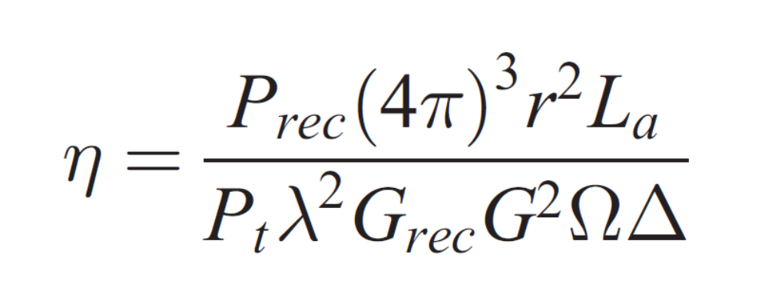
CPR Profile Data
(Stephens et al. 2008)
Range-resolved radar cross section per unit volume, η, at a specific range r:
η = range-resolved radar cross section per unit volume
P_{rec} =output power of the receiver
P_{t} = transmitted power
λ = wavelength
G_{rec} = the receiver gain
G = the antenna gain
r = range to the atmospheric target
Ω = integral of the normalized two-way antenna pattern
Δ = integral of the received waveform shape
L_{a} = the two-way atmospheric loss
Absolute calibration requires precise knowledge of:
r, λ, G_{rec}, Ω, Δ, P_{rec}, and P_{t}
Expected Accuracy of 2dBZ!

Slide 15
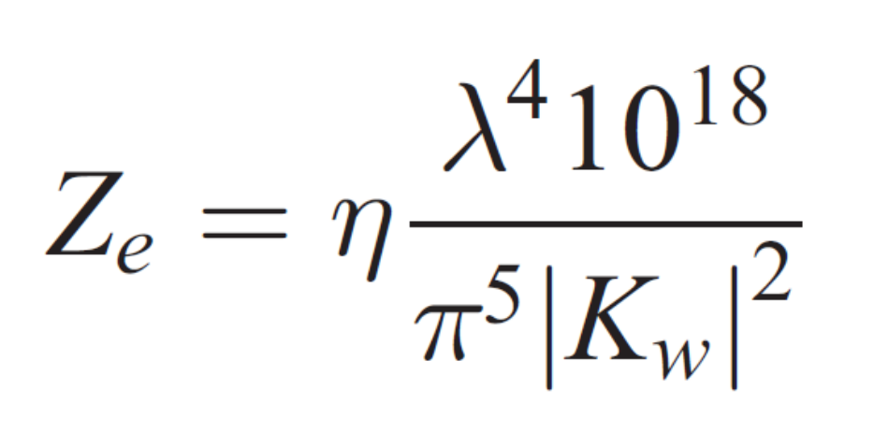
CPR Profile Data
(Stephens et al. 2008)
The quantity, η, is converted to the equivalent (attenuated) range resolved reflectivity factor:
Z_{e} = range-resolved reflectivity factor
η = range-resolved radar cross section per unit volume
λ = wavelength
|K_{w}| = set to 0.75 representative of water at 10°C

Slide 16



CloudSat Operations -Radar
Radar reflectivity (Z) of a cloud is dependent on the Number (N) and size (D) of reflectors
  Rain, Snow, Graupel, hail
(Roughly Z= [mm⁶/m³])
Z is also expressed in dBZ to account for the very large and very small values attributed to the different size reflectors
Can be converted to rainfall rates:

Slide 17
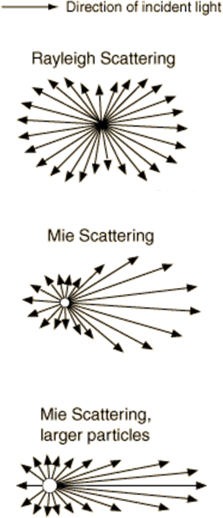
Radar in Space
While TRMM has been a successful precipitation radar, its 17-18 dBZ minimum detectable signal does not allow views of light precipitation and/or clouds (except some anvils) due to wavelength and sensitivity
Going to a higher frequency increases sensitivity to smaller particles (D⁶)
However, Mie effects are more likely to occur, so there is some tradeoff
W-Band (mm-wave) is an attractive option, since it is sensitive to many large cloud particles
It has been demonstrated as an excellent airborne (Wyoming King Air) and ground-based platform, in combination with lidar, to estimate IWC and LWC in clouds

Slide 18
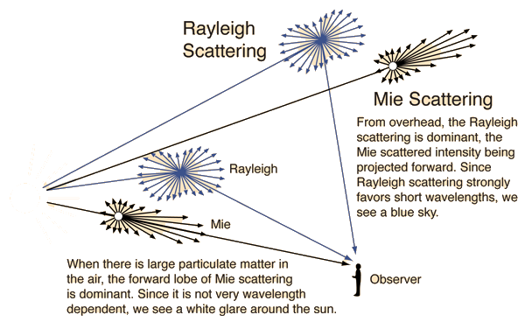
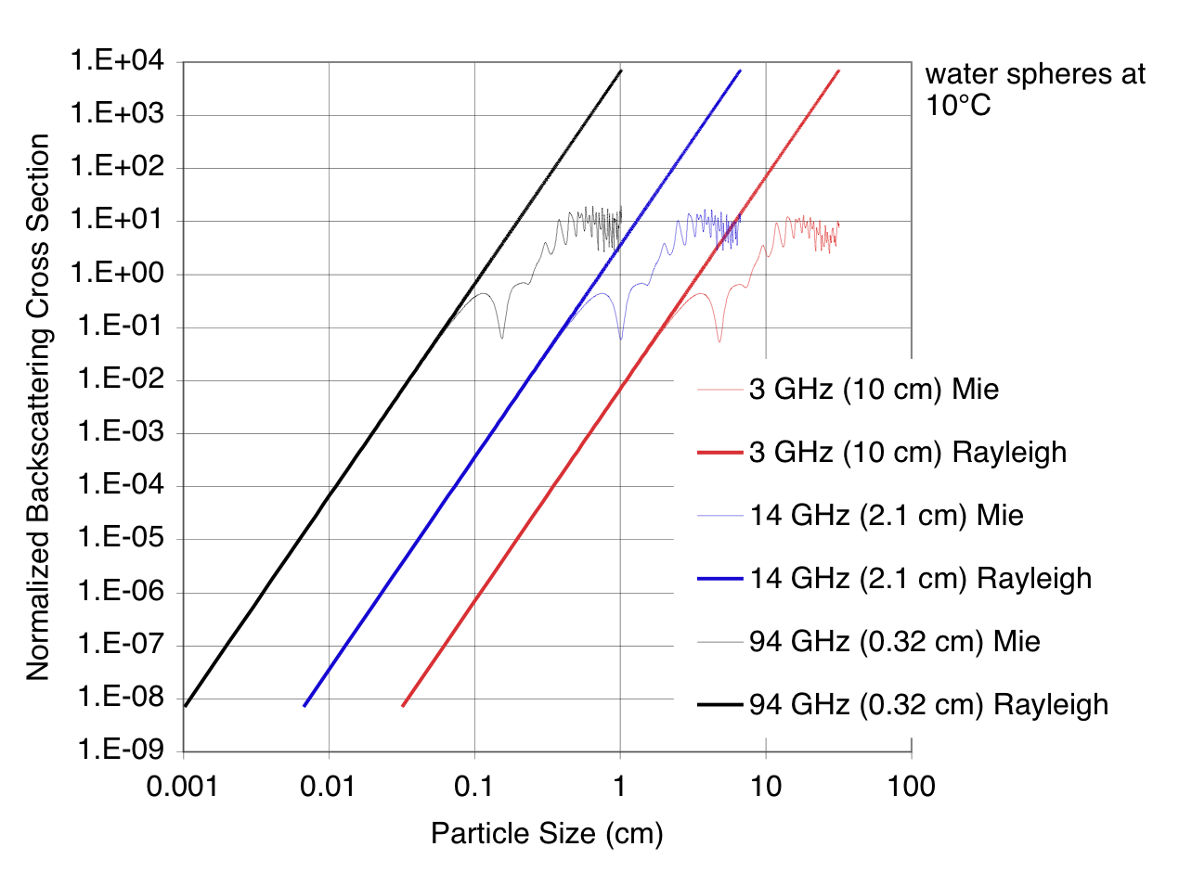
Radar in Space
Radar energy becomes more susceptible to Mie scattering as wavelength gets shorter or particles get larger (cutoff at x = π*D/λ - from geometric optics)
above this cutoff, Rayleigh assumption breaks down and backscattered energy (in this case, Z) is reduced

Slide 19
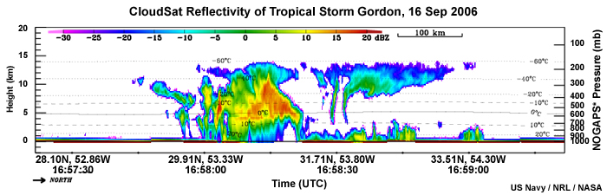

Attenuation
Attenuation From:
  Gases
    At radar wavelengths attenuation by gases is associated with absorption only
    Scattering is negligible at radar wavelengths
    Attenuation can be very substantial at wavelengths near 1 cm over long path lengths near the Earth’s surface.
  Cloud Particles & Precipitation
    Attenuation by cloud and precipitation particles can be due to both absorption and scattering. Attenuation will therefore be dependent upon particle size, shape, and composition.
Depending on wavelength and the concentration of molecules, cloud particles, and precipitation-sized particles, power loss due to attenuation can be very significant.
This power loss of either the transmitted power moving out to the target, or the backscattered power returning from the target is a result of both:
Absorption
Power loss
Scattering
(by particles along the path)

Slide 20
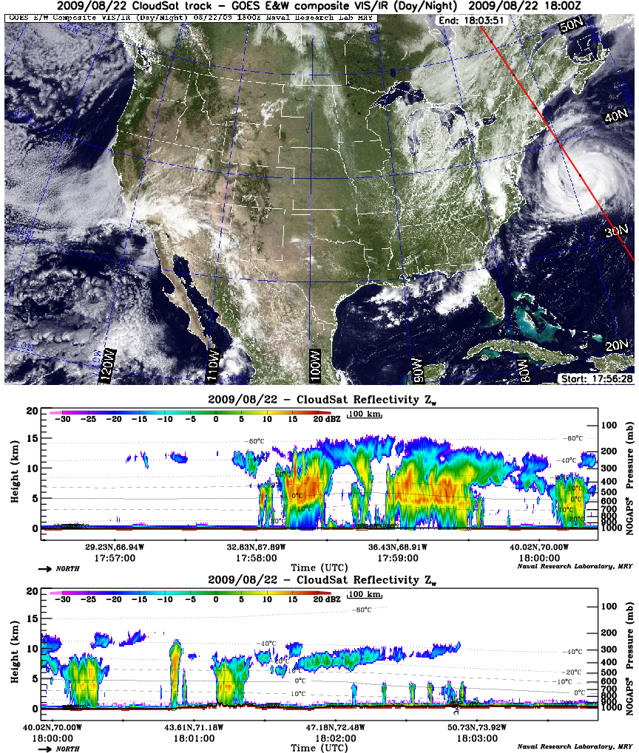
CloudSat Operations -Radar
What does dBZ stand for?
  dB = “decibel”
    Unit used to express differences in relative power or intensity
  Z = Reflectivity Factor
    amount of transmitted energy that is reflected back to the radar receiver
In General:
  The higher the dB value the larger the object detected (Ex: large rain drops)
  Values of dBZ < 15 usually indicate very light precipitation that evaporates before reaching the ground
Original requirements on CPR
  Sensitivity defined by a minimum detectable reflecitvity factor of around -30 dBZ (actual ~30-31 dBZ)
    Due to the fact that clouds are weak scatterers of microwave radiation
Hurricane Bill

Slide 21
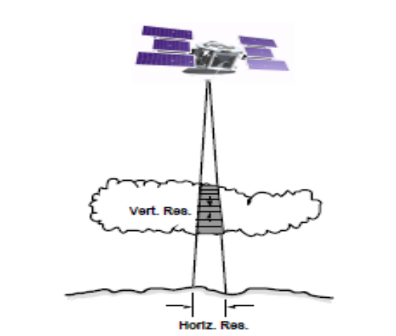
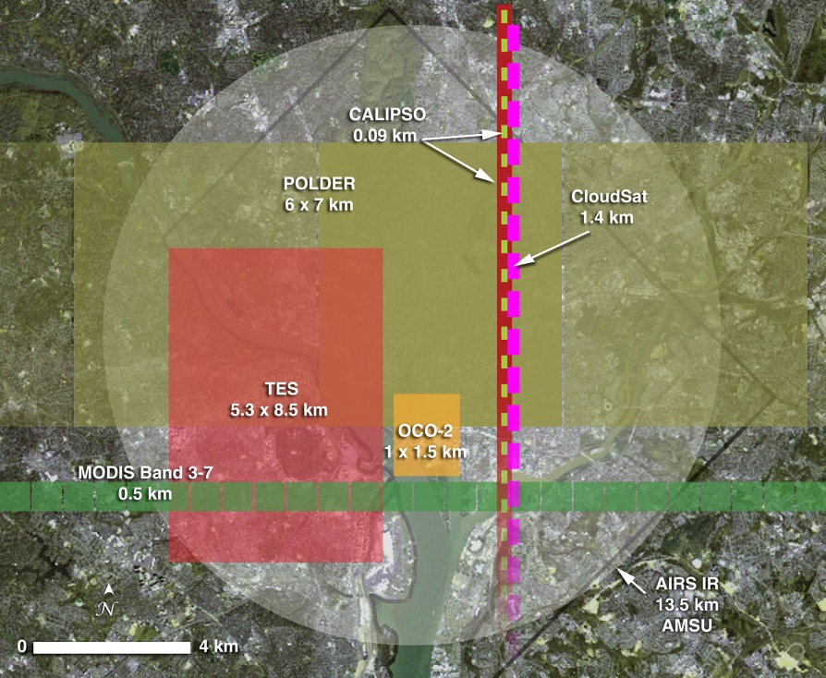
Other CPR Properties
Radar Sampling takes place at 625 kHZ
Burst Rate 0.16 s/burst
  The interval to create a CloudSat “ray” or Profile
Pulse Repetition Frequency (PRF) 3400-4300
  (4300 pule/sec) * (0.16 s/burst) = 688 pulse/burst
CloudSat antenna has a diameter of 1.85 m
  Footprint = 1.4 km across track area
    Is the area covered by a satellite
    Describes the horizontal spatial resolution
CloudSat has 125 vertical bins with approximately
  240 m Vertical Spatial Resolution.

Slide 22
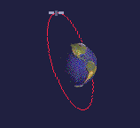
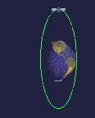
CloudSat Orbit
CPR is flown in a sun synchronous orbit at 98 deg inclination angle and altitude raging from 705-230
Along track velocity of 7 km/s
  With the velocity and sample rate of 0.16 sec/profile we determine that:
    CPR profile will be generated every 1.1 km along track
equator
Sun-syn.
polar

Slide 23
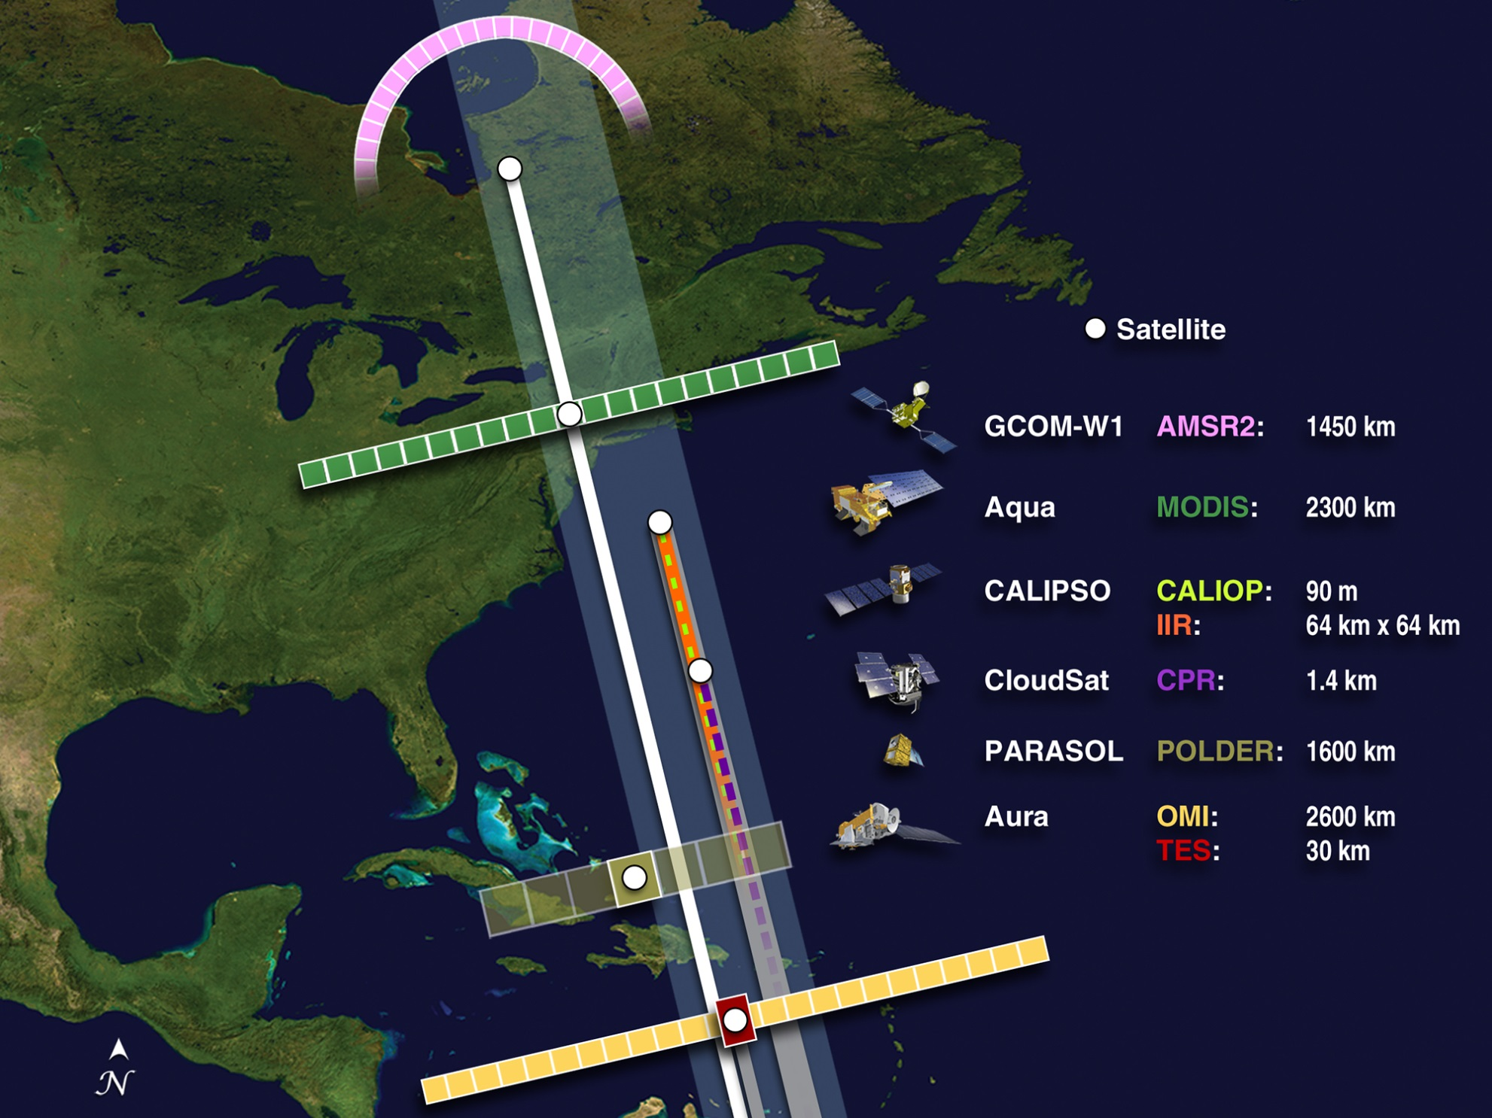

Slide 24
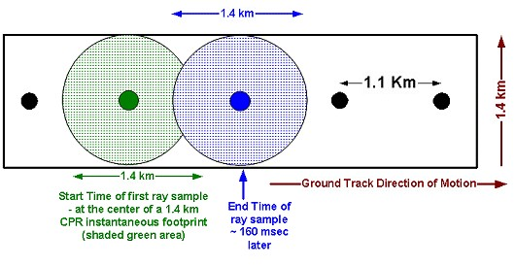
Other CPR Sampling Properties
1.1km apart
Instantaneous footprint when satellite travels one sample period of 0.16 seconds

Slide 25
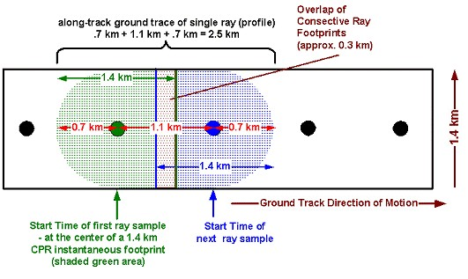
Other CPR Sampling Properties
Effect of “sliding” the instantaneous footprint along track for one sample period.

Slide 26
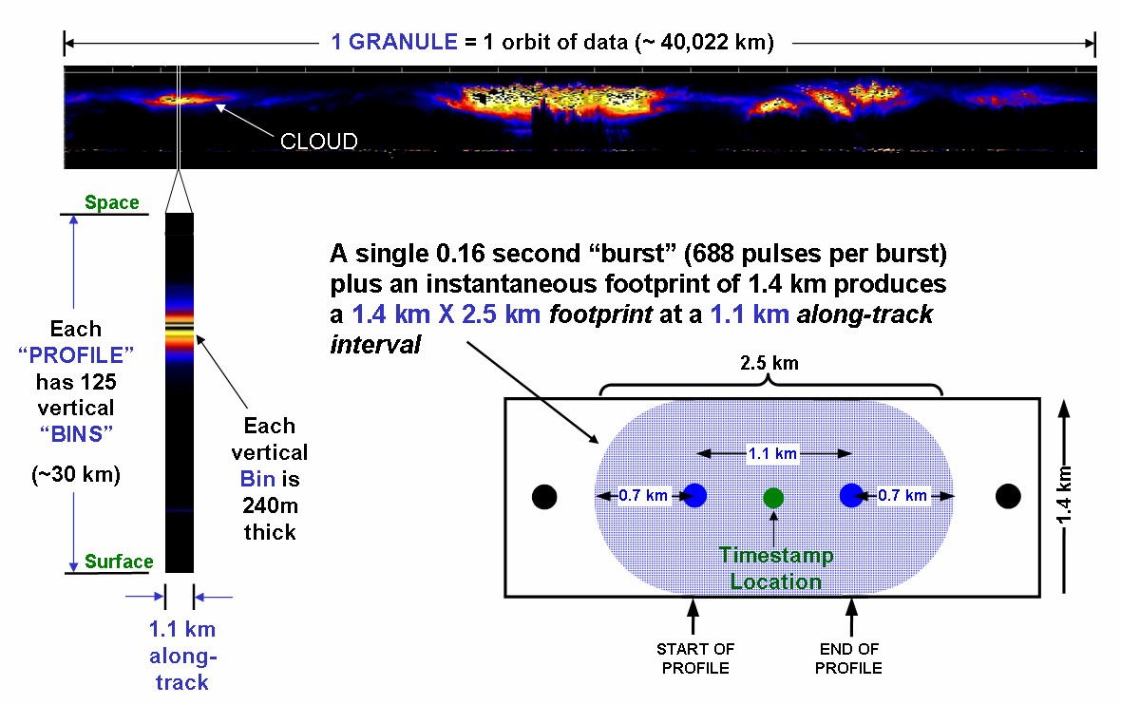
Other CPR Sampling Properties
A CloudSat Data “Granule” is defined as one orbit
which is equal to the Earth’s circumference, 40,022 km
Vertical Resolution

Slide 27
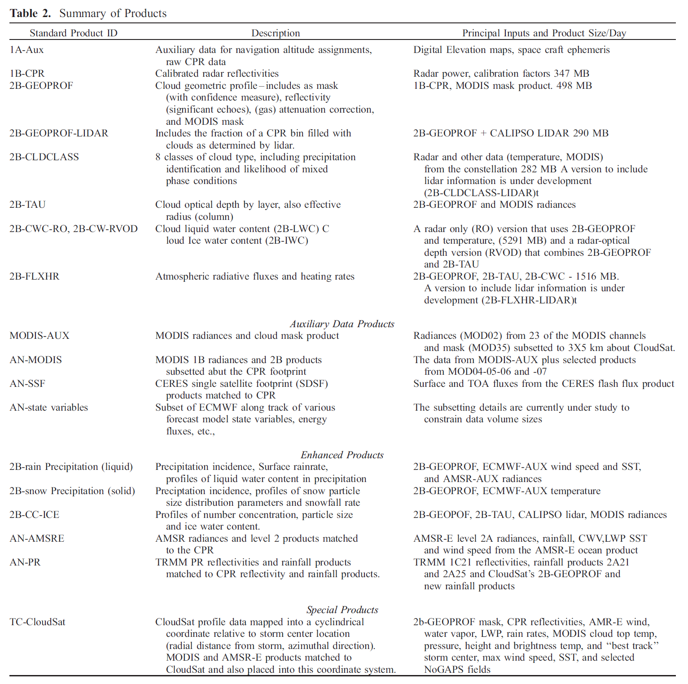
CloudSat Data Products
(Stephens et al. 2008)

Slide 28
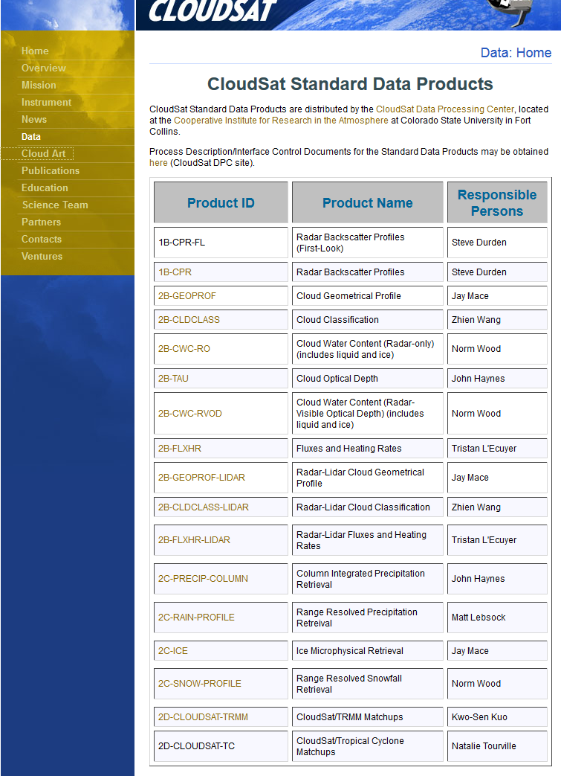
CloudSat Data
CloudSat's standard data products include:
  calibrated cloud-profiling radar reflectivity data
  cloud geometric profile
  cloud classification
  cloud optical depth by layer
  cloud liquid water content
  cloud ice water content
  atmospheric radiative fluxes and heating rates
  cloud geometrical profile with lidar input from CALIPSO
  cloud classification with lidar input from CALIPSO
http://cloudsat.atmos.colostate.edu/data

Slide 29
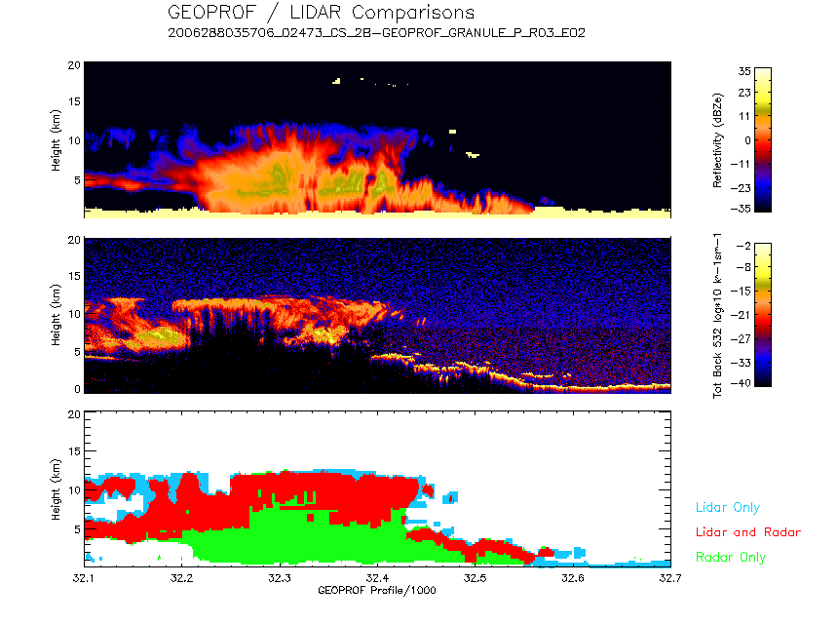
CloudSat Data
Radar/Lidar Combined Product Development
Overlap of the CloudSat footprint and the CALIPSO footprint, within 15 seconds, is achieved >90% of the time.

Slide 30
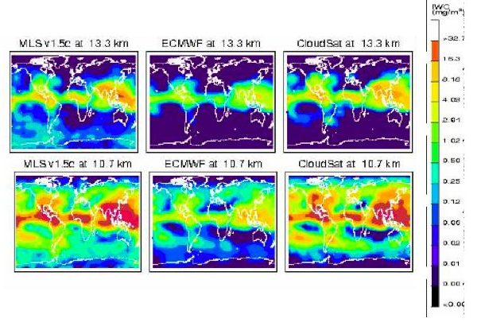
A-Train Cloud Ice
MLS
ECMWF
CloudSat

Slide 31
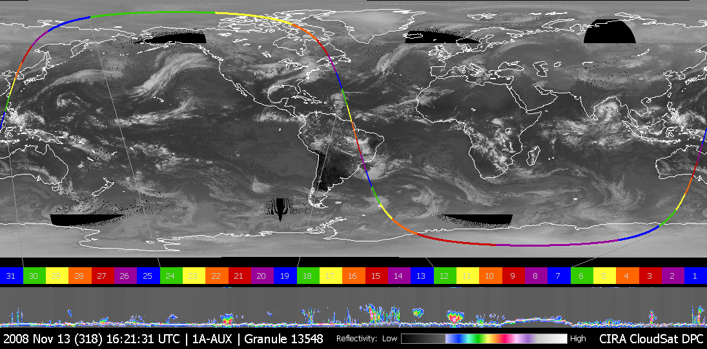
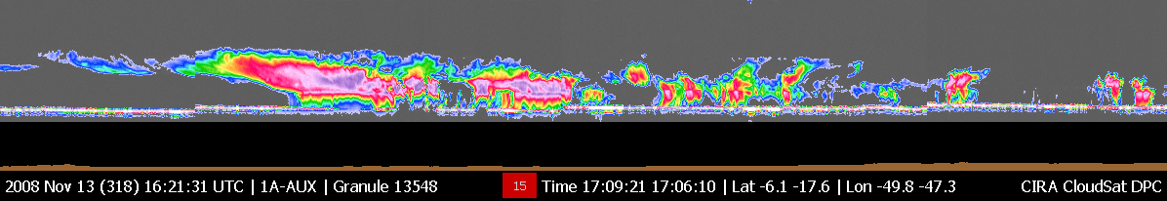
A CloudSat Granule & Subset

Slide 32
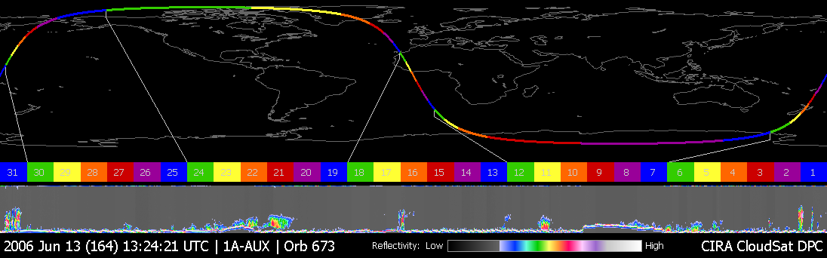
One orbit: June 13 2006
End of orbit
Start of orbit
Greenland ice sheet
Antarctic ice sheet
30 km of uncalibrated 94-GHz radar reflectivity factor
Clouds!

Slide 33
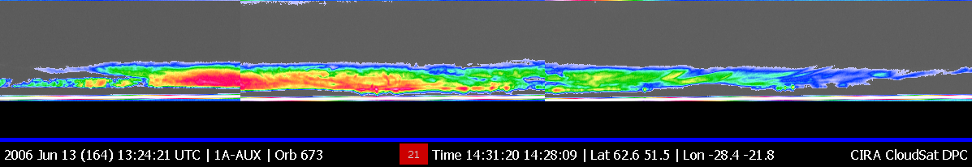
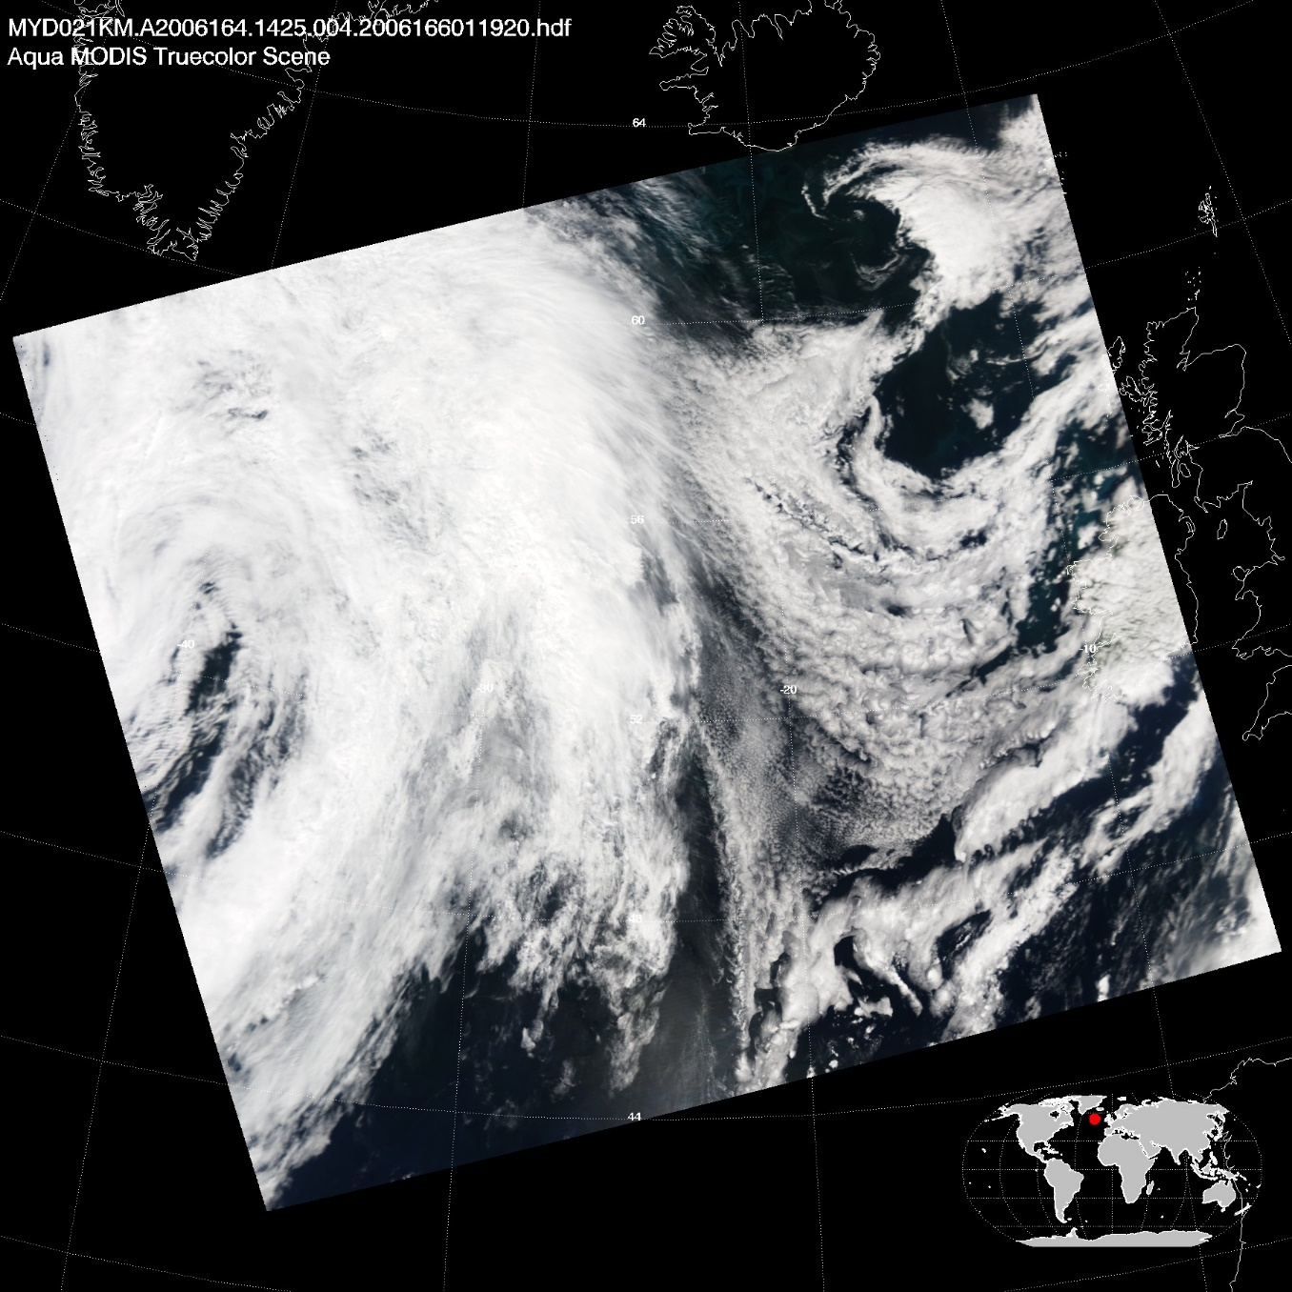
Optically thick ice cloud
Cirrus
Altocumulus: mixed-phase?
Melting ice
CloudSat reflectivity factor
14.30 UTC June 13th 2006
MODIS RGB composite

Slide 34
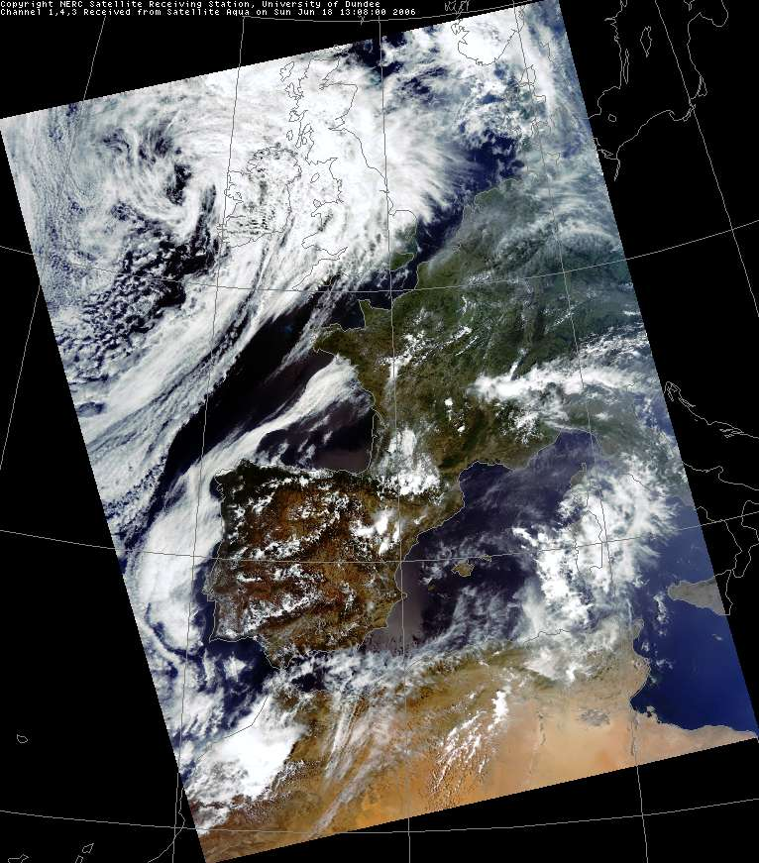
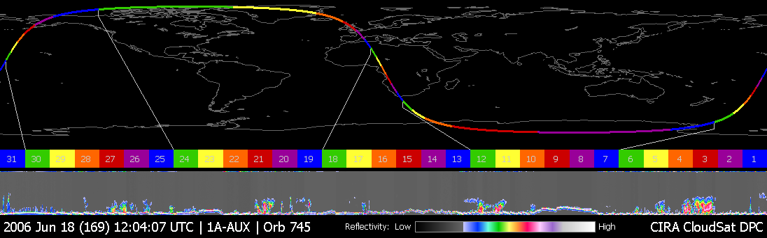
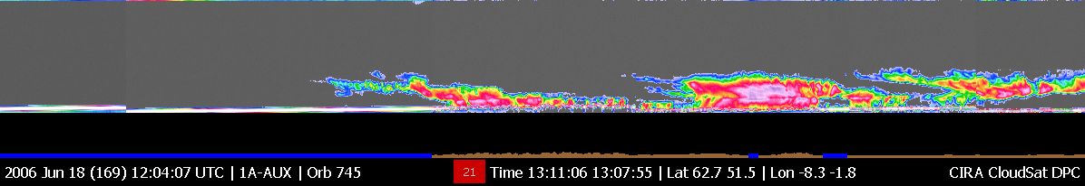

13.10 UTC June 18th 2006
MODIS RGB composite
Scotland
Lake
district
England
Isle of Wight
France

Slide 35

MODIS Infrared Window
13.10 UTC June 18th 2006
Scotland
Lake
district
England
Isle of Wight
France

Slide 36

UK Met Office rain radar network
13.10 UTC June 18th 2006
Scotland
Lake
district
England
Isle of Wight
France

Slide 37


Papua New Guinea
Tropical convection: oceanic and orographic

Slide 38


Anvil Cirrus

Slide 39


Complex Cloud Systems
  Multi-Level Clouds
  Cirrus over Cumulus
  Precipitating and non-precipitating

