Slide 1

CALIPSO Introduction
MET 611 – Satellite Data Applications
Many slides are from a talk by Meloë Kacenelenbogen, Mark Vaughan, and Jens Redemann for a NASA ARSET- AQ DRI Course June 11 - 14, 2012
Jennifer D. S. Griswold

Slide 2
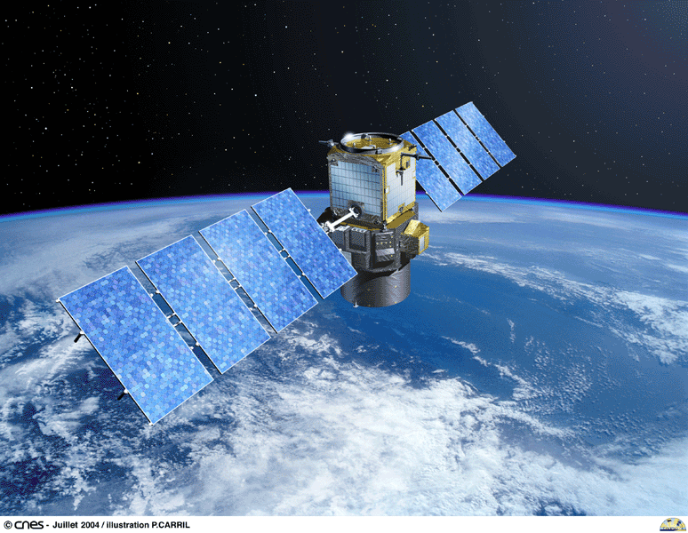
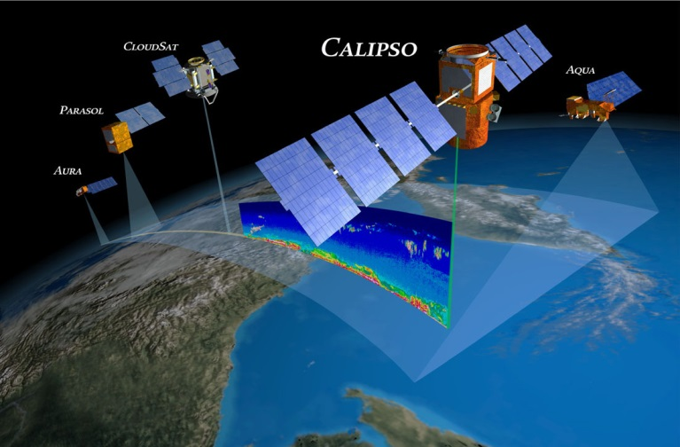
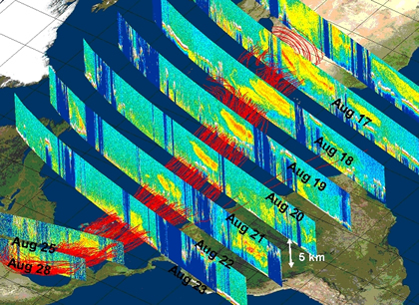
CALIPSO
The Cloud-Aerosol Lidar and Infrared Pathfinder Satellite Observation (CALIPSO)
Launched April 28 2006 with CloudSat
Provides new insight into:
  The role that clouds and atmospheric aerosols (airborne particles) play in regulating Earth's weather, climate, and air quality.
  With Cloudsat – 3D perspective on cloud-aerosol interactions
  How clouds and aerosols form and evolve
  Weather and climate studies
Combines an active lidar instrument with passive infrared and visible imagers to probe:
  vertical structure and properties
  Focus on: thin clouds and aerosols over the globe.

Slide 3
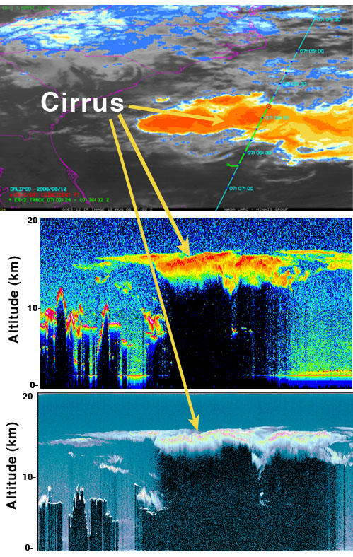
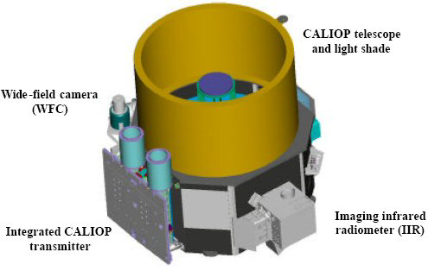
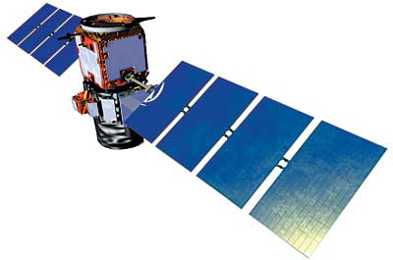
CALIPSO - CALIOP
Rhymes with “eye-oh-pee”
Joint NASA/CNES satellite
Three instruments:
  Cloud-Aerosol Lidar with Orthogonal Polarization (CALIOP): Two wavelength polarization-sensitive Lidar that provides high-resolution vertical profiles of aerosols and clouds
  Wide Field Camera (WFC): Fixed, nadir-viewing imager with a single spectral channel covering the 620-670 nm region
  Imaging Infrared Radiometer (IIR): Nadir-viewing, non-scanning imager

Slide 4
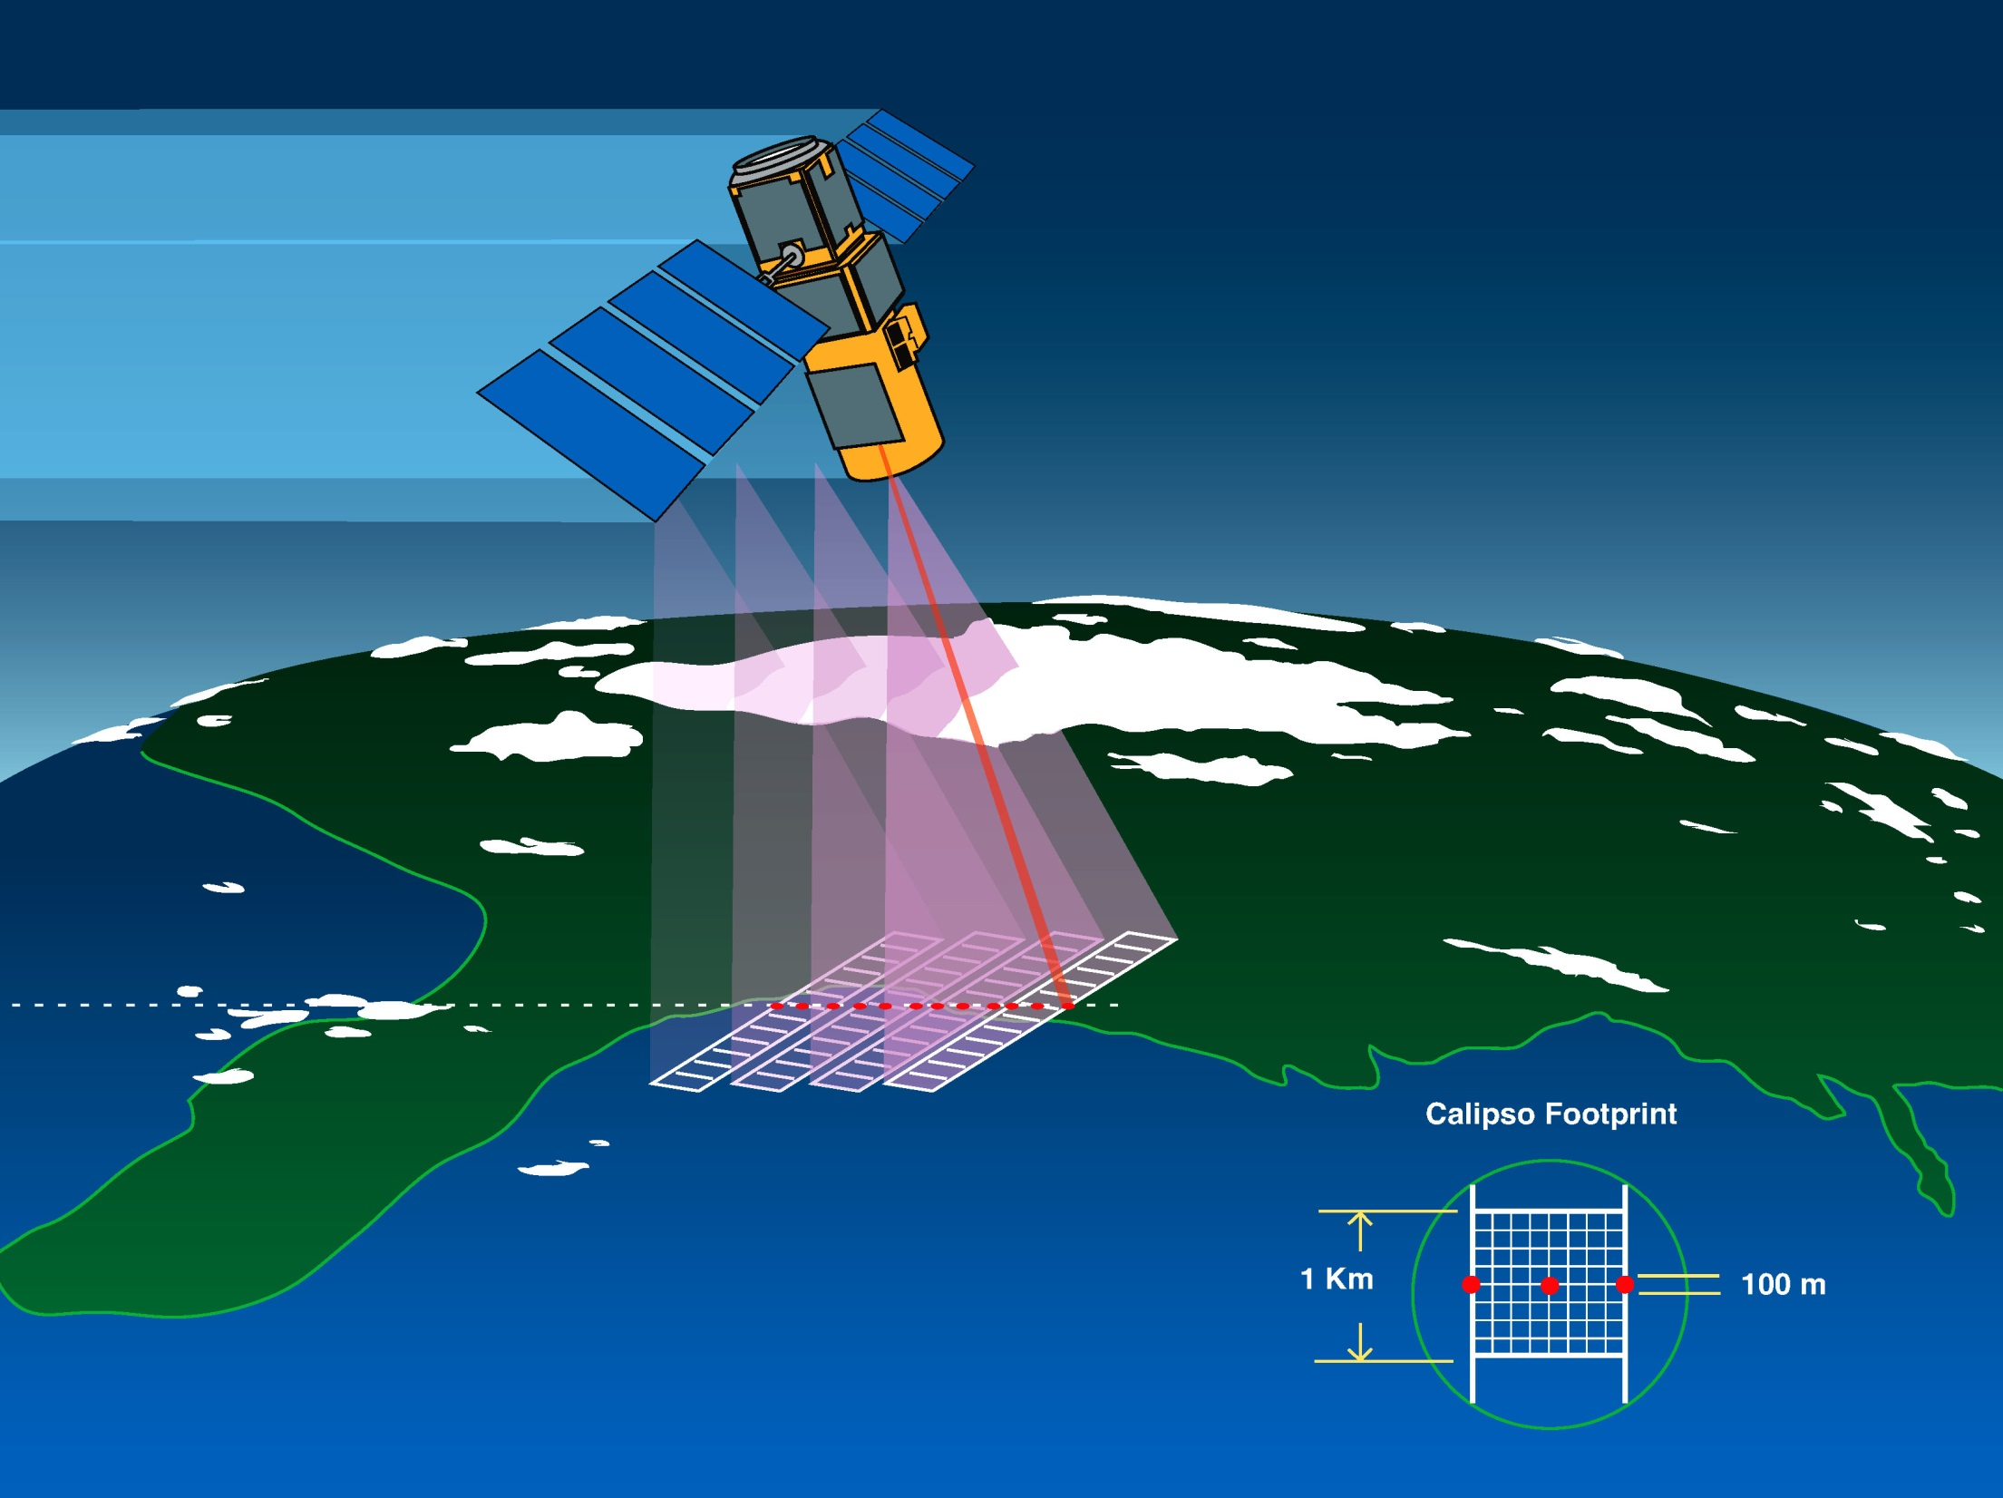
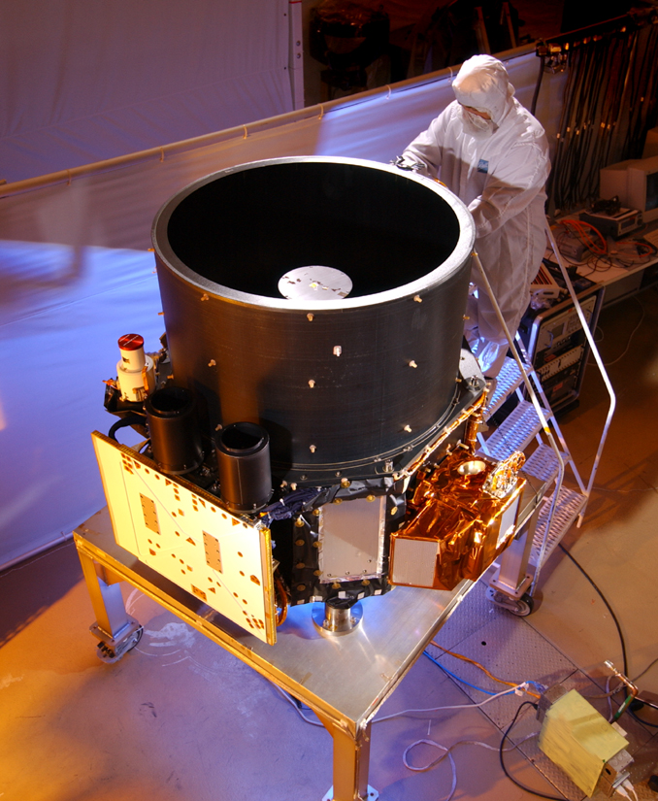
705 km, sun-synchronous
CALIOP:
backscatter Nd:YAG lidar
532, 532-perp, 1064
Launch: 28 April 2006
Active downward pointing elastic backscatter LIDAR (LIght Detection And Ranging)
90 m diameter foot print every 333m; No daily global coverage, covers a given region every 16 days

Slide 5
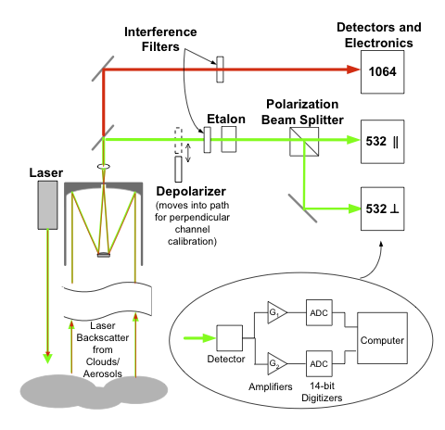
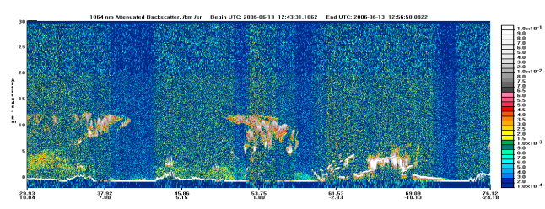
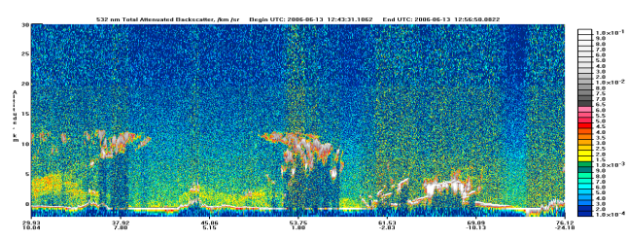
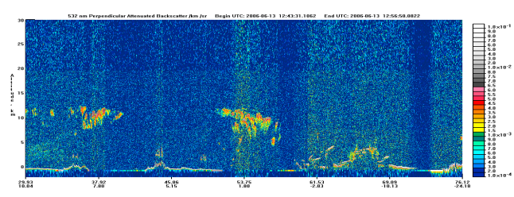
How does CALIOP work?
1064,Total
Total = || + ⊥
532,Total
532,⊥
3
4
1
LIDAR signal
Attenuated backscatter coefficient
Atmospheric two-way transmittance
= signal attenuation (cloud, aerosol, molecule, gas)
2
scattering layer
Total backscatter coefficient (cloud, aerosol, molecule)

Slide 6
Important Points to Know about CALIOP
Lidar signal β’
Is a function of extinction and backscatter
Aerosol and molecular backscatter
LIDAR Ratio S_{a} = α_{a}/β_{a} Aerosol extinction-to-backscatter ratio
(Assumed for CALIOP)
Color Ratio The ratio of the short to long wavelength.
Gives information on particle size.
For multiple wavelength lidars.

Slide 7

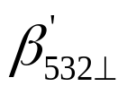

Lidar Signal Interpretation
 |  |  | Particle Type
Enhanced Signal | Enhanced Signal | Same intensity as 532 | Non-Spherical Coarse
Enhanced Signal | Enhanced Signal | Lower intensity than 532 | Non-Spherical Fine
Enhanced Signal | Non Enhanced Signal | Same intensity as 532 | Spherical Coarse
Enhanced Signal | Non Enhanced Signal | Lower intensity than 532 | Spherical Fine
Total attenuated backscatter 532 nm
Total attenuated backscatter 1064 nm
A
B

Slide 8
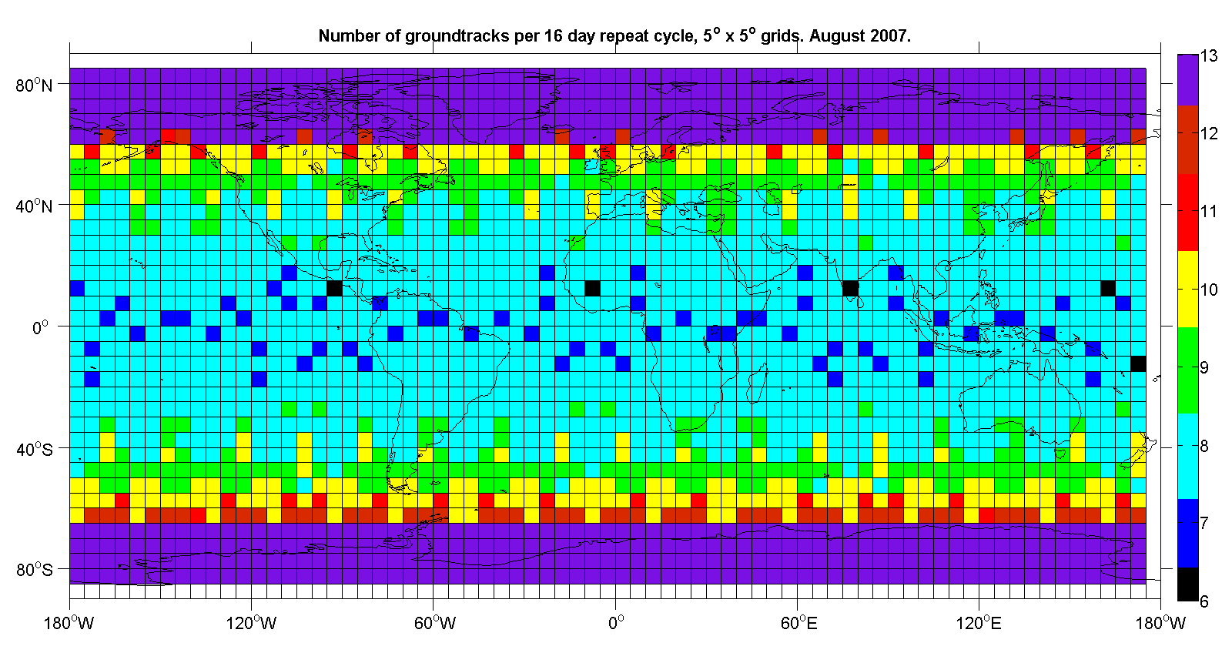
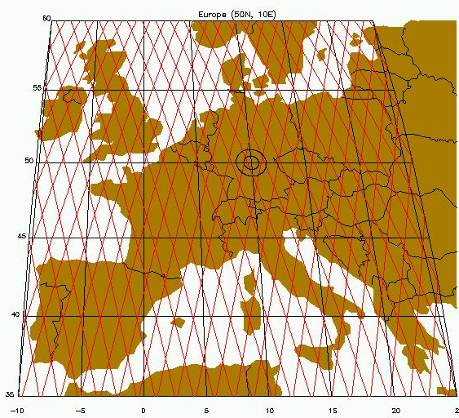
Tracks per 5x5 grid cell over 16 days
50
23

Slide 9
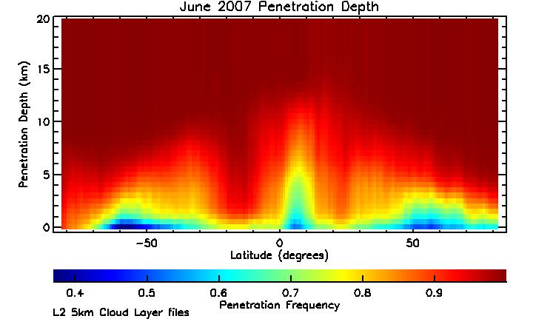
Penetration Statistics
Zonal average penetration frequency (5-km average profiles)
Global average (single shots) CALIPSO
6 km 58%
4 km 52
2 km 43
Sfc 31
CALIPSO
orbit 705 km
energy 110 mJ

Slide 10
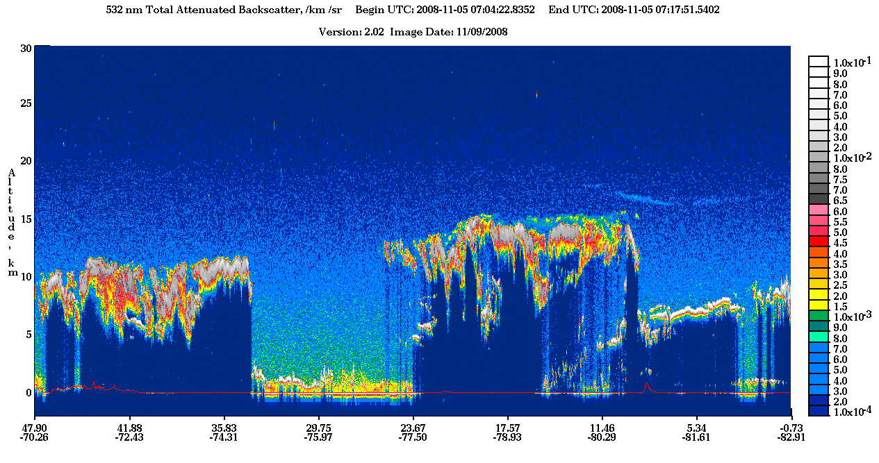
CALIPSO
“Curtain”
“/km /sr” - per km per steradian (square radian)
Notes:
Backscattering can occur in quite different physical situations, where the incoming waves or particles are deflected from their original direction by different mechanisms:
Diffuse reflection from large particles and Mie scattering, causing alpenglow and gegenschein, and showing up in weather radar;
inelastic collisions between electromagnetic waves and the transmitting medium (Brillouin scattering and Raman scattering), importa

Slide 11
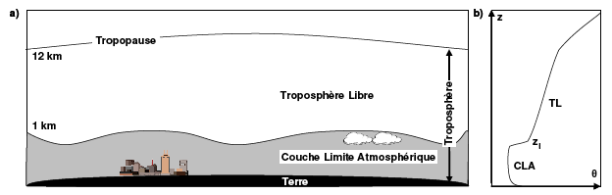
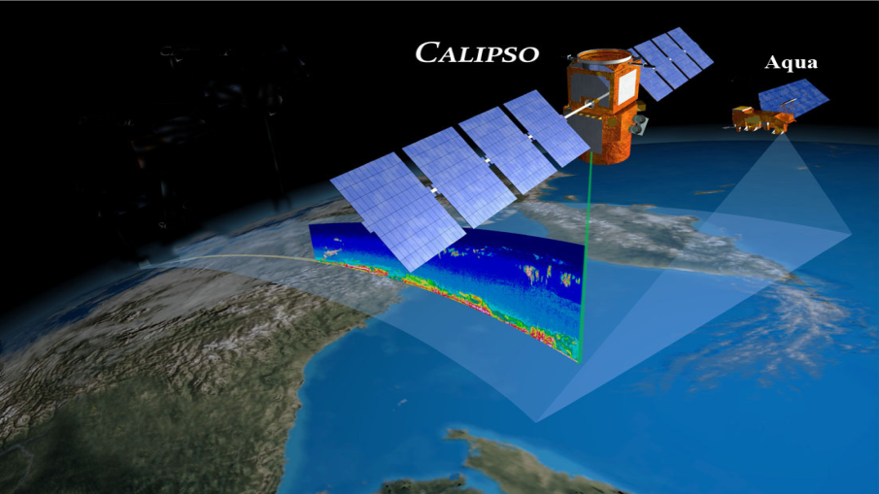
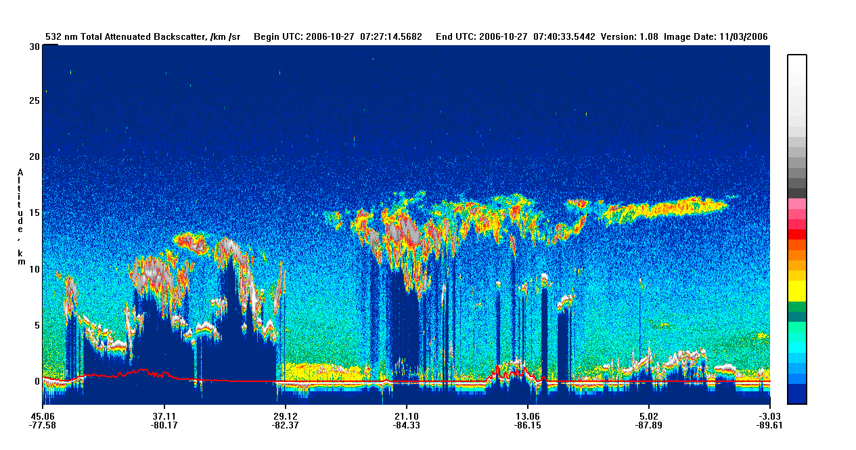
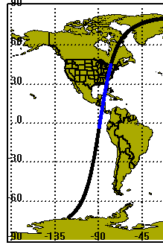
What’s a CALIPSO Curtain Scene?
Free Troposphere
Troposphere
Planetary Boundary Layer
532 nm
25km -
aerosols
20km -
clouds
15km -
Latitude
10km -
Land
5km -
0km -
PBL
Longitude

Slide 12
CALIPSO products
Version 3.3 Product | Primary Parameter | Resolution due to averaging
 |  | Horizontal | Vertical (<8km)
Level 1 Measured | Total_Attenuated_Backscatter_532 Perpendicular_Attenuated_Backscatter_532 Total_Attenuated_Backscatter_1064 | 1/3km | 30m
Level 2 LAYER Retrieved | Cloud Layer_Top/ Base_Altitude | 1/3, 1, 5km | 30m
 | Aerosol Layer_Top/ Base_Altitude | 5km | 30m
Level 2 PROFILE Retrieved | Cloud and Aerosol Total_Backscatter_Coefficient_532 Extinction_Coefficient_532 | 5km | 60m
Level 2 Vertical Feature Mask Retrieved | Feature_Classification_Flags | 5km | 30m

Slide 13

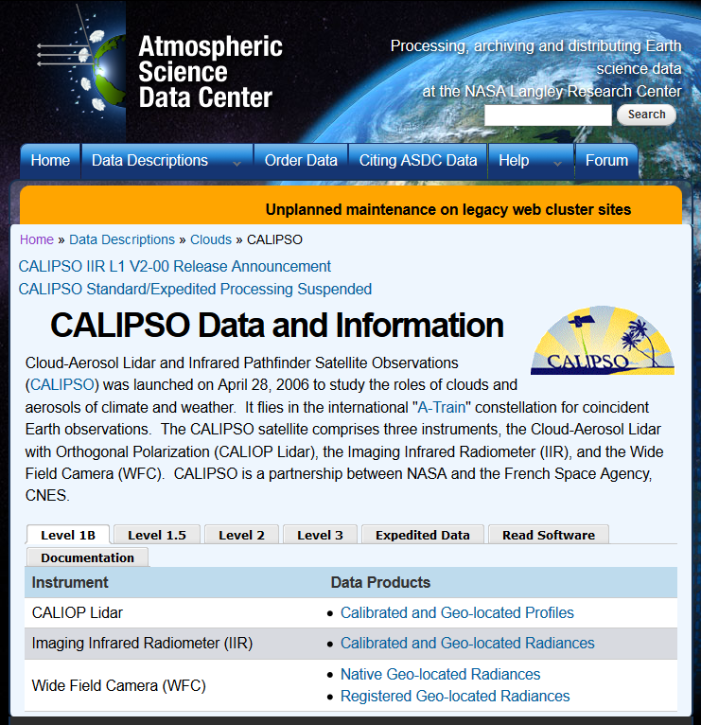
Lidar Data Products
Level 1 (geolocated and calibrated)
DP 1.1 - profiles of attenuated lidar backscatter (532, 532⊥, 1064 nm)
DP 1.2 – IR radiances (8.65, 10.6, 12.05 μm)
DP 1.3 – Visible radiances (650 nm) (WFC)
Level 2
DP 2.1A – Cloud/Aerosol layer product
  layer base and top heights, layer-integrated properties
DP 2.1B – Aerosol profile product
  backscatter, extinction, depolarization profiles
DP 2.1C – Cloud profile product
  backscatter, extinction, depolarization, ice/water content profiles
DP 2.1D – Vertical Feature mask
  cloud/aerosol locations
(available at https://eosweb.larc.nasa.gov/project/calipso/calipso_table

Slide 14
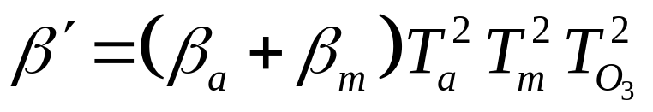
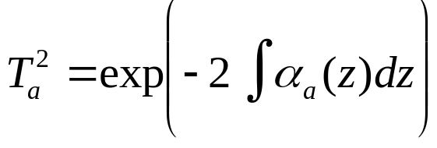
From lidar signal to extinction profile? -Theory-
Lidar signal
=> calibration => Attenuated backscatter coefficient β’
In a cloud-free atmosphere:
Aerosol and molecular backscatter
Atmospheric two-way transmittance
= signal attenuation
Aerosols, Molecules, Ozone
For aerosols:
Aerosol extinction coefficient
Molecular backscatter and attenuation can be computed
=> β’ function of β_{a} and α_{a}
One measurement
Two unknowns
If we assume an aerosol extinction-to-backscatter LIDAR ratio S_{a}= α_{a}/β_{a}
function of particle size and shape and β’ in 3 channels
=> Retrieval of β_{a} and α_{a}

Slide 15
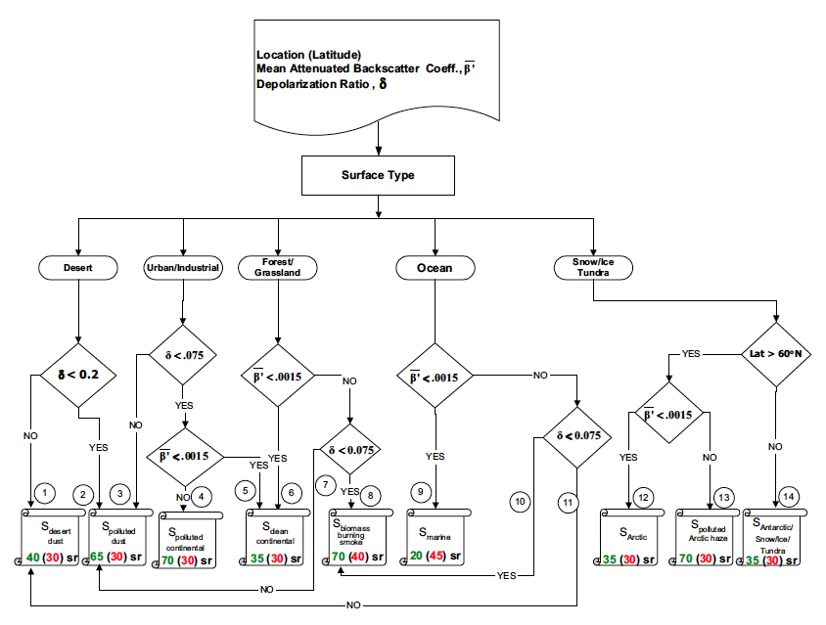
Layer classification
a) Cloud-Aerosol Discrimination [Liu et al., 2004, 2009]
b) Cloud ice-water phase discrimination [Hu et al., 2009]
Look Up Table
Aerosol Sub-type | Initial S_{a,532}
biomass burning smoke | 70
polluted dust | 65
polluted continental | 70
clean continental | 35
desert dust | 40
marine | 20
c) Aerosol sub-typing and observation-based lidar ratio S_{a}:
[Omar et al., 2005, 2009; Liu et al., 2009]

Slide 16
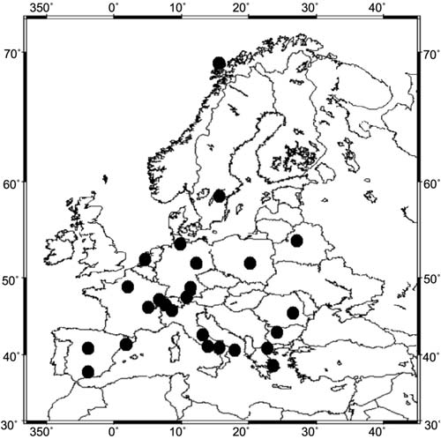
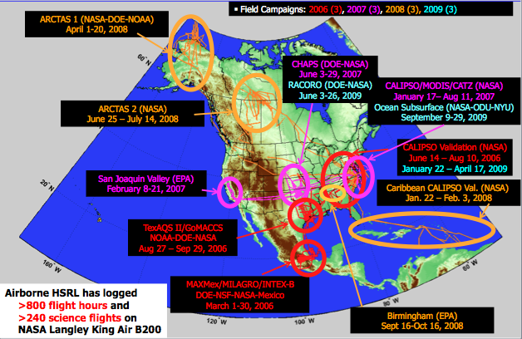
CALIPSO validation
Level 1 CALIOP attenuated backscatter
Absence of evident bias in CALIOP level 1 attenuated backscatter profiles
CALIOP 532 nm calibration algorithm seems fairly accurate
EARLINET
  1. Ground-based validation with EARLINET (European Aerosol Research LIdar NETwork):
  Relative mean difference of ~4.6% between CALIOP and EARLINET since June 2006 over Europe [Pappalardo et al., 2010]
HSRL flights
      2. Airborne validation with HSRL (High Spectral Resolution Lidar):
      HSRL and CALIOP (coincident data from 86 underflights) agree on average within 2.7±2.1% (CALIOP lower) at night and within 2.9±3.9% (CALIOP lower) during the day [Rogers et al., 2010]

Slide 17
CALIPSO validation
Level 2 CALIOP layer boundaries, backscatter and extinction
Very little validation of CALIOP level 2 data: few case studies
Significant uncertainties associated with level 2 data
1. Ground-based validation with EARLINET
Example: CALIPSO underestimates Sa (40 instead of ~50 sr, hence underestimates AOD) during 26–31 May 2008 Saharan Dust outbreak [Pappalardo et al., 2010]
2. Airborne validation with HSRL
CALIOP overestimates HSRL extinction with an average extinction bias of ~ 24% during CATZ (CALIPSO and Twilight Zone campaign) and ~59% during GoMACCS (Gulf of Mexico Atmospheric Composition and Climate Study) [Omar et al, 2009]

Slide 18
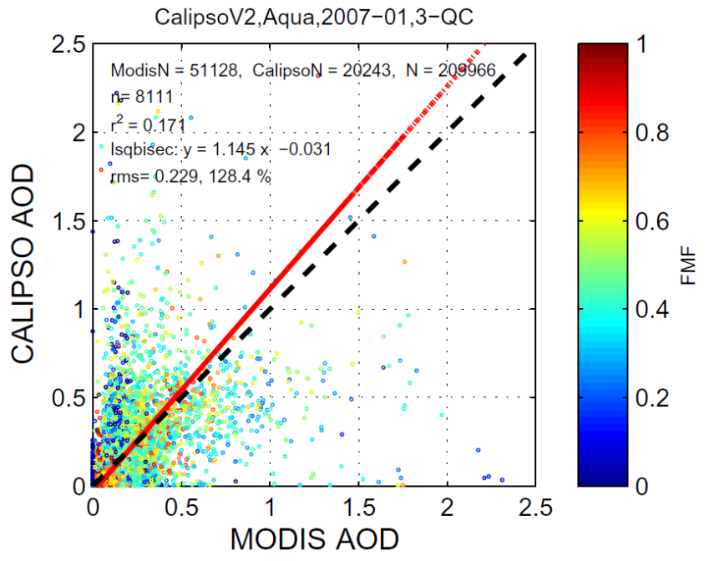
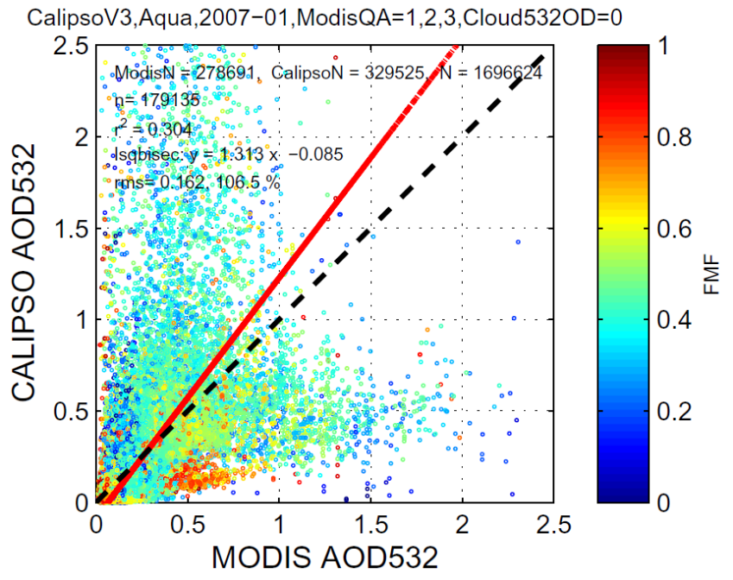
CALIPSO validation
3. CALIOP versus other A-Train satellite AOD
  CALIOP (V2) underestimates both POLDER and MODIS AOD (also AERONET and HSRL) on August 04 2007 by 0.1-0.2 during CATZ [Kacenelenbogen et al., 2010]
CALIOP Version 2
CALIOP Version 3.01
R²=0.17
R²=0.30
[Redemann et al., in prep.]
[Redemann et al., in prep.]
  CALIOP (V3.01) better than CALIOP (V2)-MODIS AOD but still not satisfactory
  CALIOP (V3.01) globally overestimates MODIS AOD over ocean with R²=0.30 in January 2007

Slide 19
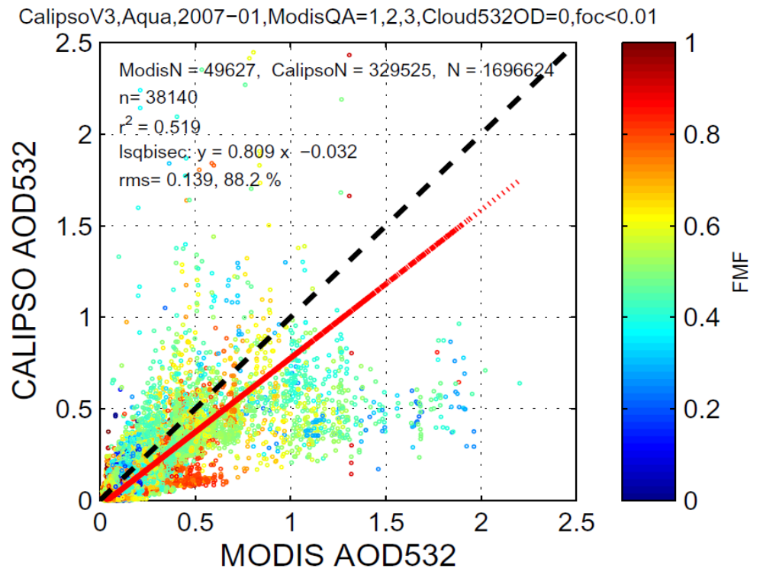
CALIPSO validation
Additional cloud-screening on both datasets with MODIS cloud fraction
CALIOP Version 3.01
Reduces discrepancies between two data sets due to cloud contamination
Higher correlation coefficient (0.52 instead of 0.30)
CALIPSO slightly underestimates MODIS AOD
R²=0.52

Slide 20
Level 2 data uncertainties
Low Signal to noise ratio
CALIOP will fail to detect layers with aerosol backscatter < 2~4 10⁻⁴ km⁻¹ sr⁻¹ in troposphere [Winker et al., 2009] (S_{a} of 50sr, α of 0.01-0.02 km⁻¹, AOD of 0.02-0.04 in 2km)
➔CALIOP not measuring tenuous aerosol layers
➔ Lack of photons returned from underneath highly attenuating layers (dense aerosol or cloud) leading to erroneous or total lack of aerosol identification in the lower part of a given atmospheric profile
Miss-classification of layer type (aerosol or cloud) and aerosol sub-type (biomass, dust, etc…)
➔ leading to incorrect assumption about lidar ratio Sa
Improved calibration technique
➔ for the lidar Level 1 532 nm daytime calibration in Version 3.01 [Powell et al., 2010]
Multiple scattering is assumed negligible in current algorithm
➔ Impact on cases with dense dust plumes recording high AOD where effects of multiple scattering applies

Slide 21
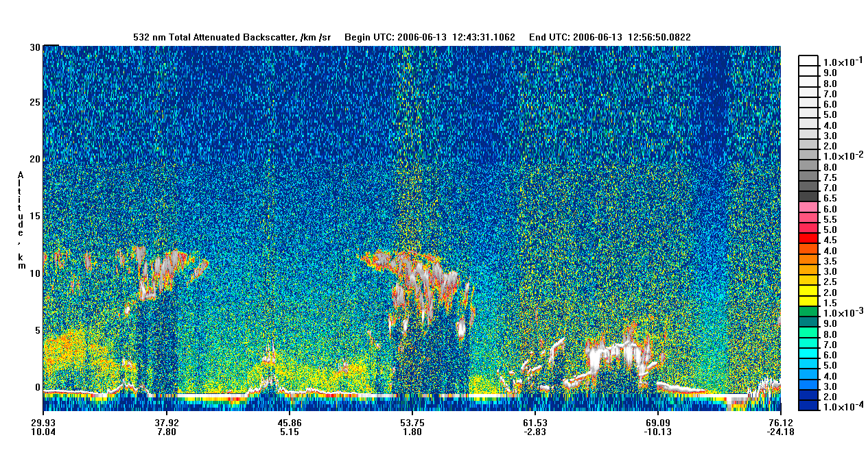
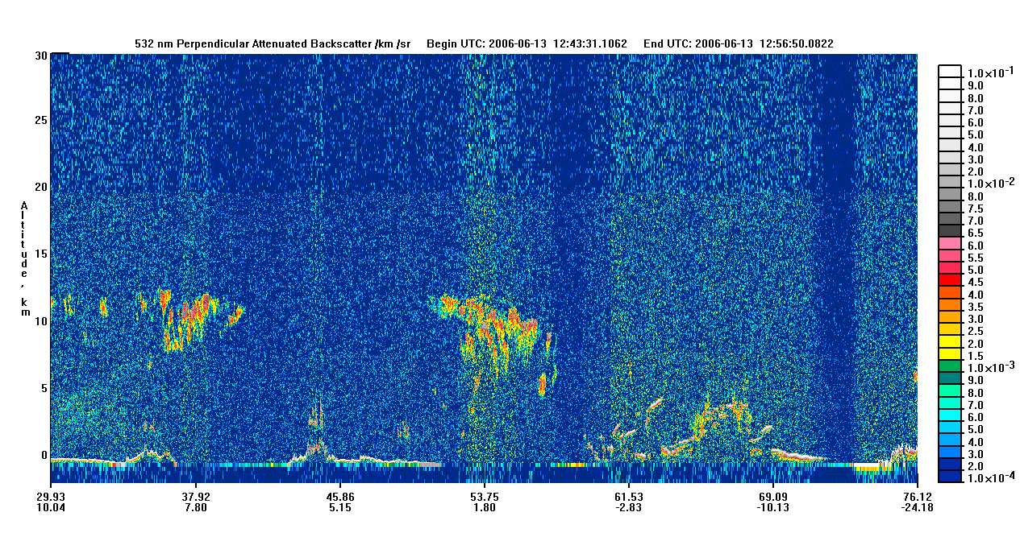

CALIPSO browse images online
Level 1 products
Total attenuated backscatter 532 nm
A
B
Perpendicular attenuated backscatter 532 nm
A
B
If enhanced signal in both images then non spherical particles (Region A)
If enhanced signal in total backscatter image but little or no enhancement in the perpendicular image, then spherical particles (Region B)

Slide 22
Lidar Signal Interpretation
 |  |  | Particle Type
Enhanced Signal | Enhanced Signal | Same intensity as 532 | Non-Spherical Coarse
Enhanced Signal | Enhanced Signal | Lower intensity than 532 | Non-Spherical Fine
Enhanced Signal | Non Enhanced Signal | Same intensity as 532 | Spherical Coarse
Enhanced Signal | Non Enhanced Signal | Lower intensity than 532 | Spherical Fine
Total attenuated backscatter 532 nm
Total attenuated backscatter 1064 nm
A
B

Slide 23
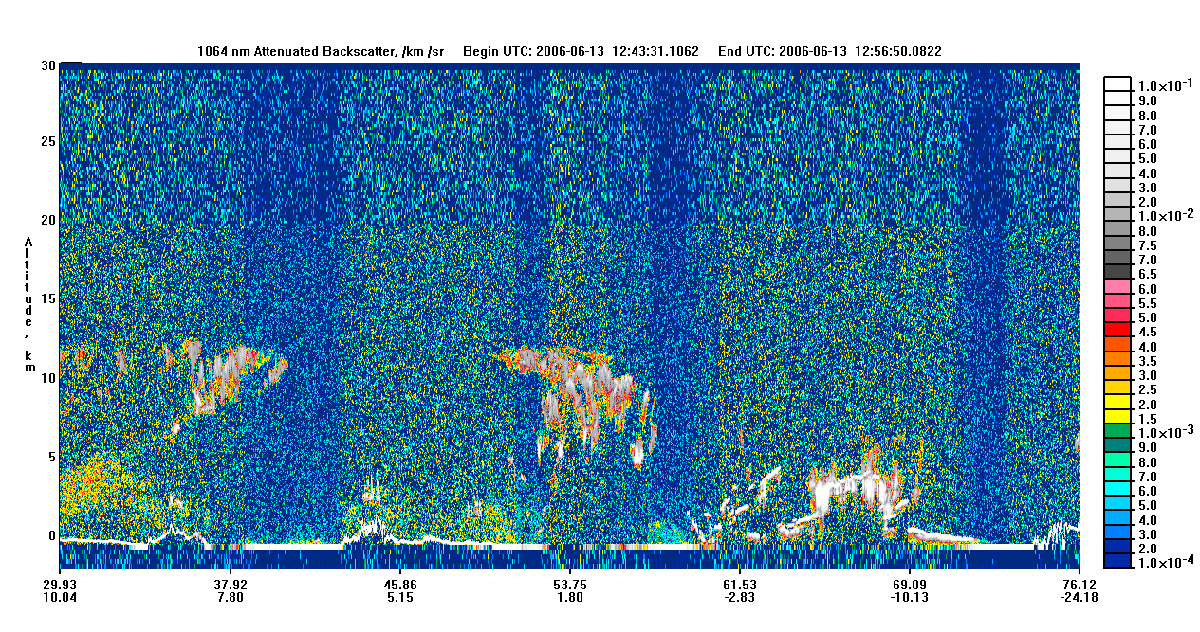
CALIPSO browse images online
Level 1 products
Total attenuated backscatter 532 nm
A
B
Total attenuated backscatter 1064 nm
A
B
Region A: coarse non spherical
= cirrus cloud?
Region B: fine spherical
= urban pollution?
If same intensity in both channels, coarse particles
If signal more intense in β’₅₃₂, fine particles

Slide 24
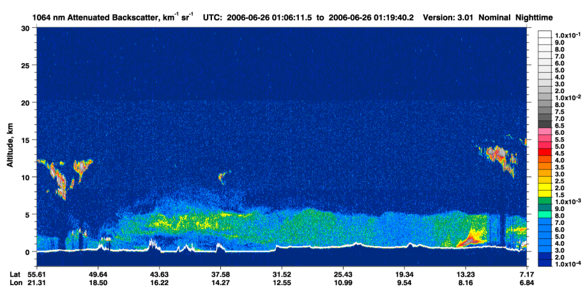

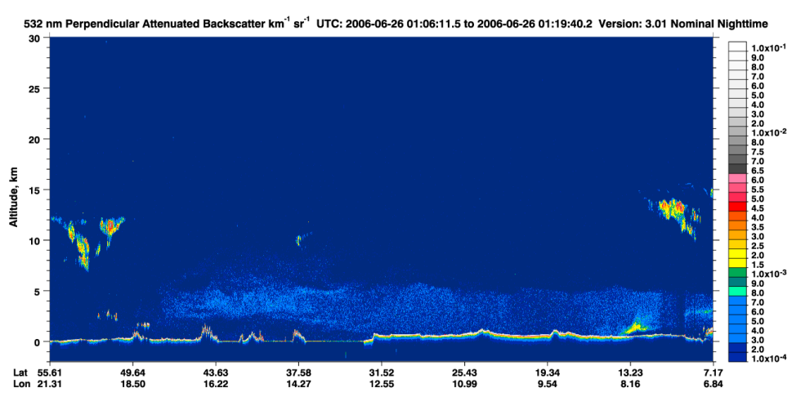
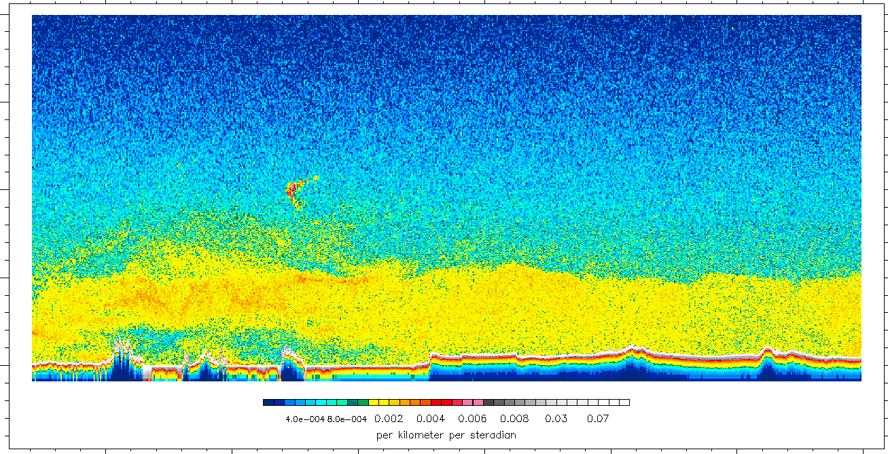
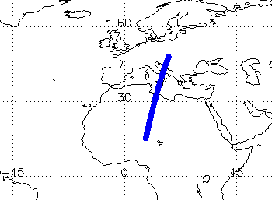
Example: June 26, 2006
Parallel channel enhanced?
Signal also strong in 1064?
20-km
Total attenuated backscatter 532 nm
15-km
10-km
5-km
0-km
45° N
40° N
35° N
30° N
25° N
20° N
15° N

Slide 25
Example: June 26, 2006
Non spherical
Coarse particles
=>Most probably dust
20-km
Total attenuated backscatter 532 nm
15-km
10-km
5-km
0-km
45° N
40° N
35° N
30° N
25° N
20° N
15° N

Slide 26
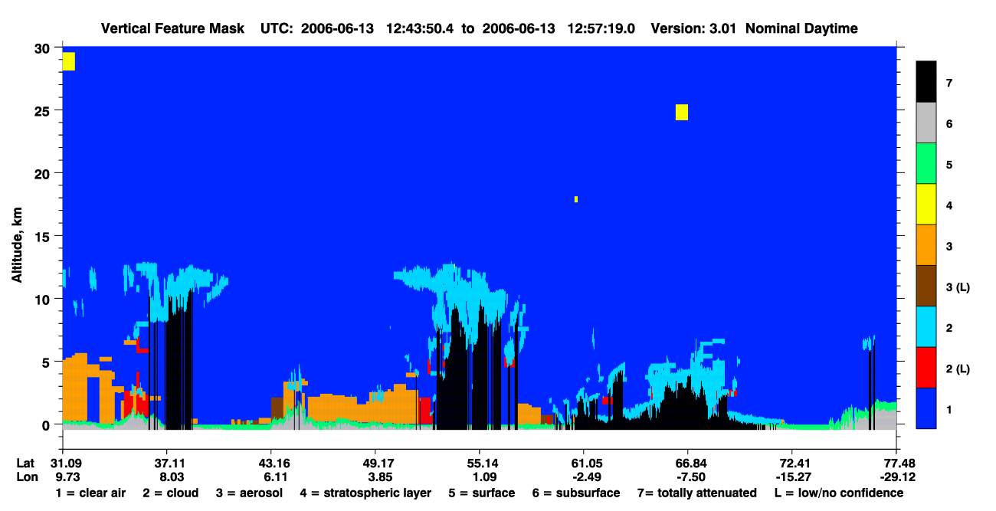
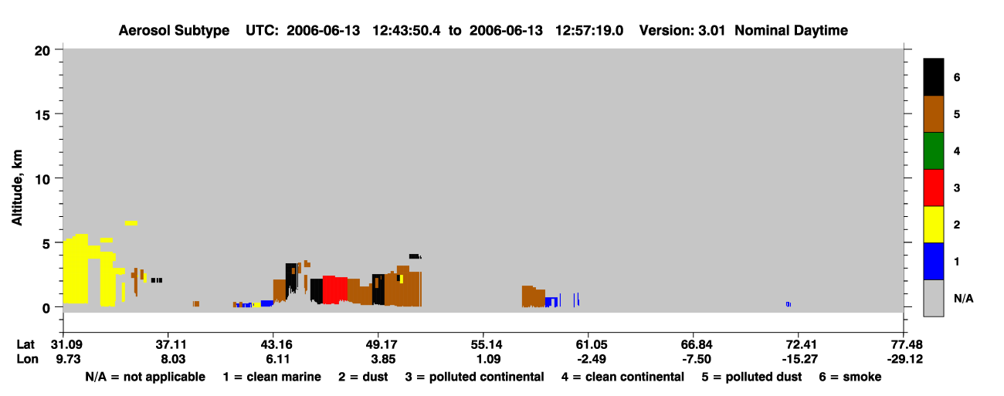
CALIPSO browse images online
Level 2 products
Vertical Feature Mask
aerosol (B)
cloud (A)
clear air
A
B
Aerosol Sub-type
clean marine
dust (B)
polluted continental
clean continental
polluted dust (B)
smoke
B
According to Level 2,
Region A: cloud
Region B: dust/ polluted dust for B
Different from Level 1 Analysis…

Slide 27
Which data should I use?
Safest is qualitative use of level 1 latest version (currently 4) attenuated backscatter data in 3 channels
→ Browse standard product lidar images online
For quantitative use, level 1 data contains less uncertainties than level 2 data
If you use level 2 data, you need to know the associated uncertainties (and most of these are reported in the level 2 data products)
Some knowledge on Level 1-to-level 2 algorithm…

Slide 28
Level 1-to-level 2 algorithm
Input (level 1, β’)
Output (level 2)
1. Layer detection
Vertical Feature Mask
Averaging engine
Combined aerosol and cloud layer
Profile Scanner
1/3km Cloud Layer Product
Composite layer Product
1km Cloud Layer Product
Scene Classification Algorithm
2. Layer classification
5km Cloud Layer Product
5km Aerosol Layer Product
Extinction Averaging Engine
Profile Solver
Preliminary Profile Product
T² corrected layer properties
5km Cloud Profile Product
Profile Averaging engine
3. Layer extinction
5km Aerosol Profile Product

Slide 29
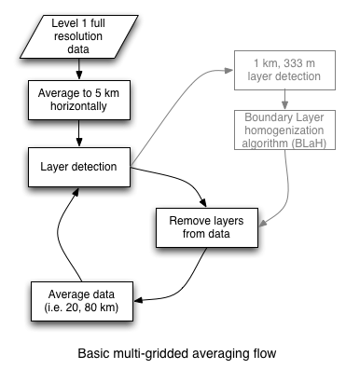
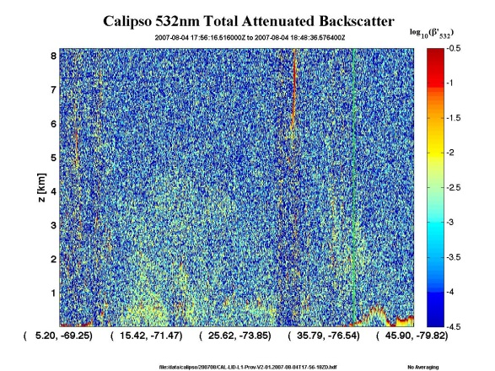
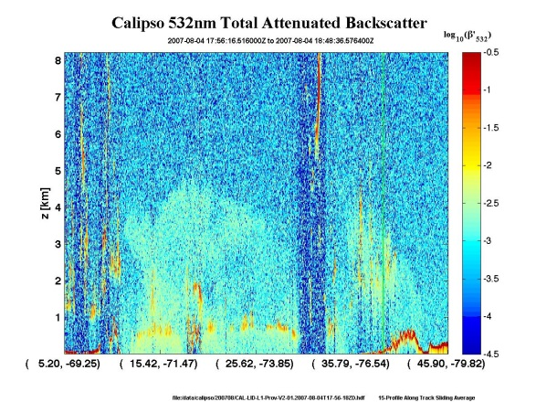
Layer Detection
a) Input is level 1 attenuated backscatter
b) Data averaged from 333m to 5km
c) Layers identified as enhancements above molecular background (adaptive threshold using β’_{532,⊥}and β’_{532,//} and molecular model)
Here cloud detected at 333m; aerosol at 5km
d) Detected layers removed from curtain scene
e) Further averaging of the data (20, 80km)…

Slide 30
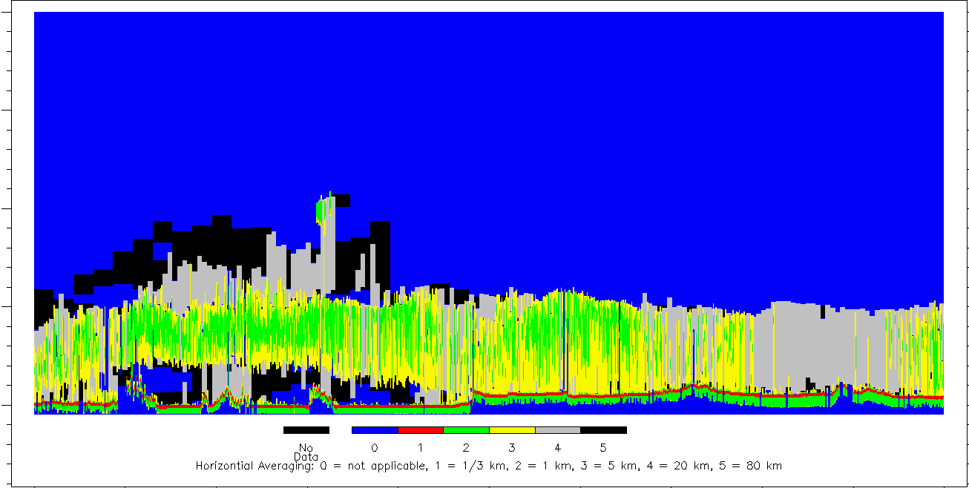
Example: June 26, 2006
20-km
Different amounts of horizontal averaging are required to detect different portions of the dust layer
15-km
10-km
5-km
0-km
N/A single shot 1-km 5-km 20-km 80-km
45° N
40° N
35° N
30° N
25° N
20° N
15° N

Slide 31
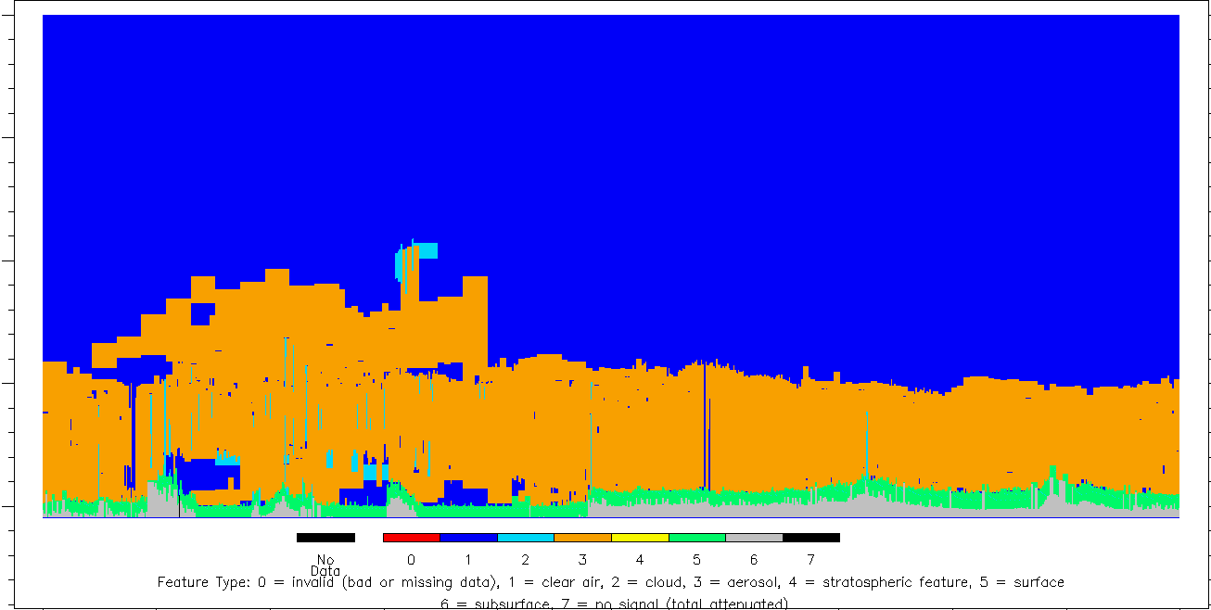
Example: June 26, 2006
20-km
Cloud-Aerosol Discrimination
15-km
10-km
5-km
0-km
invalid clear cloud aerosol stratospheric surface subsurface no signal
45° N
40° N
35° N
30° N
25° N
20° N
15° N

Slide 32

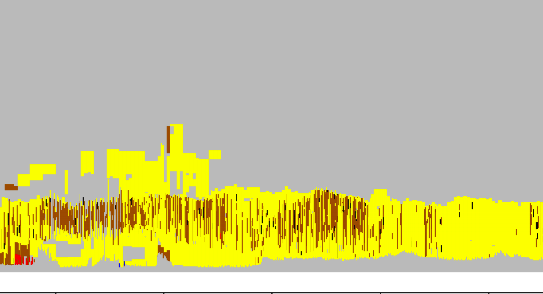
Example: June 26, 2006
Aerosol sub-typing
dust
polluted continental
polluted dust
smoke

Slide 33
CALIPSO: example of application
The detection of aerosols over clouds
Aerosols and their radiative effects are a major uncertainty in predictions of future climate change
Biomass burning aerosols usually strongly absorbing, may cause local positive radiative forcing when over clouds
CALIOP is the only satellite sensor capable of observing aerosol over clouds without any auxiliary data (OMI or POLDER need to combine with MODIS and/ or CALIOP)
Before studying aerosol radiative effects over clouds, we need to know where and when aerosol over clouds occur as well as their intensity
We use the CALIPSO level 2 aerosol layer product…

Slide 34
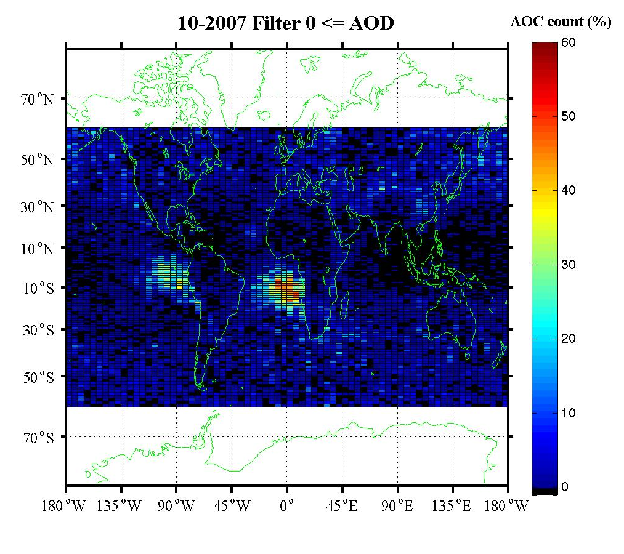
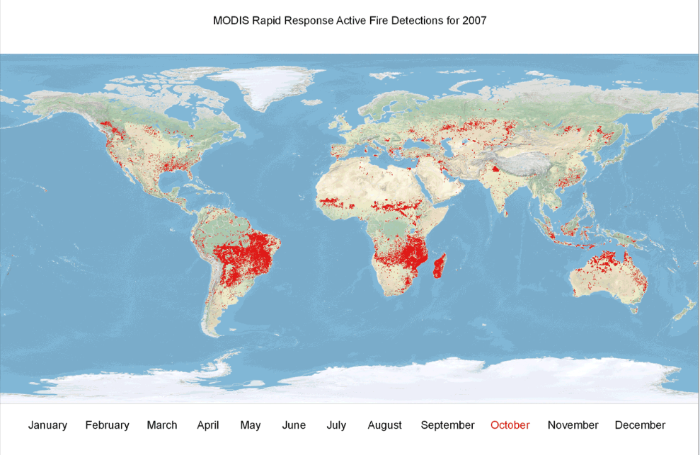
Aerosol Over Cloud (AOC)
October 2007 AOC occurrence
October 2007 MODIS active fires
Over 50 % AOC (/CALIOP data) offshore from South America and South Africa
Probably mostly biomass burning smoke
“…huge increase in fire activity in 2007… largest over the last ten years” and “largest 6-month (May–October) precipitation deficit of the last ten years in South America occurred during 2007 [Torres et al., 2009]

Slide 35
Take home message
CALIOP/ CALIPSO provides aerosol vertical distribution and info on type of particle (size and shape)
Safest use of CALIOP data:
Qualitative (browse lidar images online)
Latest version (currently V3.01)
Level 1 (contains less uncertainties than level 2 data)
Concerning the use of CALIOP Level 2 data,
recognize the unvalidated nature of the data
keep in mind the uncertainties
make sure to read all quality assurance information and to apply the appropriate quality flags (see user guide, http://www-calipso.larc.nasa.gov/resources/calipso_users_guide/)
If you have any concerns, ask the CALIPSO team

Slide 36
Online
User Guide:
  http://www-calipso.larc.nasa.gov/resources/calipso_users_guide/
  FAQ, Essential reading, Data Product Descriptions, Data quality summaries (V3.3), Example and tools, Order Data, Publications
Data download
  https://eosweb.larc.nasa.gov/HORDERBIN/HTML_Start.cgi
  http://www-calipso.larc.nasa.gov/search/ for subset files
LIDAR browse images
Level 1 and Level 2 Vertical Feature Mask; No level 2 profile
  EXPEDITED 12h-RELEASE with kmz files
  http://www-calipso.larc.nasa.gov/products/lidar/browse_images/expedited/
  STANDARD PRODUCT for detailed science analysis
  http://www-calipso.larc.nasa.gov/products/lidar/browse_images/show_calendar.php/
  Also provides horizontal averaging, Ice/ Water phase and aerosol subtype
*Note they’re doing maintanence on their websites right now

Slide 37
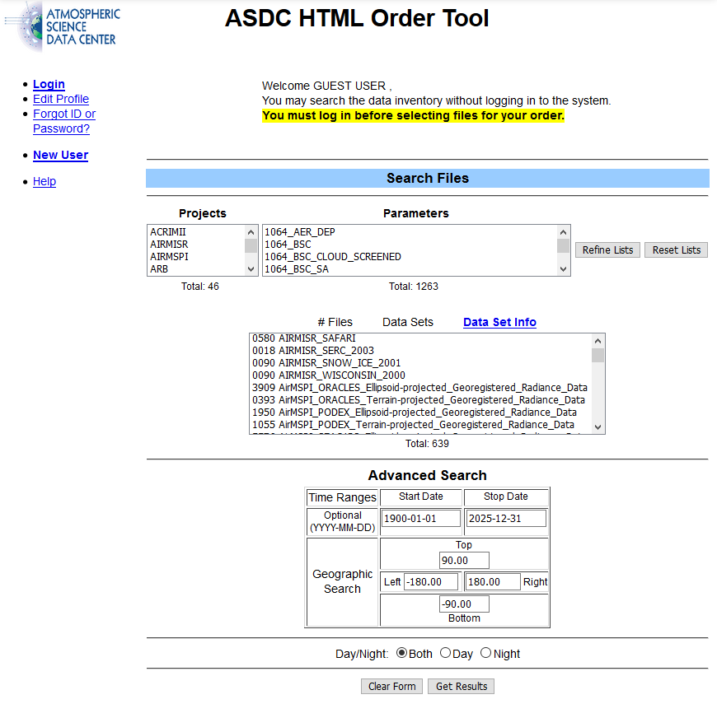
Data Access Interface
You need to know
  Project = CALIPSO
  Parameter
    e.g. Variety including 532nm backscatter coefficient
  Data Set
    Different data sets, processed with different version of the algorithm.
    Current Version is ValStage 1 3.40 for Level 1 data and Level 2 data like the virtual feature mask
  Time Frame
    Remember it went up in 2006

