Slide 1

MODIS Aerosol Introduction
MET 611 – Satellite Data Applications
Jennifer D. S. Griswold

Slide 2
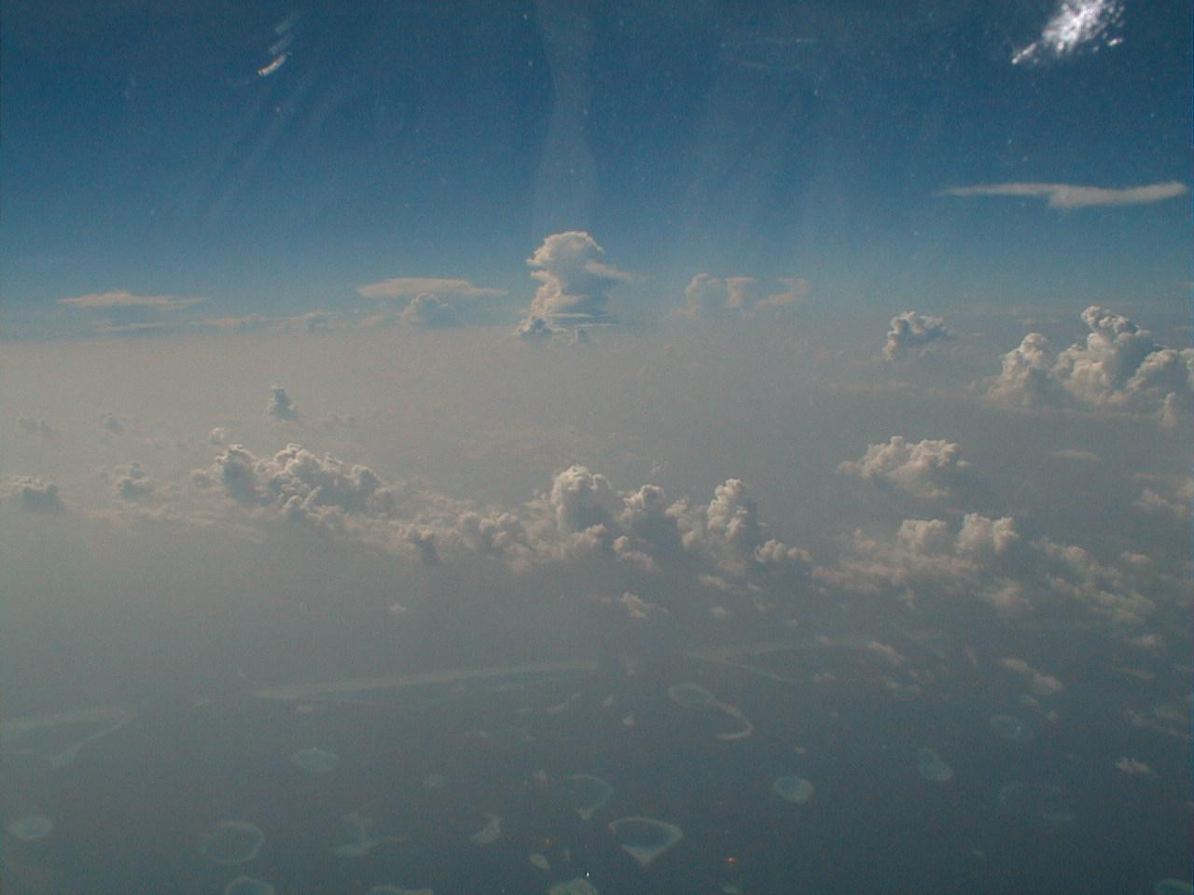
What are aerosols and where are they from ?

Slide 3
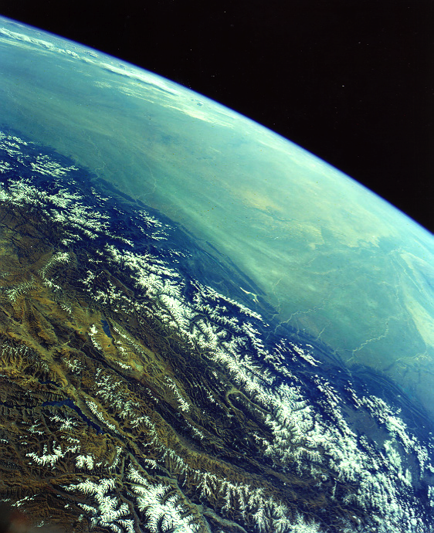
Pollution
The view from Tibet
Sea of pollution Over India
Image from the Shuttle

Slide 4
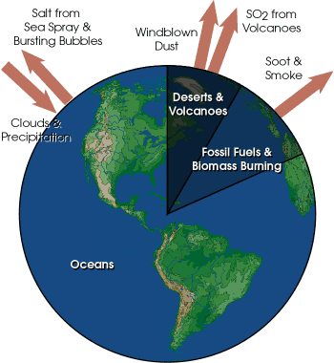
Aerosol Types and Origins
Aerosol particles larger than about 1 μm in size are produced by windblown dust and sea salt from sea spray and bursting bubbles.
Aerosols smaller than 1 µm are mostly formed by condensation processes such as conversion of sulfur dioxide (SO₂) gas (released from volcanic eruptions) to sulfate particles and by formation of soot and smoke during burning processes.
After formation, the aerosols are mixed and transported by atmospheric motions and are primarily removed by cloud and precipitation processes.

Slide 5
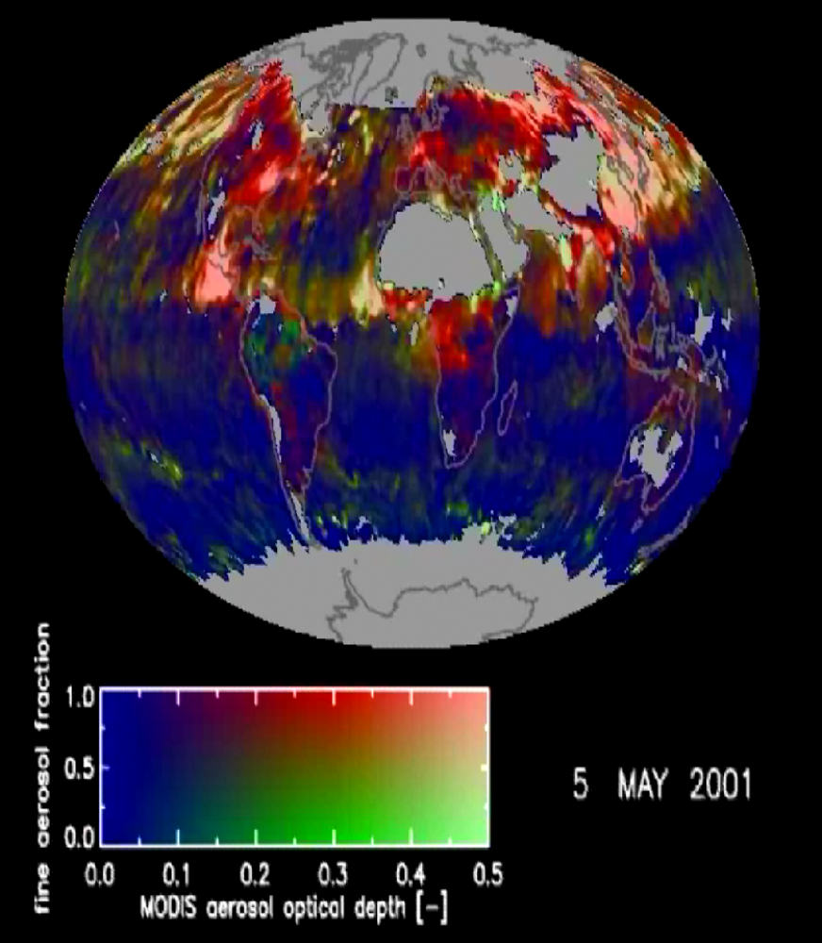
Pollution/dust in China
Smoke
Pollution
Saharan dust
Sea Salt
Pollution/dust in India
Dust and smoke are Transported to the North-East Atlantic. From MODIS

Slide 6
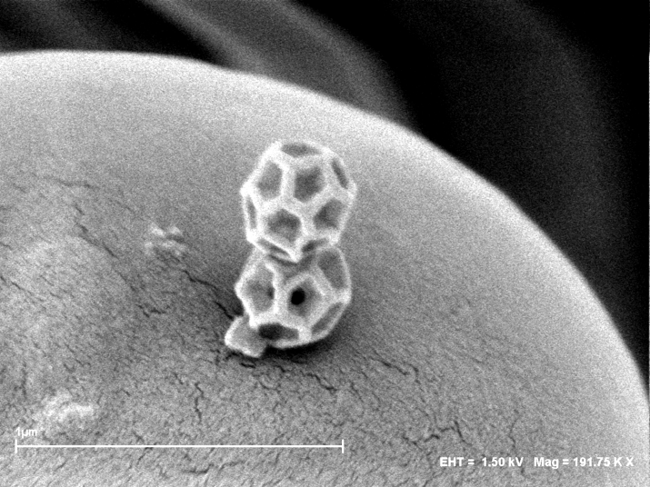
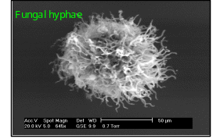
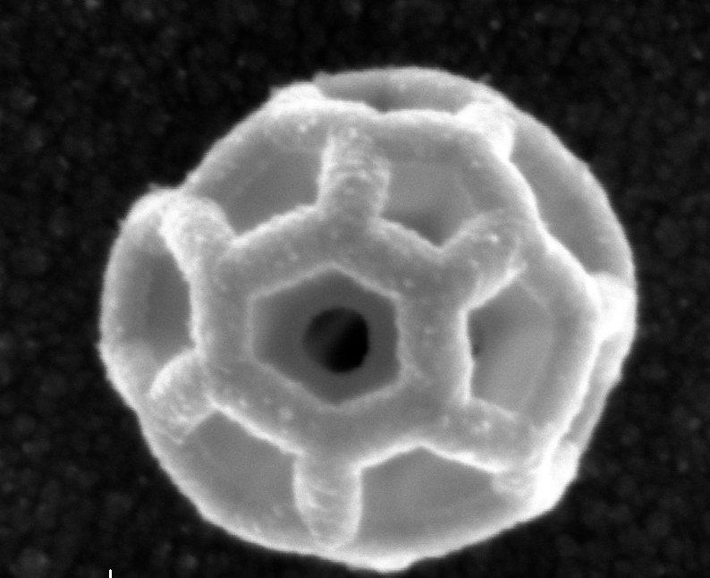
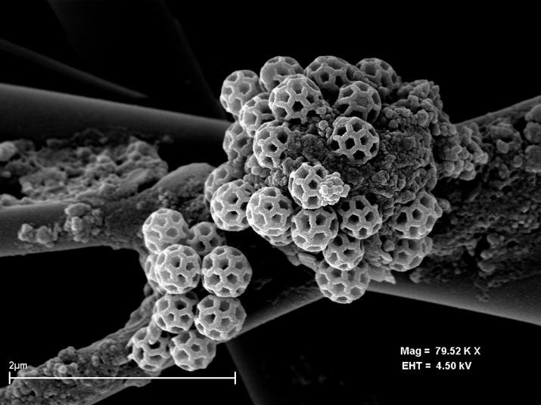
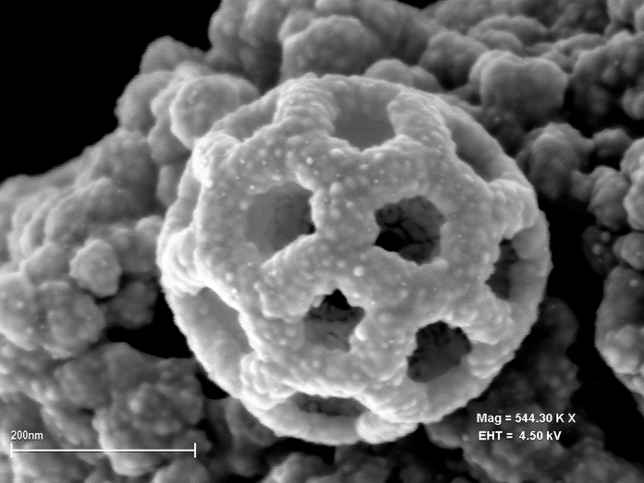
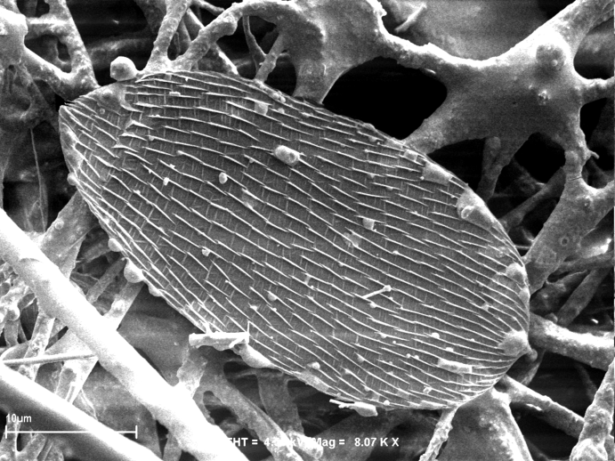
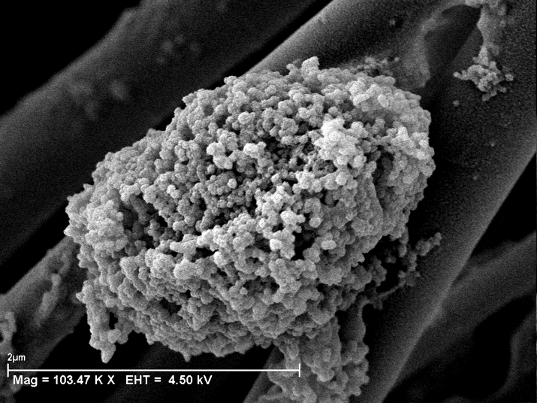
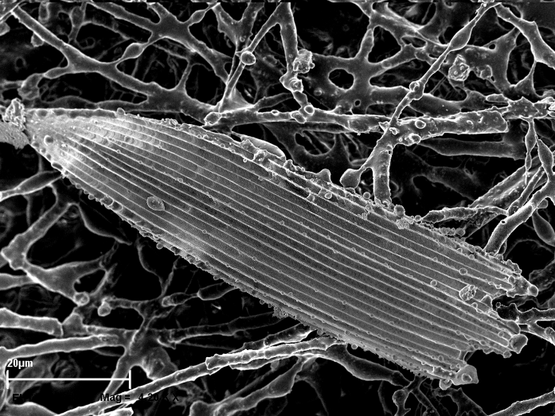
Natural Biogenic Aerosol
Wherever you have trees or vegetation, these particles are there.
These are from Brazil.
photos from Gunther Helas, MPIC

Slide 7
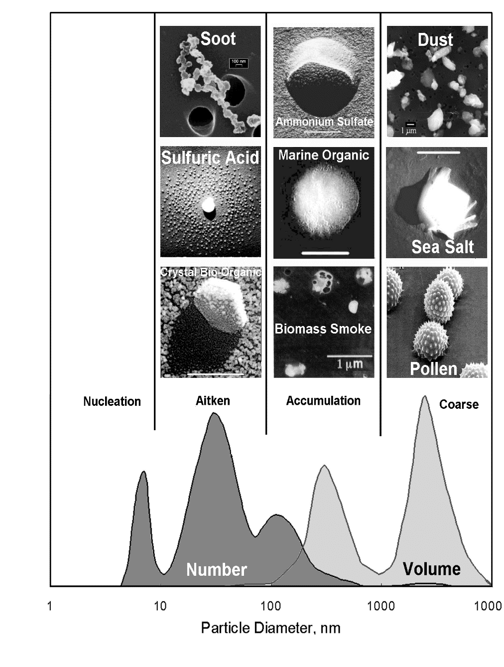
Aerosol Size Distribution
It presents 3 modes :
    - « nucleation »: radius is between 0.002 and 0.05 μm. They result from combustion processes, photo-chemical reactions, etc.
    - « accumulation »: radius is between 0.05 μm and 0.5 μm. Coagulation processes.
    - « coarse »: larger than 1 μm. From mechanical processes like aeolian erosion.
« fine » particles (nucleation and accumulation) result from anthropogenic activities, coarse particles come from natural processes.
0.01
0.1
1.0
10.0

Slide 8
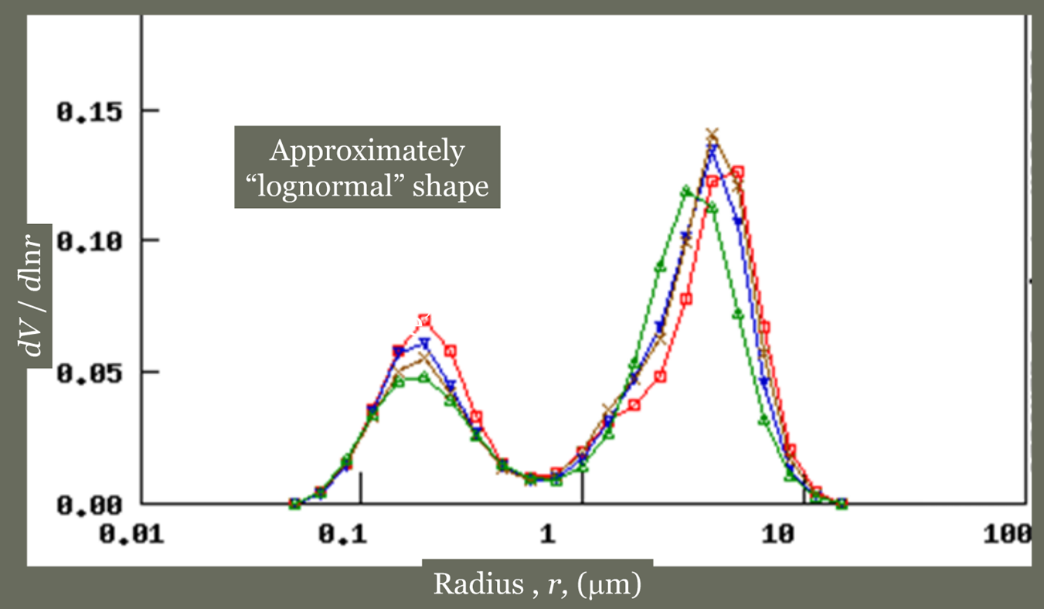
Size Distribution

Slide 9
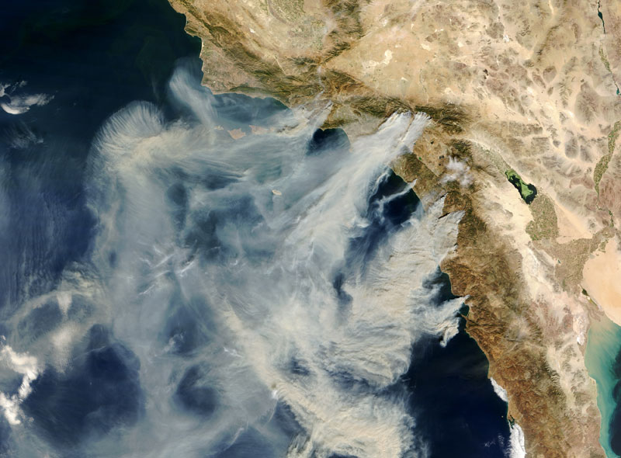
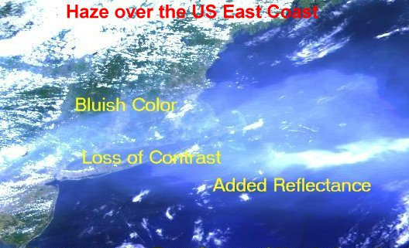
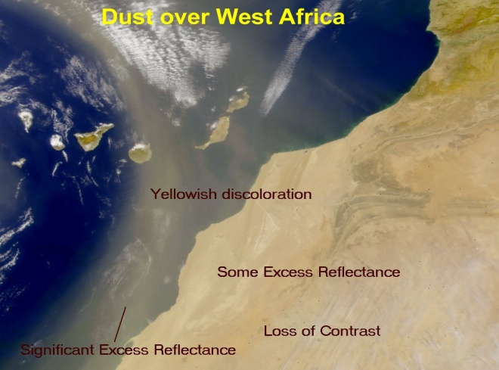
Aerosol from space by solar backscatter
Relatively easy to do qualitatively for thick plumes over dark ocean…
California fire plumes
Pollution off U.S. east coast
Dust off West Africa
I_{λ} (∞)
Measured top-of-atmosphere reflectance
= f (AOD, aerosol properties,
surface reflectance, air scattering,
gas absorption, Sun-satellite geometry)
aerosol
scattering,
absorption
I_{λ} (0)=I_{λ} (∞)exp[-AOD]

Slide 10
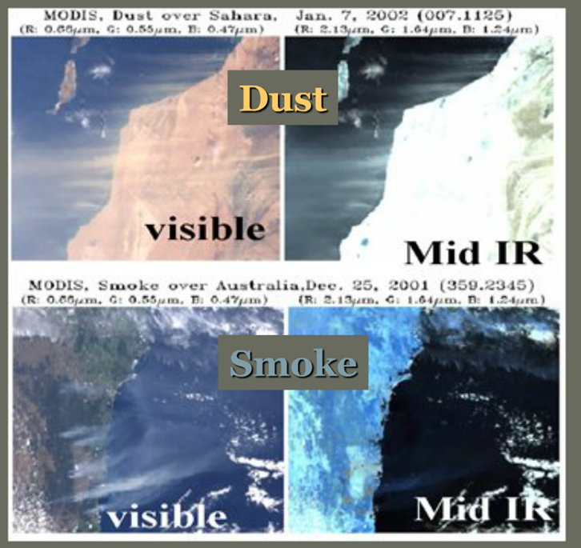
Spectral Properties of Aerosol
Particles of different size respond to different wavelengths.
Big Particles (e.g. Dust) reflect in the IR
Small Particles (e.g. smoke/polltuion) do not

Slide 11
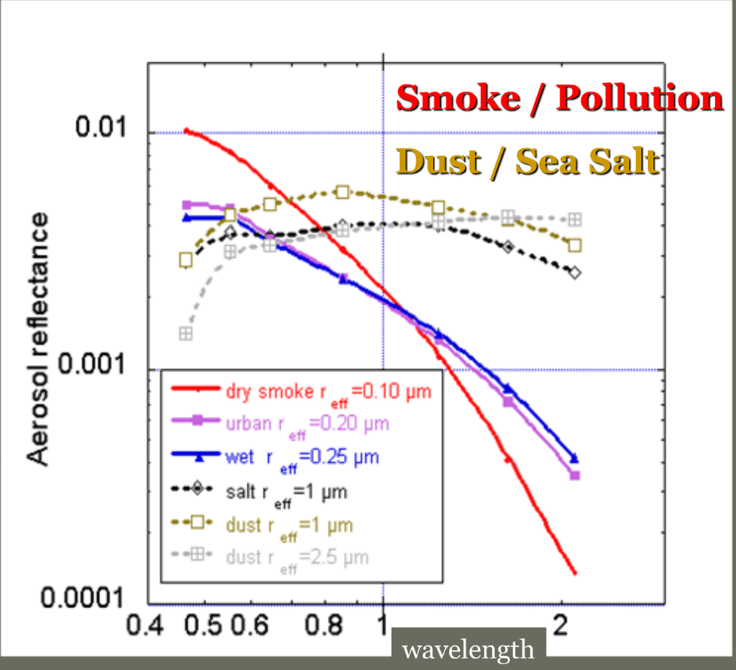
Spectral Optical Properties of Aerosol
Particles of different size respond to different wavelengths.

Slide 12
Aerosol Size and Optical Properties
These aerosols have the largest impacts on:
  radiative budget
  visibility
  cloud processes
  health issues
0.01
0.1
1.0
10.0
UV
BGR
NIR
IR

Slide 13
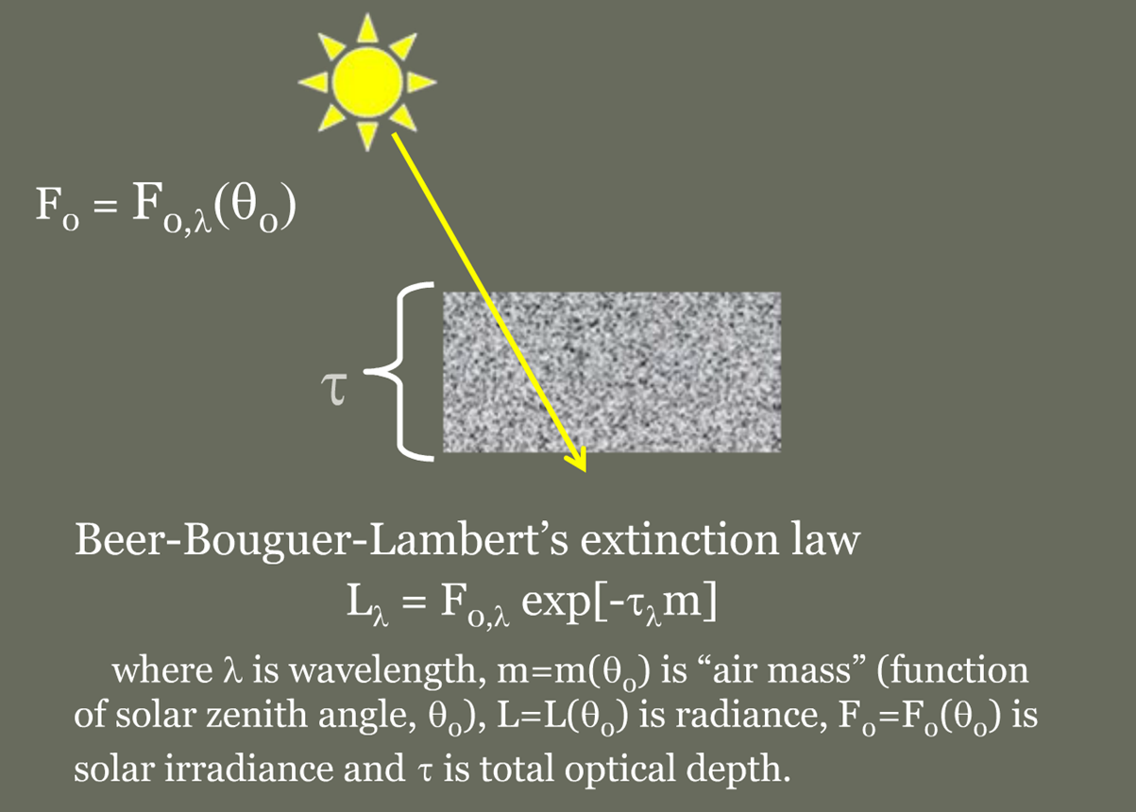
τ - Aerosol Optical Depth
figures from a talk by Y. Kaufman

Slide 14
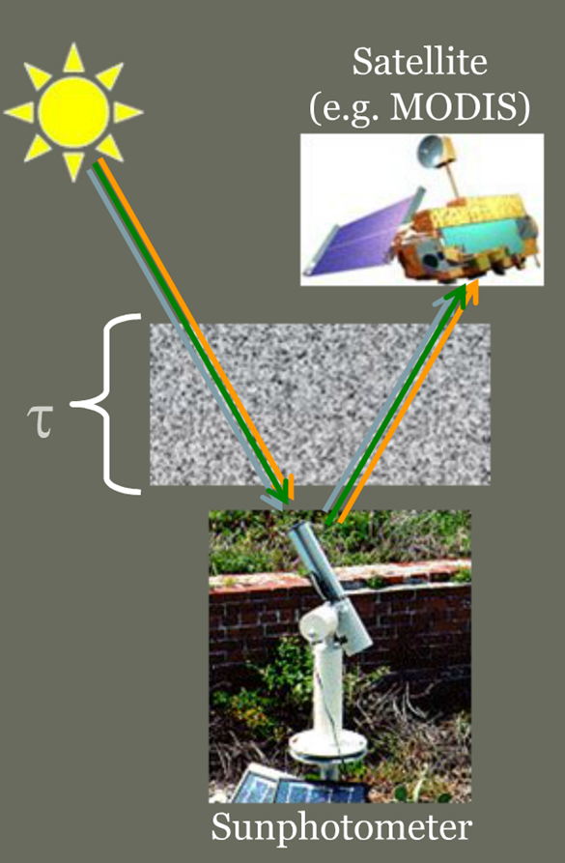
Passive Remote
Sensing (Scattering)
If we can measure spectral light extinction or scattering
And we can separate the aerosol signal (from the total that includes molecular, surface, etc)
Then we can retrieve aerosol optical properties (find a solution that fits the measurements)
Which then can be related to aerosol physical properties (type and loading)
We can do this from the ground (sunphotometer) or from space (satellite).

Slide 15
Passive Remote
Sensing (Scattering)
Unit of measure =
  Aerosol Optical Depth
  AOD
  τ
What is τ?
  τ depends on wavelength (λ)
  τ represents “total column light extinction”

Slide 16
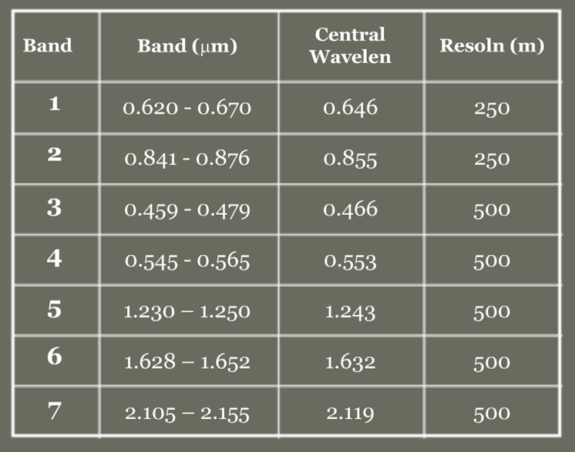
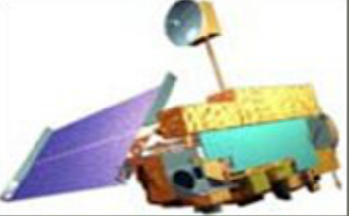
MODIS Aerosol Retrieval Bands
7 Bands for Aerosol Retrieval
All are found in “Atmospheric Windows”

Slide 17
MODIS “Observations”
MODIS observes reflectance in 7 bands at 500 m (or 250 m)
These data are “noisy”
These data must be:
  Cloud “cleared”
  Decided whether over ocean or over land
  Screened for glint and other surfaces that are too bright
  Massaged, averaged to yield…
One set of spectral reflectance that best represents average conditions in 10 km x 10 km box
The MODIS dark target algorithm is actually two separate algorithms, one over ocean and one over land
More about separate algorithms later.

Slide 18
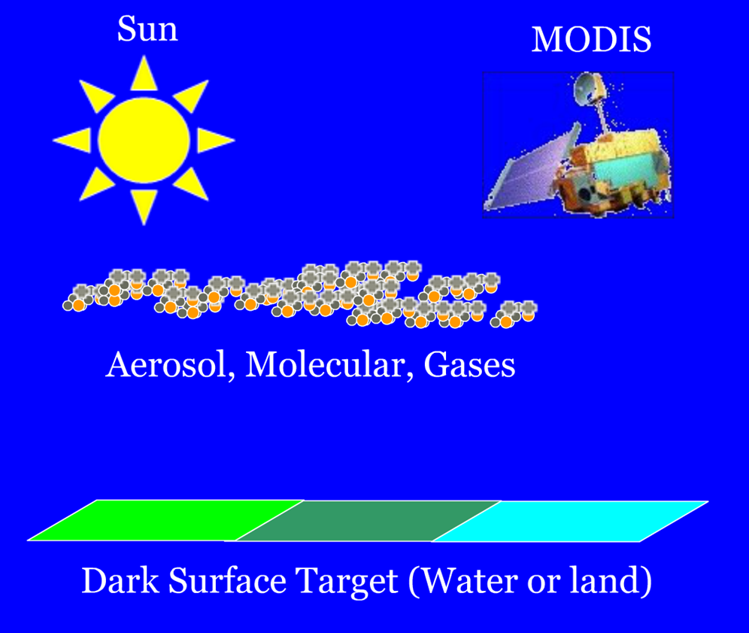
Deconstructing the Clear Sky Signal
cartoons from a talk by Y. Kaufman

Slide 19
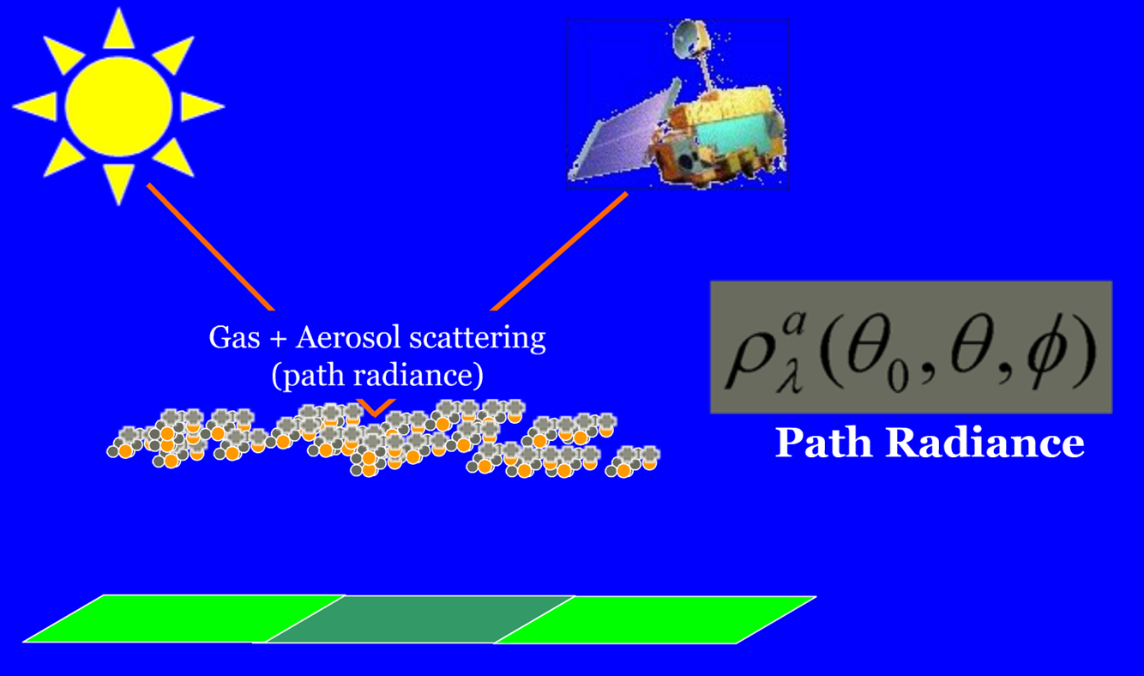
Atmospheric Path Reflectance
cartoons from a talk by Y. Kaufman

Slide 20
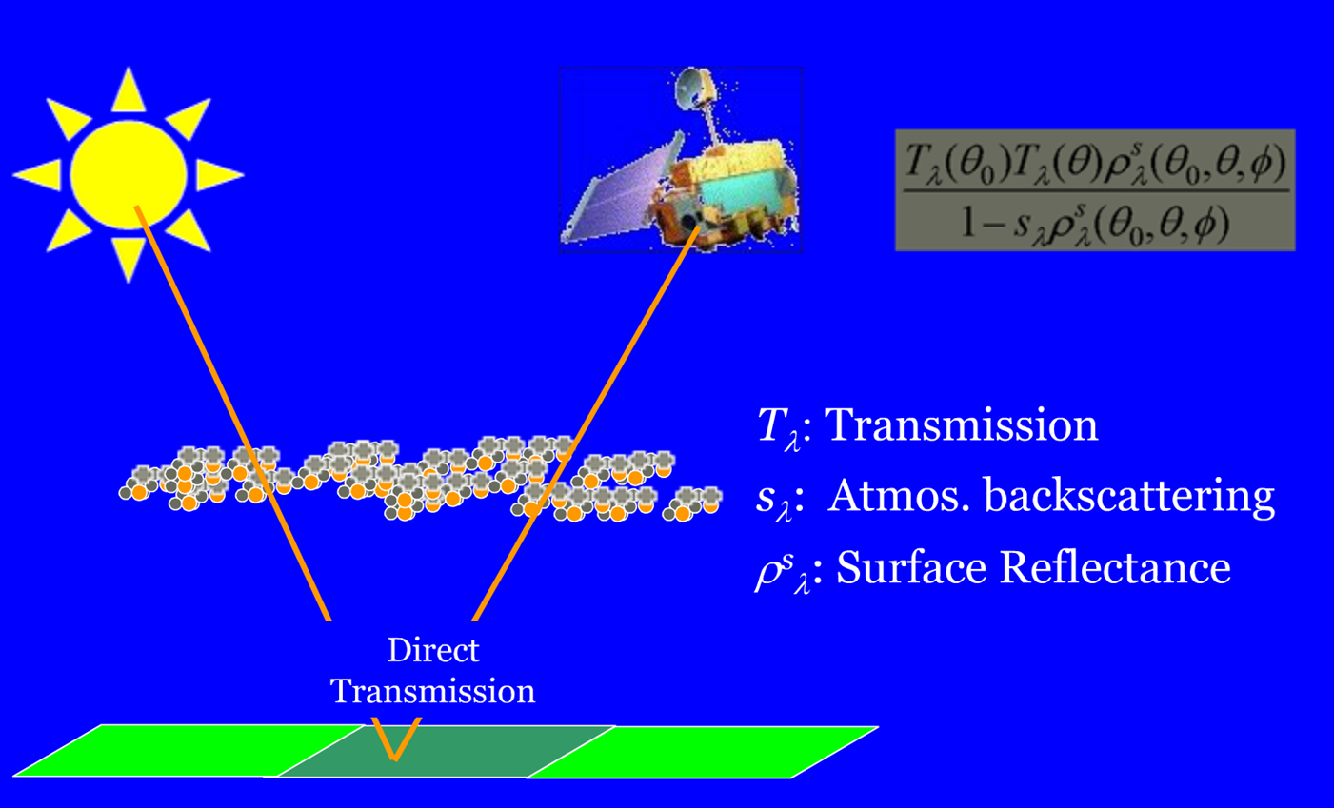
Transmission of Surface Reflectance
cartoons from a talk by Y. Kaufman

Slide 21
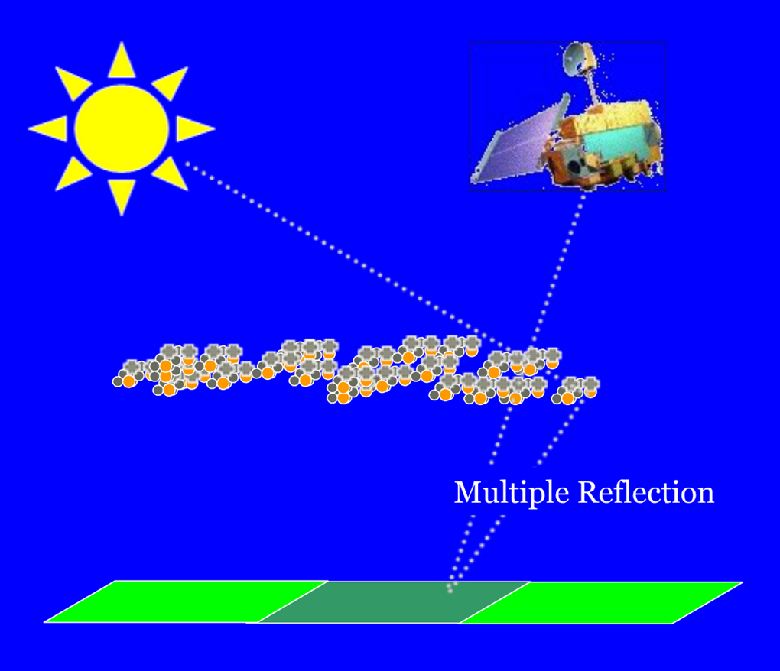
Multiple Reflection

Slide 22
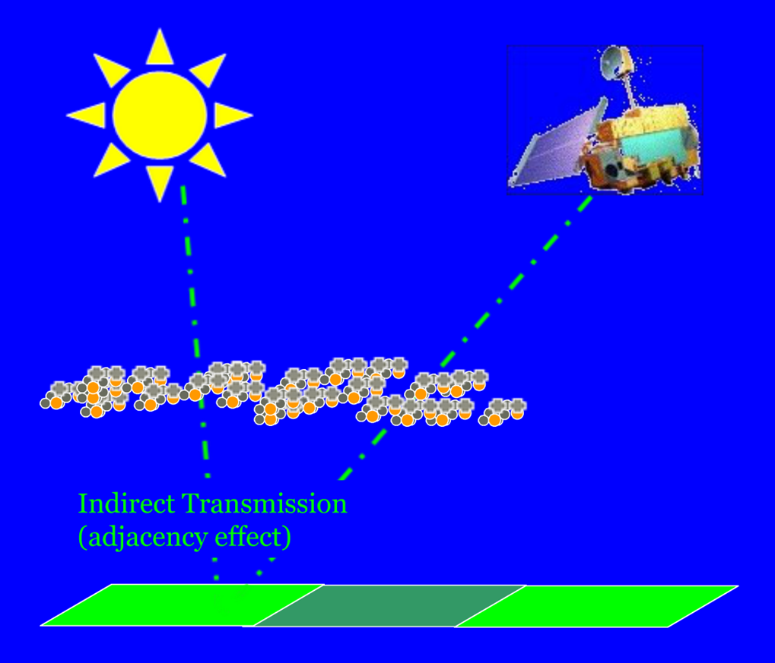
Adjacency Effect (etc)

Slide 23
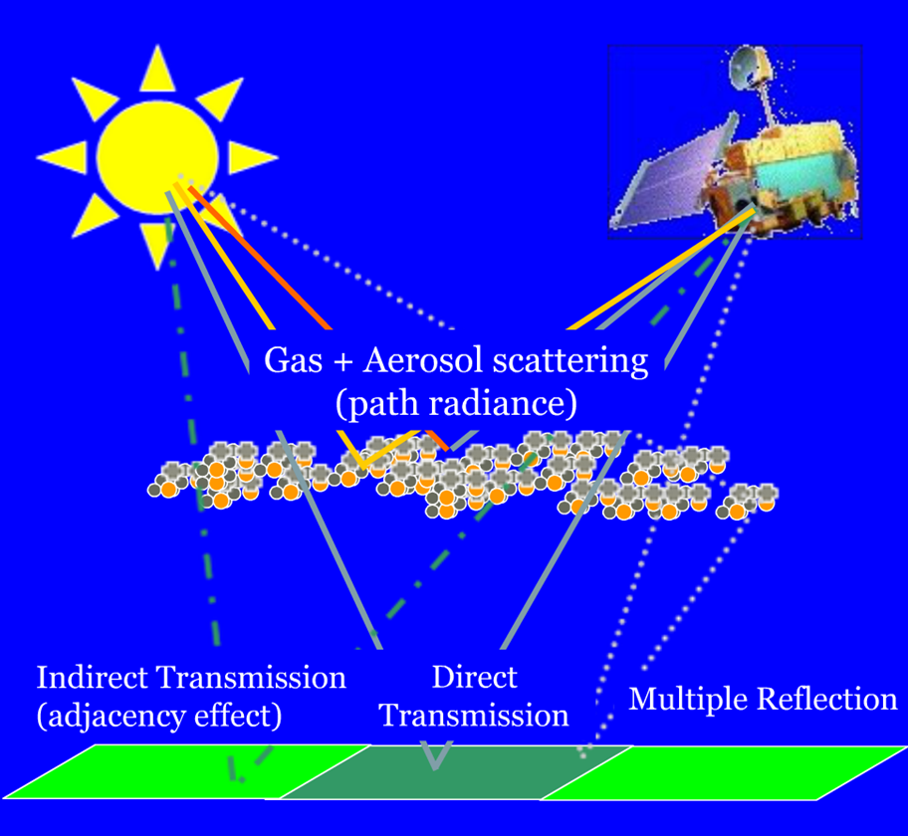
Complicated “Clear Sky” TOA Signal
Contributions From:
  Gas absorption (O₃, CO₂, etc)
  H₂O absorption
  Rayleigh (molecular scattering)
  Aerosol scattering and absorption
  Surface reflection
  Atmosphere/Surface interaction
  Contamination from neighboring pixels (clouds, etc).

Slide 24
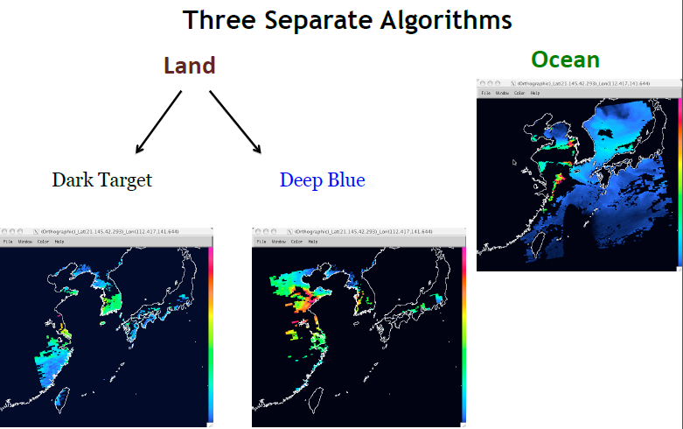
MODIS Aerosol Products

Slide 25
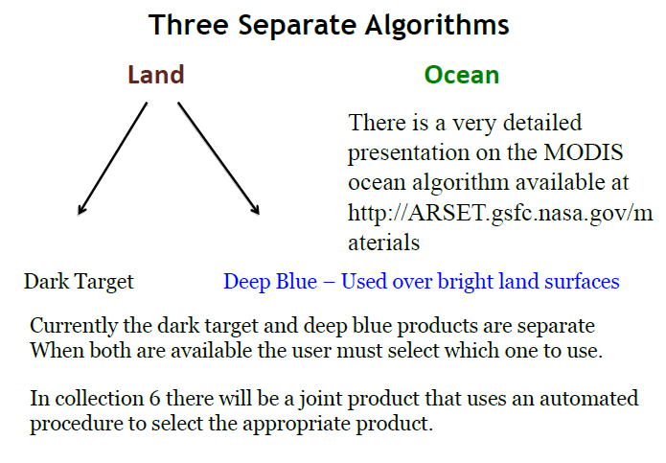
MODIS Aerosol Products
Dark target and Deep Blue products are separate and the user can decide which one to use.
In Collection 6 there is a joint product that uses an automated procedure to select the appropriate product

Slide 26
MODIS Aerosol Products
All three algorithms create a 10 km product
Land and Ocean – 400 half kilometer pixels
Deep Blue – 100 one kilometer pixels
Ocean and Land (dark target) algorithms are based on the assumption that aerosols brighten the scene
Retrievals can only occur where there are a sufficient number of spectrally dark pixels.

Slide 27
Aerosol SDS and What They Really Mean
The Ocean and Land algorithms each produce their own SDS’s.
When both algorithms retrieve the same parameter they may be combined into a joint Land_And_Ocean SDS.
The individual Land or Ocean SDS is generally preferred because
  it contains more wavelengths
  gives more information about quality
  at level 3 it gives a quality weighted product that screens out anomalies
Land_And_Ocean is useful if you need both together but may not give the same results as Land or Ocean.

Slide 28
MODIS Aerosol Products
Important to remember for MODIS Aerosol Products
  Ocean and Land Products are produced using totally separate and distinct algorithms.
  All current aerosol products are 10 km x 10 km
  The most important products are Aerosol Optical Depth and Fine Fraction.
    These exist for both Ocean and Land
    Fine Fraction over land should be seen as a qualitative indicator not as a quantitative measurement

Slide 29
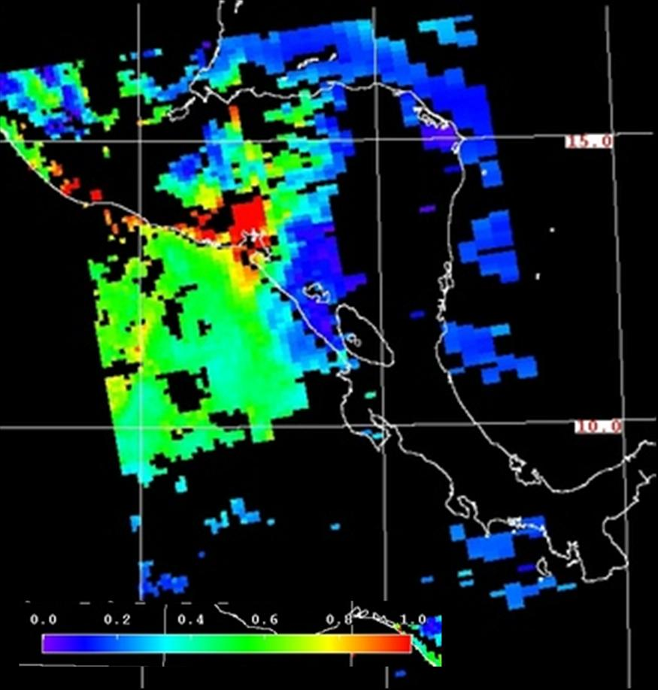
Quality Assurance
QA is our indication of how much confidence we have in the quality of the retrieval.
Quality_Assurance_Ocean – Scale is 0-3
  We use Ocean QA above 0
  Factors
    Number of pixels
    Error fitting
    How close to glint
Quality_Assurance_Land – Scale is 0-3
  We use Land QA of 3
  Factors
    Number of pixels
    Error fitting
    Surface reflectance

Slide 30
Main Products - Ocean
Effective_Optical_Depth_Average_Ocean
  Retrieved AOD at 0.47, 0.55, 0.66, 0.86, 1.24, 1.63, 2.13
Optical_Depth_Ratio_Small_Ocean_0.55*
  Fraction of Fine Mode AOD at 0.55
Optical_Depth_Small_Average_Ocean
  AOD * Fine Mode Ratio

Slide 31
Additional Products - Ocean
Optical_Depth_Large_Average_Ocean
  (1-Fine Fraction)*AOD for the 7 ocean wavelengths
Mass_Concentration_Ocean*
  Total column mass per unit area in unis of 1.0e⁻⁶g/cm²
Angstrom_Exponent_1_Ocean* 0.55/0.86
Angstrom_Exponent_2_Ocean* 0.86/2.1
Optical_Depth_by_Models_Ocean
  Retrieval AOT per model. This information is carried into the level 3 products
Effective_Radius_Ocean
  Effective Radius at 0.55 for both the fine and coarse modes
Notes:
Ångström exponent is the name of the exponent in the formula that is usually used to describe the dependency of the aerosol optical thickness, or aerosol extinction coefficient on wavelength. Depending on particle size distribution, the spectral dependence of the aerosol optical thickness is given approximately by.

Slide 32
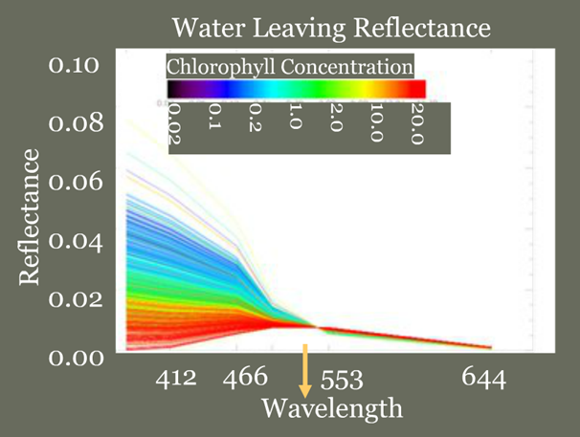
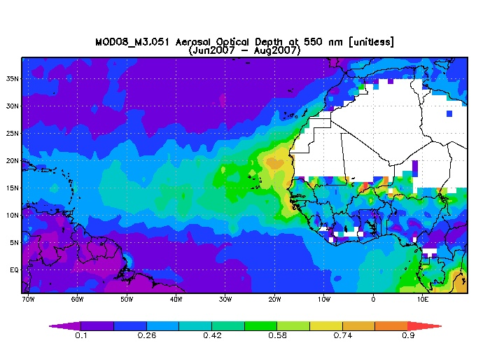
Dark Target
What is a dark target algorithm and why do we use it?
  We have a mixed signal of aerosol and surface
  If we remove the surface signal (our noise) we are left with aerosol (our signal)
  Choosing dark targets helps to minimize our error from the surface signal
  Will need to consider if we are over land or over ocean.
  Discard the brightest 50% and darkest 20% of pixels…. Apply retrieval algorithm if sufficient pixels remain

Slide 33
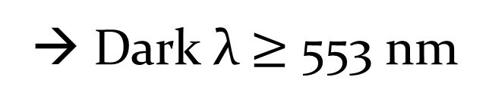
Over Oceans
We can choose the wavelengths that give little or no surface signal.
The o.55 channel is assumed to have a water leaving radiance o.oo5
Longer wavelengths have no signal at all
We account for the effects in the 0.55 channel in our radiative transfer calculations
→ Dark λ $≥$ 553 nm

Slide 34
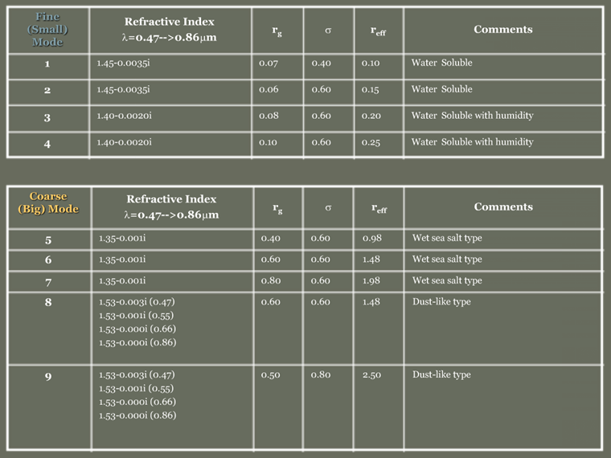
Aerosol Models over Ocean
Represented by “MODES” – Fine & Coarse

Slide 35
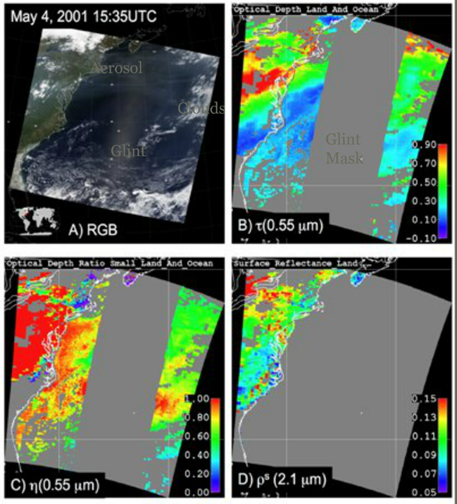
Aerosol Retrieval Combined (Land/Ocean)
Retrieved
  τ – 0.55 μm
  η – o.55 μm
  ε – fitting error
  ρ^{s} – over land
Derived
  τ_{λ}
  α – Column Mass
  Diagnostics

Slide 36
Land Retrieval
How is the land retrieval different than ocean?
Scenes are screened to remove
  Water
  Snow, Ice, Melting Snow
Aerosol models are fixed and determined only by
  Location
  Season
Only 3 wavelengths are used in the retrieval
  0.44, o.66 and 2.1

Slide 37
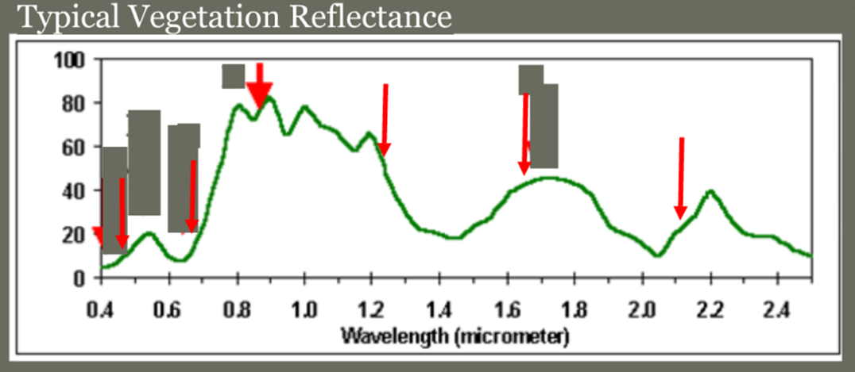
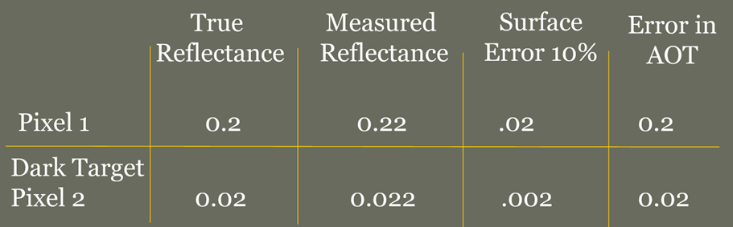
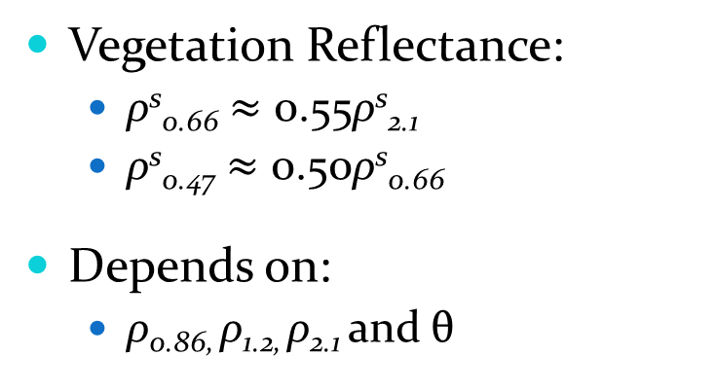
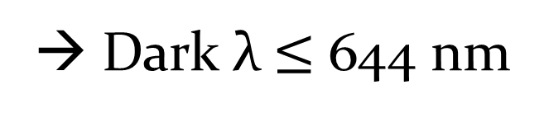
We Require “Dark Targets” Over Land
LAND
→ Dark λ $≤$ 644 nm
Vegetation Reflectance:
  ρ^{s}_{0.66} $≈$ 0.55ρ^{s}_{2.1}
  ρ^{s}_{0.47} $≈$ 0.50ρ^{s}_{0.66}
Depends on:
  ρ_{0.86,} ρ_{1.2,} ρ_{2.1} and θ

Slide 38
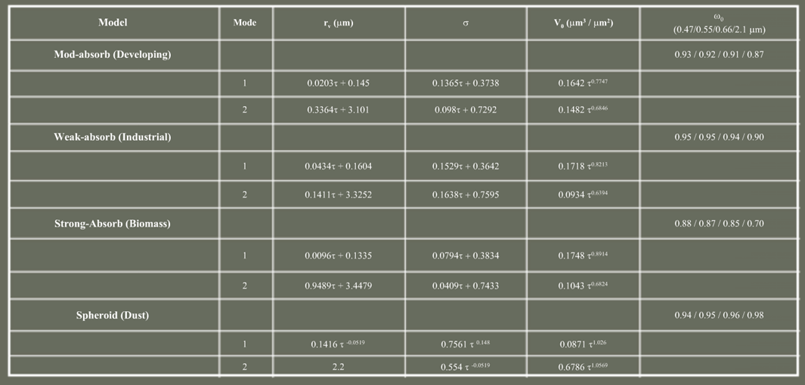
AERONET based Aerosol Modes (land)
Each “model” has two or more “modes.” Size of modes depends on τ

Slide 39
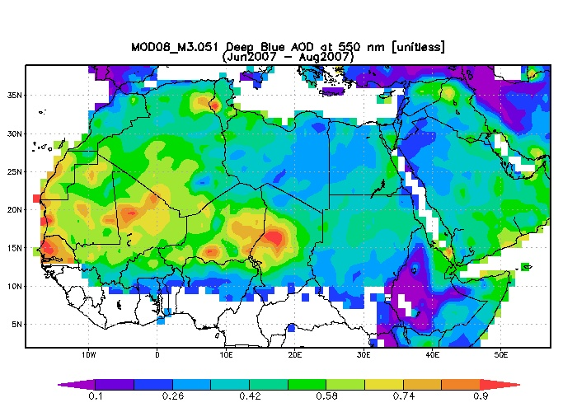
Aerosol Optical Depth
MODIS data obtained over bright surfaces
Deep Blue Algorithm!

Slide 40
Deep Blue Summary
Screen 0ut unwanted features (e.g. clouds, water, snow/ice, and vegetated pixels).
Estimate surface reflectance from seasonally-varying global data base.
Apply retrieval algorithm
  Maximum likelihood method to determine optimal aerosol model
  2-channel algorithm for low-to-moderate aerosols
  3-channel algorithm for heavy dust aerosols
Deep Blue aerosol products
  AOT, Angstrom exponent, and SSA for dust
  AOT and Angstrom exponent for fine mode and mixed aerosols

Slide 41
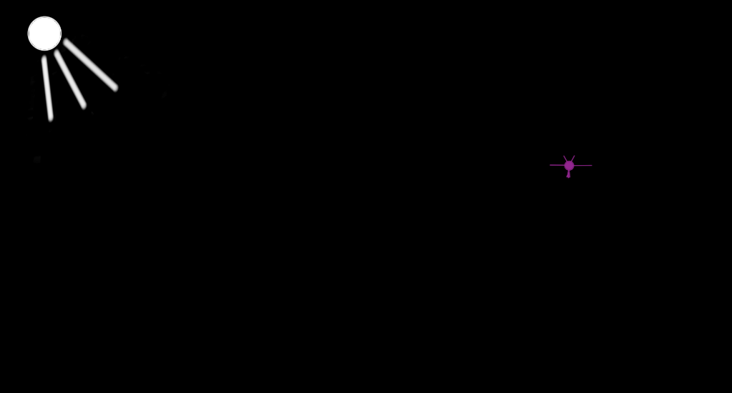
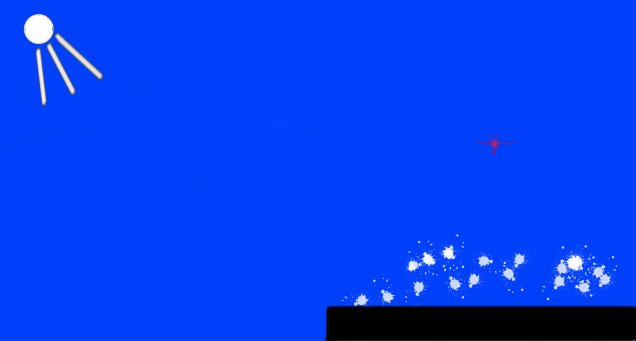

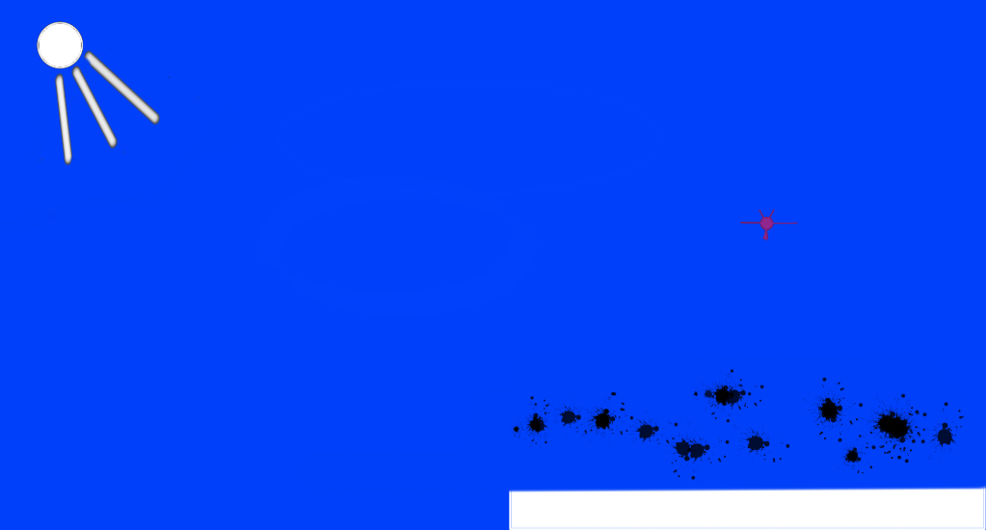
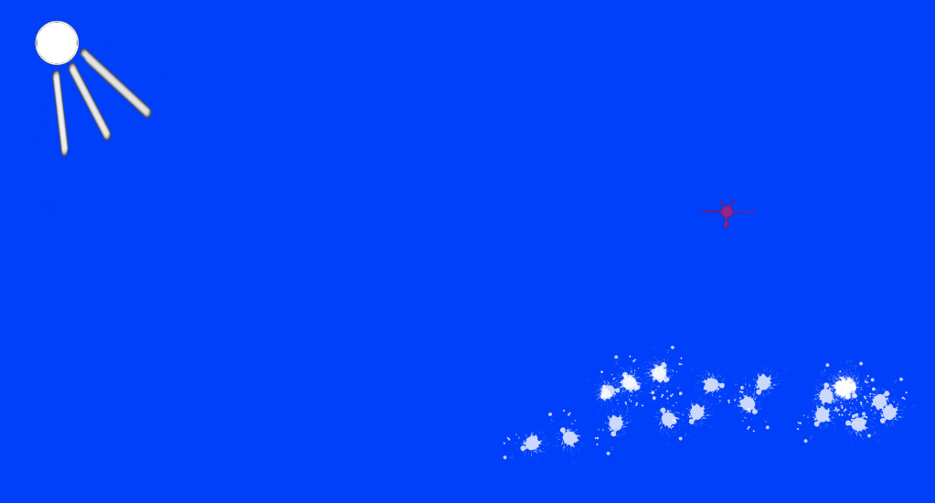
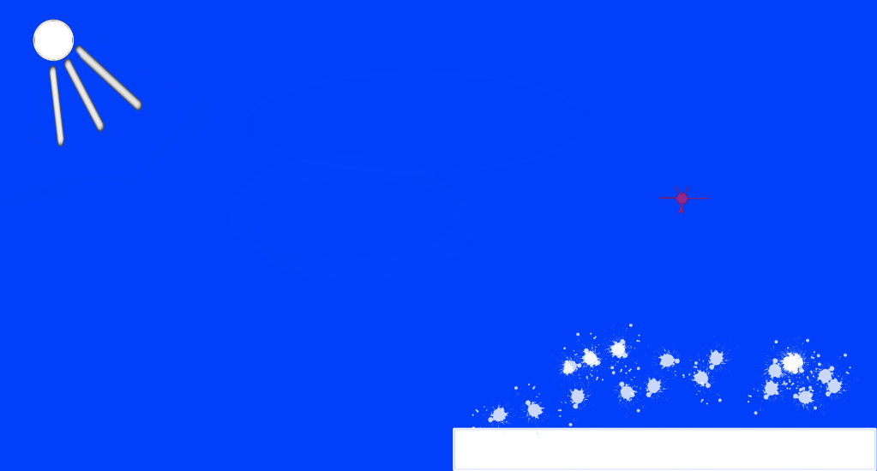
darkness
Bright aerosol
brighten dark surface
Blue sky
Dark aerosol
darken bright surface
Blue sky bright aerosol
Bright aerosol
above bright surface

Slide 42
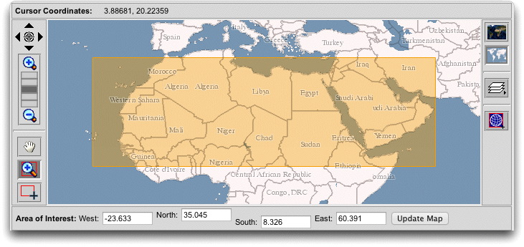
Suppose we want the AOD for this important region of the world …

Slide 43
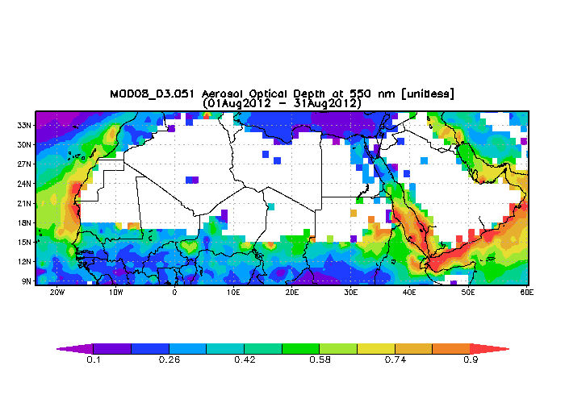
MODIS/TERRA, Standard ‘Dark Target’ Algorithm, provides no data for most of the region because the surface of the Saharan Desert is so bright.

Slide 44

Same for MODIS/AQUA.

Slide 45

The Deep Blue Algorithm applied to MODIS/AQUA data does provide AOD retrievals ☺

Slide 46

Compare: Aerosol Optical Depth from the Ozone Monitoring Instrument data set retrieval.

Slide 47

Radiative Transfer Model Calculations for Combined Reflectivity by Surface and Atmosphere: Illustrates the problem.
Dashed lines are where clear sky and aerosol laden sky reflectivities are the same: Unique retrieval not possible. Solution(s) for the problem? Use wavelengths where the surface reflectivity is lowest, near UV, e.g. 412 nm.

Slide 48

Review: MODIS ‘Dark Target’ Aerosol Retrievals Over Land Algorithm

Slide 49

Deep Blue AOD Algorithm
Database from measurements under clear sky conditions, and during different seasons.

Slide 50


Basic Idea: Desert regions are darker at shorter wavelengths so aerosol show up better.

Slide 51


Surface Reflectance Values Used in The Algorithm
Rapid changes of Vegetation may cause issues.

