Slide 1
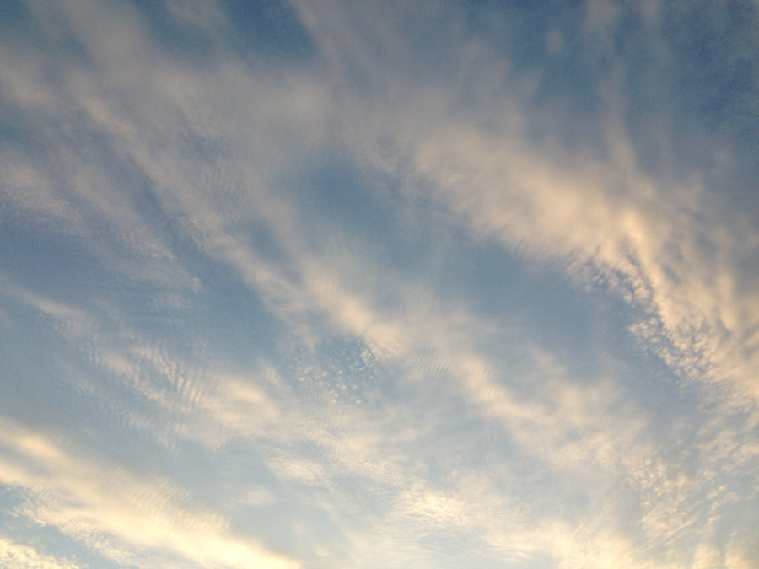
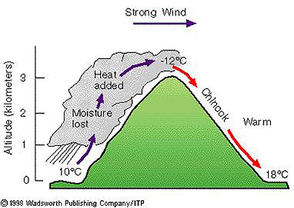
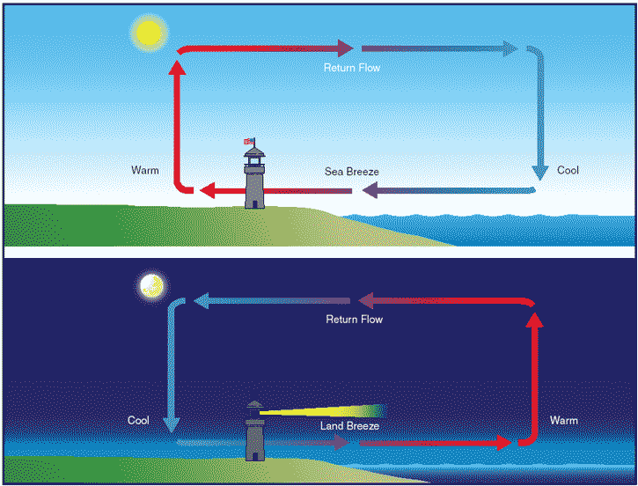
Lecture 13
Local Wind

Slide 2

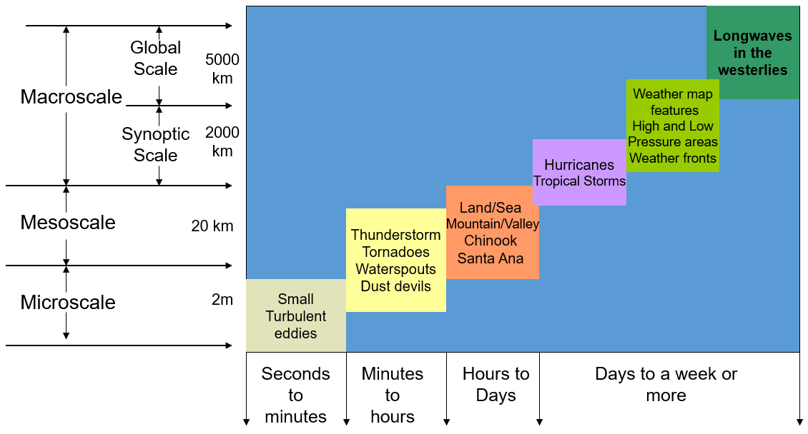
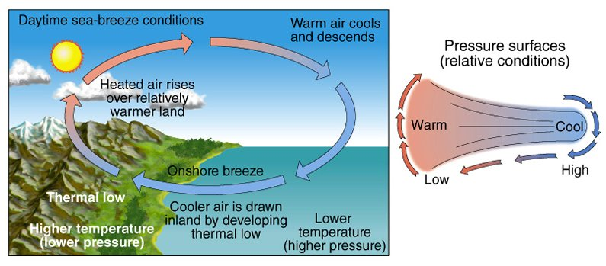
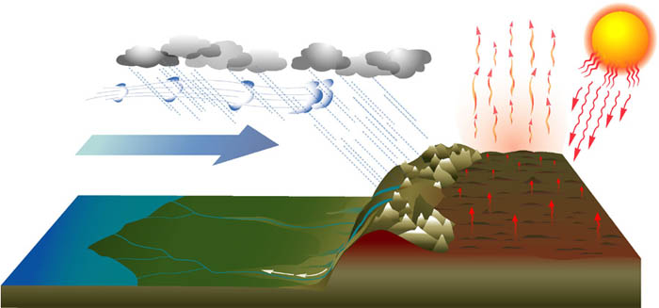
Learning Goals for Part 1 of Chapter 7
Be able to describe the THREE SCALES OF MOTION and list the types of weather events that fall into each category, the size and length of time they occur.
Be able to describe and identify in a diagram the different types of LOCAL WINDS.
Be able to describe in detail what the ASIAN MONSOON is and what happens to wind direction and precipitation during the WINTER and SUMMER.
Notes:
You can just read this slide.

Slide 3

Scales of Atmospheric Motion
Longwaves
in the
westerlies
Global Scale
5000 km
Macroscale
Weather map
features
High and Low
Pressure areas
Weather fronts
Synoptic Scale
2000 km
Hurricanes
Tropical Storms
Land/Sea
Mountain/Valley
Chinook
Santa Ana
Mesoscale
20 km
Thunderstorm
Tornadoes
Waterspouts
Dust devils
Microscale
2m
Small
Turbulent
eddies
Seconds to minutes
Minutes to hours
Hours to Days
Days to a week or more

Slide 4
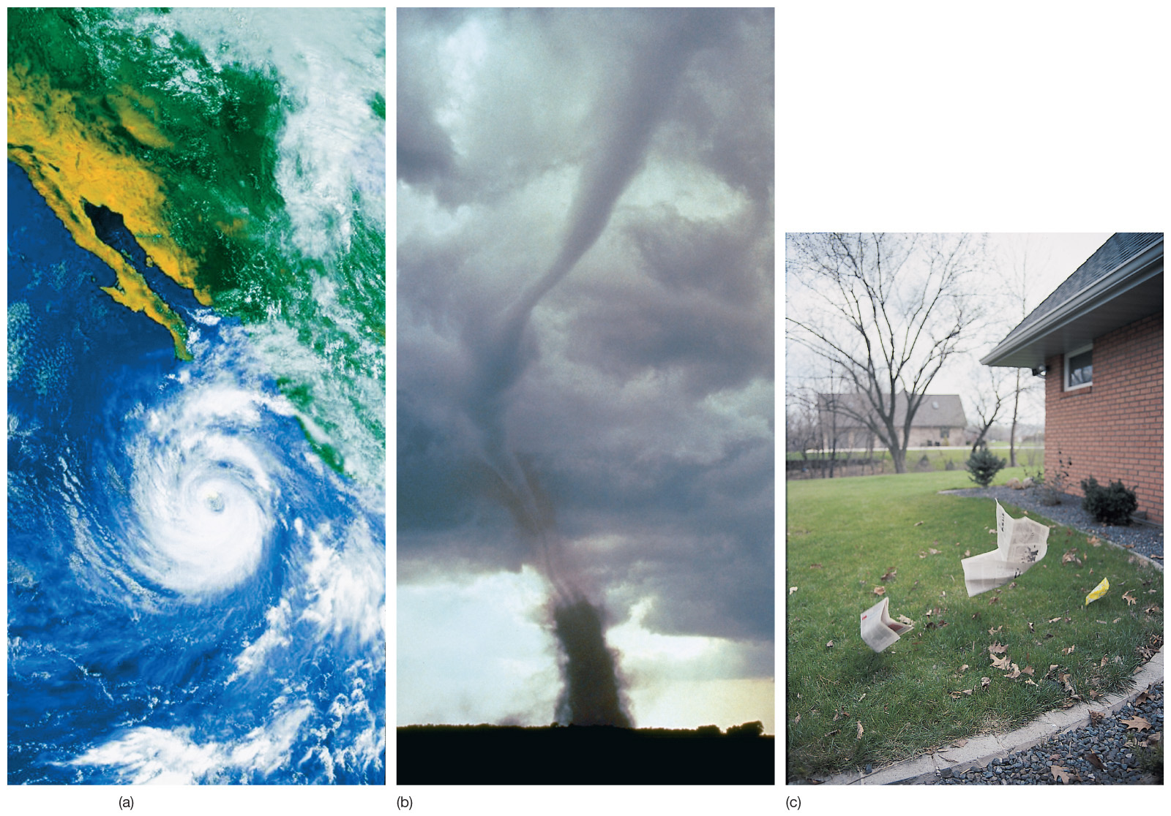
Micro-, Meso-, or Macroscale??
MACROSCALE
MESOSCALE
MICROSCALE

Slide 5
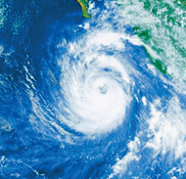
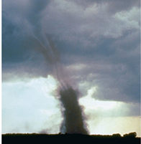
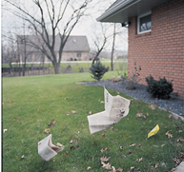
Large and Small Scale Winds
Macroscale Winds
  Planetary: Westerlies, trade winds
  Synoptic: Cyclones and anti-cyclones, Hurricanes (weather map size)
Mesoscale Winds
  Thunder storms, tornadoes, etc
  Part of larger macroscale wind systems.
Microscale Winds
  Chaotic motions including gusts and dust devils
  Small, very localized breezes

Slide 6
Summary - Scales of Atmospheric Motion
Scale | Time Scale | Distance Scale | Examples
Macroscale
Planetary | Weeks or longer | 1000-40000km | Westerlies, trade winds
Synoptic | Days to weeks | 100-5000 km | Mid-latitude cyclones, anticyclones, hurricanes
Mesoscale | Minutes to hours | 1-100 km | Thunderstorms, tornadoes, and land-sea breeze
Microscale | Seconds to minutes | <1 km | Turbulence, dust devils and gusts

Slide 7
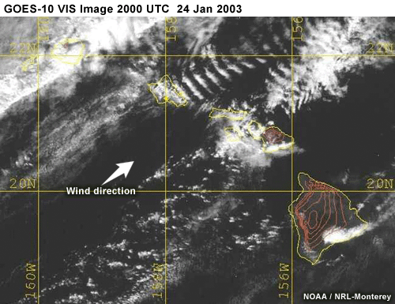
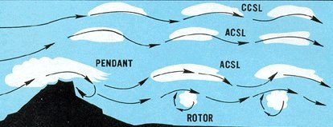
What is an Eddy?
Eddy
  Whirl of air
  Come in different sizes
  Small volume of air that behaves differently from the large flow in which it resides.
  Caused by encountering an obstacle
  Eddies are down wind from the obstacle

Slide 8
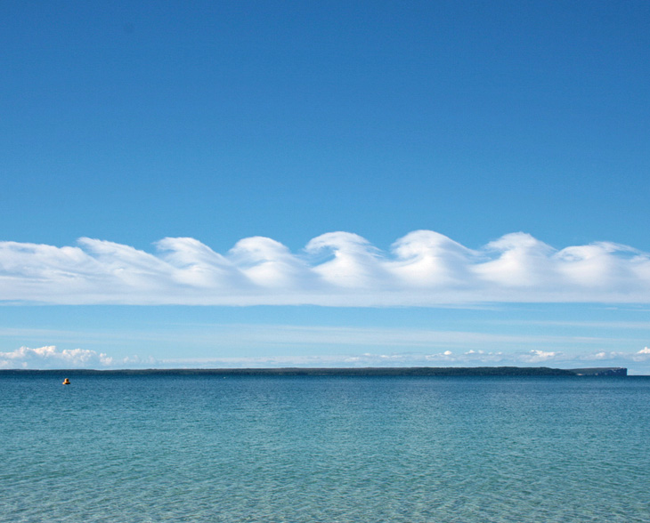
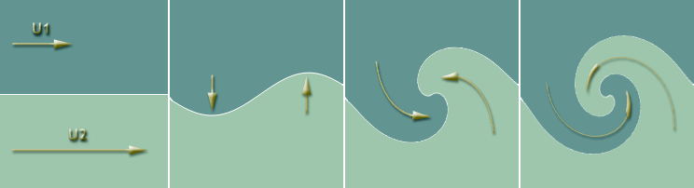
Kevin-Helmholz Instability Clouds
The formation of clear air turbulence along a boundary of increasing wind speed shear. The wind in the top layer increases in speed from left to right in the upper diagram.

Slide 9
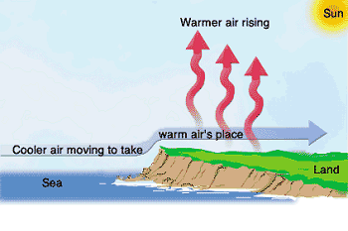
Local Winds (mesoscale)
True local winds are caused by topographic effects or variations in local surface composition
  Land and Sea Breezes
  Mountain and Valley Breezes
  Chinook (Foehn Winds)
  Katabatic (Fall Winds)
  Santa Ana
  Country Breezes
  Haboobs
  Dust Devils

Slide 10
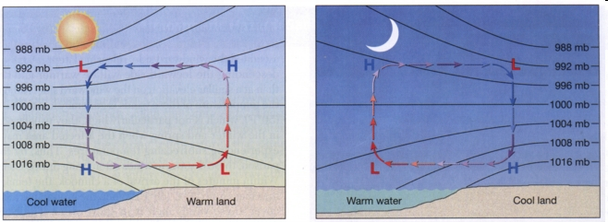
Land and Sea Breezes
Most intense Land and Sea Breezes form along tropical coastlines adjacent to cool ocean currents.
  Hawaii (including Oahu) experiences these every day.
Nice Animation: http://www.classzone.com/books/earth_science/terc/content/visualizations/es1903/es1903page01.cfm

Slide 11
Daytime – Sea Breeze Conditions
The land heats more quickly than the water.
Higher pressure is then located over the ocean.

Slide 12
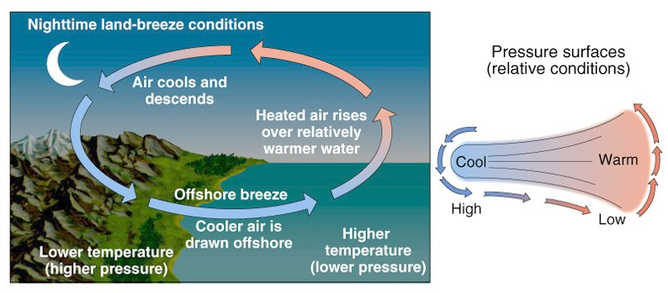
Nighttime – Land Breeze Conditions
The land cools more quickly than the water.
Higher pressure is then located over land.

Slide 13
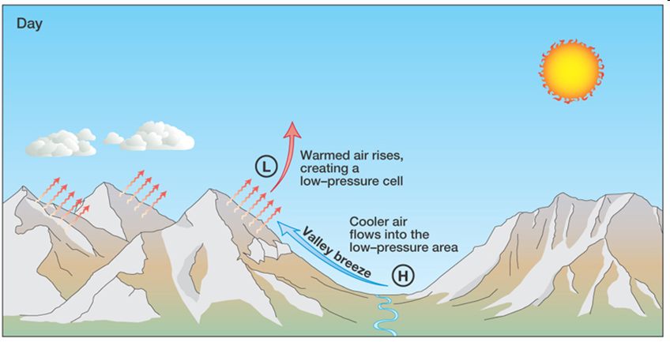
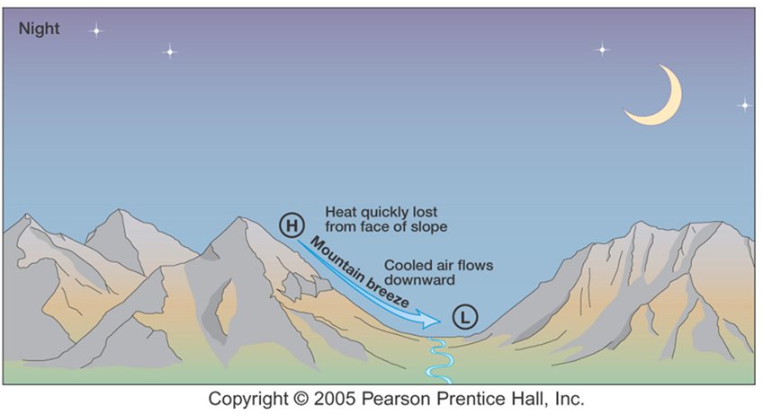
Mountain and Valley Breezes
Valley Breeze
  Daytime
  Sun warms valley walls
  Max at afternoon, cloudiness and T-storms likely
Mountain Breeze
  Nighttime
  Radiation cooling of valley walls

Slide 14
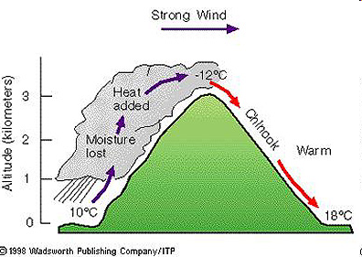
Chinook (Foehn Winds)
Warm Dry air moving down the east slopes of mountains.
  in the Rockies they are called Chinook winds
  in the Alps they are called Foehn winds.
Lee side air is heated by compression

Slide 15
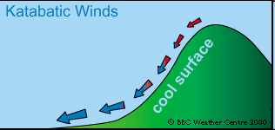
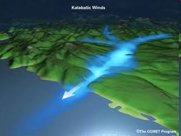
Katabatic (Fall) Winds
Originate when cold air, situated over a highland area (like an ice sheet) is set in motion.
Gravity carries the cold air over the rim like a waterfall.
The air is heated like a Chinook, but because it starts so cold it stays cold.
Same as Mountain Breeze but STRONGER

Slide 16
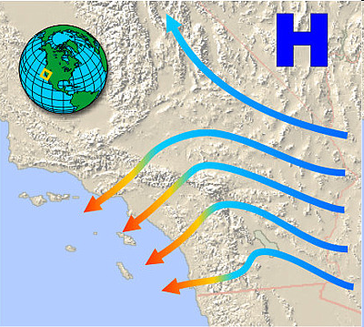
Santa Ana Winds
Increases the threat of fire in Southern California.
Typically occurs in September-March but can happen at any time the desert is cooler than SoCal.
Compressional Heating makes it warm
Desert is COLDER (Higher Pressure) than Los Angeles.

Slide 17
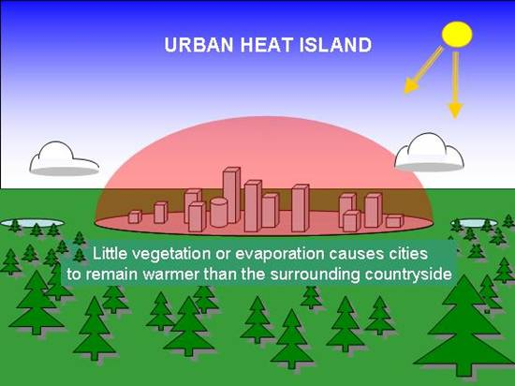
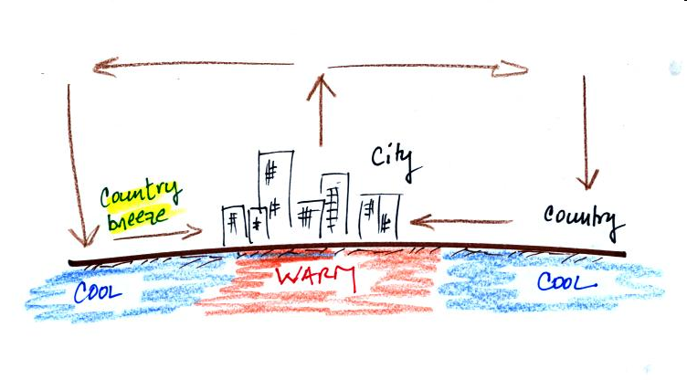
Country Breezes
Associated with large urban areas. On crowded islands, these regions will be warmer than the rural areas.
Light wind blowing in from rural areas
Clear, calm nights
City is warmer (urban heat island)

Slide 18
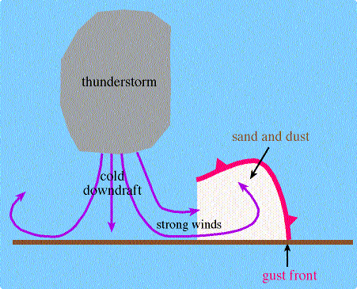
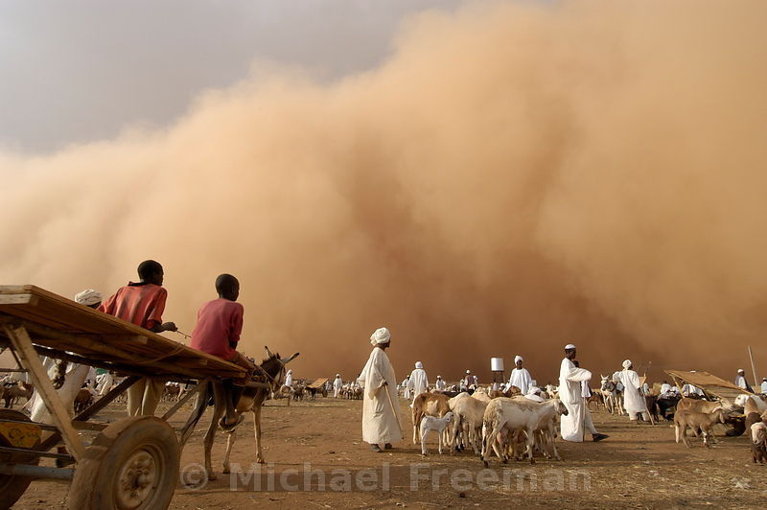
Desert Winds
Associated with Dust Storms in dry regions
  i.e. Dustbowl storms in the 1930s.
HABOOB
  Giant dust storms common in the African Sudan
  Caused by out flowing air from Thunderstorms.

Slide 19
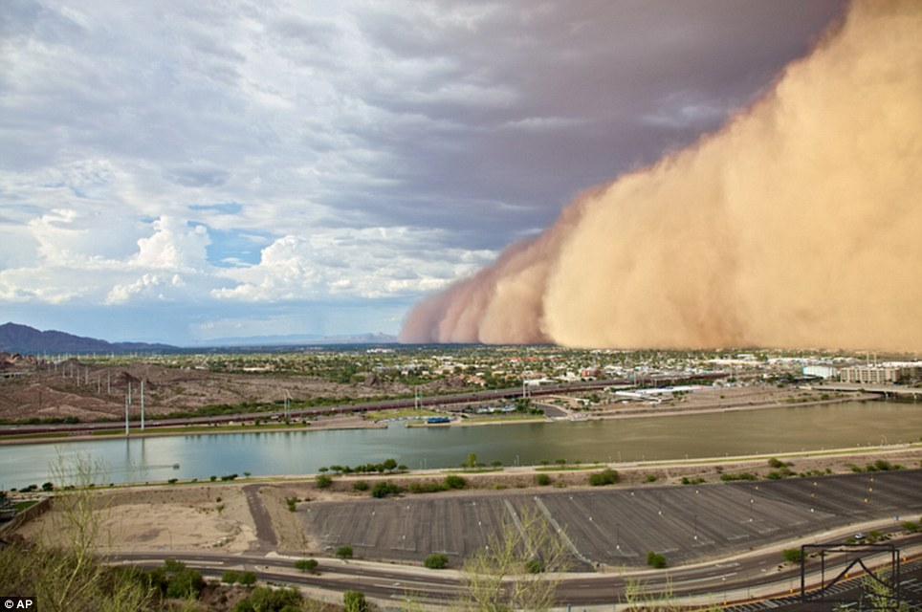
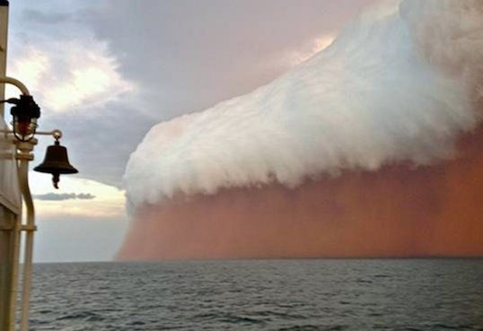
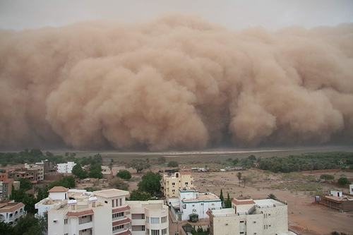
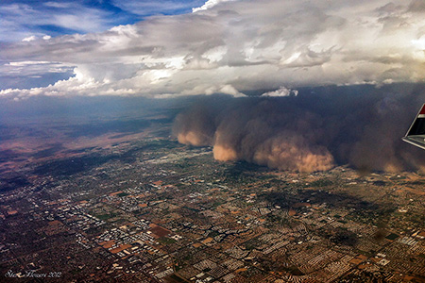
Haboob Images
Phoenix, AZ
Onslow, Western Australia
Khartoum, Sudan
Phoenix, AZ

Slide 20
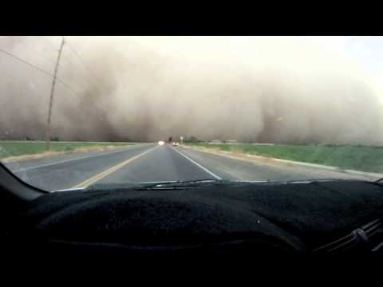
Driving into a Haboob in AZ
https://www.youtube.com/watch?v=8vQMuwRjI6s

Slide 21
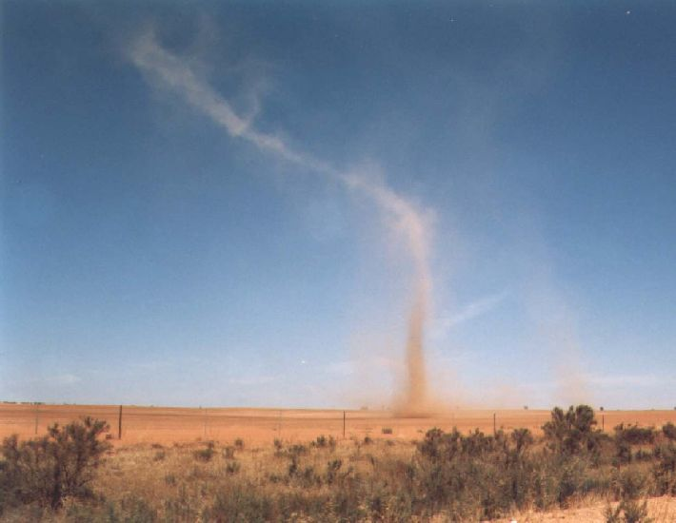
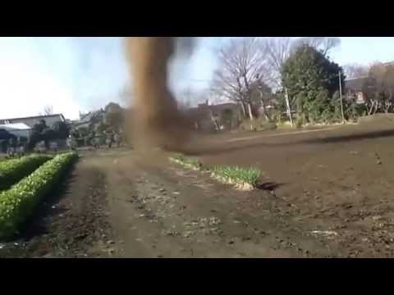
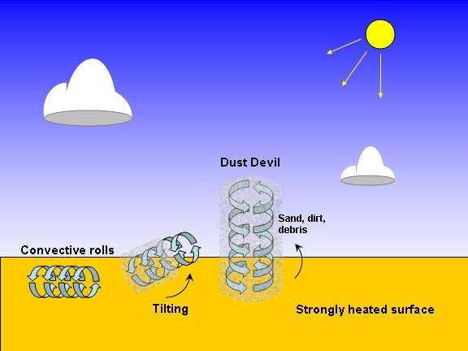
Dust Devils
Rotating columns of air
Pick up Dust
Look like tornadoes
Form after rotating air is caused to tilt upwards
  Usually from an obstruction

Slide 22
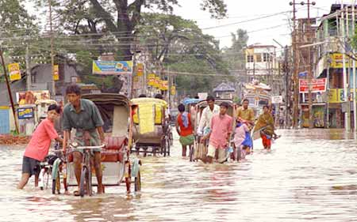
Monsoons
The greatest seasonal change in Earth’s global circulation.
Monsoon does NOT mean rainy season.
Refers to a wind system that exhibits a pronounced seasonal reversal in direction.
  Winter: Winds blow off the continents (dry)
  Summer: Winds blow from the sea towards the land (moist)

Slide 23
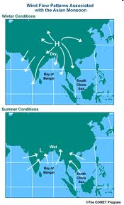
Asian Monsoon
A seasonal reversal in weather patterns
An alternation between two types of weather patters
  Ex: India – Wet hot summer, dry cool(ish) winter
A seasonal reversal of wind
SUMMER MONSOON
WINTER MONSOON
L
H
H
L
Down sloping air = No clouds
H
COLD
L
L
H
Hot Indian Continent
Warm Ocean
Warm Ocean

Slide 24
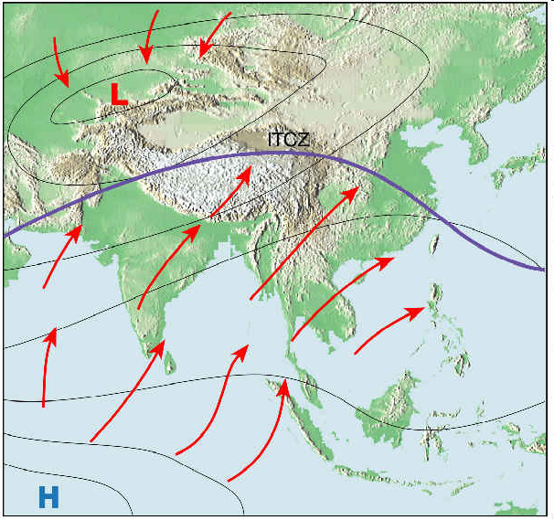
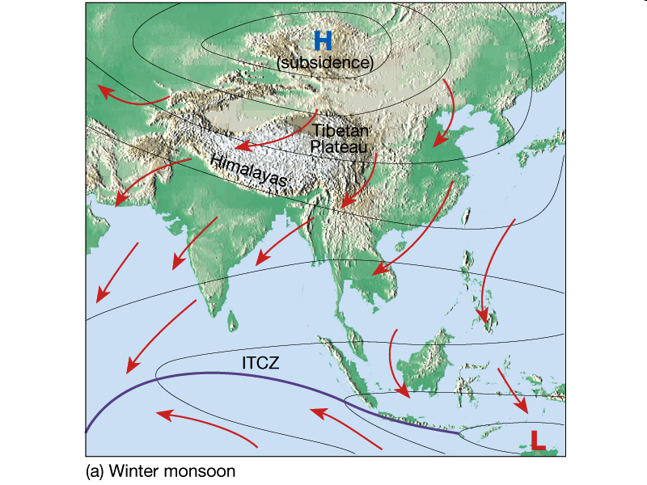
Asian Monsoon
Siberian High
SUMMER MONSOON
WINTER MONSOON

Slide 25
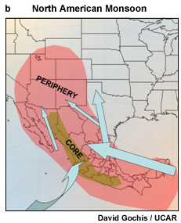
North American Monsoon
Weaker than the Asian Monsoon
Hot temperatures over the desert cause an intense low to form
Moisture for summer precipitation comes from Gulf of Mexico and California
L

Slide 26
Key Information 1
Be able to describe the THREE SCALES OF MOTION and list the types of weather events that fall into each category, the size and length of time they occur.
Macroscale Winds
  Planetary: Westerlies, trade winds
  Synoptic: Cyclones and anti-cyclones, Hurricanes (weather map size)
Mesoscale Winds
  Thunderstorms, tornadoes, etc
  Part of larger macroscale wind systems.
Microscale Winds
  Chaotic motions including gusts and dust devils
  Small, very localized breezes
Scale | Time Scale | Distance Scale | Examples
Macroscale
Planetary | Weeks or longer | 1000-40000km | Westerlies, trade winds
Synoptic | Days to weeks | 100-5000 km | Mid-latitude cyclones, anticyclones, hurricanes
Mesoscale | Minutes to hours | 1-100 km | Thunderstorms, tornadoes, and land-sea breeze
Microscale | Seconds to minutes | <1 km | Turbulence, dust devils and gusts
Notes:
You can just read this slide.

Slide 27



Key Information 2
Be able to describe and identify in a diagram the different types of LOCAL WINDS.
  Land and Sea Breezes – Change in wind direction hear coastlines (usually tropical). Sea breezes happen during the day when the land heads more quickly that the water (High is located over the ocean. Land Breezes happen at night when the land cools more quickly than the water and High switches to be located over the land.
  Mountain and Valley Breezes – Switch in wind direction between day and night near mountains. Valley Breezes happen during the day when the sun warms the valley walls, Mountain Breezes happen during the night due to radiation cooling of the walls.
  Chinook (Foehn Winds) – these occur when air is compressionally heated as air flows down the east slopes of mountains. They are called Chinook in the Rockies and Foehn in the Alps.
  Katabatic (Fall Winds) – Same as a Mountain Breeze but stronger, they originate when cold air over a very cold surface is set in motion. Gravity carries the cold, dense air over like a water fall. The air is heated like a Chinook, but is so cold it never gets “warm.”
  Santa Ana – Happens in when the desert is cooler than Southern California. The wind is warm due to compressional heating as it descents. Increases fire threat.
  Country Breezes – Associated with large urban areas that are warmer than the rural (country) nearby (urban heat island effect). The wind is light and blows from rural areas toward the cities. See most often on clear, calm nights.
  Haboobs – Giant dust storms that are cause by out-flowing air from Thunderstorms (essentially the downdraft hitting the ground and spreading out).
  Dust Devils – Form after air hits an obstruction causing air to rotate vertically, picking up dust and end up looking like tornadoes without clouds.
Notes:
You can just read this slide.

Slide 28
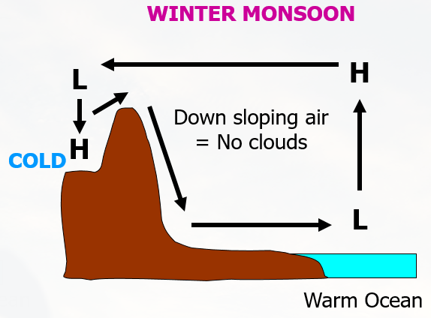
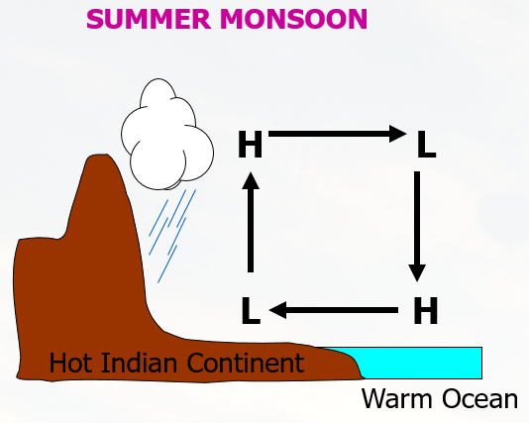
Key Information 3
Be able to describe in detail what the ASIAN MONSOON is and what happens to wind direction and precipitation during the WINTER and SUMMER.
Refers to a wind system that exhibits a pronounced seasonal reversal in direction.
  Winter: Winds blow off the continents (dry)
  Summer: Winds blow from the sea towards the land (moist)
The Asian Monsoon is the greatest seasonal change in Earth’s global circulation.
Monsoon does NOT mean rainy season.
Notes:
You can just read this slide.

