Slide 1
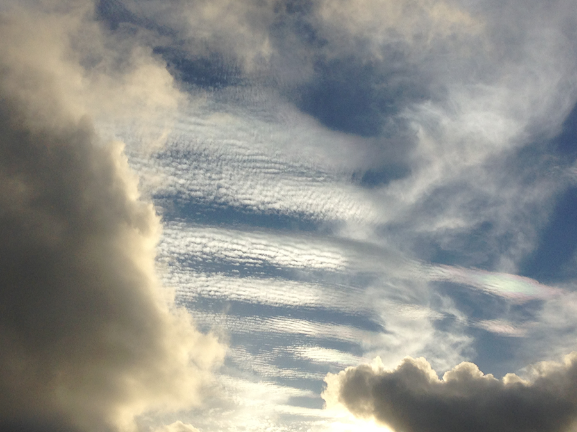
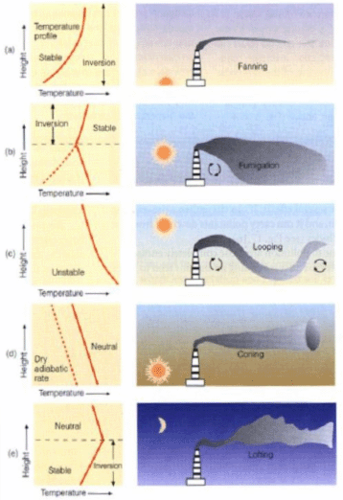
Lecture 9
Stability
&
Cloud Development

Slide 2

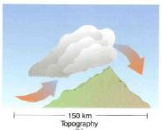
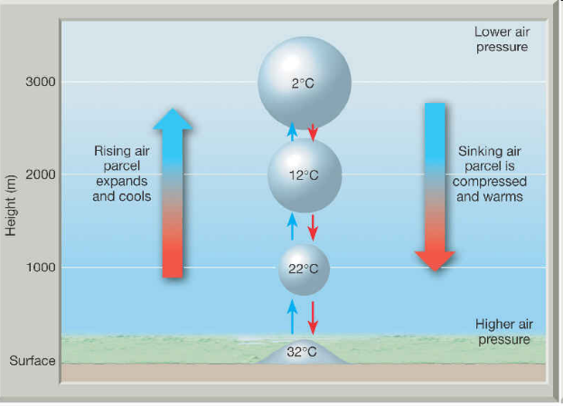
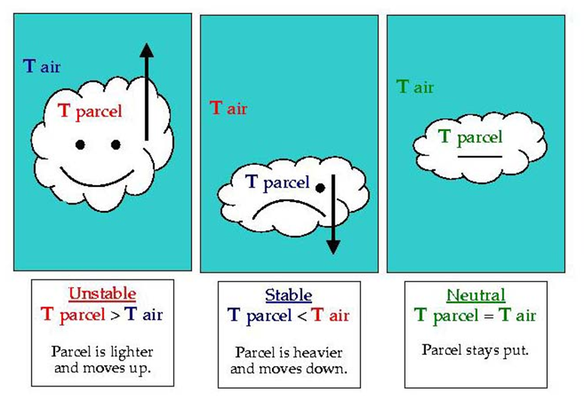
Learning Goals for Part 1 of Chapter 5
Be able to describe and DRAW a simple diagram showing the FOUR different ways for air to RISE.
Be able to describe the difference between the DRY ADIABATIC LAPSE RATE , WET ADIABATIC LAPSE RATE, and the ENVIRONMENTAL LAPSE RATE.
Be able to differentiate between the THREE different types of ATMOSPHERIC STABILITY.
Notes:
You can just read this slide.

Slide 3
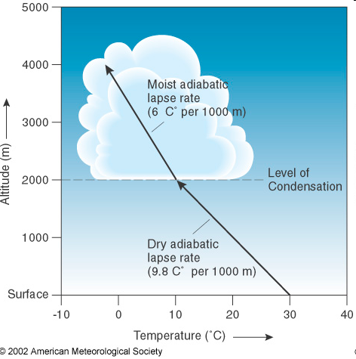
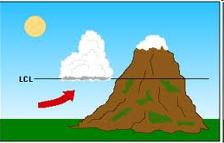
Lifted Condensation Level (LCL)
The height at which rising air that is cooling at the dry adiabatic rate becomes saturated and condensation begins.
Why most clouds have FLAT bottoms!!!

Slide 4
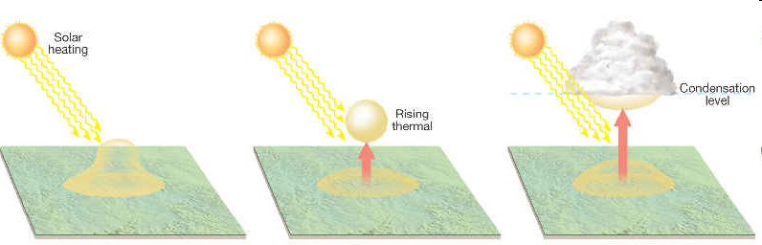
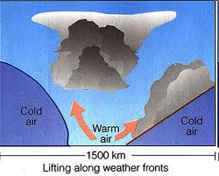
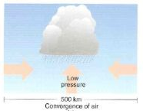
Processes that Lift Air
Orographic Lifting
Frontal Wedging
Convergence
Localized Convective Lifting (differential heating)

Slide 5
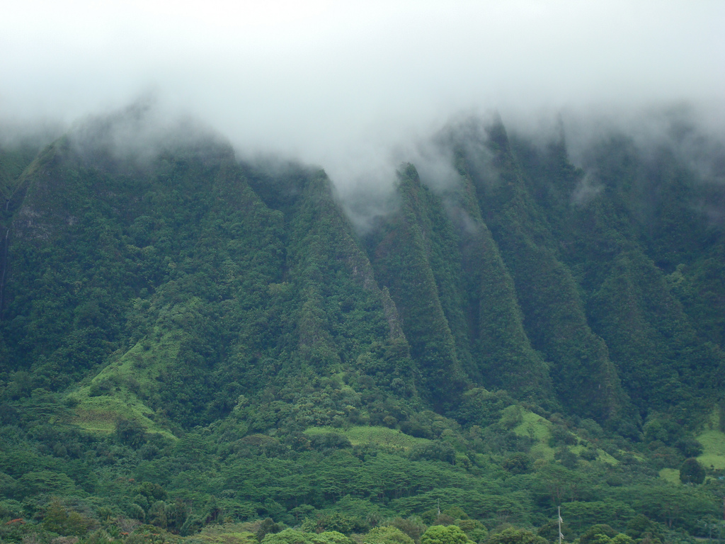
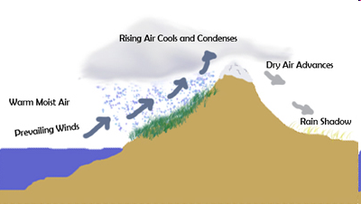
Orographic Lifting
Air is forced to rise over a mountainous or topographic barrier
Rain shadow desert

Slide 6
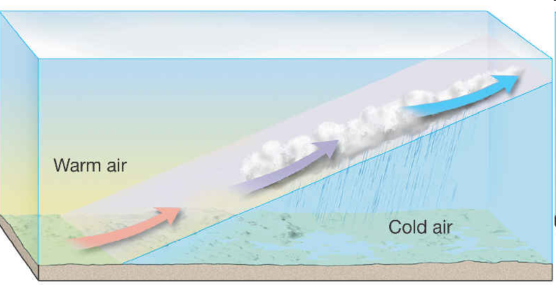
Frontal Wedging
Warmer, less dense air, is forced over cooler, denser air
Front – when warm and cold air collide (we’ll spend a whole lecture on them)

Slide 7
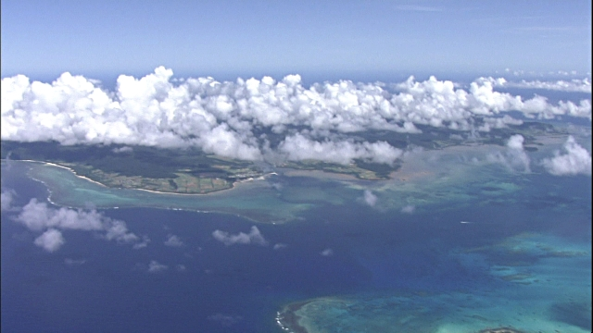
Localized Convective Lifting
Unequal heating of Earth’s surface causes pockets of air to be warmed more than the surrounding air.
Buoyant parcels (thermals) of hot air rise.
After reaching the LCL they form clouds.

Slide 8
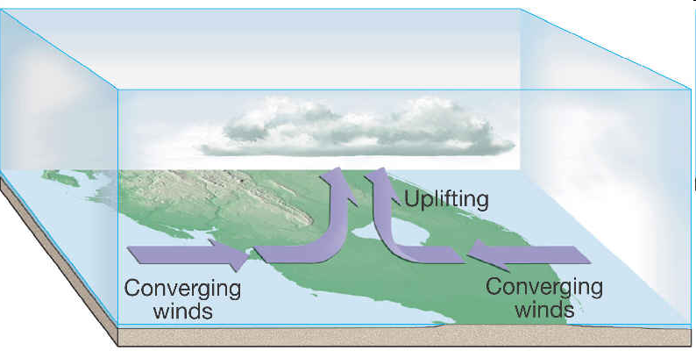
Convergence
When air flows in from more than one direction (not a front) can collides
  It cannot go down.
  It goes up.
Often happens over islands and other regions where two bodies of water are located closely together

Slide 9
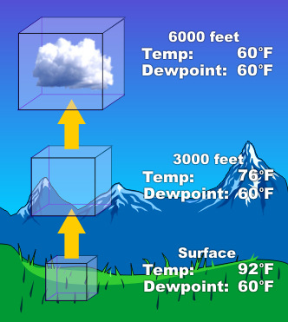
Air Parcels… What are they?
A Parcel is an imaginary volume of air
  Typically a few hundred cubic meters in volume
  Acts independently of the surrounding air
  It is assumed that no heat is transferred into, or out of it
  HIGHLY IDEALIZED
We use them to talk about the likelihood that air will rise up or sink down.
  We need to know this if we want to predict if clouds will form.

Slide 10
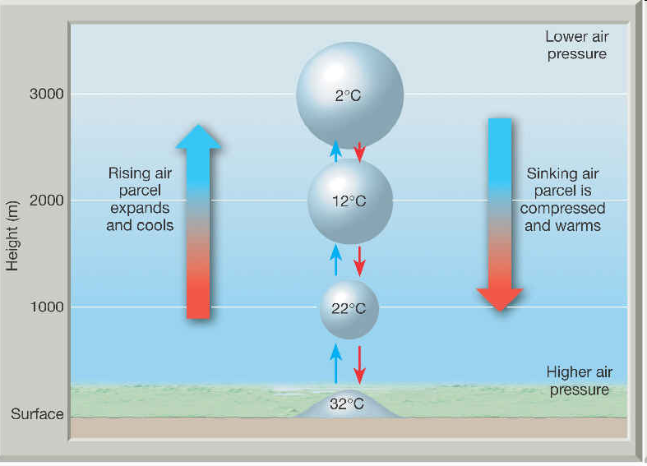
Adiabatic Temperature Changes
When heat is neither added nor subtracted
Result when air is compressed or allowed to expand
When air is allowed to expand, it COOLS.
When air is compressed, it WARMS.

Slide 11
Dry Adiabatic Lapse Rate
The change in temperature due to a change in altitude of a non-condensing parcel
Abbreviated DALR
DALR = 1°C/100m
DALR = 10°C/1000m
DALR = 5.5°F/1000ft
17°C
17°C
18°C
18°C
WARMS
COOLS
19°C
19°C
20°C
20°C

Slide 12
Wet Adiabatic Lapse Rate
The change in temperature due to a change in altitude of a condensing parcel
Abbreviated WALR
WALR = ~0.6°C/100m
WALR = ~6°C/1000m
WALR = ~3.3°F/1000ft
18.5°C
18.5°C
19.0°C
WARMS at the DALR
19.5°C
COOLS
19.5°C
20.5°C
20°C
21.5°C

Slide 13
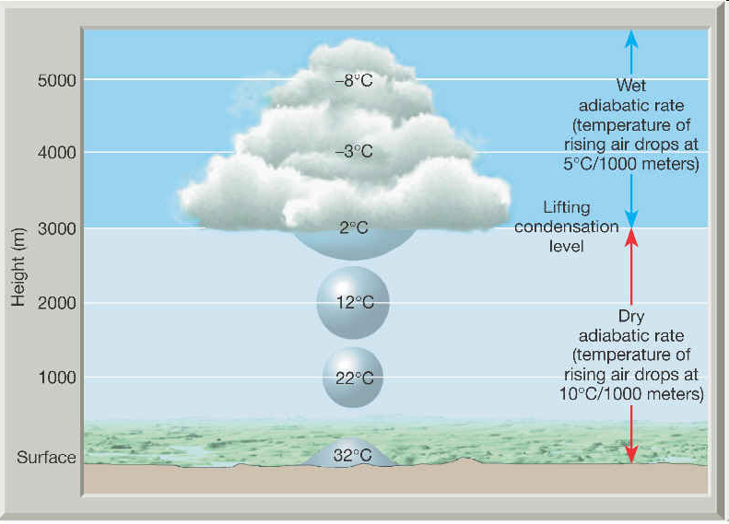
Adiabatic Lapse Rates
WALR - The change in temperature due to a change in altitude of a condensing parcel
DALR - The change in temperature due to a change in altitude of a non-condensing parcel
DALR and WALR help us understand if a parcel of air will rise or sink. This determines if we get a cloud, what type, and at what height above the surface!

Slide 14
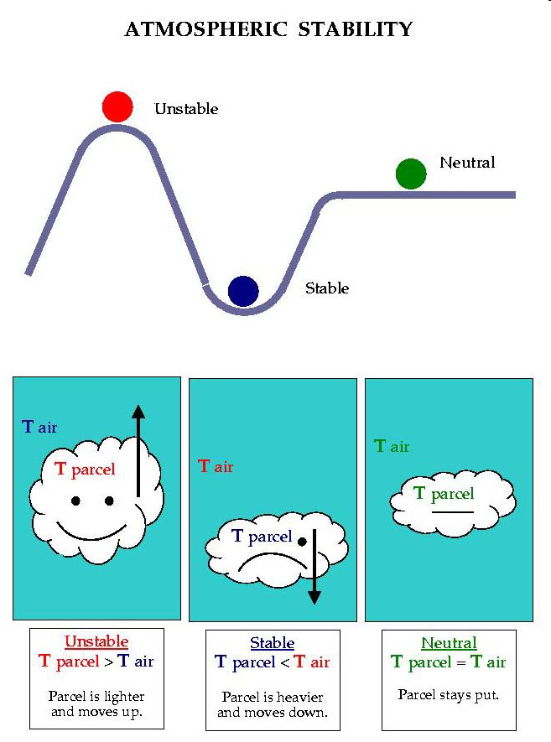
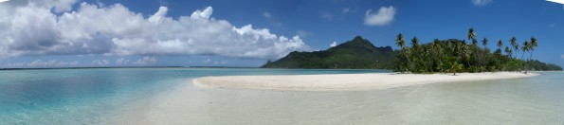
Atmospheric Stability
When air rises it cools and eventually produces clouds
By comparing a parcel of air to its surrounding you can tell if will rise or sink

Slide 15
Atmospheric Stability
Stable Air
  If a parcel were cooler than the surrounding environment, it would be more dense
  If allowed to do so it would sink back to it’s original position
  Air of this type resists vertical motion

Slide 16
Atmospheric Stability
Unstable Air
  If a parcel were warmer than the surrounding environment, it would be less dense
  If allowed to do so it would rise until it reached an altitude where it’s temperature equaled that of its surroundings.

Slide 17
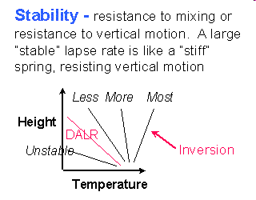
Types of Stability
Determined by measuring air temperatures at different heights and comparing it to the environmental lapse rate!
  The ELR is the ACTUAL change in temperature with height
  Absolute Stability
  Absolute Instability
  Conditional Instability

Slide 18
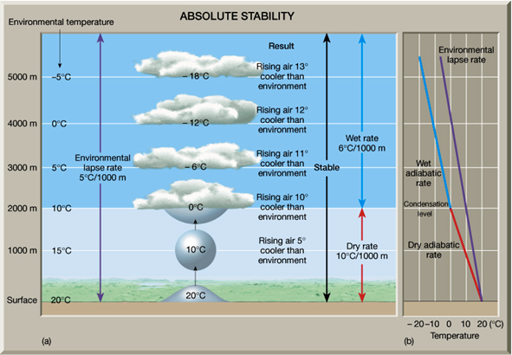
Absolute Stability
When the environmental lapse rate is LESS than the wet adiabatic lapse rate
Example:
  ELR = 5 deg/1000m
  WALR = 6 deg/1000m
ELR < WALR

Slide 19
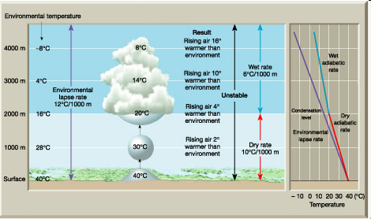
Absolute Instability
When the environmental lapse rate is GREATER than the dry adiabatic lapse rate
Example
  ELR = 12 deg/1000m
  DALR = 10 deg/1000m
ELR > DALR

Slide 20
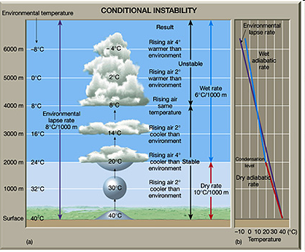
Conditional Instability
When the moist air has an environmental lapse rate BETWEEN the dry & wet adiabatic lapse rates
Example:
  ELR = 8 deg/1000m
  WALR = 5 deg/1000m
  DALR = 10 deg/1000m
WALR < ELR < DALR

Slide 21
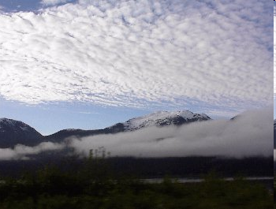
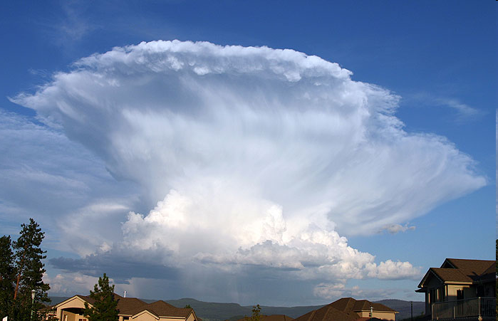
Stability and Daily Weather
In general, when stable air is forced aloft, the associated clouds have little vertical thickness, and precipitation, if any, is light.
In contrast, clouds associated with unstable air are towering and frequently accompanied by heavy rain.
  e.g. the thunderstorms we’ve been having due to the unstable air caused by the passing hurricanes

Slide 22
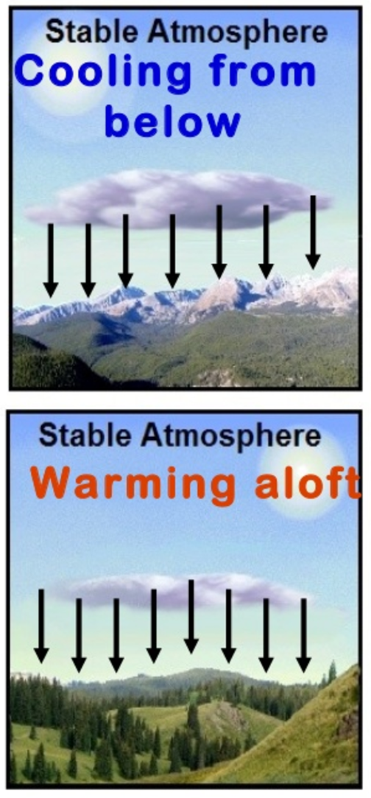
How Stability Changes
Stability is enhanced by the following:
  Radiation cooling of Earth’s surface after sunset
  The cooling of an air mass from below as it traverses a cold surface
  General subsidence within an air column (sinking)

Slide 23
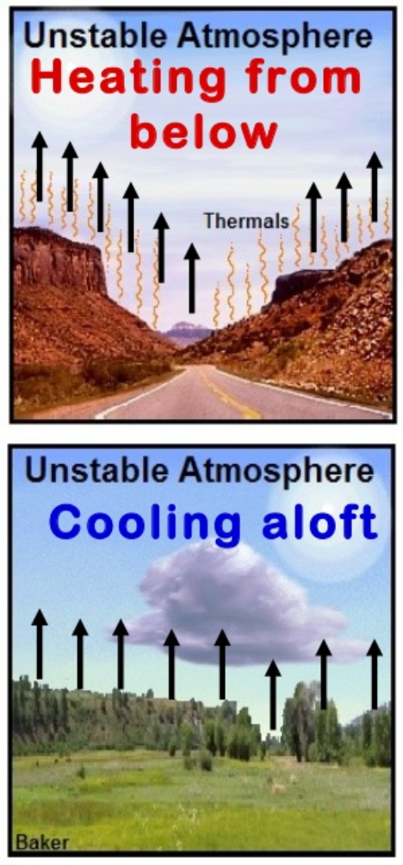
How Stability Changes
Instability is enhanced by the following:
  Intense solar heating warming the lowermost layer of the atmosphere
  The heating of an air mass from below as it passes over a warm surface.
  General upward movement of air caused by processes such as orographic lifting, frontal wedging, and convergence.
  Radiation cooling from cloud tops.

Slide 24
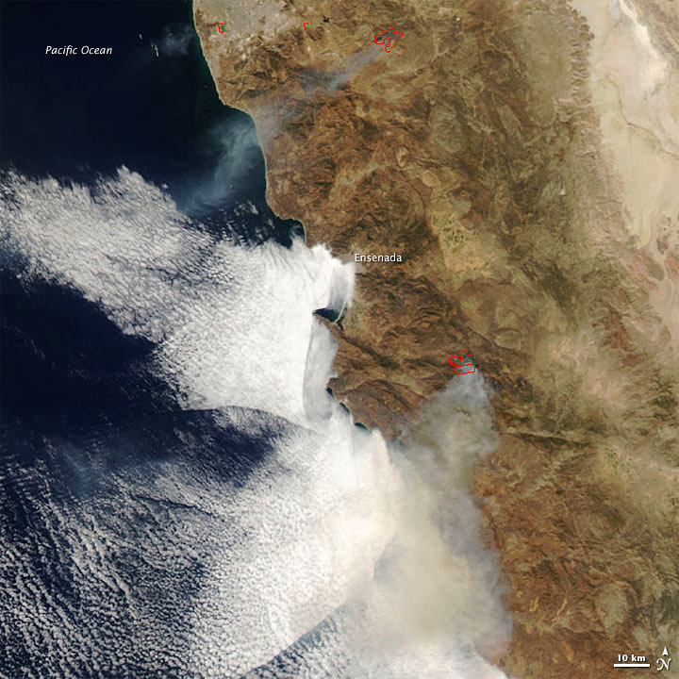
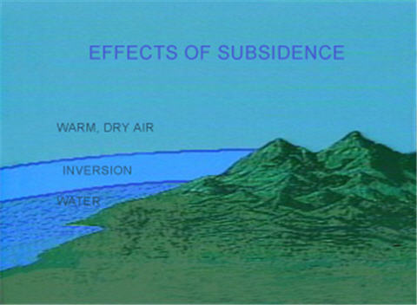
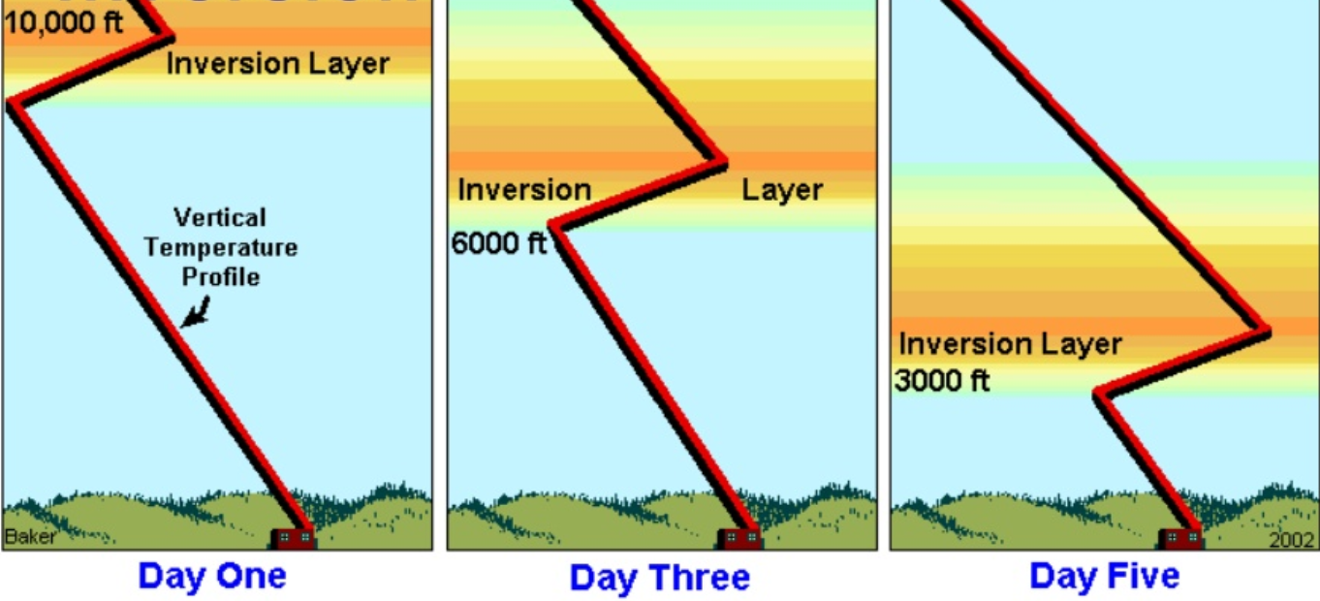
Vertical Air Movement and Stability
Subsidence
  the general downward motion of air
  Usually Stabilizes the air since the air above is warmed
  Can result in the evaporation of clouds

Slide 25
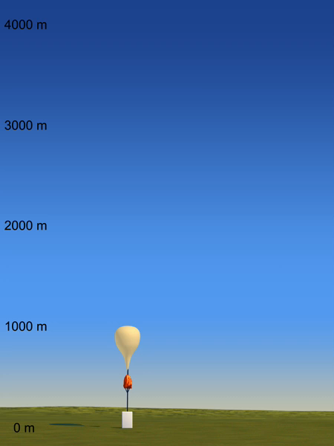
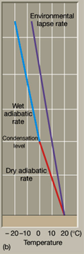
Absolutely Stable Review
Absolute Stability
When the environmental lapse rate is LESS than the wet adiabatic lapse rate
ELR < WALR

Slide 26
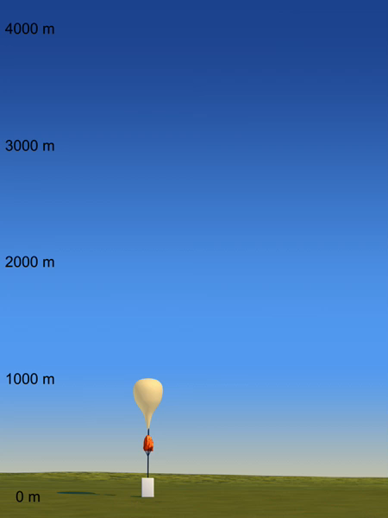
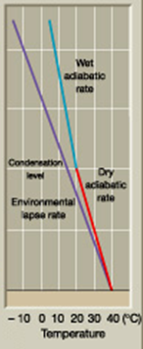
Absolutely Unstable Review
Absolute Instability
When the environmental lapse rate is GREATER than the dry adiabatic lapse rate
ELR > DALR

Slide 27
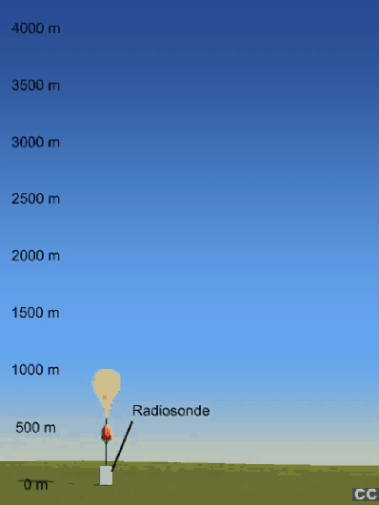
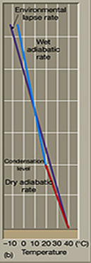
Conditionally Unstable Review
Conditionally Unstable
When the moist air has an environmental lapse rate BETWEEN the dry & wet adiabatic lapse rates
WALR < ELR < DALR

Slide 28
Key Information 1
Be able to describe and DRAW a simple diagram showing the FOUR different ways for air to RISE.
Orographic Lifting
  Air is forced over a mountain
Frontal Wedging
  Air is forced up due to difference in air temperature/density
Convergence
  Air is forced to rise as it collides
Localized Convective Lifting (differential heating)
  Air is forced to rise to heating air and lowering its density
Notes:
You can just read this slide.

Slide 29
Key Information 2
Be able to describe the difference between the DRY ADIABATIC LAPSE RATE, WET ADIABATIC LAPSE RATE, and the ENVIRONMENTAL LAPSE RATE.
Dry Adiabatic Lapse Rate (DALR)
  The change in temperature due to a change in altitude of a non-condensing parcel
  1°C/100m or 10°C/1000m or 5.5°F/1000ft
Wet Adiabatic Lapse Rate (WALR)
  The change in temperature due to a change in altitude of a condensing parcel
  ~0.6°C/100m or ~6°C/1000m or ~3.3°F/1000ft
Environmental Lapse Rate (ELR)
  What ever the ACTUAL measureable temperature change is with height.
Notes:
You can just read this slide.

Slide 30
Key Information 3
Be able to differentiate between the THREE different types of ATMOSPHERIC STABILITY.
Absolute Stability
Absolute Instability
Conditionally Unstable
Absolute Stability
  When the environmental lapse rate is LESS than the wet adiabatic lapse rate
  ELR < WALR
Absolute Instability
  When the environmental lapse rate is GREATER than the dry adiabatic lapse rate
  ELR > DALR
Conditionally Unstable
  When the moist air has an environmental lapse rate BETWEEN the dry & wet adiabatic lapse rates
  WALR < ELR < DALR
ELR < WALR
ELR > DALR
WALR < ELR < DALR
Notes:
You can just read this slide.

