Slide 1
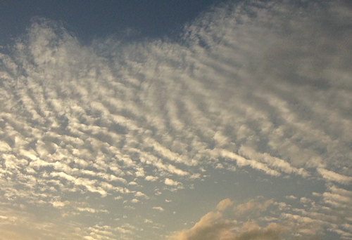
ATMO 102 Pacific Climates and Cultures
ATMO 102 Pacific Climates and Cultures
Lecture: Hawaiian Surfing

Slide 2

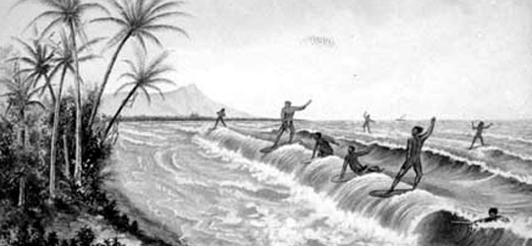
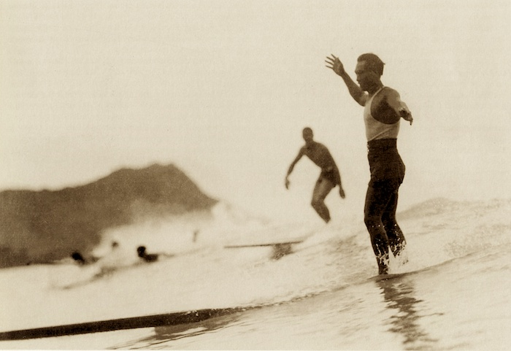
Quick Hawaiian Surfing Facts
Hawaiians were first discovered surfing by European explorers in 1778.
Duke Kahanamoku, an Olympic swimmer is the father of modern surfing.
  Photo of Duke in Waikiki in the 1930s
Surfing has been and continues to be a major influence in popular American culture and international culture.

Slide 3
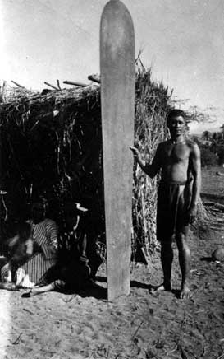

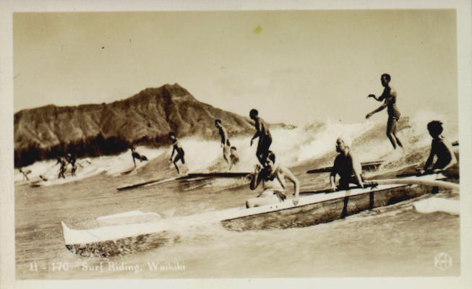
Surfing Imagery
Surfing and Canoe riding in Waikiki
Hawaiian petroglyph
of surfer.
One of the earliest known pictures of a surfer with his board from around 1890.

Slide 4
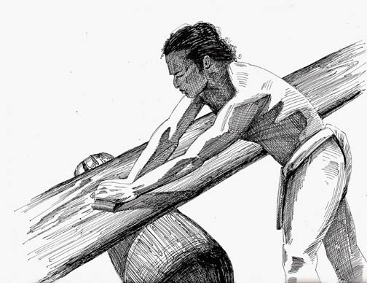
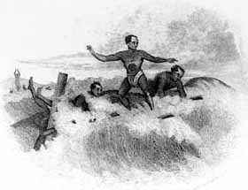
History of Surfing
Hawaiians may not have invented surfing
  Captain James Cook observed Tahitians canoe and body surfing in 1777, the year before he arrived in Hawai’i
Surfing could have had its start anywhere in the Pacific
The Hawaiians earned the greatest renown as surfers.
Recorded Hawaiian chants as far back as the 15th century honor surfing and mention contests, competing chiefs, surfing wagers and remarkable waves.

Slide 5
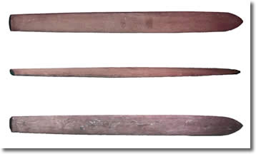
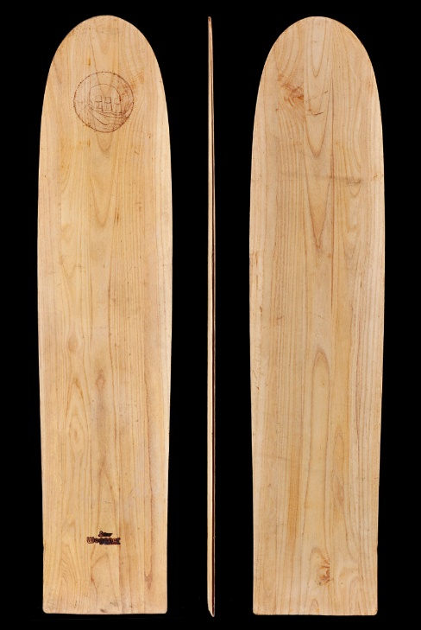
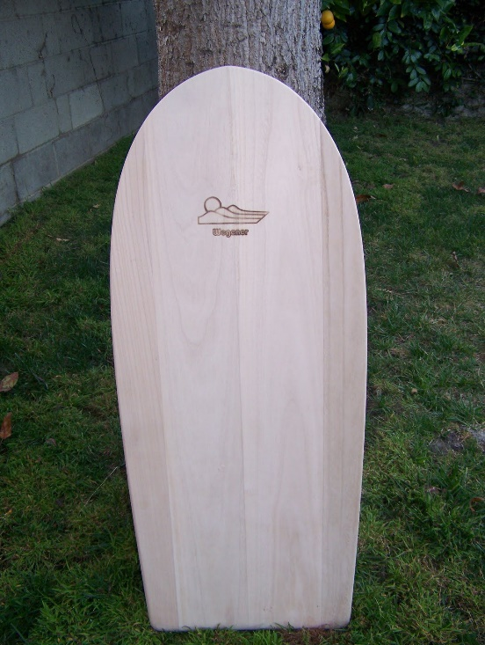
Who Surfed What?
Chiefs, men women, and youth surfed in Polynesian society in Hawaii
Chiefs rode a long, narrow, wood board called olo (18 feet long)
Common people rode short, wide, thin wood boards called alaia (6-8 feet long)
Common people also rode small belly boards called paipo.

Slide 6
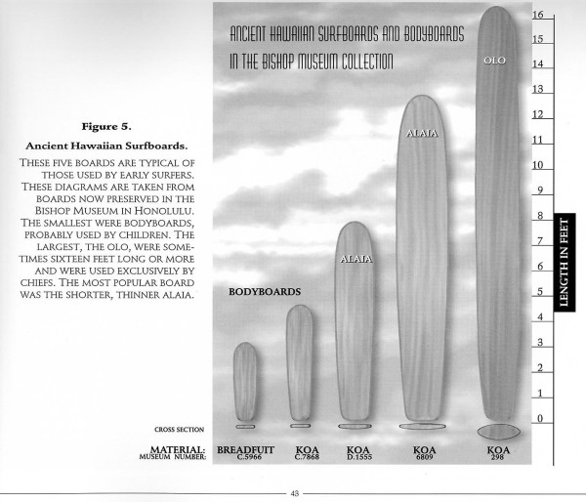
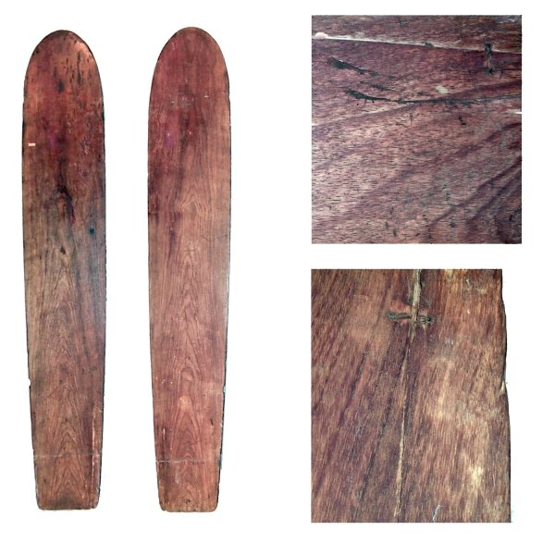
Comparison of Surfboard Shapes and Sizes

Slide 7
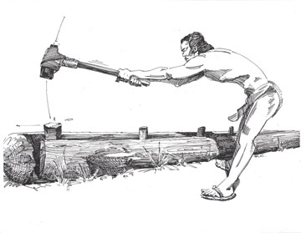
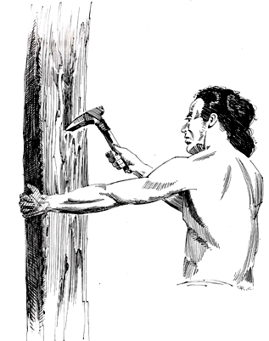
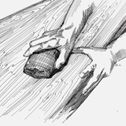
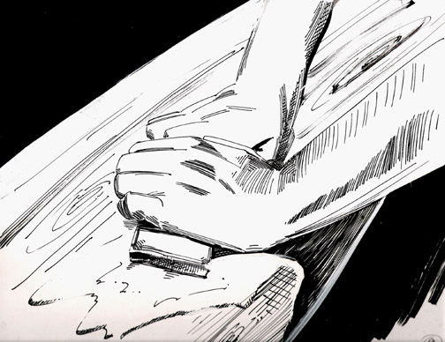
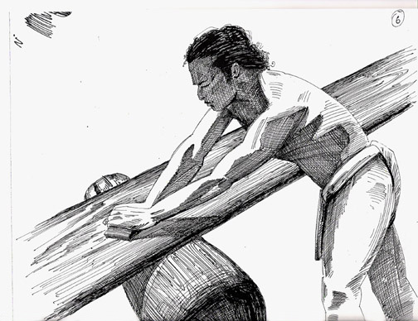
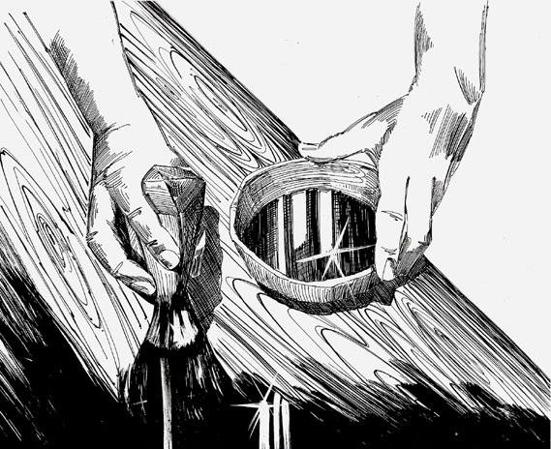
Royal Surfboard Construction
Kahuna (priest) places a red kumu fish at the trunk of the chosen tree
Tree was cut down and split
Prayers were offered
Kumu was placed in a hole at the roots
Tree cut with adzes (bone tools) to rough surfboard dimensions
In a canoe shed final shaping was completed with coral and rough stone
The board was then sanded with water, and sharkskin.
Then, a coat of Kukui nut oil was applied with a Pandanas kernel, that was pounded to make a brush.

Slide 8
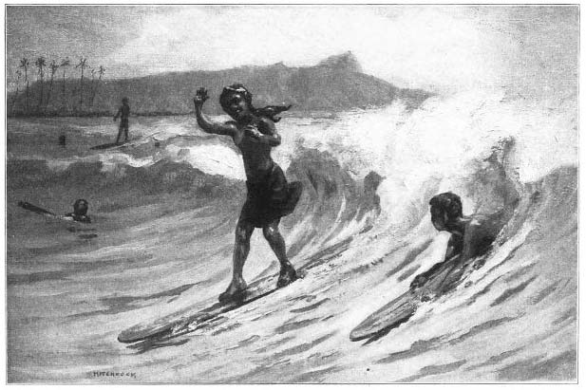
Surfing Culture
Hawaiians’ excitement peaked in `Ikuwa (November) when winter storms brought big surf to the Islands.
If seas were calm, they enlisted a kahuna to pray and chant for surf.
In addition to being fun for the athletes, surfing was a big sport for betting amongst the spectators.
  Hawaiians wagered their most important properties on contests, betting everything from pigs and poultry to canoes and their lives.

Slide 9
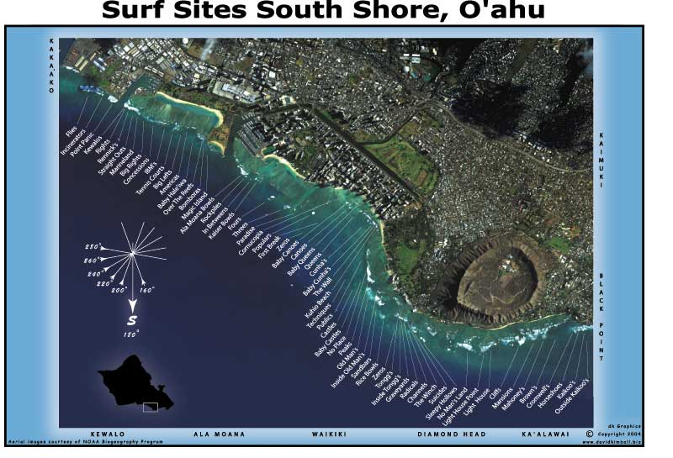
Surfing Culture
Surfing was especially popular among chiefs (ali’i).
They could reserve the best resources and locations for themselves by declaring a favorite beach kapu - off limits - or by ordering the best koa or wiliwili trees cut for making their boards.
They also had greater leisure time to practice their skills
Commoners, by contrast, surfed when they could, riding the waves on anything handy, even banana trunks.

Slide 10
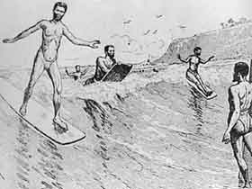
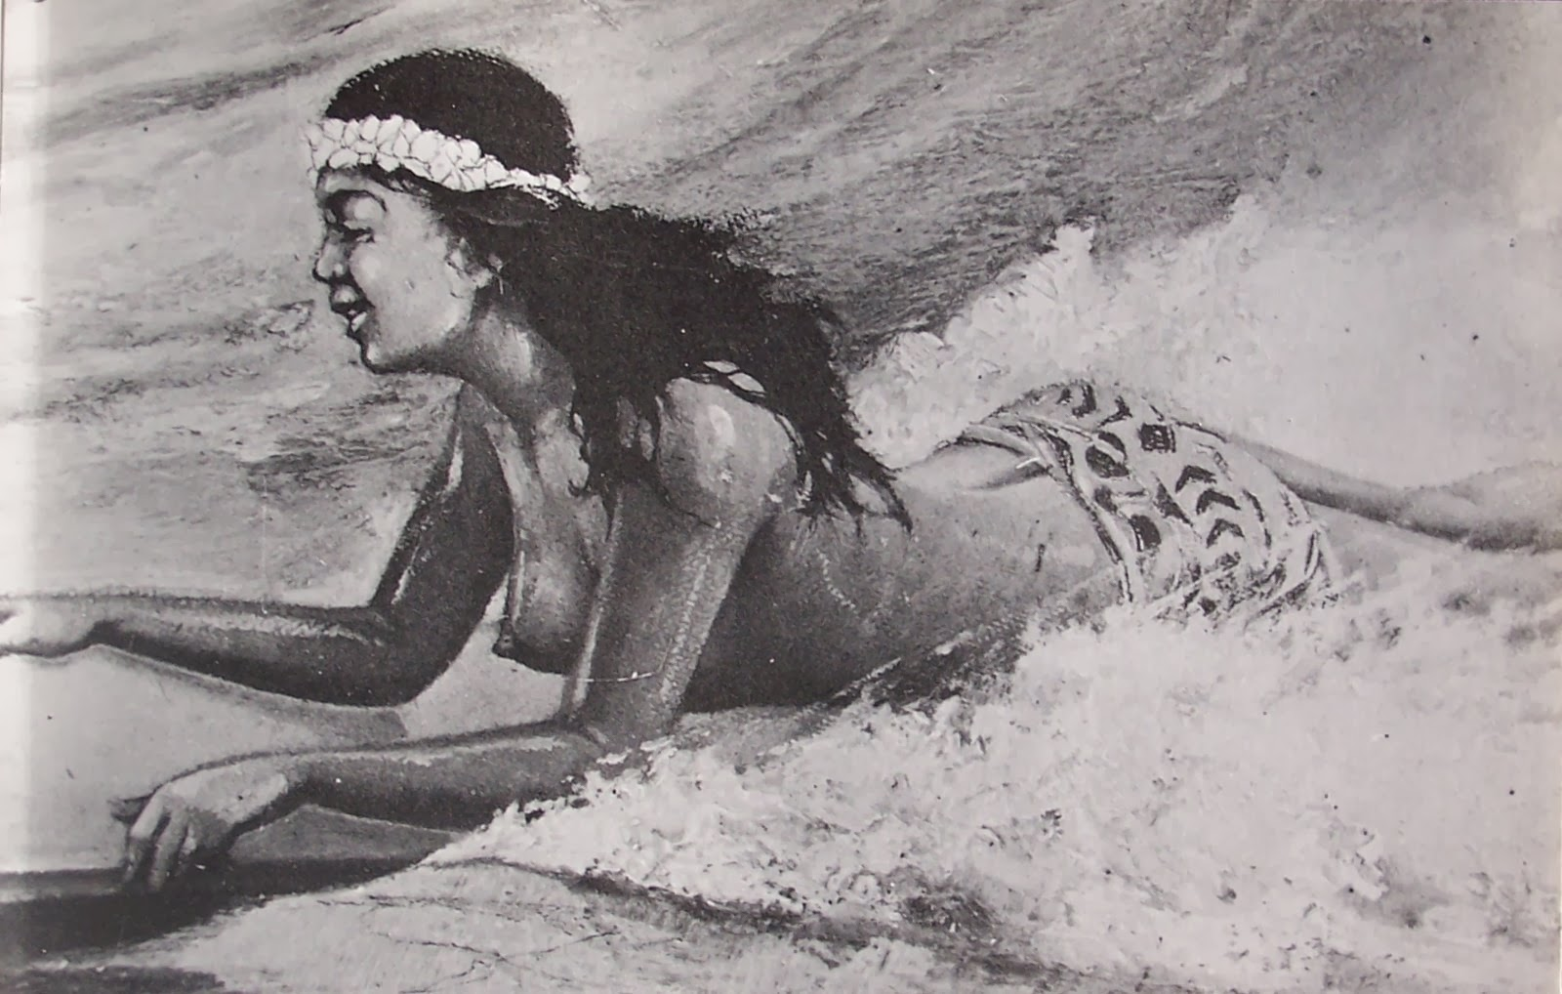
Always an “addiction”
Then, as now, surfers found it hard to resist dropping everything when the waves beckoned.
Hawaiian historian Kepelino describes surfers of old:
  "Expert surfers going upland to farm, if part way up perhaps they look back and see the rollers combing the beach, will leave their work ... then hurrying away home, they will pick up the board and go. All thought of work is at an end, only that of sport is left. The wife may go hungry, the children, the whole family, but the head of the house does not care. He is all for sport, that is his food."

Slide 11
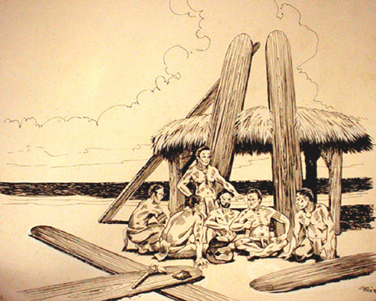
Hawaiian Surf Diction
Kai emi, nalu miki – receding wave
Kai pi’i, nalu pú – high wave
kai po’i nalu ha’i – breaking wave
nalu – surf, ocean wave
nalu h’i lala – wave that breaks diagonally
pae – to mount or catch a wave
pae i ka nalu – to ride a wave into shore

Slide 12
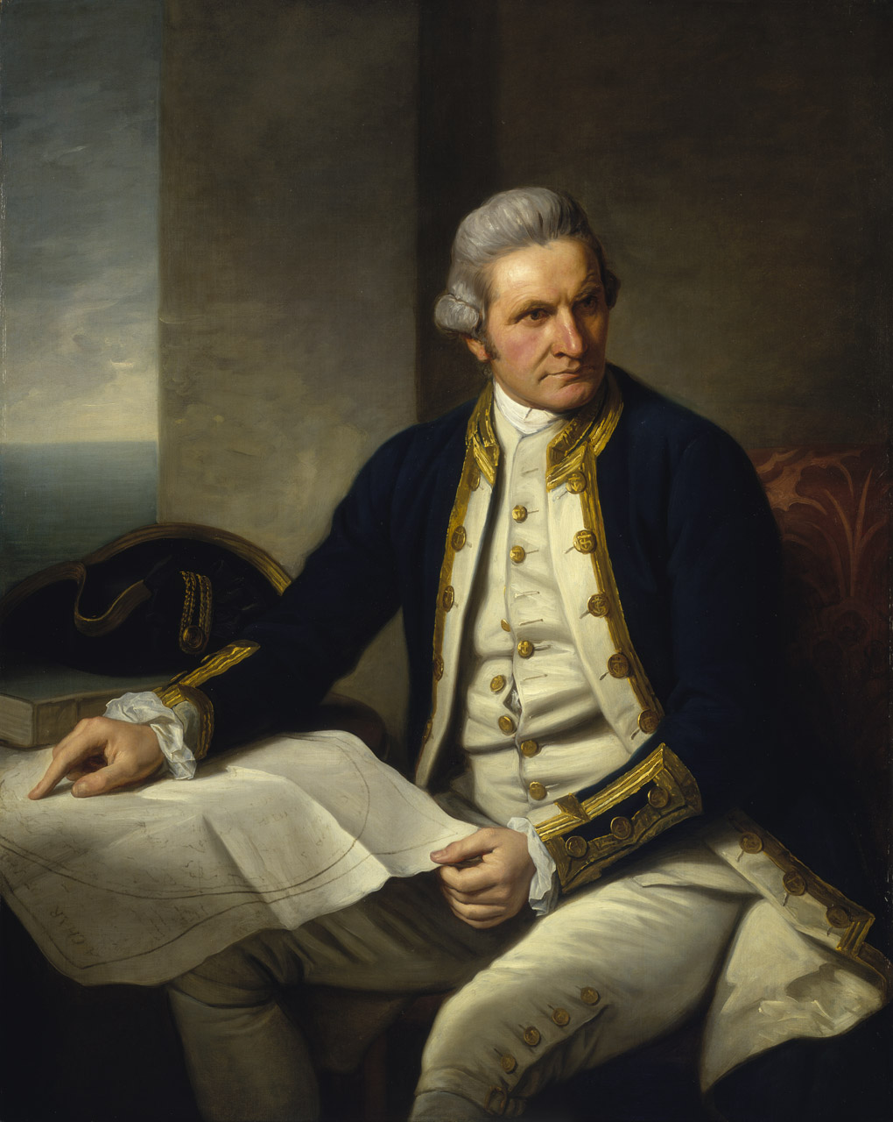
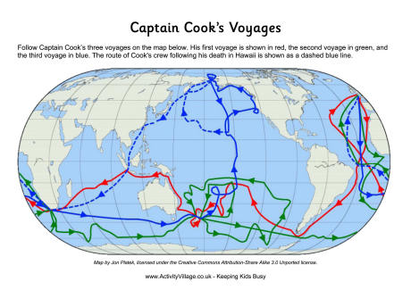
Cooke and the Hawaiian Islands
Captain James Cook
  1728-1779
  British Navigator and Explorer
  in 1778 he became the first known European to reach the Hawaiian Islands
  He was impressed with Hawaiians riding waves on boards and canoes
  Hawaiians were curious and unfamiliar with European concepts of ownership, and thus were shot and killed by Cook and his mean for thievery.
  Hawaiians stabbed Cook in self-defense on Feb 14, 1779

Slide 13
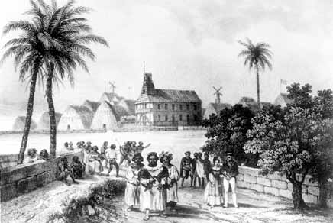
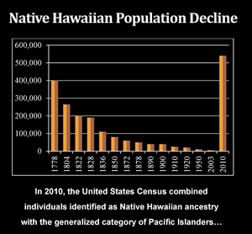
Changes to Hawaiian Culture
Cooke and Early Europeans Changed the Culture
  Brought metal, guns, cannons, uniforms, venereal diseases, other diseases, alcohol, and new religion
  Hawaiian culture disintegrated
  Between Cook’s arrival (1778) and 1890, an estimated population decrease occurred from 400,000 to 40,000 from exposure to European viruses and bacteria

Slide 14
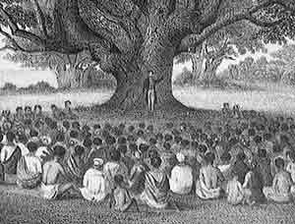
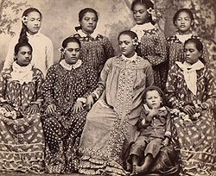
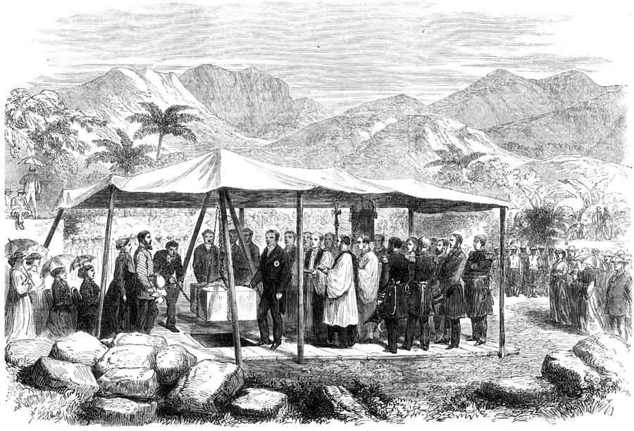
Changes to Hawaiian Culture
Protestant Paradigm took over
  modest attire
  new language
  discourage casual sex, gambling and playing in the ocean
Drew Kampion writes “Surfing’s association with nakedness, sexuality, wagering, shameless exuberance, informality, ignorant joy, and freedom were counterproductive to the designs of the church fathers, who, curiously, would end up owning most of the land in the islands”

Slide 15
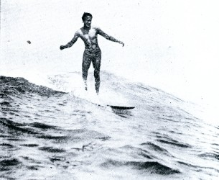
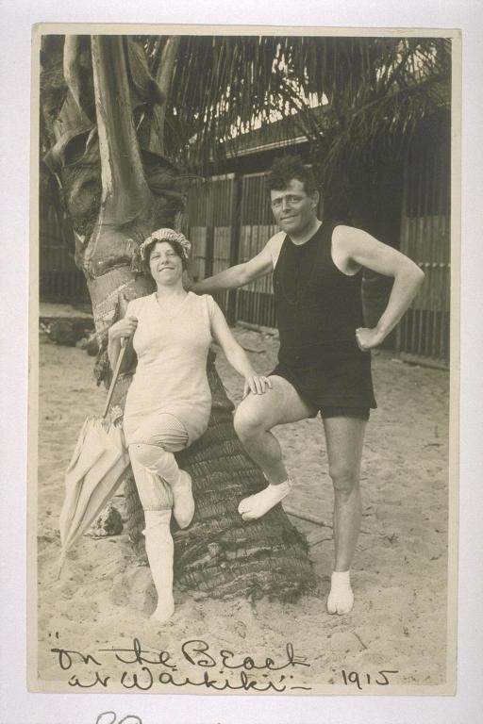
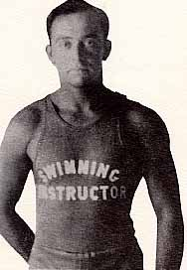
Surfing Renaissance
By 1900, the Islands had become a U.S. territory
Growing number of haoles (white people or foreigners) came to Islands to visit or live
Three men got together to surf in Hawaii and resurrected surfing in 1907
  Alexander Hume Ford (businessman, write)
  Jack London (famous author of adventure literature)
  George David Freeth (surfer)

Slide 16
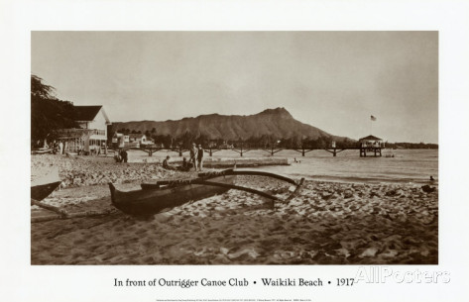
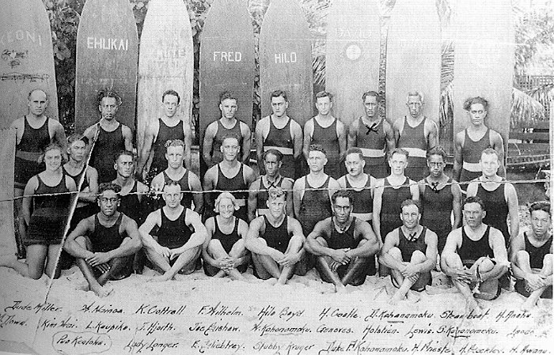
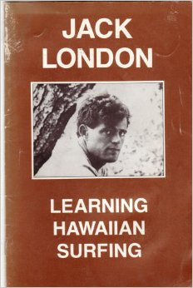
Surfing Renaissance
In 1907 in “A Royal Sport’ Surfing at Waikiki” in A Woman’s Home Companion, London published a description of Freeth on a wave, “I saw him tearing in on the back of it, standing upright on his board, carelessly poised, a young god bronzed with sunburn.”
Ford created the Outrigger Canoe and Surfboard Club (haole organization)
Three years later predominantly Native Hawaiians created Hui Nalu
The two clubs competed often
By 1911 Outrigger Club had 1200 members
Surfboard riding was the local craze.

Slide 17
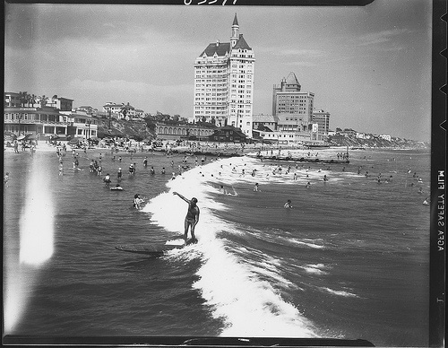
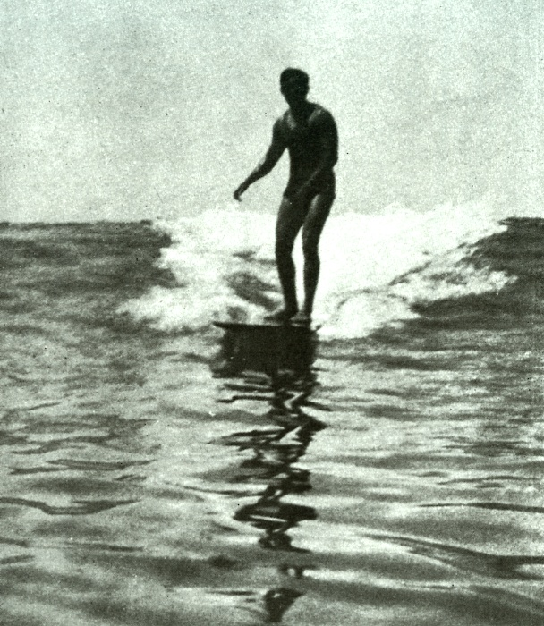
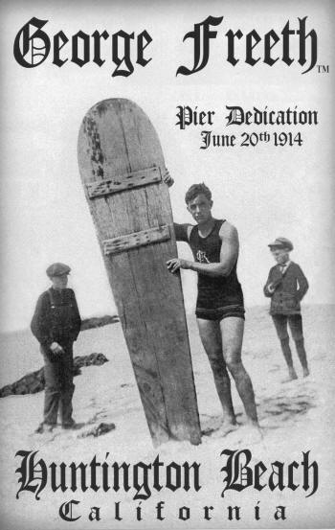
Bringing Surfing to CA
In 1907, Henry E. Huntington hired Irish-Hawaii Freeth to give surfing demonstrations at Redondo and Venice Beaches to promote Huntington’s Los Angeles-Redondo Beach rail service.
Thousands watched in awe
The introduction of trains and cars made California’s coast an accessible playground
Freeth is credited with introducing surfing to CA.

Slide 18
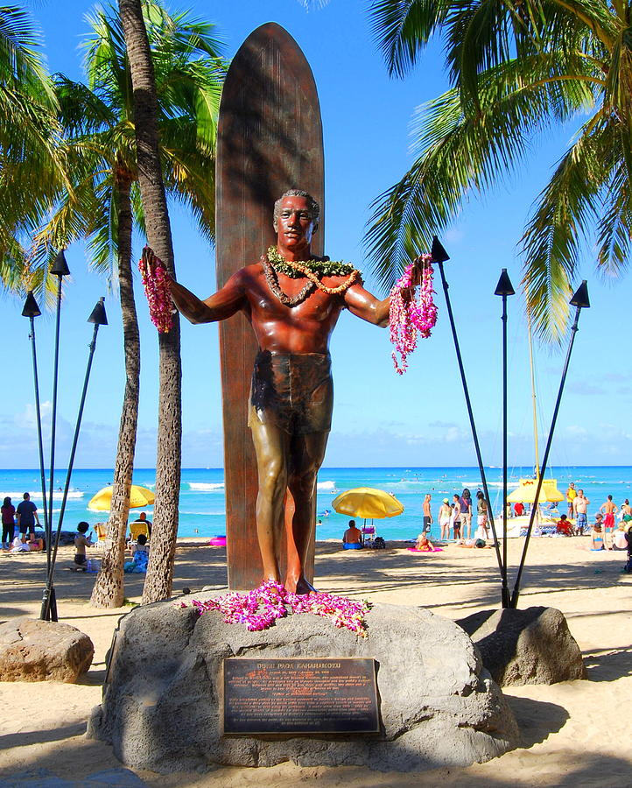
Duke Kahanamoku
Winner of 3 Olympic gold medals in swimming.
Member of both the Swimming Hall of Fame & Surfing Hall of Fame.
Rescued 8 men in 1925 from the ocean using his surfboard.
Helped spread the popularity of surfing throughout the world.

Slide 19
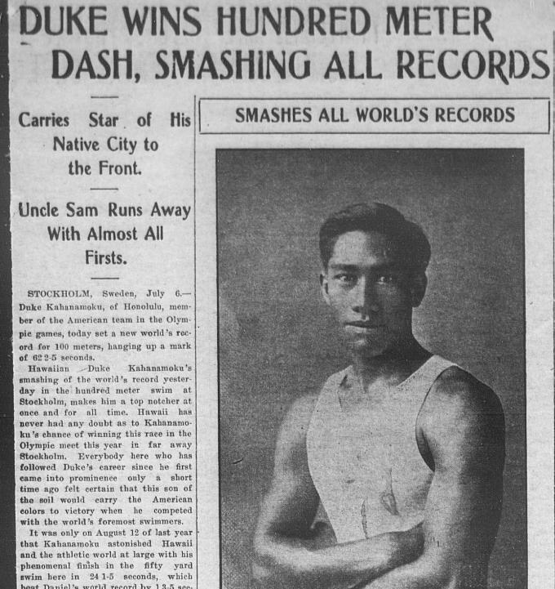
Duke Kahanamoku
Freeth enlisted “beach boys” to teach tourists how to surf in Hawaii, including Duke Kahanamoku (born in 1890), not royalty
Duke was a phenomenal waterman and athlete and remembered as a father of modern surfing
Duke won 100-meter freestyle at Olympic games in Stockholm, Sweden in 1912
No Olympiad in 1916 due to WWI
Duke won 100-meter freestyle in Olympic games in Antwerp, Belgium in 1920 (age 30) in 60.4 seconds

Slide 20
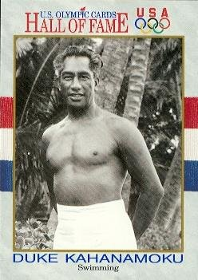
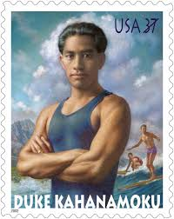
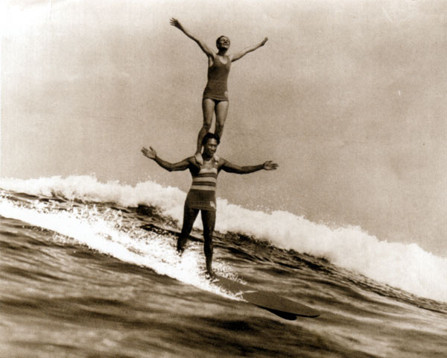
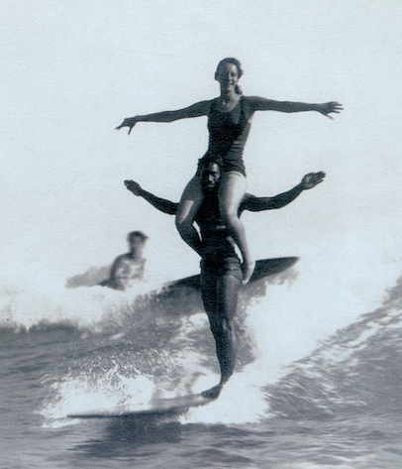
Duke Kahanamoku
Revealed surfing to crowds in Atlantic City and Nassau (NY) and Corona Del Mar and other beaches in CA
Introduced surfing to Australians in 1914 at Freshwater (now Harbord) near Sydney
  Demonstrated headstand and tandem surfing
  Victorian values: knee-to-neck-costumes
Duke played minor roles in 7 films and 2002 stamp commemorates him

Slide 21
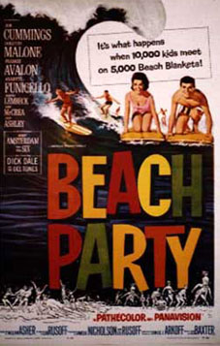
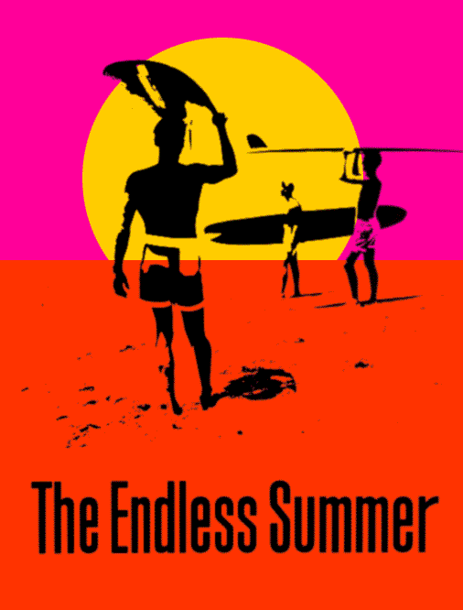
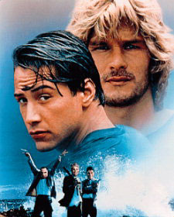
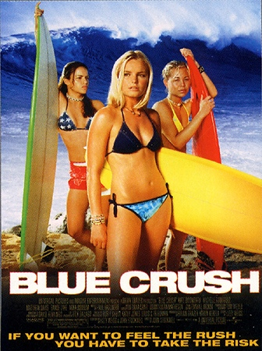
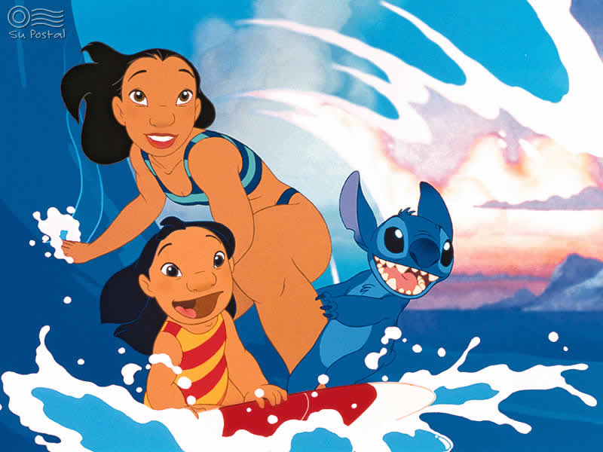




Current Popular Culture References to Surfing

