Slide 1
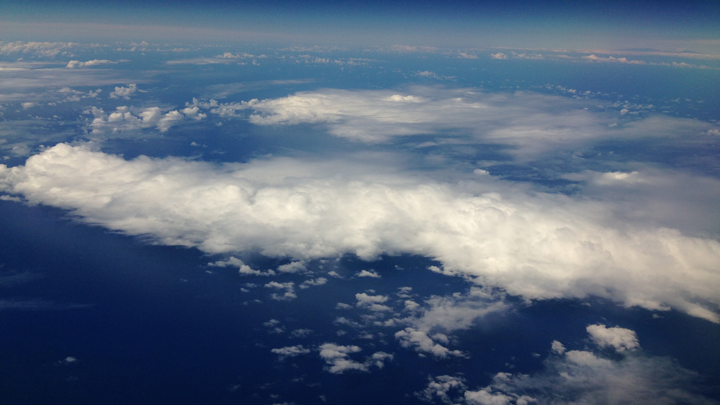
ATMO 102 Pacific Climates and Cultures
ATMO 102 Pacific Climates and Cultures
Air Masses & Fronts

Slide 2
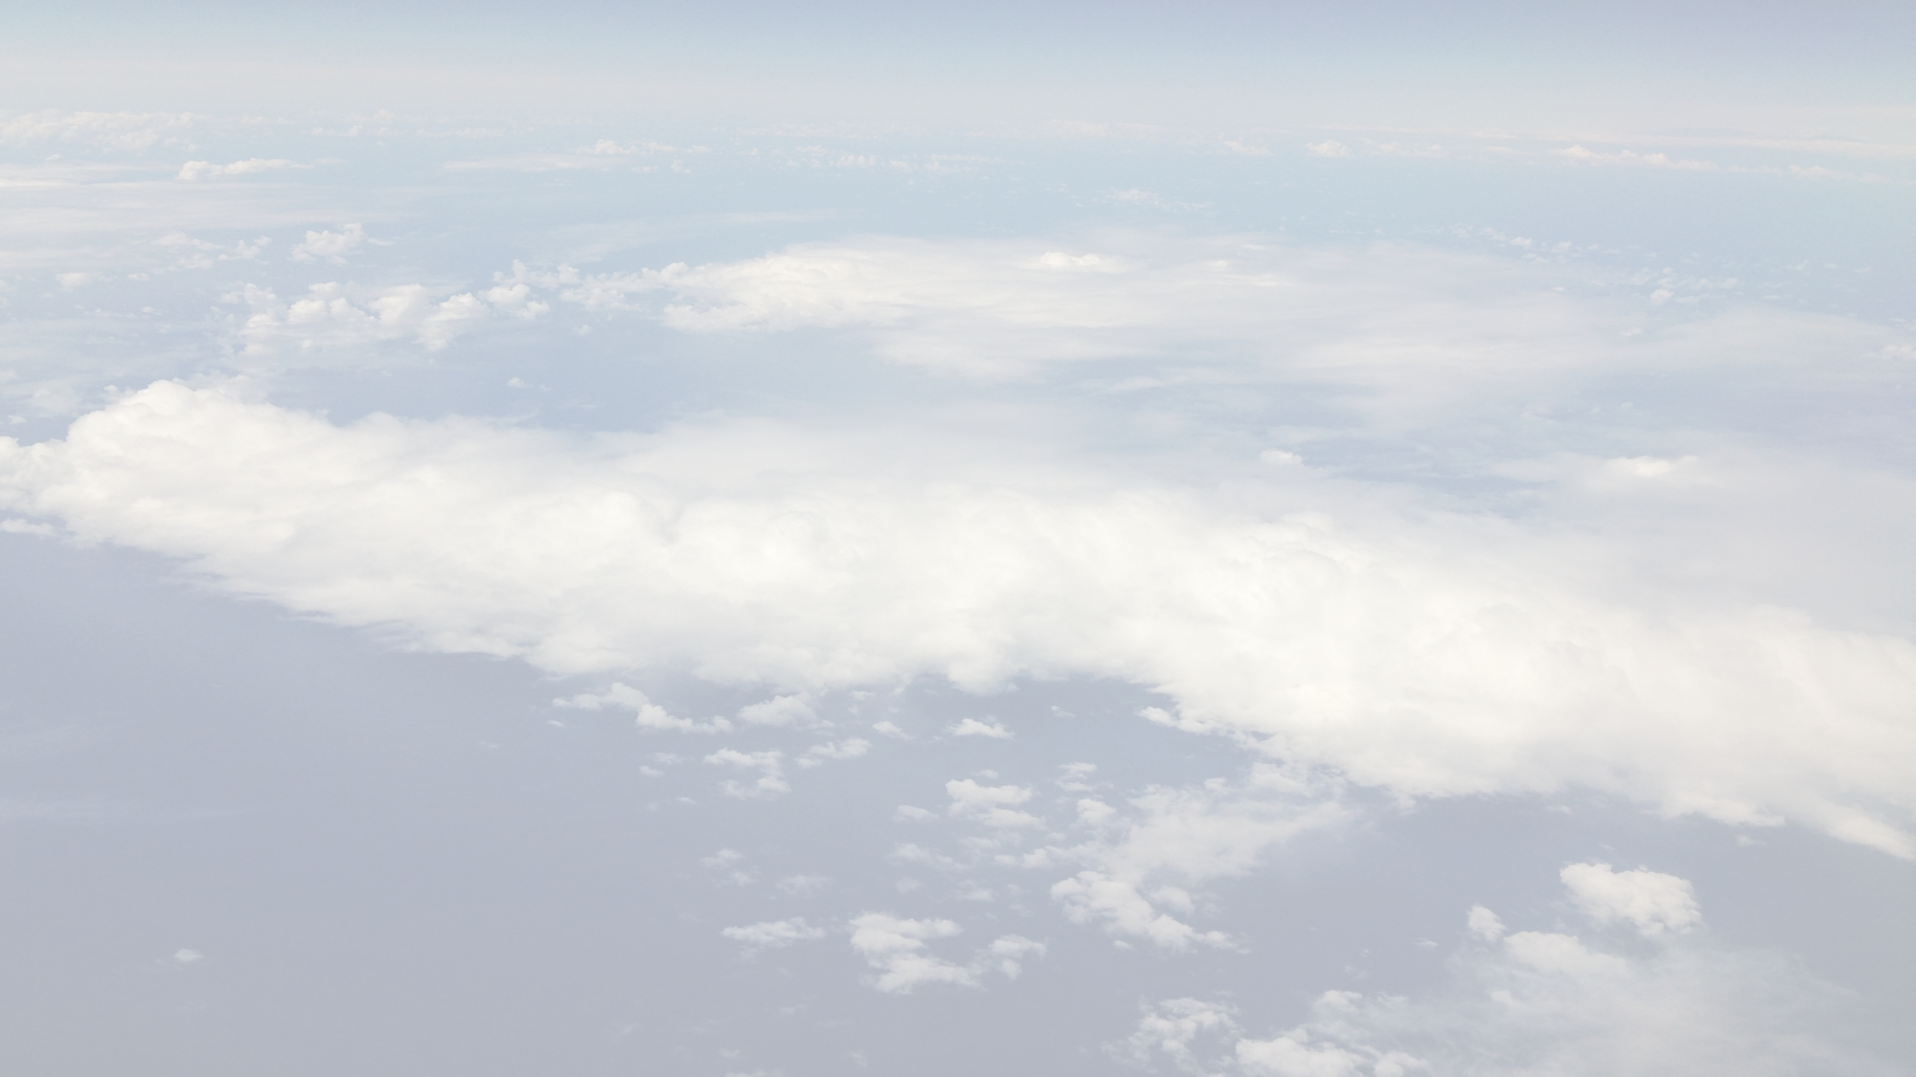
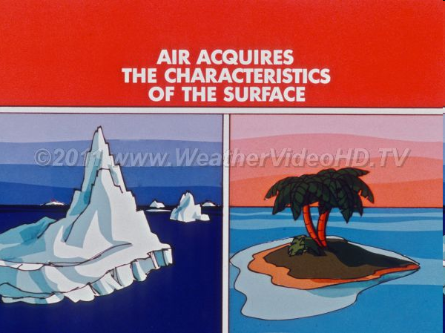
What is an Airmass?
Air Mass
  really big blob of air with similar properties
  Usually 1600 km (1000 miles) across
  Several km thick
Change in weather when one air moves out and a new air moves in
  Also known as a FRONTAL PASSAGE
  Brings changes in T, P, RH and Winds
Air masses form when they move over large regions that exhibit very similar properties

Slide 3
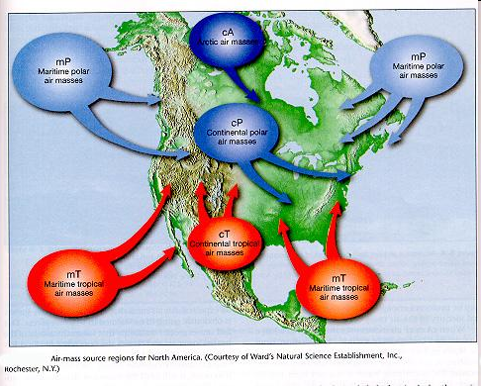
Airmass Source Regions
Polar and Tropical regions tend to exhibit such properties and therefore are good source regions.
The mid-latitudes tend to be variable and therefore are not good source regions

Slide 4
Types of Airmasses
Polar (P) air masses form over northern Canada and the Arctic.
  They tend to be COLD. (Artic (A) and Antarctic (AA) are special designations for those regions)
Tropical (T) air masses form to the south of the United States.
  These tend to be WARM. (Equatorial (E) is a special designation for the Equator)
Maritime (m) Air masses form over oceans (e.g. the Pacific, North Atlantic, subtropical Pacific, or Gulf of Mexico).
  These tend to be HUMID.
Continental (c) air masses form over land (e.g northern Canada or northern Mexico).
  These tend to be DRY.
Air masses are designated by two-letter combinations describing whether they are m or c, P or T.
  Describes basic info about T and RH.

Slide 5
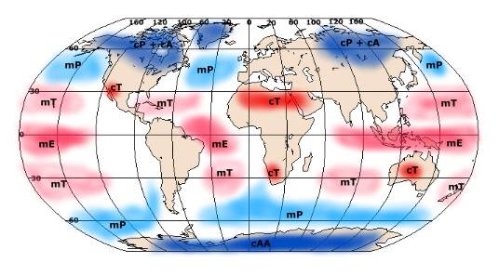
Airmass Designations
All the possible combinations are:
  mP
  mT
  mE
  cP
  cA & cAA
  cT
Yellow boxes are where your countries are located

Slide 6
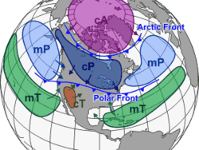
Continental Polar
Also continental Arctic (cA) continental Antarctic (cAA)
Generally cold and dry
Form during winter, they are cooled by the land, creating stable air mass.
  Mostly cloud free
In summer, warmer and more humid than in winter
  Tend to remain farther north and therefore do not influence as much of North America as during winter

Slide 7
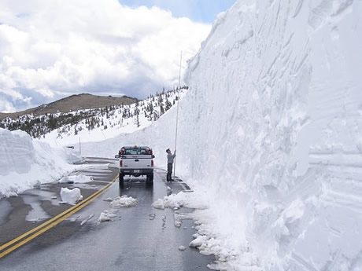
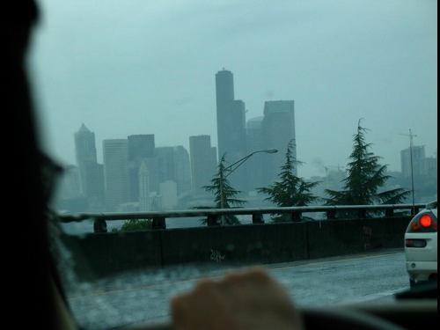
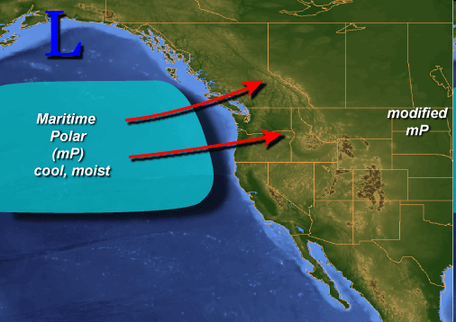
Maritime Polar
Humid and cool
Generates low level stratus clouds, which maintain instability through cloud-top radiative cooling
This leads to somewhat unpleasant showers in Pacific NW, and much of Western US winter weather.

Slide 8
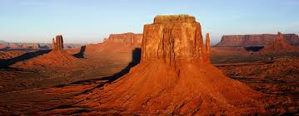
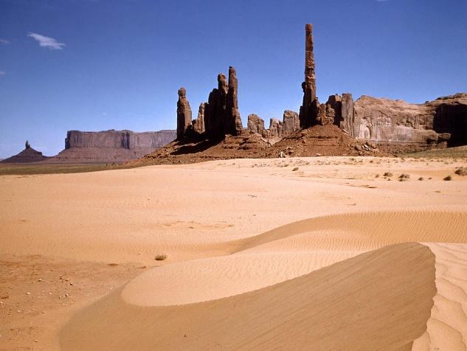
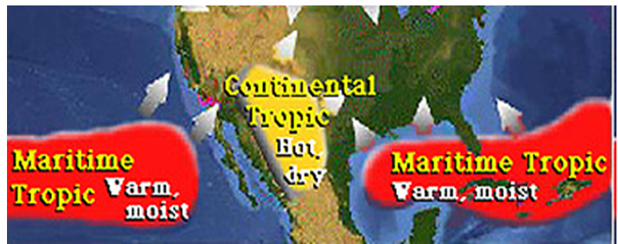
Continental Tropical
Hot and dry, e.g. forming over the desert regions of North Mexico and South West US.
Intense surface heating creates very unstable air, but generally cloud-free because of extremely dry conditions
If however, some moisture is acquired, intense thunderstorms can develop.

Slide 9
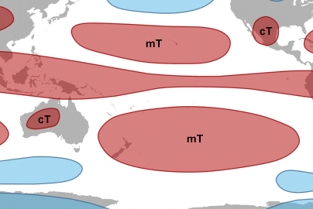
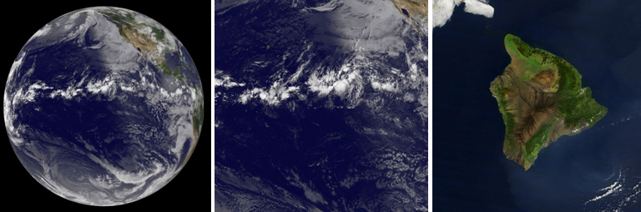
Maritime Tropical
Warm and moist
Can be unstable because of high heating from warm waters → perfect for precipitation.
Can trigger Thunderstorms.

Slide 10
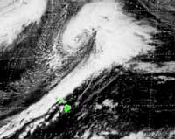
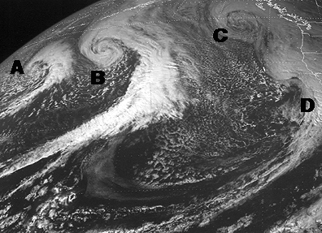
Polar Front Theory
Also called the Norwegian Cyclone Model
Discovered by Norwegian scientists during World War I
Theory states that Mid-Latitude Cyclones (MLCs)
  Develop in conjunction with the Polar Front
  Cold equatorward moving air collides with warm poleward moving air.
  The collisions create FRONTS!
  In the upper atmosphere polar front is continuous, at the surface it is DISCONTINUOUS.

Slide 11
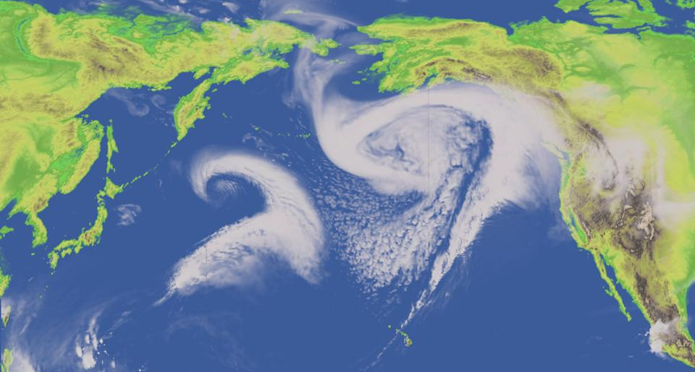
Pacific Mid-Latitude Cyclones

Slide 12
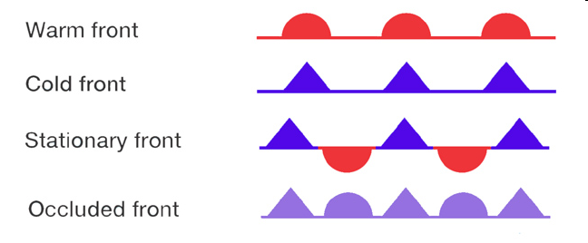

Fronts
Boundaries surfaces that separate air masses of different densities (think temperature)
  Can be combinations of warm, cold, dry, moist…
  Usually 15-200 km wide bands but narrow
  Represented by narrow lines on a weather map
    Warm
    Cold
    Stationary
    Occluded
    Dry lines
Dry Line

Slide 13
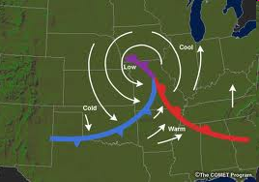
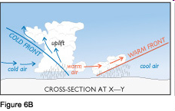
Fronts
Warmer air overlies cooler air (it is less dense)
Ideally the fronts move in approx. the same direction.
The FRONT is the barrier that travels with the air masses
No matter which air mass is moving faster the warm air ALWAYS moves above cold air.
  Overrunning – describes warm air moving over cooler air.

Slide 14

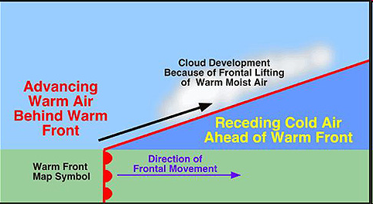
Warm Fronts
When temperatures change from cold to warm after a frontal passage.
Moisture content and Stability of the warm air mass determine the amount and type of precipitation.
Travel at 15-20 mph
Tend to produce light-moderate precipitation over a LARGE area for a LONG time.

Slide 15

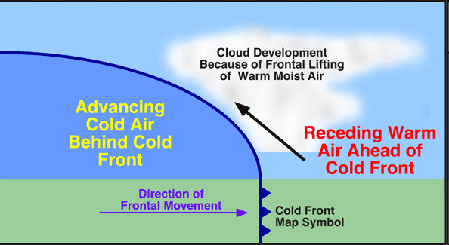
Cold Fronts
When temperatures change from warm to cold after a frontal passage.
Friction slows the surface position of the front compared to the position aloft.
Travel at 20-35 mph
More VIOLENT in nature than warm fronts
Tend to produce heavy precipitation over a SMALL area for a SHORT time.

Slide 16
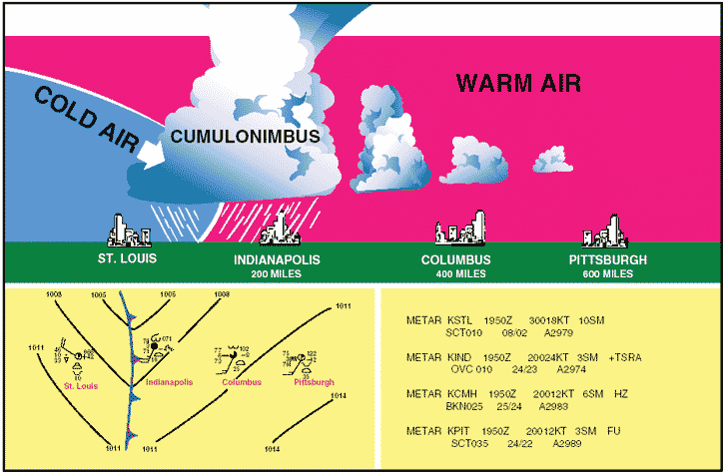
Weather Behind a Cold Front
Weather behind cold fronts is usually characterized by SUBSIDING air
  usually a continental polar (cP) air mass
  usually cloudless
  generally stable which limits cloud development

Slide 17
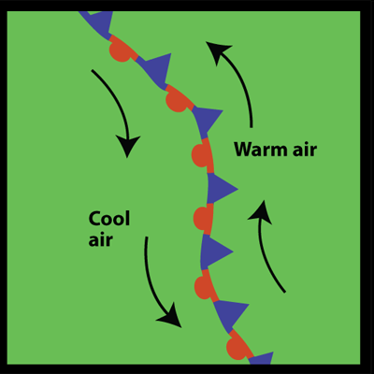

Stationary Front
A front between warm and cold air masses that is moving very slowly or not at all.
Air flow is parallel to the front
Symbol

Slide 18
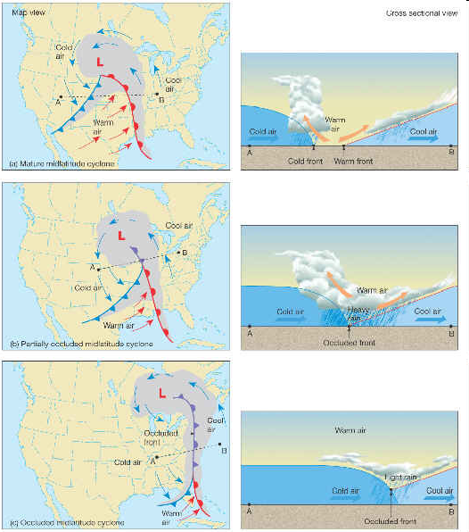

Occluded Front
Symbol
Warm air becomes suspended over the cold and cool air.
Weather near an occluded front is complex

Slide 19
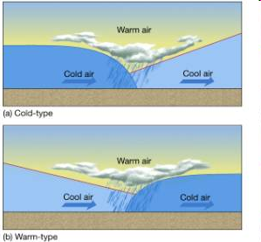
Occluded Front
Cold-type occluded front
  In the Rockies
  Weather resembles cold fronts
  Cold front air is colder than the cool air it is invading.
Warm-type occluded front
  Pacific Coast
  Milder maritime air invades cP air

Slide 20
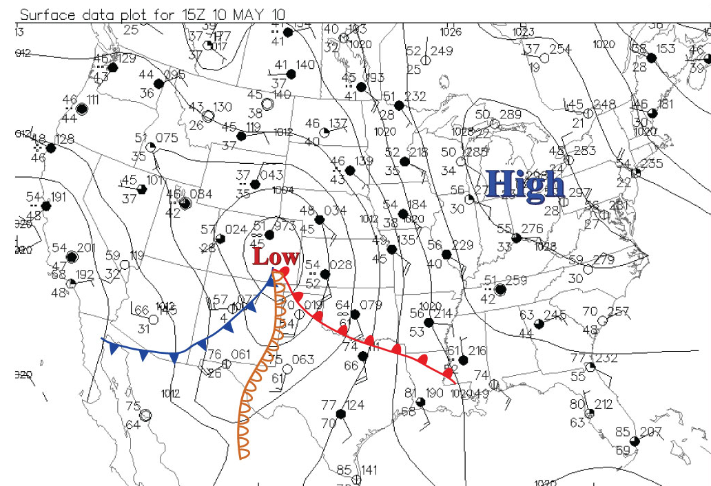

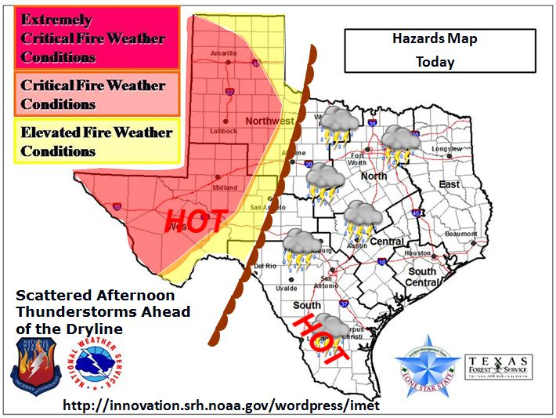
Dry Lines
A narrow zone where there is an abrupt change in moisture.
When dry continental (cT) air converges with humid maritime tropical (mT) air.
Denser cT air acts to lift the less dense mT air.
Seen commonly in the Desert Southwest

Slide 21
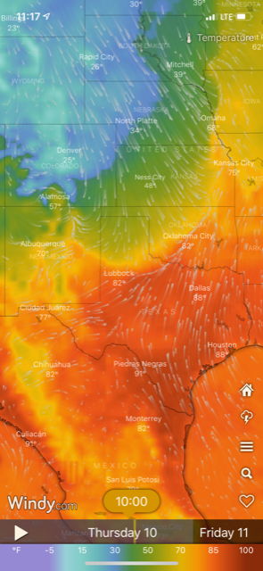
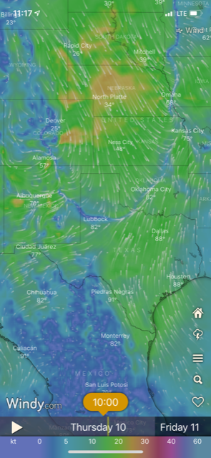
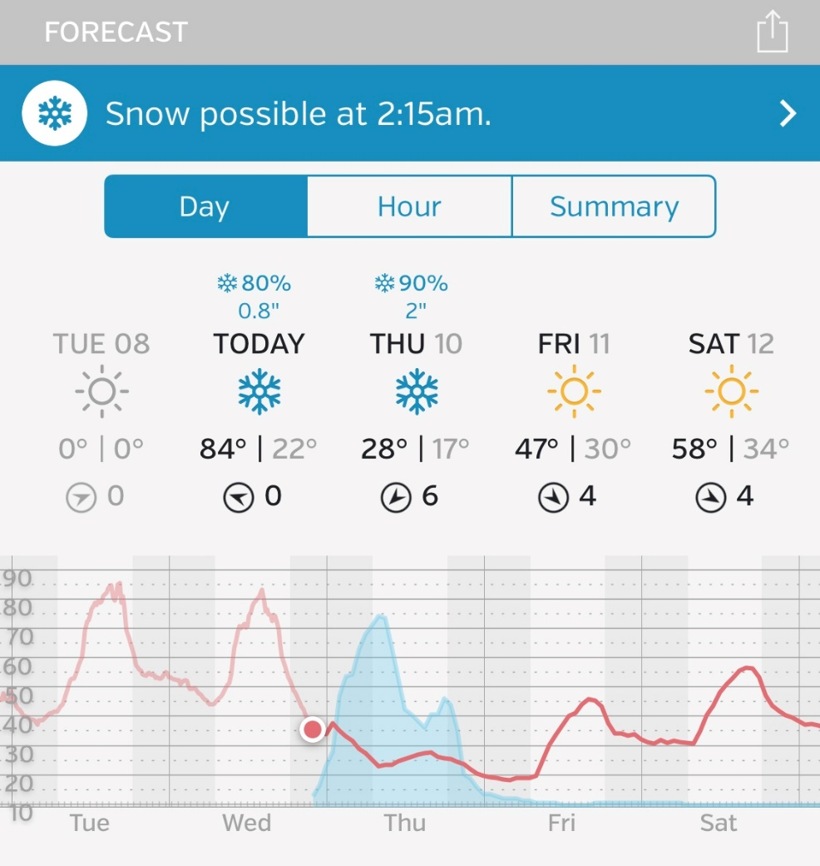
REAL Front

