Slide 1
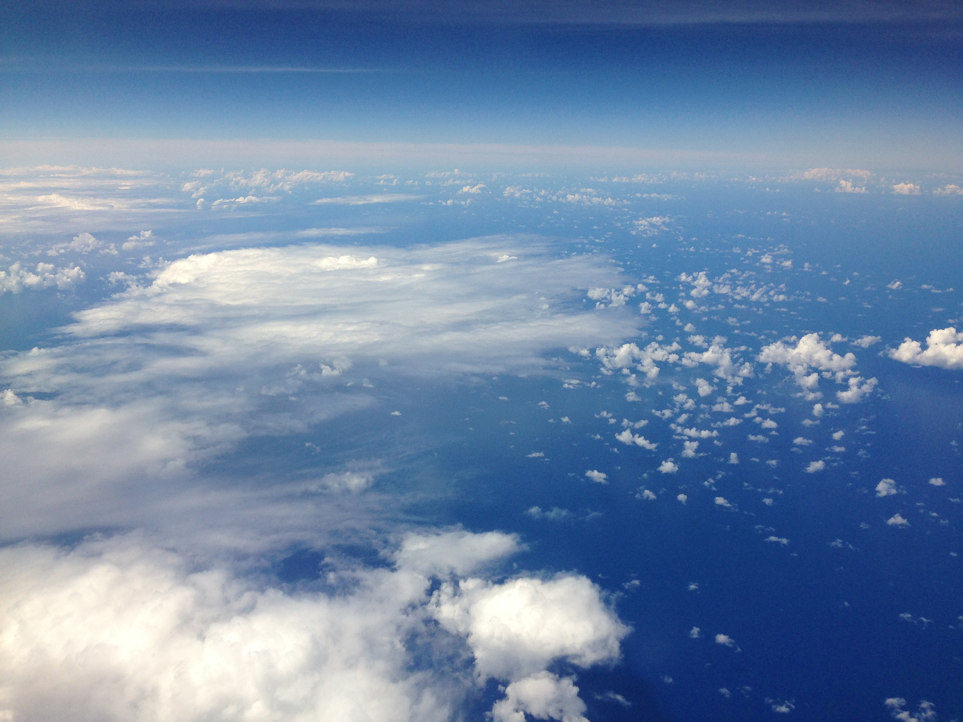
ATMO 102 Pacific Climates and Cultures
ATMO 102 Pacific Climates and Cultures
Cyclones & Storms

Slide 2

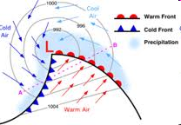
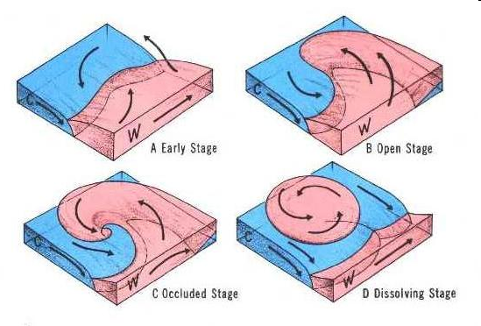
Mid-Latitude Cyclones
Cyclones (storms) generally form along fronts.
Go through a pretty consistent “Life-Cycle”
  We’ll cover the stages in the MLC life cycle
Last a few days to a week

Slide 3
Mid-Latitude Cyclones
Stages include:
  Cyclogenesis -when the cyclone forms
    Development of a Low pressure system along the polar front
  Mature Stage
    Presence of cold and warm fronts with associated clouds and precipitation
    Pressure in center decreases
  Occluded
    Warm air lifted over cold
    Pressure in center stops decreasing

Slide 4
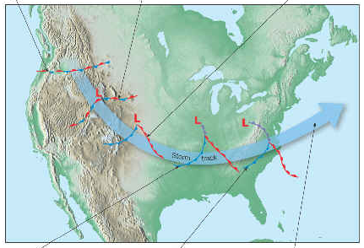
Mid-Latitude Cyclones
Westerlies move the cyclones from west to east as they rotate counter-clockwise.
First signs of a cyclone are usually seen in the western skies.
In the Mississippi valley (due to the jet stream) they typically start to move northeast or northerly in direction.
Usually takes 2-4 days to pass over a region.

Slide 5
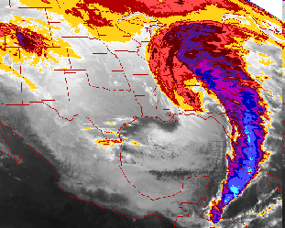
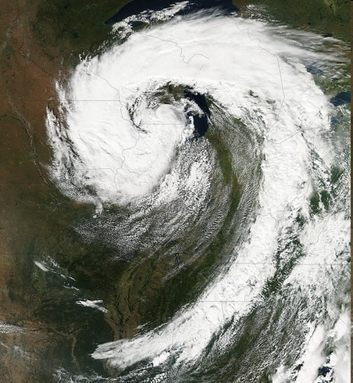
Mid-Latitude Cyclones – Comma Shape

Slide 6
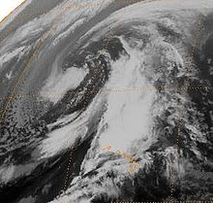
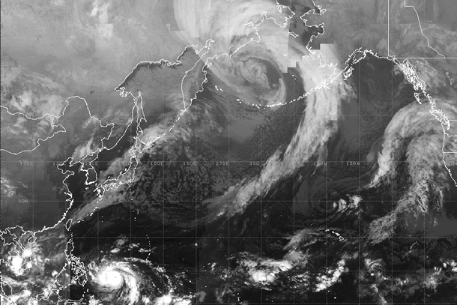
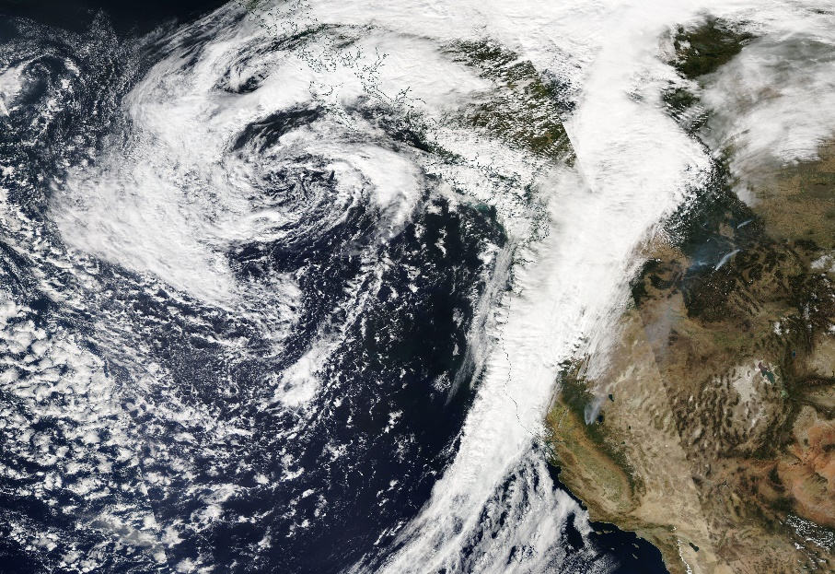
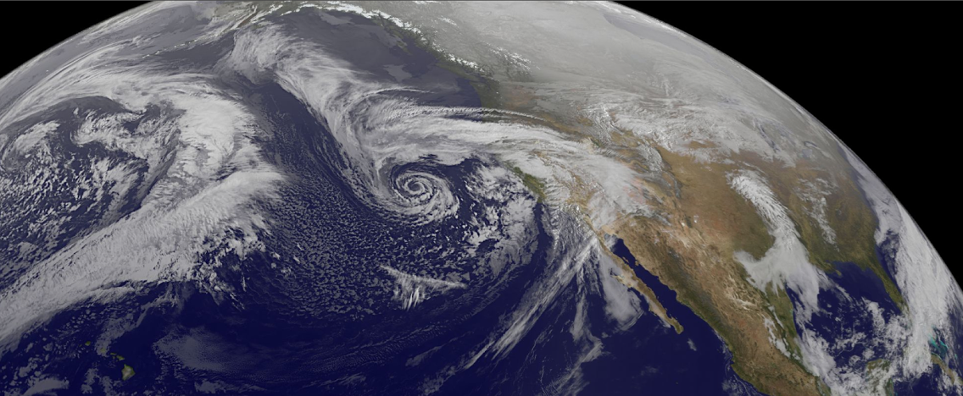
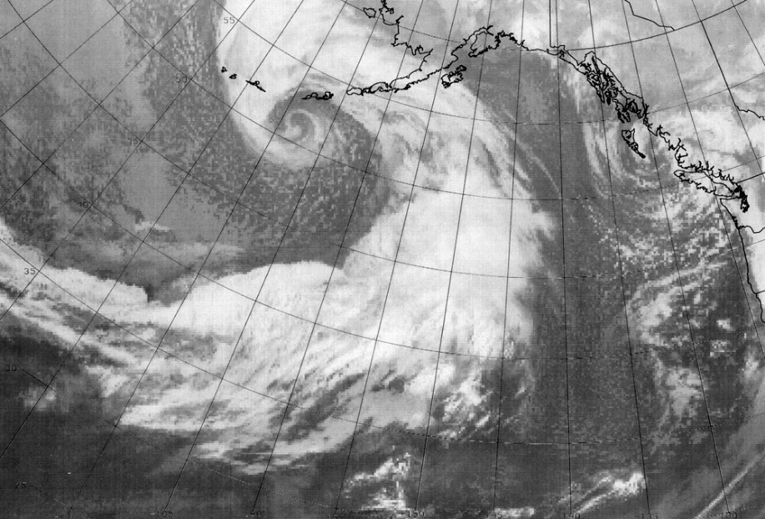
Kona Lows and Pacific Storms

Slide 7
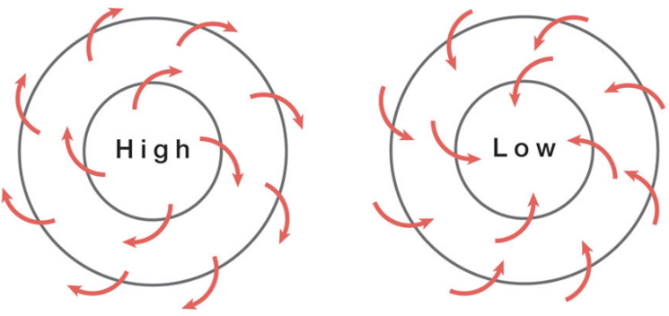
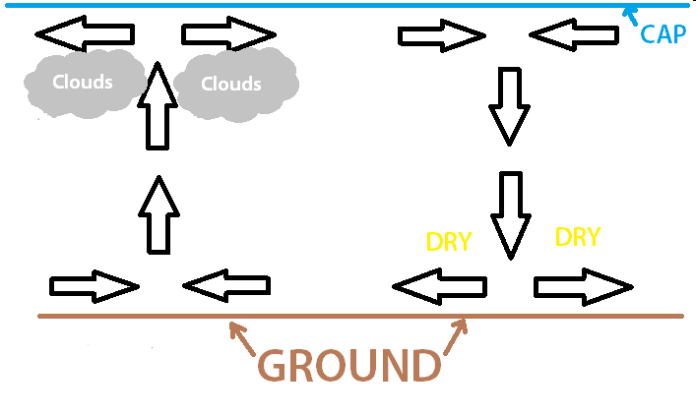
Cyclone Formation
Cyclonic and Anticyclonic Circulation
  Cyclones – CCW spiral in – surface convergence
  Anticyclone – CW spiral out – surface divergence
Divergence and Convergence Aloft
  Air has to go somewhere!
  In order for surface convergence to last it has to be offset by divergence aloft!

Slide 8
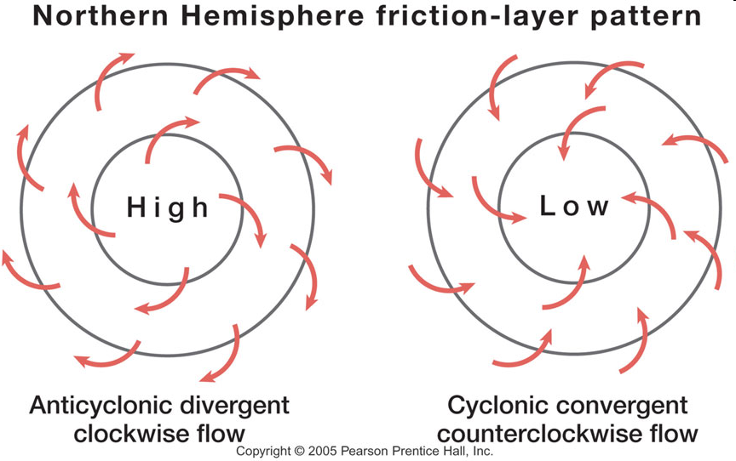
Cyclones in the Northern Hemisphere

Slide 9
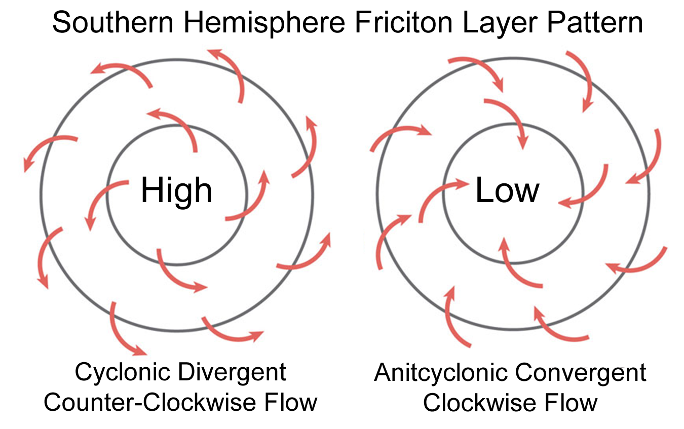
Cyclones in the Southern Hemisphere

Slide 10
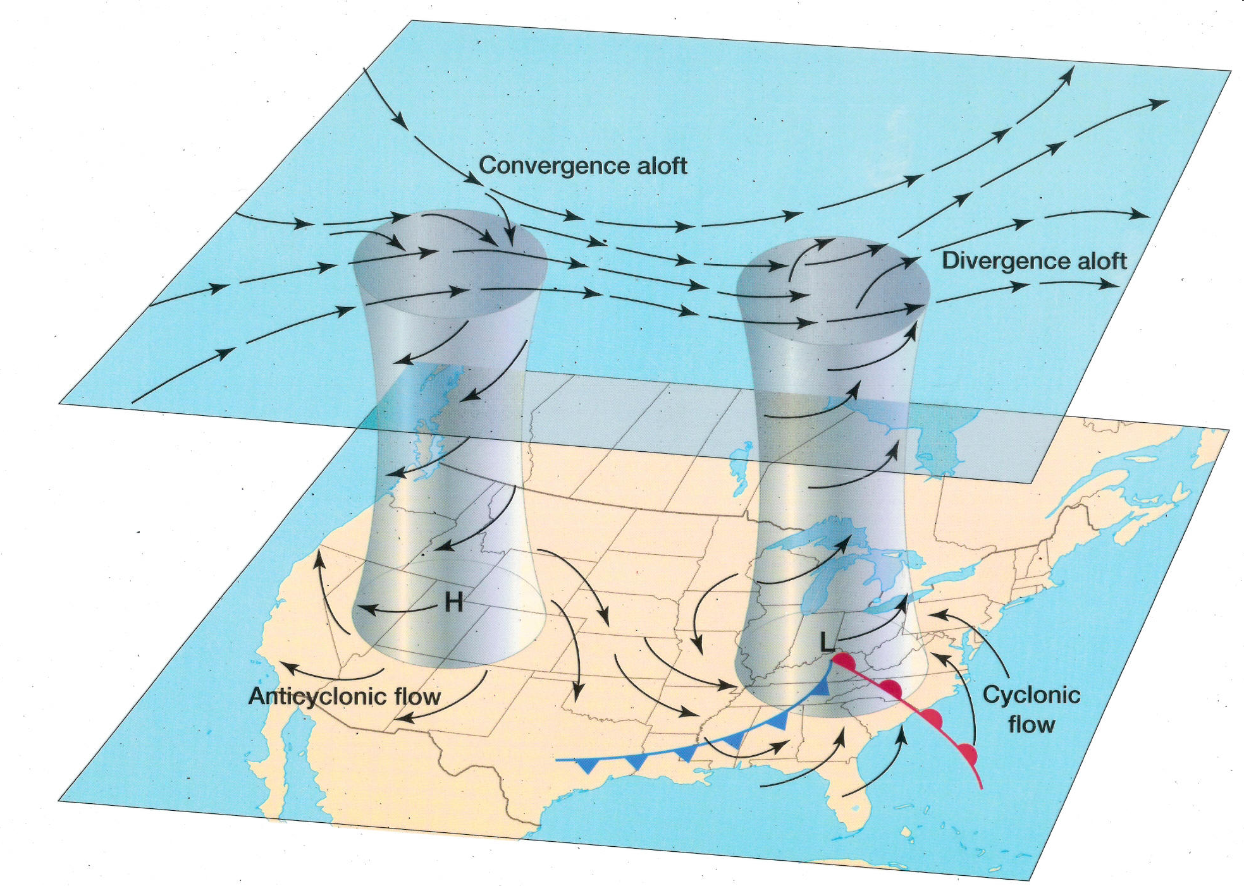
Convergence and Divergence Aloft

Slide 11

Convergence and Divergence Aloft
Why doesn’t air spiral out aloft?
  It’s “zonal” – Goes from west to east… think like a fast highway
  Speed Divergence
    In a zone of high wind the air “stretches out” or diverges.
    In a zone of low wind the air “piles” up or converges.
  Directional Divergence – horizontal spreading
  Vorticity - rotation

Slide 12
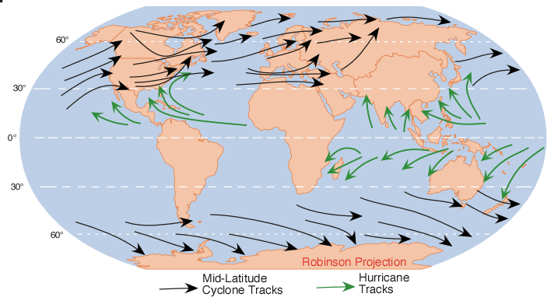
Cyclogenesis Regions

Slide 13
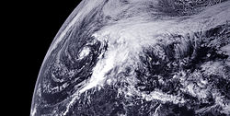
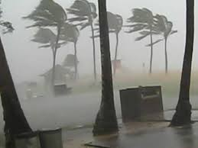
What is a Kona Storm?
Kona storms (also called Kona Lows)
  from the westerly "kona" (normally leeward) direction.
  They are mainly cold core cyclones, which places them in the extratropical cyclone rather than the subtropical cyclone category.
  Hawaii typically experiences two to three annually and can last for a week or more.
Kona Storm Hazards
  heavy rain, hailstorms, flashfloods and their associated landslides, high elevation snow, high winds which result in large surf and swells, and waterspouts.

Slide 14
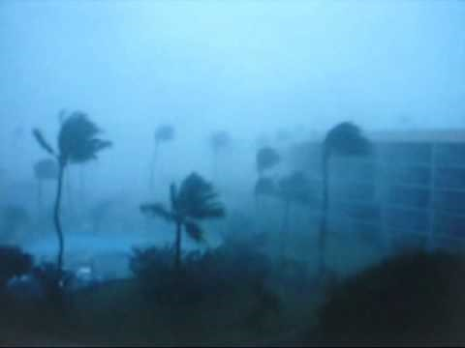
Kona Storm Medley from a Storm Chaser

Slide 15
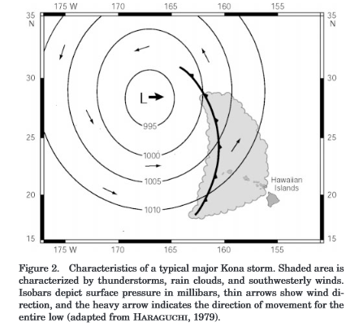
1980 Kona Storm
The most powerful Kona storm in the last fifty years struck the Hawaiian islands between 8 January and 11 January 1980.
The low pressure primarily responsible for the severe conditions had a barometric pressure of 975mb on January 8, while passing north of the state, one of the lowest pressure readings ever recorded in Hawaiian waters as a result of an extratropical storm.
The storm caused severe weather across the entire state, forcing the closure of all airports. Rainfall from the storm was extremely heavy, surpassing twenty inches in many locations, particularly on the Big Island and Maui.

Slide 16
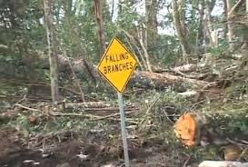
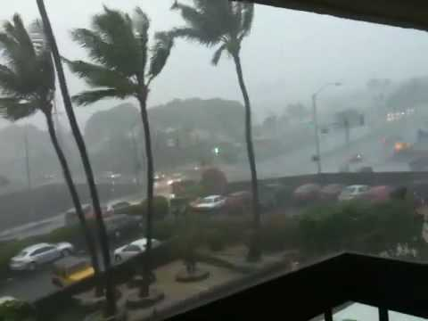
1980 Kona Storm
Some areas experienced wind gusts well over hurricane force, including a low altitude gust of 106 mph (171 km/h) on Lahaina Roads, Maui.
Haiku, on the windward coast of Maui, experienced a wind gust of 75 mph (121 km/h).
On the high mountain summits of the Big Island and Maui, winds of over 110 mph (180 km/h) were recorded.
Damage from the storm was estimated at between $25 and 35 million (in 1980 dollars).

Slide 17
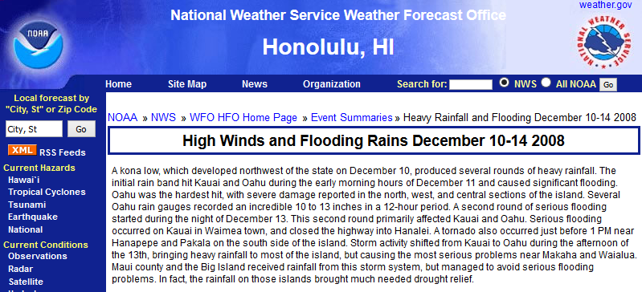
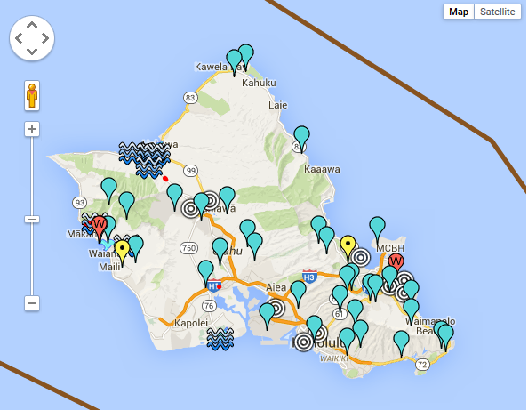
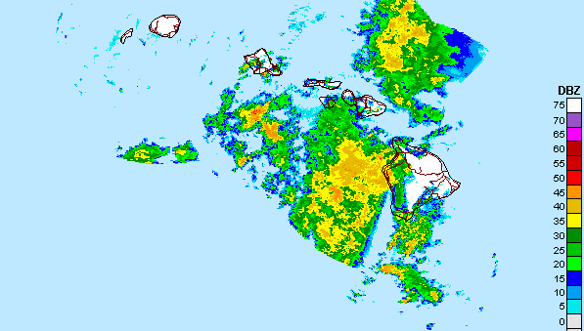
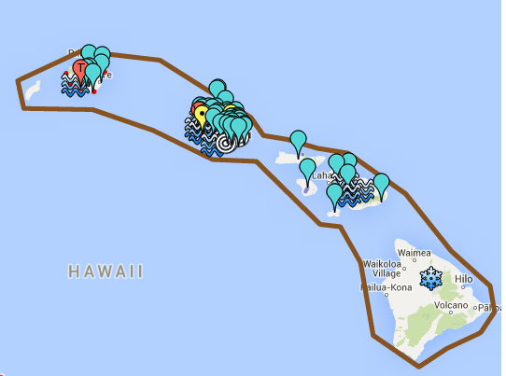
2008 Kona Storm
In December 2008, lightning strikes from a Kona storm caused the entire power grid of the island of Oahu to black out, while then President-elect Obama was visiting.
Yellow – Power Outage
Light Blue – Heavy Rain
Squiggles – Flooding
Red – High Winds
White Circles – Sewage Spill

Slide 18
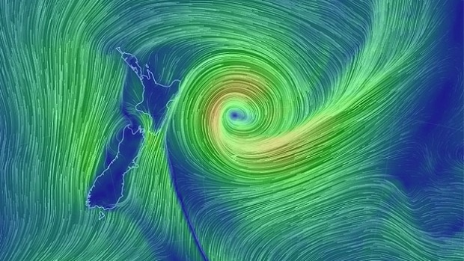
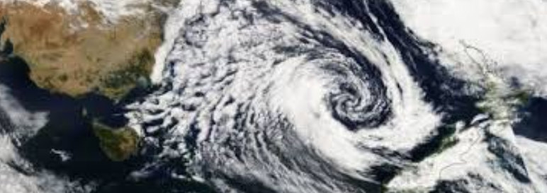
New Zealand Cyclones
Same formation mechanisms as with Northern Hemisphere MLCs.
They are commonly known as extratropical cyclones or wave cyclones.
Can cause considerable damage.
Rotate in the opposite direction from MLCs in the Northern Hemisphere.

