Slide 1
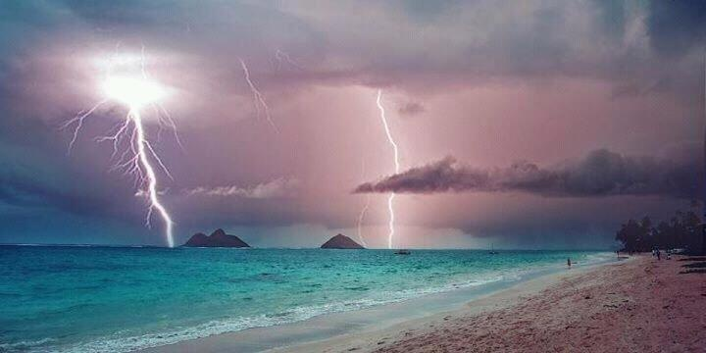
ATMO 102 Pacific Climates and Cultures
ATMO 102 Pacific Climates and Cultures
Lecture: Thunderstorms in the Pacific

Slide 2
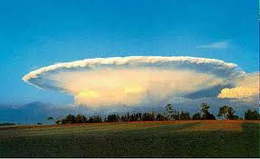

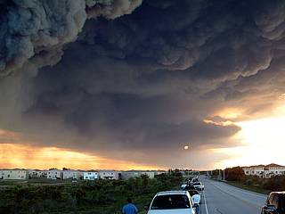
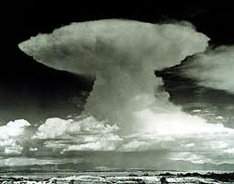
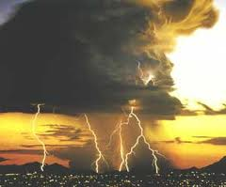
Thunderstorm Introduction
A storm that generates lightning and thunder.
Are characterized by strong “up” and “down” motions
Frequently produces gusty winds, heavy rain and hail.
They can form on their own or they can form in conjunction with mid-latitude cyclone on the edge of a Cold-Front
They can form in conjunction with hurricanes
Locations in the continental US
  Florida has the most thunderstorms (100s per year)
  Commonly occur in the foothills of the Rocky Mountains
  Associated with Tornado Alley in the middle of the country
  Associated with drylines and air with different humidities

Slide 3
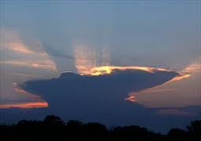
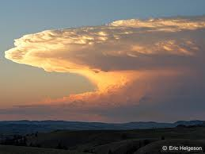
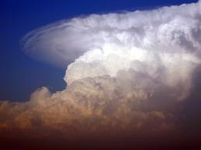
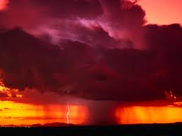
Thunderstorm Formation Introduction
Form when warm, humid air rises in a conditionally unstable or unstable environment
There are two categories:
  Air Mass Thunderstorms – formed by unequal heating of the Earth’s surface within a maritime tropical (mT) air mass.
  Severe Thunderstorms – formed by unequal heating & lifting of warm air along a front or mountain.

Slide 4
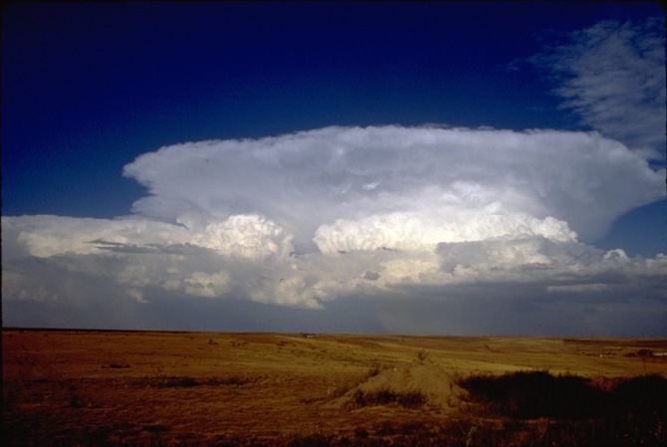
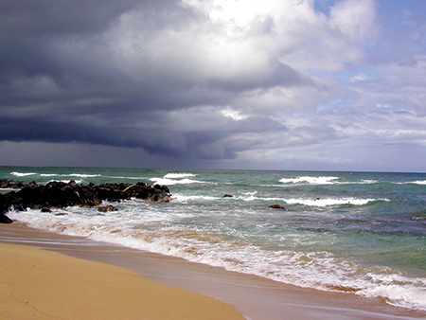
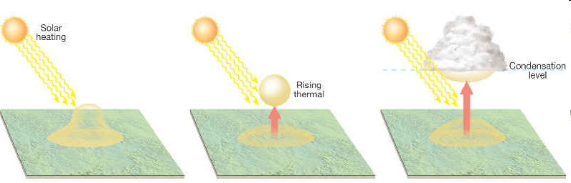
Air Mass Thunderstorms
Happens inside an air mass (usually mT)
Usually in spring and summer
Usually in mid-afternoon
Not associated with a front
Due to local differences in temperature

Slide 5
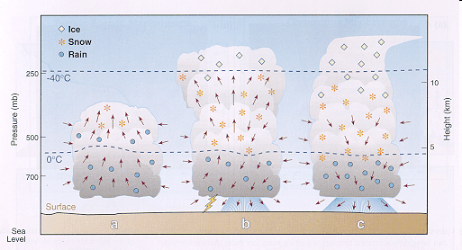
Air Mass Thunderstorm Life Cycle
Like mid-latitude cyclones T-Storms have a “Life Cycle”
Stages of Development
  Stage 1: Cumulus Stage
  Stage 2: Mature Stage
  Stage 3: Dissipating Stage

Slide 6
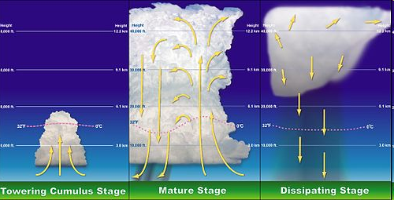
Air Mass Thunderstorm Life Cycle
Stage 1
Stage 2
Stage 3

Slide 7
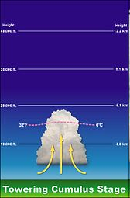
Stage 1: The Cumulus Stage
Rising air only
Makes a cloud
Cloud gets bigger and bigger
Moisture is being added to higher and higher altitudes
Needs a continuous supply of moisture to survive

Slide 8
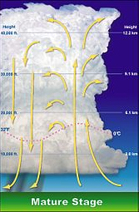
Stage 2: The Mature Stage
Precipitation forms
  Mainly by the Bergeron Process
Rain begins to fall
  Associated with the downdraft (air going down)
Most active stage
  Gusty winds, lightning, heavy rain, hail
Updrafts and downdrafts exist side by side

Slide 9
Stage 2: The Mature Stage
Downdrafts form for two reasons
  Entrainment – mixing of dry air with cloud air at the edge of the cloud
    Causes the cloud drops to evaporate
    Energy from evaporation comes from the temperature of the air parcel
    By evaporating drops, you use up the energy and end up cooling the air parcel
    Temperature drops, parcel cools
    Cooler air sinks to the surface
  Drag – Air is dragged downwards as precipitation falls.

Slide 10
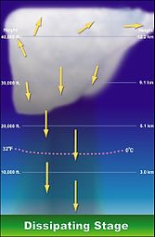
Stage 3: Dissipating Stage
Cooling effect of falling precipitation and influx of colder air up top mark it’s END!
Downdraft cuts off updraft
Cloud stops growing
You’re left with weakly descending air parcels
The cloud basically KILLS itself

Slide 11
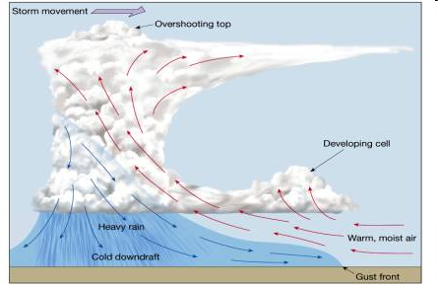
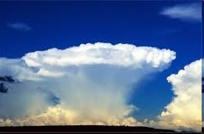
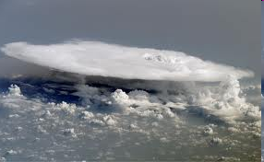
Severe Thunderstorms
Heavy downpours, flooding, gusty straight-line winds, large hail, lightning and tornadoes!
NOT Common on the Hawaiian and Pacific Islands.
To be classified as Severe:
  Must have winds in excess of 93 km/h or 58 mph
  or hail 0.75 inches
  or a confirmed tornado

Slide 12
Severe Thunderstorm

Slide 13
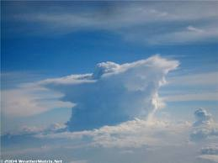
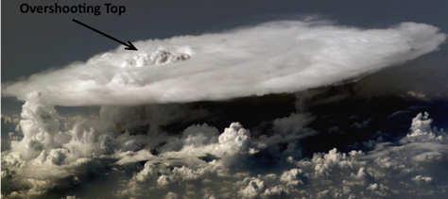
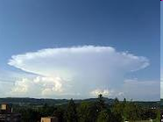
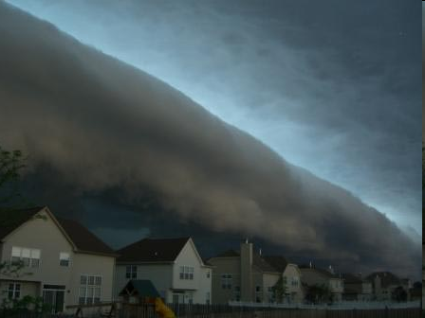
Severe Thunderstorm
Overshooting Top
Persist for many hours
  Vertical wind sheer causes precipitation to fall in downdraft, allowing the updraft to retain strength.
  Sometimes the updraft is so strong you get overshooting tops and anvils!
Cold air of the downdrafts spread out making:
  “mini cold front”
  Called a GUST FRONT
  Called an Outflow Boundary
  Can form a Roll Cloud
Anvil

Slide 14
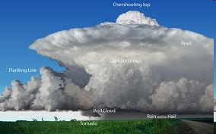
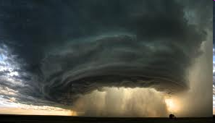
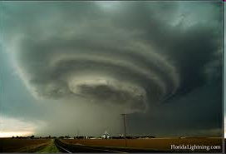
Supercell Thunderstorm
Causes dangerous weather
Large, very powerful, up to 20 km in height
Last many hours
20-50 km in diameter
Vertical wind profile may cause the updraft to ROTATE!
  MESOCYCLONE – usually spawns Tornadoes!
Need a lot of Latent Heat
  Requires moist troposphere
  An inversion a couple of km above the surface (caps moisture)
  Unstable air can break through the inversion by “eroding” it

Slide 15
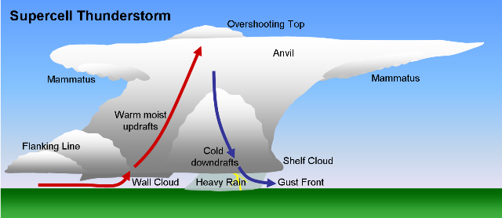
Supercell Diagram

Slide 16
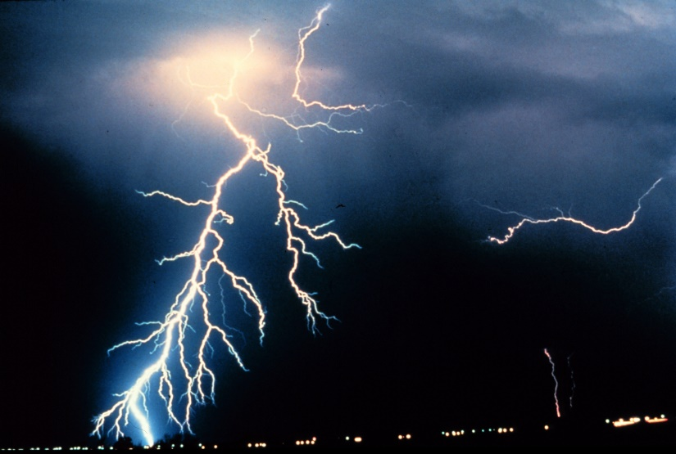
Lightning and Thunder
Lightning is ulia in Hawaiian
Thunder is hekili in Hawaiian
A storm is classified as a thunderstorm only after thunder is heard!!
  Because thunder is produced by lightning, lightning must also be present!
Lightning is a discharge of electrical energy.
Essentially a giant “spark” between regions of positive (+) and negative (-) charge.

Slide 17
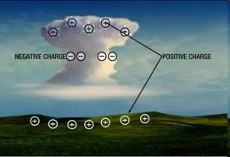
Lightning
May occur:
  Between cells in the same storm
    inter-cloud lightning
  Within a cloud
    intra-cloud lightning
  Cloud to air
  Cloud to ground (CG)
Lightning forms when a charge separation occurs in a cloud
  The earth is trying to equalize the electrical difference
  Negative charges want to flow to the ground.

Slide 18
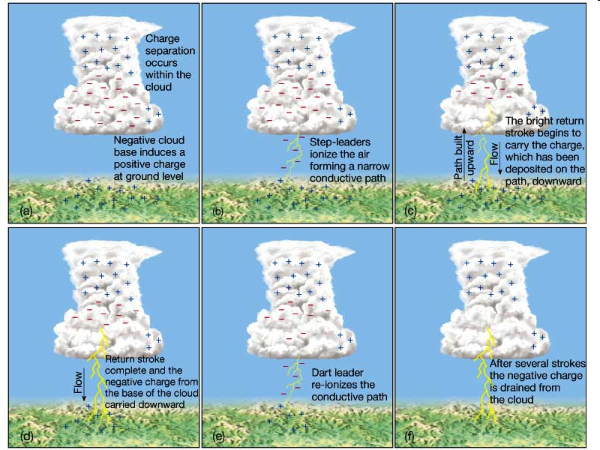

Slide 19
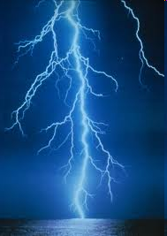
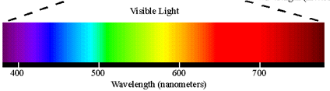
Lightning Formation
AGAIN: Electrons are drained at the surface first so the FLASH starts at the ground!!!
  This is why lightning is said to GO UP, rather than down
The movement is STILL from CLOUD to GROUND
  But the “heating” happens at the surface FIRST.
The electrons closest to Earth are “discharged” first
Heat that is released causes air around a step-leader to reach 30,000°C (54,000°F)
  The warmer, the shorter the shorter the wavelength
30,000 K
8,000 K

Slide 20
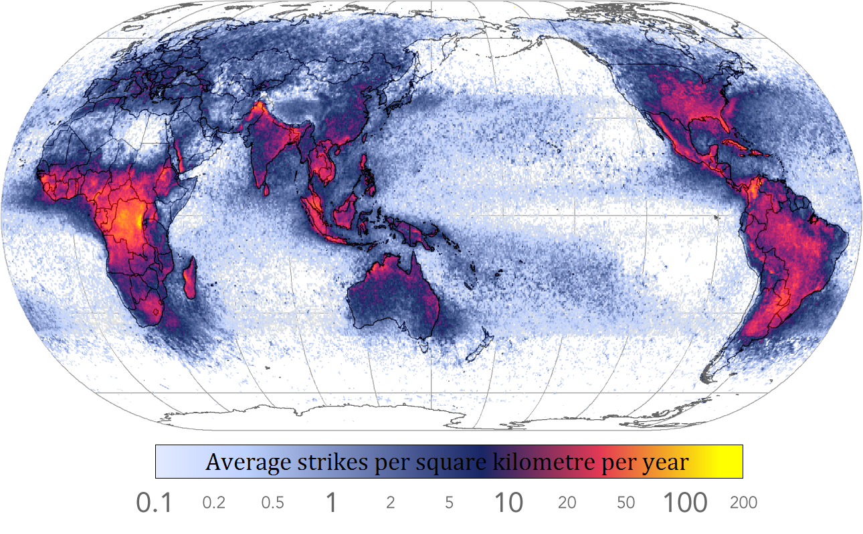
Global Lightning Occurrence

Slide 21
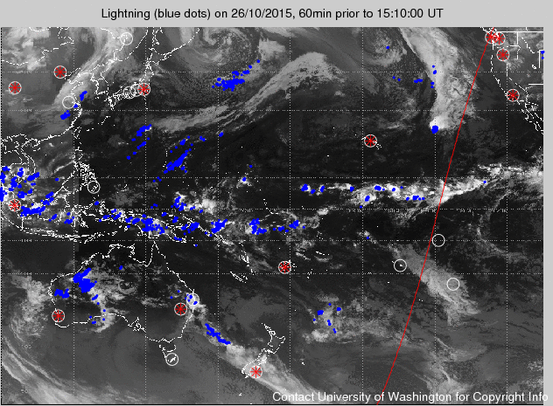
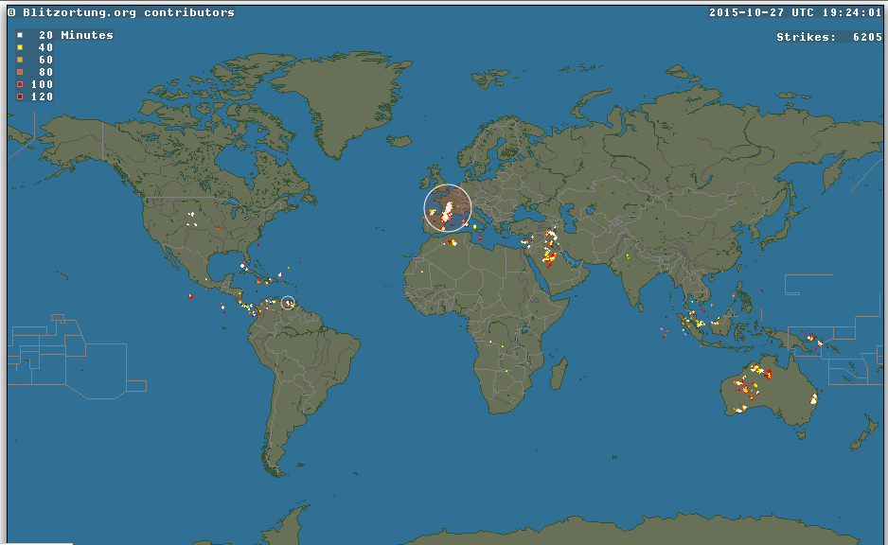
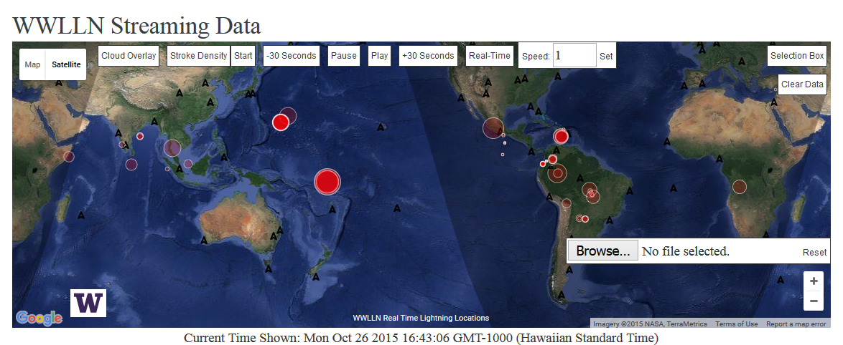
Real-time Lightning Websites
World Wide Lightning Location Network
  http://wwlln.net/
  http://wwlln.net/new/map/
Blitzortung.org - Oceana
  http://www.blitzortung.org/Webpages/index.php?lang=en&page_0=20

Slide 22
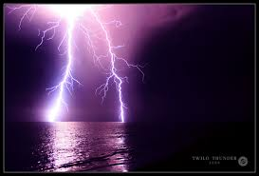
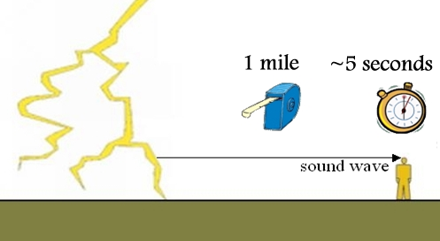
Thunder
When air is heated quickly a shockwave forms → causes thunder
Similar to planes crossing the sound barrier, firecrackers and gun shots
Sound travels at 330 m/s or 1000ft/s
If thunder takes 3 seconds to happen after observing lightning then the storm is:
  3 s * 1000 ft/s = 3000 ft away (6/10 of a mile away).

