Slide 1
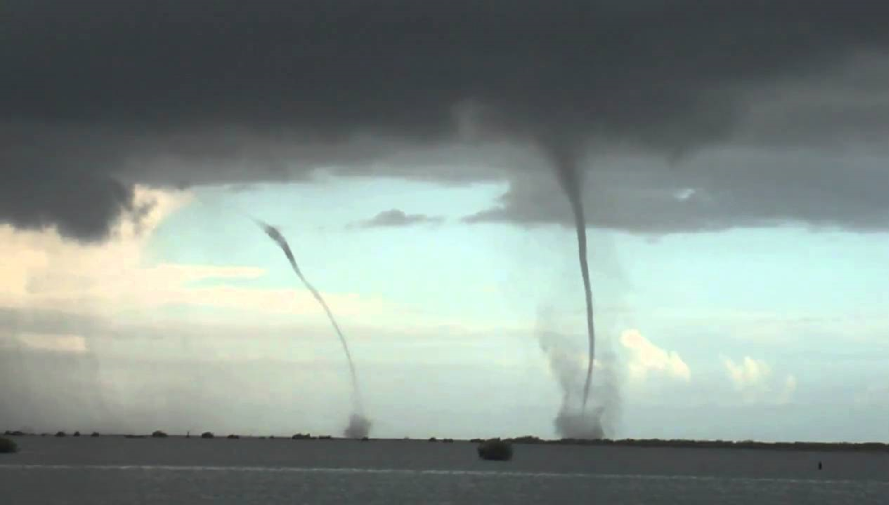
Lecture
Thunder & Lightning Con’t
and
Tornadoes

Slide 2

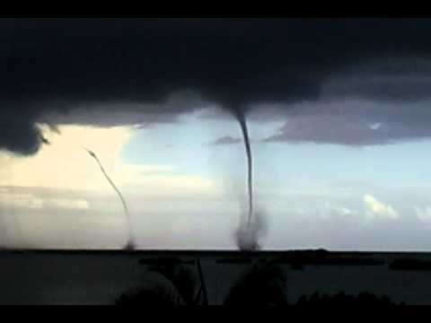
Water Spouts

Slide 3
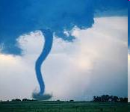
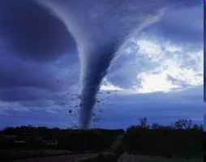
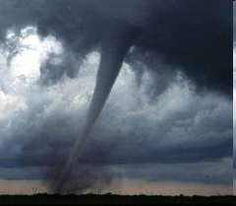
Tornado Introduction
A tornado is a rapidly rotating narrow region of low pressure
Wind speeds from 70-300 mph
Pressure can be as low as 900 mb
Tornadoes form during intense thunderstorms.

Slide 4
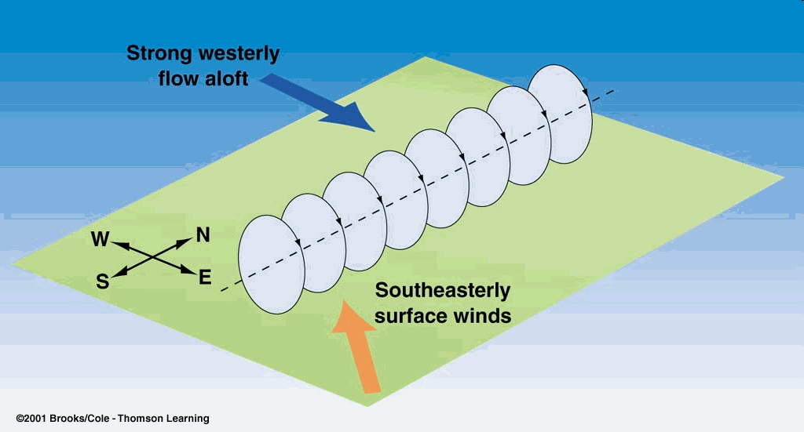
Tornado Development
Step 1: The first object that forms is a rotating body of air at the ground
  This occurs because of vertical wind shear
Wind speeds are higher as you increase in altitude
Drag and Friction: Friction and drag at the surface cause the air at the ground to move more slowly.

Slide 5
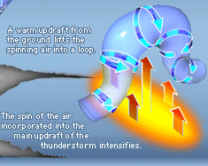
Tornado Development
Step 2: Horizontal rotating air is lifted off the ground by the Updraft of a Thunderstorm
Once the horizontal rotating air mass is lifted nearly vertically it is considered a
MESOCYCLONE!

Slide 6
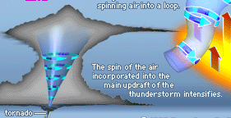
Tornado Development
Step 3: Mesocyclone is fully developed in the updraft of a thunderstorm
  If a tornado develops it descends from the slowly rotating “wall cloud” in the lower part of the cloud.

Slide 7
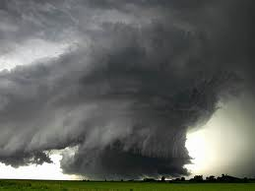
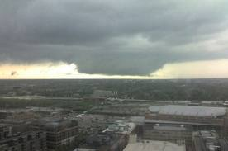
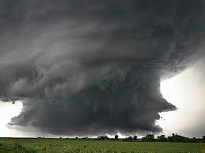
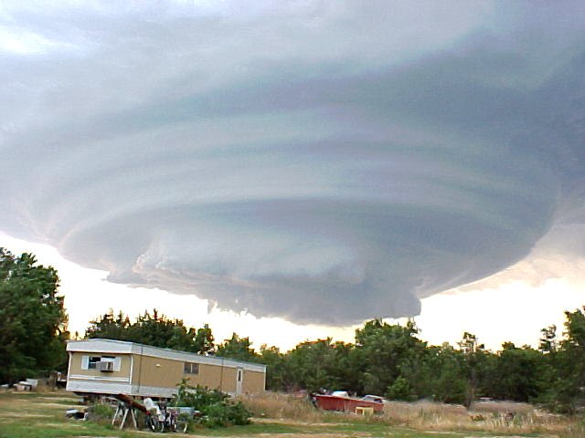
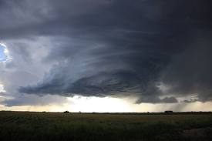
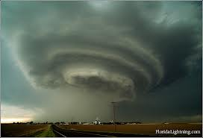
Photos of Wall Clouds

Slide 8
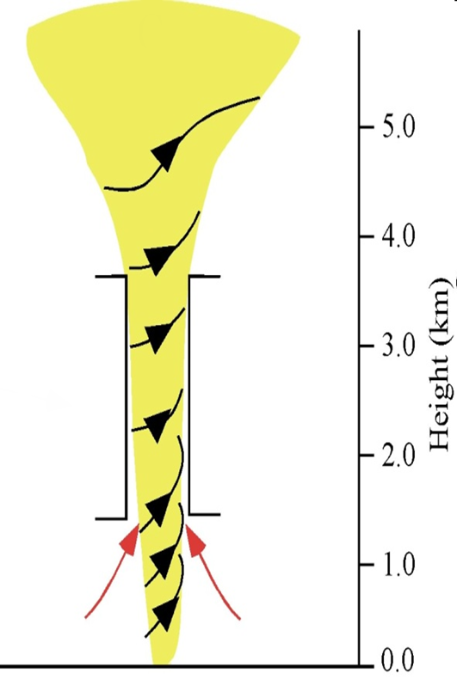
Mesocyclone Review
Remember it is a vertical cylinder of rotating air, typically 3-10 km across (2-6 miles)
Develops in the updrafts of severe T-Storms
Usually precedes tornadoes by 30 min
Stretching of the mesocyclone column causes faster rotation
  Just like a figure skater!! Something that begins with a larger diameter rotating at a slow speed begins to rotate faster as the tube is elongated and the diameter decreases

Slide 9
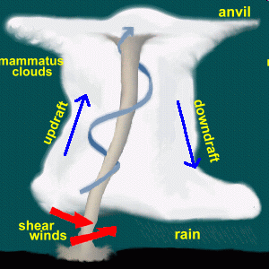
Thunderstorm + Tornado
From the wall cloud a very narrow, fast rotating structure emerges.
This forms a funnel cloud (as long as the cloud does not touch the ground)
As soon as the funnel cloud touches the ground it is called a tornado.

Slide 10
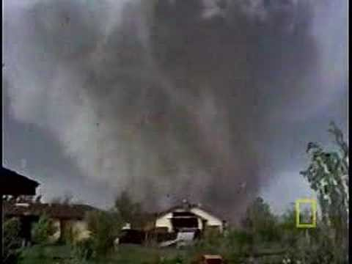
Tornado!

Slide 11
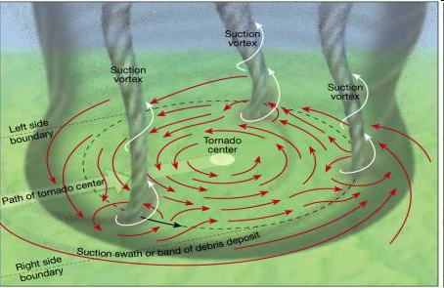
Suction Vorticies
Some tornadoes have multiple suction vortices
Intense areas of high winds that are part of ONE tornado
There can be 4-6 suction vortices.
The stronger the tornado the more vortices you’re likely to get.
Weak tornadoes usually don’t have them

Slide 12
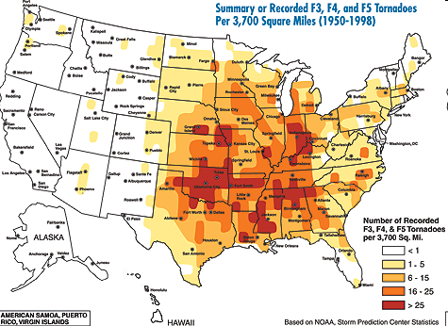
Tornado Occurrence on the Mainland
TORNADOALLEY!

Slide 13
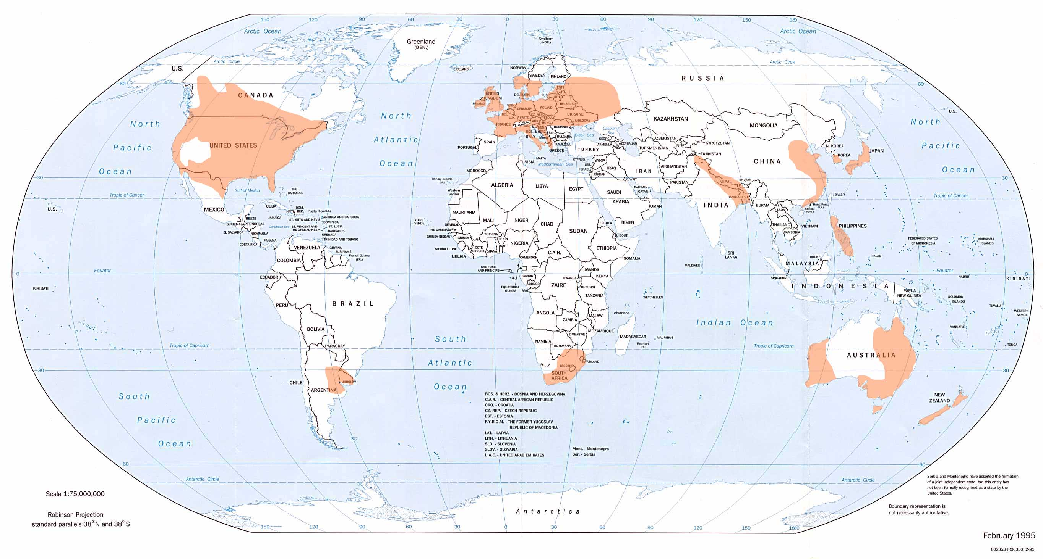
Global Tornado Distribution

Slide 14
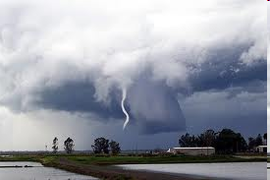
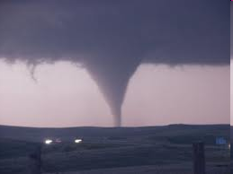
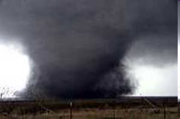
Tornado Classification
Tornados are classified as “weak,” “strong,” and “violent”
  WEAK – usually rope like and narrow
  STRONG – usually the classic funnel shape
  VIOLENT – usually have lots of debris associated with them and can be quite dark in color.

Slide 15
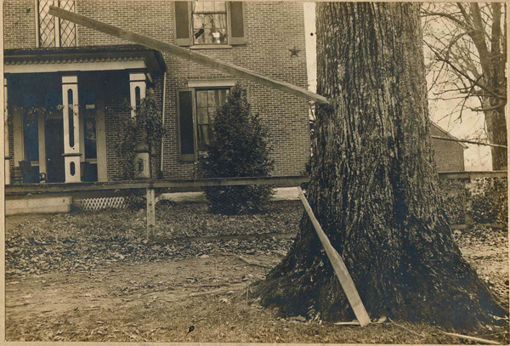
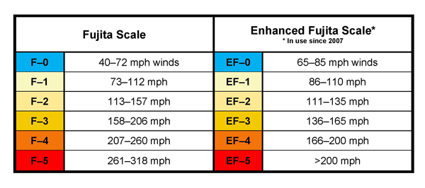
Fujita and Enhanced Fujita Scale
Scale for Damage caused by tornadoes
  Wind Speed
  Amount and Type of damage
There are two scales used:
  Fujita Scale (F)
  Enhanced Fujita Scale (EF)
Timber driven by a tornado into a large tree

Slide 16
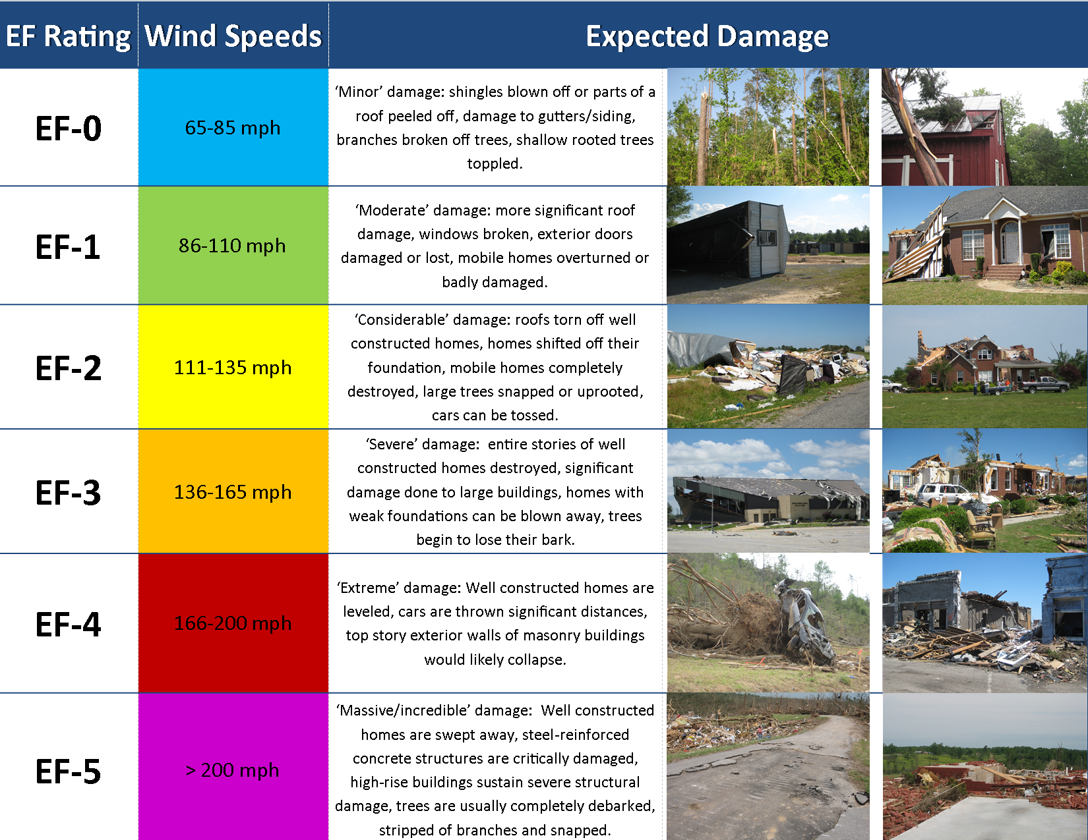

Slide 17
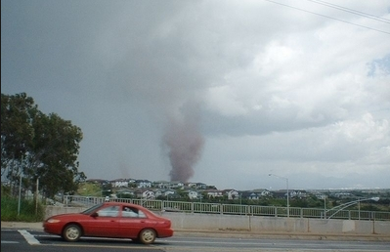
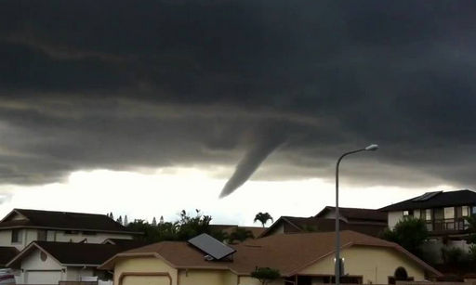
Hawaii Tornadoes
Tornado in Kapolei in 2009
Hawaii ranks 48th in tornado occurrence
Hawaii averages about one per year.
40 confirmed tornadoes since 1950.
None of these tornadoes have caused loss of life and none exceeded F2 intensity.
Funnel Cloud in 2011 over Central Oahu

Slide 18
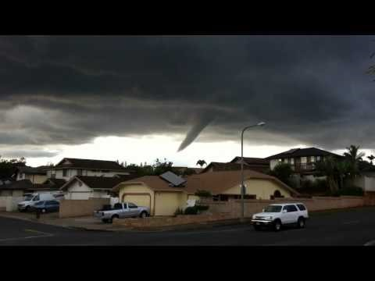
Hawaiian Tornado - 2011

Slide 19
Hawaii Tornadoes
Date | Intensity | Description
Mar 24, 2002 | F0 | tornado touched down in Anahola, Kauai. The tornado first formed in the Anahola Valley and skipped along a 1 mile (1.6 km) path, ending in Moloaa Valley. Along the track, several sheds were destroyed, numerous trees were snapped and six homes sustained roof and wall damage. Damages from the tornado amounted to $60,000.
Jun 7, 2003 | F0 | tornado touched down roughly 3 miles (4.8 km) northeast of Mililani, Honolulu. A meteorologist from the National Weather Service spotted the tornado and reported that it was tracking towards Pearl City; however, the tornado dissipated before causing any damage.
Jan 25, 2004 | F0 | tornado touched down roughly 3 miles (4.8 km) northwest of Waipahu, Honolulu; no damage was reported in relation to the tornado.
Feb 7, 2004 | F0 | tornado touched down roughly 3 miles (4.8 km) east of Aiea, Honolulu; no damage was reported in relation to the tornado.
Feb 27, 2004 | F0 | tornado tracked for 5 miles (8.0 km), starting roughly 2 miles (3.2 km) southeast of Pahala, Hawaii. No structural damage occurred along the path; however, numerous trees were downed and several power poles were snapped.
Jan 8, 2005 | F0 | tornado touched down in Waimea, Kauai and tracked east for 5 miles (8.0 km). Along the tornado's path, a carport was damaged and numerous trees were downed.
Dec 4, 2005 | F0 | tornado touched down in Aiea, Honolulu, downing several trees and damaging the roof of a home. One tree also fell on a truck.
Mar 23, 2006 | F0 | tornado touched down in Kaumalapau Harbor, Maui. The tornado flipped over a construction trailer and carried it for about ten feet, damaged an adjacent small building, and snapped a power pole.
Mar 25, 2006 | F0 | tornado touched down roughly 2 miles (3.2 km) west of Haiku, Maui. No damage was reported in relation to it.
Sep 23, 2008 | EF0 | tornado touched down about 1 mile (1.6 km) northeast of Lanai Airport on Lanai. No damage was reported in relation to it.
Dec 13, 2008 | EF0 | tornado touched down in Pakala Village, Kauai, causing only minor crop damage.
Feb 11, 2009 | EF1, EF0 | Two tornadoes touched down on Oahu in Hawaii. At 12:50 pm local time, the first tornado touched down near a quarry, damaging nearby buildings. The tornado moved through a golf course next, throwing a utility cart about 50 to 60 ft. The tornado lifted at 1:10 pm, 20 minutes after it touched down. Numerous trees were damaged throughout the tornado's mile long path. Following an assessment by the National Weather Service, the tornado was rated as an EF1. During the assessment of the tornado, another weaker tornado was discovered to the northeast. The tornado touched down in a construction site and damaged dust barriers. The second tornado was on the ground for about ten minutes and traveled less than half a mile. The National Weather Service rated the tornado as a low-end EF0.
May 2, 2011 | WS | During a massive thunderstorm, twin waterspouts appeared off the southeast coast of O'ahu at 5:50pm, moving slowly westward and dissipating after about 12 minutes.
Mar 9, 2012 | WS, EF0 | A tornadic waterspout associated with a supercell thunderstorm moved ashore on Lanikai Beach, Oahu at 7:10 AM. The tornado, rated an EF-0, tracked inland for 1.5 miles, reaching the Enchanted Lakes subdivision of Kailua.

