Slide 1
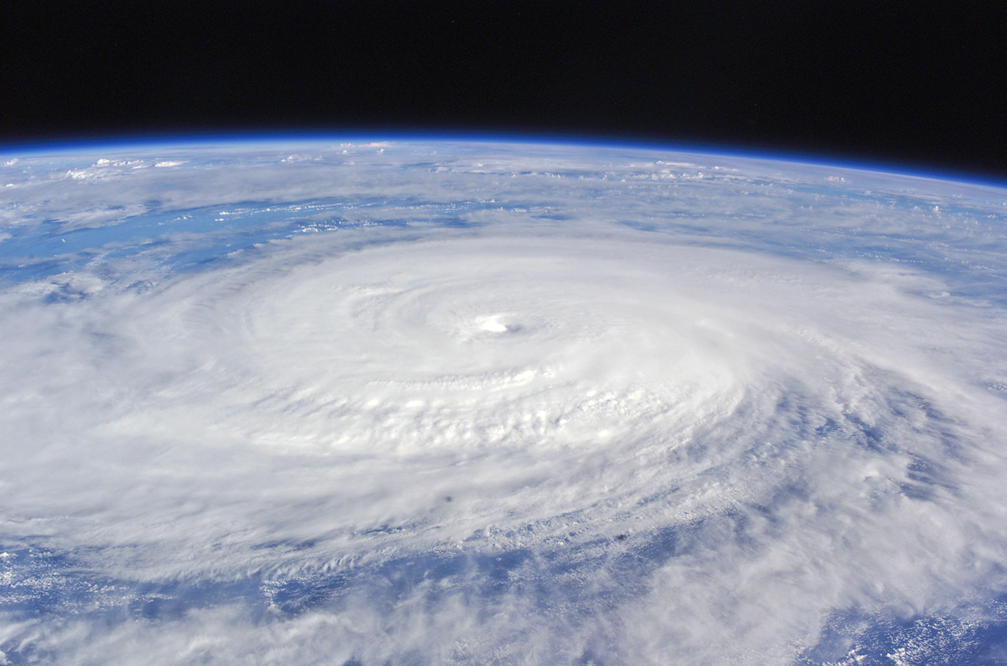
ATMO 102 Pacific Climates and Cultures
ATMO 102 Pacific Climates and Cultures
Lecture: Introduction to Hurricanes

Slide 2

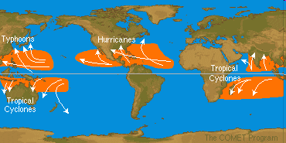
Formation Regions
Form in the Tropics
Hurricanes are called by other names (depends on where they occur)
  Hurricanes in the Atlantic and East Pacific
  Cyclones in the Indian Ocean near Australia
  Typhoons off the coast of China and Indonesia

Slide 3
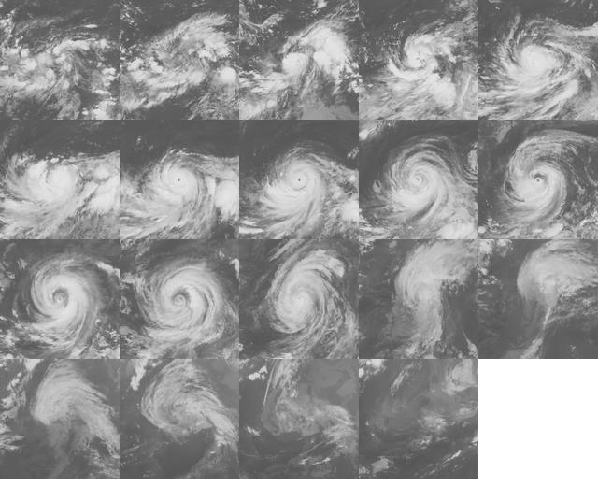
Tropical Cyclone Life Cycle
Tropical Depression: surface wind < 39 mph (33 kt)
Tropical Storm: 39 ≤ surface wind ≤ 74 mph (64 kt)
Hurricane: surface winds > 74 mph (65 kt)

Slide 4
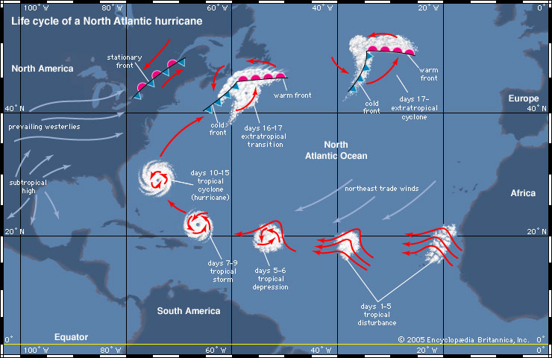

Slide 5
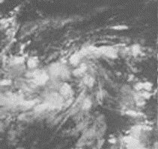
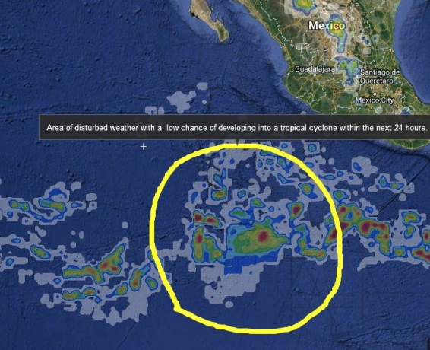
Tropical Disturbance
The majority of tropical storms and hurricanes start out as tropical disturbances.
These weather systems are unorganized masses of thunderstorms with very little, if any, organized wind circulation.
During the hurricane season in the Atlantic Ocean and Gulf of Mexico, tropical disturbances often grow from a pattern of stormy weather, called an African easterly wave.
These waves typically emerge every three or four days off the west coast of Africa and then drift west within the trade winds into the Atlantic Ocean.
If weather and ocean conditions continue to be favorable, the system may then strengthen.

Slide 6
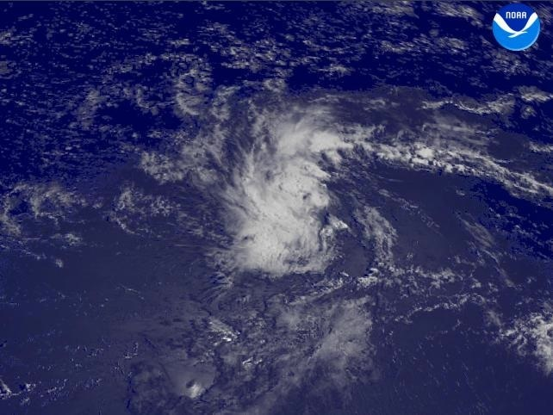
Tropical Depression
As a system continues to become organized and winds begin to circulate, it may become a tropical depression, the weakest form of tropical cyclone.
It is called a “depression” because it has low, or depressed, air pressure at its center.
As the system develops, winds converge towards the center and the pressure near the center drops.
During this transition, the disturbance begins to obtain its energy from the ocean instead of from horizontal temperature gradients in the atmosphere and the environmental wind.
Tropical Depression 6 from the 2004 Atlantic hurricane season. Instead of a round appearance similar to hurricanes, these weather systems look like individual thunderstorms that are grouped together.

Slide 7
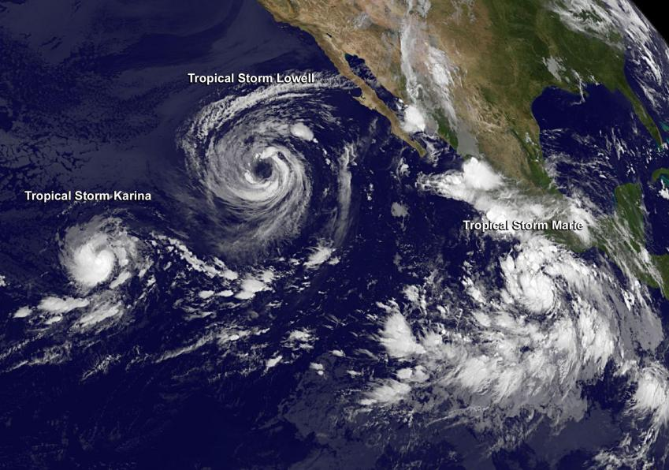
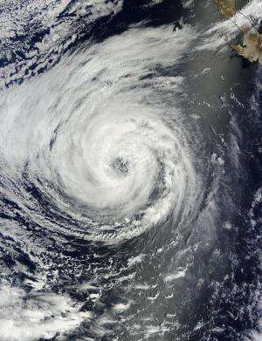
Tropical Storm
As bands of thunderstorms continue to develop, the depression may intensify into a tropical storm with maximum sustained wind speeds of 63-117.5 km/hr (39-73mph).
A tropical storm usually forms in this manner (i.e. from an intensifying tropical depression).
Once a system is classified as a tropical storm, it is given a name.
Approximately 100 tropical cyclones form globally each calendar year. Many of them die out before they can grow stronger, with only approximately half of them (50) eventually strengthening into a mature hurricane (or typhoon).

Slide 8
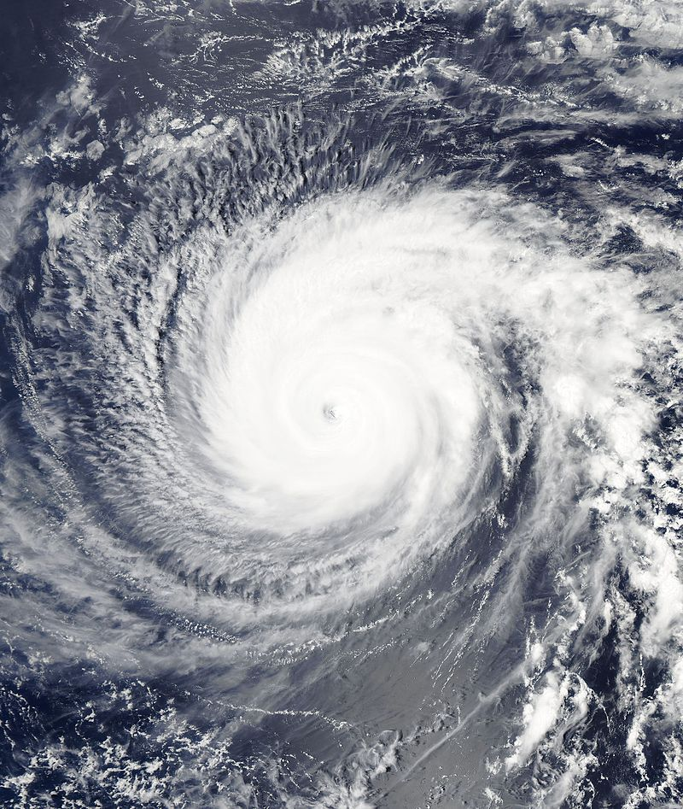
Hurricanes
If a tropical cyclone obtains a maximum sustained wind speed greater than or equal to 119 km/hr (74 mph), it is reclassified as a hurricane (Typhoon or Cyclone).
At this point, the recognizable, cloud-free eye of a hurricane typically forms.
In the Atlantic, Central Pacific, or Eastern Pacific regions, hurricane intensity is often classified based on maximum surface wind speed using the five categories of the Saffir-Simpson Hurricane Wine Scale.
Hurricane Jimena – Category 4

Slide 9
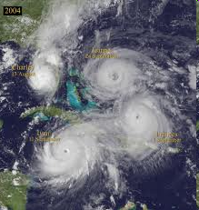
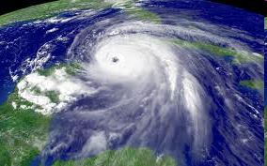
Quick Hurricane Facts
Strong Center of Low Pressure
Sustained winds > 74 mph (64 kts)
  To be considered a Category 1 Hurricane
On average there are 45 hurricanes world wide every year
Size ranges from 60 miles – 900 miles in diameter with a typical size of about 400 miles
Can last from days to weeks

Slide 10
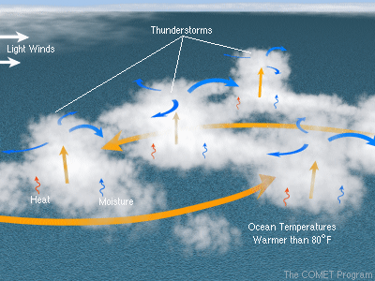
Ingredients for Hurricane Formation
Warm ocean Temp (>80°F, 27°C) that is deep (~200 m in depth)
  Because you need lots of evaporation
  So when winds churn up the water, you still have WARM water.
  Both only happen equator-ward of 20°N, S
Coriolis is needed to initiate the spinning
  Need to be between > 5°N, S
Low values of vertical wind sheer
  Necessary for the storm to organize

Slide 11
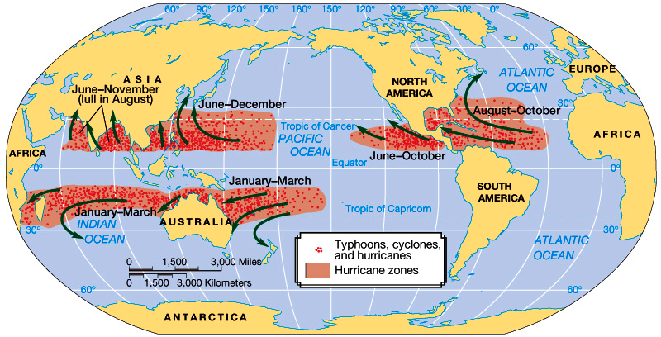
Where do these ingredients Occur?

Slide 12
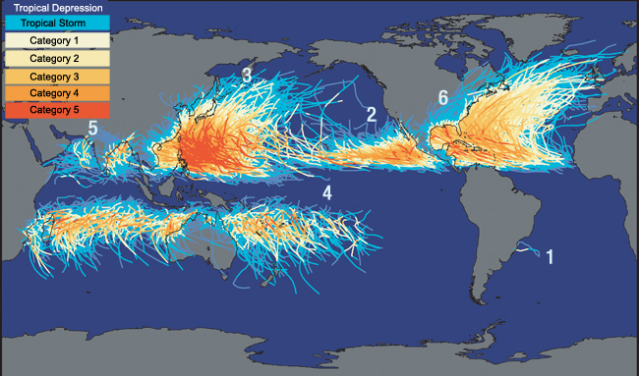
Tropical Cyclone and Storm Tracks
The strength of the storms is color coded along the tracks, with light blue for weak tropical storms and orange and red for strong hurricanes (cat 3-5)

Slide 13
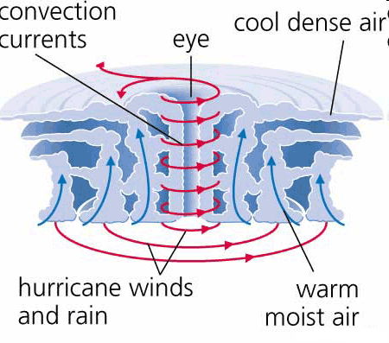
Hurricane Structure
As air rushes inward in a spiral pattern “bands” of clouds and thunderstorms are formed.
Closest to the “eye” you get
  The most severe thunderstorms
  The most intense rain and wind
  The eye wall has the highest wind and rain, encircles the eye
There can be more than three sets of bands

Slide 14
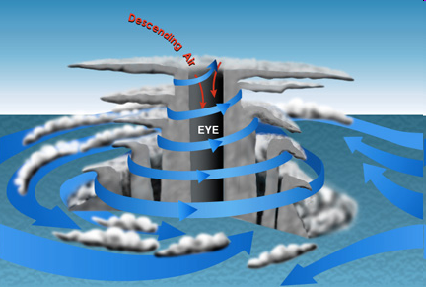
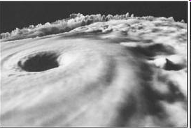
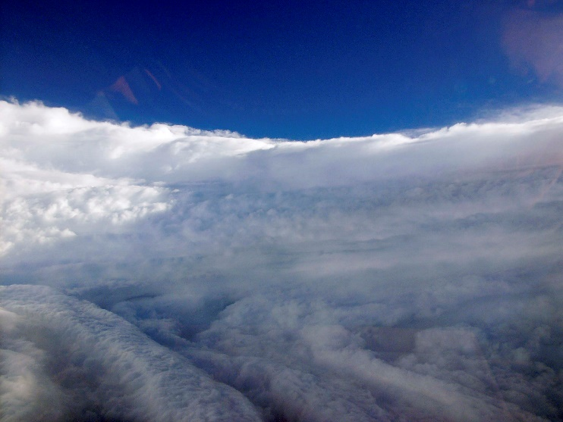
Hurricane Eye
Surrounded by the Eye Wall with severe thunderstorms
In the Eye air is converging toward the center
Spiraling DOWNWARD and INWARD
Has a very intense High pressure located above it
Subsiding air = CLEAR SKIES
Usually 30-60 miles in diameter

Slide 15
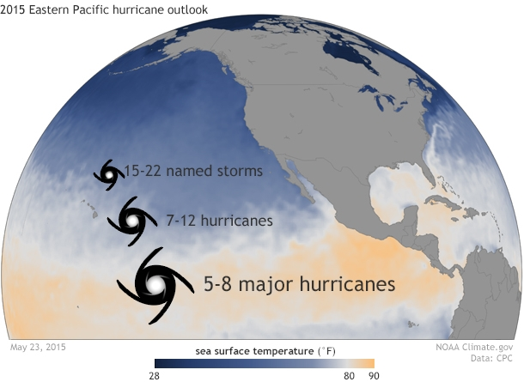
Hurricane Intensification
The storm can intensify if there is:
  Weak vertical sheer which allows the energy from condensation to be concentrated over a small area
  Relatively moist humid air in the upper troposphere
    So you can get lots of condensation
  Cold upper atmospheric conditions
    Which leads to a large PGF

Slide 16
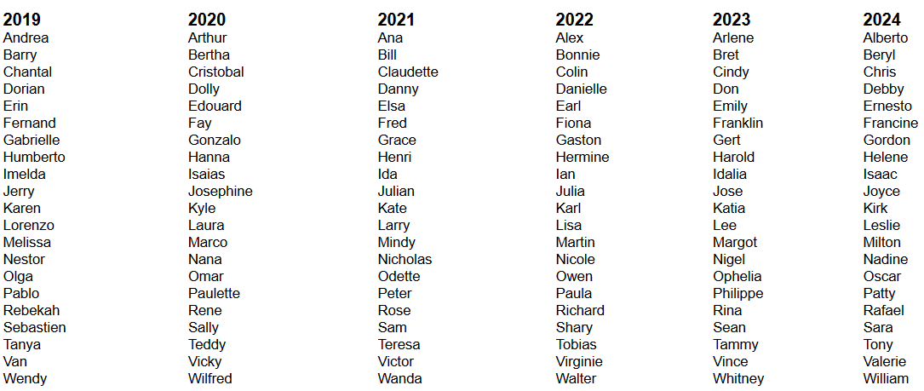
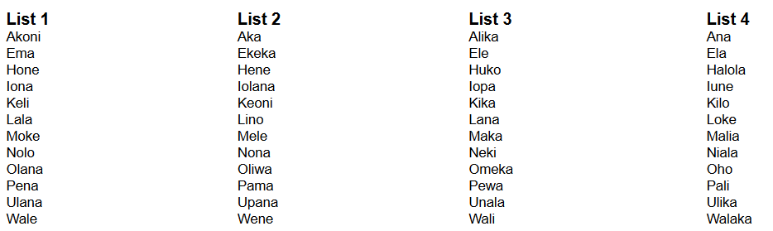
Atlantic Names
Naming
Hurricanes
When they reach tropical storm strength (40-74 mph)
Used to be all women’s names (1953-1977)
Now they alternate male-female
Names are “Retired” if they cause enough damage.
Hawaii gets their own Names!

Slide 17
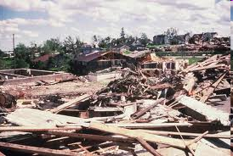
Hurricane Damage
Wind Damages
  Hurricanes move at ~45 miles an hour
  Spirally converging air moves at a much faster velocity
  The velocity of the winds you experience depends on your location within the hurricane:
  You add the wind speed of motion to the wind speed of rotation (100 mph + 45 mph = 145 mph) when it’s coming towards you
  You subtract the wind speed of motion from the that of rotation (100 – 45 = 65 mph) when it’s going away.

Slide 18
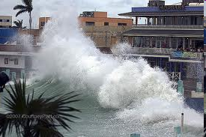
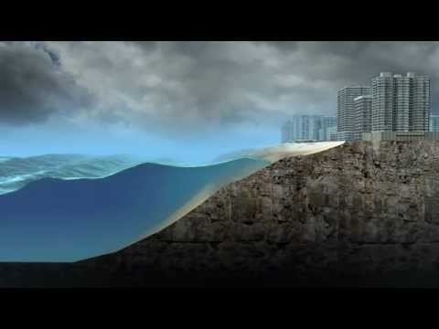
Hurricane Damage
Storm Surges
  The abnormal rise of the sea along the shore as the result of strong winds.
  Can be as high as 7 m (21 ft) but are typically 1-2 m
  On top of this, waves around 6-15 m can occur!!!

Slide 19
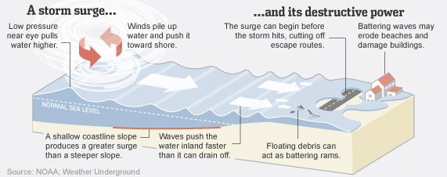
Hurricane Damage

Slide 20
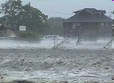
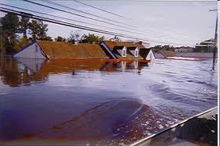
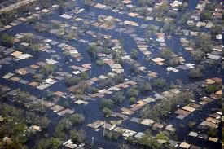
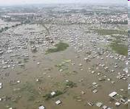
Hurricane Damage
Flooding
  Caused by intense rains that accumulate
  Rain accumulation can be up to 10 ft/day
  Typical numbers are 1-3 ft/day

Slide 21
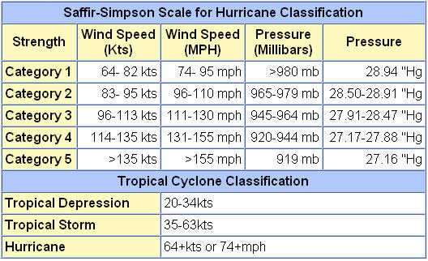
Hurricane Classification Saffir-Simpson Scale

Slide 22
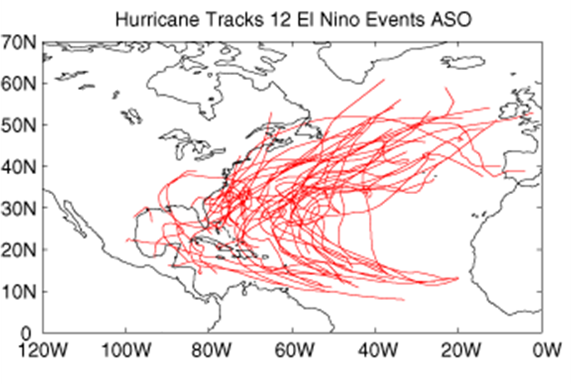
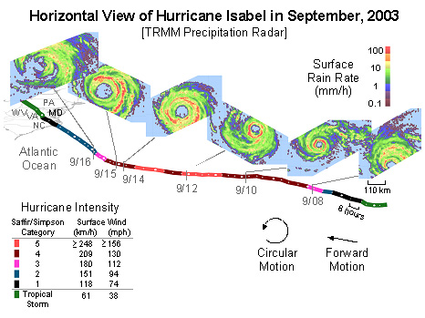
Hurricane Decay
When conditions become unfavorable the hurricane starts to decay
Colder sea surface temperatures
  <80F will cause the storm to weaken or even dissipate.
Land, of course
  friction caused by a large land mass, and their terrain cuts off the hurricane's circulation, and squeezes out the storm's moisture
Shearing winds aloft
  Hostile upper level wind conditions produce shearing, which blow off the high cloud tops of these storms, and causes them to become disorganized.
Sinking air
  Sinking air from high pressure hinders thunderstorm development.
  Trajectory is “C” shaped and ultimately brings them over cold waters

