Slide 1
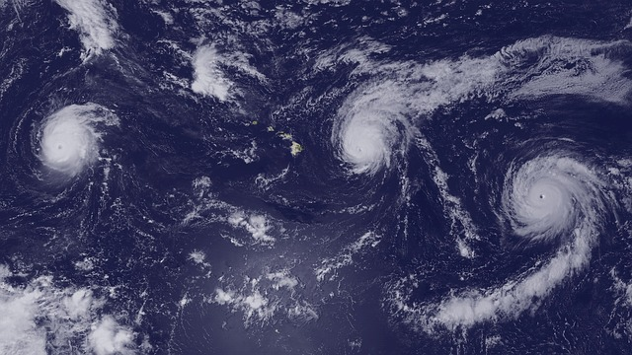
ATMO 102 Pacific Climates and Cultures
ATMO 102 Pacific Climates and Cultures
Lecture: Pacific Hurricanes

Slide 2


Slide 3
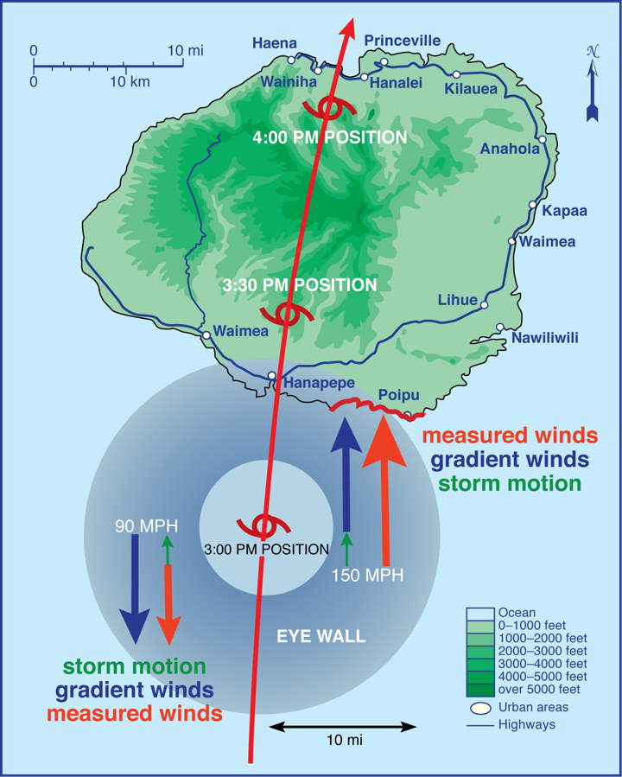
Hurricane Hazards in Hawaii
The winds, storm surge, and storm waves are all greatest just to the right of the storm track. Why?
The storm surge and storm waves are greatest just to the right of the storm track.
Wind hazard is greatest on exposed ridges and mountain slopes.
Flash flood hazard is greatest near steam beds.

Slide 4
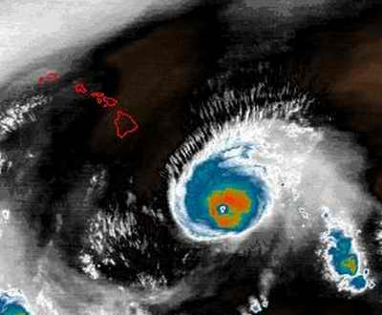
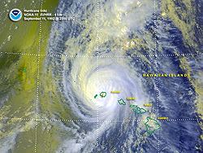
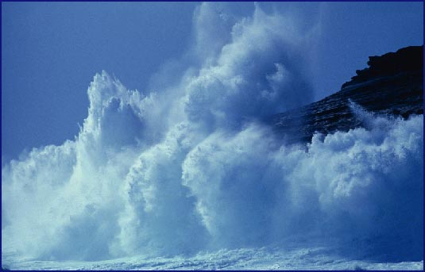
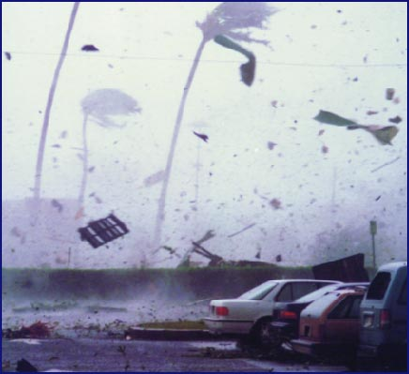
Hawaiian Hurricanes
So far no hurricane has made landfall on Oahu.
Recently only Kauai has been hit
  The Big Island and Maui were struck by a hurricane in 1871
  Dot 1959, Iwa 1982, and Iniki 1992 all impacted Kauai
There is no Hawaiian word for hurricane
  No “Hawaiian Term” actually is not a surprise, since words such as Hurricane and Typhoon arise from local words for the winds observed.
  David Malo (1843) defined five different Kona Winds but none for hurricanes.

Slide 5
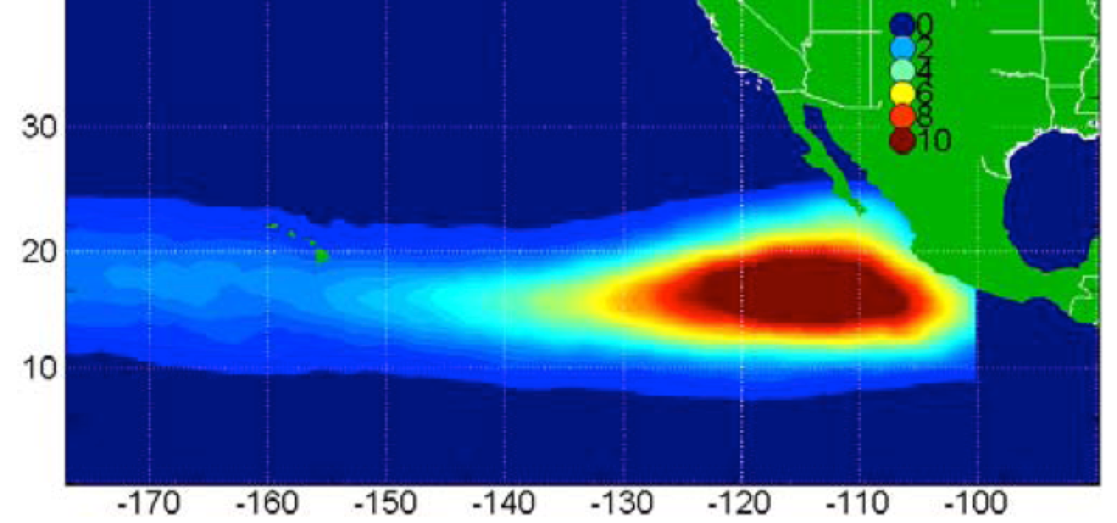
Eastern Pacific Hurricane Climatology
Simulation showing the number of times a hurricane passes within 75 nautical miles per 10 years in the Eastern and Central Pacific.
Red is more likely and blue is less likely.
Hawaii is on the edges of the blue area, meaning hurricanes are not likely to hit.

Slide 6
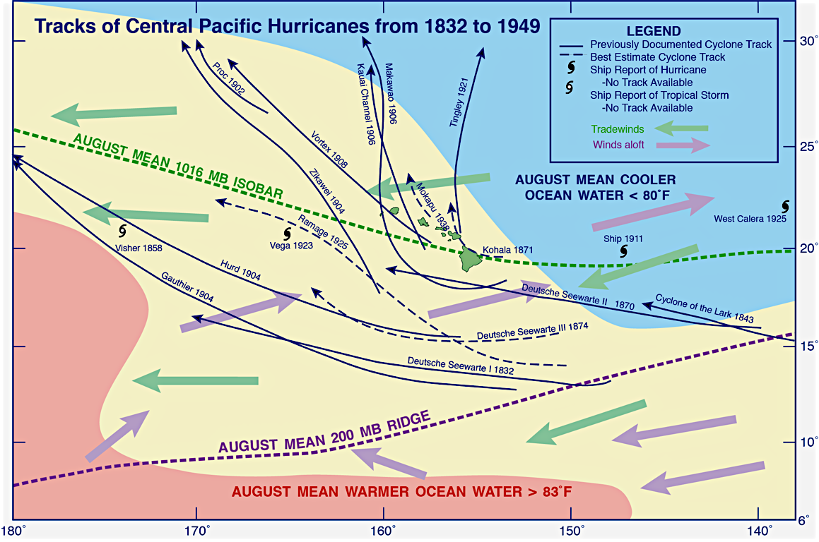
Hawaii Hurricane Climatology
Hurricane tracks in the central Pacific from 1832 to 1949
Notice the Wind Shear!
Tradewinds and Winds Aloft go in OPPOSITE directions

Slide 7
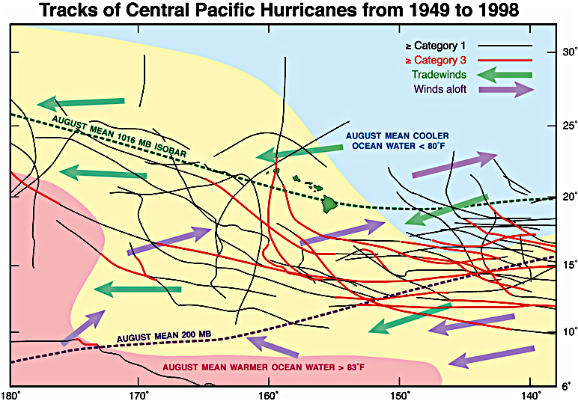
Hawaii Hurricane Climatology
Hurricane tracks in the central Pacific from 1949-1998
Notice the Wind Shear!
Tradewinds and Winds Aloft go in OPPOSITE directions

Slide 8
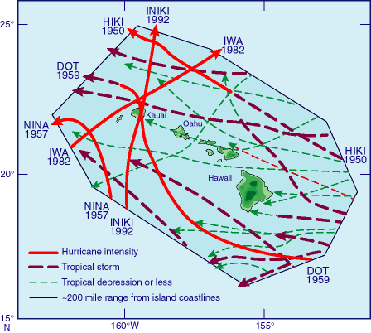
Hawaii Hurricane Climatology
Tropical Cyclone tracks within 200 miles of the Hawaiian Islands since 1949.
Kauai is the only island to be hit directly with storms that reached Hurricane intensity.

Slide 9
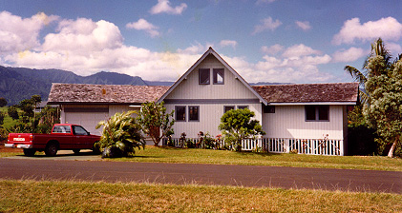
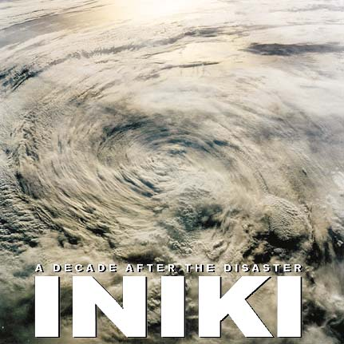
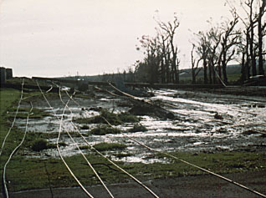
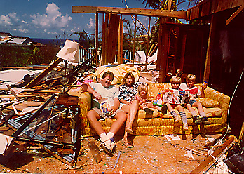
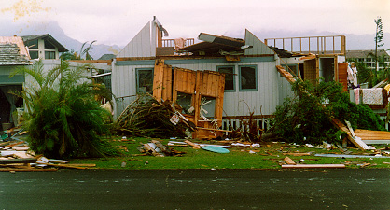
Impacts on Hawaii
BEFORE INIKI
AFTER INIKI
http://helzhalfacre.com/iniki/

Slide 10
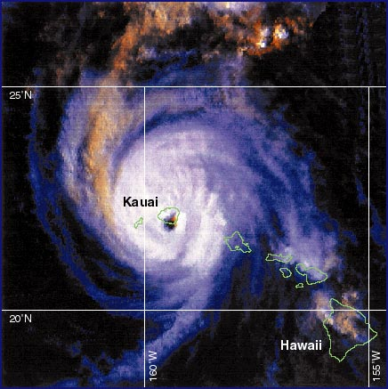
Iniki Impacts
90% of structures on Kauai affected
14,118 damaged or destroyed
30% telephone poles down
3 years later unemployment 12%
Social fabric altered
  10% moved away to other islands or to the mainland

Slide 11
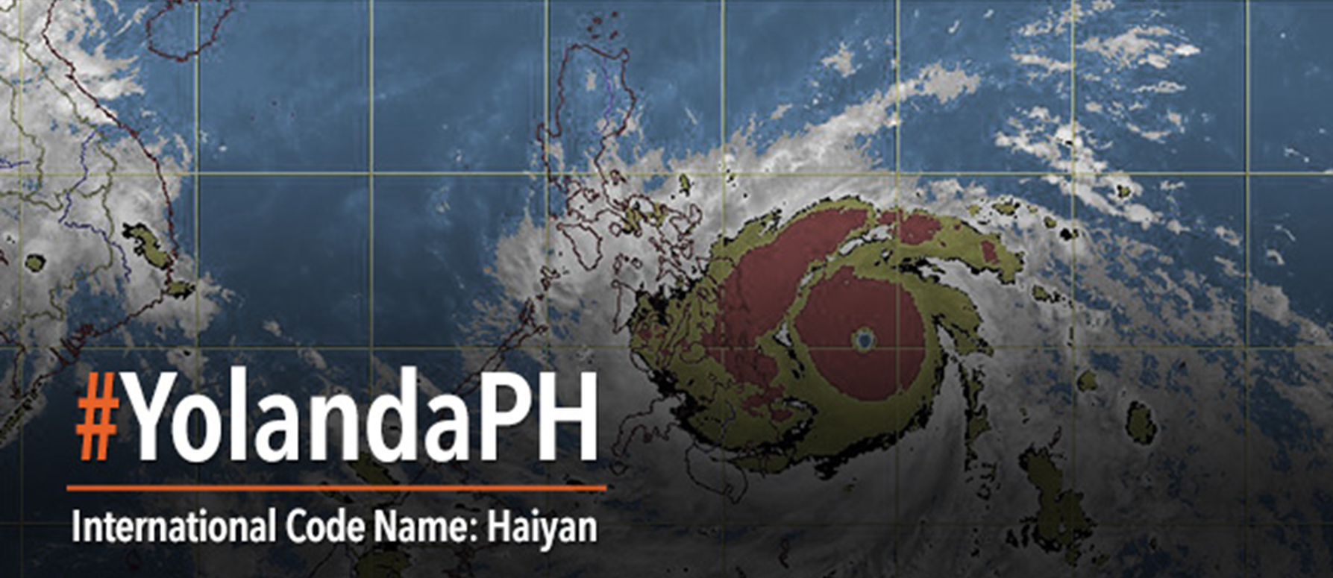
Super Typhoon Yolanda a.k.a Haiyan

Slide 12
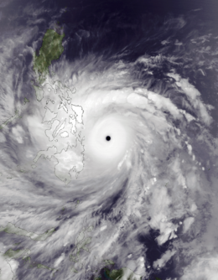
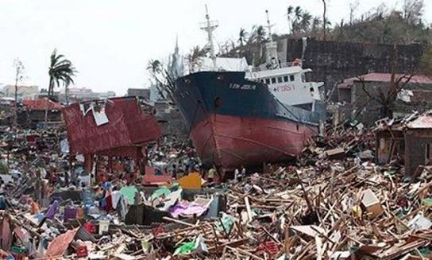
Super Typhoon Haiyan
Formed: November 3, 2013
Dissipated: November 11, 2013
Highest Winds:
  10-minute sustained: 145 mph (230 km/h)
  1-minute sustained: 195 mph (315 km/h)
Lowest Pressure: 895 mb (26.43 inHg)
Fatalities: 6,340 confirmed, 1,061 missing
Damage: $2.86 billion (US 2013 dollars)
Areas Affected:
  Micronesia
  Philippines
  Southern China
  Vietnam
sdfdsdf
Typhoon Haiyan at peak intensity on November 7

Slide 13
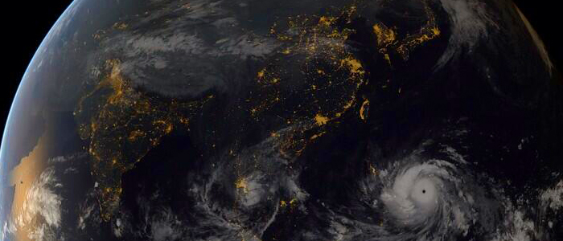
Yolanda (Haiyan) From Space

Slide 14
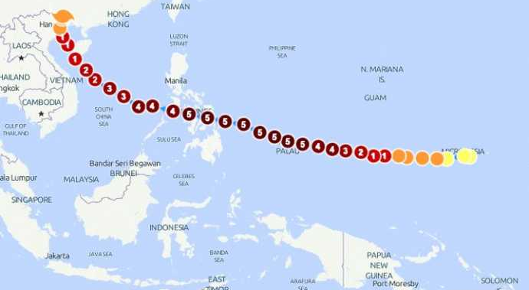
Super Typhoon Haiyan Track
The 13th named storm of the 2013 Pacific typhoon season
Haiyan originated from an area of low pressure several hundred kilometers east-southeast of Pohnpei in the Federated States of Micronesia on November 2, 2013.

Slide 15
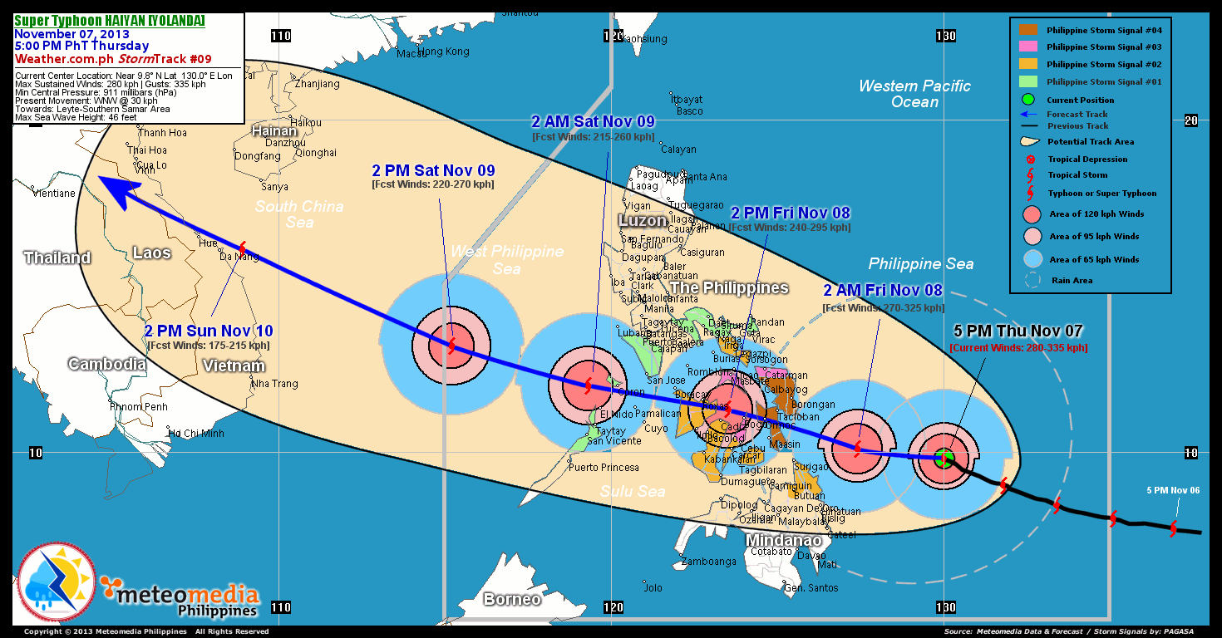
Super Typhoon Haiyan

Slide 16
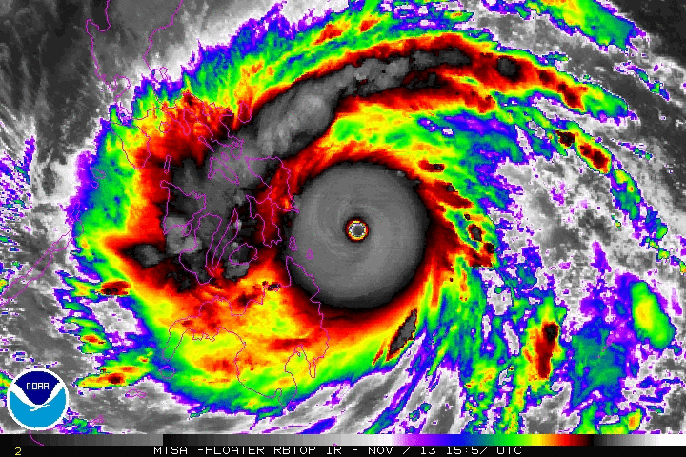
Haiyan (Yolanda) Hitting the Philippines

Slide 17
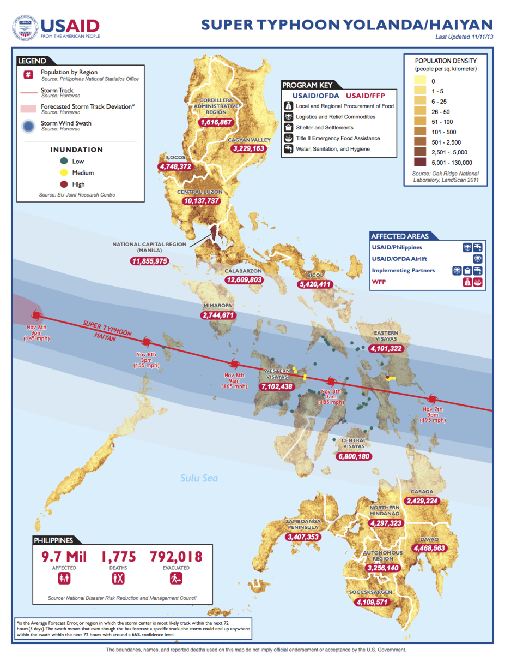
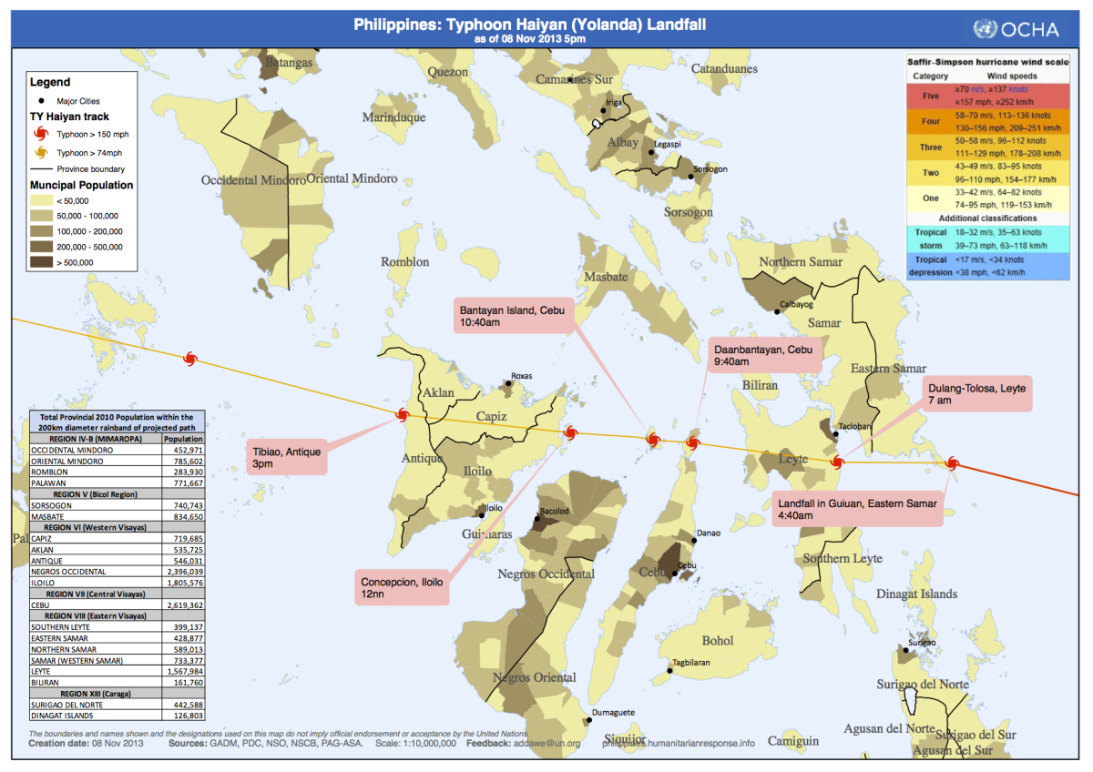
Yolanda (Haiyan) Damage in Philippines

Slide 18
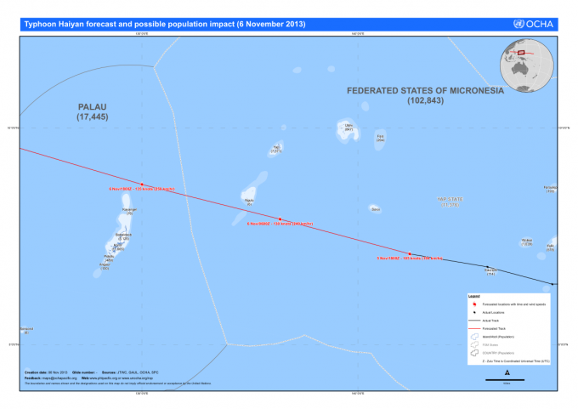
Haiyan impacts on Micronesia and Palau
Palau
  the strongest tropical cyclone that struck Palau since reliable records.
  Kayangel was flooded in its entirety, and all homes were destroyed.
  On Kayangel in Palau, a high storm surge damaged several houses, while strong winds downed trees.
  Despite residents' refusal to evacuate, no fatalities or major injuries took place on the island, 69 people were displaced by the storm.

Slide 19
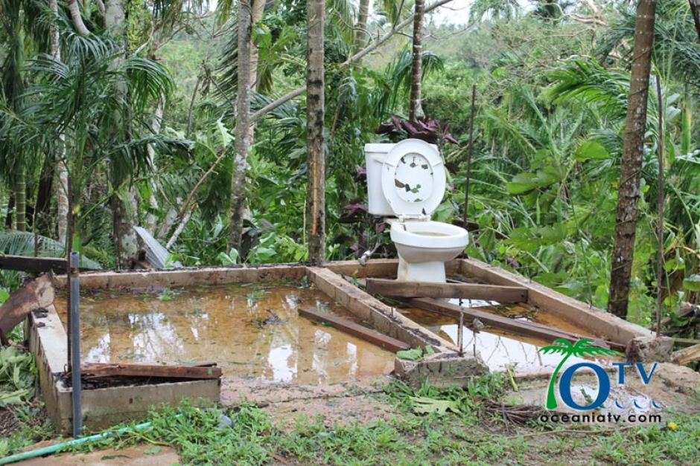
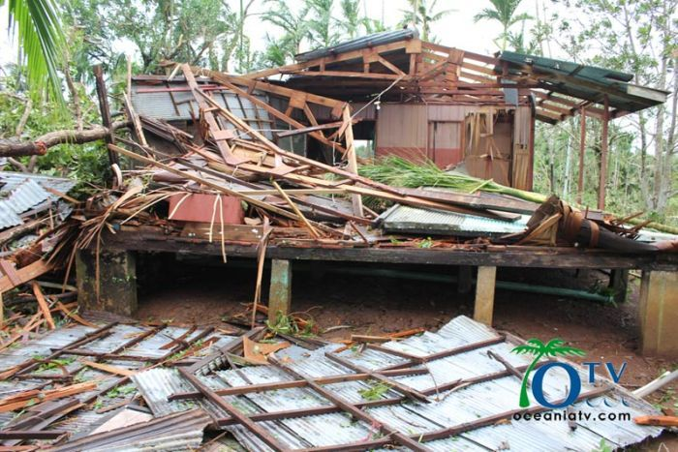
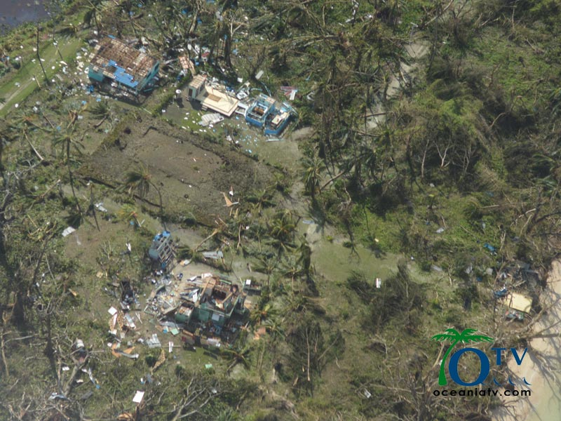
Haiyan impacts on Micronesia and Palau
  Koror, Babeldaob and Kayangel each lost access to water and power.
    In Koror, winds reaching as high as 120 km/h (75 mph) blew out rooftops and downed trees and power lines.
    A causeway linking an offshore hospital to the main island was temporarily shut down after being inundated by water.
    On the northern end of Babeldaob, Haiyan damaged schools and buildings.

Slide 20
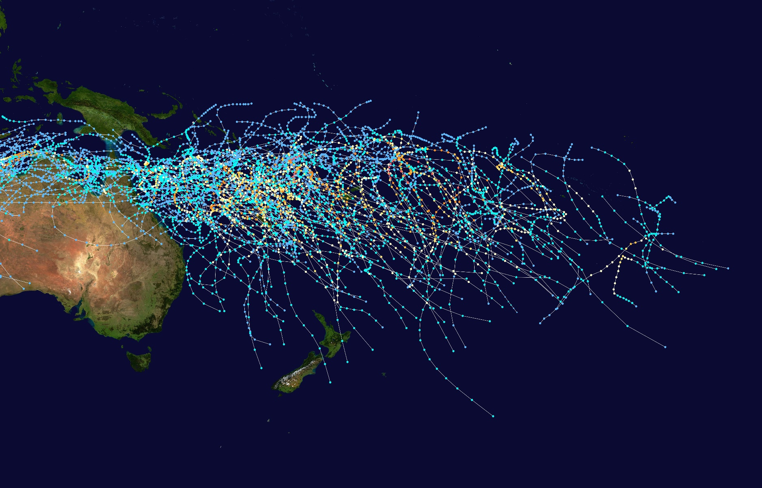
Cyclones in the South Pacific
Tropical cyclone season: November 1-April 30.
Most tropical cyclones have their origins within the South Pacific Convergence Zone or within the Northern Australian monsoon trough.
  both of which form an extensive area of cloudiness and are dominant features of the season.

Slide 21
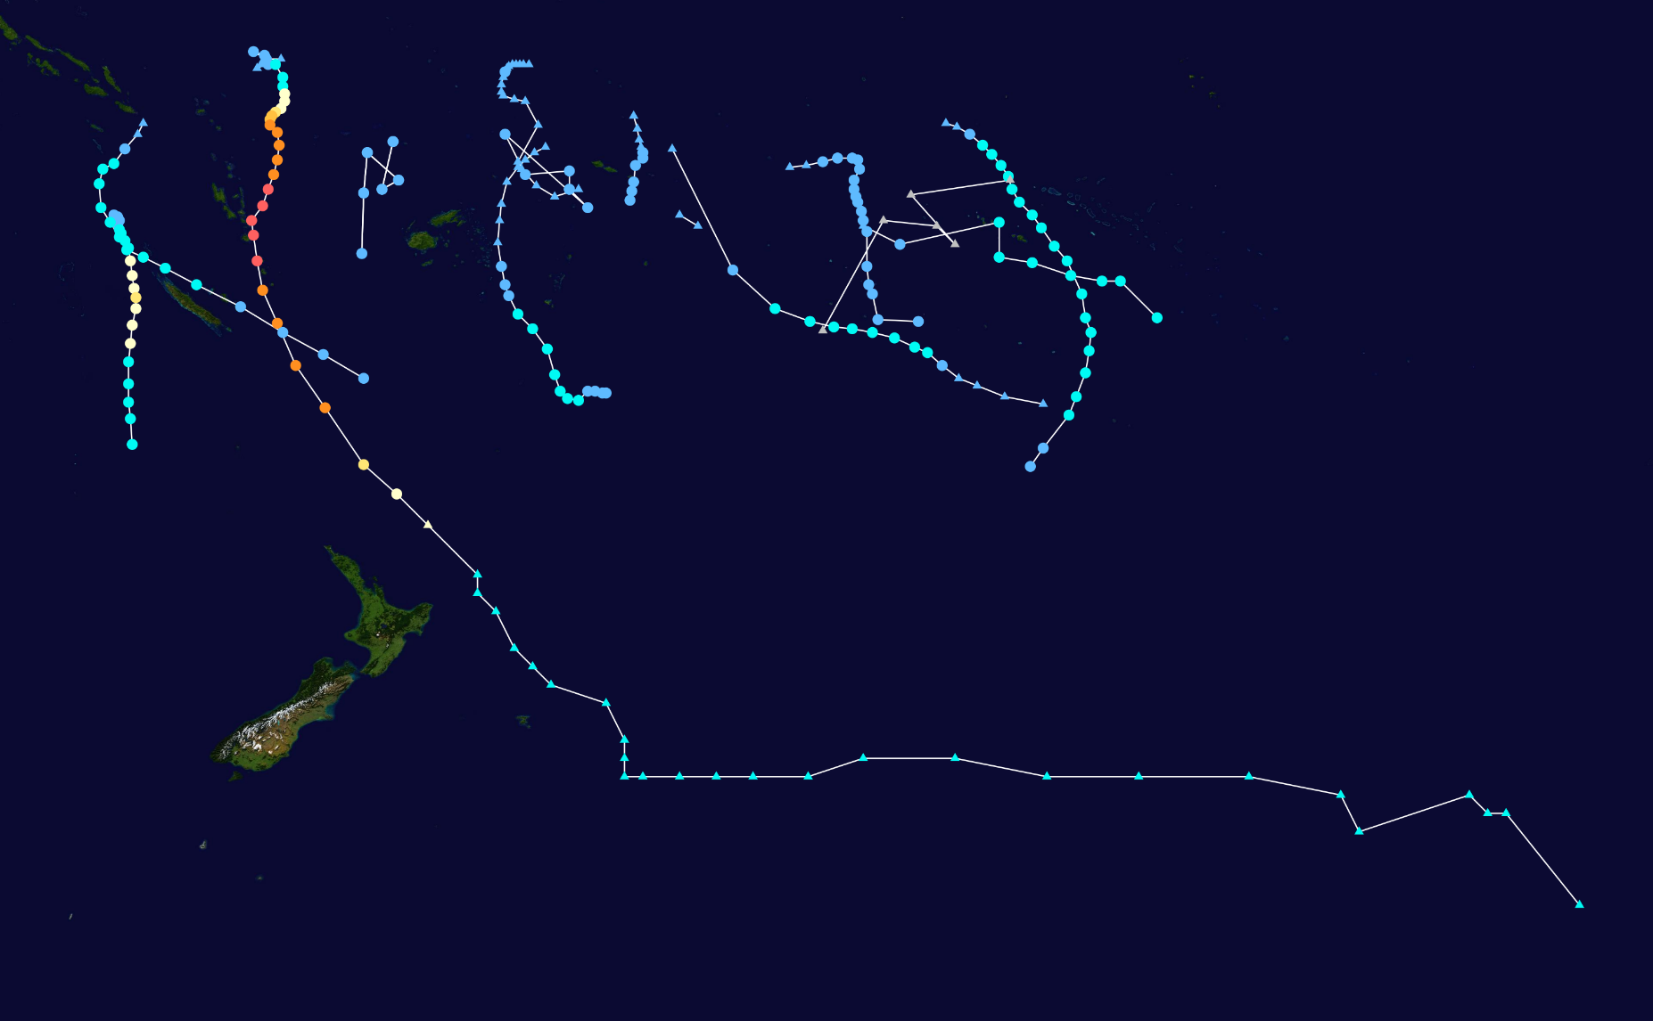
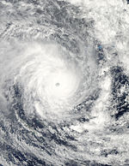
Cyclones in the South Pacific
Tropical cyclone season: November 1-April 30.
Tropical Disturbance: 10-minute sustained wind speeds of more than 65 km/h (35 mph), that wrap halfway around the low level circulation center.
Severe Tropical Cyclone: maximum 10-minute sustained wind speeds are greater than 120 km/h (75 mph).
Tropical
Cyclone Pam

Slide 22
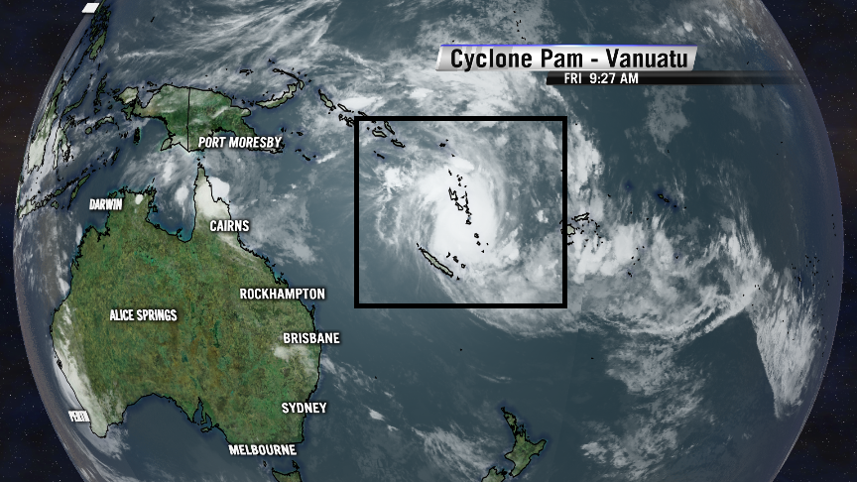
Tropical Cyclone Pam – South Pacific

Slide 23
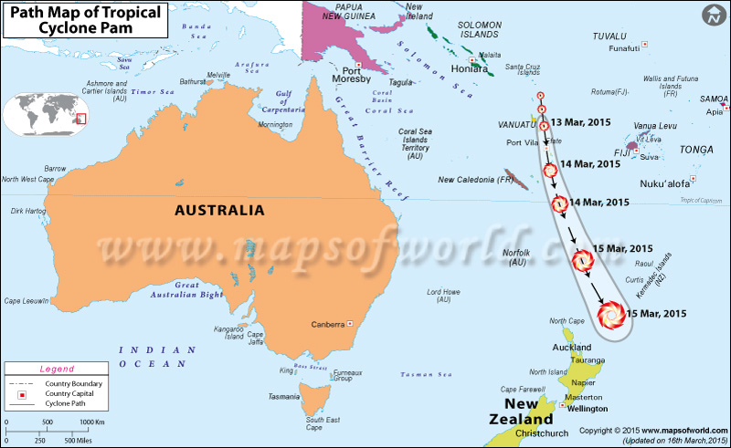
Cyclone Pam – South Pacific
Pam gradually intensified into a powerful, category 5 severe tropical cyclone by March 12.
Pam's ten-minute maximum sustained winds peaked at 250 km/h (155 mph)
Minimum pressure of 896 mb, making Pam the most intense tropical cyclone in the basin.

Slide 24
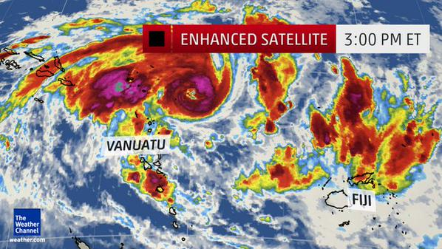
Cyclone Pam – South Pacific
Vanuatu devastation
  Pam passed just east of Efate.
  It is the single worst natural disaster in the history of Vanuatu.
  Vanuatu's infrastructure was crippled: ~90 % of the nation's buildings were impacted by the storm's effects, telecommunications were paralyzed, and there were water shortages

