Slide 1
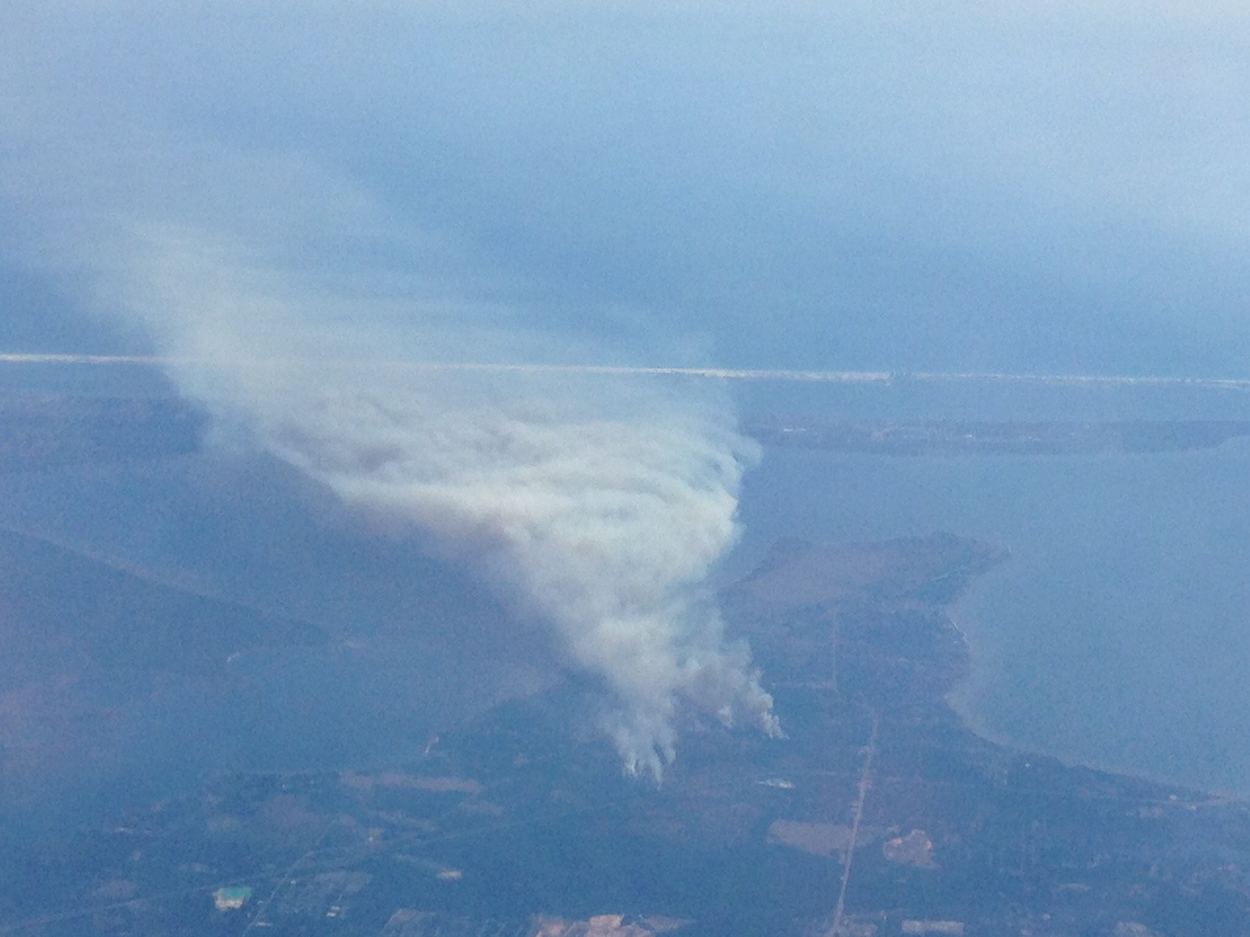
ATMO 102 Pacific Climates and Cultures
ATMO 102 Pacific Climates and Cultures
Lecture: Air Pollution Intro

Slide 2

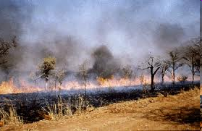
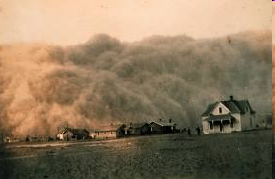
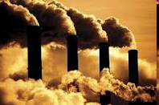
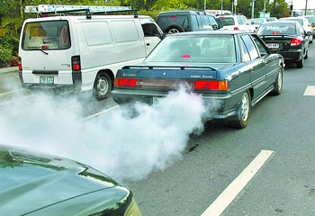

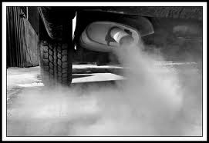
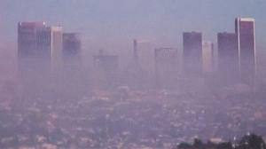
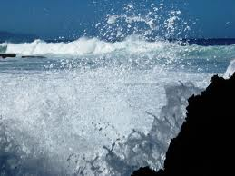
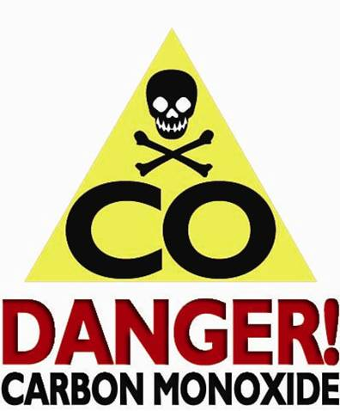
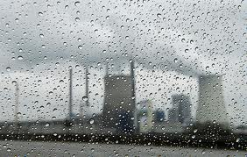
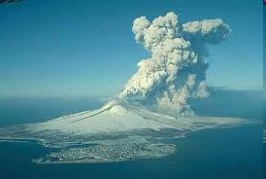
What do you consider Pollution?
Smoke
Dust
Factory Emissions
Pollen and Tree Emissions
Automobile and Truck Emissions
Sea Salt from Sea Spray
Smog
Ozone
Carbon Monoxide
Sulfur Dioxide
Volcanic Ash

Slide 3
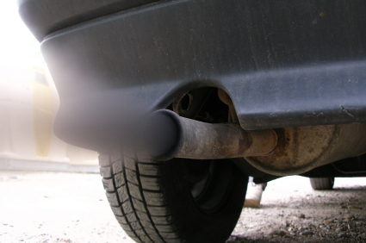
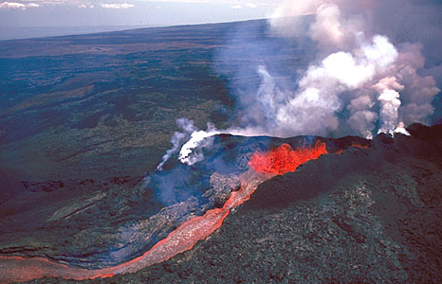
Air Pollution: How do YOU define it?
Air Quality?
  Hard to breathe, smells bad, looks dirty?
Urban/City Pollution?
  Health concerns
    Decreased life expectancy (1.8-3.1 years)
    Premature deaths (4000 per year)
An Anthropogenic (people) Problem
A Natural Problem….
Related to ATMOSPHERIC STABILITY!
Air is NEVER Perfectly Clean!!!

Slide 4
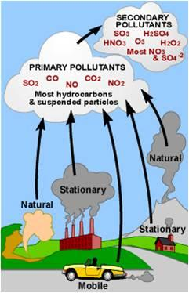
Sources and Types of Air Pollution
Air pollutants
  Airborne particles and gases that occur in concentrations that endanger the health and well-being of organisms.
Primary Pollutants
  Emitted directly from the identifiable source
  Pollutes the air immediately after being emitted
Secondary Pollutants
  Are produced in the atmosphere by chemical reactions between primary pollutants (i.e. smog)

Slide 5
Sources of Primary Pollutants
Created by Humans
Combustion
Processes
Chemical
Processes
Roasting, Heating, Refining processes
Nuclear or atomic process
Mining, Quarrying, Farming
ACCENTUATED BY HUMANS
Volcanoes
Breaking
seas
Pollens,
terpenes
Fire
Dust
Bacteria,
Viruses
NATURAL

Slide 6
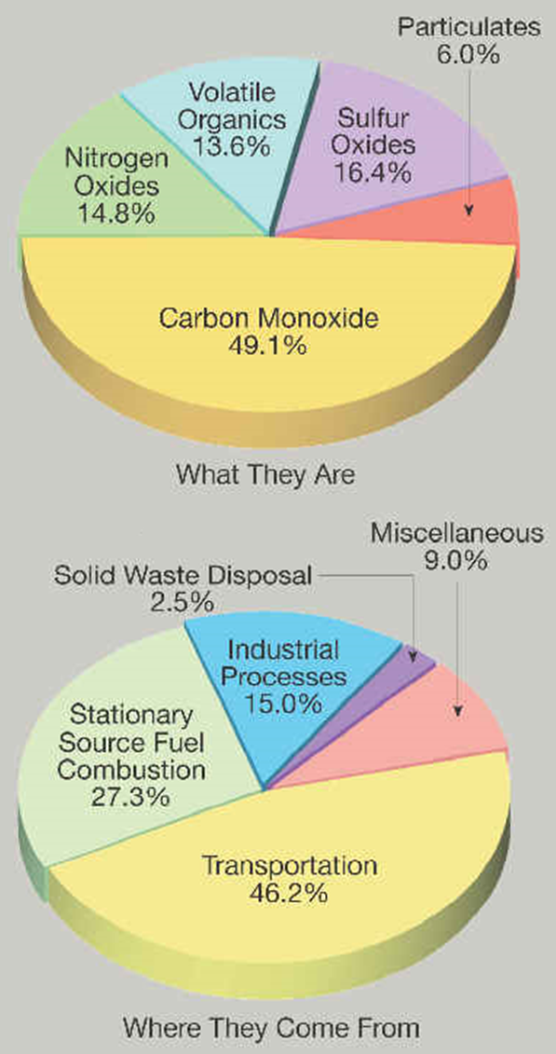
Primary Pollutants
Particulate Matter (solid and liquid)
  Fine are 2.5 micrometers (µm) or less (PM 2.5)
  Coarse are 10 µm or greater (PM 10)
Sulfur Dioxide (SO₂)
Nitrogen Oxides (NO_{x}) – includes NO₂ and NO
Volatile Organic Compounds (VOCs)
Carbon Monoxide (CO)
Lead (Pb)

Slide 7
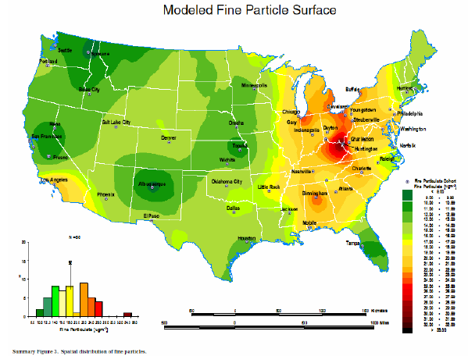
Primary Pollutants – Particulate Matter
Particulate Matter (solid and liquid)
  Fine are 2.5 µm or less (PM 2.5)
    Fuel combustion, fireplaces, wood stoves
    Get deep into lungs, cause serious health problems
    Can cause premature death
  Coarse are 10 µm or greater (PM 10)
    Crushing and grinding operations, dust, soot
    Aggravate asthma and other respiratory conditions
  Main cause for REDUCED VISIBILITY in US.
  Midwest is a big problem due to regions with a lot of industry
    Lots of coal burning power plants cause a problem because they emit SO₂ which turns into fine particles.

Slide 8
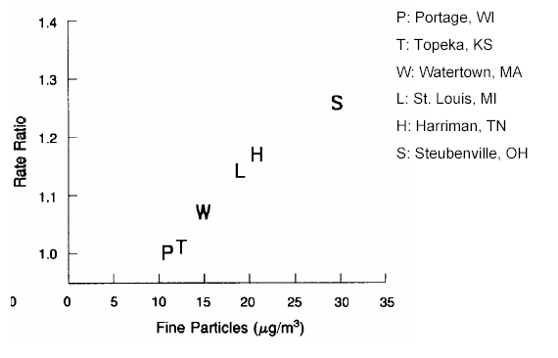
Primary Pollutants - Effects of PM 2.5
Many scientific studies have linked breathing PM to a series of significant health problems, including:
  Aggravates asthma
  Increases in respiratory symptoms like coughing and difficult or painful breathing
  Chronic bronchitis
  Decreased lung function
  Premature death [see Six Cities Study]
Six Cities Study
  They found that PM2.5 correlated very strongly with increased mortality. That’s not to say that other pollutants aren’t harmful; they just don’t lead to shortened life-spans.

Slide 9
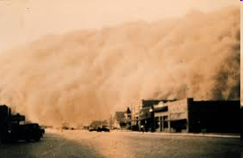
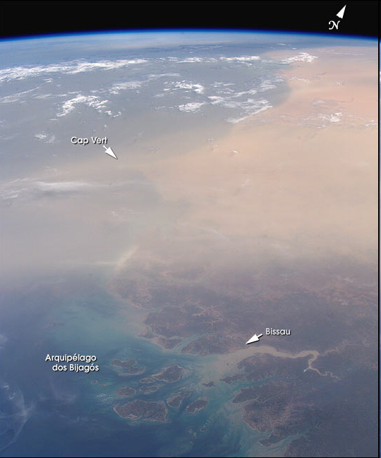
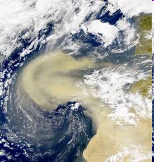
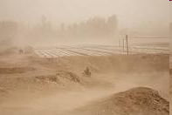
Primary Pollutant – Particulate Matter: Dust
Dust Bowl in US 1930s
Dust Bowl in US 1930s
Visibility reduction
Breathing issues
Saharan Dust from Africa
Saharan Dust
from Africa
Dust Bowl in US 1930s

Slide 10
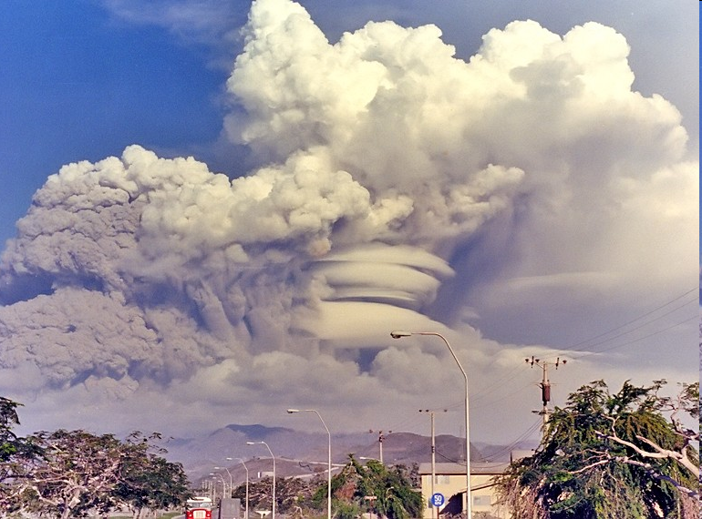
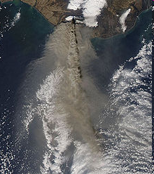
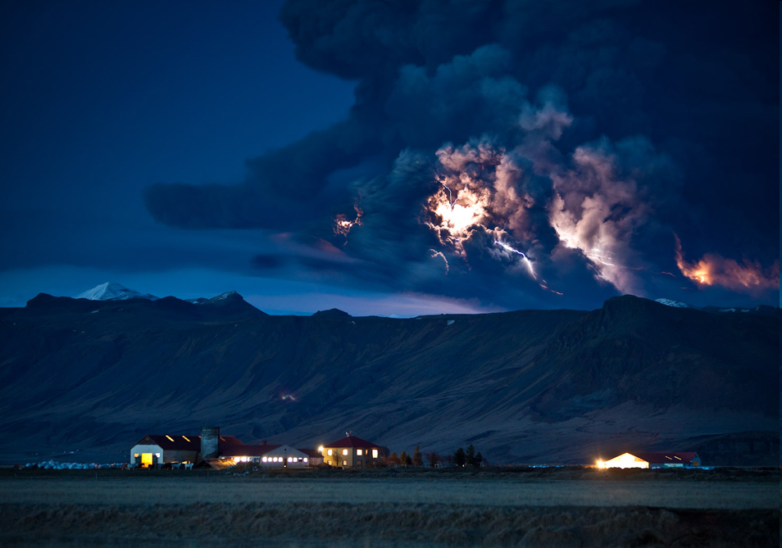
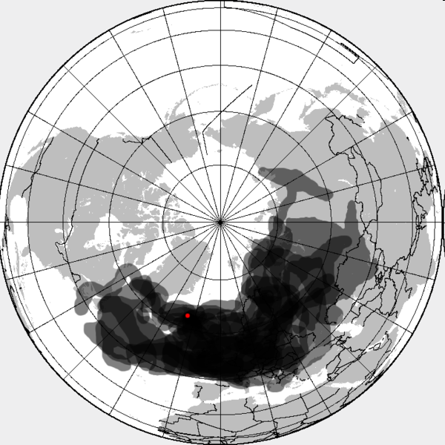
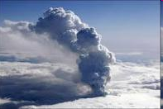
Primary Pollution – Particulate Matter: Volcanic Ash
1991 - Mt. Pinatubo Philippines
Ash reflects sunlight back to space (cools Earth)
Dangerous to breathe
Covers the land surface
Can cause issues with air travel
All Below: Eyjafjallajökull, Iceland. a) the plume is clearly different than the clouds, b) it can cause thunderstorms (surface heating from lava), c) plumes of ash covering Europe, red dot is the volcano, d) plume got very high above the regular cloud deck
a)
b)
c)
d)

Slide 11
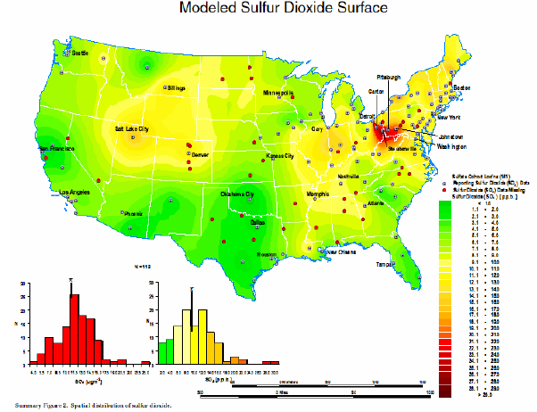
Primary Pollutant – Sulfur Dioxide
Is a colorless and corrosive gas
  Originates from combustion of sulfur containing fuels (like COAL and OIL)
Sources include:
  Power plants
  Smelters
  Petroleum refineries
  Pulp and paper mills
Through chemical reactions in the atmosphere can ultimately form ACID RAIN (sulfuric acid).
Midwest is BAD.
There is also the problem of transport:
  The pollution itself may not be produced in the areas that are affected
  The pollution can be blown/carried with the wind.
  Affects both the US and Canada

Slide 12
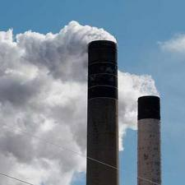
Primary Pollutants - Nitrogen Oxides (NO_{x})
Formation:
  Form during the high-temperature combustion of fuel when nitrogen reacts with oxygen.
Acid Rain:
  NO_{x} can react with other substances in the air to form acids which fall to earth as rain, fog, snow or dry particles. Some may be carried by wind.
Toxic Chemicals:
  In the air, NO_{x} reacts readily with common organic chemicals and even ozone, to form a wide variety of toxic products, some of which may cause biological mutations.
Sources include:
  Motor vehicles
  Power plants
  Some bacteria

Slide 13

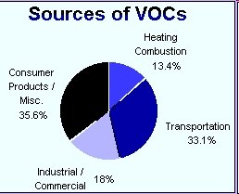
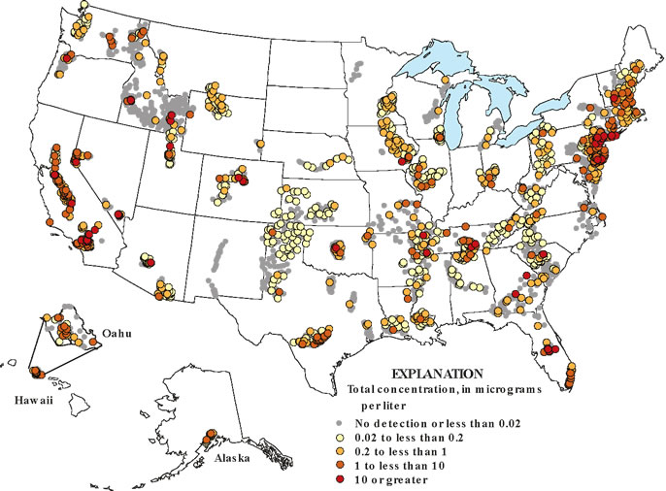
Primary Pollutant - Volatile Organic Compounds
Also called hydrocarbons
  Solid, liquid and gaseous forms
Sources include:
  Large quantities occur naturally (CH₄ = methane)
  In cities incomplete combustion of gasoline
Hazard?
  by themselves they tend to be harmless…
Reactions in the atmosphere:
  If they react with other chemicals in the atmosphere they can produce harmful secondary pollutants.

Slide 14
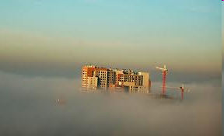
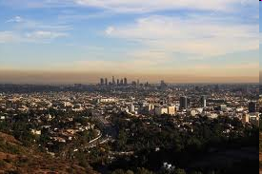
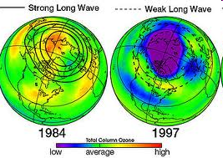
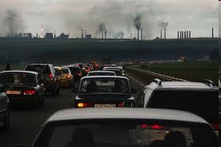
Tropospheric Ozone – “Bad” Ozone vs. “Good” Ozone
BAD Ozone is found in the troposphere
  Caused by reactions with “smog” and nitrogen gases including NO₂ and NO:
Urban air pollution causes ozone formation.
  Sunlight breaks apart NO₂ to produce NO and a free oxygen atom, which reacts with regular oxygen (O₂) to form ozone (O₃)
  Ozone is an irritant to lungs and is dangerous to those with lung conditions or who are very young or very old.
Good Ozone is found in the Stratosphere
  Makes the temperature in this layer increase
  Protects life from harmful UV radiation
  Is destroyed by chemical reactions involving CFCs (chlorofluorocarbons)
    Reduced the Ozone layer in the mid 1970 – 1990
    Problem remediated by international political and scientific cooperation: Montreal Protocol (1990)

Slide 15
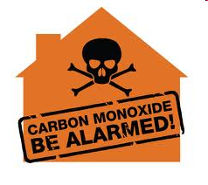
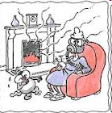
Primary Pollutant - Carbon Monoxide (CO)
Is a colorless, odorless and poisonous gas produced by incomplete burning of carbon in fuels
It is the MOST abundant primary pollutant
Sources include:
  In cities incomplete combustion of gasoline or gas used in fireplaces and stoves
Central Nervous System Effects:
  People who breathe high levels of CO can develop vision problems, reduced ability to work or learn, reduced manual dexterity, and difficulty performing complex tasks.
At extremely high levels, CO is poisonous and can cause death.

Slide 16
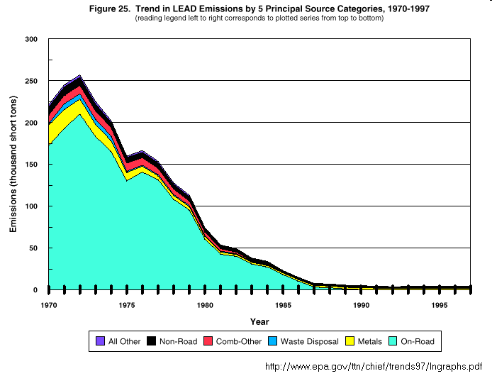
Primary Pollutant – Lead
Used to come from Automotive sources
  There used to be lead in gasoline!!!
  That’s why we have “unleaded gas” nowadays
Damages organs:
  Lead causes damage to the kidneys, liver, brain and nerves, and other organs. Exposure to lead may also lead to osteoporosis (brittle bone disease) and reproductive disorders.
Affects the brain and nerves:
  Excessive exposure to lead causes seizures, behavioral disorders, memory problems, and mood changes. Low levels of lead damage the brain and nerves in fetuses and young children, resulting in learning deficits and lowered IQ.

Slide 17
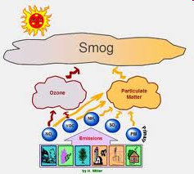
Secondary Pollutants
Not emitted directly to the atmosphere
Result from chemical reactions between primary pollutants.
For Example: SMOG!! – Cities like Los Angeles and Mexico City are prone to SMOG!
Different types of reactions produce different types of secondary pollutants
  Industrial Smog
  Photochemical Smog

Slide 18
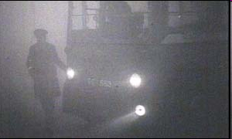
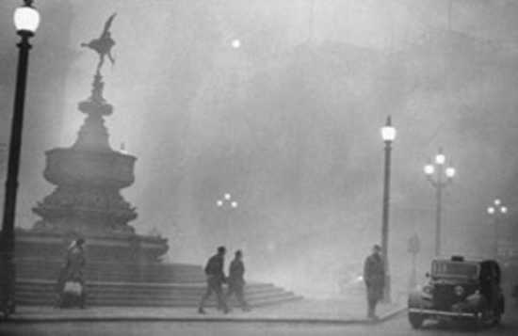
Secondary Pollution - Smog from Industry
Where is this?
  London, England
  The 1952 Smog Disaster Killed 4,000 people!
  Industrial Smog
    coal or oil is burned, some portion is completely combusted, forming CO₂, some partially combusted producing CO, and some unburned that is released as soot, or particles of carbon.
    With reactions in the atmosphere some sulfur containing compounds are made.

Slide 19
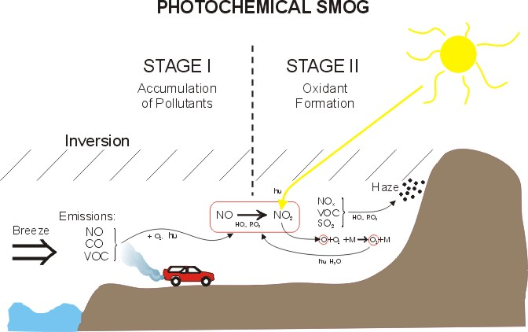
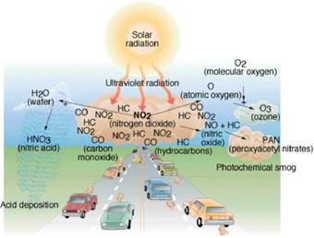
Secondary Pollutants – Photochemical Smog
Photochemical Reactions
  “Photo” → photons & energy from the sun
  “Chemical” → the compounds in the atmosphere
Can result in “Photochemical Smog”
  Ex: Nitrogen oxides absorb solar radiation causing chemical reactions to occur.
  If certain VOCs are present, other more dangerous and toxic compounds can be formed.

Slide 20
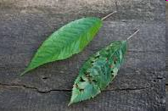
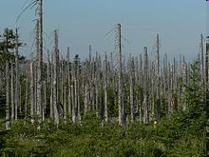
Acid Precipitation
Fossil fuel burning releases tons of sulfur and nitrogen oxides
These pollutants can be converted into acids (like sulfuric acid)
They leave the atmosphere by:
  Wet deposition (rain)
  Dry deposition (dust/smoke)
Effects:
  Damage and Kill Trees
  Damage and “melt away” stone statues and structures
  Changes the pH of lakes and rivers
    Kills fish and other wildlife

Slide 21
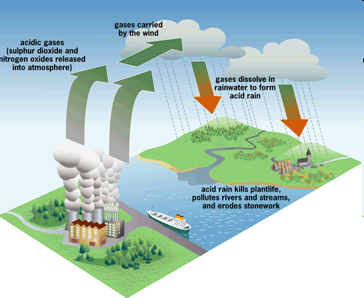
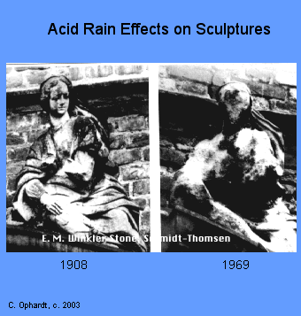
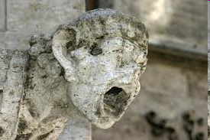
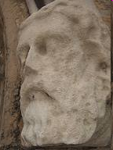
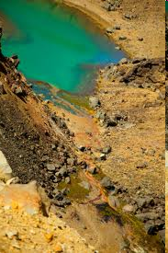
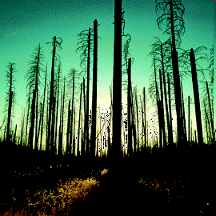
Acid Rain Formation & Effects

Slide 22
The Role of Weather in Pollution
Wind
  Speed
    Determines the concentration of pollution
    Determines how turbulent the air is
    How fast the plume moves and is mixed with “clean” air
  Direction
    What area (near people or not) is affected
Atmospheric Stability
  Determines the extent to which vertical motions will mix the pollution with cleaner air above.
An increase in air temperature with height.
  Often simply called an inversion
  Warm air over cooler air
  Acts as a lid and can trap pollution
  This is why LA and Mexico City have such bad pollution problems!!!!

Slide 23

Without a Temperature Inversion
Here we have warmer temperatures by the surface and cooler air on top with mixing in the atmosphere.
The temperature decrease with height is represented by the red line.
The decrease is known as the environmental lapse rate and is approximately 6.4 ºC/1000m (3.5 ºF/ 1000ft)

Slide 24

With a Temperature Inversion
Here we have cool air trapped below a warmer layer.
The height at which the temperature increase occurs corresponds to where the pollution gets stopped.
Your rising warm air is inhibited by the inversion.

