Slide 1
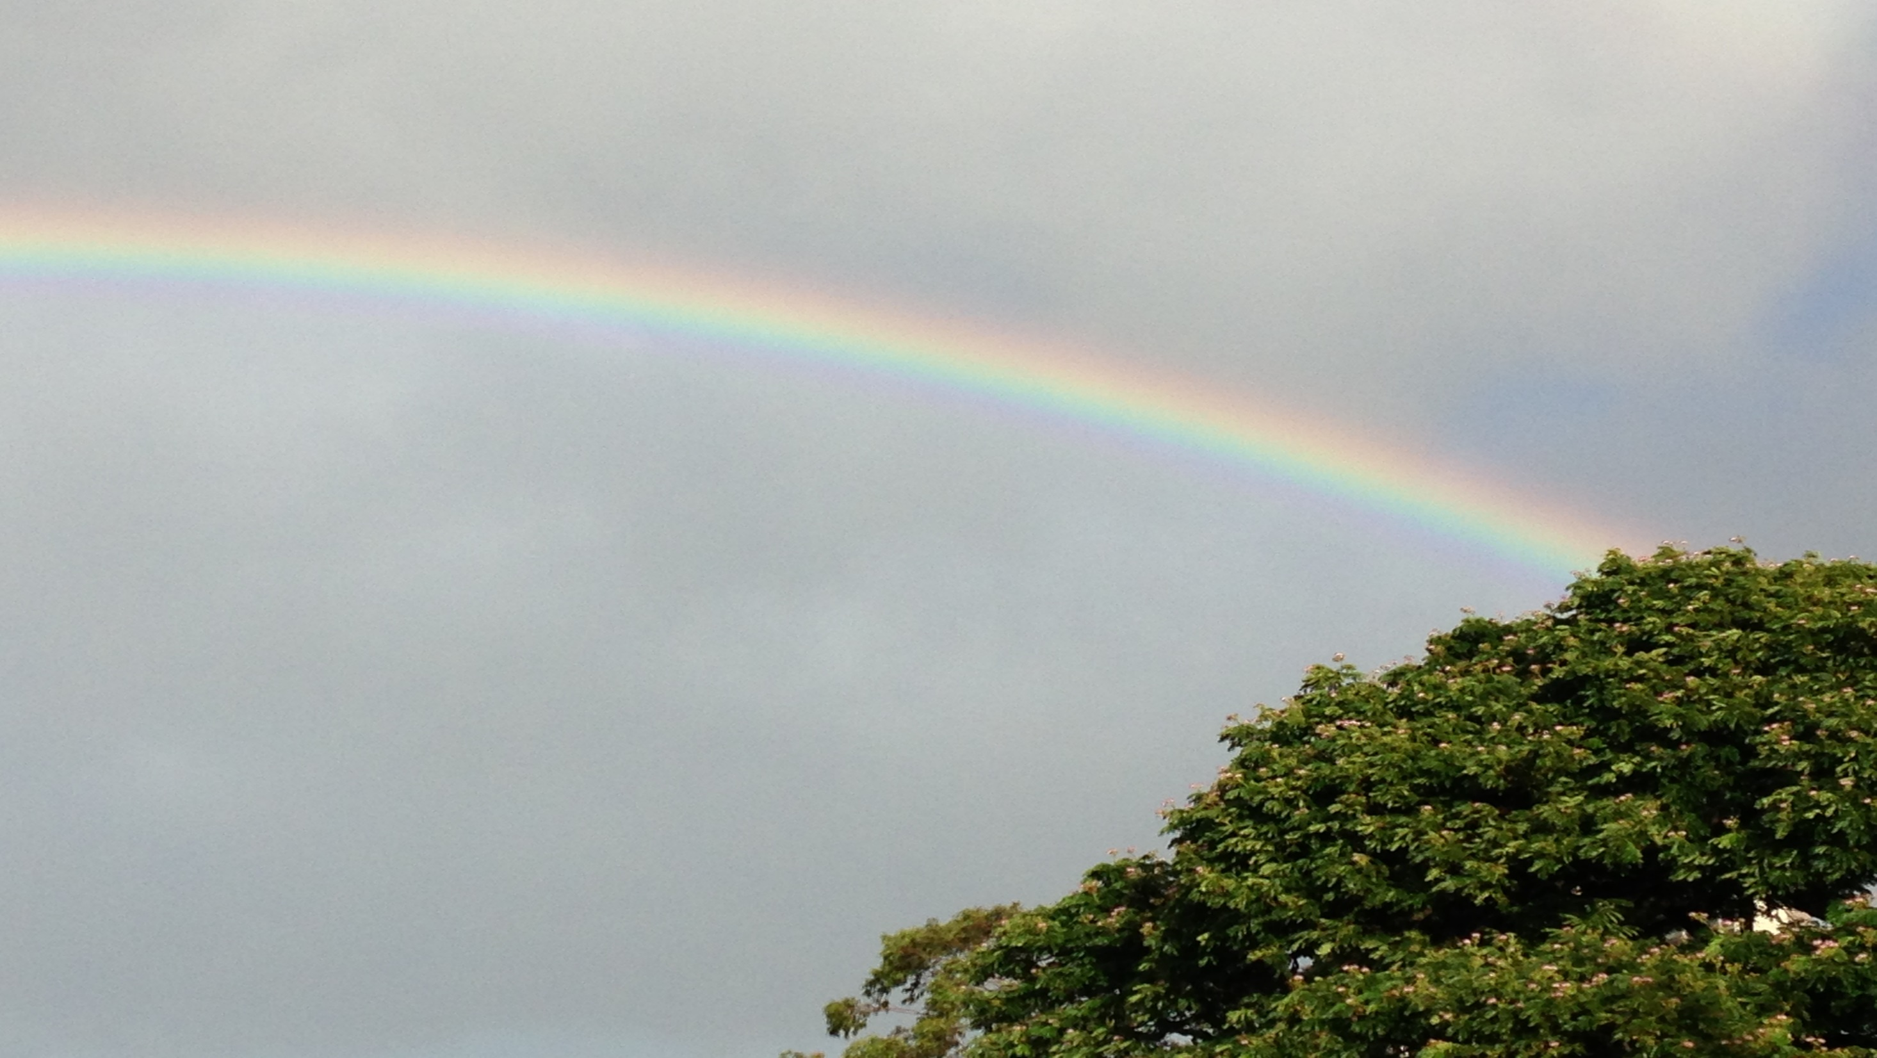
ATMO 102 Pacific Climates and Cultures
ATMO 102 Pacific Climates and Cultures
Lecture: Atmospheric Optics Introduction

Slide 2

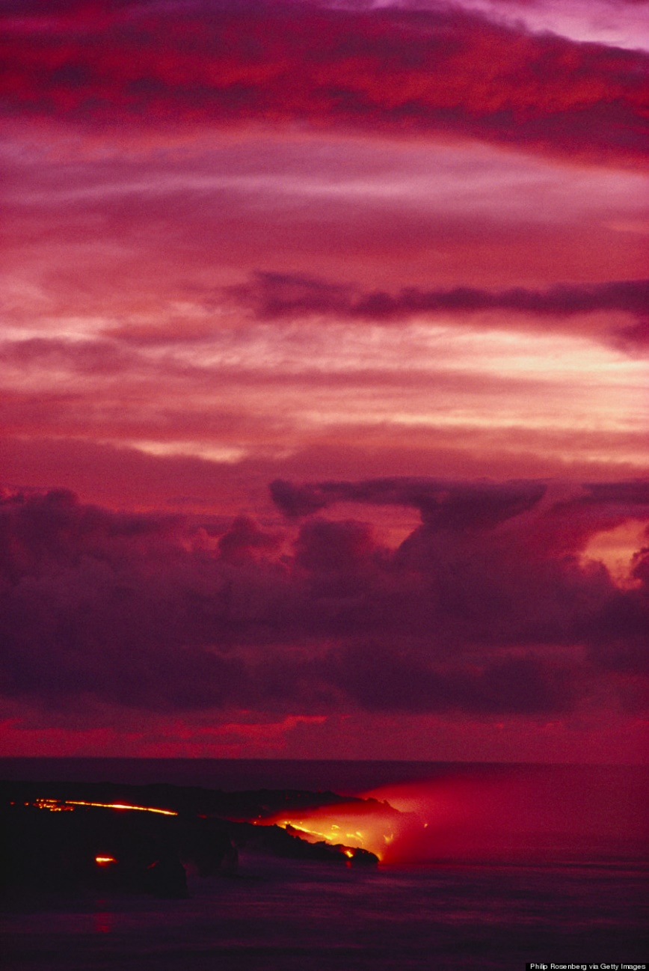
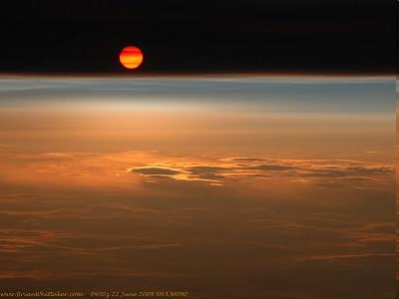
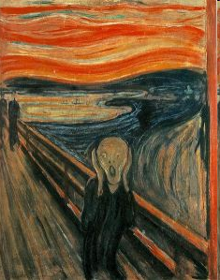
Red and other Colored Sunsets
Most spectacular Sunsets occur when there are lots of fine particles in the atmosphere…
  Dust
  Volcanic Ash
  Vog
Volcanic sunsets depicted in Munch's The Scream
1883 eruption of Krakatoa
Spectacular sunsets from the Sarychev volcanic eruption June 2009 from the International Space Station
Purple Sunset off Big Island
Date unknown

Slide 3
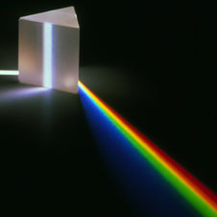
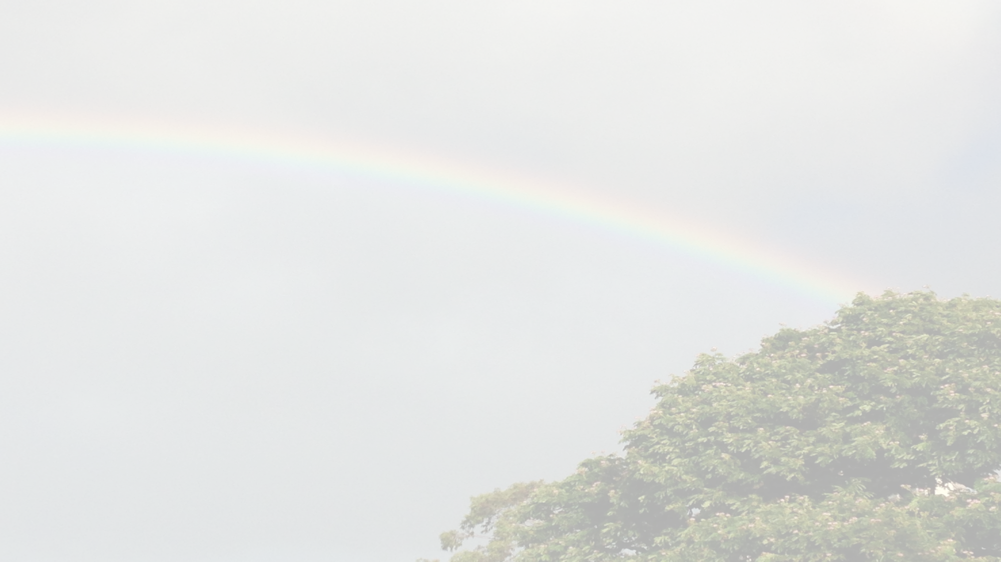
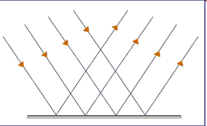
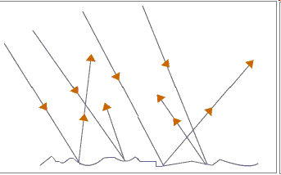
White Light & The Nature of Light
The Law of Reflection
  Light rays always bounce off the reflecting surface at the same angle at which the meet at that surface.
White light is composed of many wavelengths
  Atmospheric gases, clouds and particles interact differently with these wavelengths
  Sky Color
  Optical Phenomena
On a SMOOTH surface you can easily see that the angles are the same.
On a ROUGH surface light will strike (and reflect) at different angles.

Slide 4
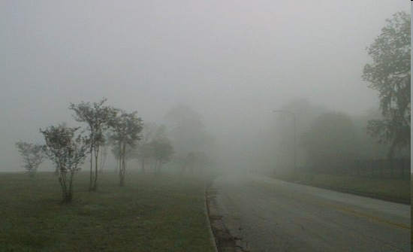
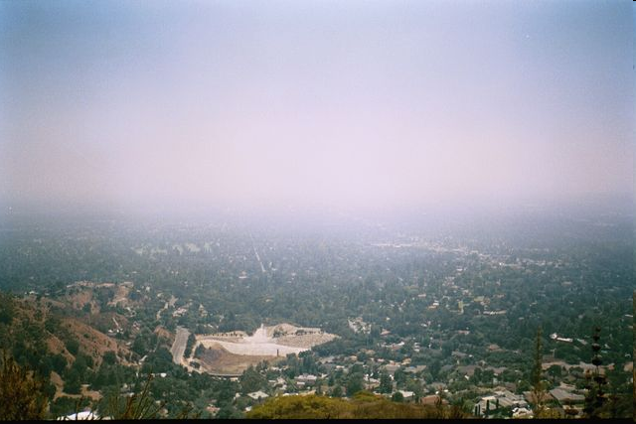
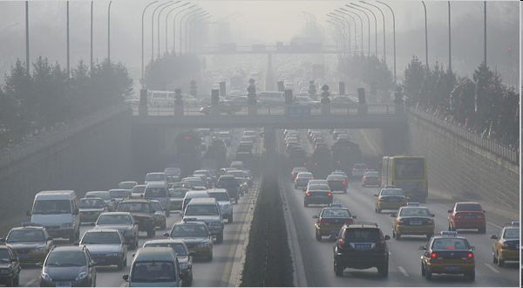
White Skies – Hazy, Fog and SMOG
Fog
Fog, haze or smog scatter light more equally in all wavelengths so the resulting sky looks white
Haze
Smog

Slide 5
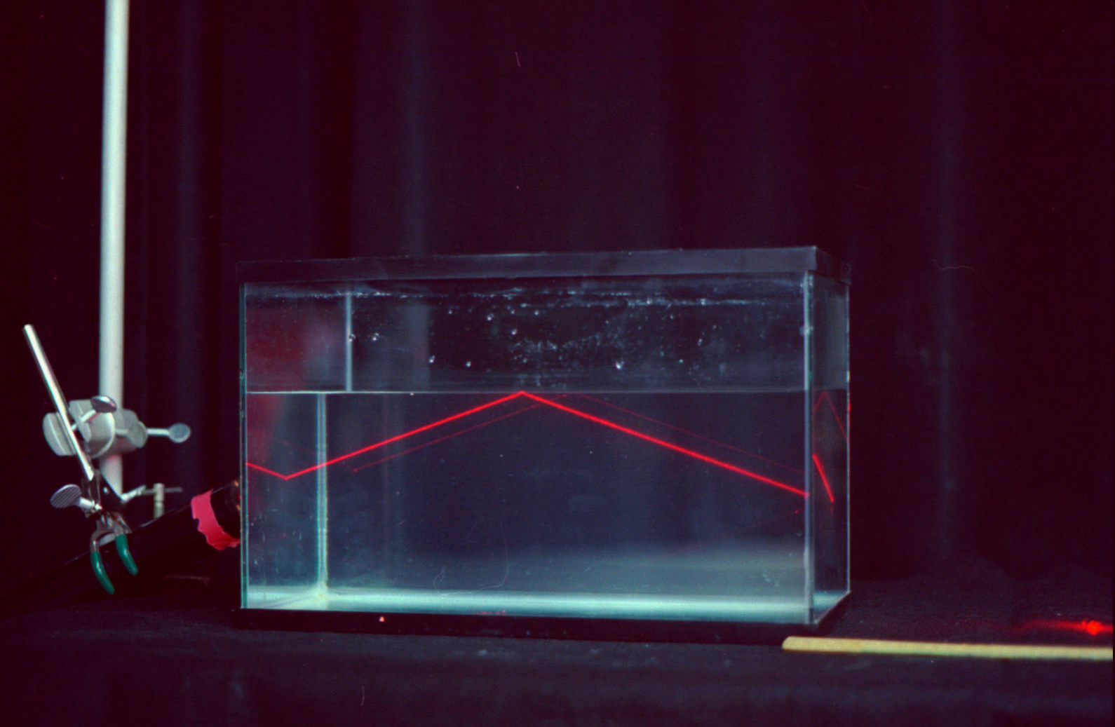
Nature of Light – Internal Reflection
Occurs when light that is traveling through a transparent material (like water) reaches the opposite surface and is reflected back into the transparent material.

Slide 6
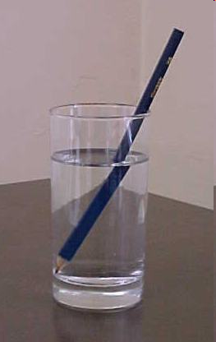
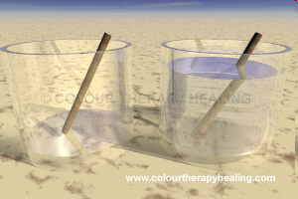
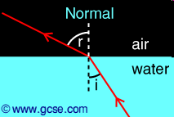
Nature of Light – Refraction
Some rays are not reflected
Refraction is the bending of light as it passes obliquely (not at 90 deg) from one transparent medium to another.
  The velocity of light varies depending on the medium.
  It is slower in water or ice than in a vacuum.
No water
Water

Slide 7
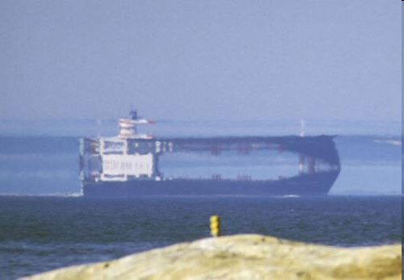
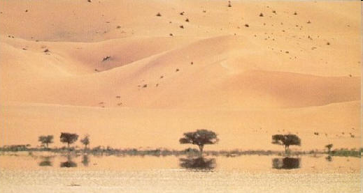
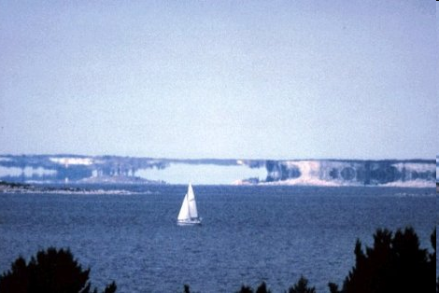
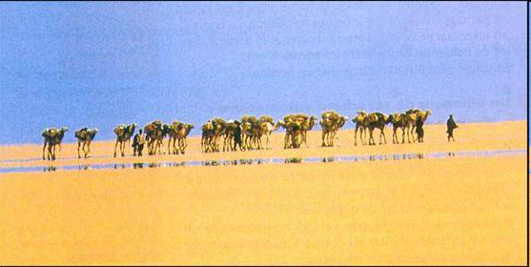
Mirages
What do you think of when you think of the word “Mirage?”
These are still mirages!
What’s going on here?
These are probably what
you thought of!

Slide 8
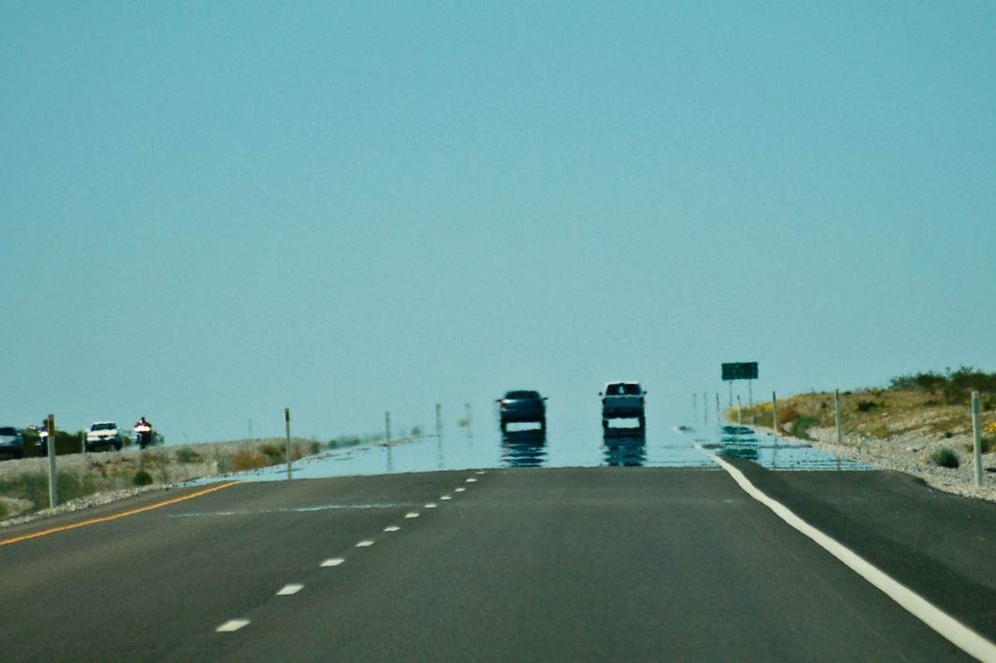
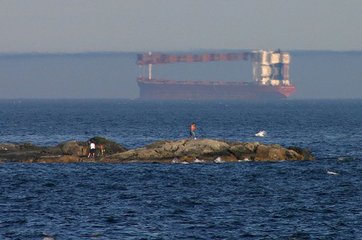
Mirages
Usually associated with desert regions
Can happen anywhere
  Related to air of different densities
Different types
  Inferior Mirage
    The image is BELOW the true location of the object
    Usually warm air below, cold above
  Superior Mirage
    The image is ABOVE the true location of the object
    Usually warm air above, cold below

Slide 9
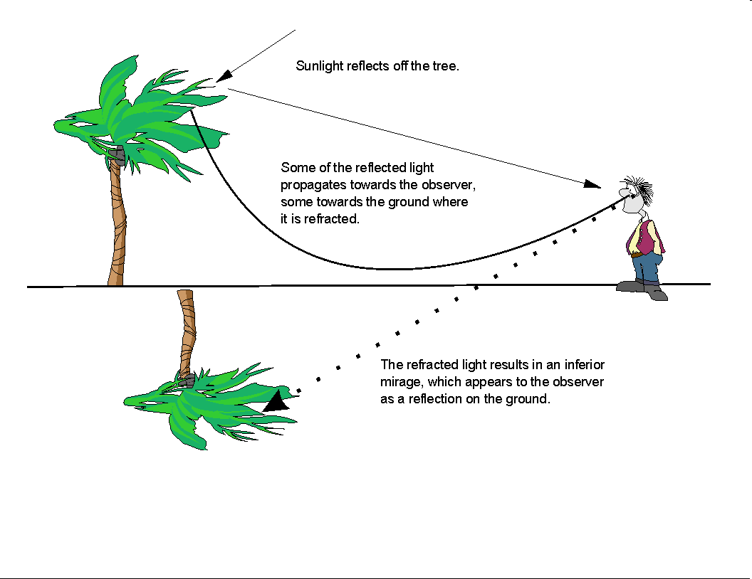
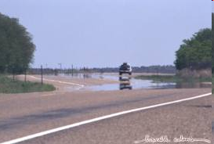
How inferior mirages work….
Change in air density = gradual bending of light rays
Near the earth’s surface light traveling through less dense air develops a curvature in a direction OPPOSITE to the Earth’s Curvature.
When light rays pass from hotter to colder, they bend toward the direction of the cooler air.
Makes objects appear below (or above) where they are, often inverted (upside down).
Human brain perceives light as traveling in a straight line.
COOL AIR
HOT AIR

Slide 10
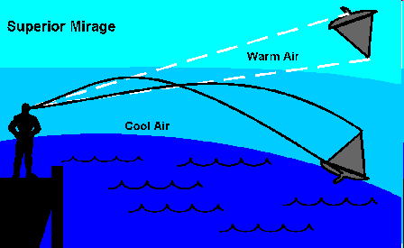
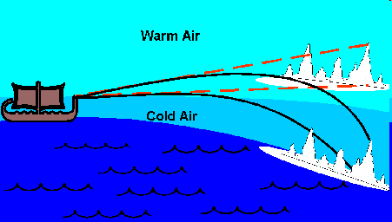
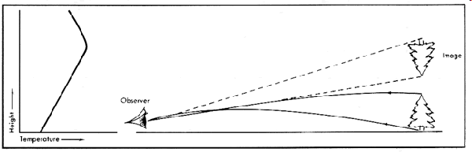
Superior Mirages
The air close to the surface must be much colder than the air above it.
This condition is common over snow, ice and cold water surfaces.
When very cold air lies below warm air, light rays are bent downward toward the surface, thus tricking our eyes into thinking an object is located higher or is taller in appearance than it actually is.

Slide 11
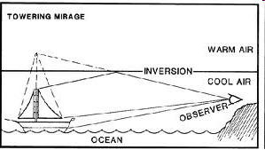
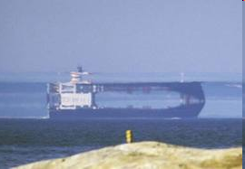
Superior Mirages
Towering: changes in the apparent size of an object
Looming: Makes it appear object is suspended over the horizon.

Slide 12
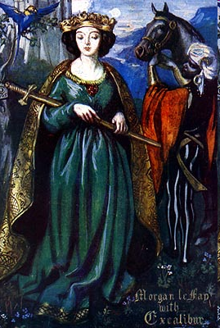
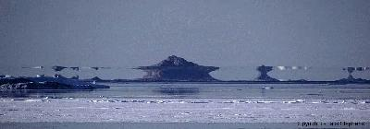
Fata Morgana
Named after the sister of King Arthur
a.k.a Morgan La Fey –An evil witch, rival of Merlyn.
Credited with the ability to create towering castles out of thin air.

Slide 13
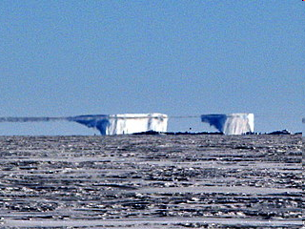
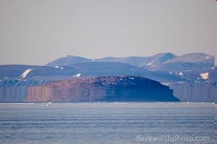
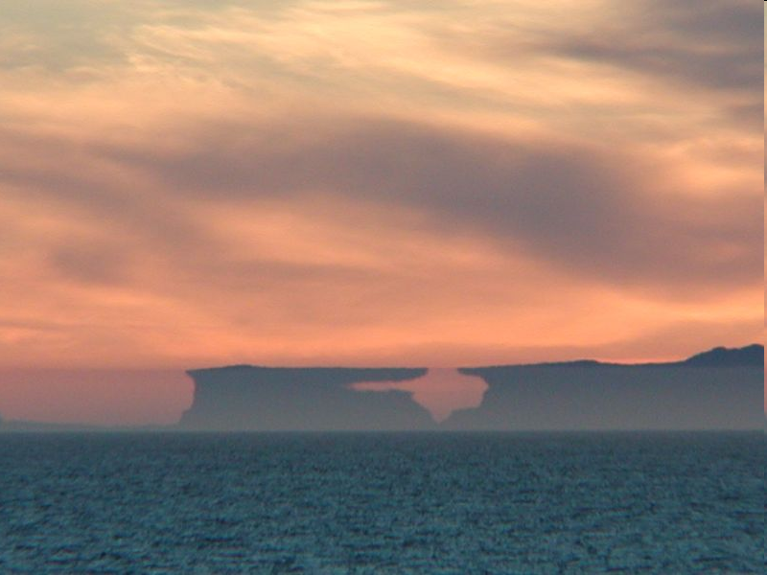
Fata Morgana
A complex mirage in which distant objects are distorted as well as elongated vertically.
For example, a relatively flat shoreline may appear to have tall cliffs, columns, and pedestals.
The phenomenon occurs under much the same meteorological conditions as the superior mirage with inversion, and contains features of both towering and inversion.

Slide 14
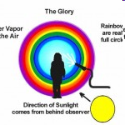
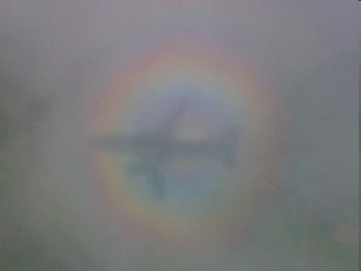
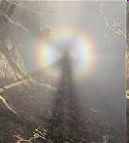
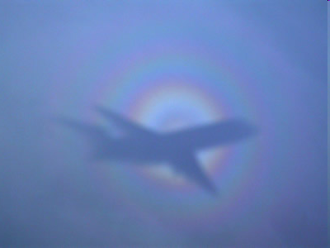
Glory
Not usually seen when the observer is on the ground … Easier to see when in an airplane
Colored rings surrounding the shadow of the airplane
Named after the “halo” it produces around a person’s shadow
Can be see at the surface if the observer is located such that:
  Above a layer of fog
  Sun at his or her back
The shadow on the ground the glory will enshroud the observer’s head.

Slide 15
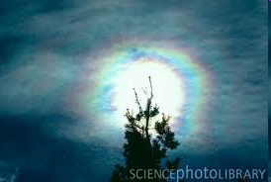
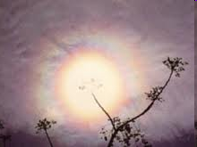
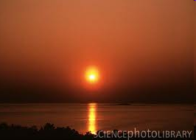
Corona
Appears as a bright whitish disk centered on the Moon or Sun. But mostly the MOON!
Sometimes colors are seen, but are rare
  Red outer band, blue in the middle
Produced when a thin layer of water-laden clouds (usually altostratus) cover the Moon (or the Sun)
The Corona is due to the BENDING of light around the EDGES of the drops causing them to collide and interfere with each other.
  Diffraction – The bending of light around sharp edges.
  Interference – Occurs when light rays of different frequencies (colors) meet.

Slide 16
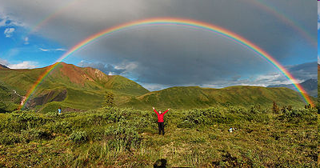
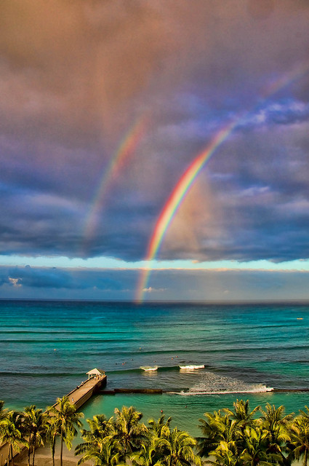
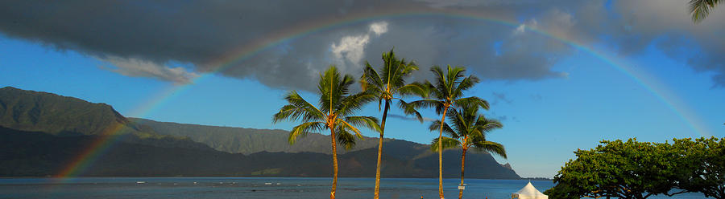
Rainbows

Slide 17
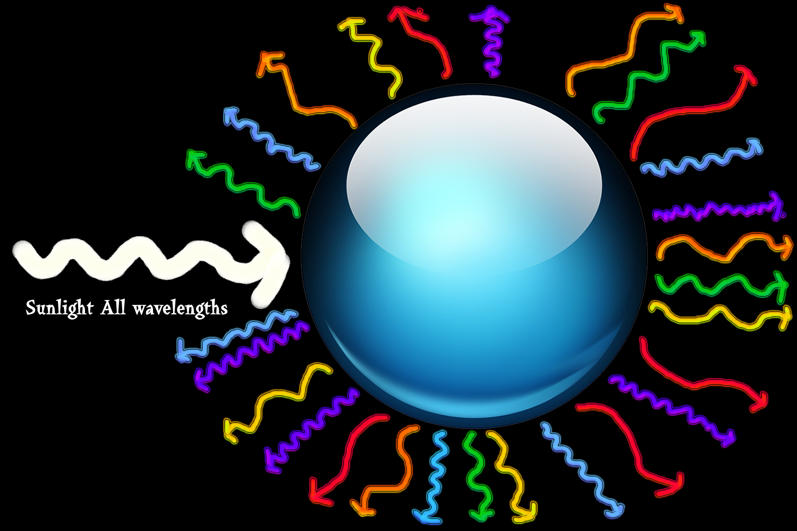
Cloud drops scatter white light

Slide 18

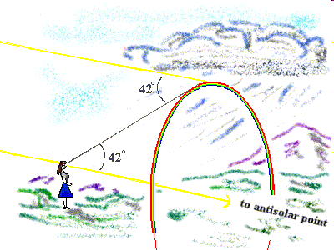
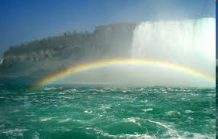
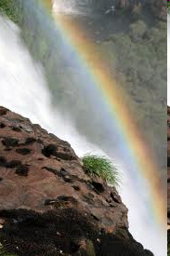
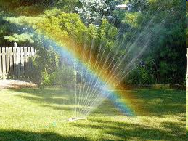
Rainbows
Clarity of color varies
Outermost band is always RED
Innermost band is always VIOLET
Usually see SIX Colors
  Red, Orange, Yellow, Green, Blue, Violet
Usually seen when the observer has the Sun on one side and a rain shower on the opposite side.
  i.e. Sun at your back, facing the rain
Fine mists from waterfalls and sprinklers can generate mini-rainbows.

Slide 19
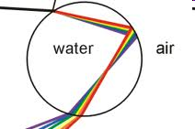
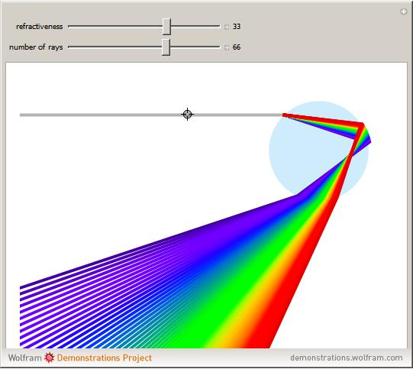
Rainbow Formation
Need three things:
  1) Sunlight
  2) Water droplets
  3) An observer in between the rain and the sun
Refraction
  As light travels through water it is bent
  Different colors travel at different speed in water
    Each color is then bent at a different angle
    Violet is refracted and bent the most
    Red is refracted and bent the least

Slide 20


Rainbow Formation
The angle between sunlight and the dispersed color is always:
  42° for red
  40° for violet
The curved shape results from the fact that the light always travels at 42° from the path of sunlight
An observer will only see one color from each raindrop
Each observer sees their OWN rainbow!

