Slide 1
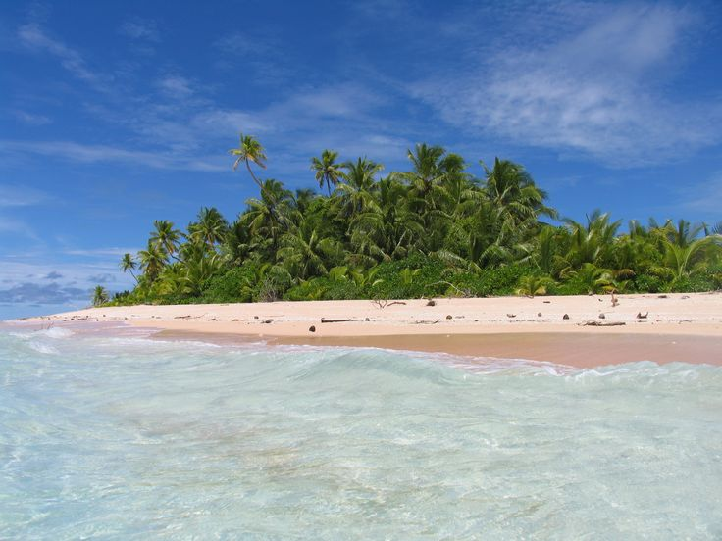
ATMO 102 Pacific Climates and Cultures
ATMO 102 Pacific Climates and Cultures
Lecture: Pacific Island Climate Vulnerability

Slide 2

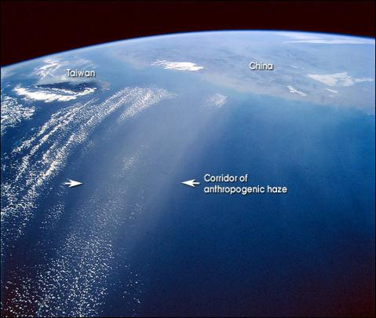
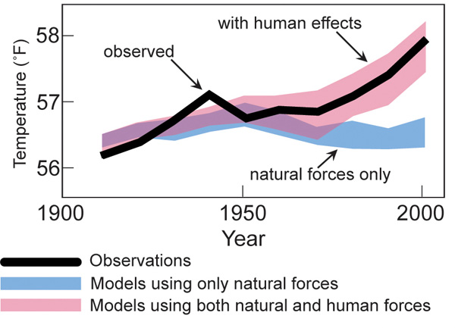
Human Forced, Climate Change is an Empirical Scientific Fact
Two necessary responses:
1. Mitigation – reducing GHG emissions to a safe level
2. Adaptation – adapting to impacts of unavoidable climate change
When we look at observed temperuatre (black) and compare it to simulations without human actions (blue) they temperature don’t match. When we include human activity (pink), the temperatures since 1950 track very well.

Slide 3

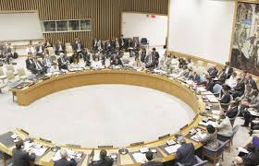
International Recognition of Climate Change as a Security Issue
Make no mistake… climate change not only exacerbates threats to peace and security, it is a threat to international peace and security
Ban Ki-moon, UN Secretary-General
Climate change has very real implications for international peace and security
  Susan Rice (US Ambassador to UN)
Most national security establishments consider global warming as among the biggest security challenges of the century
  Peter Wittig (Permanent Representative of Germany to UN)

Slide 4
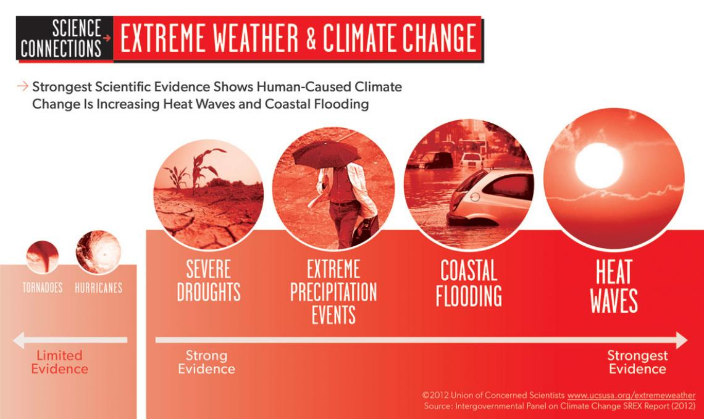
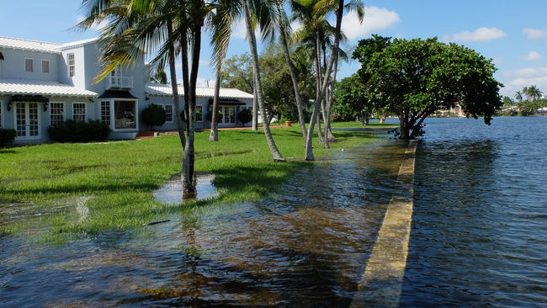
Future Climate Change Impacts
Rising sea levels - storms surges, king tides, coastal inundation, ground water intrusion
Increasing intensity and frequency of extreme weather events – more droughts & floods
Increasing land and sea temperatures
Ocean acidification
Shifting ocean currents
Melting of land ice

Slide 5
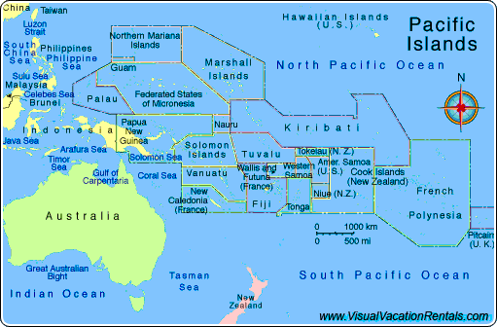
The Challenge for the South Pacific
South Pacific region:
  22 Island Countries & Territories
  200 high islands
  2,500 low islands & atolls
Pop. 2010: 9.9 million (15 million by 2035) 60% rural/40% urban

Slide 6
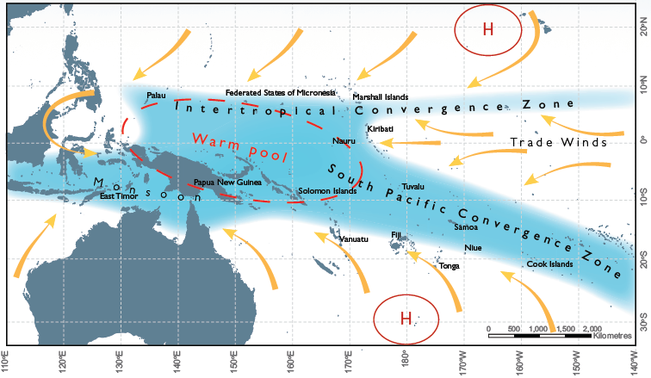
Summary of Regional Climate Change
Temperatures increase
More very hot days
Sea level will continue to rise
Changing rainfall patterns
Ocean acidification continues
Less frequent but more intense tropical cyclones
Potential changes to ocean currents
Source: Climate Change in the Pacific: Scientific Assessment and New Research. Volume 1: Regional Overview. Volume 2: Country Reports. Available from November 2011.
The average positions of the major climate features in November to April. The arrows show near surface winds, the blue shading represents the bands of rainfall convergence zones, the dashed oval shows the West Pacific Warm Pool and H represents typical positions of moving high pressure systems.

Slide 7
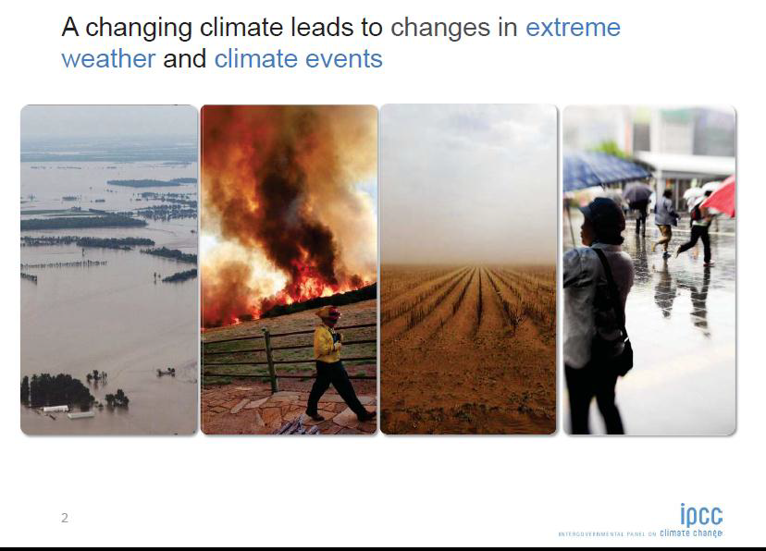
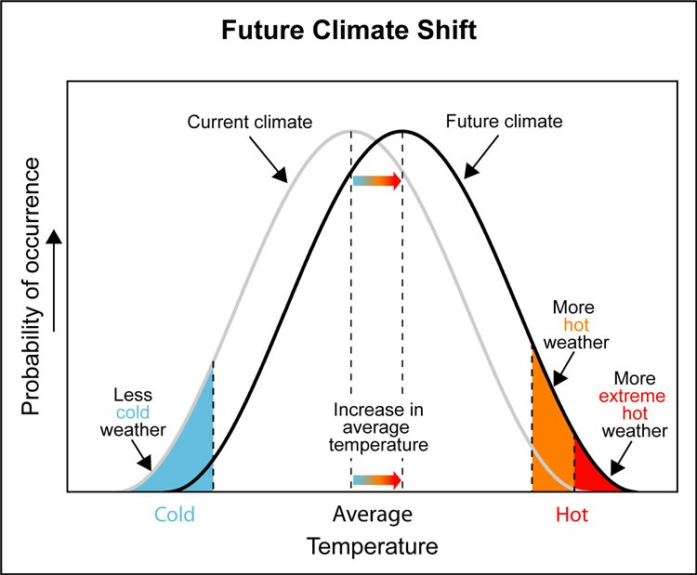
Increase in Local Extremes not just Means
Generally, increasing intensity & frequency of extreme events; floods, droughts, fires, cyclones (not earthquakes)

Slide 8
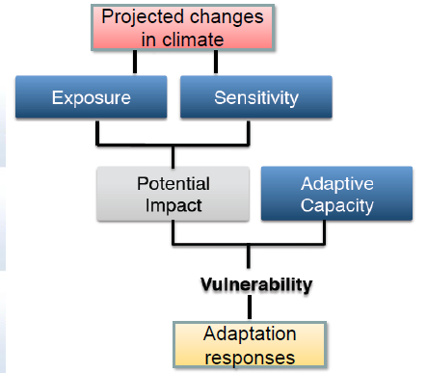
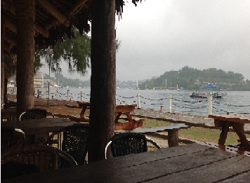
Local Climate Changes
No one lives in a place called “Average”
The question is how will the climate change where you live and work?

Slide 9
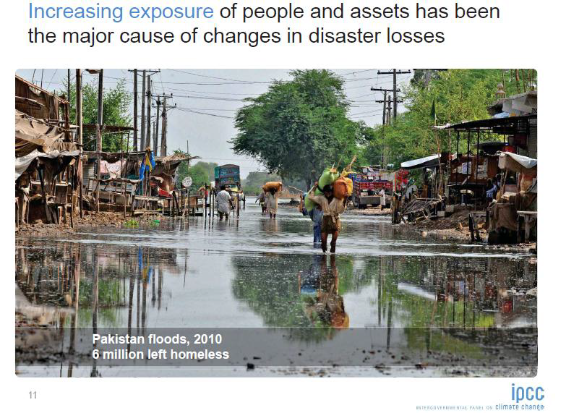
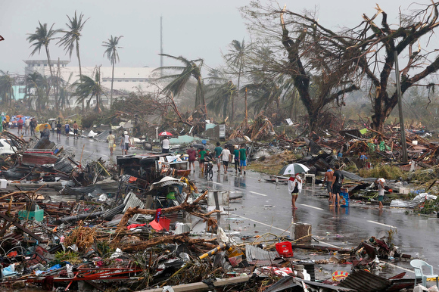
Exposure is a Critical Factor
http://www.crs.org/media-center/typhoon-haiyan-update
Super Typhoon Haiyan’s devastation was directly related to the number of people and the infrastructure in it’s path.
As climate changes new risks will emerge for each island and sub-sections of islands.

Slide 10
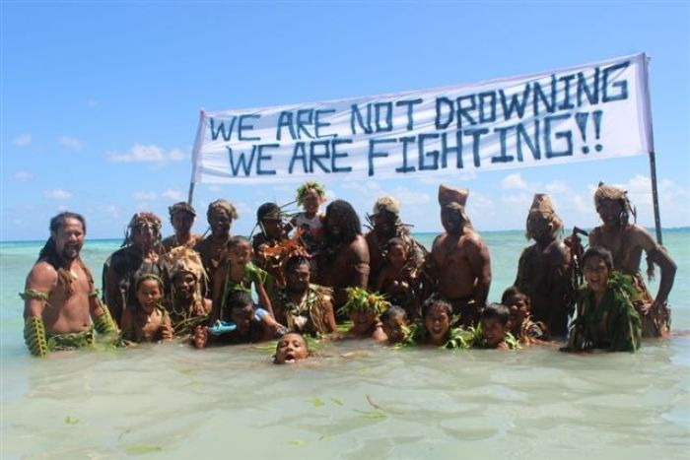
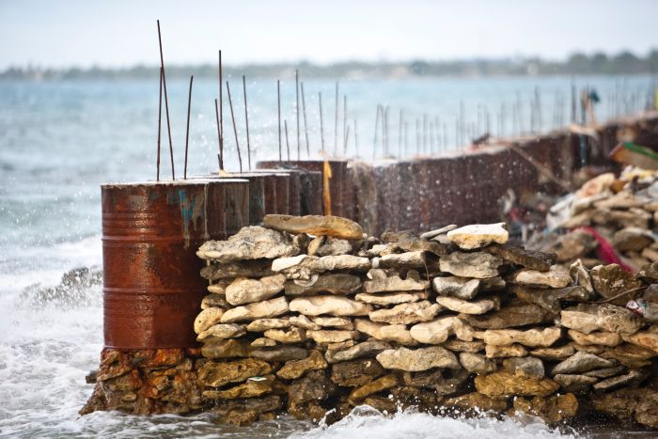
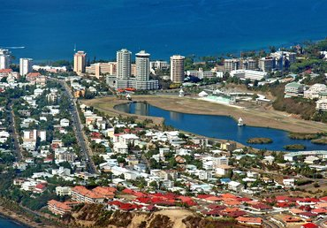
Adaptive Capacity Varies Within/Between Countries
Source: http://www.abc.net.au/news/2013-03-04/pacific-warriors-climate-change-action/4550898
They have long been described as climate refugees: the hundreds of thousands of people living on low-lying Pacific islands who may be forced to migrate if rising sea levels leave their homes uninhabitable.
But it is a term Pacific leaders say is loaded with political connotations and does not reflect the true dimensions of the problem.

Slide 11
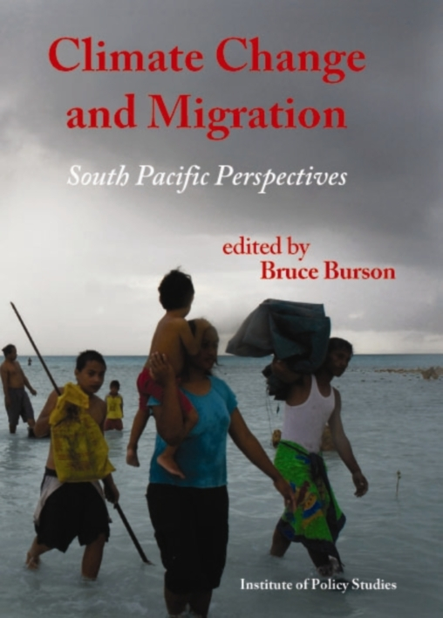
Migration, Displacement & Refugees
A number of dimensions of climate change have the potential – along with non-climatic environmental changes – to influence the drivers of migration
  Internal and trans-boundary migration
  Poses logistical challenges & geo-political challenges
  Trapped populations
  Cities are extremely vulnerable to future environmental change
  Long term interactions critical
Book Access: http://igps.victoria.ac.nz/publications/publications/show/300
Notes:
Climate changed forced migration will generally be an additional forcing to existing pressures (e.g. economic)
Displacements can be short-term or permanent; if short term then present logistic challenges, if permanent they create geopolitical problems
Trends of internal migration to urban areas will be exacerbated

Slide 12
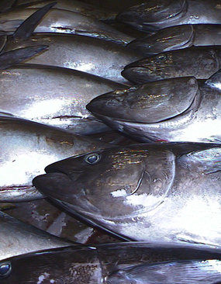
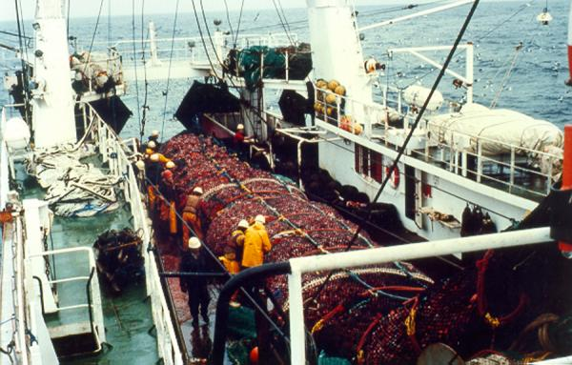
Climate Change Impacts on Fisheries
Changes in the distribution and abundance of tuna
Decline in coastal fisheries and coral reefs
Increases in freshwater fisheries production
Increased operating costs
A range of adaptations can substantially reduce the risks and costs, but they need to be tailored to the circumstances
Planning for change is vital because fish are the single biggest source of animal protein in the Pacific diet.
Another 115,000 tonnes of fish needed to help provide good nutrition for the expanding population of the region by 2030 - an increase of 47%
Source: Vulnerability of Tropical Pacific Fisheries and Aquaculture to Climate Change, published by the Secretariat of the Pacific Community (SPC)

Slide 13
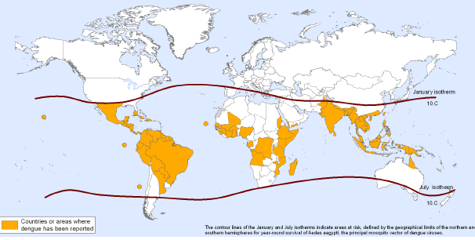
Climate Change Impacts on Vector-Borne Diseases
  VBDs such as malaria, dengue, tick-borne diseases and plague are particularly susceptible for a number of reasons that tend to favour warmer, wetter environments including:
  geographical distribution
  behaviour of vectors and their hosts are intimately associated with environmental determinants
  transmission dynamics
Countries or areas at risk of dengue, 2011.
The disease is currently distributed only in areas in which the temperature remains >10°C year-round.)
Source: Final project report: Strengthen control of vector borne diseases to lessen the impact of climate change in the Western Pacific Region with focus on Cambodia, Mongolia and Papua New Guinea. World Health Organization Western Pacific Region 2012; http://www.wpro.who.int/mvp/climate_change/en/

Slide 14
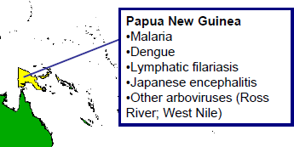
Climate Change Impacts on Vector-Borne Diseases
In recent years, cases of malaria reported at increasingly higher altitudes - the effects of climate change such as increased ambient temperature, rainfall affecting the availability of breeding sites and vector ecology and indirect effects on human behaviour, may be contributory factors
Historically experienced relatively few malaria outbreaks and the population has limited immunity to the disease and less awareness of its prevention than lowland populations.
Source: Final project report: Strengthen control of vector borne diseases to lessen the impact of climate change in the Western Pacific Region with focus on Cambodia, Mongolia and Papua New Guinea. World Health Organization Western Pacific Region 2012; http://www.wpro.who.int/mvp/climate_change/en/

