Slide 1
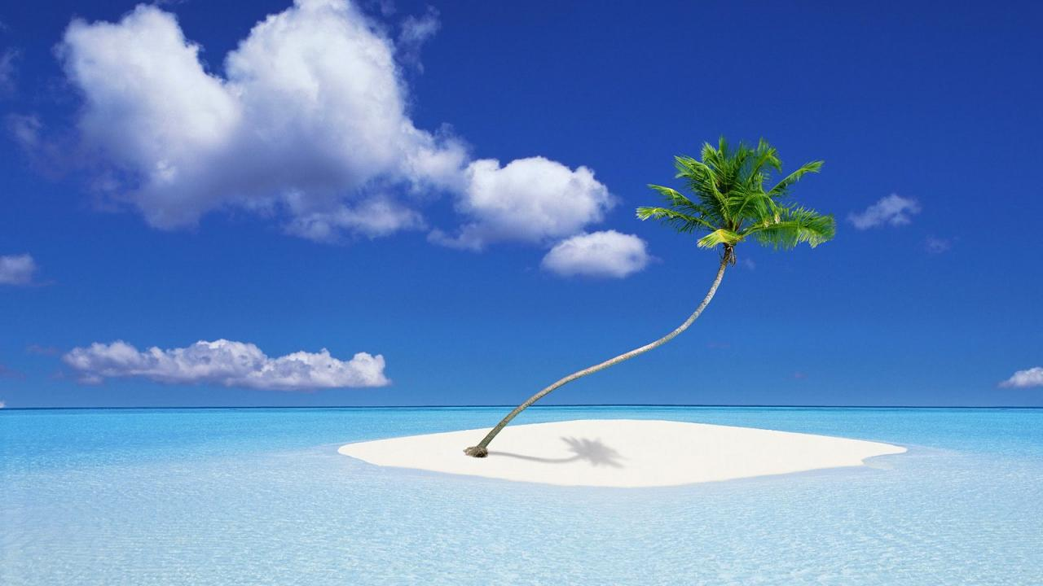
ATMO 102 Pacific Climates and Cultures
ATMO 102 Pacific Climates and Cultures
Lecture: Sea Level Rise

Slide 2

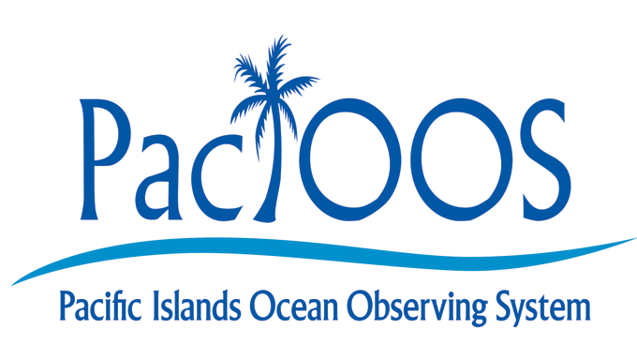
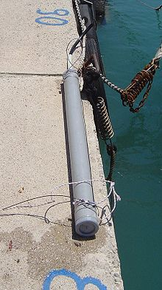
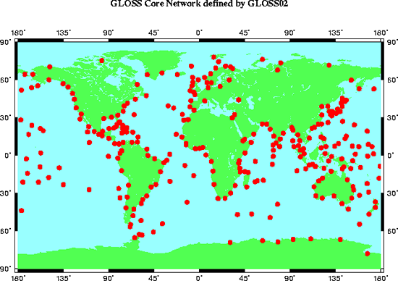
Sea Level Stations
Tide gauge stations all over the world continuously monitor water level
Coastal Wave Buoy Measurements
Notes:
Sea level stations or tide gauges, measure continually monitor the water level in the ocean. There are many sea level stations around the world. Shown on the left is a tide gauge mounted on a dock.

Slide 3
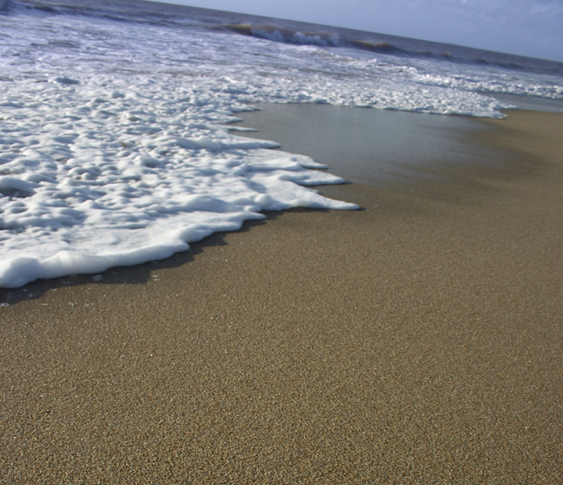
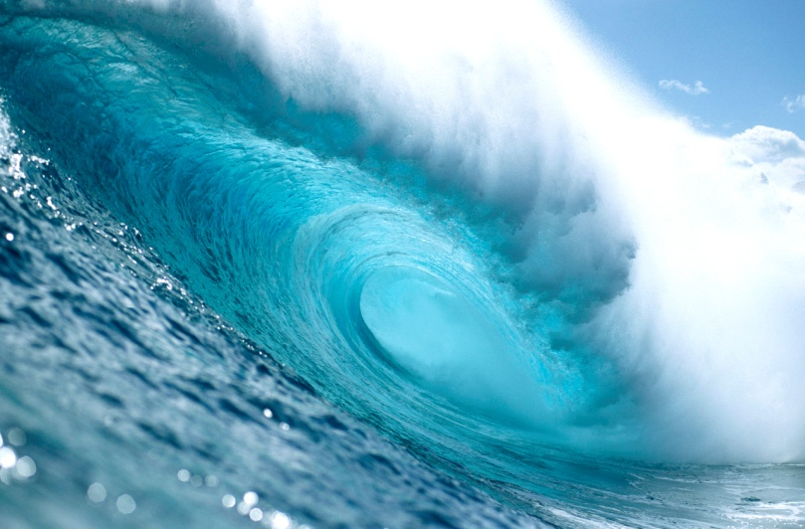
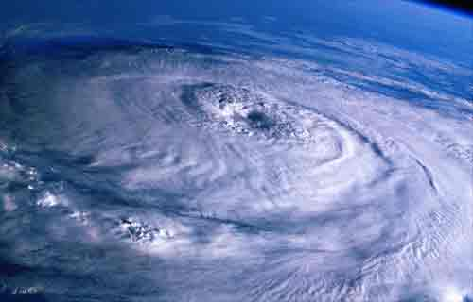
What affects sea level on short time scales?
Tides
  High and Low Tides
  Changes in the future
Weather
  Storms, hurricanes, waves
  Intensity, timing, and amount
El Niño
  Can lower or raise sea level depending on location
  Can change precipitation amount and timing.
Notes:
OK. Now you know why climate change happening and now we want to talk about sea level rise. Before we do that, we need to understand what changes sea level. On timescales of days, weeks or months, the observed sea level is affected by tides, weather events (such as storms, hurricanes, and waves), El Nino (in S. America, this causes warmer water, decreased fishing catches, possible flooding, and potentially higher sea levels; in the western Pacific, this causes decreased rain or even drought and possibly lower sea levels). El Nino is a change in the way the Pacific ocean and the atmosphere interact – this changes weather and climate around the world.

Slide 4
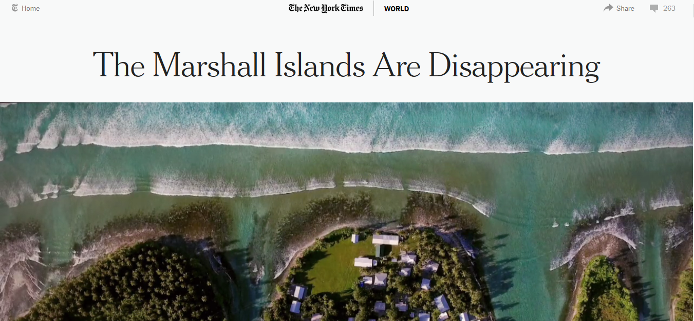
Case Study: Marshall Islands
Article in NY Times Dec 2, 2015
  http://www.nytimes.com/interactive/2015/12/02/world/The-Marshall-Islands-Are-Disappearing.html?_r=0
Notes:
A recent World Bank report states that Kiribati could experience flooding by rising sea waters of up to 80 per cent of the land mass in some areas. The report also warns that Fiji could experience a 100 per cent increase in cyclone damage, an increase in dengue fever cases of between 20 and 30 per cent and a decline in crop yields of up to 15 per cent.

Slide 5
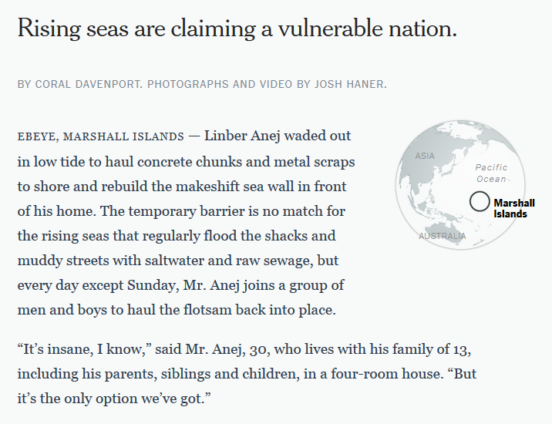
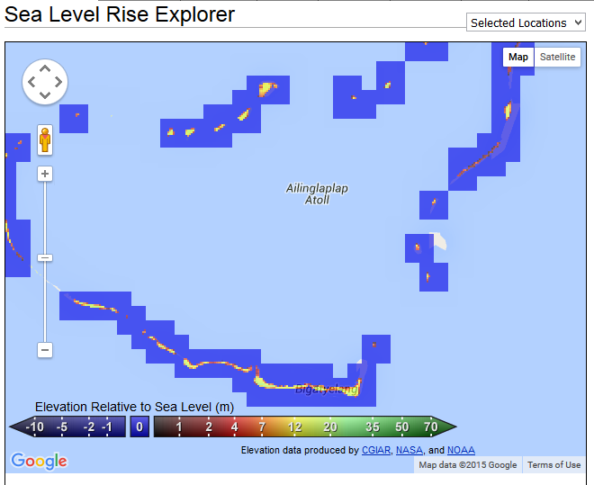
Case Study: Marshall Islands
Notes:
OK. Now you know why climate change happening and now we want to talk about sea level rise. Before we do that, we need to understand what changes sea level. On timescales of days, weeks or months, the observed sea level is affected by tides, weather events (such as storms, hurricanes, and waves), El Nino (in S. America, this causes warmer water, decreased fishing catches, possible flooding, and potentially higher sea levels; in the western Pacific, this causes decreased rain or even drought and possibly lower sea levels). El Nino is a change in the way the Pacific ocean and the atmosphere interact – this changes weather and climate around the world.

Slide 6
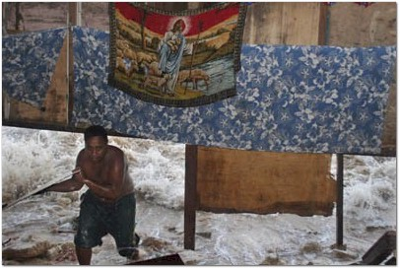
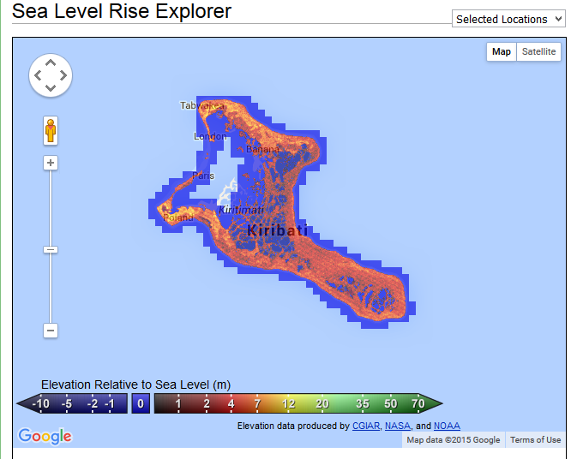
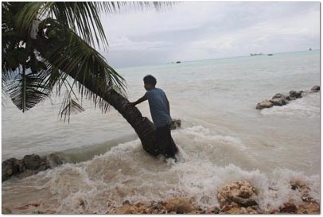
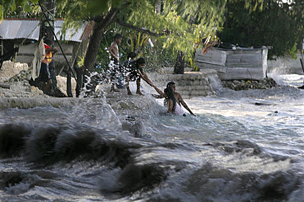
Case Study King Tides in Kiribati
A family climbs to safety when their house is hit by a king tide in Betio, on the South Pacific island of Kiribati, in February, 2005.
King tide is a colloquial term for an especially high tide. "King tide" is not a scientific term, nor is it used in a scientific context.
Waves peaked at 2.87 metres!
Notes:
A recent World Bank report states that Kiribati could experience flooding by rising sea waters of up to 80 per cent of the land mass in some areas. The report also warns that Fiji could experience a 100 per cent increase in cyclone damage, an increase in dengue fever cases of between 20 and 30 per cent and a decline in crop yields of up to 15 per cent.

Slide 7
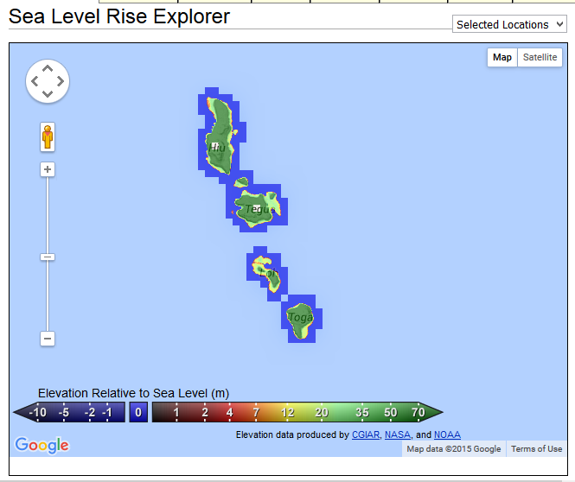
Case Study: Tuvalu
The threat of sea level rise may bring complete disaster to the 11,000 Tuvaluans currently residing on nine extremely low-lying coral atolls with its entire population having to relocate to other countries over the next few decades.
Assistant Secretary for Foreign Affairs in Tuvalu, Paani Laupepa made it clear that “we feel threatened, our whole culture would have to be transplanted”
Already, warmer ocean temperatures are eating away at the coral reefs that form Tuvalu's archipelagic spine.
Tuvaluans themselves point to more tangible indicators of trouble:
  "king tides" that increasingly inundate their homes
  the briny water oozing up into the "grow pits" where they used to cultivate taro and other vegetables.
Notes:
Most of Tuvalu is two metres above sea level with its highest point a mere 4.6 metres above sea level. The threat of sea level rise may bring complete disaster to the 11,000 Tuvaluans currently residing on nine extremely low-lying coral atolls with its entire population having to relocate to other countries over the next few decades. Currently, the population of Tuvalu live by fishing, receiving financial support from Tuvaluan workers overseas and accessing an international trust fund set up in 1987. The increasing sea levels are taking its toll on infrastructure and the remaining population. Assistant Secretary for Foreign Affairs in Tuvalu, Paani Laupepa made it clear that “we feel threatened, our whole culture would have to be transplanted” (http://news.bbc.co.uk/1/hi/sci/tech/1581457.stm). Tuvalu has twice approached the Australian Government for assistance with accepting climate change refugees. So far, the Australian Government has refused assistance. (http://news.bbc.co.uk/1/hi/sci/tech/1581457.stm)

Slide 8
The Case of Tegua, Vanuatu
A small community living in the Pacific island chain of Vanuatu has become one of first to be formally moved as a result of climate change.
The community has been relocated higher into the interior of Tegua Island after their coastal homes were repeatedly swamped by storm surges and waves.
Notes:
Over recent years the increasing rates of flooding have triggered an increasing variety of problems including malaria and skin diseases among children. The one metre high coral reef, the previous line of defence against high tides and waves, is increasingly being swamped. According to Taito Nakalevu, climate change adaptation officer with SPREP, “People are being forced to build sea walls and other defences, not just to defend their homes but to defend agricultural land." Under the project, water tanks able to harvest rainwater, have been supplied and installed in the interior enabling the community to move.

Slide 9
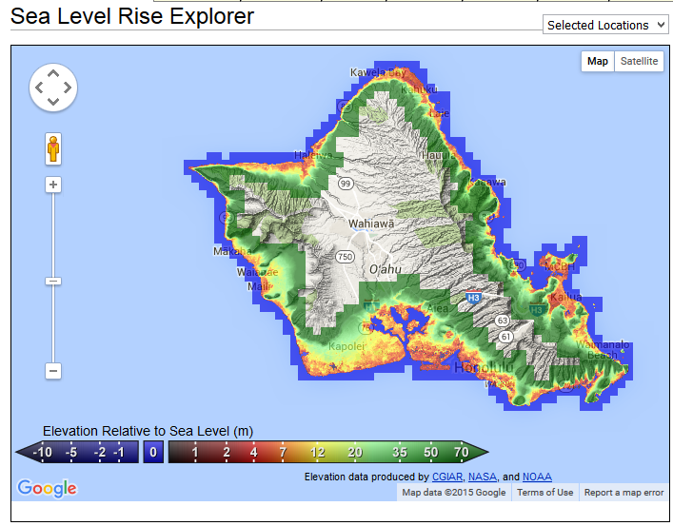
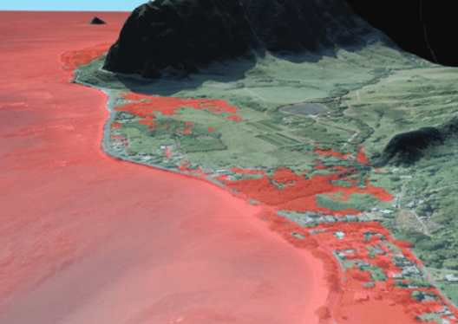
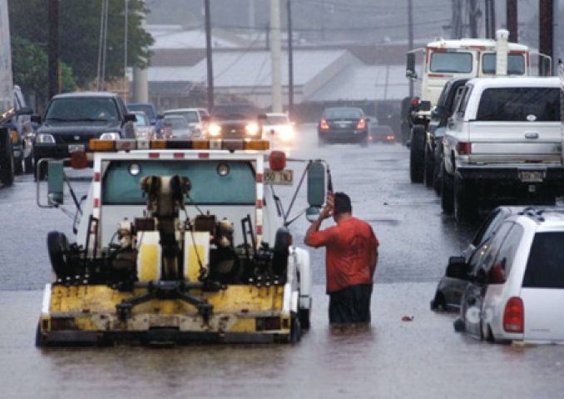
Sea-Level Rise Impacts in Hawai’i
Sea-level rise can intensify the effects of coastal hazards and processes by making areas more vulnerable to:
  Wave inundation
  Hurricanes
  Tsunamis
  More frequent and extreme high water events.
Long-term sea-level rise will exacerbate chronic coastal erosion, flooding, and drainage problems.
Water table levels are closely tied to sea level
  As sea levels rise, groundwater may break through land surface under roads, buildings and houses.
  High water tables also prevent rainwater from filtering into the ground.
  Compounded with high tides, heavy rains, and high surf, high water tables may lead to large-scale inundation of low-lying areas and roads.
As sea levels rise and shorelines erode, coastal land may be permanently lost
Notes:
Citizens on the Carteret Islands in Papua New Guinea are also currently being moved because of concerns for sea-level rise.
The Carteret's are six small islands that surround an atoll about 25 kilometres wide. The islands are approximately one metre above high tide and made of sand.
The community’s health has been affected as they lose access to fresh water, and advancing salt-water is destroying gardens.
According to a community spokesperson “We are frustrated, and we are angry at the same time. We are victims of something that we are not responsible for. We believe that these islands are ours, and that our future generations should not go away from these islands. I think it’s about time these industrialised countries realised that these island countries in the Pacific are taking the toll. We are bearing the brunt of all these gas emissions.”
It would be a sad irony if a community like the Carteret's, with a carbon footprint amongst the lowest in the world, were to be the first to have to abandon their islands because of rising seas attributable to emissions from nations elsewhere.

Slide 10
Vulnerable Areas on Oahu
Red means more likely to see an impact from rising seas!!
Notice that the majority of the coastline, Honolulu, and the Airport are red.
Remember it’s not just the sea level rise that’s important you need to consider the tides, wave heights, storm surges, etc.
http://www.globalwarmingart.com/wiki/Special:SeaLevel
Notes:
Citizens on the Carteret Islands in Papua New Guinea are also currently being moved because of concerns for sea-level rise.
The Carteret's are six small islands that surround an atoll about 25 kilometres wide. The islands are approximately one metre above high tide and made of sand.
The community’s health has been affected as they lose access to fresh water, and advancing salt-water is destroying gardens.
According to a community spokesperson “We are frustrated, and we are angry at the same time. We are victims of something that we are not responsible for. We believe that these islands are ours, and that our future generations should not go away from these islands. I think it’s about time these industrialised countries realised that these island countries in the Pacific are taking the toll. We are bearing the brunt of all these gas emissions.”
It would be a sad irony if a community like the Carteret's, with a carbon footprint amongst the lowest in the world, were to be the first to have to abandon their islands because of rising seas attributable to emissions from nations elsewhere.

Slide 11
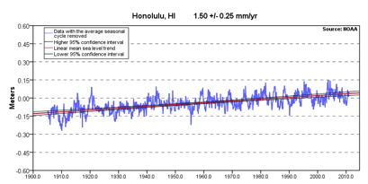
Honolulu – Sea Level 1900-2010
This equates to about 6 inches of sea level rise over the last 100 years.
Notes:
Citizens on the Carteret Islands in Papua New Guinea are also currently being moved because of concerns for sea-level rise.
The Carteret's are six small islands that surround an atoll about 25 kilometres wide. The islands are approximately one metre above high tide and made of sand.
The community’s health has been affected as they lose access to fresh water, and advancing salt-water is destroying gardens.
According to a community spokesperson “We are frustrated, and we are angry at the same time. We are victims of something that we are not responsible for. We believe that these islands are ours, and that our future generations should not go away from these islands. I think it’s about time these industrialised countries realised that these island countries in the Pacific are taking the toll. We are bearing the brunt of all these gas emissions.”
It would be a sad irony if a community like the Carteret's, with a carbon footprint amongst the lowest in the world, were to be the first to have to abandon their islands because of rising seas attributable to emissions from nations elsewhere.

Slide 12
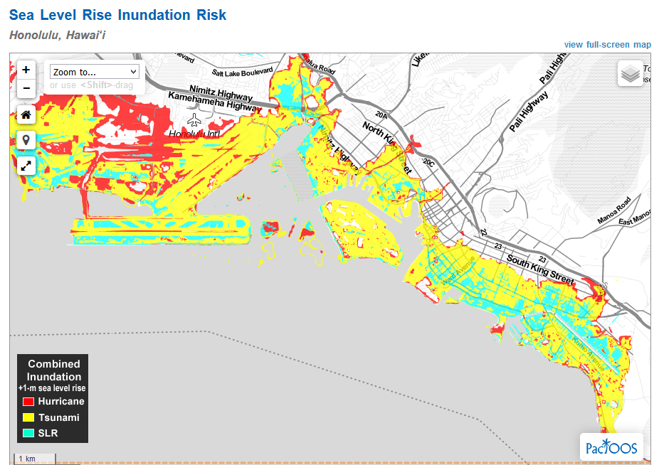
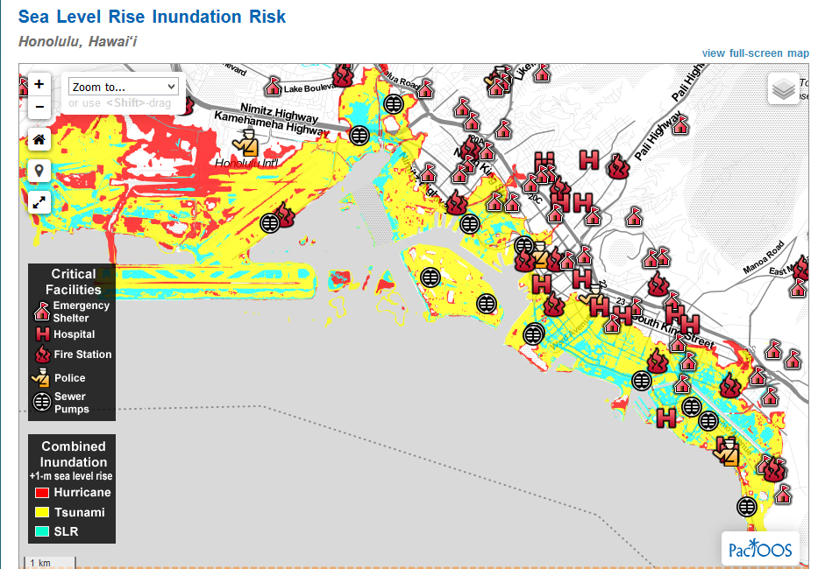
http://oos.soest.hawaii.edu/pacioos/projects/slr/
http://www.soest.hawaii.edu/coasts/sealevel/3ftHonoluluTour.html
Video Fly-through of Honolulu with a 3 foot sea level rise.
Notes:
Citizens on the Carteret Islands in Papua New Guinea are also currently being moved because of concerns for sea-level rise.
The Carteret's are six small islands that surround an atoll about 25 kilometres wide. The islands are approximately one metre above high tide and made of sand.
The community’s health has been affected as they lose access to fresh water, and advancing salt-water is destroying gardens.
According to a community spokesperson “We are frustrated, and we are angry at the same time. We are victims of something that we are not responsible for. We believe that these islands are ours, and that our future generations should not go away from these islands. I think it’s about time these industrialised countries realised that these island countries in the Pacific are taking the toll. We are bearing the brunt of all these gas emissions.”
It would be a sad irony if a community like the Carteret's, with a carbon footprint amongst the lowest in the world, were to be the first to have to abandon their islands because of rising seas attributable to emissions from nations elsewhere.

Slide 13
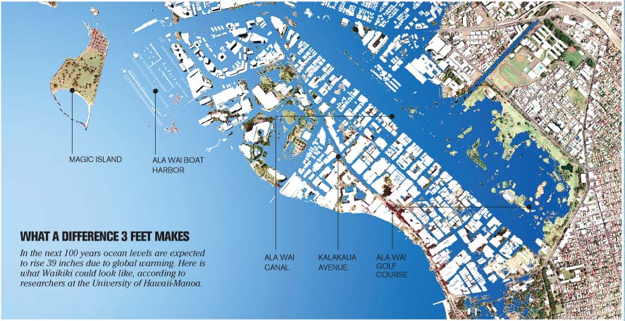
Honolulu – 3 Feet Rise in Sea Level
Notes:
Citizens on the Carteret Islands in Papua New Guinea are also currently being moved because of concerns for sea-level rise.
The Carteret's are six small islands that surround an atoll about 25 kilometres wide. The islands are approximately one metre above high tide and made of sand.
The community’s health has been affected as they lose access to fresh water, and advancing salt-water is destroying gardens.
According to a community spokesperson “We are frustrated, and we are angry at the same time. We are victims of something that we are not responsible for. We believe that these islands are ours, and that our future generations should not go away from these islands. I think it’s about time these industrialised countries realised that these island countries in the Pacific are taking the toll. We are bearing the brunt of all these gas emissions.”
It would be a sad irony if a community like the Carteret's, with a carbon footprint amongst the lowest in the world, were to be the first to have to abandon their islands because of rising seas attributable to emissions from nations elsewhere.

Slide 14
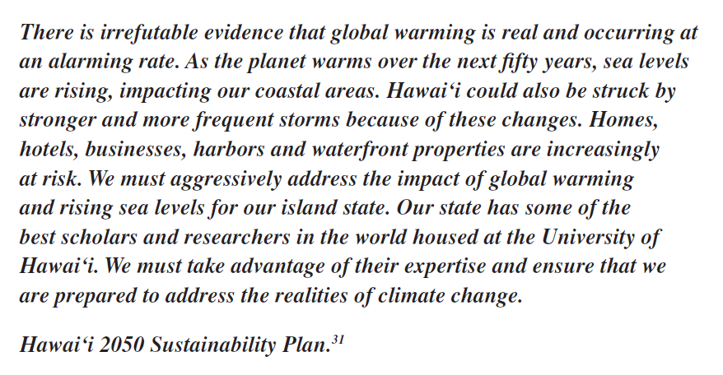
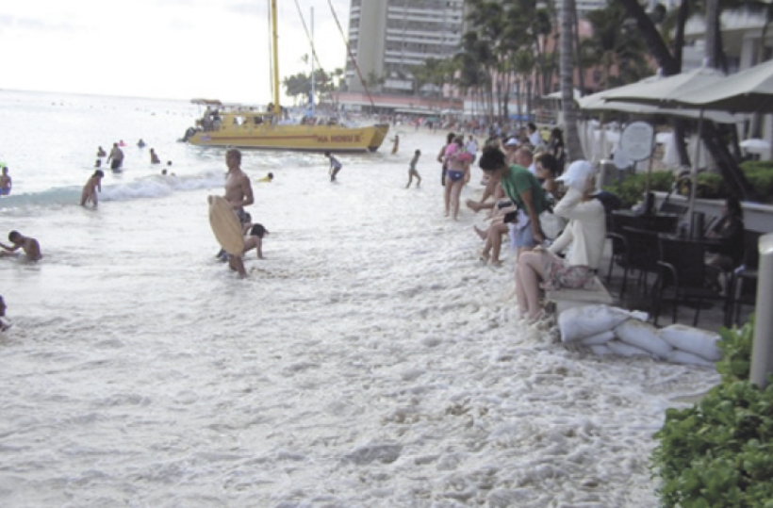
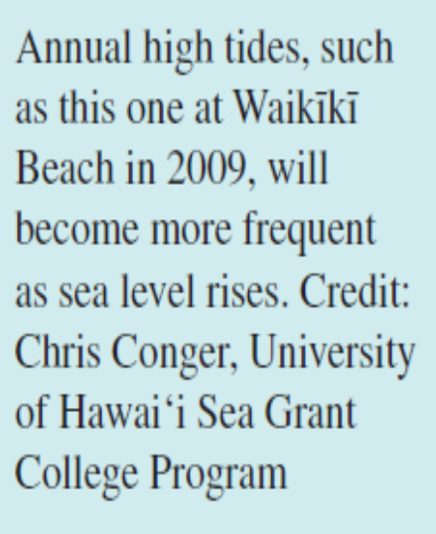
Sea-Level Rise Adaptation in the Future?
Three basic approaches to sea-level rise adaptation have been identified:
  Accomodation – Adjustment of an existing system to changing natural conditions (e.g., strengthening flood-proofing regulations or expanding hazard zones).
  Protection – Hardening of a system in its existing location to withstand impacts from changing conditions (e.g., shoreline hardening such as seawalls and revetments).
  Retreat – Relocating existing structures to avoid impacts.
Notes:
Citizens on the Carteret Islands in Papua New Guinea are also currently being moved because of concerns for sea-level rise.
The Carteret's are six small islands that surround an atoll about 25 kilometres wide. The islands are approximately one metre above high tide and made of sand.
The community’s health has been affected as they lose access to fresh water, and advancing salt-water is destroying gardens.
According to a community spokesperson “We are frustrated, and we are angry at the same time. We are victims of something that we are not responsible for. We believe that these islands are ours, and that our future generations should not go away from these islands. I think it’s about time these industrialised countries realised that these island countries in the Pacific are taking the toll. We are bearing the brunt of all these gas emissions.”
It would be a sad irony if a community like the Carteret's, with a carbon footprint amongst the lowest in the world, were to be the first to have to abandon their islands because of rising seas attributable to emissions from nations elsewhere.

Slide 15
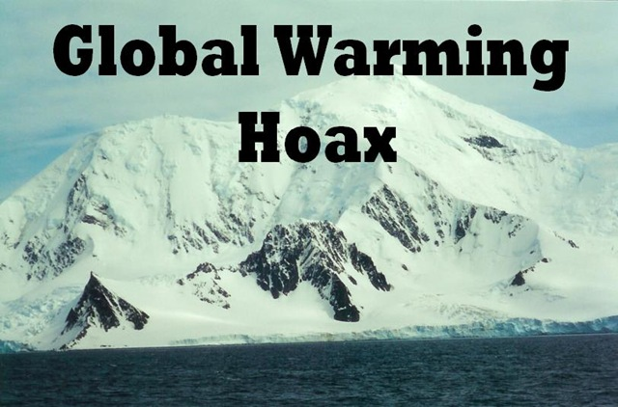
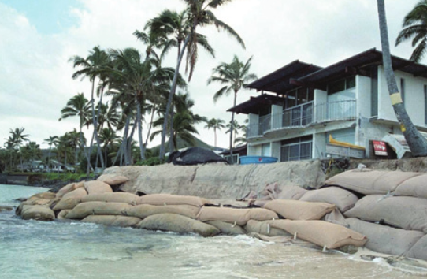
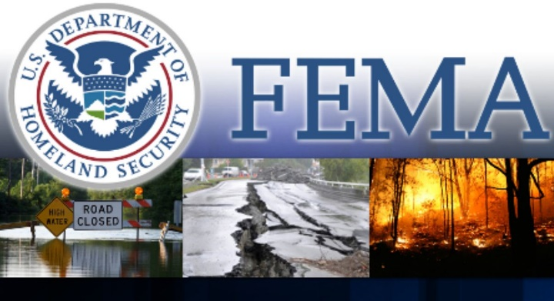
Challenges to Adaptation and Implementation
Four major obstacles to long-term sea-level rise adaptation planning:
  Government and public resistance – Resistance to acknowledging sea-level rise (i.e., skepticism concerning human-caused climate change)
  Limited effectiveness of resource management – to address a “slowly emerging disaster” (e.g., overlapping state and county regulatory jurisdictions, irregularities in the law, and political resistance and legal challenges
  Environmental and social justice concerns – equitable allocation of protection measures for varying degrees and types of shoreline development
  Government incentives – these can shield property owners from the risks of their decisions (e.g., FEMA policies and flood insurance programs that incentivize rebuilding in vulnerable areas.
Notes:
Citizens on the Carteret Islands in Papua New Guinea are also currently being moved because of concerns for sea-level rise.
The Carteret's are six small islands that surround an atoll about 25 kilometres wide. The islands are approximately one metre above high tide and made of sand.
The community’s health has been affected as they lose access to fresh water, and advancing salt-water is destroying gardens.
According to a community spokesperson “We are frustrated, and we are angry at the same time. We are victims of something that we are not responsible for. We believe that these islands are ours, and that our future generations should not go away from these islands. I think it’s about time these industrialised countries realised that these island countries in the Pacific are taking the toll. We are bearing the brunt of all these gas emissions.”
It would be a sad irony if a community like the Carteret's, with a carbon footprint amongst the lowest in the world, were to be the first to have to abandon their islands because of rising seas attributable to emissions from nations elsewhere.

