Slide 1
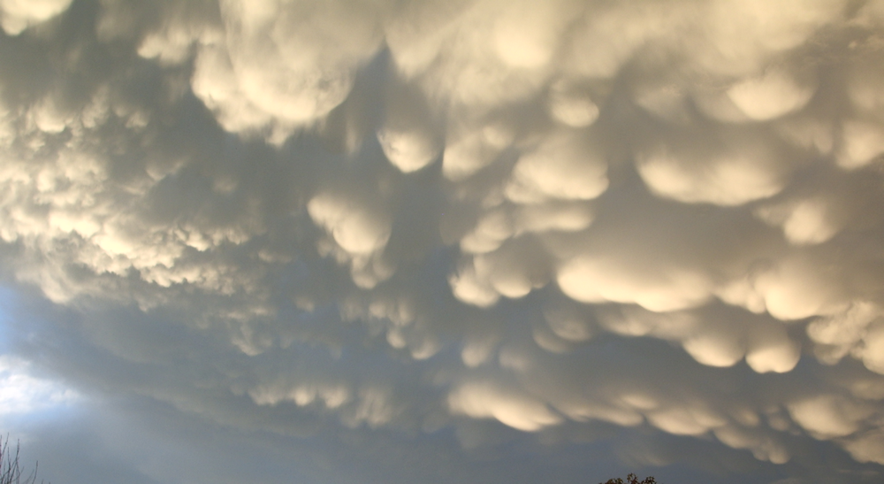
ATMO 102 Pacific Climates and Cultures
Lecture 6: Precipitation Processes

Slide 2

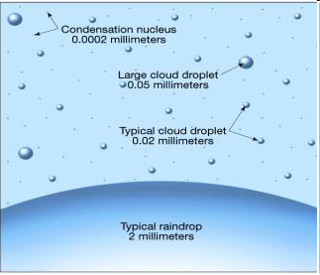
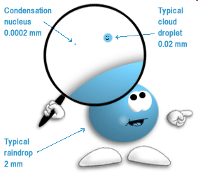
How Precipitation Forms
It’s actually really hard to make a rain drop
  Cloud drops are VERY TINY (0.02 mm)
  Rain drops are VERY BIG (2 mm)
  There has to be a mechanism for cloud drops to join together to form rain droplets.
    100 times larger in diameter…. but it’s more than that…. it’s VOLUME!!!

Slide 3
Cloud droplet (D_{p}= 10um, V = 5.2x10² um³)
Cloud Drop
It takes 1 MILLION cloud droplets
to make 1 rain drop!!

Slide 4
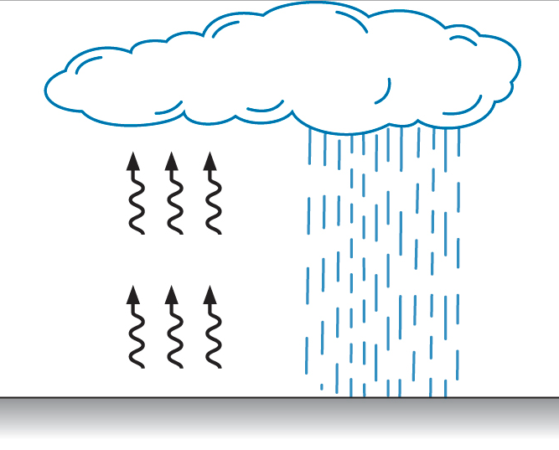
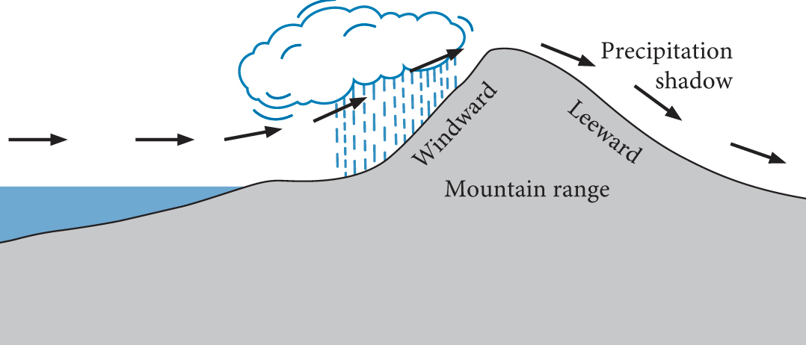
Precipitation Types
Precipitation as a result of local heating of air at the earth’s surface is called convective precipitation
Active in tropical areas and interiors of continents
Precipitation is often local and intense (thunderstorms)
When horizontal air currents are forced to rise over natural barriers such as mountains, orographic precipitation occurs
Precipitation falls on the windward side
Leeward side is the other side which is a precipitation shadow area

Slide 5
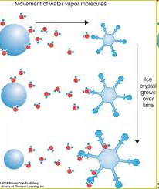
Precipitation in Cold Clouds
Ice, water and water vapor exist at the same time.
Cloud drops DON’T FREEZE at 0C!!
Liquid water won’t freeze until -40C
  SUPERCOOLED
Supercooled water freezes when it touches a Freezing Nuclei
  FN are rare

Slide 6
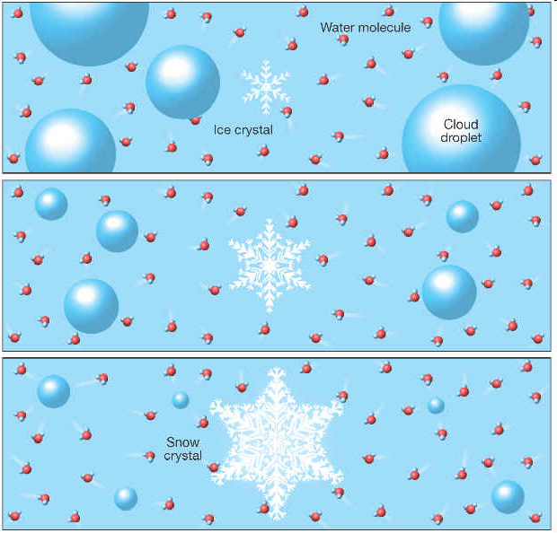
The Bergeron Process
One little ice crystal and lots of water droplets
Grows Bigger by “Stealing” moisture from the Cloud droplets

Slide 7
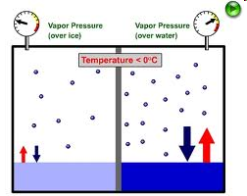
Precipitation in Cold Clouds
Saturation vapor pressure above ice crystals is somewhat lower than above supercooled liquid droplets
  It’s easier for water vapor to escape from the supercooled liquid

Slide 8
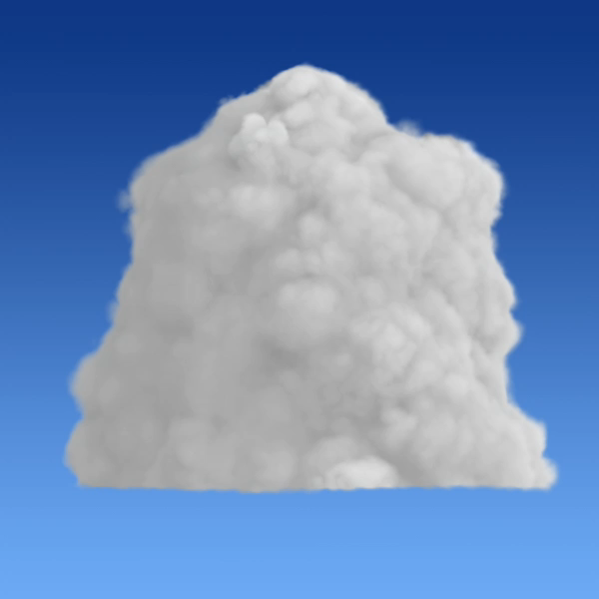
Bergeron Process
Eventually the ice crystals will grow large enough to fall.
The Bergeron Process often results in liquid precipitation.
  As the crystals grow and fall, they pass through the base of the cloud, which may be above freezing.
  This causes the crystals to melt and fall as rain.

Slide 9
The Bergeron Process
Summary - 1
The air reaches saturation and some of the resulting droplets will come in contact with freezing nuclei (assuming they have reached the activation temperature).
There is then a combination of ice crystals and supercooled water droplets.
From the perspective of the supercooled droplets, the air is in equilibrium at saturation, but from the perspective of the ice crystals, the air is supersaturated.

Slide 10
The Bergeron Process
Summary - 2
Therefore, water vapor will sublimate on the ice crystals. Since the amount of water vapor in the air has decreased, and from the perspective of the supercooled water droplet, the air is subsaturated, the supercooled water will evaporate until the air once again reaches saturation.
The process then continues. In short summary, the ice crystal grows through sublimation at the expense of the supercooled water droplet.

Slide 11
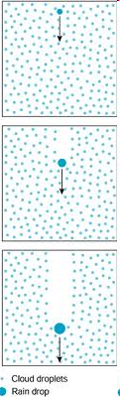
Precipitation in Warm Clouds
In warm clouds there are no Ice Crystals so the Bergeron Process can’t operate
Collision-Coalescence a.k.a. Bump and Stick
Need one BIGGER than average Cloud Drop
  Really large aerosol (CCN) → Start Big…. End Big
  Entrainment Mixing (evaporation and redistribution)
  Turbulence (smashing together of droplets)

Slide 12
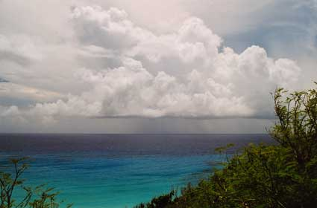
Collision-Coalescence
Terminal Velocity matters
  the highest velocity attainable by an object as it falls through the air.
  Sum of the drag force and buoyancy equals the downward force of gravity.
  If cloud drops were all the same size could they bump into each other?
    NO
Large Cloud Drop (55 um)
Small Drop (100 um)
Cloud Drop (10 um)
Rain Drop (1000 um)
BIG drops fall FASTER than SMALL drops!!!!

Slide 13
Precipitation Summary
Warm cloud
Cold cloud
Water vapor
Water vapor
EVAPORATION
CONDENSATION
EVAPORATION
SUBLIMATION
Supercooled
water droplets
Ice crystals
Large and heavy
enough to fall ?
Water
droplets
Large and heavy
enough to fall ?
YES
CONDENSATION
YES
CONDENSATION
SUBLIMATION
Water vapor
SNOW
RAIN
Water vapor

Slide 14
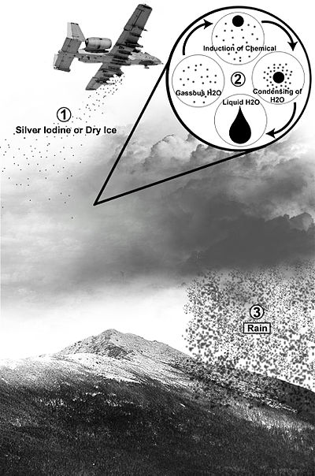
Cloud Seeding and Precipitation
Weather Modification is Termed “WX-Mod”
“Fake Ice” to simulate the Bergeron Process
  Dry Ice or Silver Iodide
Hard to “prove” that it actually worked.
Need the right ratio of cloud droplets to ice crystals.
Concern over toxicity of silver iodide.
You can “overseed” a cloud and too many ice crystals are formed so it doesn’t rain
  You can also “overseed” cold fog with dry ice to dissipate it.

Slide 15
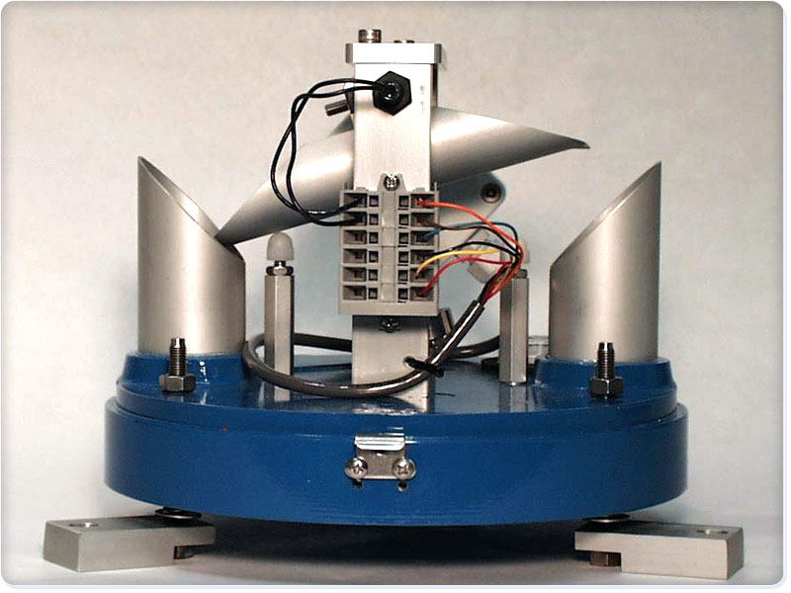
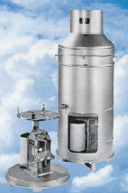
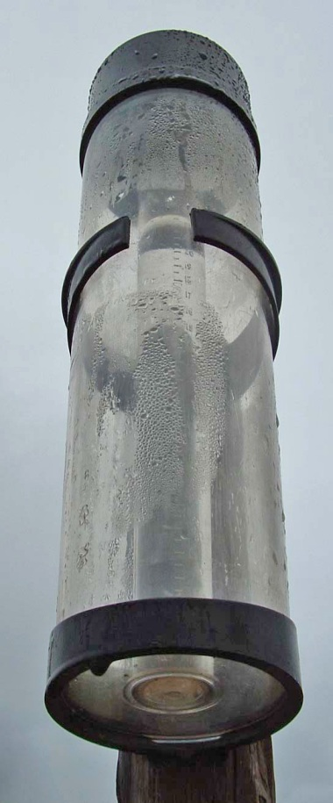
A rain gauge (also known as an udometer, pluviometer, ombrometer ) is a type of instrument used by meteorologists and hydrologists to gather and measure the amount of liquid precipitation over a set period of time.
Precipitation
Measurement
The standard NWS rain gauge, developed around the start of the 20th century, consists of a funnel emptying into a graduated cylinder, 2 cm in diameter, that fits inside a larger container which is 20 cm in diameter and 50 cm tall.
The tipping bucket rain gauge consists of a funnel that collects and channels the precipitation into a small seesaw-like container. After a pre-set amount of precipitation falls, the lever tips, dumping the collected water and sending an electrical signal.
A weighing-type precipitation gauge consists of a storage bin, which is weighed to record the mass.

