Slide 1
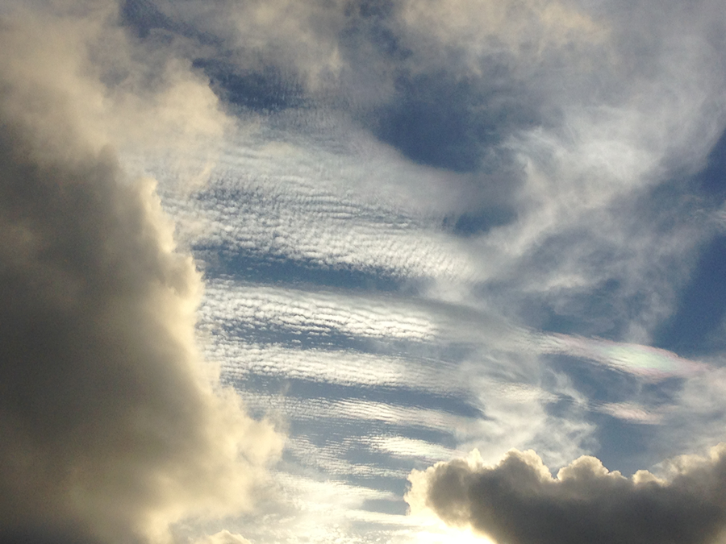
ATMO 102 Pacific Climates and Cultures
ATMO 102 Pacific Climates and Cultures
Lecture 9: Pressure and Wind

Slide 2

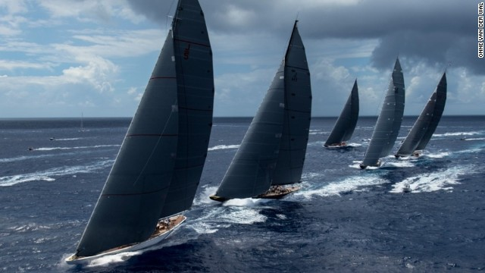

Pressure and Wind
AIR PRESSURE
  is the pressure exerted by the weight of the air above.
Horizontal differences in pressure causes winds
Horizontal differences in pressure are caused by differences in heating
Winds flow from regions of high pressure to regions of low pressure
Horizontal differences in P lead to the PRESSURE GRADIENT FORCE

Slide 3

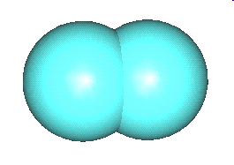

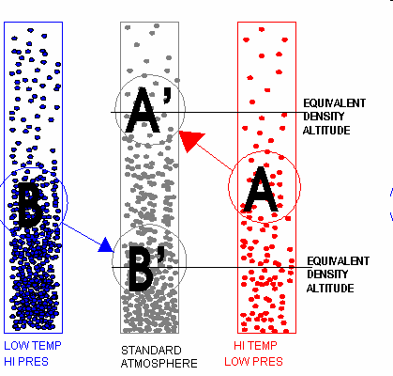

Influence of Temperature and Water Vapor
(A) Warm Air
  Fast moving molecules
  Typically less dense
  LOW PRESSURE
(B) Cold Air
  Slow moving molecules
  Typically more dense
  HIGH PRESSURE
The addition of water vapor actually makes air LIGHTER (less Dense)!!!!
Molecular weights of N₂ (14) and O₂ (16) are greater than H₂O (10)
If you “substitute” some of the N₂ and O₂ with H₂0 the overall weight of air will be less!
N₂: 7 * 14 = 98
O₂: 3 * 16 =48
Total = 146
N₂: 4 * 14 = 56
O₂: 2 * 16 =32
H₂O: 5 * 10 = 50
Total = 138

Slide 4
Influence of Temperature and Water Vapor
SUMMARY
  Cold, dry air masses produce High Surface Pressures
  Cold, humid air masses are less “high” than cold, dry
  Warm, dry air masses are less “low” than warm, humid
  Warm, humid air masses produce Low Surface Pressures
HIGH PRESSURE
LOW PRESSURE

Slide 5
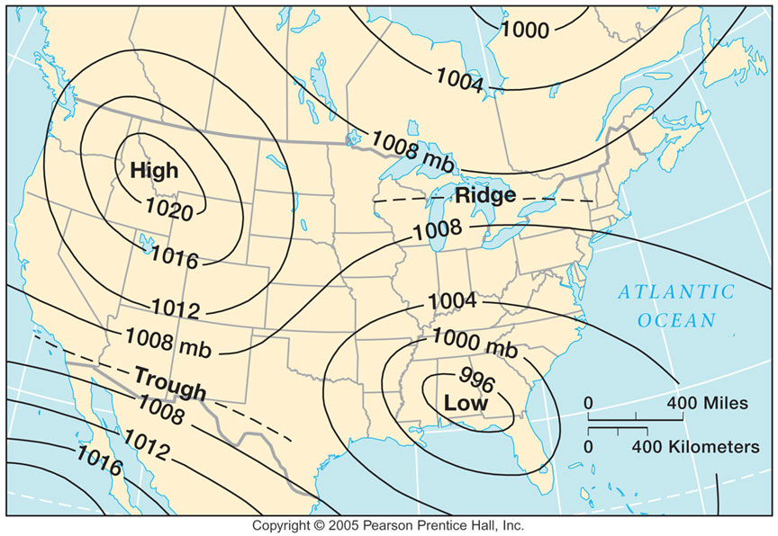
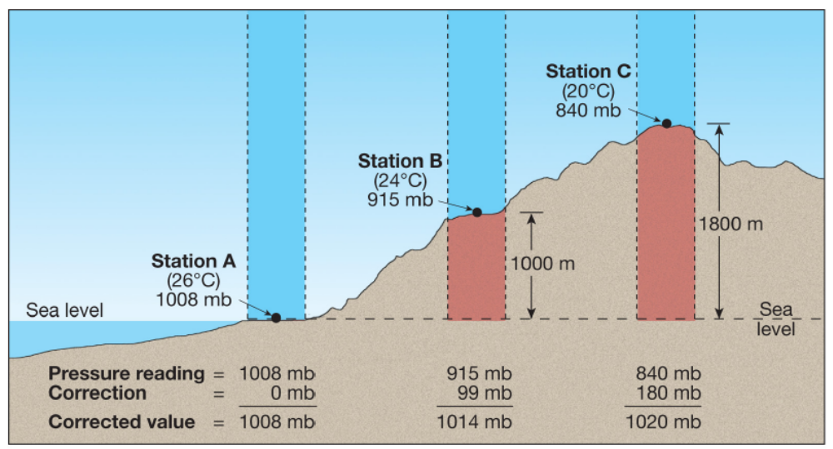
Isobars – A Map View of Pressure
Contours (lines or curves) of constant PRESSURE
They are corrected for altitude to equivalent Sea Level Pressure (SLP)

Slide 6
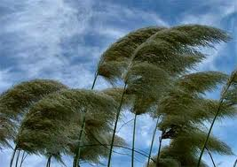
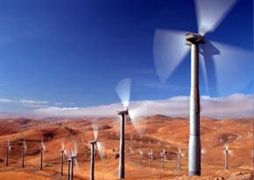
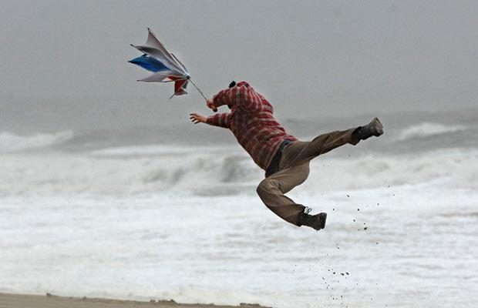
What is Wind?
Wind is nature’s attempt at balancing inequalities in pressure
  Unequal heating of the Earth’s surface generates these inequalities.
  Solar radiation is the ultimate source of energy for Wind
Wind is the result of horizontal differences in air pressure!
Air flows from areas of HIGH pressure to areas of LOW pressure
HIGH
LOW

Slide 7
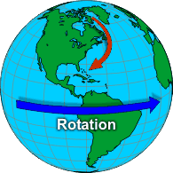
Factors Affecting Winds
If the Earth did NOT rotate and if there was NO friction wind would flow in a straight line from High to Low pressure
Main forces that affect wind
  Pressure Gradient Force
  Coriolis Force
  Centripetal force
  Friction
  Gravity

Slide 8
Pressure Gradient Force
Horizontal Pressure Differences (HPD)
Winds flow from High pressure to Low pressure if only affected by HPD
Higher P at surface
Lower P at surface
500 mb
500 mb
700 mb
700 mb
Sea Breeze
1000 mb
1000 mb
COOL
WARM Nighttime

Slide 9
Pressure Gradient Force – HPD
STRONGER when isobars are closer together
Same CHANGE in Pressure (ΔP)
When given Pressure Heights, the PGF points from regions of High Pressure to regions of Low Pressure
ΔP
ΔP
T = 20
T = 30
T = 20
T = 30
SMALL DISTANCE
LARGE DISTANCE

Slide 10
Isobars & PGF – More
Winds if we ONLY knew the PGF.
WIND
IS
SLOW
WIND
IS
FAST
If the isobars are further or closer together…
1004 mb
992 mb
996 mb
1008 mb
1000 mb
1012 mb
1004 mb
1008 mb
1016 mb
1012 mb
For a conical hill, the PGF points in all direction
1016 mb
1020 mb
1020 mb
PGF
PGF
Change in P over large distance:
SMALL PGF
Change in P over small distance:
LARGE PGF

Slide 11
PGF Summary
Change in P over large distance = small PGF
Change in P over small distance = large PGF
PGF is at right angles to isobars
Causes wind to START MOVING
  However… two forces cause wind speed and direction to be different than predicted by the PGF
    Coriolis (rotation of the Earth)
    Friction

Slide 12
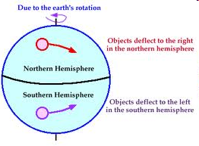
Coriolis Force
Results from the rotation of the Earth
Causes the PGF to cross isobars NOT at right angles.
Winds curve to the RIGHT in the Northern Hemisphere
Winds curve to the LEFT in the Southern Hemisphere

Slide 13
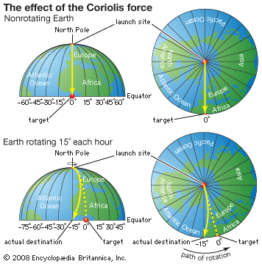
Coriolis Example
On a non-rotating Earth, the rocket would travel straight to it’s target.
Earth rotates 15 deg per hour….
Even though the rock travels in STRAIGHT line, when we plot it’s path on the surface it follows a path that CURVES to the RIGHT!

Slide 14
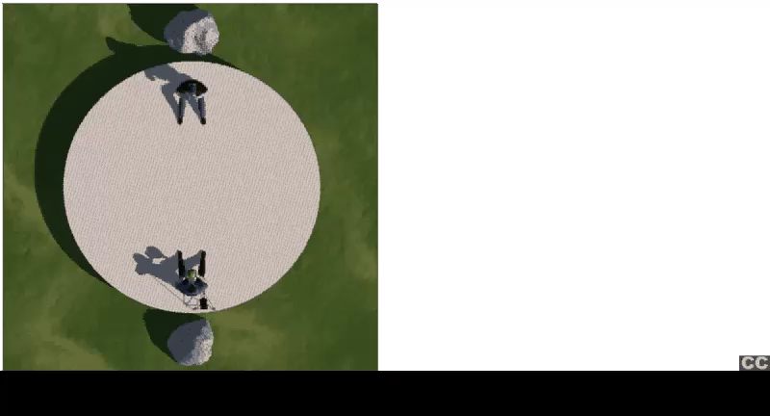
Coriolis Visualization

Slide 15
Coriolis Summary
Always Deflects a moving body (wind) to the right in the Northern Hemisphere
Only affects wind direction, not speed
Is affected by wind speed (the stronger the wind, the greater the deflecting force)
Is strongest at the poles and nonexistent at the equator… latitude dependent
These two determine the MAGNITUDE of the Coriolis Force

Slide 16
Winds Aloft and Geostrophic Flow
Where friction doesn’t play a role!!
When only the PGF and Coriolis Forces (F_{c}) affect an air parcel
1000 mb
F_{c}
F_{c}
1004 mb
F_{c}
1008mb
WIND
1012 mb
F_{c}
1016 mb
1020 mb
Direction of MOTION!
PGF

Slide 17
Winds Aloft & Geostrophic Flow
An air parcel is at equilibrium only if PGF acts in the opposite direction to the Coriolis force (no net force).
Therefore in Geostrophic Flow, winds run parallel to isobars in a straight path
WIND
PGF
900 mb
904 mb
Direction of MOTION!
908 mb
Coriolis, F_{c}
912 mb

Slide 18
Curved Flow and Gradient Wind
Gradient Wind – winds that follow curved paths around high and low pressure cells.
Speed of the wind depends on how close the isobars are
Northern Hemisphere!
H
L
PGF
Coriolis
Wind

Slide 19
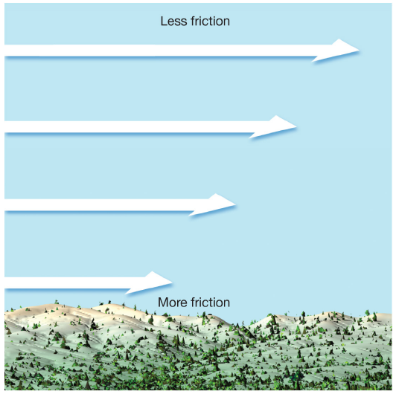
Friction
Applied to wind within 1 to 1.5 km of the surface
Friction ALWAYS acts in the direction OPPOSITE the direction of motion!!!!
Friction affects air at the surface more than air aloft.

Slide 20
Adding Friction to PGF and Coriolis
Geostrophic Flow and Friction
  Causes parcel to slow down
  Coriolis decreases in strength
Friction causes wind to lean towards the direction of the PGF
PGF
Direction of MOTION!
Friction
Coriolis, F_{c}

Slide 21
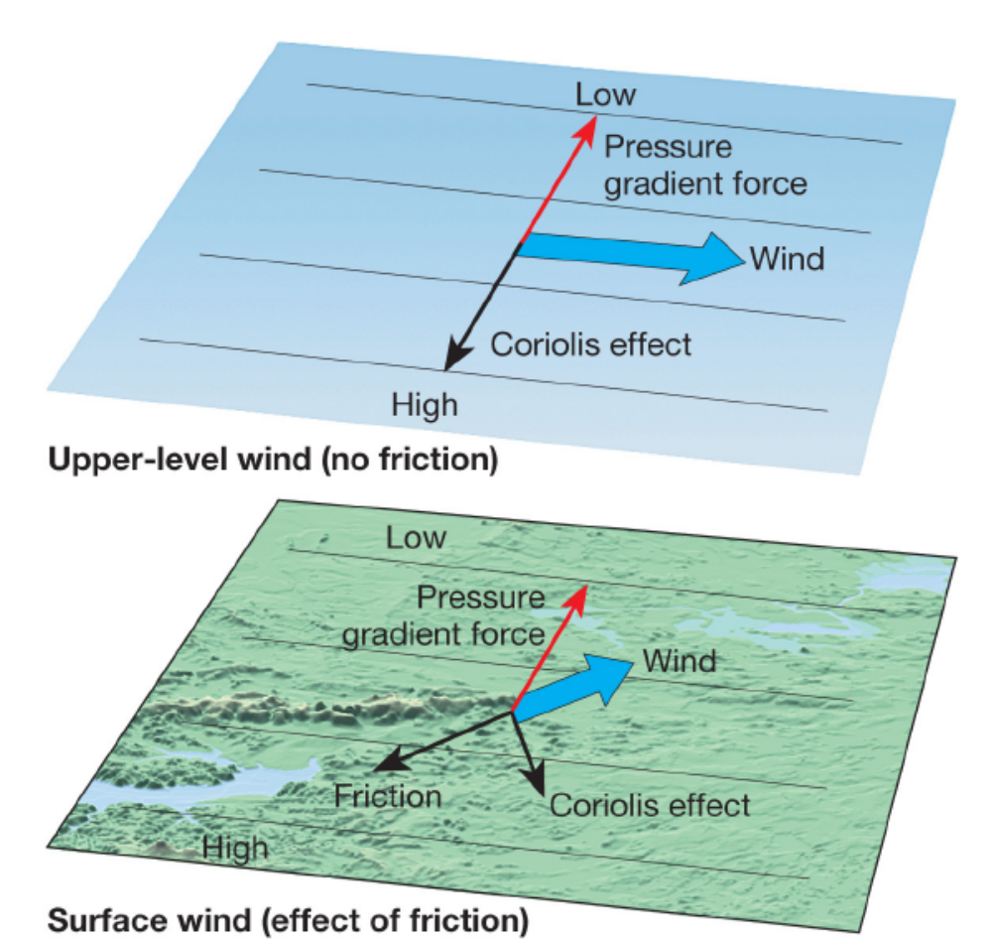
Adding Friction to PGF and Coriolis
The addition of friction causes the wind to lean toward the PGF force (or in the direction of the low pressure) in both hemispheres.
Because the Coriolis Force pulls wind to the right in the NH and to the left in the SH we see opposite wind directions when comparing the NH to the SH.

Slide 22
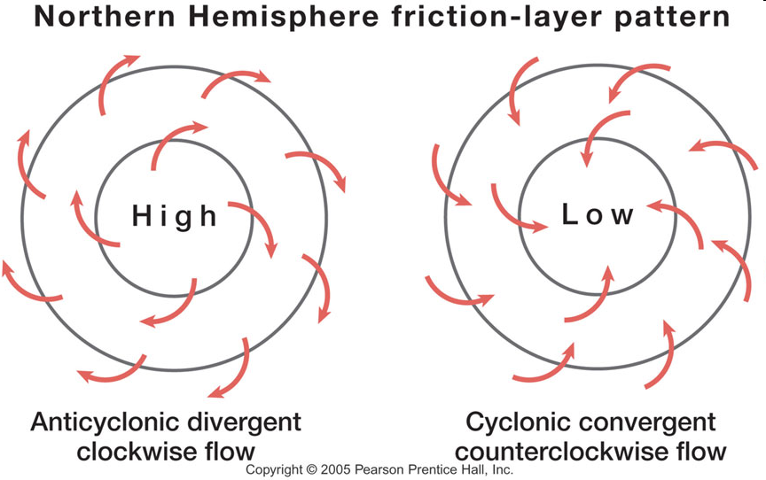
Surface Winds – PGF + Coriolis + Friction

Slide 23
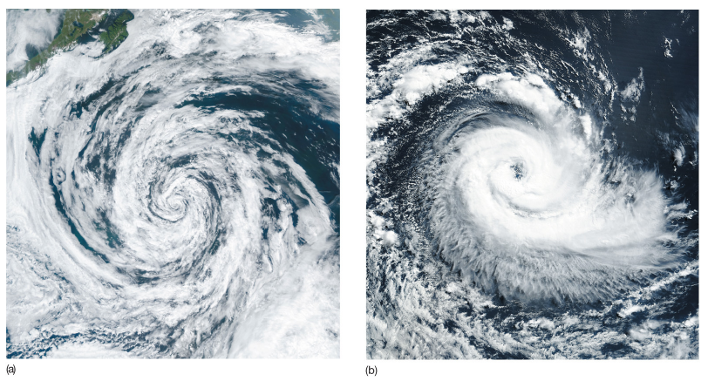
Lows in Different Hemispheres
CCW - Northern Hemisphere
CW - Southern Hemisphere

